Slide 1
IB Biology D1.1
LESSON 1 OF 4
BY THE END YOU CAN
DNA replication
Explain why cells copy their DNA, and why every copy must carry the same base sequence (D1.1.1)
Explain what semi-conservative means, and how complementary base pairing makes copying accurate (D1.1.2)
Describe what helicase and DNA polymerase do at a replication fork (D1.1.3)
Copying the code
D1.1.1 to D1.1.3
Why cells copy DNA, how the copy stays exact, and the two enzymes that do it
60 minutes · chapters 1, 2, 3
Minute 0
Notes:
IB Biology D1.1, DNA replication. Lesson 1 of 4: Copying the code, 60 minutes.
The plan, minute by minute (each slide's footer says where you are):
0 to 6 min (6) Do now: draw it again
6 to 14 min (8) Why copy, and how many times?
14 to 26 min (12) One old strand, one new
26 to 40 min (14) Unzip, then build
40 to 54 min (14) Improve the answer
54 to 60 min (6) Exit
What students get wrong:
Replication happens during division. It happens before it, in interphase.
The new molecule is all new, or each strand is half old and half new. It is one whole old strand and one whole new one (the site’s misconception 38).
Helicase breaks the strands, or the bonds between sugar and phosphate. It breaks only the hydrogen bonds between bases.
DNA polymerase “adds bases”. It adds nucleotides.
Stretch and support:
Support: use the dotted key terms as a glossary, and cut chapter 4’s captions up for students to put in order.
Stretch: Meselson and Stahl ran a third generation. Predict the bands for each model, and the ratio of hybrid to light.
The lesson plan to print: https://www.biologybybradford.com/guides/downloads/ib-biology-d1-1-dna-replication-lesson-1-plan.pdf

Slide 2
DO NOW
Draw it again
Students sketch one nucleotide the IB way, then three nucleotides of one strand paired with their partners.
6:00
minutes
Start now: the timer is running.
Minutes 0 to 6
Notes:
Minutes 0 to 6 of 60: Do now: draw it again (6 min).
The plan: Students sketch one nucleotide the IB way, then three nucleotides of one strand paired with their partners (Draw it again, below). Check the drawings against the ones in A1.2.
Start a 6 minute timer as they come in.

Slide 3
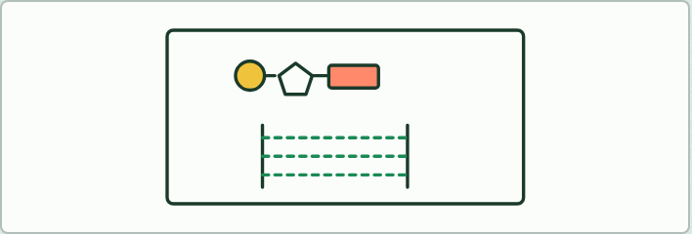
DRAWING
6 MIN
Draw it again
THE TASK
Students sketch one nucleotide the IB way: a circle for the phosphate, a pentagon for the sugar and a rectangle for the base. Then they draw three nucleotides of one strand paired with three of its partner, running the other way, A with T and C with G. They check against the drawings in A1.2.
STUDENTS NEED
Mini whiteboards and pens.
Minutes 0 to 6
Notes:
Minutes 0 to 6 of 60: Do now: draw it again (6 min).
The plan: Students sketch one nucleotide the IB way, then three nucleotides of one strand paired with their partners (Draw it again, below). Check the drawings against the ones in A1.2.
The activity: Draw it again. Students sketch one nucleotide the IB way: a circle for the phosphate, a pentagon for the sugar and a rectangle for the base. Then they draw three nucleotides of one strand paired with three of its partner, running the other way, A with T and C with G. They check against the drawings in A1.2.
Needs: mini whiteboards and pens.
The time: 6 minutes, minutes 0 to 6 of the plan.

Slide 4
STEP 2
8 MIN
Why copy, and how many times?
Chapter 1: A copy for every new cell
Minutes 6 to 14
Notes:
Minutes 6 to 14 of 60: Why copy, and how many times? (8 min).
The plan: Chapter 1’s figure on the board, then chapter 1’s predict box (how many rounds) by show of hands. Land on doubling: it comes back in lesson 2.

Slide 5
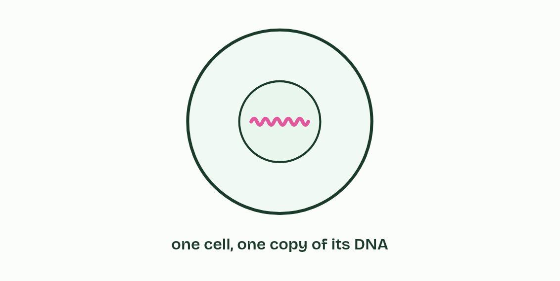
CHAPTER 1 · D1.1.1 Exact copies
1 / 4
A copy for every new cell
A cell holds one copy of its DNA.
Minutes 6 to 14
Notes:
Minutes 6 to 14 of 60: Why copy, and how many times? (8 min).
The plan: Chapter 1’s figure on the board, then chapter 1’s predict box (how many rounds) by show of hands. Land on doubling: it comes back in lesson 2.
Almost every cell in your body came from another cell dividing. Before a cell divides it has to hand each of the two new cells a full set of instructions, and the instructions are written in its DNA. Making a copy of a DNA molecule is called DNA replication.
The copy has to be exact. The message in DNA is the order of its bases, the base sequence (A1.2), so a faithful copy has the same bases in the same order. Change the sequence and you may change a protein. A change that slips through is a mutation (D1.3), which is why copying has to be so careful. Chapter 2 shows how the pairing rule keeps it accurate, and chapter 10 how the enzyme checks its own work.
Copying comes before every cell division. In a eukaryote it happens in the part of interphase before mitosis, when each chromosome’s DNA molecule becomes two identical molecules (D2.1 has the cell cycle). Cells divide for three reasons.
Copying is how genetic continuity runs from one cell to the next, and from parent to offspring.

Slide 6
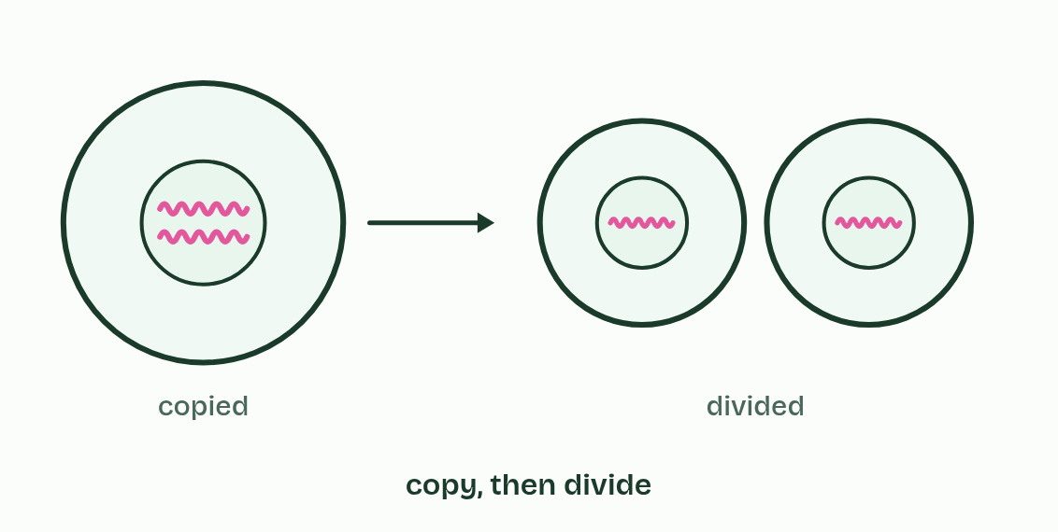
CHAPTER 1 · D1.1.1 Exact copies
2 / 4
A copy for every new cell
Before it divides, it copies it, so each new cell has a full set.
Minutes 6 to 14
Notes:
Minutes 6 to 14 of 60: Why copy, and how many times? (8 min).
The plan: Chapter 1’s figure on the board, then chapter 1’s predict box (how many rounds) by show of hands. Land on doubling: it comes back in lesson 2.
Almost every cell in your body came from another cell dividing. Before a cell divides it has to hand each of the two new cells a full set of instructions, and the instructions are written in its DNA. Making a copy of a DNA molecule is called DNA replication.
The copy has to be exact. The message in DNA is the order of its bases, the base sequence (A1.2), so a faithful copy has the same bases in the same order. Change the sequence and you may change a protein. A change that slips through is a mutation (D1.3), which is why copying has to be so careful. Chapter 2 shows how the pairing rule keeps it accurate, and chapter 10 how the enzyme checks its own work.
Copying comes before every cell division. In a eukaryote it happens in the part of interphase before mitosis, when each chromosome’s DNA molecule becomes two identical molecules (D2.1 has the cell cycle). Cells divide for three reasons.
Copying is how genetic continuity runs from one cell to the next, and from parent to offspring.

Slide 7
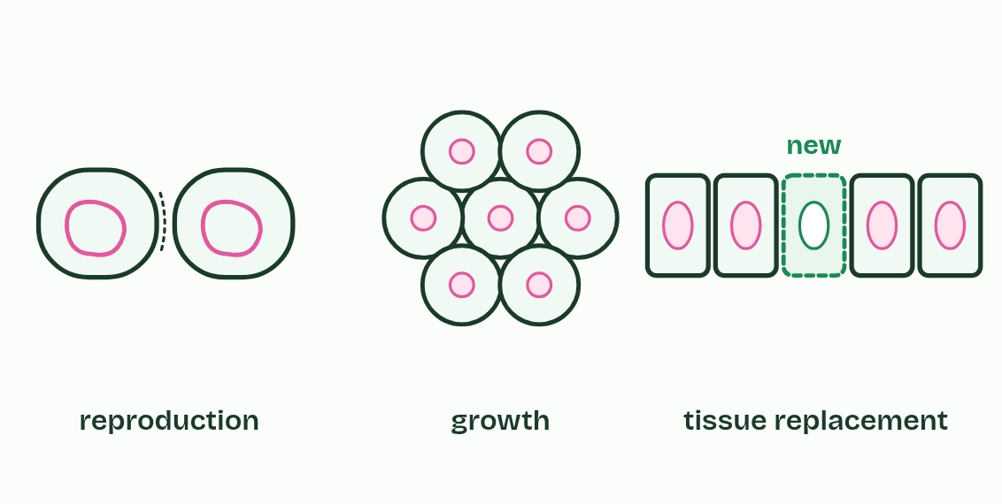
CHAPTER 1 · D1.1.1 Exact copies
3 / 4
A copy for every new cell
Cells divide to reproduce, to grow and to replace what is lost.
Minutes 6 to 14
Notes:
Minutes 6 to 14 of 60: Why copy, and how many times? (8 min).
The plan: Chapter 1’s figure on the board, then chapter 1’s predict box (how many rounds) by show of hands. Land on doubling: it comes back in lesson 2.
Almost every cell in your body came from another cell dividing. Before a cell divides it has to hand each of the two new cells a full set of instructions, and the instructions are written in its DNA. Making a copy of a DNA molecule is called DNA replication.
The copy has to be exact. The message in DNA is the order of its bases, the base sequence (A1.2), so a faithful copy has the same bases in the same order. Change the sequence and you may change a protein. A change that slips through is a mutation (D1.3), which is why copying has to be so careful. Chapter 2 shows how the pairing rule keeps it accurate, and chapter 10 how the enzyme checks its own work.
Copying comes before every cell division. In a eukaryote it happens in the part of interphase before mitosis, when each chromosome’s DNA molecule becomes two identical molecules (D2.1 has the cell cycle). Cells divide for three reasons.
Copying is how genetic continuity runs from one cell to the next, and from parent to offspring.

Slide 8
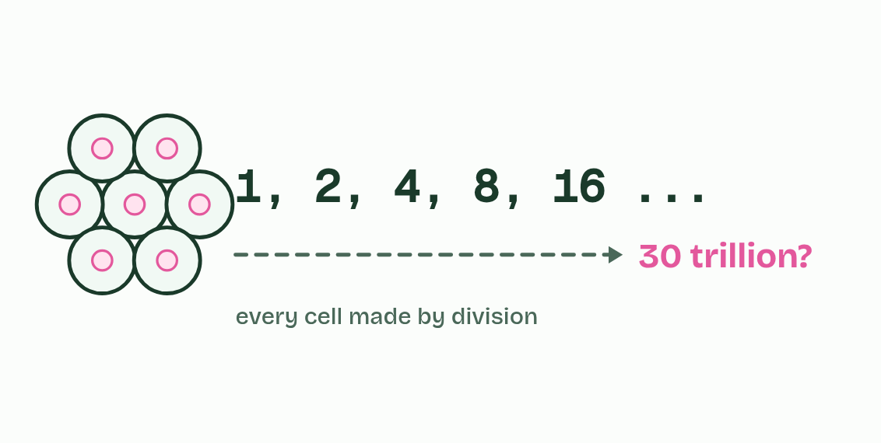
CHAPTER 1 · D1.1.1 Exact copies
4 / 4
A copy for every new cell
Every one of your cells came from one by division.
Minutes 6 to 14
Notes:
Minutes 6 to 14 of 60: Why copy, and how many times? (8 min).
The plan: Chapter 1’s figure on the board, then chapter 1’s predict box (how many rounds) by show of hands. Land on doubling: it comes back in lesson 2.
Almost every cell in your body came from another cell dividing. Before a cell divides it has to hand each of the two new cells a full set of instructions, and the instructions are written in its DNA. Making a copy of a DNA molecule is called DNA replication.
The copy has to be exact. The message in DNA is the order of its bases, the base sequence (A1.2), so a faithful copy has the same bases in the same order. Change the sequence and you may change a protein. A change that slips through is a mutation (D1.3), which is why copying has to be so careful. Chapter 2 shows how the pairing rule keeps it accurate, and chapter 10 how the enzyme checks its own work.
Copying comes before every cell division. In a eukaryote it happens in the part of interphase before mitosis, when each chromosome’s DNA molecule becomes two identical molecules (D2.1 has the cell cycle). Cells divide for three reasons.
Copying is how genetic continuity runs from one cell to the next, and from parent to offspring.

Slide 9
CHAPTER 1 · D1.1.1 Exact copies
A copy for every new cell
Reproduction. A bacterium splits in two, yeast buds and a strawberry plant sends out runners: asexual reproduction. Even the cells that become eggs and sperm come from cells that copied their DNA first.
Growth. A fertilised egg becomes a body of about 30 trillion cells, every one made by division. This is growth.
Tissue replacement. Skin, the lining of the gut and blood cells are replaced all the time, and a cut heals with new cells: tissue replacement.
Minutes 6 to 14
Notes:
Minutes 6 to 14 of 60: Why copy, and how many times? (8 min).
The plan: Chapter 1’s figure on the board, then chapter 1’s predict box (how many rounds) by show of hands. Land on doubling: it comes back in lesson 2.
Almost every cell in your body came from another cell dividing. Before a cell divides it has to hand each of the two new cells a full set of instructions, and the instructions are written in its DNA. Making a copy of a DNA molecule is called DNA replication.
The copy has to be exact. The message in DNA is the order of its bases, the base sequence (A1.2), so a faithful copy has the same bases in the same order. Change the sequence and you may change a protein. A change that slips through is a mutation (D1.3), which is why copying has to be so careful. Chapter 2 shows how the pairing rule keeps it accurate, and chapter 10 how the enzyme checks its own work.
Copying comes before every cell division. In a eukaryote it happens in the part of interphase before mitosis, when each chromosome’s DNA molecule becomes two identical molecules (D2.1 has the cell cycle). Cells divide for three reasons.
Copying is how genetic continuity runs from one cell to the next, and from parent to offspring.

Slide 10
WATCH OUT
Replication is not the same as cell division. Replication copies the DNA; the cell divides afterwards. And the copy is of the whole molecule, not of one gene.
Minutes 6 to 14
Notes:
Minutes 6 to 14 of 60: Why copy, and how many times? (8 min).
The plan: Chapter 1’s figure on the board, then chapter 1’s predict box (how many rounds) by show of hands. Land on doubling: it comes back in lesson 2.
A common mistake: say it, then ask who can say why it is wrong.

Slide 11
PREDICT
You began as one fertilised egg and now have about 30 trillion cells. If every cell divided in step, about how many rounds of copying and dividing would it take?
A About 30 thousand
B About 45
C About 30 trillion
Minutes 6 to 14
Notes:
Minutes 6 to 14 of 60: Why copy, and how many times? (8 min).
The plan: Chapter 1’s figure on the board, then chapter 1’s predict box (how many rounds) by show of hands. Land on doubling: it comes back in lesson 2.
Ask for a show of hands, or mini whiteboards, before revealing. (Answer: B, on the next slide.)

Slide 12
WHAT HAPPENS
You began as one fertilised egg and now have about 30 trillion cells. If every cell divided in step, about how many rounds of copying and dividing would it take?
A About 30 thousand
B About 45
C About 30 trillion
About 45. Each round doubles the number of cells, so 45 rounds give 2⁴⁵, about 35 trillion. Real cells do not divide in step, and many die and are replaced, so your DNA has been copied far more times than that in all, and every one of those copies had to be exact. Doubling comes back in chapter 4, where it is the secret of PCR.
Minutes 6 to 14
Notes:
Minutes 6 to 14 of 60: Why copy, and how many times? (8 min).
The plan: Chapter 1’s figure on the board, then chapter 1’s predict box (how many rounds) by show of hands. Land on doubling: it comes back in lesson 2.
Answer: B. About 45. Each round doubles the number of cells, so 45 rounds give 2⁴⁵, about 35 trillion. Real cells do not divide in step, and many die and are replaced, so your DNA has been copied far more times than that in all, and every one of those copies had to be exact. Doubling comes back in chapter 4, where it is the secret of PCR.

Slide 13
STEP 3
12 MIN
One old strand, one new
Chapter 2: One old strand, one new
Data: Predict the tubes
Minutes 14 to 26
Notes:
Minutes 14 to 26 of 60: One old strand, one new (12 min).
The plan: Chapter 2: the predict box first (four molecules, how many hold an old strand), then chapter 2’s figure step by step. Then the How we know box: show chapter 2’s Meselson and Stahl states, and students predict each model’s tubes on mini whiteboards before each state is shown (Predict the tubes, below).

Slide 14
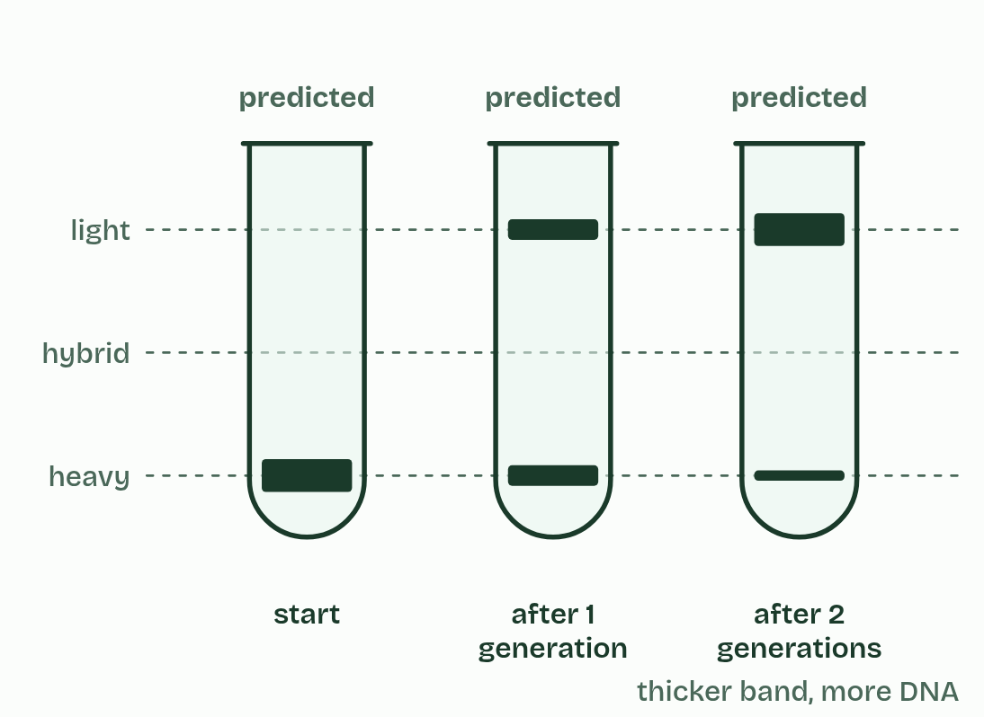
CHAPTER 2 · D1.1.2 Semi-conservative replication
1 / 4
One old strand, one new
Conservative
Minutes 14 to 26
Notes:
Minutes 14 to 26 of 60: One old strand, one new (12 min).
The plan: Chapter 2: the predict box first (four molecules, how many hold an old strand), then chapter 2’s figure step by step. Then the How we know box: show chapter 2’s Meselson and Stahl states, and students predict each model’s tubes on mini whiteboards before each state is shown (Predict the tubes, below).
The two strands of a double helix are held together by hydrogen bonds between their bases (A1.2). To copy the molecule, the cell pulls the strands apart. Each old strand then acts as a template: free nucleotides line up against its exposed bases, A opposite T and C opposite G, and are joined into a new strand. That is complementary base pairing, and nothing else fits.
So each new molecule, a daughter molecule, is made of one old strand and one new one. That is what semi-conservative means: half of each molecule is conserved from the one before.
Why is the copy so accurate? The pairing rule allows only one base opposite each base of the template. A new strand is therefore the exact complement of its template, and the complement of a complement is the original, so both daughter molecules carry the base sequence of the molecule that went in. Accurate is not the same as perfect: very rarely a wrong base is joined in, and chapter 10 shows how the enzyme catches it.
Example: How we know (beyond the IB guide’s statements) People once proposed two other patterns: both old strands staying together in one molecule (conservative), or old and new pieces mixed along every strand (dispersive). An experiment decided between the three. In 1958 Matthew Meselson and Franklin Stahl grew the bacterium E. coli for many generations on food whose nitrogen was the heavy isotope nitrogen-15, so all of its DNA was heavy. They moved the bacteria to food with ordinary nitrogen-14 and took samples after one and after two generations. Spun very fast in a dense salt solution, DNA settles as a band at the height that matches its density: heavy low, light high, hybrid in between. Each model predicts a different pattern, so the results could rule two of them out. Choose a model to see the tubes it predicts, then what they saw. lighthybridheavystartafter 1generationafter 2generationspredictedpredictedpredictedpredictedpredictedpredictedpredictedpredictedpredictedobservedobservedobservedthicker band, more DNA ConservativeSemi-conservativeDispersiveWhat they saw Generation 1 ruled out conservative. Generation 2 ruled out dispersive. Each tube spins DNA into bands by density. Pick a model, then compare it with what was seen.

Slide 15
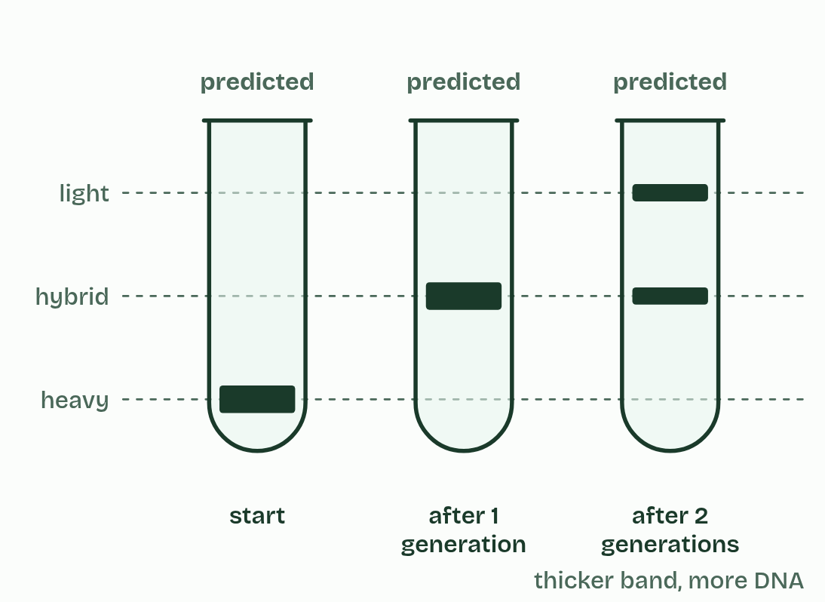
CHAPTER 2 · D1.1.2 Semi-conservative replication
2 / 4
One old strand, one new
Semi-conservative
Minutes 14 to 26
Notes:
Minutes 14 to 26 of 60: One old strand, one new (12 min).
The plan: Chapter 2: the predict box first (four molecules, how many hold an old strand), then chapter 2’s figure step by step. Then the How we know box: show chapter 2’s Meselson and Stahl states, and students predict each model’s tubes on mini whiteboards before each state is shown (Predict the tubes, below).
The two strands of a double helix are held together by hydrogen bonds between their bases (A1.2). To copy the molecule, the cell pulls the strands apart. Each old strand then acts as a template: free nucleotides line up against its exposed bases, A opposite T and C opposite G, and are joined into a new strand. That is complementary base pairing, and nothing else fits.
So each new molecule, a daughter molecule, is made of one old strand and one new one. That is what semi-conservative means: half of each molecule is conserved from the one before.
Why is the copy so accurate? The pairing rule allows only one base opposite each base of the template. A new strand is therefore the exact complement of its template, and the complement of a complement is the original, so both daughter molecules carry the base sequence of the molecule that went in. Accurate is not the same as perfect: very rarely a wrong base is joined in, and chapter 10 shows how the enzyme catches it.
Example: How we know (beyond the IB guide’s statements) People once proposed two other patterns: both old strands staying together in one molecule (conservative), or old and new pieces mixed along every strand (dispersive). An experiment decided between the three. In 1958 Matthew Meselson and Franklin Stahl grew the bacterium E. coli for many generations on food whose nitrogen was the heavy isotope nitrogen-15, so all of its DNA was heavy. They moved the bacteria to food with ordinary nitrogen-14 and took samples after one and after two generations. Spun very fast in a dense salt solution, DNA settles as a band at the height that matches its density: heavy low, light high, hybrid in between. Each model predicts a different pattern, so the results could rule two of them out. Choose a model to see the tubes it predicts, then what they saw. lighthybridheavystartafter 1generationafter 2generationspredictedpredictedpredictedpredictedpredictedpredictedpredictedpredictedpredictedobservedobservedobservedthicker band, more DNA ConservativeSemi-conservativeDispersiveWhat they saw Generation 1 ruled out conservative. Generation 2 ruled out dispersive. Each tube spins DNA into bands by density. Pick a model, then compare it with what was seen.

Slide 16
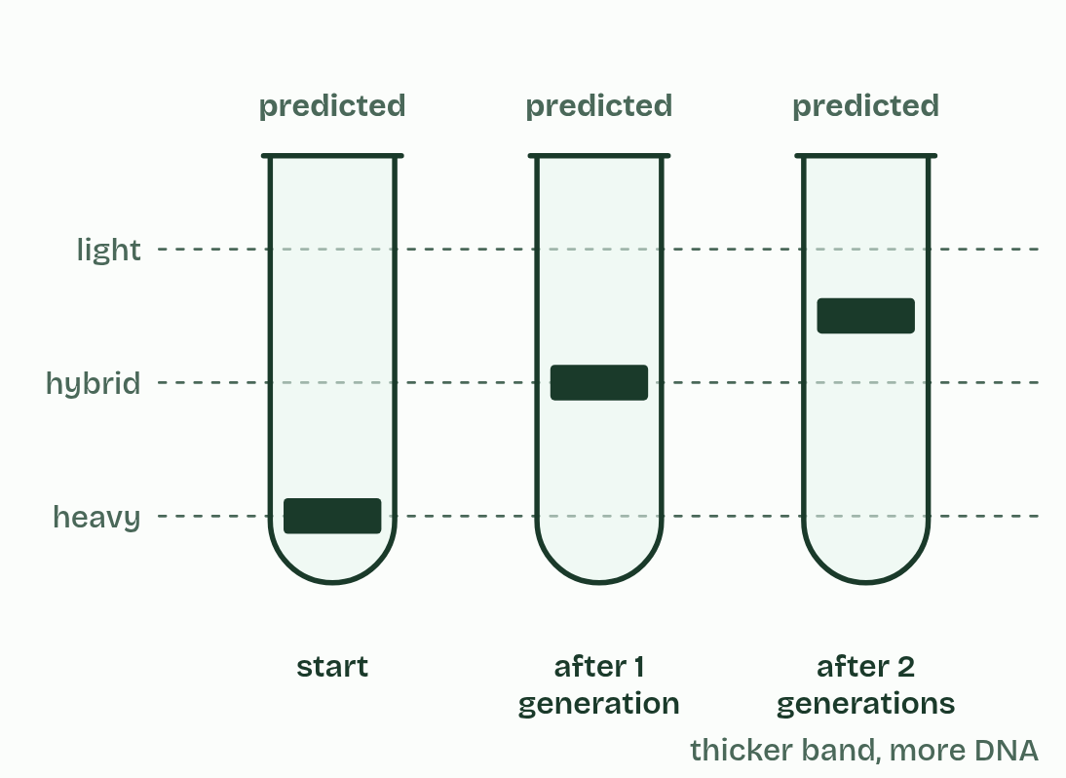
CHAPTER 2 · D1.1.2 Semi-conservative replication
3 / 4
One old strand, one new
Dispersive
Minutes 14 to 26
Notes:
Minutes 14 to 26 of 60: One old strand, one new (12 min).
The plan: Chapter 2: the predict box first (four molecules, how many hold an old strand), then chapter 2’s figure step by step. Then the How we know box: show chapter 2’s Meselson and Stahl states, and students predict each model’s tubes on mini whiteboards before each state is shown (Predict the tubes, below).
The two strands of a double helix are held together by hydrogen bonds between their bases (A1.2). To copy the molecule, the cell pulls the strands apart. Each old strand then acts as a template: free nucleotides line up against its exposed bases, A opposite T and C opposite G, and are joined into a new strand. That is complementary base pairing, and nothing else fits.
So each new molecule, a daughter molecule, is made of one old strand and one new one. That is what semi-conservative means: half of each molecule is conserved from the one before.
Why is the copy so accurate? The pairing rule allows only one base opposite each base of the template. A new strand is therefore the exact complement of its template, and the complement of a complement is the original, so both daughter molecules carry the base sequence of the molecule that went in. Accurate is not the same as perfect: very rarely a wrong base is joined in, and chapter 10 shows how the enzyme catches it.
Example: How we know (beyond the IB guide’s statements) People once proposed two other patterns: both old strands staying together in one molecule (conservative), or old and new pieces mixed along every strand (dispersive). An experiment decided between the three. In 1958 Matthew Meselson and Franklin Stahl grew the bacterium E. coli for many generations on food whose nitrogen was the heavy isotope nitrogen-15, so all of its DNA was heavy. They moved the bacteria to food with ordinary nitrogen-14 and took samples after one and after two generations. Spun very fast in a dense salt solution, DNA settles as a band at the height that matches its density: heavy low, light high, hybrid in between. Each model predicts a different pattern, so the results could rule two of them out. Choose a model to see the tubes it predicts, then what they saw. lighthybridheavystartafter 1generationafter 2generationspredictedpredictedpredictedpredictedpredictedpredictedpredictedpredictedpredictedobservedobservedobservedthicker band, more DNA ConservativeSemi-conservativeDispersiveWhat they saw Generation 1 ruled out conservative. Generation 2 ruled out dispersive. Each tube spins DNA into bands by density. Pick a model, then compare it with what was seen.

Slide 17

CHAPTER 2 · D1.1.2 Semi-conservative replication
4 / 4
One old strand, one new
What they saw
Minutes 14 to 26
Notes:
Minutes 14 to 26 of 60: One old strand, one new (12 min).
The plan: Chapter 2: the predict box first (four molecules, how many hold an old strand), then chapter 2’s figure step by step. Then the How we know box: show chapter 2’s Meselson and Stahl states, and students predict each model’s tubes on mini whiteboards before each state is shown (Predict the tubes, below).
The two strands of a double helix are held together by hydrogen bonds between their bases (A1.2). To copy the molecule, the cell pulls the strands apart. Each old strand then acts as a template: free nucleotides line up against its exposed bases, A opposite T and C opposite G, and are joined into a new strand. That is complementary base pairing, and nothing else fits.
So each new molecule, a daughter molecule, is made of one old strand and one new one. That is what semi-conservative means: half of each molecule is conserved from the one before.
Why is the copy so accurate? The pairing rule allows only one base opposite each base of the template. A new strand is therefore the exact complement of its template, and the complement of a complement is the original, so both daughter molecules carry the base sequence of the molecule that went in. Accurate is not the same as perfect: very rarely a wrong base is joined in, and chapter 10 shows how the enzyme catches it.
Example: How we know (beyond the IB guide’s statements) People once proposed two other patterns: both old strands staying together in one molecule (conservative), or old and new pieces mixed along every strand (dispersive). An experiment decided between the three. In 1958 Matthew Meselson and Franklin Stahl grew the bacterium E. coli for many generations on food whose nitrogen was the heavy isotope nitrogen-15, so all of its DNA was heavy. They moved the bacteria to food with ordinary nitrogen-14 and took samples after one and after two generations. Spun very fast in a dense salt solution, DNA settles as a band at the height that matches its density: heavy low, light high, hybrid in between. Each model predicts a different pattern, so the results could rule two of them out. Choose a model to see the tubes it predicts, then what they saw. lighthybridheavystartafter 1generationafter 2generationspredictedpredictedpredictedpredictedpredictedpredictedpredictedpredictedpredictedobservedobservedobservedthicker band, more DNA ConservativeSemi-conservativeDispersiveWhat they saw Generation 1 ruled out conservative. Generation 2 ruled out dispersive. Each tube spins DNA into bands by density. Pick a model, then compare it with what was seen.

Slide 18
CHAPTER 2 · D1.1.2 Semi-conservative replication
One old strand, one new
Each old strand is a template for one new strand.
Base pairing, A with T and C with G, makes each new strand the complement of its template.
Each daughter molecule: one whole old strand and one whole new strand.
Minutes 14 to 26
Notes:
Minutes 14 to 26 of 60: One old strand, one new (12 min).
The plan: Chapter 2: the predict box first (four molecules, how many hold an old strand), then chapter 2’s figure step by step. Then the How we know box: show chapter 2’s Meselson and Stahl states, and students predict each model’s tubes on mini whiteboards before each state is shown (Predict the tubes, below).
The two strands of a double helix are held together by hydrogen bonds between their bases (A1.2). To copy the molecule, the cell pulls the strands apart. Each old strand then acts as a template: free nucleotides line up against its exposed bases, A opposite T and C opposite G, and are joined into a new strand. That is complementary base pairing, and nothing else fits.
So each new molecule, a daughter molecule, is made of one old strand and one new one. That is what semi-conservative means: half of each molecule is conserved from the one before.
Why is the copy so accurate? The pairing rule allows only one base opposite each base of the template. A new strand is therefore the exact complement of its template, and the complement of a complement is the original, so both daughter molecules carry the base sequence of the molecule that went in. Accurate is not the same as perfect: very rarely a wrong base is joined in, and chapter 10 shows how the enzyme catches it.
Example: How we know (beyond the IB guide’s statements) People once proposed two other patterns: both old strands staying together in one molecule (conservative), or old and new pieces mixed along every strand (dispersive). An experiment decided between the three. In 1958 Matthew Meselson and Franklin Stahl grew the bacterium E. coli for many generations on food whose nitrogen was the heavy isotope nitrogen-15, so all of its DNA was heavy. They moved the bacteria to food with ordinary nitrogen-14 and took samples after one and after two generations. Spun very fast in a dense salt solution, DNA settles as a band at the height that matches its density: heavy low, light high, hybrid in between. Each model predicts a different pattern, so the results could rule two of them out. Choose a model to see the tubes it predicts, then what they saw. lighthybridheavystartafter 1generationafter 2generationspredictedpredictedpredictedpredictedpredictedpredictedpredictedpredictedpredictedobservedobservedobservedthicker band, more DNA ConservativeSemi-conservativeDispersiveWhat they saw Generation 1 ruled out conservative. Generation 2 ruled out dispersive. Each tube spins DNA into bands by density. Pick a model, then compare it with what was seen.

Slide 19
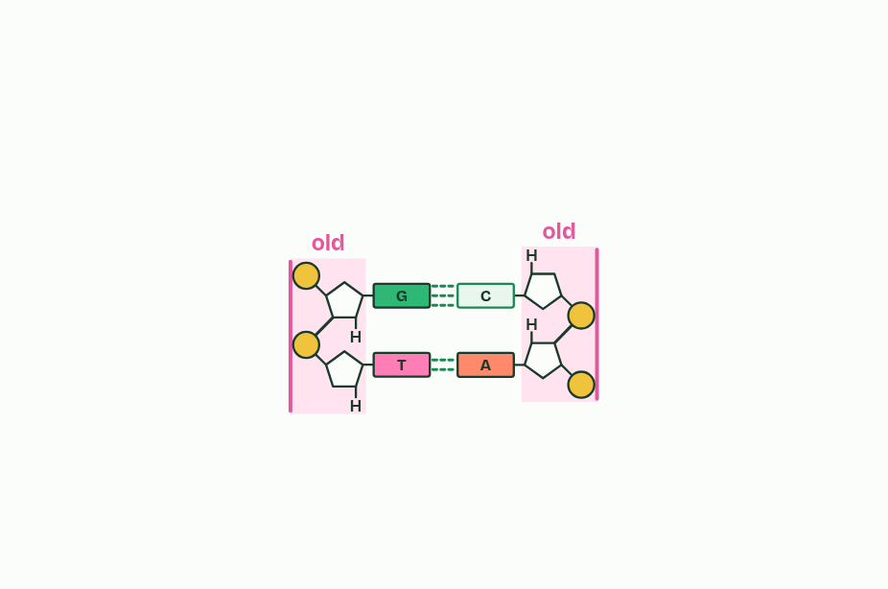
CHAPTER 2 · D1.1.2 Semi-conservative replication
1 / 5
One old strand, one new
One molecule: two old strands.
Minutes 14 to 26
Notes:
Minutes 14 to 26 of 60: One old strand, one new (12 min).
The plan: Chapter 2: the predict box first (four molecules, how many hold an old strand), then chapter 2’s figure step by step. Then the How we know box: show chapter 2’s Meselson and Stahl states, and students predict each model’s tubes on mini whiteboards before each state is shown (Predict the tubes, below).
The two strands of a double helix are held together by hydrogen bonds between their bases (A1.2). To copy the molecule, the cell pulls the strands apart. Each old strand then acts as a template: free nucleotides line up against its exposed bases, A opposite T and C opposite G, and are joined into a new strand. That is complementary base pairing, and nothing else fits.
So each new molecule, a daughter molecule, is made of one old strand and one new one. That is what semi-conservative means: half of each molecule is conserved from the one before.
Why is the copy so accurate? The pairing rule allows only one base opposite each base of the template. A new strand is therefore the exact complement of its template, and the complement of a complement is the original, so both daughter molecules carry the base sequence of the molecule that went in. Accurate is not the same as perfect: very rarely a wrong base is joined in, and chapter 10 shows how the enzyme catches it.
Example: How we know (beyond the IB guide’s statements) People once proposed two other patterns: both old strands staying together in one molecule (conservative), or old and new pieces mixed along every strand (dispersive). An experiment decided between the three. In 1958 Matthew Meselson and Franklin Stahl grew the bacterium E. coli for many generations on food whose nitrogen was the heavy isotope nitrogen-15, so all of its DNA was heavy. They moved the bacteria to food with ordinary nitrogen-14 and took samples after one and after two generations. Spun very fast in a dense salt solution, DNA settles as a band at the height that matches its density: heavy low, light high, hybrid in between. Each model predicts a different pattern, so the results could rule two of them out. Choose a model to see the tubes it predicts, then what they saw. lighthybridheavystartafter 1generationafter 2generationspredictedpredictedpredictedpredictedpredictedpredictedpredictedpredictedpredictedobservedobservedobservedthicker band, more DNA ConservativeSemi-conservativeDispersiveWhat they saw Generation 1 ruled out conservative. Generation 2 ruled out dispersive. Each tube spins DNA into bands by density. Pick a model, then compare it with what was seen.

Slide 20
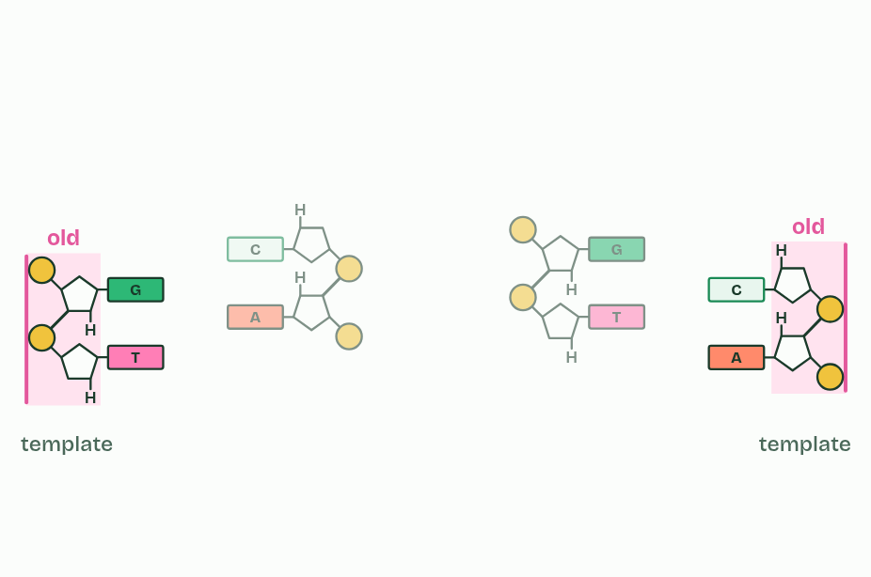
CHAPTER 2 · D1.1.2 Semi-conservative replication
2 / 5
One old strand, one new
A new partner is built along each strand: its template.
Minutes 14 to 26
Notes:
Minutes 14 to 26 of 60: One old strand, one new (12 min).
The plan: Chapter 2: the predict box first (four molecules, how many hold an old strand), then chapter 2’s figure step by step. Then the How we know box: show chapter 2’s Meselson and Stahl states, and students predict each model’s tubes on mini whiteboards before each state is shown (Predict the tubes, below).
The two strands of a double helix are held together by hydrogen bonds between their bases (A1.2). To copy the molecule, the cell pulls the strands apart. Each old strand then acts as a template: free nucleotides line up against its exposed bases, A opposite T and C opposite G, and are joined into a new strand. That is complementary base pairing, and nothing else fits.
So each new molecule, a daughter molecule, is made of one old strand and one new one. That is what semi-conservative means: half of each molecule is conserved from the one before.
Why is the copy so accurate? The pairing rule allows only one base opposite each base of the template. A new strand is therefore the exact complement of its template, and the complement of a complement is the original, so both daughter molecules carry the base sequence of the molecule that went in. Accurate is not the same as perfect: very rarely a wrong base is joined in, and chapter 10 shows how the enzyme catches it.
Example: How we know (beyond the IB guide’s statements) People once proposed two other patterns: both old strands staying together in one molecule (conservative), or old and new pieces mixed along every strand (dispersive). An experiment decided between the three. In 1958 Matthew Meselson and Franklin Stahl grew the bacterium E. coli for many generations on food whose nitrogen was the heavy isotope nitrogen-15, so all of its DNA was heavy. They moved the bacteria to food with ordinary nitrogen-14 and took samples after one and after two generations. Spun very fast in a dense salt solution, DNA settles as a band at the height that matches its density: heavy low, light high, hybrid in between. Each model predicts a different pattern, so the results could rule two of them out. Choose a model to see the tubes it predicts, then what they saw. lighthybridheavystartafter 1generationafter 2generationspredictedpredictedpredictedpredictedpredictedpredictedpredictedpredictedpredictedobservedobservedobservedthicker band, more DNA ConservativeSemi-conservativeDispersiveWhat they saw Generation 1 ruled out conservative. Generation 2 ruled out dispersive. Each tube spins DNA into bands by density. Pick a model, then compare it with what was seen.

Slide 21
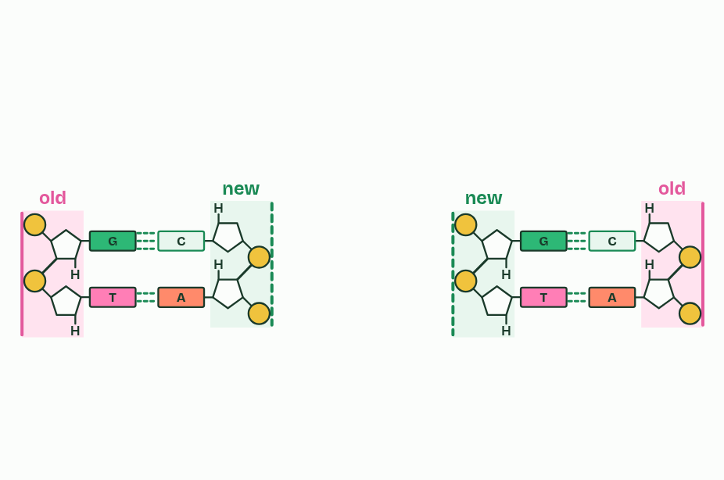
CHAPTER 2 · D1.1.2 Semi-conservative replication
3 / 5
One old strand, one new
Each new molecule keeps one old strand: semi-conservative.
Minutes 14 to 26
Notes:
Minutes 14 to 26 of 60: One old strand, one new (12 min).
The plan: Chapter 2: the predict box first (four molecules, how many hold an old strand), then chapter 2’s figure step by step. Then the How we know box: show chapter 2’s Meselson and Stahl states, and students predict each model’s tubes on mini whiteboards before each state is shown (Predict the tubes, below).
The two strands of a double helix are held together by hydrogen bonds between their bases (A1.2). To copy the molecule, the cell pulls the strands apart. Each old strand then acts as a template: free nucleotides line up against its exposed bases, A opposite T and C opposite G, and are joined into a new strand. That is complementary base pairing, and nothing else fits.
So each new molecule, a daughter molecule, is made of one old strand and one new one. That is what semi-conservative means: half of each molecule is conserved from the one before.
Why is the copy so accurate? The pairing rule allows only one base opposite each base of the template. A new strand is therefore the exact complement of its template, and the complement of a complement is the original, so both daughter molecules carry the base sequence of the molecule that went in. Accurate is not the same as perfect: very rarely a wrong base is joined in, and chapter 10 shows how the enzyme catches it.
Example: How we know (beyond the IB guide’s statements) People once proposed two other patterns: both old strands staying together in one molecule (conservative), or old and new pieces mixed along every strand (dispersive). An experiment decided between the three. In 1958 Matthew Meselson and Franklin Stahl grew the bacterium E. coli for many generations on food whose nitrogen was the heavy isotope nitrogen-15, so all of its DNA was heavy. They moved the bacteria to food with ordinary nitrogen-14 and took samples after one and after two generations. Spun very fast in a dense salt solution, DNA settles as a band at the height that matches its density: heavy low, light high, hybrid in between. Each model predicts a different pattern, so the results could rule two of them out. Choose a model to see the tubes it predicts, then what they saw. lighthybridheavystartafter 1generationafter 2generationspredictedpredictedpredictedpredictedpredictedpredictedpredictedpredictedpredictedobservedobservedobservedthicker band, more DNA ConservativeSemi-conservativeDispersiveWhat they saw Generation 1 ruled out conservative. Generation 2 ruled out dispersive. Each tube spins DNA into bands by density. Pick a model, then compare it with what was seen.

Slide 22
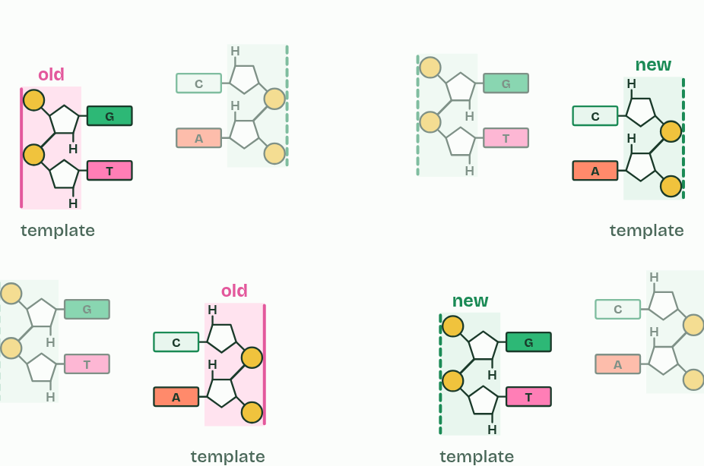
CHAPTER 2 · D1.1.2 Semi-conservative replication
4 / 5
One old strand, one new
Copied again: every strand is a template.
Minutes 14 to 26
Notes:
Minutes 14 to 26 of 60: One old strand, one new (12 min).
The plan: Chapter 2: the predict box first (four molecules, how many hold an old strand), then chapter 2’s figure step by step. Then the How we know box: show chapter 2’s Meselson and Stahl states, and students predict each model’s tubes on mini whiteboards before each state is shown (Predict the tubes, below).
The two strands of a double helix are held together by hydrogen bonds between their bases (A1.2). To copy the molecule, the cell pulls the strands apart. Each old strand then acts as a template: free nucleotides line up against its exposed bases, A opposite T and C opposite G, and are joined into a new strand. That is complementary base pairing, and nothing else fits.
So each new molecule, a daughter molecule, is made of one old strand and one new one. That is what semi-conservative means: half of each molecule is conserved from the one before.
Why is the copy so accurate? The pairing rule allows only one base opposite each base of the template. A new strand is therefore the exact complement of its template, and the complement of a complement is the original, so both daughter molecules carry the base sequence of the molecule that went in. Accurate is not the same as perfect: very rarely a wrong base is joined in, and chapter 10 shows how the enzyme catches it.
Example: How we know (beyond the IB guide’s statements) People once proposed two other patterns: both old strands staying together in one molecule (conservative), or old and new pieces mixed along every strand (dispersive). An experiment decided between the three. In 1958 Matthew Meselson and Franklin Stahl grew the bacterium E. coli for many generations on food whose nitrogen was the heavy isotope nitrogen-15, so all of its DNA was heavy. They moved the bacteria to food with ordinary nitrogen-14 and took samples after one and after two generations. Spun very fast in a dense salt solution, DNA settles as a band at the height that matches its density: heavy low, light high, hybrid in between. Each model predicts a different pattern, so the results could rule two of them out. Choose a model to see the tubes it predicts, then what they saw. lighthybridheavystartafter 1generationafter 2generationspredictedpredictedpredictedpredictedpredictedpredictedpredictedpredictedpredictedobservedobservedobservedthicker band, more DNA ConservativeSemi-conservativeDispersiveWhat they saw Generation 1 ruled out conservative. Generation 2 ruled out dispersive. Each tube spins DNA into bands by density. Pick a model, then compare it with what was seen.

Slide 23
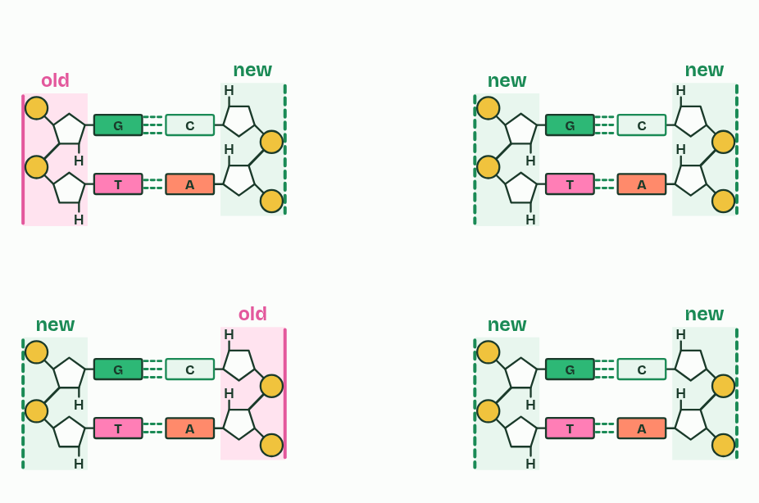
CHAPTER 2 · D1.1.2 Semi-conservative replication
5 / 5
One old strand, one new
Count the old strands.
Minutes 14 to 26
Notes:
Minutes 14 to 26 of 60: One old strand, one new (12 min).
The plan: Chapter 2: the predict box first (four molecules, how many hold an old strand), then chapter 2’s figure step by step. Then the How we know box: show chapter 2’s Meselson and Stahl states, and students predict each model’s tubes on mini whiteboards before each state is shown (Predict the tubes, below).
The two strands of a double helix are held together by hydrogen bonds between their bases (A1.2). To copy the molecule, the cell pulls the strands apart. Each old strand then acts as a template: free nucleotides line up against its exposed bases, A opposite T and C opposite G, and are joined into a new strand. That is complementary base pairing, and nothing else fits.
So each new molecule, a daughter molecule, is made of one old strand and one new one. That is what semi-conservative means: half of each molecule is conserved from the one before.
Why is the copy so accurate? The pairing rule allows only one base opposite each base of the template. A new strand is therefore the exact complement of its template, and the complement of a complement is the original, so both daughter molecules carry the base sequence of the molecule that went in. Accurate is not the same as perfect: very rarely a wrong base is joined in, and chapter 10 shows how the enzyme catches it.
Example: How we know (beyond the IB guide’s statements) People once proposed two other patterns: both old strands staying together in one molecule (conservative), or old and new pieces mixed along every strand (dispersive). An experiment decided between the three. In 1958 Matthew Meselson and Franklin Stahl grew the bacterium E. coli for many generations on food whose nitrogen was the heavy isotope nitrogen-15, so all of its DNA was heavy. They moved the bacteria to food with ordinary nitrogen-14 and took samples after one and after two generations. Spun very fast in a dense salt solution, DNA settles as a band at the height that matches its density: heavy low, light high, hybrid in between. Each model predicts a different pattern, so the results could rule two of them out. Choose a model to see the tubes it predicts, then what they saw. lighthybridheavystartafter 1generationafter 2generationspredictedpredictedpredictedpredictedpredictedpredictedpredictedpredictedpredictedobservedobservedobservedthicker band, more DNA ConservativeSemi-conservativeDispersiveWhat they saw Generation 1 ruled out conservative. Generation 2 ruled out dispersive. Each tube spins DNA into bands by density. Pick a model, then compare it with what was seen.

Slide 24
CHAPTER 2 · D1.1.2 Semi-conservative replication
One old strand, one new
Each old strand is a template for one new strand.
Base pairing, A with T and C with G, makes each new strand the complement of its template.
Each daughter molecule: one whole old strand and one whole new strand.
Minutes 14 to 26
Notes:
Minutes 14 to 26 of 60: One old strand, one new (12 min).
The plan: Chapter 2: the predict box first (four molecules, how many hold an old strand), then chapter 2’s figure step by step. Then the How we know box: show chapter 2’s Meselson and Stahl states, and students predict each model’s tubes on mini whiteboards before each state is shown (Predict the tubes, below).
The two strands of a double helix are held together by hydrogen bonds between their bases (A1.2). To copy the molecule, the cell pulls the strands apart. Each old strand then acts as a template: free nucleotides line up against its exposed bases, A opposite T and C opposite G, and are joined into a new strand. That is complementary base pairing, and nothing else fits.
So each new molecule, a daughter molecule, is made of one old strand and one new one. That is what semi-conservative means: half of each molecule is conserved from the one before.
Why is the copy so accurate? The pairing rule allows only one base opposite each base of the template. A new strand is therefore the exact complement of its template, and the complement of a complement is the original, so both daughter molecules carry the base sequence of the molecule that went in. Accurate is not the same as perfect: very rarely a wrong base is joined in, and chapter 10 shows how the enzyme catches it.
Example: How we know (beyond the IB guide’s statements) People once proposed two other patterns: both old strands staying together in one molecule (conservative), or old and new pieces mixed along every strand (dispersive). An experiment decided between the three. In 1958 Matthew Meselson and Franklin Stahl grew the bacterium E. coli for many generations on food whose nitrogen was the heavy isotope nitrogen-15, so all of its DNA was heavy. They moved the bacteria to food with ordinary nitrogen-14 and took samples after one and after two generations. Spun very fast in a dense salt solution, DNA settles as a band at the height that matches its density: heavy low, light high, hybrid in between. Each model predicts a different pattern, so the results could rule two of them out. Choose a model to see the tubes it predicts, then what they saw. lighthybridheavystartafter 1generationafter 2generationspredictedpredictedpredictedpredictedpredictedpredictedpredictedpredictedpredictedobservedobservedobservedthicker band, more DNA ConservativeSemi-conservativeDispersiveWhat they saw Generation 1 ruled out conservative. Generation 2 ruled out dispersive. Each tube spins DNA into bands by density. Pick a model, then compare it with what was seen.

Slide 25
PREDICT
A DNA molecule is copied, and then both copies are copied again. Of the four molecules, how many still contain a strand from the original?
A All four: each keeps some of the original
B None: the old strands get broken down after copying
C Two: each old strand sits in one molecule
Minutes 14 to 26
Notes:
Minutes 14 to 26 of 60: One old strand, one new (12 min).
The plan: Chapter 2: the predict box first (four molecules, how many hold an old strand), then chapter 2’s figure step by step. Then the How we know box: show chapter 2’s Meselson and Stahl states, and students predict each model’s tubes on mini whiteboards before each state is shown (Predict the tubes, below).
Ask for a show of hands, or mini whiteboards, before revealing. (Answer: C, on the next slide.)

Slide 26
WHAT HAPPENS
A DNA molecule is copied, and then both copies are copied again. Of the four molecules, how many still contain a strand from the original?
A All four: each keeps some of the original
B None: the old strands get broken down after copying
C Two: each old strand sits in one molecule
Two. The original’s two strands are never broken up or thrown away: each stays whole and ends up in one molecule, paired with a new partner. The other two molecules are made entirely of new strands. Every round after that, the two old strands are still in just two molecules, however many copies there are.
Minutes 14 to 26
Notes:
Minutes 14 to 26 of 60: One old strand, one new (12 min).
The plan: Chapter 2: the predict box first (four molecules, how many hold an old strand), then chapter 2’s figure step by step. Then the How we know box: show chapter 2’s Meselson and Stahl states, and students predict each model’s tubes on mini whiteboards before each state is shown (Predict the tubes, below).
Answer: C. Two. The original’s two strands are never broken up or thrown away: each stays whole and ends up in one molecule, paired with a new partner. The other two molecules are made entirely of new strands. Every round after that, the two old strands are still in just two molecules, however many copies there are.

Slide 27
WATCH OUT
Semi-conservative does not mean each new strand is half old and half new. Every strand is entirely old or entirely new; it is the molecule that is half and half.
Minutes 14 to 26
Notes:
Minutes 14 to 26 of 60: One old strand, one new (12 min).
The plan: Chapter 2: the predict box first (four molecules, how many hold an old strand), then chapter 2’s figure step by step. Then the How we know box: show chapter 2’s Meselson and Stahl states, and students predict each model’s tubes on mini whiteboards before each state is shown (Predict the tubes, below).
A common mistake: say it, then ask who can say why it is wrong.

Slide 28
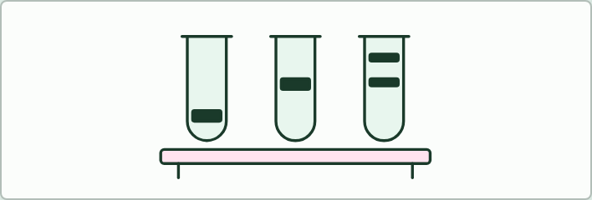
DATA
12 MIN
Predict the tubes
THE TASK
With chapter 2’s Meselson and Stahl figure on the board, pairs draw the three tubes that each model predicts before its state is shown. Then they draw the tubes that were observed and say which generation ruled out which model.
STUDENTS NEED
Mini whiteboards.
Minutes 14 to 26
Notes:
Minutes 14 to 26 of 60: One old strand, one new (12 min).
The plan: Chapter 2: the predict box first (four molecules, how many hold an old strand), then chapter 2’s figure step by step. Then the How we know box: show chapter 2’s Meselson and Stahl states, and students predict each model’s tubes on mini whiteboards before each state is shown (Predict the tubes, below).
The activity: Predict the tubes. With chapter 2’s Meselson and Stahl figure on the board, pairs draw the three tubes that each model predicts before its state is shown. Then they draw the tubes that were observed and say which generation ruled out which model.
Needs: mini whiteboards.
The time: 12 minutes, minutes 14 to 26 of the plan.

Slide 29
STEP 4
14 MIN
Unzip, then build
Chapter 3: Unzip, then build
Minutes 26 to 40
Notes:
Minutes 26 to 40 of 60: Unzip, then build (14 min).
The plan: Chapter 3’s figure: tap helicase and DNA polymerase. Then Run the fork’s standard level rounds in pairs (chapter 3’s game): compare each pair’s speed with the real polymerase’s.

Slide 30
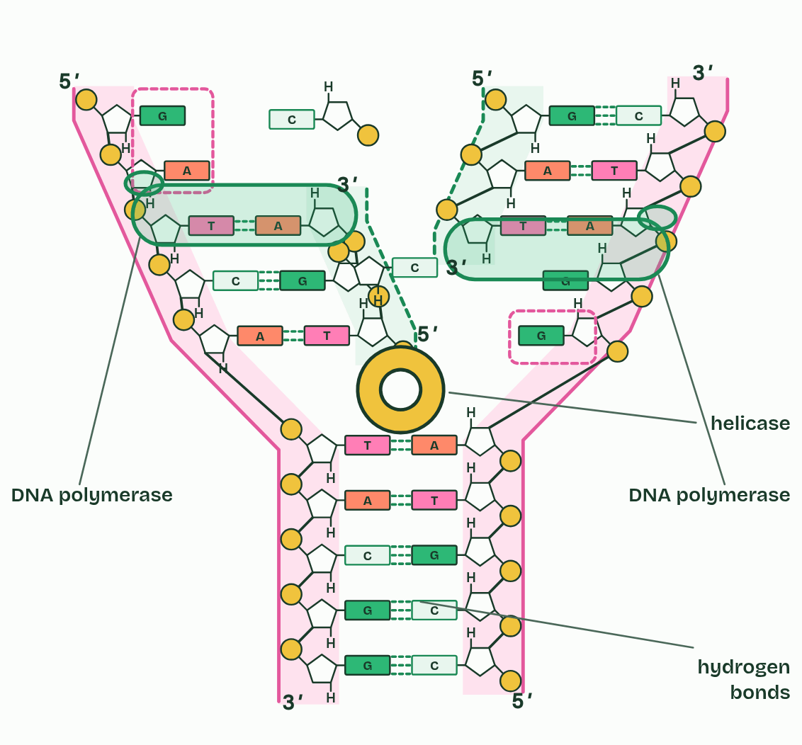
CHAPTER 3 · D1.1.3 Helicase and DNA polymerase
Unzip, then build
Helicase unwinds the helix and breaks the hydrogen bonds between bases.
DNA polymerase joins free nucleotides into a new strand, matched to the template by base pairing.
One polymerase works on each template strand.
Minutes 26 to 40
Notes:
Minutes 26 to 40 of 60: Unzip, then build (14 min).
The plan: Chapter 3’s figure: tap helicase and DNA polymerase. Then Run the fork’s standard level rounds in pairs (chapter 3’s game): compare each pair’s speed with the real polymerase’s.
Copying is two jobs, and a different enzyme does each. First the helix has to open, because inside it every base is already paired and tucked away. Then a new strand has to be built against each old one.
Helicase is the unzipper. It moves along the double helix, unwinding it and breaking the hydrogen bonds between the base pairs, so that the two strands part. The point where the helix is opening is the replication fork. Only hydrogen bonds break. The covalent bonds along each strand stay whole, so each template keeps its sequence.
DNA polymerase is the builder. Free nucleotides drift in the nucleus, or in the cytoplasm of a bacterium. One whose base pairs with an exposed base on the template is joined to the end of the new strand by a covalent bond in the sugar and phosphate backbone. DNA polymerase only joins a nucleotide that pairs correctly, which is why the copy is accurate. It adds whole nucleotides, already made: it does not make bases.
Each template strand has its own DNA polymerase. The strands run in opposite directions, so the two enzymes work in opposite directions, and that makes the two new strands very different: chapter 8 explains how.
That answers the first guiding question. New DNA is made by unzipping the old and building a complementary strand on each half. Next, do it yourself: Run the fork.
Parts of the figure:
An old strand of the parent molecule. Where the helix has opened, it is a template for a new strand.
An old strand of the parent molecule. Where the helix has opened, it is a template for a new strand.
Hydrogen bonds hold the base pairs together. They are weak one by one, so they can be broken without harm.
A new strand, complementary to its template.
A new strand, complementary to its template.
Exposed bases. Only one kind of nucleotide can pair with each.
Exposed bases. Only one kind of nucleotide can pair with each.
A free nucleotide: a phosphate, deoxyribose and one of four bases, waiting to pair.
A free nucleotide: a phosphate, deoxyribose and one of four bases, waiting to pair.
DNA polymerase joins each new nucleotide to the strand it is building, after its base has paired with the template.
DNA polymerase joins each new nucleotide to the strand it is building, after its base has paired with the template.
Helicase unwinds the helix and pulls the base pairs apart, breaking only the hydrogen bonds that held them. Each strand stays whole.

Slide 31
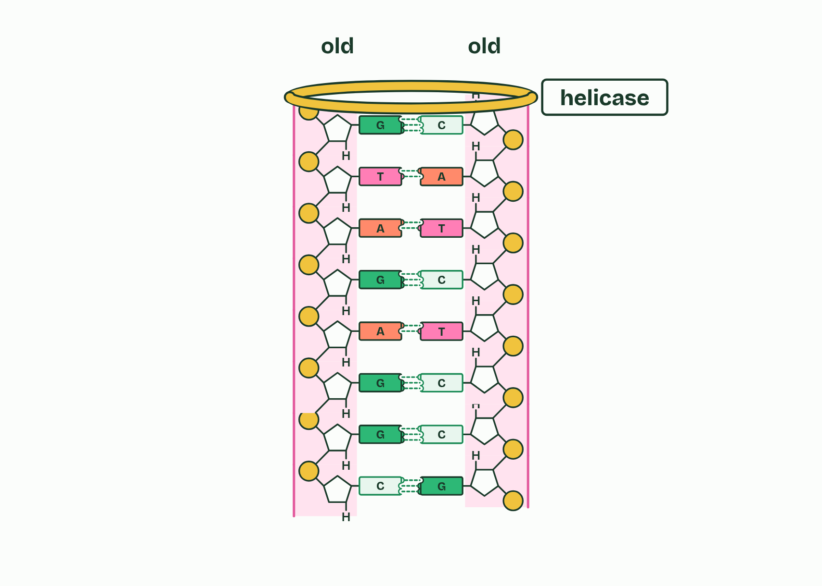
CHAPTER 3 · D1.1.3 Helicase and DNA polymerase
1 / 4
Unzip, then build
One molecule: two old strands.
Minutes 26 to 40
Notes:
Minutes 26 to 40 of 60: Unzip, then build (14 min).
The plan: Chapter 3’s figure: tap helicase and DNA polymerase. Then Run the fork’s standard level rounds in pairs (chapter 3’s game): compare each pair’s speed with the real polymerase’s.
Copying is two jobs, and a different enzyme does each. First the helix has to open, because inside it every base is already paired and tucked away. Then a new strand has to be built against each old one.
Helicase is the unzipper. It moves along the double helix, unwinding it and breaking the hydrogen bonds between the base pairs, so that the two strands part. The point where the helix is opening is the replication fork. Only hydrogen bonds break. The covalent bonds along each strand stay whole, so each template keeps its sequence.
DNA polymerase is the builder. Free nucleotides drift in the nucleus, or in the cytoplasm of a bacterium. One whose base pairs with an exposed base on the template is joined to the end of the new strand by a covalent bond in the sugar and phosphate backbone. DNA polymerase only joins a nucleotide that pairs correctly, which is why the copy is accurate. It adds whole nucleotides, already made: it does not make bases.
Each template strand has its own DNA polymerase. The strands run in opposite directions, so the two enzymes work in opposite directions, and that makes the two new strands very different: chapter 8 explains how.
That answers the first guiding question. New DNA is made by unzipping the old and building a complementary strand on each half. Next, do it yourself: Run the fork.

Slide 32
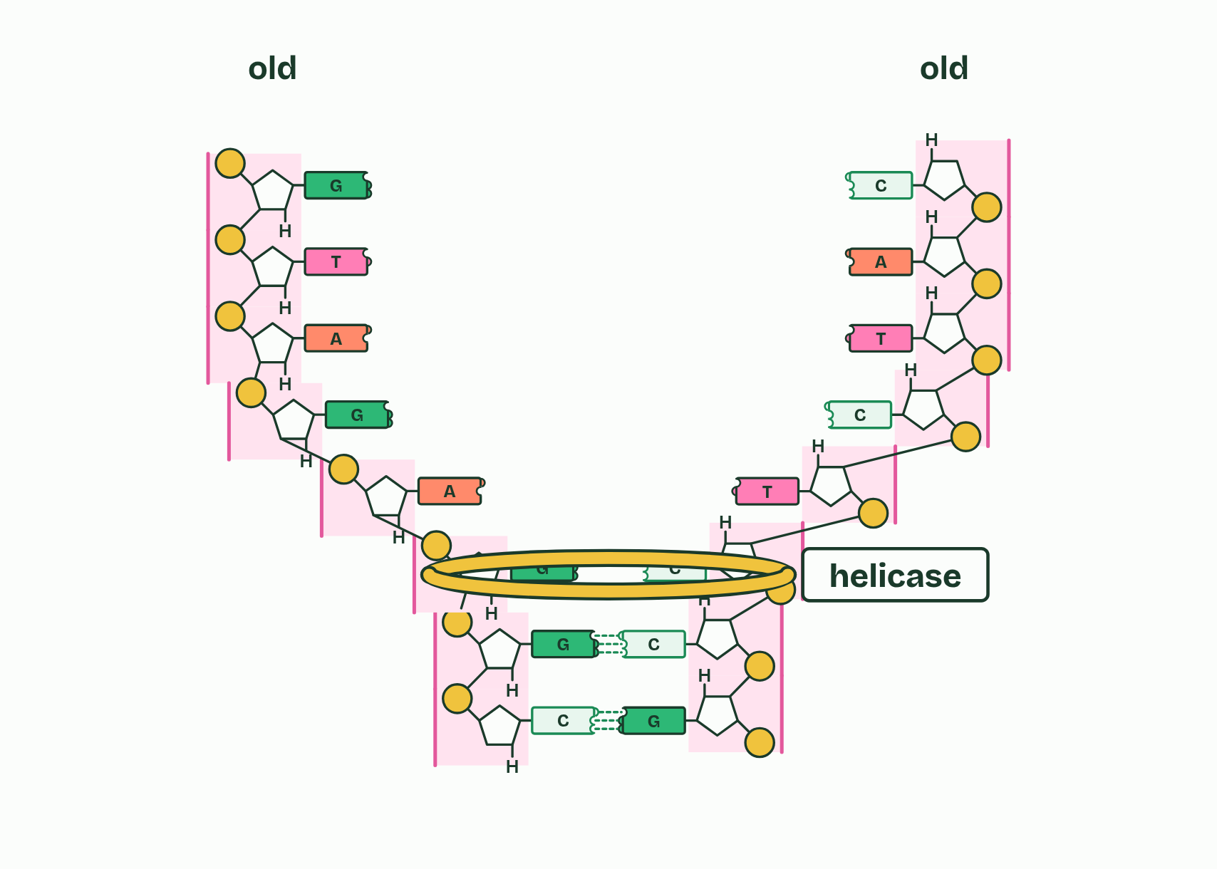
CHAPTER 3 · D1.1.3 Helicase and DNA polymerase
2 / 4
Unzip, then build
Helicase unwinds the helix and breaks the hydrogen bonds.
Minutes 26 to 40
Notes:
Minutes 26 to 40 of 60: Unzip, then build (14 min).
The plan: Chapter 3’s figure: tap helicase and DNA polymerase. Then Run the fork’s standard level rounds in pairs (chapter 3’s game): compare each pair’s speed with the real polymerase’s.
Copying is two jobs, and a different enzyme does each. First the helix has to open, because inside it every base is already paired and tucked away. Then a new strand has to be built against each old one.
Helicase is the unzipper. It moves along the double helix, unwinding it and breaking the hydrogen bonds between the base pairs, so that the two strands part. The point where the helix is opening is the replication fork. Only hydrogen bonds break. The covalent bonds along each strand stay whole, so each template keeps its sequence.
DNA polymerase is the builder. Free nucleotides drift in the nucleus, or in the cytoplasm of a bacterium. One whose base pairs with an exposed base on the template is joined to the end of the new strand by a covalent bond in the sugar and phosphate backbone. DNA polymerase only joins a nucleotide that pairs correctly, which is why the copy is accurate. It adds whole nucleotides, already made: it does not make bases.
Each template strand has its own DNA polymerase. The strands run in opposite directions, so the two enzymes work in opposite directions, and that makes the two new strands very different: chapter 8 explains how.
That answers the first guiding question. New DNA is made by unzipping the old and building a complementary strand on each half. Next, do it yourself: Run the fork.

Slide 33
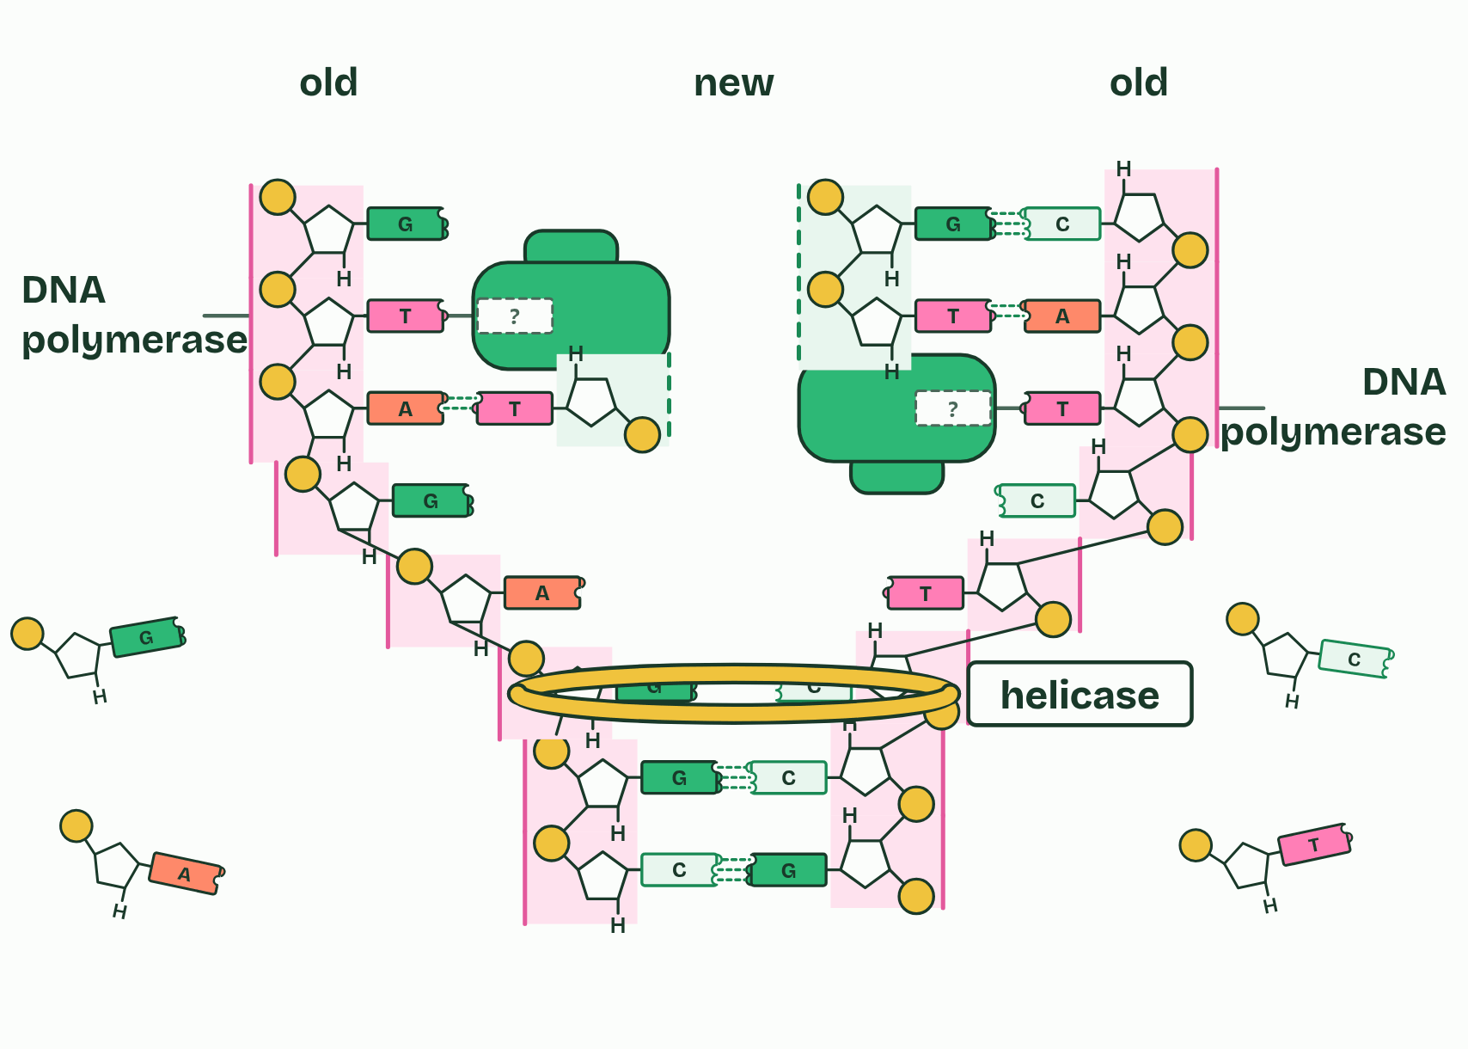
CHAPTER 3 · D1.1.3 Helicase and DNA polymerase
3 / 4
Unzip, then build
DNA polymerase joins nucleotides that pair with each exposed base.
Minutes 26 to 40
Notes:
Minutes 26 to 40 of 60: Unzip, then build (14 min).
The plan: Chapter 3’s figure: tap helicase and DNA polymerase. Then Run the fork’s standard level rounds in pairs (chapter 3’s game): compare each pair’s speed with the real polymerase’s.
Copying is two jobs, and a different enzyme does each. First the helix has to open, because inside it every base is already paired and tucked away. Then a new strand has to be built against each old one.
Helicase is the unzipper. It moves along the double helix, unwinding it and breaking the hydrogen bonds between the base pairs, so that the two strands part. The point where the helix is opening is the replication fork. Only hydrogen bonds break. The covalent bonds along each strand stay whole, so each template keeps its sequence.
DNA polymerase is the builder. Free nucleotides drift in the nucleus, or in the cytoplasm of a bacterium. One whose base pairs with an exposed base on the template is joined to the end of the new strand by a covalent bond in the sugar and phosphate backbone. DNA polymerase only joins a nucleotide that pairs correctly, which is why the copy is accurate. It adds whole nucleotides, already made: it does not make bases.
Each template strand has its own DNA polymerase. The strands run in opposite directions, so the two enzymes work in opposite directions, and that makes the two new strands very different: chapter 8 explains how.
That answers the first guiding question. New DNA is made by unzipping the old and building a complementary strand on each half. Next, do it yourself: Run the fork.

Slide 34
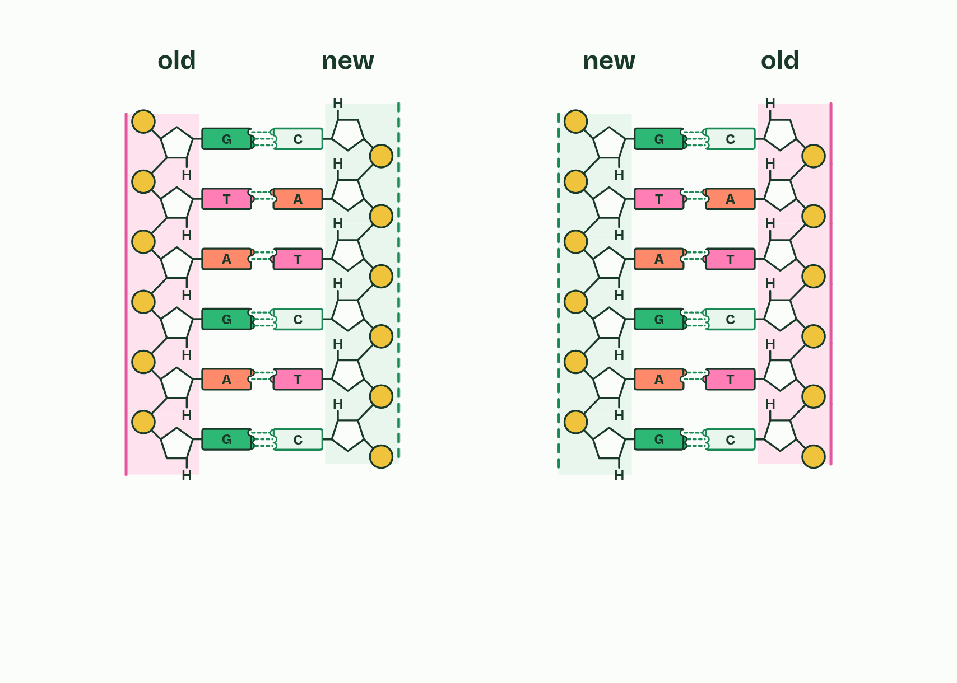
CHAPTER 3 · D1.1.3 Helicase and DNA polymerase
4 / 4
Unzip, then build
Two molecules, each with one old strand and one new.
Minutes 26 to 40
Notes:
Minutes 26 to 40 of 60: Unzip, then build (14 min).
The plan: Chapter 3’s figure: tap helicase and DNA polymerase. Then Run the fork’s standard level rounds in pairs (chapter 3’s game): compare each pair’s speed with the real polymerase’s.
Copying is two jobs, and a different enzyme does each. First the helix has to open, because inside it every base is already paired and tucked away. Then a new strand has to be built against each old one.
Helicase is the unzipper. It moves along the double helix, unwinding it and breaking the hydrogen bonds between the base pairs, so that the two strands part. The point where the helix is opening is the replication fork. Only hydrogen bonds break. The covalent bonds along each strand stay whole, so each template keeps its sequence.
DNA polymerase is the builder. Free nucleotides drift in the nucleus, or in the cytoplasm of a bacterium. One whose base pairs with an exposed base on the template is joined to the end of the new strand by a covalent bond in the sugar and phosphate backbone. DNA polymerase only joins a nucleotide that pairs correctly, which is why the copy is accurate. It adds whole nucleotides, already made: it does not make bases.
Each template strand has its own DNA polymerase. The strands run in opposite directions, so the two enzymes work in opposite directions, and that makes the two new strands very different: chapter 8 explains how.
That answers the first guiding question. New DNA is made by unzipping the old and building a complementary strand on each half. Next, do it yourself: Run the fork.

Slide 35
CHAPTER 3 · D1.1.3 Helicase and DNA polymerase
Unzip, then build
Helicase unwinds the helix and breaks the hydrogen bonds between bases.
DNA polymerase joins free nucleotides into a new strand, matched to the template by base pairing.
One polymerase works on each template strand.
Minutes 26 to 40
Notes:
Minutes 26 to 40 of 60: Unzip, then build (14 min).
The plan: Chapter 3’s figure: tap helicase and DNA polymerase. Then Run the fork’s standard level rounds in pairs (chapter 3’s game): compare each pair’s speed with the real polymerase’s.
Copying is two jobs, and a different enzyme does each. First the helix has to open, because inside it every base is already paired and tucked away. Then a new strand has to be built against each old one.
Helicase is the unzipper. It moves along the double helix, unwinding it and breaking the hydrogen bonds between the base pairs, so that the two strands part. The point where the helix is opening is the replication fork. Only hydrogen bonds break. The covalent bonds along each strand stay whole, so each template keeps its sequence.
DNA polymerase is the builder. Free nucleotides drift in the nucleus, or in the cytoplasm of a bacterium. One whose base pairs with an exposed base on the template is joined to the end of the new strand by a covalent bond in the sugar and phosphate backbone. DNA polymerase only joins a nucleotide that pairs correctly, which is why the copy is accurate. It adds whole nucleotides, already made: it does not make bases.
Each template strand has its own DNA polymerase. The strands run in opposite directions, so the two enzymes work in opposite directions, and that makes the two new strands very different: chapter 8 explains how.
That answers the first guiding question. New DNA is made by unzipping the old and building a complementary strand on each half. Next, do it yourself: Run the fork.

Slide 36
PREDICT
A drug stops helicase but leaves DNA polymerase working. What happens to replication?
A It stops: polymerase needs single strands to read
B It carries on, only more slowly than before
C Polymerase copies the double strand without opening it
Minutes 26 to 40
Notes:
Minutes 26 to 40 of 60: Unzip, then build (14 min).
The plan: Chapter 3’s figure: tap helicase and DNA polymerase. Then Run the fork’s standard level rounds in pairs (chapter 3’s game): compare each pair’s speed with the real polymerase’s.
Ask for a show of hands, or mini whiteboards, before revealing. (Answer: A, on the next slide.)

Slide 37
WHAT HAPPENS
A drug stops helicase but leaves DNA polymerase working. What happens to replication?
A It stops: polymerase needs single strands to read
B It carries on, only more slowly than before
C Polymerase copies the double strand without opening it
It stops. DNA polymerase can only pair new nucleotides with bases it can reach, and in the double helix every base is already paired and tucked inside. No unzipping, no templates, no copying.
Minutes 26 to 40
Notes:
Minutes 26 to 40 of 60: Unzip, then build (14 min).
The plan: Chapter 3’s figure: tap helicase and DNA polymerase. Then Run the fork’s standard level rounds in pairs (chapter 3’s game): compare each pair’s speed with the real polymerase’s.
Answer: A. It stops. DNA polymerase can only pair new nucleotides with bases it can reach, and in the double helix every base is already paired and tucked inside. No unzipping, no templates, no copying.

Slide 38
WATCH OUT
Helicase breaks the hydrogen bonds between the bases, not the bonds between sugar and phosphate. And DNA polymerase does not “make bases”: it joins whole nucleotides, already made, into the new strand.
Minutes 26 to 40
Notes:
Minutes 26 to 40 of 60: Unzip, then build (14 min).
The plan: Chapter 3’s figure: tap helicase and DNA polymerase. Then Run the fork’s standard level rounds in pairs (chapter 3’s game): compare each pair’s speed with the real polymerase’s.
A common mistake: say it, then ask who can say why it is wrong.

Slide 39
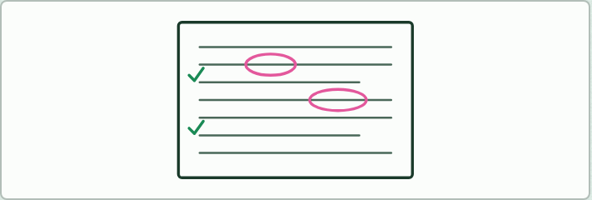
WRITING
14 MIN
Improve the answer
THE TASK
The question: “A skin cell is about to divide. Explain how it makes two identical copies of each of its DNA molecules. (8 marks)” Give students this weak answer: “The DNA comes apart into two halves. Each half picks up new bases that match it. An enzyme sticks them together. You end up with two lots of DNA that are the same because the bases match up.”Students mark it against the points the class agrees from chapters 1 to 3: helicase named, hydrogen bonds broken, strands as templates, free nucleotides (not “bases”), complementary pairing, DNA polymerase joining nucleotides, semi-conservative explained, two identical molecules, and why (growth, repair, reproduction). Then they rewrite it. Tips to draw out: begin by saying what replication is, name each enzyme and give its job in the same sentence, write “nucleotides” where the weak answer says “bases”, and reach for the exact term (“semi-conservative”, “complementary”, “hydrogen bonds”) rather than an everyday phrase that circles it.
STUDENTS NEED
The answer printed or on the board.
Minutes 40 to 54
Notes:
Minutes 40 to 54 of 60: Improve the answer (14 min).
The plan: Students mark a weak eight-mark answer about copying a skin cell’s DNA against the points the class has agreed from chapters 1 to 3, then rewrite it (Improve the answer, below).
The activity: Improve the answer. The question: “A skin cell is about to divide. Explain how it makes two identical copies of each of its DNA molecules. (8 marks)” Give students this weak answer: “The DNA comes apart into two halves. Each half picks up new bases that match it. An enzyme sticks them together. You end up with two lots of DNA that are the same because the bases match up.”Students mark it against the points the class agrees from chapters 1 to 3: helicase named, hydrogen bonds broken, strands as templates, free nucleotides (not “bases”), complementary pairing, DNA polymerase joining nucleotides, semi-conservative explained, two identical molecules, and why (growth, repair, reproduction). Then they rewrite it. Tips to draw out: begin by saying what replication is, name each enzyme and give its job in the same sentence, write “nucleotides” where the weak answer says “bases”, and reach for the exact term (“semi-conservative”, “complementary”, “hydrogen bonds”) rather than an everyday phrase that circles it.
Needs: the answer printed or on the board.
The time: 14 minutes, minutes 40 to 54 of the plan.

Slide 40
PLENARY
Can you now...
Explain why cells copy their DNA, and why every copy must carry the same base sequence (D1.1.1)
Explain what semi-conservative means, and how complementary base pairing makes copying accurate (D1.1.2)
Describe what helicase and DNA polymerase do at a replication fork (D1.1.3)
Minutes 54 to 60
Notes:
Minutes 54 to 60 of 60: Exit (6 min).
The plan: “Explain why DNA replication is described as semi-conservative, using the words template and complementary.” Homework: the Meselson and Stahl doodle (below).
Thumbs up, sideways or down on each goal before the exit question. The goals come from the statements this lesson covers.

Slide 41
EXIT QUESTION
Before you go
“Explain why DNA replication is described as semi-conservative, using the words template and complementary.”
Minutes 54 to 60
Notes:
Minutes 54 to 60 of 60: Exit (6 min).
The plan: “Explain why DNA replication is described as semi-conservative, using the words template and complementary.” Homework: the Meselson and Stahl doodle (below).

Slide 42

DOODLE
6 MIN
Meselson and Stahl doodle
THE TASK
Homework after lesson 1, in the summary doodle style: three small doodles and eight keywords that fit on one sticky note, telling the story of the experiment. A small prize for the best.
STUDENTS NEED
Sticky notes and pens.
Minutes 54 to 60
Notes:
Minutes 54 to 60 of 60: Exit (6 min).
The plan: “Explain why DNA replication is described as semi-conservative, using the words template and complementary.” Homework: the Meselson and Stahl doodle (below).
The activity: Meselson and Stahl doodle. Homework after lesson 1, in the summary doodle style: three small doodles and eight keywords that fit on one sticky note, telling the story of the experiment. A small prize for the best.
Needs: sticky notes and pens.
The time: 6 minutes, minutes 54 to 60 of the plan.

Slide 43
PRACTISE AND REVISE
Keep going
Exam practice: a fresh paper of exam questions on D1.1 at standard level, marked as you go
The guide, with the animations and the dry lab
This lesson in the guide: 1 A copy for every new cell, 2 One old strand, one new, 3 Unzip, then build
BUILD FOR YOUR CLASS
ALREADY ON THE SITE FOR D1.1
CARD SETS ON SPLYCR
Tarsia puzzle, dominoes and picture reveal on D1.1, built from its key terms and ready to print
A pub quiz with rounds on D1.1, to present or run with no projector
An escape room built from the question bank on D1.1
Quiz: DNA Replication
Revision map: D1.1 DNA replication, to fill in
Exam questions: D1.1 in the exam maker, a paper with its markscheme
Open a set to host it as a class game, or make a copy to edit.
D1.1 DNA Replication
How this was made. The course structure, the activities and the teaching choices come from my own classroom, my presentations and my years of teaching IB and AP Biology. I use Claude, an AI, to help write and build the interactive guides, lesson plans, slides and practice questions, and to draw the diagrams and code the interactives. I direct the work and review it against the IB and AP specifications before it goes live.
Minute 60: after the lesson
Notes:
Every link here is live. Set the exam practice paper for homework: it is fresh each time, marked as students go and saved to their Exam practice when they are signed in.
Exam practice: https://www.biologybybradford.com/exam-maker/sit?topics=D1.1&level=SL&paper=quiz&marks=15&src=ep
The guide: https://www.biologybybradford.com/guides/ib-biology-d1-1-dna-replication

