Slide 1
IB Biology D1.1
LESSON 2 OF 4
BY THE END YOU CAN
DNA replication
Outline how PCR copies a small sample of DNA, with primers, three temperatures and Taq polymerase (D1.1.4)
Explain how gel electrophoresis separates DNA fragments by size, and read sizes against a ladder (D1.1.4)
Use DNA profiles to settle paternity and forensic cases, and explain why more markers mean fewer false matches (D1.1.5)
Amplify, separate, identify
D1.1.4, D1.1.5
PCR, gels and DNA profiles, and why more markers mean fewer false matches
60 minutes · chapters 4, 5, 6 · the dry lab
Minute 0
Notes:
IB Biology D1.1, DNA replication. Lesson 2 of 4: Amplify, separate, identify, 60 minutes.
The plan, minute by minute (each slide's footer says where you are):
0 to 5 min (5) Do now: fold and double
5 to 17 min (12) One PCR cycle
17 to 25 min (8) Run the gel
25 to 45 min (20) The dry lab in pairs
45 to 55 min (10) How many markers?
55 to 60 min (5) Exit
What students get wrong:
PCR copies the whole genome. It copies the stretch between the two primers.
Taq is used because it is fast. It is used because it survives 95 °C (misconception 18 is the related belief that every enzyme works best at 37 °C, with Taq as its counter-example).
Large fragments travel further. Small ones do: the gel holds large ones back (misconception 77).
DNA moves to the negative electrode. It is negative, so it moves to the positive one.
A profile match at one marker proves who it was. Many people share one marker; many markers together make a chance match rare.
Profiling cuts DNA with restriction enzymes. Modern profiling copies STR markers by PCR and sizes them.
Contamination does not matter because PCR is sensitive. It matters more (misconception 76).
Stretch and support:
Support: use the dotted key terms as a glossary, and cut chapter 4’s captions up for students to put in order.
Support: use the Dragons Always Exhale tiles as a starter in lesson 2.
Stretch: a PCR runs at 90 % efficiency, not 100 %. How many copies of one molecule after 30 cycles? (1.9³⁰, about 230 million.) Why does real PCR level off?
Stretch: in the dry lab’s harder cases a brother of a suspect matches at several markers. Why do relatives make profiling harder, and what would a lab do?
The lesson plan to print: https://www.biologybybradford.com/guides/downloads/ib-biology-d1-1-dna-replication-lesson-2-plan.pdf

Slide 2
DO NOW
Fold and double
Students fold a strip of paper in half again and again and count the layers, then estimate what thirty doublings would give.
5:00
minutes
Start now: the timer is running.
Minutes 0 to 5
Notes:
Minutes 0 to 5 of 60: Do now: fold and double (5 min).
The plan: Students fold a strip of paper in half again and again and count the layers, then estimate what thirty doublings would give (Fold and double, below).
Start a 5 minute timer as they come in.

Slide 3
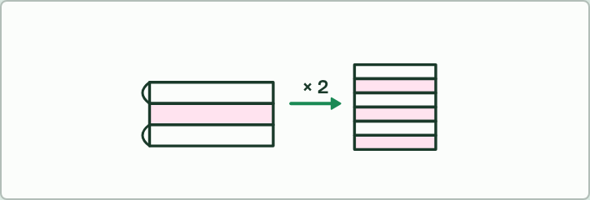
ESTIMATE
5 MIN
Fold and double
THE TASK
Students fold a strip of paper in half again and again and count the layers; most give up at six or seven folds, with 64 or 128 layers. Then: one molecule doubling for 30 cycles. How many copies?
STUDENTS NEED
Strips of scrap paper.
Minutes 0 to 5
Notes:
Minutes 0 to 5 of 60: Do now: fold and double (5 min).
The plan: Students fold a strip of paper in half again and again and count the layers, then estimate what thirty doublings would give (Fold and double, below).
The activity: Fold and double. Students fold a strip of paper in half again and again and count the layers; most give up at six or seven folds, with 64 or 128 layers. Then: one molecule doubling for 30 cycles. How many copies?
Needs: strips of scrap paper.
The time: 5 minutes, minutes 0 to 5 of the plan.

Slide 4
STEP 2
12 MIN
One PCR cycle
Chapter 4: A millionfold copy
Minutes 5 to 17
Notes:
Minutes 5 to 17 of 60: One PCR cycle (12 min).
The plan: Chapter 4’s figure step by step, then the Dragons Always Exhale tiles. Chapter 4’s predict box on Taq polymerase by vote, then chapter 4’s worked example.

Slide 5
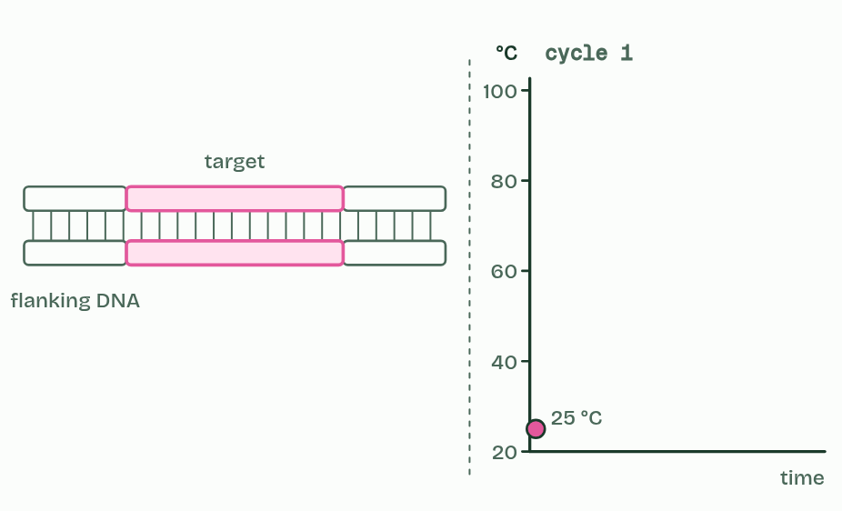
CHAPTER 4 · D1.1.4 The polymerase chain reaction
1 / 6
A millionfold copy
A sample of DNA, too little to study.
Minutes 5 to 17
Notes:
Minutes 5 to 17 of 60: One PCR cycle (12 min).
The plan: Chapter 4’s figure step by step, then the Dragons Always Exhale tiles. Chapter 4’s predict box on Taq polymerase by vote, then chapter 4’s worked example.
A smear of blood, a hair root or a swab holds far too little DNA to study. The polymerase chain reaction (PCR) copies one chosen stretch of DNA over and over until there is plenty. Making many copies of a small amount of DNA is to amplify it.
The tube holds the sample, plenty of free nucleotides, a buffer, a polymerase and two primers: short single strands of DNA, one matching each end of the stretch to be copied. A thermal cycler then changes the temperature again and again. One cycle has three steps.
A cycle takes two or three minutes, and 30 cycles take an hour or two. Each cycle doubles the number of copies, so after n cycles one molecule can give up to 2n: 30 cycles give 1,073,741,824. In practice the doubling slows near the end, as primers and nucleotides run low.
Why primers? A DNA polymerase cannot start a strand on its own. It can only add to the end of a strand that is already paired with the template. The primers give it that start, and their sequences choose which stretch gets copied; chapter 8 shows that a cell has the same problem.
The polymerase used is Taq polymerase, from Thermus aquaticus, a bacterium found in hot springs.
PCR mimics replication: strands are separated, nucleotides pair with a template and a polymerase joins them. What differs is that heat does the unzipping instead of helicase, the primers are made by a chemist, and one short stretch is copied instead of a whole chromosome. Chapter 5 shows how the copies are then sorted by size.
Example: Doubling A crime-scene swab holds about 10 copies of the stretch to be tested. After 30 cycles there are 10 × 2³⁰ = 10 × 1,073,741,824, about 10.7 billion copies: enough to see as a band on a gel (chapter 5).

Slide 6
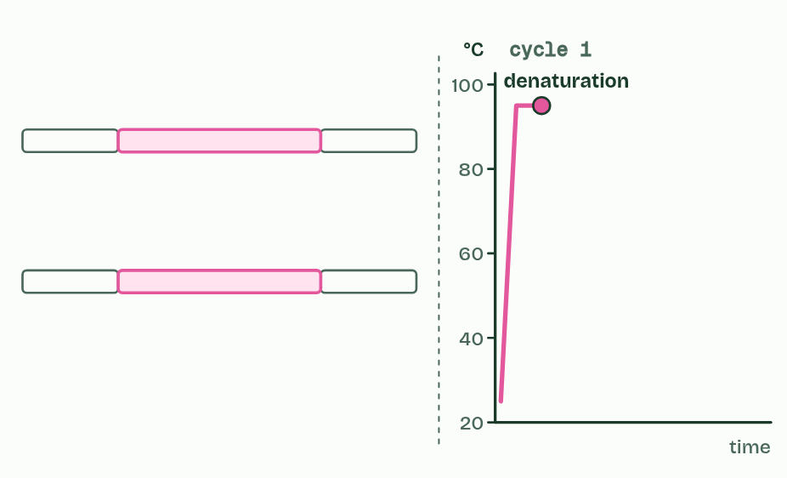
CHAPTER 4 · D1.1.4 The polymerase chain reaction
2 / 6
A millionfold copy
About 95 °C: the strands separate.
Minutes 5 to 17
Notes:
Minutes 5 to 17 of 60: One PCR cycle (12 min).
The plan: Chapter 4’s figure step by step, then the Dragons Always Exhale tiles. Chapter 4’s predict box on Taq polymerase by vote, then chapter 4’s worked example.
A smear of blood, a hair root or a swab holds far too little DNA to study. The polymerase chain reaction (PCR) copies one chosen stretch of DNA over and over until there is plenty. Making many copies of a small amount of DNA is to amplify it.
The tube holds the sample, plenty of free nucleotides, a buffer, a polymerase and two primers: short single strands of DNA, one matching each end of the stretch to be copied. A thermal cycler then changes the temperature again and again. One cycle has three steps.
A cycle takes two or three minutes, and 30 cycles take an hour or two. Each cycle doubles the number of copies, so after n cycles one molecule can give up to 2n: 30 cycles give 1,073,741,824. In practice the doubling slows near the end, as primers and nucleotides run low.
Why primers? A DNA polymerase cannot start a strand on its own. It can only add to the end of a strand that is already paired with the template. The primers give it that start, and their sequences choose which stretch gets copied; chapter 8 shows that a cell has the same problem.
The polymerase used is Taq polymerase, from Thermus aquaticus, a bacterium found in hot springs.
PCR mimics replication: strands are separated, nucleotides pair with a template and a polymerase joins them. What differs is that heat does the unzipping instead of helicase, the primers are made by a chemist, and one short stretch is copied instead of a whole chromosome. Chapter 5 shows how the copies are then sorted by size.
Example: Doubling A crime-scene swab holds about 10 copies of the stretch to be tested. After 30 cycles there are 10 × 2³⁰ = 10 × 1,073,741,824, about 10.7 billion copies: enough to see as a band on a gel (chapter 5).

Slide 7
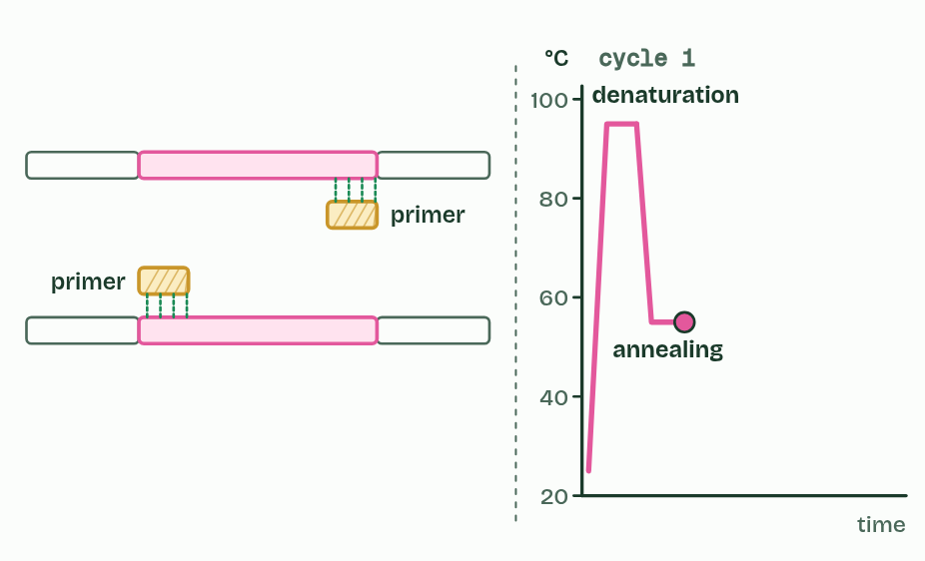
CHAPTER 4 · D1.1.4 The polymerase chain reaction
3 / 6
A millionfold copy
About 55 °C: primers bind at each end of the target.
Minutes 5 to 17
Notes:
Minutes 5 to 17 of 60: One PCR cycle (12 min).
The plan: Chapter 4’s figure step by step, then the Dragons Always Exhale tiles. Chapter 4’s predict box on Taq polymerase by vote, then chapter 4’s worked example.
A smear of blood, a hair root or a swab holds far too little DNA to study. The polymerase chain reaction (PCR) copies one chosen stretch of DNA over and over until there is plenty. Making many copies of a small amount of DNA is to amplify it.
The tube holds the sample, plenty of free nucleotides, a buffer, a polymerase and two primers: short single strands of DNA, one matching each end of the stretch to be copied. A thermal cycler then changes the temperature again and again. One cycle has three steps.
A cycle takes two or three minutes, and 30 cycles take an hour or two. Each cycle doubles the number of copies, so after n cycles one molecule can give up to 2n: 30 cycles give 1,073,741,824. In practice the doubling slows near the end, as primers and nucleotides run low.
Why primers? A DNA polymerase cannot start a strand on its own. It can only add to the end of a strand that is already paired with the template. The primers give it that start, and their sequences choose which stretch gets copied; chapter 8 shows that a cell has the same problem.
The polymerase used is Taq polymerase, from Thermus aquaticus, a bacterium found in hot springs.
PCR mimics replication: strands are separated, nucleotides pair with a template and a polymerase joins them. What differs is that heat does the unzipping instead of helicase, the primers are made by a chemist, and one short stretch is copied instead of a whole chromosome. Chapter 5 shows how the copies are then sorted by size.
Example: Doubling A crime-scene swab holds about 10 copies of the stretch to be tested. After 30 cycles there are 10 × 2³⁰ = 10 × 1,073,741,824, about 10.7 billion copies: enough to see as a band on a gel (chapter 5).

Slide 8
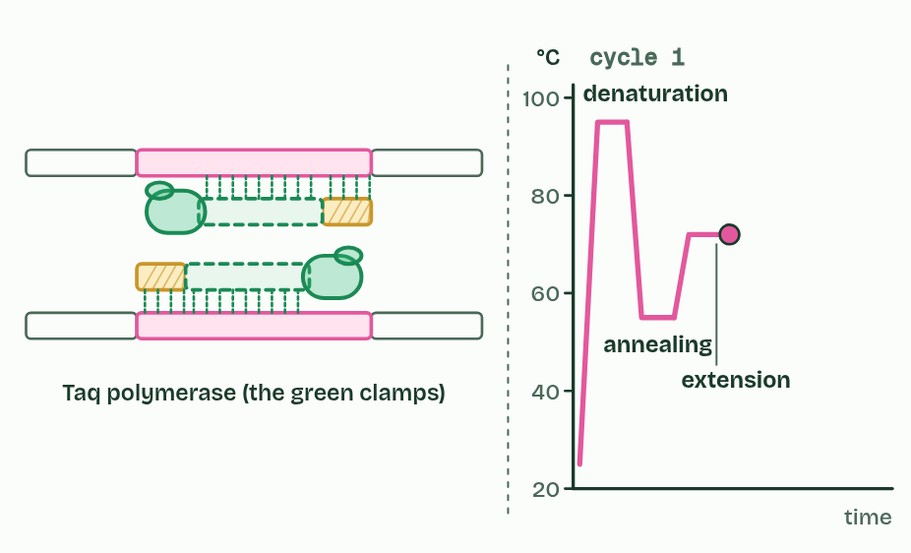
CHAPTER 4 · D1.1.4 The polymerase chain reaction
4 / 6
A millionfold copy
About 72 °C: Taq polymerase extends each primer.
Minutes 5 to 17
Notes:
Minutes 5 to 17 of 60: One PCR cycle (12 min).
The plan: Chapter 4’s figure step by step, then the Dragons Always Exhale tiles. Chapter 4’s predict box on Taq polymerase by vote, then chapter 4’s worked example.
A smear of blood, a hair root or a swab holds far too little DNA to study. The polymerase chain reaction (PCR) copies one chosen stretch of DNA over and over until there is plenty. Making many copies of a small amount of DNA is to amplify it.
The tube holds the sample, plenty of free nucleotides, a buffer, a polymerase and two primers: short single strands of DNA, one matching each end of the stretch to be copied. A thermal cycler then changes the temperature again and again. One cycle has three steps.
A cycle takes two or three minutes, and 30 cycles take an hour or two. Each cycle doubles the number of copies, so after n cycles one molecule can give up to 2n: 30 cycles give 1,073,741,824. In practice the doubling slows near the end, as primers and nucleotides run low.
Why primers? A DNA polymerase cannot start a strand on its own. It can only add to the end of a strand that is already paired with the template. The primers give it that start, and their sequences choose which stretch gets copied; chapter 8 shows that a cell has the same problem.
The polymerase used is Taq polymerase, from Thermus aquaticus, a bacterium found in hot springs.
PCR mimics replication: strands are separated, nucleotides pair with a template and a polymerase joins them. What differs is that heat does the unzipping instead of helicase, the primers are made by a chemist, and one short stretch is copied instead of a whole chromosome. Chapter 5 shows how the copies are then sorted by size.
Example: Doubling A crime-scene swab holds about 10 copies of the stretch to be tested. After 30 cycles there are 10 × 2³⁰ = 10 × 1,073,741,824, about 10.7 billion copies: enough to see as a band on a gel (chapter 5).

Slide 9
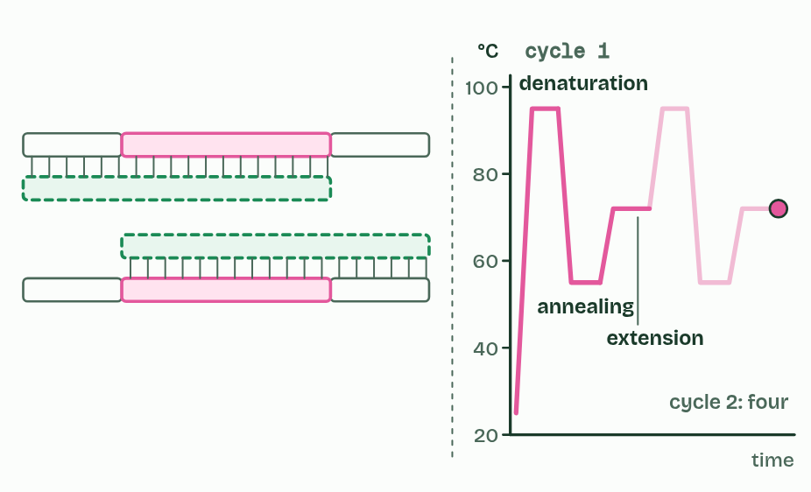
CHAPTER 4 · D1.1.4 The polymerase chain reaction
5 / 6
A millionfold copy
One cycle: the copies double.
Minutes 5 to 17
Notes:
Minutes 5 to 17 of 60: One PCR cycle (12 min).
The plan: Chapter 4’s figure step by step, then the Dragons Always Exhale tiles. Chapter 4’s predict box on Taq polymerase by vote, then chapter 4’s worked example.
A smear of blood, a hair root or a swab holds far too little DNA to study. The polymerase chain reaction (PCR) copies one chosen stretch of DNA over and over until there is plenty. Making many copies of a small amount of DNA is to amplify it.
The tube holds the sample, plenty of free nucleotides, a buffer, a polymerase and two primers: short single strands of DNA, one matching each end of the stretch to be copied. A thermal cycler then changes the temperature again and again. One cycle has three steps.
A cycle takes two or three minutes, and 30 cycles take an hour or two. Each cycle doubles the number of copies, so after n cycles one molecule can give up to 2n: 30 cycles give 1,073,741,824. In practice the doubling slows near the end, as primers and nucleotides run low.
Why primers? A DNA polymerase cannot start a strand on its own. It can only add to the end of a strand that is already paired with the template. The primers give it that start, and their sequences choose which stretch gets copied; chapter 8 shows that a cell has the same problem.
The polymerase used is Taq polymerase, from Thermus aquaticus, a bacterium found in hot springs.
PCR mimics replication: strands are separated, nucleotides pair with a template and a polymerase joins them. What differs is that heat does the unzipping instead of helicase, the primers are made by a chemist, and one short stretch is copied instead of a whole chromosome. Chapter 5 shows how the copies are then sorted by size.
Example: Doubling A crime-scene swab holds about 10 copies of the stretch to be tested. After 30 cycles there are 10 × 2³⁰ = 10 × 1,073,741,824, about 10.7 billion copies: enough to see as a band on a gel (chapter 5).

Slide 10
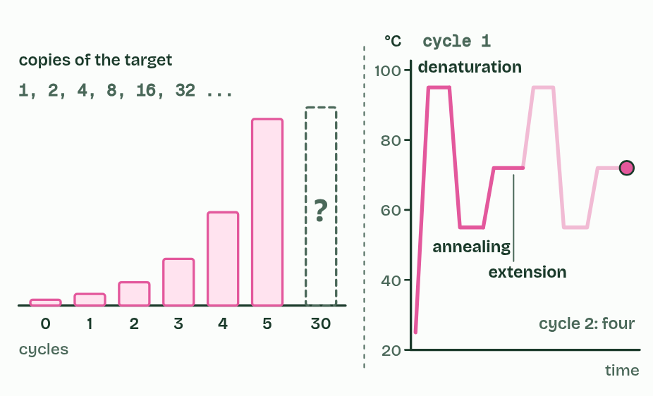
CHAPTER 4 · D1.1.4 The polymerase chain reaction
6 / 6
A millionfold copy
Thirty cycles later: how many?
Minutes 5 to 17
Notes:
Minutes 5 to 17 of 60: One PCR cycle (12 min).
The plan: Chapter 4’s figure step by step, then the Dragons Always Exhale tiles. Chapter 4’s predict box on Taq polymerase by vote, then chapter 4’s worked example.
A smear of blood, a hair root or a swab holds far too little DNA to study. The polymerase chain reaction (PCR) copies one chosen stretch of DNA over and over until there is plenty. Making many copies of a small amount of DNA is to amplify it.
The tube holds the sample, plenty of free nucleotides, a buffer, a polymerase and two primers: short single strands of DNA, one matching each end of the stretch to be copied. A thermal cycler then changes the temperature again and again. One cycle has three steps.
A cycle takes two or three minutes, and 30 cycles take an hour or two. Each cycle doubles the number of copies, so after n cycles one molecule can give up to 2n: 30 cycles give 1,073,741,824. In practice the doubling slows near the end, as primers and nucleotides run low.
Why primers? A DNA polymerase cannot start a strand on its own. It can only add to the end of a strand that is already paired with the template. The primers give it that start, and their sequences choose which stretch gets copied; chapter 8 shows that a cell has the same problem.
The polymerase used is Taq polymerase, from Thermus aquaticus, a bacterium found in hot springs.
PCR mimics replication: strands are separated, nucleotides pair with a template and a polymerase joins them. What differs is that heat does the unzipping instead of helicase, the primers are made by a chemist, and one short stretch is copied instead of a whole chromosome. Chapter 5 shows how the copies are then sorted by size.
Example: Doubling A crime-scene swab holds about 10 copies of the stretch to be tested. After 30 cycles there are 10 × 2³⁰ = 10 × 1,073,741,824, about 10.7 billion copies: enough to see as a band on a gel (chapter 5).

Slide 11
CHAPTER 4 · D1.1.4 The polymerase chain reaction
A millionfold copy
Denaturation, about 95 °C. Heat breaks the hydrogen bonds and the strands separate. It does helicase’s job.
Annealing, about 55 °C. The mixture cools and a primer binds, by hydrogen bonds, to its matching sequence at each end of the target.
Extension, about 72 °C. The polymerase adds nucleotides onto each primer and builds a complementary strand.
Minutes 5 to 17
Notes:
Minutes 5 to 17 of 60: One PCR cycle (12 min).
The plan: Chapter 4’s figure step by step, then the Dragons Always Exhale tiles. Chapter 4’s predict box on Taq polymerase by vote, then chapter 4’s worked example.
A smear of blood, a hair root or a swab holds far too little DNA to study. The polymerase chain reaction (PCR) copies one chosen stretch of DNA over and over until there is plenty. Making many copies of a small amount of DNA is to amplify it.
The tube holds the sample, plenty of free nucleotides, a buffer, a polymerase and two primers: short single strands of DNA, one matching each end of the stretch to be copied. A thermal cycler then changes the temperature again and again. One cycle has three steps.
A cycle takes two or three minutes, and 30 cycles take an hour or two. Each cycle doubles the number of copies, so after n cycles one molecule can give up to 2n: 30 cycles give 1,073,741,824. In practice the doubling slows near the end, as primers and nucleotides run low.
Why primers? A DNA polymerase cannot start a strand on its own. It can only add to the end of a strand that is already paired with the template. The primers give it that start, and their sequences choose which stretch gets copied; chapter 8 shows that a cell has the same problem.
The polymerase used is Taq polymerase, from Thermus aquaticus, a bacterium found in hot springs.
PCR mimics replication: strands are separated, nucleotides pair with a template and a polymerase joins them. What differs is that heat does the unzipping instead of helicase, the primers are made by a chemist, and one short stretch is copied instead of a whole chromosome. Chapter 5 shows how the copies are then sorted by size.
Example: Doubling A crime-scene swab holds about 10 copies of the stretch to be tested. After 30 cycles there are 10 × 2³⁰ = 10 × 1,073,741,824, about 10.7 billion copies: enough to see as a band on a gel (chapter 5).

Slide 12
WATCH OUT
PCR does not copy a whole genome, and it does not make a new organism. It copies one short stretch chosen by the primers. And denaturing DNA is harmless to it: the strands come apart and pair again, unlike a protein that loses its shape for good.
Minutes 5 to 17
Notes:
Minutes 5 to 17 of 60: One PCR cycle (12 min).
The plan: Chapter 4’s figure step by step, then the Dragons Always Exhale tiles. Chapter 4’s predict box on Taq polymerase by vote, then chapter 4’s worked example.
A common mistake: say it, then ask who can say why it is wrong.

Slide 13
REMEMBER IT
One PCR cycle
D
A
E
Dragons
Always
Exhale
Minutes 5 to 17
Notes:
Minutes 5 to 17 of 60: One PCR cycle (12 min).
The plan: Chapter 4’s figure step by step, then the Dragons Always Exhale tiles. Chapter 4’s predict box on Taq polymerase by vote, then chapter 4’s worked example.
Ask the class what each letter stands for before revealing.

Slide 14
REMEMBER IT
One PCR cycle
D
A
E
Dragons
Always
Exhale
Denaturation
Annealing
Extension
about 95 °C: the strands separate
about 55 °C: primers bind
about 72 °C: Taq builds the new strands
Minutes 5 to 17
Notes:
Minutes 5 to 17 of 60: One PCR cycle (12 min).
The plan: Chapter 4’s figure step by step, then the Dragons Always Exhale tiles. Chapter 4’s predict box on Taq polymerase by vote, then chapter 4’s worked example.
Dragons: Denaturation (about 95 °C: the strands separate)
Always: Annealing (about 55 °C: primers bind)
Exhale: Extension (about 72 °C: Taq builds the new strands)

Slide 15
PREDICT
PCR uses a DNA polymerase from bacteria that live in hot springs. Why not a polymerase from human cells?
A A human polymerase would copy human DNA only
B A human polymerase would be denatured at 95 °C each cycle
C Hot-spring polymerase copies DNA without any primers at all
Minutes 5 to 17
Notes:
Minutes 5 to 17 of 60: One PCR cycle (12 min).
The plan: Chapter 4’s figure step by step, then the Dragons Always Exhale tiles. Chapter 4’s predict box on Taq polymerase by vote, then chapter 4’s worked example.
Ask for a show of hands, or mini whiteboards, before revealing. (Answer: B, on the next slide.)

Slide 16
WHAT HAPPENS
PCR uses a DNA polymerase from bacteria that live in hot springs. Why not a polymerase from human cells?
A A human polymerase would copy human DNA only
B A human polymerase would be denatured at 95 °C each cycle
C Hot-spring polymerase copies DNA without any primers at all
Every cycle heats the tube to about 95 °C to separate the strands. A human polymerase, made to work at 37 °C, would lose its shape in the first heating and never work again. Taq polymerase, from a bacterium that lives in hot springs, keeps its shape through 30 heatings, so it can be added once at the start.
Minutes 5 to 17
Notes:
Minutes 5 to 17 of 60: One PCR cycle (12 min).
The plan: Chapter 4’s figure step by step, then the Dragons Always Exhale tiles. Chapter 4’s predict box on Taq polymerase by vote, then chapter 4’s worked example.
Answer: B. Every cycle heats the tube to about 95 °C to separate the strands. A human polymerase, made to work at 37 °C, would lose its shape in the first heating and never work again. Taq polymerase, from a bacterium that lives in hot springs, keeps its shape through 30 heatings, so it can be added once at the start.

Slide 17
STEP 3
8 MIN
Run the gel
Add “run to red”.
Minutes 17 to 25
Notes:
Minutes 17 to 25 of 60: Run the gel (8 min).
The plan: Chapter 5’s slider on the board, then chapter 5’s predict box. Add “run to red”: DNA runs towards the positive electrode.

Slide 18
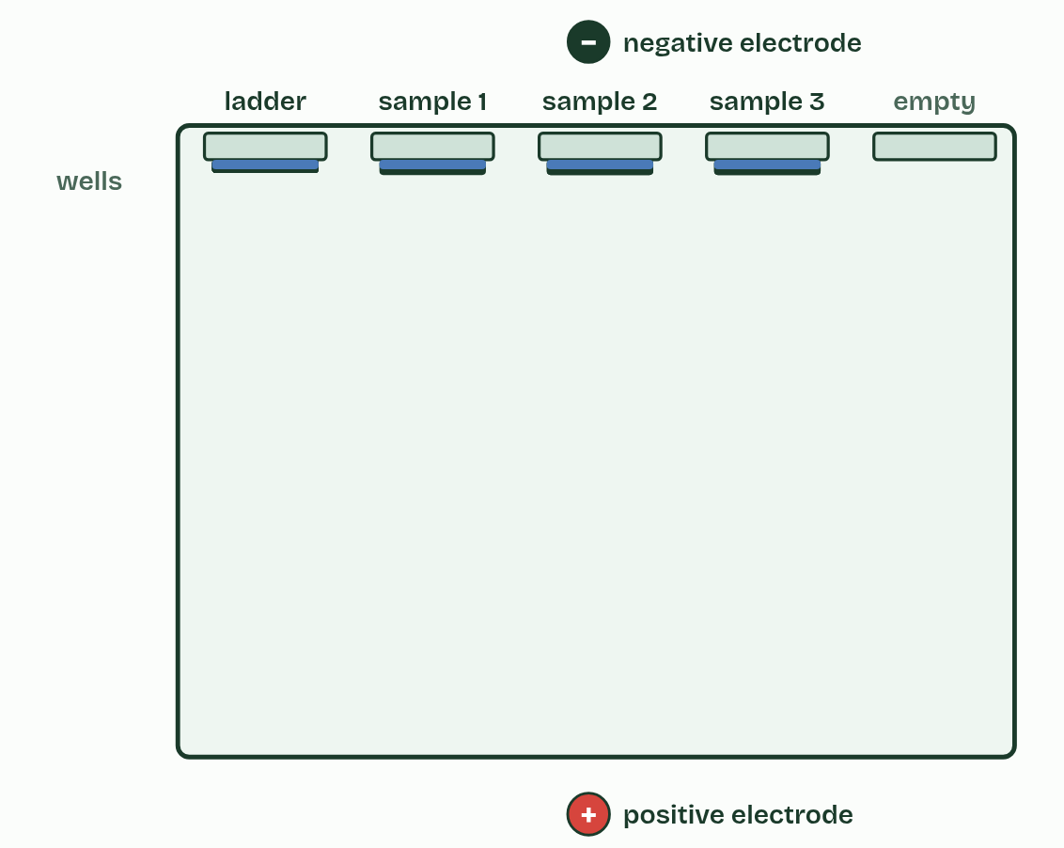
CHAPTER 5 · D1.1.4 Gel electrophoresis
Sorted by size
The negative charge of the phosphates pulls DNA towards the positive electrode.
The mesh holds long fragments back more, so short ones travel furthest.
The ladder gives the scale for reading sizes.
Minutes 17 to 25
Notes:
Minutes 17 to 25 of 60: Run the gel (8 min).
The plan: Chapter 5’s slider on the board, then chapter 5’s predict box. Add “run to red”: DNA runs towards the positive electrode.
PCR gives you a tube of identical copies. To see what is in it, you sort the DNA by size. Gel electrophoresis does that: it separates DNA fragments by their length, counted in base pairs (bp).
A slab of gel, a jelly made from seaweed, has a row of small pits at one end, the wells. The slab lies in a tank of salty buffer between two electrodes. Each sample is mixed with a dense loading solution, so it sinks into its well, and a blue dye in the mix shows how far the run has gone. Then the current goes on.
Why does DNA move? Every nucleotide carries a phosphate group with a negative charge, so DNA is pulled towards the positive electrode, and the wells go at the negative end. At the bench: run to red, because the positive lead is usually red.
Why does it separate? The gel is a mesh of fibres. Short fragments slip through quickly and long ones are held back more. Every fragment carries about the same charge for each base pair, so the pull on each base pair is the same, and size decides how far a fragment gets in a set time. The shortest travel furthest.
A DNA ladder, a mix of fragments of known sizes, runs in its own lane and gives a scale. To size an unknown band, find the ladder band level with it, or the two it sits between.
DNA is colourless, so afterwards the gel is soaked in a stain that glows under blue or ultraviolet light when it binds DNA. Each set of same-length fragments shows as one band, so the number of bands is the number of different fragment lengths in the sample, and the distances between bands show their relative sizes. A band holds millions of identical fragments, because a single molecule is far too little to see. That is why PCR comes first.
One more fact for the curious: distance travelled is not in proportion to size. It falls roughly with the logarithm of the size, so doubling a fragment’s length does not halve its distance. And real profiling labs run the same separation in a hair-thin tube of gel, a capillary, that can tell apart fragments one base pair different in length. Textbooks, and this guide, draw slab gels.

Slide 19
WATCH OUT
Bigger fragments do not travel further because they are “heavier” or “more charged”: they travel less far, because the gel holds them back. And DNA moves to the positive electrode, because it is negative.
Minutes 17 to 25
Notes:
Minutes 17 to 25 of 60: Run the gel (8 min).
The plan: Chapter 5’s slider on the board, then chapter 5’s predict box. Add “run to red”: DNA runs towards the positive electrode.
A common mistake: say it, then ask who can say why it is wrong.

Slide 20
PREDICT
Fragments of 300, 1,000 and 5,000 base pairs are run on the same gel. Which ends up nearest the wells?
A 300 base pairs: small fragments stick to the gel
B 1,000 base pairs: middle sizes are held back most
C 5,000 base pairs: long fragments move slowest
Minutes 17 to 25
Notes:
Minutes 17 to 25 of 60: Run the gel (8 min).
The plan: Chapter 5’s slider on the board, then chapter 5’s predict box. Add “run to red”: DNA runs towards the positive electrode.
Ask for a show of hands, or mini whiteboards, before revealing. (Answer: C, on the next slide.)

Slide 21
WHAT HAPPENS
Fragments of 300, 1,000 and 5,000 base pairs are run on the same gel. Which ends up nearest the wells?
A 300 base pairs: small fragments stick to the gel
B 1,000 base pairs: middle sizes are held back most
C 5,000 base pairs: long fragments move slowest
The longest, 5,000 base pairs. All three carry the same charge per base pair, so the pull per base pair is the same. What differs is how easily each threads through the mesh of the gel: long fragments snag more and move slowest, so they stay nearest the wells. Nothing sticks to the gel.
Minutes 17 to 25
Notes:
Minutes 17 to 25 of 60: Run the gel (8 min).
The plan: Chapter 5’s slider on the board, then chapter 5’s predict box. Add “run to red”: DNA runs towards the positive electrode.
Answer: C. The longest, 5,000 base pairs. All three carry the same charge per base pair, so the pull per base pair is the same. What differs is how easily each threads through the mesh of the gel: long fragments snag more and move slowest, so they stay nearest the wells. Nothing sticks to the gel.

Slide 22
STEP 4
20 MIN
The dry lab in pairs
The dry lab: Who’s the father? first with three markers, then with more, then Whose blood?
Pairs report the number of markers they needed (Who’s the father?
Minutes 25 to 45
Notes:
Minutes 25 to 45 of 60: The dry lab in pairs (20 min).
The plan: The dry lab: Who’s the father? first with three markers, then with more, then Whose blood? Pairs report the number of markers they needed (Who’s the father? Who did it?, below).

Slide 23
DRY LAB
20 MIN
PCR and gel: whose DNA is it?
THE TASK
The dry lab, with the tasks and questions under it. Pairs share one device, and the results download as a CSV for a class graph of the chance of a false match against the markers run.
STUDENTS NEED
One device per pair.
Minutes 25 to 45
Notes:
Minutes 25 to 45 of 60: The dry lab in pairs (20 min).
The plan: The dry lab: Who’s the father? first with three markers, then with more, then Whose blood? Pairs report the number of markers they needed (Who’s the father? Who did it?, below).
The activity: PCR and gel: whose DNA is it?. The dry lab, with the tasks and questions under it. Pairs share one device, and the results download as a CSV for a class graph of the chance of a false match against the markers run.
Needs: one device per pair.
The time: 20 minutes, minutes 25 to 45 of the plan.

Slide 24
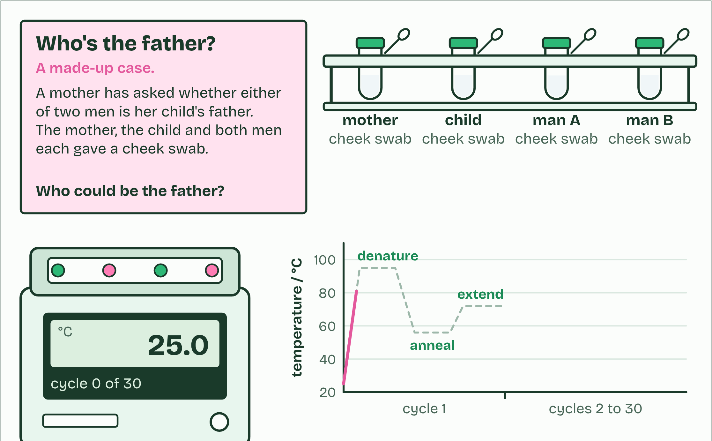
DRY LAB
PCR and gel: whose DNA is it?
Your question: Do the profiles show who the father is, or whose blood was left at the scene, and how many markers do you need before you can be confident?
What you can change: The case; how much DNA you start with; the number of PCR cycles; the three temperatures; the polymerase; the primers; the gel; how long the gel runs; how many markers you run.
What to record: For each person and each marker: the sizes of the bands, read against the ladder, and the alleles they stand for. Then your verdict, and the chance that an unrelated person would match by luck.
Run it: biologybybradford.com/guides/ib-biology-d1-1-dna-replication#lab
Minutes 25 to 45
Notes:
Minutes 25 to 45 of 60: The dry lab in pairs (20 min).
The plan: The dry lab: Who’s the father? first with three markers, then with more, then Whose blood? Pairs report the number of markers they needed (Who’s the father? Who did it?, below).
The dry lab runs in the guide: https://www.biologybybradford.com/guides/ib-biology-d1-1-dna-replication#lab

Slide 25
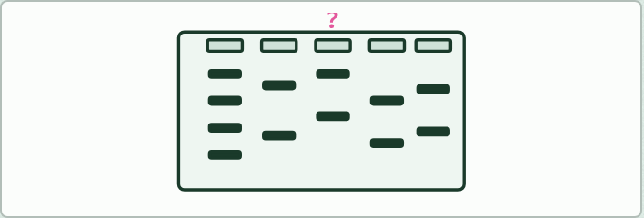
DATA
20 MIN
Who’s the father? Who did it?
THE TASK
The teacher prints three cases from the dry lab (Print this gel on the bench gives the lanes and the question, with no answer): a paternity case, a crime scene and a case review. Pairs decide each one and write the band-by-band reason.
STUDENTS NEED
The printed gels.
Minutes 25 to 45
Notes:
Minutes 25 to 45 of 60: The dry lab in pairs (20 min).
The plan: The dry lab: Who’s the father? first with three markers, then with more, then Whose blood? Pairs report the number of markers they needed (Who’s the father? Who did it?, below).
The activity: Who’s the father? Who did it?. The teacher prints three cases from the dry lab (Print this gel on the bench gives the lanes and the question, with no answer): a paternity case, a crime scene and a case review. Pairs decide each one and write the band-by-band reason.
Needs: the printed gels.
The time: 20 minutes, minutes 25 to 45 of the plan.

Slide 26
STEP 5
10 MIN
How many markers?
Chapter 6: Profiles, parents and crime scenes
Discussion: How conclusive is DNA evidence?
Minutes 45 to 55
Notes:
Minutes 45 to 55 of 60: How many markers? (10 min).
The plan: Chapter 6’s figure 6.2 and its predict box, then How conclusive is DNA evidence? as a class discussion.

Slide 27
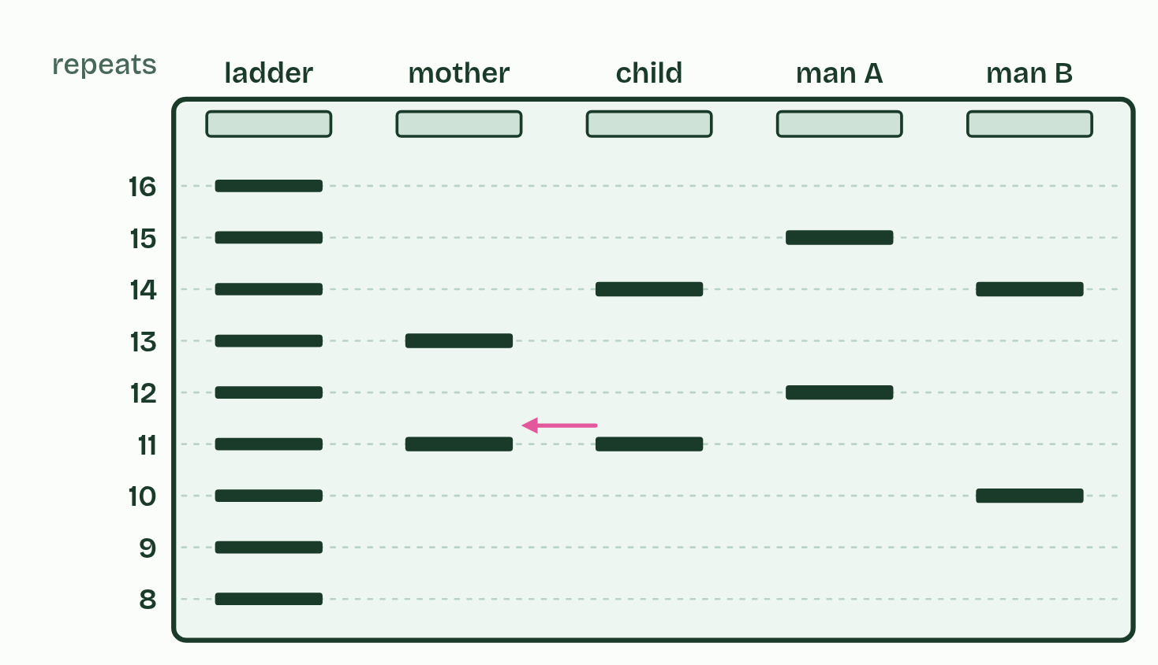
CHAPTER 6 · D1.1.5 Applications of PCR and gel electrophoresis
1 / 2
Profiles, parents and crime scenes
Paternity
Minutes 45 to 55
Notes:
Minutes 45 to 55 of 60: How many markers? (10 min).
The plan: Chapter 6’s figure 6.2 and its predict box, then How conclusive is DNA evidence? as a class discussion.
PCR and gel electrophoresis are used far beyond the classroom.
Most of our DNA is the same from one person to the next, but some places hold a short sequence repeated over and over, end to end: a short tandem repeat (STR), such as GATA GATA GATA. People differ in how many repeats they have. Such a place is a marker, each version (a number of repeats) is an allele, and each person has two alleles at each marker, one from each parent.
DNA profiling starts with a sample: blood, saliva, a hair root, or skin cells left on a handle. PCR copies the markers, using primers that bind either side of each repeat. Electrophoresis then separates the copies by length: more repeats, longer copy, shorter distance. The pattern of bands at several markers is the person’s profile.
In a forensic investigation, the profile from the scene is compared with those of the suspects and the victim. A match at every marker is strong evidence that the sample came from that person, and a single clear mismatch excludes them. Profiling has cleared innocent people as well as convicting guilty ones.
In a paternity test, a child has at each marker one allele from the mother and one from the father. A band in the child that the mother does not have must come from the father, so a man without it is excluded. Labs look for exclusions at two or more markers, because a rare new mutation can change one.
So how many markers are enough? One marker proves little, because many people share any one pair of alleles. Each extra independent marker is another test that a person must pass by luck, so the chance of a false match is multiplied by another small number and falls very fast. Reliability rises with the number of measurements. Real profiles use about 15 to 20 markers: 16 in the UK and 20 in the USA.
Take care all the same. Identical twins share a profile, close relatives share more than strangers, and a sample can be contaminated. The evidence is strong, but not proof on its own.

Slide 28
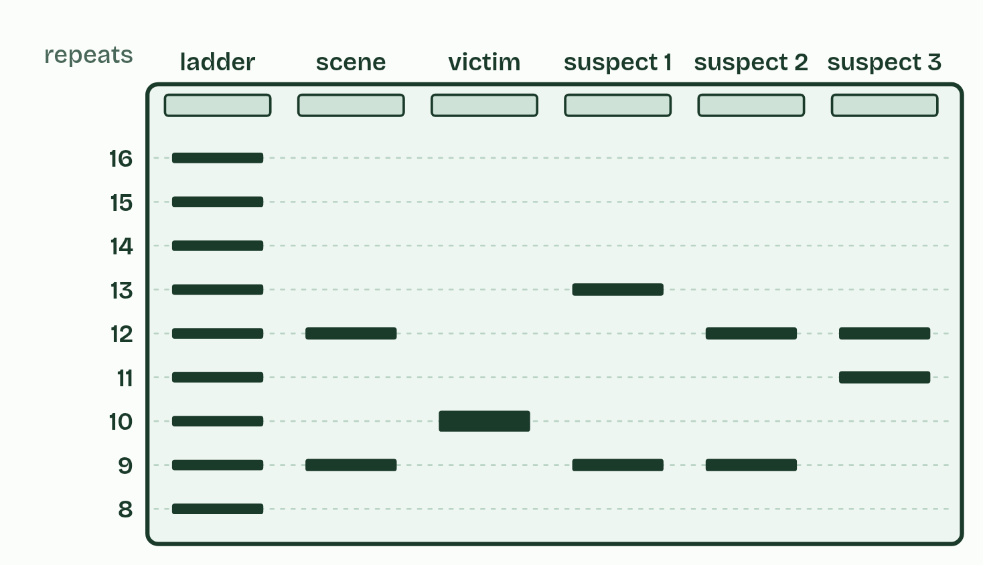
CHAPTER 6 · D1.1.5 Applications of PCR and gel electrophoresis
2 / 2
Profiles, parents and crime scenes
Crime scene
Minutes 45 to 55
Notes:
Minutes 45 to 55 of 60: How many markers? (10 min).
The plan: Chapter 6’s figure 6.2 and its predict box, then How conclusive is DNA evidence? as a class discussion.
PCR and gel electrophoresis are used far beyond the classroom.
Most of our DNA is the same from one person to the next, but some places hold a short sequence repeated over and over, end to end: a short tandem repeat (STR), such as GATA GATA GATA. People differ in how many repeats they have. Such a place is a marker, each version (a number of repeats) is an allele, and each person has two alleles at each marker, one from each parent.
DNA profiling starts with a sample: blood, saliva, a hair root, or skin cells left on a handle. PCR copies the markers, using primers that bind either side of each repeat. Electrophoresis then separates the copies by length: more repeats, longer copy, shorter distance. The pattern of bands at several markers is the person’s profile.
In a forensic investigation, the profile from the scene is compared with those of the suspects and the victim. A match at every marker is strong evidence that the sample came from that person, and a single clear mismatch excludes them. Profiling has cleared innocent people as well as convicting guilty ones.
In a paternity test, a child has at each marker one allele from the mother and one from the father. A band in the child that the mother does not have must come from the father, so a man without it is excluded. Labs look for exclusions at two or more markers, because a rare new mutation can change one.
So how many markers are enough? One marker proves little, because many people share any one pair of alleles. Each extra independent marker is another test that a person must pass by luck, so the chance of a false match is multiplied by another small number and falls very fast. Reliability rises with the number of measurements. Real profiles use about 15 to 20 markers: 16 in the UK and 20 in the USA.
Take care all the same. Identical twins share a profile, close relatives share more than strangers, and a sample can be contaminated. The evidence is strong, but not proof on its own.

Slide 29
CHAPTER 6 · D1.1.5 Applications of PCR and gel electrophoresis
Profiles, parents and crime scenes
Forensic investigations and paternity tests, by DNA profiling.
Diagnosing infections. The COVID-19 test copies a stretch of the virus’s genes (the virus’s RNA is first copied into DNA).
Testing for inherited conditions.
Identifying species: a fish sold as cod that is not, the source of a meat sample, wildlife trading.
Copying a gene so that it can be studied or moved.
Studying ancient DNA from bones.
Minutes 45 to 55
Notes:
Minutes 45 to 55 of 60: How many markers? (10 min).
The plan: Chapter 6’s figure 6.2 and its predict box, then How conclusive is DNA evidence? as a class discussion.
PCR and gel electrophoresis are used far beyond the classroom.
Most of our DNA is the same from one person to the next, but some places hold a short sequence repeated over and over, end to end: a short tandem repeat (STR), such as GATA GATA GATA. People differ in how many repeats they have. Such a place is a marker, each version (a number of repeats) is an allele, and each person has two alleles at each marker, one from each parent.
DNA profiling starts with a sample: blood, saliva, a hair root, or skin cells left on a handle. PCR copies the markers, using primers that bind either side of each repeat. Electrophoresis then separates the copies by length: more repeats, longer copy, shorter distance. The pattern of bands at several markers is the person’s profile.
In a forensic investigation, the profile from the scene is compared with those of the suspects and the victim. A match at every marker is strong evidence that the sample came from that person, and a single clear mismatch excludes them. Profiling has cleared innocent people as well as convicting guilty ones.
In a paternity test, a child has at each marker one allele from the mother and one from the father. A band in the child that the mother does not have must come from the father, so a man without it is excluded. Labs look for exclusions at two or more markers, because a rare new mutation can change one.
So how many markers are enough? One marker proves little, because many people share any one pair of alleles. Each extra independent marker is another test that a person must pass by luck, so the chance of a false match is multiplied by another small number and falls very fast. Reliability rises with the number of measurements. Real profiles use about 15 to 20 markers: 16 in the UK and 20 in the USA.
Take care all the same. Identical twins share a profile, close relatives share more than strangers, and a sample can be contaminated. The evidence is strong, but not proof on its own.

Slide 30
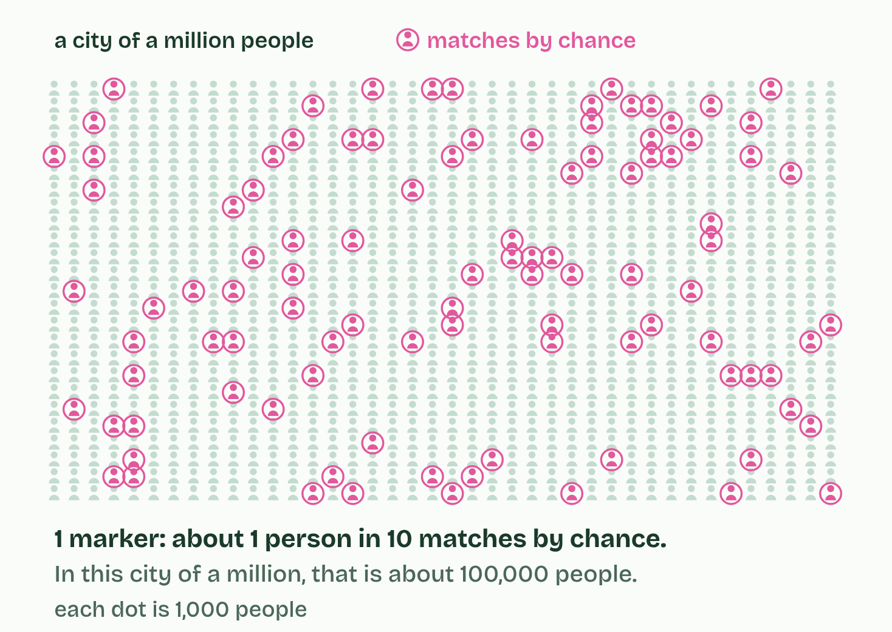
CHAPTER 6 · D1.1.5 Applications of PCR and gel electrophoresis
1 / 4
Profiles, parents and crime scenes
1 marker
Minutes 45 to 55
Notes:
Minutes 45 to 55 of 60: How many markers? (10 min).
The plan: Chapter 6’s figure 6.2 and its predict box, then How conclusive is DNA evidence? as a class discussion.
PCR and gel electrophoresis are used far beyond the classroom.
Most of our DNA is the same from one person to the next, but some places hold a short sequence repeated over and over, end to end: a short tandem repeat (STR), such as GATA GATA GATA. People differ in how many repeats they have. Such a place is a marker, each version (a number of repeats) is an allele, and each person has two alleles at each marker, one from each parent.
DNA profiling starts with a sample: blood, saliva, a hair root, or skin cells left on a handle. PCR copies the markers, using primers that bind either side of each repeat. Electrophoresis then separates the copies by length: more repeats, longer copy, shorter distance. The pattern of bands at several markers is the person’s profile.
In a forensic investigation, the profile from the scene is compared with those of the suspects and the victim. A match at every marker is strong evidence that the sample came from that person, and a single clear mismatch excludes them. Profiling has cleared innocent people as well as convicting guilty ones.
In a paternity test, a child has at each marker one allele from the mother and one from the father. A band in the child that the mother does not have must come from the father, so a man without it is excluded. Labs look for exclusions at two or more markers, because a rare new mutation can change one.
So how many markers are enough? One marker proves little, because many people share any one pair of alleles. Each extra independent marker is another test that a person must pass by luck, so the chance of a false match is multiplied by another small number and falls very fast. Reliability rises with the number of measurements. Real profiles use about 15 to 20 markers: 16 in the UK and 20 in the USA.
Take care all the same. Identical twins share a profile, close relatives share more than strangers, and a sample can be contaminated. The evidence is strong, but not proof on its own.

Slide 31
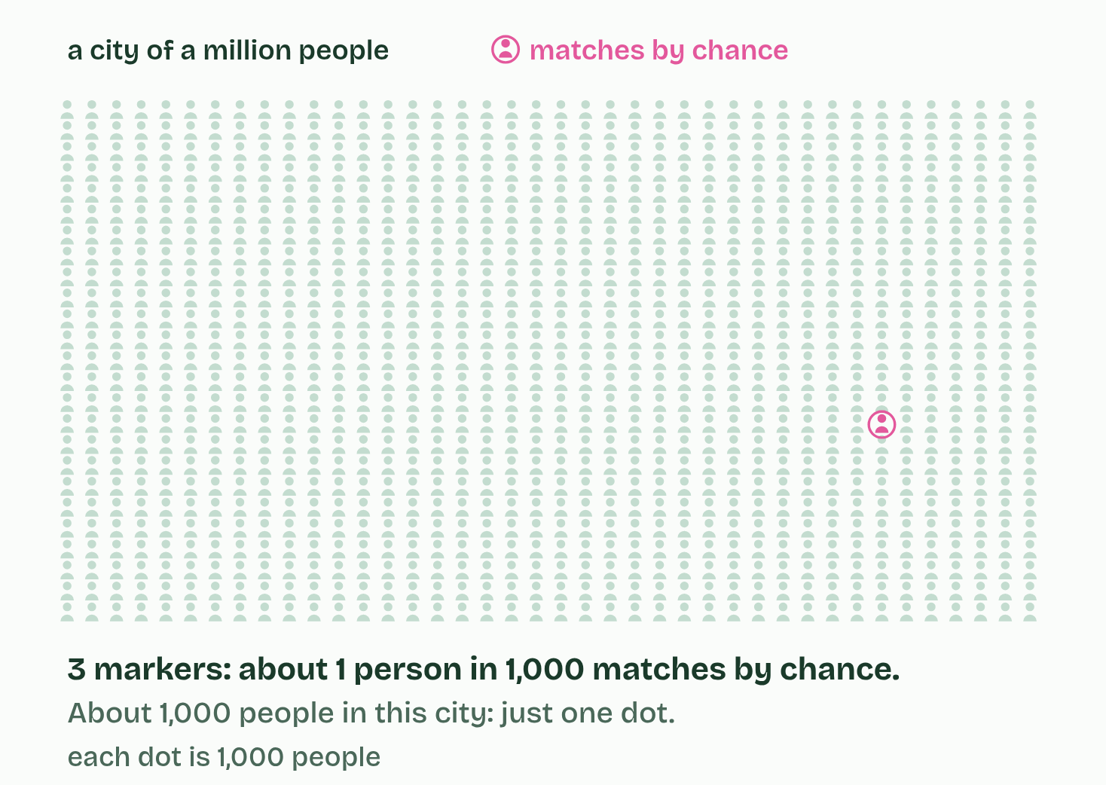
CHAPTER 6 · D1.1.5 Applications of PCR and gel electrophoresis
2 / 4
Profiles, parents and crime scenes
3
Minutes 45 to 55
Notes:
Minutes 45 to 55 of 60: How many markers? (10 min).
The plan: Chapter 6’s figure 6.2 and its predict box, then How conclusive is DNA evidence? as a class discussion.
PCR and gel electrophoresis are used far beyond the classroom.
Most of our DNA is the same from one person to the next, but some places hold a short sequence repeated over and over, end to end: a short tandem repeat (STR), such as GATA GATA GATA. People differ in how many repeats they have. Such a place is a marker, each version (a number of repeats) is an allele, and each person has two alleles at each marker, one from each parent.
DNA profiling starts with a sample: blood, saliva, a hair root, or skin cells left on a handle. PCR copies the markers, using primers that bind either side of each repeat. Electrophoresis then separates the copies by length: more repeats, longer copy, shorter distance. The pattern of bands at several markers is the person’s profile.
In a forensic investigation, the profile from the scene is compared with those of the suspects and the victim. A match at every marker is strong evidence that the sample came from that person, and a single clear mismatch excludes them. Profiling has cleared innocent people as well as convicting guilty ones.
In a paternity test, a child has at each marker one allele from the mother and one from the father. A band in the child that the mother does not have must come from the father, so a man without it is excluded. Labs look for exclusions at two or more markers, because a rare new mutation can change one.
So how many markers are enough? One marker proves little, because many people share any one pair of alleles. Each extra independent marker is another test that a person must pass by luck, so the chance of a false match is multiplied by another small number and falls very fast. Reliability rises with the number of measurements. Real profiles use about 15 to 20 markers: 16 in the UK and 20 in the USA.
Take care all the same. Identical twins share a profile, close relatives share more than strangers, and a sample can be contaminated. The evidence is strong, but not proof on its own.

Slide 32
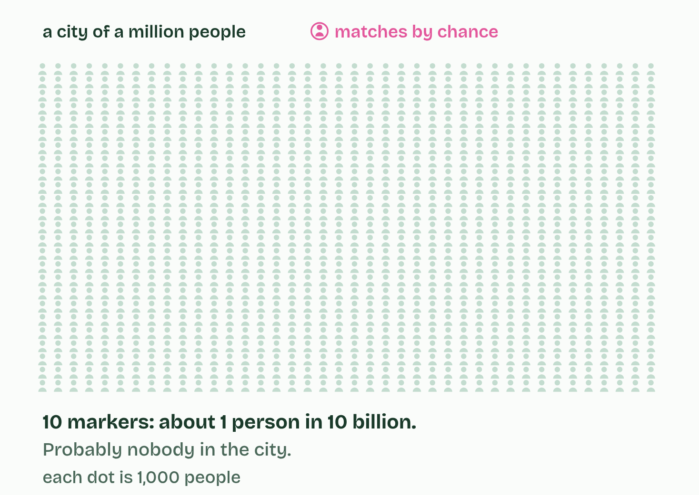
CHAPTER 6 · D1.1.5 Applications of PCR and gel electrophoresis
3 / 4
Profiles, parents and crime scenes
10
Minutes 45 to 55
Notes:
Minutes 45 to 55 of 60: How many markers? (10 min).
The plan: Chapter 6’s figure 6.2 and its predict box, then How conclusive is DNA evidence? as a class discussion.
PCR and gel electrophoresis are used far beyond the classroom.
Most of our DNA is the same from one person to the next, but some places hold a short sequence repeated over and over, end to end: a short tandem repeat (STR), such as GATA GATA GATA. People differ in how many repeats they have. Such a place is a marker, each version (a number of repeats) is an allele, and each person has two alleles at each marker, one from each parent.
DNA profiling starts with a sample: blood, saliva, a hair root, or skin cells left on a handle. PCR copies the markers, using primers that bind either side of each repeat. Electrophoresis then separates the copies by length: more repeats, longer copy, shorter distance. The pattern of bands at several markers is the person’s profile.
In a forensic investigation, the profile from the scene is compared with those of the suspects and the victim. A match at every marker is strong evidence that the sample came from that person, and a single clear mismatch excludes them. Profiling has cleared innocent people as well as convicting guilty ones.
In a paternity test, a child has at each marker one allele from the mother and one from the father. A band in the child that the mother does not have must come from the father, so a man without it is excluded. Labs look for exclusions at two or more markers, because a rare new mutation can change one.
So how many markers are enough? One marker proves little, because many people share any one pair of alleles. Each extra independent marker is another test that a person must pass by luck, so the chance of a false match is multiplied by another small number and falls very fast. Reliability rises with the number of measurements. Real profiles use about 15 to 20 markers: 16 in the UK and 20 in the USA.
Take care all the same. Identical twins share a profile, close relatives share more than strangers, and a sample can be contaminated. The evidence is strong, but not proof on its own.

Slide 33
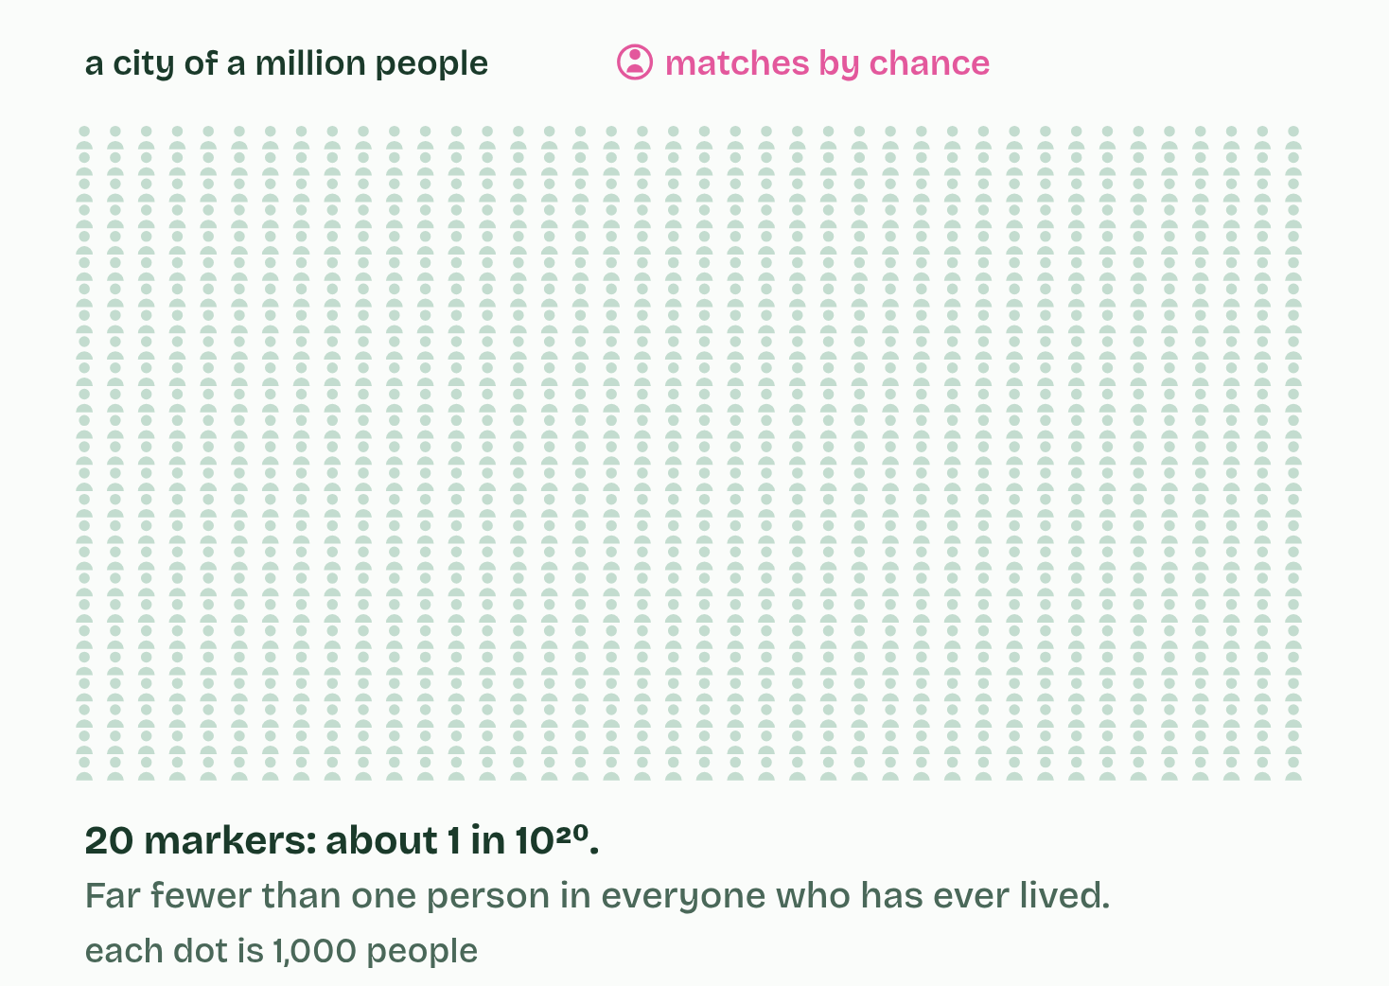
CHAPTER 6 · D1.1.5 Applications of PCR and gel electrophoresis
4 / 4
Profiles, parents and crime scenes
20
Minutes 45 to 55
Notes:
Minutes 45 to 55 of 60: How many markers? (10 min).
The plan: Chapter 6’s figure 6.2 and its predict box, then How conclusive is DNA evidence? as a class discussion.
PCR and gel electrophoresis are used far beyond the classroom.
Most of our DNA is the same from one person to the next, but some places hold a short sequence repeated over and over, end to end: a short tandem repeat (STR), such as GATA GATA GATA. People differ in how many repeats they have. Such a place is a marker, each version (a number of repeats) is an allele, and each person has two alleles at each marker, one from each parent.
DNA profiling starts with a sample: blood, saliva, a hair root, or skin cells left on a handle. PCR copies the markers, using primers that bind either side of each repeat. Electrophoresis then separates the copies by length: more repeats, longer copy, shorter distance. The pattern of bands at several markers is the person’s profile.
In a forensic investigation, the profile from the scene is compared with those of the suspects and the victim. A match at every marker is strong evidence that the sample came from that person, and a single clear mismatch excludes them. Profiling has cleared innocent people as well as convicting guilty ones.
In a paternity test, a child has at each marker one allele from the mother and one from the father. A band in the child that the mother does not have must come from the father, so a man without it is excluded. Labs look for exclusions at two or more markers, because a rare new mutation can change one.
So how many markers are enough? One marker proves little, because many people share any one pair of alleles. Each extra independent marker is another test that a person must pass by luck, so the chance of a false match is multiplied by another small number and falls very fast. Reliability rises with the number of measurements. Real profiles use about 15 to 20 markers: 16 in the UK and 20 in the USA.
Take care all the same. Identical twins share a profile, close relatives share more than strangers, and a sample can be contaminated. The evidence is strong, but not proof on its own.

Slide 34
CHAPTER 6 · D1.1.5 Applications of PCR and gel electrophoresis
Profiles, parents and crime scenes
Forensic investigations and paternity tests, by DNA profiling.
Diagnosing infections. The COVID-19 test copies a stretch of the virus’s genes (the virus’s RNA is first copied into DNA).
Testing for inherited conditions.
Identifying species: a fish sold as cod that is not, the source of a meat sample, wildlife trading.
Copying a gene so that it can be studied or moved.
Studying ancient DNA from bones.
Minutes 45 to 55
Notes:
Minutes 45 to 55 of 60: How many markers? (10 min).
The plan: Chapter 6’s figure 6.2 and its predict box, then How conclusive is DNA evidence? as a class discussion.
PCR and gel electrophoresis are used far beyond the classroom.
Most of our DNA is the same from one person to the next, but some places hold a short sequence repeated over and over, end to end: a short tandem repeat (STR), such as GATA GATA GATA. People differ in how many repeats they have. Such a place is a marker, each version (a number of repeats) is an allele, and each person has two alleles at each marker, one from each parent.
DNA profiling starts with a sample: blood, saliva, a hair root, or skin cells left on a handle. PCR copies the markers, using primers that bind either side of each repeat. Electrophoresis then separates the copies by length: more repeats, longer copy, shorter distance. The pattern of bands at several markers is the person’s profile.
In a forensic investigation, the profile from the scene is compared with those of the suspects and the victim. A match at every marker is strong evidence that the sample came from that person, and a single clear mismatch excludes them. Profiling has cleared innocent people as well as convicting guilty ones.
In a paternity test, a child has at each marker one allele from the mother and one from the father. A band in the child that the mother does not have must come from the father, so a man without it is excluded. Labs look for exclusions at two or more markers, because a rare new mutation can change one.
So how many markers are enough? One marker proves little, because many people share any one pair of alleles. Each extra independent marker is another test that a person must pass by luck, so the chance of a false match is multiplied by another small number and falls very fast. Reliability rises with the number of measurements. Real profiles use about 15 to 20 markers: 16 in the UK and 20 in the USA.
Take care all the same. Identical twins share a profile, close relatives share more than strangers, and a sample can be contaminated. The evidence is strong, but not proof on its own.

Slide 35
PREDICT
At one marker, 1 person in 10 shares the crime-scene pattern by chance. With ten independent markers, each 1 in 10, how many people in a city of 10 million would you expect to match by chance?
A Almost certainly none of them
B About 1 million: one person in every ten
C About 100, as the chances add up each time
Minutes 45 to 55
Notes:
Minutes 45 to 55 of 60: How many markers? (10 min).
The plan: Chapter 6’s figure 6.2 and its predict box, then How conclusive is DNA evidence? as a class discussion.
Ask for a show of hands, or mini whiteboards, before revealing. (Answer: A, on the next slide.)

Slide 36
WHAT HAPPENS
At one marker, 1 person in 10 shares the crime-scene pattern by chance. With ten independent markers, each 1 in 10, how many people in a city of 10 million would you expect to match by chance?
A Almost certainly none of them
B About 1 million: one person in every ten
C About 100, as the chances add up each time
Almost certainly none. The chances multiply, not add: 1 in 10, ten times over, is 1 in 10 billion. In a city of 10 million that is an expected 0.001 people, so a chance match is very unlikely. That is why a profile uses many markers: each one makes a false match far rarer.
Minutes 45 to 55
Notes:
Minutes 45 to 55 of 60: How many markers? (10 min).
The plan: Chapter 6’s figure 6.2 and its predict box, then How conclusive is DNA evidence? as a class discussion.
Answer: A. Almost certainly none. The chances multiply, not add: 1 in 10, ten times over, is 1 in 10 billion. In a city of 10 million that is an expected 0.001 people, so a chance match is very unlikely. That is why a profile uses many markers: each one makes a false match far rarer.

Slide 37
WATCH OUT
A child does not share half of each parent’s bands in some fixed way. At each marker the child has exactly one allele from each parent, and those may happen to be the same size as the other parent’s. And a profile is not the person’s whole genome: it is a handful of repeat counts.
Minutes 45 to 55
Notes:
Minutes 45 to 55 of 60: How many markers? (10 min).
The plan: Chapter 6’s figure 6.2 and its predict box, then How conclusive is DNA evidence? as a class discussion.
A common mistake: say it, then ask who can say why it is wrong.

Slide 38

DISCUSSION
10 MIN
How conclusive is DNA evidence?
THE TASK
In what ways does a DNA profile resemble a fingerprint left on a glass, and where does the comparison break down? How much weight should a jury give a match? Where could a mistake creep in: contamination, relatives, mixtures, tiny samples, human error? Land on this: a match is strong evidence, a mismatch excludes, and more markers make a chance match rarer.
STUDENTS NEED
Nothing.
Minutes 45 to 55
Notes:
Minutes 45 to 55 of 60: How many markers? (10 min).
The plan: Chapter 6’s figure 6.2 and its predict box, then How conclusive is DNA evidence? as a class discussion.
The activity: How conclusive is DNA evidence?. In what ways does a DNA profile resemble a fingerprint left on a glass, and where does the comparison break down? How much weight should a jury give a match? Where could a mistake creep in: contamination, relatives, mixtures, tiny samples, human error? Land on this: a match is strong evidence, a mismatch excludes, and more markers make a chance match rarer.
Needs: nothing.
The time: 10 minutes, minutes 45 to 55 of the plan.

Slide 39
PLENARY
Can you now...
Outline how PCR copies a small sample of DNA, with primers, three temperatures and Taq polymerase (D1.1.4)
Explain how gel electrophoresis separates DNA fragments by size, and read sizes against a ladder (D1.1.4)
Use DNA profiles to settle paternity and forensic cases, and explain why more markers mean fewer false matches (D1.1.5)
Minutes 55 to 60
Notes:
Minutes 55 to 60 of 60: Exit (5 min).
The plan: Students draw a keyword diagram of one PCR cycle, with what happens to the number of copies, for three marks (A keyword diagram of PCR, below).
Thumbs up, sideways or down on each goal before the exit question. The goals come from the statements this lesson covers.

Slide 40
EXIT QUESTION
Before you go
Students draw a keyword diagram of one PCR cycle, with what happens to the number of copies, for three marks.
Minutes 55 to 60
Notes:
Minutes 55 to 60 of 60: Exit (5 min).
The plan: Students draw a keyword diagram of one PCR cycle, with what happens to the number of copies, for three marks (A keyword diagram of PCR, below).

Slide 41

DRAWING
5 MIN
A keyword diagram of PCR
THE TASK
Students draw one PCR cycle as a loop, using keywords only, for three marks: the three temperatures and what each does, primers, Taq polymerase, and the copies doubling.
STUDENTS NEED
Paper.
Minutes 55 to 60
Notes:
Minutes 55 to 60 of 60: Exit (5 min).
The plan: Students draw a keyword diagram of one PCR cycle, with what happens to the number of copies, for three marks (A keyword diagram of PCR, below).
The activity: A keyword diagram of PCR. Students draw one PCR cycle as a loop, using keywords only, for three marks: the three temperatures and what each does, primers, Taq polymerase, and the copies doubling.
Needs: paper.
The time: 5 minutes, minutes 55 to 60 of the plan.

Slide 42
PRACTISE AND REVISE
Keep going
Exam practice: a fresh paper of exam questions on D1.1 at standard level, marked as you go
The guide, with the animations and the dry lab
This lesson in the guide: 4 A millionfold copy, 5 Sorted by size, 6 Profiles, parents and crime scenes, the dry lab
BUILD FOR YOUR CLASS
ALREADY ON THE SITE FOR D1.1
CARD SETS ON SPLYCR
Tarsia puzzle, dominoes and picture reveal on D1.1, built from its key terms and ready to print
A pub quiz with rounds on D1.1, to present or run with no projector
An escape room built from the question bank on D1.1
Quiz: DNA Replication
Revision map: D1.1 DNA replication, to fill in
Exam questions: D1.1 in the exam maker, a paper with its markscheme
Open a set to host it as a class game, or make a copy to edit.
D1.1 DNA Replication
How this was made. The course structure, the activities and the teaching choices come from my own classroom, my presentations and my years of teaching IB and AP Biology. I use Claude, an AI, to help write and build the interactive guides, lesson plans, slides and practice questions, and to draw the diagrams and code the interactives. I direct the work and review it against the IB and AP specifications before it goes live.
Minute 60: after the lesson
Notes:
Every link here is live. Set the exam practice paper for homework: it is fresh each time, marked as students go and saved to their Exam practice when they are signed in.
Exam practice: https://www.biologybybradford.com/exam-maker/sit?topics=D1.1&level=SL&paper=quiz&marks=15&src=ep
The guide: https://www.biologybybradford.com/guides/ib-biology-d1-1-dna-replication

