Slide 1
IB Biology D1.1
LESSON 3 OF 4
HL
BY THE END YOU CAN
DNA replication
Explain why DNA polymerases add nucleotides only to the 3′ end, so new strands grow 5′ to 3′ (D1.1.6)
Compare replication on the leading and lagging strands, with Okazaki fragments and RNA primers (D1.1.7)
Two directions at one fork
D1.1.6, D1.1.7
Why polymerase adds only at the 3′ end, and what that means for the two new strands
60 minutes · chapters 7, 8
Minute 0
Notes:
IB Biology D1.1, DNA replication. Lesson 3 of 4: Two directions at one fork (higher level), 60 minutes.
The plan, minute by minute (each slide's footer says where you are):
0 to 6 min (6) Do now: ends and numbers
6 to 16 min (10) Only at the 3&prime; end
16 to 28 min (12) One strand smooth, one in pieces
28 to 48 min (20) Be the fork
48 to 56 min (8) A written question
56 to 60 min (4) Exit
A mnemonic for the board once chapter 8’s predict box is answered (not before, as it gives the answer away): “Lagging needs lots”: lots of primers, lots of fragments, lots of sealing.
What students get wrong:
New strands grow 3&prime; to 5&prime;, or the template is read 5&prime; to 3&prime;. New strands grow 5&prime; to 3&prime;, and templates are read 3&prime; to 5&prime;.
The lagging strand is copied after the leading strand. Both are made at the same time, the lagging one in pieces.
Only the lagging strand needs a primer. Both do: the leading strand once.
Stretch and support:
Support: cut chapter 8’s captions up for students to put in order, and give a fork outline with the enzymes’ places marked for the higher level drawing.
Stretch: in E. coli two forks leave one starting point and meet halfway round the circle. Sketch both forks and mark the leading and lagging strands at each.
The lesson plan to print: https://www.biologybybradford.com/guides/downloads/ib-biology-d1-1-dna-replication-lesson-3-plan.pdf

Slide 2
DO NOW
Ends and numbers
Students sketch a short double strand, number the carbons of one nucleotide and mark the 5&prime; and 3&prime; ends of both strands.
6:00
minutes
Start now: the timer is running.
Minutes 0 to 6
Notes:
Minutes 0 to 6 of 60: Do now: ends and numbers (6 min).
The plan: Students sketch a short double strand, number the carbons of one nucleotide and mark the 5&prime; and 3&prime; ends of both strands.
Start a 6 minute timer as they come in.

Slide 3
STEP 2
10 MIN
Only at the 3&prime; end
Chapter 7: Only ever at the 3′ end
Minutes 6 to 16
Notes:
Minutes 6 to 16 of 60: Only at the 3&prime; end (10 min).
The plan: Chapter 7’s figure, one step at a time, then chapter 7’s predict box on mini whiteboards.

Slide 4
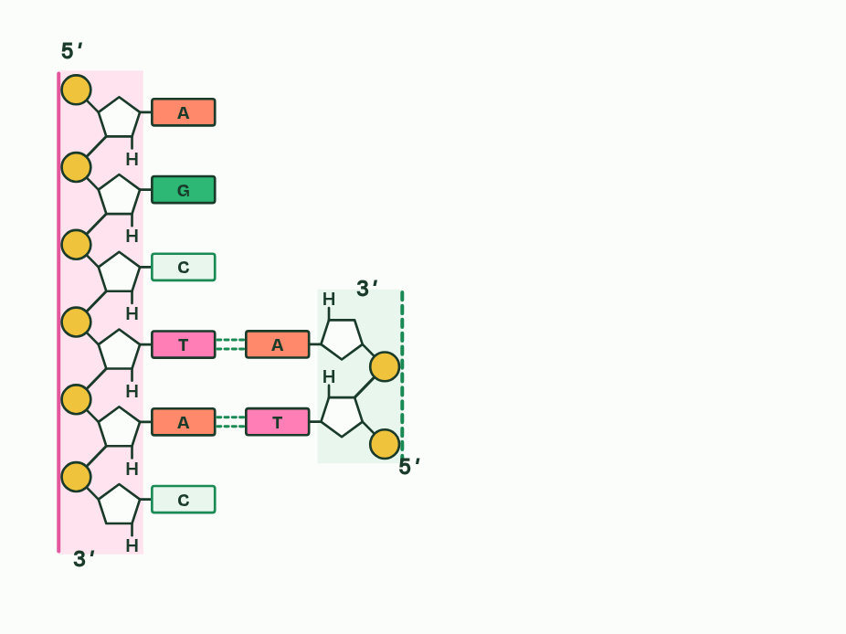
CHAPTER 7 · D1.1.6 Directionality of DNA polymerases
1 / 5
Only ever at the 3′ end
Every strand has a 5′ end and a 3′ end.
Minutes 6 to 16
Notes:
Minutes 6 to 16 of 60: Only at the 3&prime; end (10 min).
The plan: Chapter 7’s figure, one step at a time, then chapter 7’s predict box on mini whiteboards.
From A1.2: the carbons of the sugar in a nucleotide are numbered 1′ to 5′, and in a strand each phosphate links the 5′ carbon of one nucleotide to the 3′ carbon of the one before. So the two ends of a strand are different. One end has a free phosphate on a 5′ carbon, the 5′ terminal. The other has a free hydroxyl group (OH) on a 3′ carbon, the 3′ terminal.
DNA polymerases follow one rule. They join the 5′ phosphate of an incoming nucleotide to the 3′ OH at the end of the strand they are building, by a covalent bond in the sugar and phosphate backbone. So nucleotides are only ever added at the 3′ end, and a new strand grows 5′ to 3′. This one-way working is the directionality of DNA polymerases.
The template is read the other way. As the new strand grows 5′ to 3′, the polymerase moves along its template 3′ to 5′, because the two strands are antiparallel. At a fork the two templates run in opposite directions, so the two new strands have to grow in opposite directions. Chapter 8 follows what that means.
A polymerase also cannot start a strand from nothing. It needs a 3′ end to add to, which is what the primers of chapter 8 are for.
Directionality rules other copying too. RNA is built 5′ to 3′ in transcription, and a ribosome reads messenger RNA 5′ to 3′ in translation (D1.2).
Example: Where the energy comes from (not needed for the exam) Free nucleotides arrive carrying three phosphates. DNA polymerase cuts off two, and the energy released makes the new bond.

Slide 5
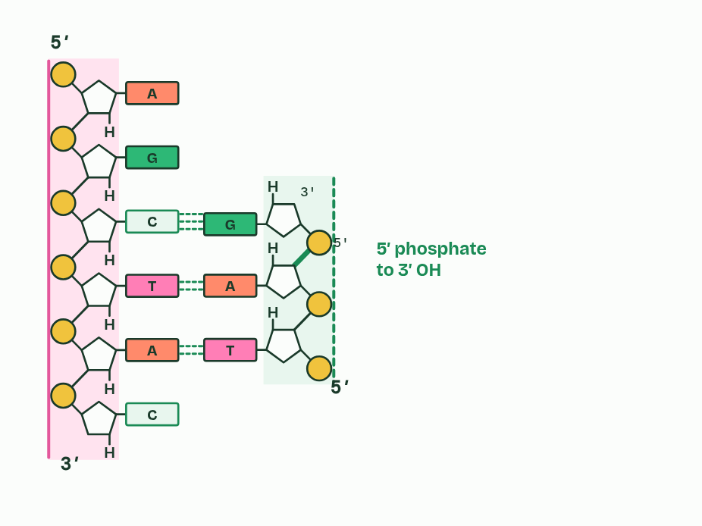
CHAPTER 7 · D1.1.6 Directionality of DNA polymerases
2 / 5
Only ever at the 3′ end
DNA polymerase joins a nucleotide’s 5′ phosphate to the 3′ end.
Minutes 6 to 16
Notes:
Minutes 6 to 16 of 60: Only at the 3&prime; end (10 min).
The plan: Chapter 7’s figure, one step at a time, then chapter 7’s predict box on mini whiteboards.
From A1.2: the carbons of the sugar in a nucleotide are numbered 1′ to 5′, and in a strand each phosphate links the 5′ carbon of one nucleotide to the 3′ carbon of the one before. So the two ends of a strand are different. One end has a free phosphate on a 5′ carbon, the 5′ terminal. The other has a free hydroxyl group (OH) on a 3′ carbon, the 3′ terminal.
DNA polymerases follow one rule. They join the 5′ phosphate of an incoming nucleotide to the 3′ OH at the end of the strand they are building, by a covalent bond in the sugar and phosphate backbone. So nucleotides are only ever added at the 3′ end, and a new strand grows 5′ to 3′. This one-way working is the directionality of DNA polymerases.
The template is read the other way. As the new strand grows 5′ to 3′, the polymerase moves along its template 3′ to 5′, because the two strands are antiparallel. At a fork the two templates run in opposite directions, so the two new strands have to grow in opposite directions. Chapter 8 follows what that means.
A polymerase also cannot start a strand from nothing. It needs a 3′ end to add to, which is what the primers of chapter 8 are for.
Directionality rules other copying too. RNA is built 5′ to 3′ in transcription, and a ribosome reads messenger RNA 5′ to 3′ in translation (D1.2).
Example: Where the energy comes from (not needed for the exam) Free nucleotides arrive carrying three phosphates. DNA polymerase cuts off two, and the energy released makes the new bond.

Slide 6
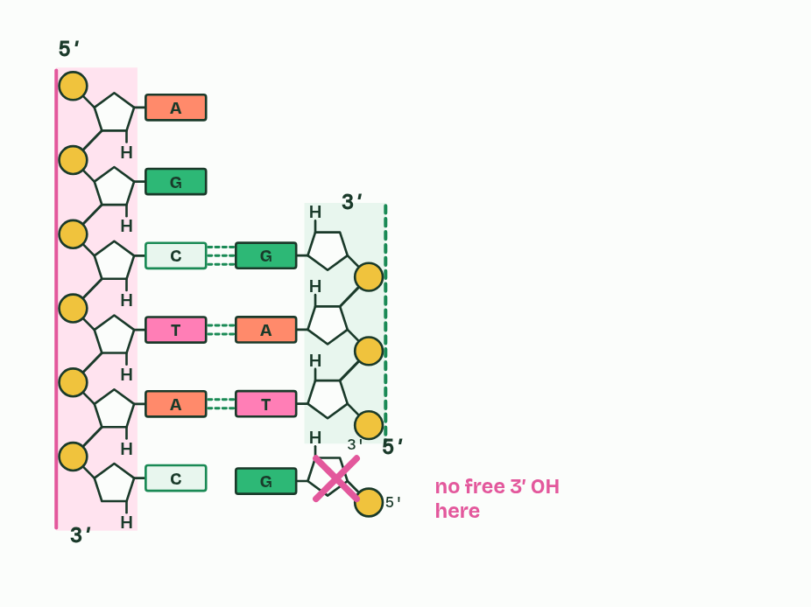
CHAPTER 7 · D1.1.6 Directionality of DNA polymerases
3 / 5
Only ever at the 3′ end
There is nothing to join to at the 5′ end.
Minutes 6 to 16
Notes:
Minutes 6 to 16 of 60: Only at the 3&prime; end (10 min).
The plan: Chapter 7’s figure, one step at a time, then chapter 7’s predict box on mini whiteboards.
From A1.2: the carbons of the sugar in a nucleotide are numbered 1′ to 5′, and in a strand each phosphate links the 5′ carbon of one nucleotide to the 3′ carbon of the one before. So the two ends of a strand are different. One end has a free phosphate on a 5′ carbon, the 5′ terminal. The other has a free hydroxyl group (OH) on a 3′ carbon, the 3′ terminal.
DNA polymerases follow one rule. They join the 5′ phosphate of an incoming nucleotide to the 3′ OH at the end of the strand they are building, by a covalent bond in the sugar and phosphate backbone. So nucleotides are only ever added at the 3′ end, and a new strand grows 5′ to 3′. This one-way working is the directionality of DNA polymerases.
The template is read the other way. As the new strand grows 5′ to 3′, the polymerase moves along its template 3′ to 5′, because the two strands are antiparallel. At a fork the two templates run in opposite directions, so the two new strands have to grow in opposite directions. Chapter 8 follows what that means.
A polymerase also cannot start a strand from nothing. It needs a 3′ end to add to, which is what the primers of chapter 8 are for.
Directionality rules other copying too. RNA is built 5′ to 3′ in transcription, and a ribosome reads messenger RNA 5′ to 3′ in translation (D1.2).
Example: Where the energy comes from (not needed for the exam) Free nucleotides arrive carrying three phosphates. DNA polymerase cuts off two, and the energy released makes the new bond.

Slide 7
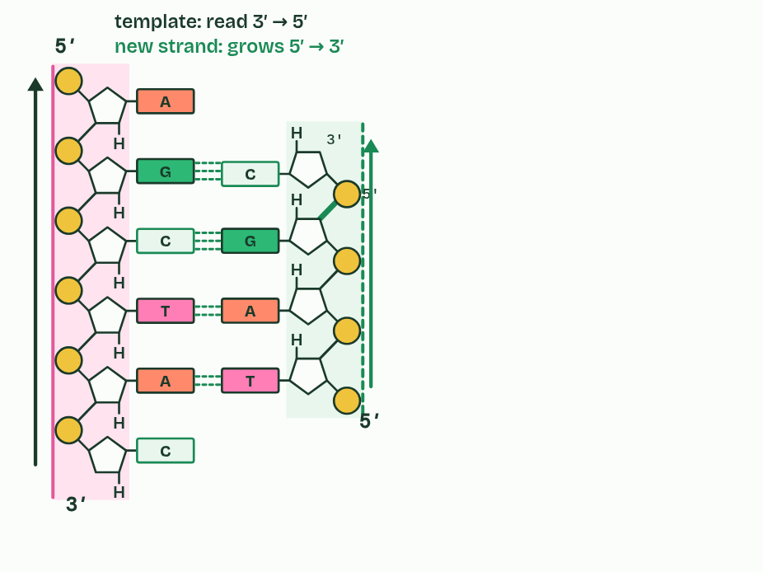
CHAPTER 7 · D1.1.6 Directionality of DNA polymerases
4 / 5
Only ever at the 3′ end
So new strands grow 5′ to 3′.
Minutes 6 to 16
Notes:
Minutes 6 to 16 of 60: Only at the 3&prime; end (10 min).
The plan: Chapter 7’s figure, one step at a time, then chapter 7’s predict box on mini whiteboards.
From A1.2: the carbons of the sugar in a nucleotide are numbered 1′ to 5′, and in a strand each phosphate links the 5′ carbon of one nucleotide to the 3′ carbon of the one before. So the two ends of a strand are different. One end has a free phosphate on a 5′ carbon, the 5′ terminal. The other has a free hydroxyl group (OH) on a 3′ carbon, the 3′ terminal.
DNA polymerases follow one rule. They join the 5′ phosphate of an incoming nucleotide to the 3′ OH at the end of the strand they are building, by a covalent bond in the sugar and phosphate backbone. So nucleotides are only ever added at the 3′ end, and a new strand grows 5′ to 3′. This one-way working is the directionality of DNA polymerases.
The template is read the other way. As the new strand grows 5′ to 3′, the polymerase moves along its template 3′ to 5′, because the two strands are antiparallel. At a fork the two templates run in opposite directions, so the two new strands have to grow in opposite directions. Chapter 8 follows what that means.
A polymerase also cannot start a strand from nothing. It needs a 3′ end to add to, which is what the primers of chapter 8 are for.
Directionality rules other copying too. RNA is built 5′ to 3′ in transcription, and a ribosome reads messenger RNA 5′ to 3′ in translation (D1.2).
Example: Where the energy comes from (not needed for the exam) Free nucleotides arrive carrying three phosphates. DNA polymerase cuts off two, and the energy released makes the new bond.

Slide 8
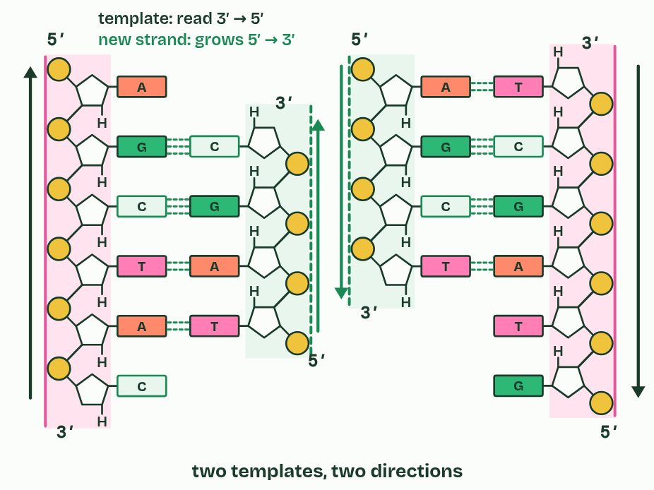
CHAPTER 7 · D1.1.6 Directionality of DNA polymerases
5 / 5
Only ever at the 3′ end
The templates are antiparallel, so the new strands grow in opposite directions.
Minutes 6 to 16
Notes:
Minutes 6 to 16 of 60: Only at the 3&prime; end (10 min).
The plan: Chapter 7’s figure, one step at a time, then chapter 7’s predict box on mini whiteboards.
From A1.2: the carbons of the sugar in a nucleotide are numbered 1′ to 5′, and in a strand each phosphate links the 5′ carbon of one nucleotide to the 3′ carbon of the one before. So the two ends of a strand are different. One end has a free phosphate on a 5′ carbon, the 5′ terminal. The other has a free hydroxyl group (OH) on a 3′ carbon, the 3′ terminal.
DNA polymerases follow one rule. They join the 5′ phosphate of an incoming nucleotide to the 3′ OH at the end of the strand they are building, by a covalent bond in the sugar and phosphate backbone. So nucleotides are only ever added at the 3′ end, and a new strand grows 5′ to 3′. This one-way working is the directionality of DNA polymerases.
The template is read the other way. As the new strand grows 5′ to 3′, the polymerase moves along its template 3′ to 5′, because the two strands are antiparallel. At a fork the two templates run in opposite directions, so the two new strands have to grow in opposite directions. Chapter 8 follows what that means.
A polymerase also cannot start a strand from nothing. It needs a 3′ end to add to, which is what the primers of chapter 8 are for.
Directionality rules other copying too. RNA is built 5′ to 3′ in transcription, and a ribosome reads messenger RNA 5′ to 3′ in translation (D1.2).
Example: Where the energy comes from (not needed for the exam) Free nucleotides arrive carrying three phosphates. DNA polymerase cuts off two, and the energy released makes the new bond.

Slide 9
CHAPTER 7 · D1.1.6 Directionality of DNA polymerases
Only ever at the 3′ end
Nucleotides are added only at the 3′ end of the new strand.
So a new strand grows 5′ to 3′, and its template is read 3′ to 5′.
Antiparallel templates mean the two new strands at a fork grow in opposite directions.
Minutes 6 to 16
Notes:
Minutes 6 to 16 of 60: Only at the 3&prime; end (10 min).
The plan: Chapter 7’s figure, one step at a time, then chapter 7’s predict box on mini whiteboards.
From A1.2: the carbons of the sugar in a nucleotide are numbered 1′ to 5′, and in a strand each phosphate links the 5′ carbon of one nucleotide to the 3′ carbon of the one before. So the two ends of a strand are different. One end has a free phosphate on a 5′ carbon, the 5′ terminal. The other has a free hydroxyl group (OH) on a 3′ carbon, the 3′ terminal.
DNA polymerases follow one rule. They join the 5′ phosphate of an incoming nucleotide to the 3′ OH at the end of the strand they are building, by a covalent bond in the sugar and phosphate backbone. So nucleotides are only ever added at the 3′ end, and a new strand grows 5′ to 3′. This one-way working is the directionality of DNA polymerases.
The template is read the other way. As the new strand grows 5′ to 3′, the polymerase moves along its template 3′ to 5′, because the two strands are antiparallel. At a fork the two templates run in opposite directions, so the two new strands have to grow in opposite directions. Chapter 8 follows what that means.
A polymerase also cannot start a strand from nothing. It needs a 3′ end to add to, which is what the primers of chapter 8 are for.
Directionality rules other copying too. RNA is built 5′ to 3′ in transcription, and a ribosome reads messenger RNA 5′ to 3′ in translation (D1.2).
Example: Where the energy comes from (not needed for the exam) Free nucleotides arrive carrying three phosphates. DNA polymerase cuts off two, and the energy released makes the new bond.

Slide 10
WATCH OUT
“5′ to 3′” describes the new strand. The template is read 3′ to 5′. And 5′ and 3′ name carbons of the sugar, not ends of a gene.
Minutes 6 to 16
Notes:
Minutes 6 to 16 of 60: Only at the 3&prime; end (10 min).
The plan: Chapter 7’s figure, one step at a time, then chapter 7’s predict box on mini whiteboards.
A common mistake: say it, then ask who can say why it is wrong.

Slide 11
PREDICT
A free nucleotide arrives at the 5′ end of a growing new strand, and its base pairs with the template. What happens?
A It is joined, and the strand grows at both ends
B It is not joined: there is no free 3′ OH there
C It is joined if its base pairs with the template
Minutes 6 to 16
Notes:
Minutes 6 to 16 of 60: Only at the 3&prime; end (10 min).
The plan: Chapter 7’s figure, one step at a time, then chapter 7’s predict box on mini whiteboards.
Ask for a show of hands, or mini whiteboards, before revealing. (Answer: B, on the next slide.)

Slide 12
WHAT HAPPENS
A free nucleotide arrives at the 5′ end of a growing new strand, and its base pairs with the template. What happens?
A It is joined, and the strand grows at both ends
B It is not joined: there is no free 3′ OH there
C It is joined if its base pairs with the template
It is not joined. DNA polymerase only makes the bond between a nucleotide’s 5′ phosphate and the 3′ OH of the strand. At the 5′ end there is a phosphate, not an OH, so there is nothing to join to, however well the base pairs. Every DNA polymerase works this way, so every new strand grows 5′ to 3′.
Minutes 6 to 16
Notes:
Minutes 6 to 16 of 60: Only at the 3&prime; end (10 min).
The plan: Chapter 7’s figure, one step at a time, then chapter 7’s predict box on mini whiteboards.
Answer: B. It is not joined. DNA polymerase only makes the bond between a nucleotide’s 5′ phosphate and the 3′ OH of the strand. At the 5′ end there is a phosphate, not an OH, so there is nothing to join to, however well the base pairs. Every DNA polymerase works this way, so every new strand grows 5′ to 3′.

Slide 13
STEP 3
12 MIN
One strand smooth, one in pieces
Chapter 8: One strand smooth, one in pieces
Minutes 16 to 28
Notes:
Minutes 16 to 28 of 60: One strand smooth, one in pieces (12 min).
The plan: Chapter 8: the predict box first (primers on each strand), then chapter 8’s figure step by step.

Slide 14
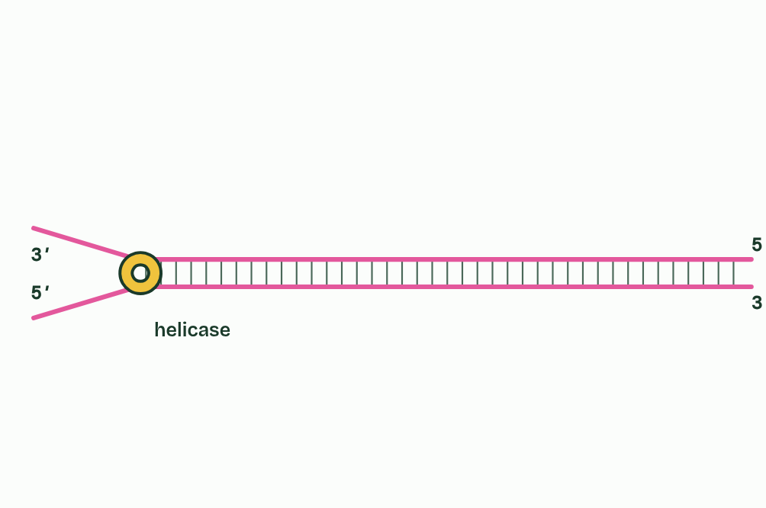
CHAPTER 8 · D1.1.7 Leading and lagging strands
1 / 6
One strand smooth, one in pieces
Helicase opens the fork and moves on.
Minutes 16 to 28
Notes:
Minutes 16 to 28 of 60: One strand smooth, one in pieces (12 min).
The plan: Chapter 8: the predict box first (primers on each strand), then chapter 8’s figure step by step.
The fork moves along the DNA as helicase unwinds it. One template is the right way round for its new strand, growing 5′ to 3′, to grow in the same direction as the fork moves. DNA polymerase follows right behind helicase and builds without stopping. This is the leading strand, made continuously.
On the other template the new strand must also grow 5′ to 3′, and for this one that is away from the fork. As the fork opens a fresh stretch of template, a polymerase starts near the fork and builds back towards the piece before it. Then the fork opens a little more and the polymerase starts again. This is the lagging strand, made discontinuously in short pieces called Okazaki fragments.
A polymerase cannot start a strand from nothing, as chapter 7 said. So every new piece of DNA begins with a short RNA primer, made by an enzyme you meet in chapter 9, which gives the polymerase a 3′ end to add to. The leading strand needs a primer only once, at its start. The lagging strand needs one for every Okazaki fragment.
Why “lagging”? Its pieces are finished a little behind the fork. Its polymerase is not lazier: both strands are made at the same fork at the same time. The pace differs, though. The leading strand grows steadily, at the speed the fork opens; the lagging strand grows in stop-start bursts, one fragment at a time, and keeps up only on average.
You will run both strands yourself in Run the fork’s higher level rounds, after chapter 10.
Example: In E. coli Okazaki fragments are about 1,000 to 2,000 nucleotides long, and the fork moves about 1,000 base pairs a second. Copying begins at one place on the circular chromosome and two forks travel away from it in opposite directions, meeting on the far side about 40 minutes later, for 4.6 million base pairs. Each fork has its own leading and lagging strand.

Slide 15
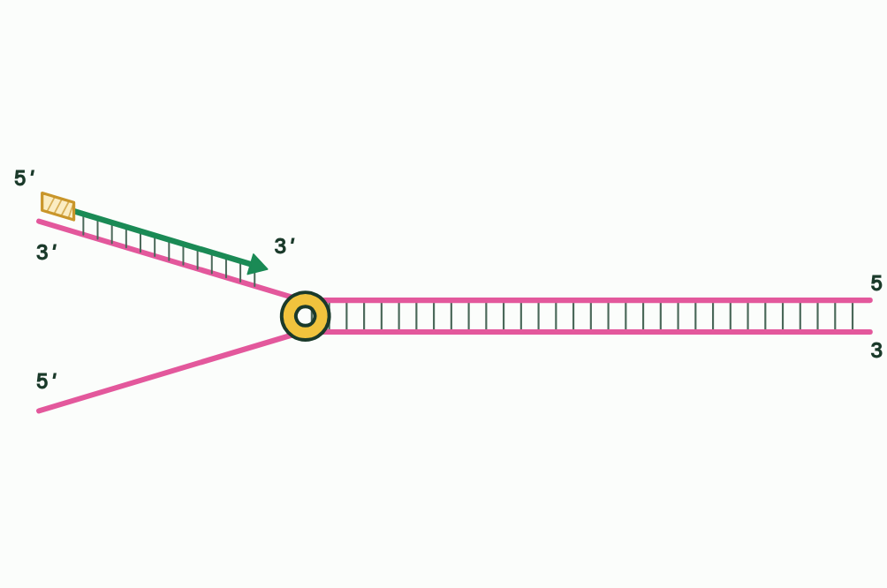
CHAPTER 8 · D1.1.7 Leading and lagging strands
2 / 6
One strand smooth, one in pieces
Leading strand: one primer, then built continuously, towards the fork.
Minutes 16 to 28
Notes:
Minutes 16 to 28 of 60: One strand smooth, one in pieces (12 min).
The plan: Chapter 8: the predict box first (primers on each strand), then chapter 8’s figure step by step.
The fork moves along the DNA as helicase unwinds it. One template is the right way round for its new strand, growing 5′ to 3′, to grow in the same direction as the fork moves. DNA polymerase follows right behind helicase and builds without stopping. This is the leading strand, made continuously.
On the other template the new strand must also grow 5′ to 3′, and for this one that is away from the fork. As the fork opens a fresh stretch of template, a polymerase starts near the fork and builds back towards the piece before it. Then the fork opens a little more and the polymerase starts again. This is the lagging strand, made discontinuously in short pieces called Okazaki fragments.
A polymerase cannot start a strand from nothing, as chapter 7 said. So every new piece of DNA begins with a short RNA primer, made by an enzyme you meet in chapter 9, which gives the polymerase a 3′ end to add to. The leading strand needs a primer only once, at its start. The lagging strand needs one for every Okazaki fragment.
Why “lagging”? Its pieces are finished a little behind the fork. Its polymerase is not lazier: both strands are made at the same fork at the same time. The pace differs, though. The leading strand grows steadily, at the speed the fork opens; the lagging strand grows in stop-start bursts, one fragment at a time, and keeps up only on average.
You will run both strands yourself in Run the fork’s higher level rounds, after chapter 10.
Example: In E. coli Okazaki fragments are about 1,000 to 2,000 nucleotides long, and the fork moves about 1,000 base pairs a second. Copying begins at one place on the circular chromosome and two forks travel away from it in opposite directions, meeting on the far side about 40 minutes later, for 4.6 million base pairs. Each fork has its own leading and lagging strand.

Slide 16
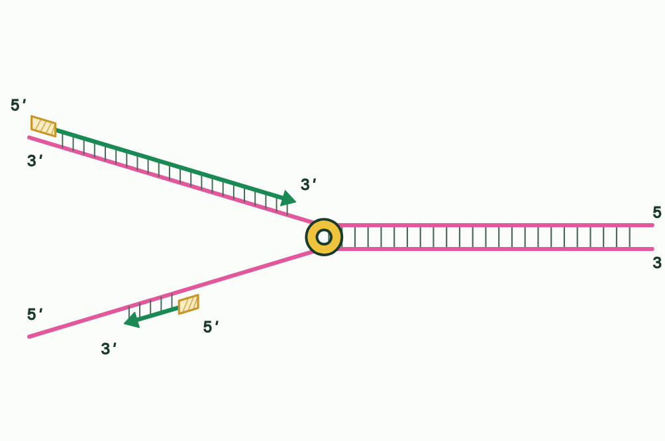
CHAPTER 8 · D1.1.7 Leading and lagging strands
3 / 6
One strand smooth, one in pieces
Lagging strand: built away from the fork, so it must start again.
Minutes 16 to 28
Notes:
Minutes 16 to 28 of 60: One strand smooth, one in pieces (12 min).
The plan: Chapter 8: the predict box first (primers on each strand), then chapter 8’s figure step by step.
The fork moves along the DNA as helicase unwinds it. One template is the right way round for its new strand, growing 5′ to 3′, to grow in the same direction as the fork moves. DNA polymerase follows right behind helicase and builds without stopping. This is the leading strand, made continuously.
On the other template the new strand must also grow 5′ to 3′, and for this one that is away from the fork. As the fork opens a fresh stretch of template, a polymerase starts near the fork and builds back towards the piece before it. Then the fork opens a little more and the polymerase starts again. This is the lagging strand, made discontinuously in short pieces called Okazaki fragments.
A polymerase cannot start a strand from nothing, as chapter 7 said. So every new piece of DNA begins with a short RNA primer, made by an enzyme you meet in chapter 9, which gives the polymerase a 3′ end to add to. The leading strand needs a primer only once, at its start. The lagging strand needs one for every Okazaki fragment.
Why “lagging”? Its pieces are finished a little behind the fork. Its polymerase is not lazier: both strands are made at the same fork at the same time. The pace differs, though. The leading strand grows steadily, at the speed the fork opens; the lagging strand grows in stop-start bursts, one fragment at a time, and keeps up only on average.
You will run both strands yourself in Run the fork’s higher level rounds, after chapter 10.
Example: In E. coli Okazaki fragments are about 1,000 to 2,000 nucleotides long, and the fork moves about 1,000 base pairs a second. Copying begins at one place on the circular chromosome and two forks travel away from it in opposite directions, meeting on the far side about 40 minutes later, for 4.6 million base pairs. Each fork has its own leading and lagging strand.

Slide 17
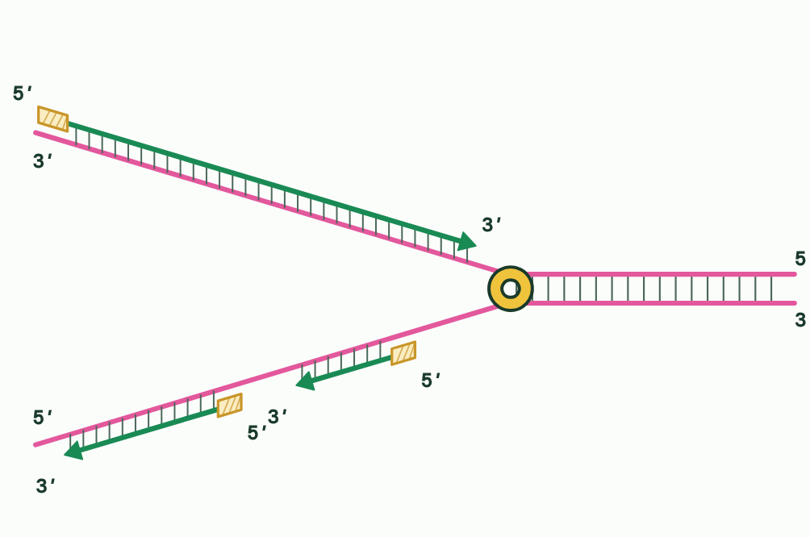
CHAPTER 8 · D1.1.7 Leading and lagging strands
4 / 6
One strand smooth, one in pieces
Each new stretch gets its own primer.
Minutes 16 to 28
Notes:
Minutes 16 to 28 of 60: One strand smooth, one in pieces (12 min).
The plan: Chapter 8: the predict box first (primers on each strand), then chapter 8’s figure step by step.
The fork moves along the DNA as helicase unwinds it. One template is the right way round for its new strand, growing 5′ to 3′, to grow in the same direction as the fork moves. DNA polymerase follows right behind helicase and builds without stopping. This is the leading strand, made continuously.
On the other template the new strand must also grow 5′ to 3′, and for this one that is away from the fork. As the fork opens a fresh stretch of template, a polymerase starts near the fork and builds back towards the piece before it. Then the fork opens a little more and the polymerase starts again. This is the lagging strand, made discontinuously in short pieces called Okazaki fragments.
A polymerase cannot start a strand from nothing, as chapter 7 said. So every new piece of DNA begins with a short RNA primer, made by an enzyme you meet in chapter 9, which gives the polymerase a 3′ end to add to. The leading strand needs a primer only once, at its start. The lagging strand needs one for every Okazaki fragment.
Why “lagging”? Its pieces are finished a little behind the fork. Its polymerase is not lazier: both strands are made at the same fork at the same time. The pace differs, though. The leading strand grows steadily, at the speed the fork opens; the lagging strand grows in stop-start bursts, one fragment at a time, and keeps up only on average.
You will run both strands yourself in Run the fork’s higher level rounds, after chapter 10.
Example: In E. coli Okazaki fragments are about 1,000 to 2,000 nucleotides long, and the fork moves about 1,000 base pairs a second. Copying begins at one place on the circular chromosome and two forks travel away from it in opposite directions, meeting on the far side about 40 minutes later, for 4.6 million base pairs. Each fork has its own leading and lagging strand.

Slide 18
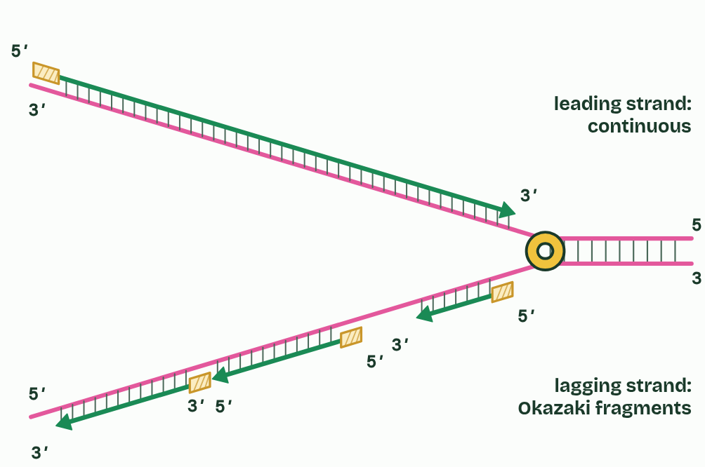
CHAPTER 8 · D1.1.7 Leading and lagging strands
5 / 6
One strand smooth, one in pieces
The lagging strand comes in Okazaki fragments.
Minutes 16 to 28
Notes:
Minutes 16 to 28 of 60: One strand smooth, one in pieces (12 min).
The plan: Chapter 8: the predict box first (primers on each strand), then chapter 8’s figure step by step.
The fork moves along the DNA as helicase unwinds it. One template is the right way round for its new strand, growing 5′ to 3′, to grow in the same direction as the fork moves. DNA polymerase follows right behind helicase and builds without stopping. This is the leading strand, made continuously.
On the other template the new strand must also grow 5′ to 3′, and for this one that is away from the fork. As the fork opens a fresh stretch of template, a polymerase starts near the fork and builds back towards the piece before it. Then the fork opens a little more and the polymerase starts again. This is the lagging strand, made discontinuously in short pieces called Okazaki fragments.
A polymerase cannot start a strand from nothing, as chapter 7 said. So every new piece of DNA begins with a short RNA primer, made by an enzyme you meet in chapter 9, which gives the polymerase a 3′ end to add to. The leading strand needs a primer only once, at its start. The lagging strand needs one for every Okazaki fragment.
Why “lagging”? Its pieces are finished a little behind the fork. Its polymerase is not lazier: both strands are made at the same fork at the same time. The pace differs, though. The leading strand grows steadily, at the speed the fork opens; the lagging strand grows in stop-start bursts, one fragment at a time, and keeps up only on average.
You will run both strands yourself in Run the fork’s higher level rounds, after chapter 10.
Example: In E. coli Okazaki fragments are about 1,000 to 2,000 nucleotides long, and the fork moves about 1,000 base pairs a second. Copying begins at one place on the circular chromosome and two forks travel away from it in opposite directions, meeting on the far side about 40 minutes later, for 4.6 million base pairs. Each fork has its own leading and lagging strand.

Slide 19
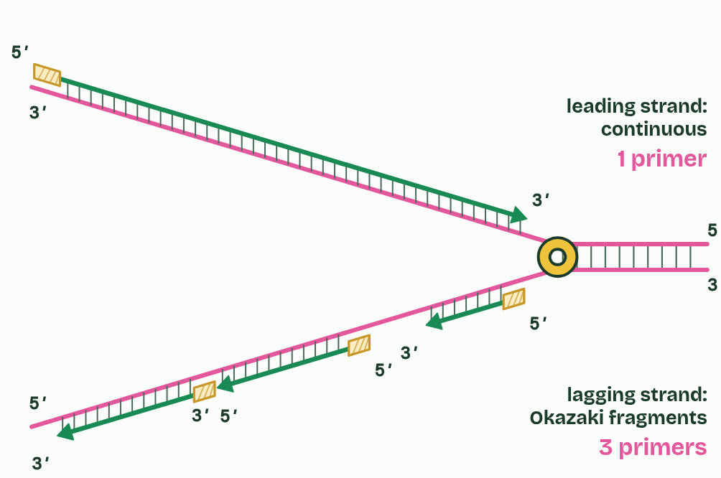
CHAPTER 8 · D1.1.7 Leading and lagging strands
6 / 6
One strand smooth, one in pieces
One primer on the leading strand; one per fragment on the lagging strand.
Minutes 16 to 28
Notes:
Minutes 16 to 28 of 60: One strand smooth, one in pieces (12 min).
The plan: Chapter 8: the predict box first (primers on each strand), then chapter 8’s figure step by step.
The fork moves along the DNA as helicase unwinds it. One template is the right way round for its new strand, growing 5′ to 3′, to grow in the same direction as the fork moves. DNA polymerase follows right behind helicase and builds without stopping. This is the leading strand, made continuously.
On the other template the new strand must also grow 5′ to 3′, and for this one that is away from the fork. As the fork opens a fresh stretch of template, a polymerase starts near the fork and builds back towards the piece before it. Then the fork opens a little more and the polymerase starts again. This is the lagging strand, made discontinuously in short pieces called Okazaki fragments.
A polymerase cannot start a strand from nothing, as chapter 7 said. So every new piece of DNA begins with a short RNA primer, made by an enzyme you meet in chapter 9, which gives the polymerase a 3′ end to add to. The leading strand needs a primer only once, at its start. The lagging strand needs one for every Okazaki fragment.
Why “lagging”? Its pieces are finished a little behind the fork. Its polymerase is not lazier: both strands are made at the same fork at the same time. The pace differs, though. The leading strand grows steadily, at the speed the fork opens; the lagging strand grows in stop-start bursts, one fragment at a time, and keeps up only on average.
You will run both strands yourself in Run the fork’s higher level rounds, after chapter 10.
Example: In E. coli Okazaki fragments are about 1,000 to 2,000 nucleotides long, and the fork moves about 1,000 base pairs a second. Copying begins at one place on the circular chromosome and two forks travel away from it in opposite directions, meeting on the far side about 40 minutes later, for 4.6 million base pairs. Each fork has its own leading and lagging strand.

Slide 20
CHAPTER 8 · D1.1.7 Leading and lagging strands
One strand smooth, one in pieces
Leading strand: built continuously towards the fork, from one primer.
Lagging strand: built discontinuously, away from the fork, as Okazaki fragments, each from its own primer.
Both are made at the same fork at the same time.
Minutes 16 to 28
Notes:
Minutes 16 to 28 of 60: One strand smooth, one in pieces (12 min).
The plan: Chapter 8: the predict box first (primers on each strand), then chapter 8’s figure step by step.
The fork moves along the DNA as helicase unwinds it. One template is the right way round for its new strand, growing 5′ to 3′, to grow in the same direction as the fork moves. DNA polymerase follows right behind helicase and builds without stopping. This is the leading strand, made continuously.
On the other template the new strand must also grow 5′ to 3′, and for this one that is away from the fork. As the fork opens a fresh stretch of template, a polymerase starts near the fork and builds back towards the piece before it. Then the fork opens a little more and the polymerase starts again. This is the lagging strand, made discontinuously in short pieces called Okazaki fragments.
A polymerase cannot start a strand from nothing, as chapter 7 said. So every new piece of DNA begins with a short RNA primer, made by an enzyme you meet in chapter 9, which gives the polymerase a 3′ end to add to. The leading strand needs a primer only once, at its start. The lagging strand needs one for every Okazaki fragment.
Why “lagging”? Its pieces are finished a little behind the fork. Its polymerase is not lazier: both strands are made at the same fork at the same time. The pace differs, though. The leading strand grows steadily, at the speed the fork opens; the lagging strand grows in stop-start bursts, one fragment at a time, and keeps up only on average.
You will run both strands yourself in Run the fork’s higher level rounds, after chapter 10.
Example: In E. coli Okazaki fragments are about 1,000 to 2,000 nucleotides long, and the fork moves about 1,000 base pairs a second. Copying begins at one place on the circular chromosome and two forks travel away from it in opposite directions, meeting on the far side about 40 minutes later, for 4.6 million base pairs. Each fork has its own leading and lagging strand.

Slide 21
PREDICT
A fork opens 10,000 bases of a bacterial chromosome. Okazaki fragments there are about 1,000 to 2,000 nucleotides long. How many RNA primers does each new strand need?
A Leading about 5 to 10, lagging just 1
B Both need about 5 to 10, one for each stretch
C Leading just 1, lagging about 5 to 10
Minutes 16 to 28
Notes:
Minutes 16 to 28 of 60: One strand smooth, one in pieces (12 min).
The plan: Chapter 8: the predict box first (primers on each strand), then chapter 8’s figure step by step.
Ask for a show of hands, or mini whiteboards, before revealing. (Answer: C, on the next slide.)

Slide 22
WHAT HAPPENS
A fork opens 10,000 bases of a bacterial chromosome. Okazaki fragments there are about 1,000 to 2,000 nucleotides long. How many RNA primers does each new strand need?
A Leading about 5 to 10, lagging just 1
B Both need about 5 to 10, one for each stretch
C Leading just 1, lagging about 5 to 10
The leading strand is primed once and then built continuously as the fork moves, so it needs one primer. The lagging strand is built in fragments, each started from its own primer: 10,000 bases in pieces of 1,000 to 2,000 is about 5 to 10 fragments, so about 5 to 10 primers.
Minutes 16 to 28
Notes:
Minutes 16 to 28 of 60: One strand smooth, one in pieces (12 min).
The plan: Chapter 8: the predict box first (primers on each strand), then chapter 8’s figure step by step.
Answer: C. The leading strand is primed once and then built continuously as the fork moves, so it needs one primer. The lagging strand is built in fragments, each started from its own primer: 10,000 bases in pieces of 1,000 to 2,000 is about 5 to 10 fragments, so about 5 to 10 primers.

Slide 23
WATCH OUT
The lagging strand is not copied later, after the leading strand is finished: both are made at the same fork at the same time. And “continuous” and “discontinuous” describe how each new strand is built, not the template.
Minutes 16 to 28
Notes:
Minutes 16 to 28 of 60: One strand smooth, one in pieces (12 min).
The plan: Chapter 8: the predict box first (primers on each strand), then chapter 8’s figure step by step.
A common mistake: say it, then ask who can say why it is wrong.

Slide 24
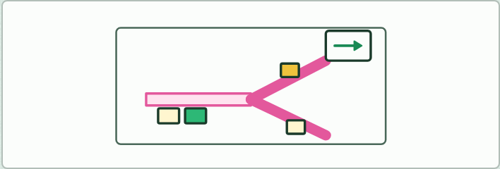
MODEL · HL
20 MIN
Be the fork
THE TASK
A table-top role play of a fork. Two long paper strips are taped down running opposite ways, each with its 5&prime; and 3&prime; ends marked, and a stack of sticky-note nucleotides sits to one side. The roles: helicase slides a ruler along to “open” the strips a hand’s width at a time; primase places a different colour of sticky note, written in RNA letters; polymerase III may only place notes moving away from a primer in the 5&prime; to 3&prime; direction of the new strand, shown by an arrow card held in one direction; polymerase I swaps primer notes for DNA notes; ligase draws the last link with a pen. Run it for a few minutes, then swap roles. Finish on the limits of the model: no hydrogen bonds, no twist, no speed, and enzymes not to scale.
STUDENTS NEED
Paper strips, two colours of sticky notes, arrow cards and pens.
Minutes 28 to 48
Notes:
Minutes 28 to 48 of 60: Be the fork (20 min).
The plan: In groups of five, students act out a fork with paper strips and sticky notes, then swap roles (Be the fork, below).
The activity: Be the fork. A table-top role play of a fork. Two long paper strips are taped down running opposite ways, each with its 5&prime; and 3&prime; ends marked, and a stack of sticky-note nucleotides sits to one side. The roles: helicase slides a ruler along to “open” the strips a hand’s width at a time; primase places a different colour of sticky note, written in RNA letters; polymerase III may only place notes moving away from a primer in the 5&prime; to 3&prime; direction of the new strand, shown by an arrow card held in one direction; polymerase I swaps primer notes for DNA notes; ligase draws the last link with a pen. Run it for a few minutes, then swap roles. Finish on the limits of the model: no hydrogen bonds, no twist, no speed, and enzymes not to scale.
Needs: paper strips, two colours of sticky notes, arrow cards and pens.
The time: 20 minutes, minutes 28 to 48 of the plan.

Slide 25
STEP 5
8 MIN
A written question
Set a compare-and-contrast question on the leading and lagging strands from the D1.1 exam maker, timed, then marked in pairs against its markscheme.
Minutes 48 to 56
Notes:
Minutes 48 to 56 of 60: A written question (8 min).
The plan: Set a compare-and-contrast question on the leading and lagging strands from the D1.1 exam maker (in Practise and revise), timed, then marked in pairs against its markscheme.

Slide 26
PLENARY
Can you now...
Explain why DNA polymerases add nucleotides only to the 3′ end, so new strands grow 5′ to 3′ (D1.1.6)
Compare replication on the leading and lagging strands, with Okazaki fragments and RNA primers (D1.1.7)
Minutes 56 to 60
Notes:
Minutes 56 to 60 of 60: Exit (4 min).
The plan: “Why can the lagging strand not be copied continuously?” One sentence.
Thumbs up, sideways or down on each goal before the exit question. The goals come from the statements this lesson covers.

Slide 27
EXIT QUESTION
Before you go
“Why can the lagging strand not be copied continuously?”
One sentence.
Minutes 56 to 60
Notes:
Minutes 56 to 60 of 60: Exit (4 min).
The plan: “Why can the lagging strand not be copied continuously?” One sentence.

Slide 28
PRACTISE AND REVISE
Keep going
Exam practice: a fresh paper of exam questions on D1.1 at higher level, marked as you go
The guide, with the animations and the dry lab
This lesson in the guide: 7 Only ever at the 3′ end, 8 One strand smooth, one in pieces
BUILD FOR YOUR CLASS
ALREADY ON THE SITE FOR D1.1
CARD SETS ON SPLYCR
Tarsia puzzle, dominoes and picture reveal on D1.1, built from its key terms and ready to print
A pub quiz with rounds on D1.1, to present or run with no projector
An escape room built from the question bank on D1.1
Quiz: DNA Replication (HL)
Quiz: DNA Replication
Revision map: D1.1 DNA replication, to fill in
Exam questions: D1.1 in the exam maker, a paper with its markscheme
Open a set to host it as a class game, or make a copy to edit.
D1.1 DNA Replication
How this was made. The course structure, the activities and the teaching choices come from my own classroom, my presentations and my years of teaching IB and AP Biology. I use Claude, an AI, to help write and build the interactive guides, lesson plans, slides and practice questions, and to draw the diagrams and code the interactives. I direct the work and review it against the IB and AP specifications before it goes live.
Minute 60: after the lesson
Notes:
Every link here is live. Set the exam practice paper for homework: it is fresh each time, marked as students go and saved to their Exam practice when they are signed in.
Exam practice: https://www.biologybybradford.com/exam-maker/sit?topics=D1.1&level=HL&paper=quiz&marks=15&src=ep
The guide: https://www.biologybybradford.com/guides/ib-biology-d1-1-dna-replication

