Slide 1
IB Biology D1.1
LESSON 4 OF 4
HL
BY THE END YOU CAN
DNA replication
State what DNA primase, DNA polymerase I, DNA polymerase III and DNA ligase each do (D1.1.8)
Explain how DNA polymerase III proofreads the strand it is building (D1.1.9)
The enzymes and the checks
D1.1.8, D1.1.9
Primase, polymerases III and I, ligase, and proofreading
60 minutes · chapters 9, 10
Minute 0
Notes:
IB Biology D1.1, DNA replication. Lesson 4 of 4: The enzymes and the checks (higher level), 60 minutes.
The plan, minute by minute (each slide's footer says where you are):
0 to 5 min (5) Do now: riddles of the fork
5 to 15 min (10) Four enzymes
15 to 23 min (8) Checking as it goes
23 to 40 min (17) Run the fork, the whole fork
40 to 52 min (12) Where did it go wrong?
52 to 60 min (8) Exit
What students get wrong:
Polymerase III removes primers, and ligase adds nucleotides. Polymerase I removes and replaces primers, and ligase makes one bond.
Primers are DNA. They are RNA.
Proofreading checks the finished strand. It removes the last nucleotide added, as it goes.
Stretch and support:
Support: use the Hungry Pandas Prefer Plain Lettuce tiles as a starter in lesson 4.
Stretch: why might a polymerase that can only extend from a correctly paired 3&prime; end be more accurate than one that could also start strands? (Hint: the need for a primer and proofreading go together.)
The lesson plan to print: https://www.biologybybradford.com/guides/downloads/ib-biology-d1-1-dna-replication-lesson-4-plan.pdf

Slide 2
DO NOW
Riddles of the fork
Five short riddles on the board, each describing an enzyme; students name them.
5:00
minutes
Start now: the timer is running.
Minutes 0 to 5
Notes:
Minutes 0 to 5 of 60: Do now: riddles of the fork (5 min).
The plan: Five short riddles on the board, each describing an enzyme; students name them (Riddles of the fork, below).
Start a 5 minute timer as they come in.

Slide 3

WRITING · HL
5 MIN
Riddles of the fork
THE TASK
Five riddles, each an enzyme; students name them.
STUDENTS NEED
The riddles on the board.
Minutes 0 to 5
Notes:
Minutes 0 to 5 of 60: Do now: riddles of the fork (5 min).
The plan: Five short riddles on the board, each describing an enzyme; students name them (Riddles of the fork, below).
The activity: Riddles of the fork. Five riddles, each an enzyme; students name them. “I open the door and the pairs let go; I break only the weakest bonds.” (helicase) “I write in RNA, a few letters only, so the builder has somewhere to start.” (primase) “I add to the 3&prime; end and nowhere else, and I check each letter as I go.” (DNA polymerase III) “I take out what was only ever a placeholder and put DNA in its place.” (DNA polymerase I) “I add no letters at all; I make one bond where two pieces meet.” (ligase)
Needs: the riddles on the board.
The time: 5 minutes, minutes 0 to 5 of the plan.

Slide 4
STEP 2
10 MIN
Four enzymes
Chapter 9: Four enzymes at the fork
Minutes 5 to 15
Notes:
Minutes 5 to 15 of 60: Four enzymes (10 min).
The plan: Chapter 9’s figure: tap each enzyme. Then the Hungry Pandas Prefer Plain Lettuce tiles and chapter 9’s predict box.

Slide 5
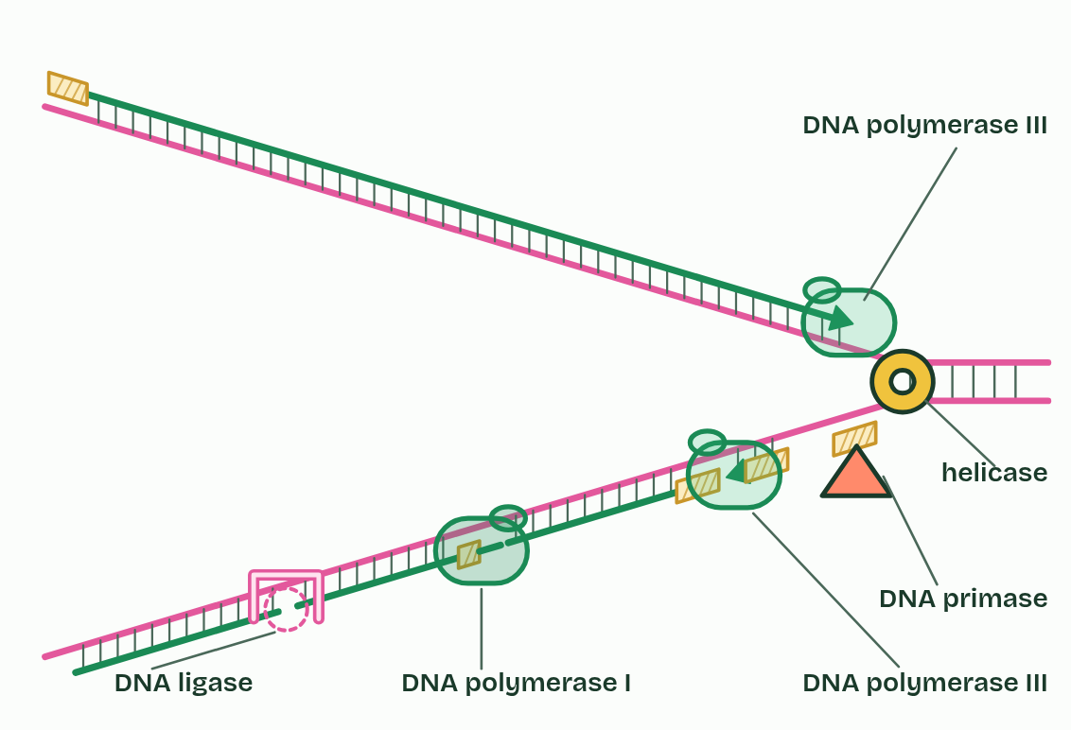
CHAPTER 9 · D1.1.8 Primase, polymerases I and III, ligase
Four enzymes at the fork
DNA primase makes a short RNA primer (about ten nucleotides in E. coli) on the template, complementary to it: once at the start of the leading strand, and once for each Okazaki fragment.
DNA polymerase III extends each primer from its 3′ end, one nucleotide at a time, each paired with the template, so it builds almost all of each new strand, 5′ to 3′. It also proofreads (chapter 10).
DNA polymerase I removes the RNA primers and replaces their nucleotides with DNA nucleotides. Like every DNA polymerase it needs a 3′ end to add to, so it works from the 3′ end of the newer fragment that has grown up to the primer, taking out RNA ahead of it and filling in DNA behind. A primer is only replaced once the next fragment has reached it.
DNA ligase joins the fragments. It makes the last covalent bond in the sugar and phosphate backbone, where one fragment’s 3′ end meets the next fragment’s 5′ end. The unjoined gap is a nick.
Minutes 5 to 15
Notes:
Minutes 5 to 15 of 60: Four enzymes (10 min).
The plan: Chapter 9’s figure: tap each enzyme. Then the Hungry Pandas Prefer Plain Lettuce tiles and chapter 9’s predict box.
Helicase has opened the fork. Four more enzymes finish the job. This is the system of a bacterium such as E. coli, which is the one the IB asks for, and the order they act in is the order to learn.
Why RNA primers, and then their removal? The finished strand must be DNA all through, so every primer’s RNA has to be swapped out. That is also why ligase works many times on the lagging strand, once at every join, and once on the leading strand, where its single primer was replaced. It also answers why neighbouring Okazaki fragments are not joined at first: between them lies an RNA primer at first, then, once polymerase I has swapped it for DNA, a nick, and only then can ligase seal it.
Helicase, from chapter 3, is the fifth enzyme at the fork: named again here, not taught again.
Parts of the figure:
The leading strand is built continuously towards the fork, from a single primer.
An RNA primer: a few RNA nucleotides that give DNA polymerase III a 3′ end to start from.
An Okazaki fragment: one short piece of the lagging strand. In E. coli it is 1,000 to 2,000 nucleotides long; here it is drawn much shorter.
An RNA primer: a few RNA nucleotides that give DNA polymerase III a 3′ end to start from.
An RNA primer: a few RNA nucleotides that give DNA polymerase III a 3′ end to start from.
A nick: two DNA fragments side by side, with one bond missing in the backbone.
DNA ligase joins fragments: it makes the last covalent bond in the sugar and phosphate backbone where one fragment&rsquo;s 3′ end meets the next fragment&rsquo;s 5′ end.
DNA polymerase I removes the RNA primers and fills the gap with DNA nucleotides. It works from the 3′ end of the newer fragment, taking out RNA ahead of it and adding DNA behind.
DNA polymerase III extends each primer from its 3′ end, one nucleotide at a time, each paired with the template. It builds almost all of each new strand, 5′ to 3′, and checks its work (chapter 10).
DNA polymerase III extends each primer from its 3′ end, one nucleotide at a time, each paired with the template. It builds almost all of each new strand, 5′ to 3′, and checks its work (chapter 10).
DNA primase makes a short RNA primer on the template, complementary to it: once at the start of the leading strand, and once for each Okazaki fragment.
Helicase opens the fork ahead of the other enzymes, unwinding the helix and breaking the hydrogen bonds between the base pairs.

Slide 6
WATCH OUT
DNA polymerase III does not remove primers: polymerase I does. Ligase does not add nucleotides: it makes one bond where two pieces meet. And primers are RNA, which is why they must be replaced.
Minutes 5 to 15
Notes:
Minutes 5 to 15 of 60: Four enzymes (10 min).
The plan: Chapter 9’s figure: tap each enzyme. Then the Hungry Pandas Prefer Plain Lettuce tiles and chapter 9’s predict box.
A common mistake: say it, then ask who can say why it is wrong.

Slide 7
REMEMBER IT
The enzymes at the fork, in order
H
P
P
P
L
Hungry
Pandas
Prefer
Plain
Lettuce
Minutes 5 to 15
Notes:
Minutes 5 to 15 of 60: Four enzymes (10 min).
The plan: Chapter 9’s figure: tap each enzyme. Then the Hungry Pandas Prefer Plain Lettuce tiles and chapter 9’s predict box.
Ask the class what each letter stands for before revealing.

Slide 8
REMEMBER IT
The enzymes at the fork, in order
H
P
P
P
L
Hungry
Pandas
Prefer
Plain
Lettuce
Helicase
DNA primase
DNA polymerase III
DNA polymerase I
DNA ligase
unwinds and breaks hydrogen bonds
lays an RNA primer
builds the new strand 5′ to 3′, and proofreads
swaps RNA primers for DNA
seals the nicks
Minutes 5 to 15
Notes:
Minutes 5 to 15 of 60: Four enzymes (10 min).
The plan: Chapter 9’s figure: tap each enzyme. Then the Hungry Pandas Prefer Plain Lettuce tiles and chapter 9’s predict box.
Hungry: Helicase (unwinds and breaks hydrogen bonds)
Pandas: DNA primase (lays an RNA primer)
Prefer: DNA polymerase III (builds the new strand 5′ to 3′, and proofreads)
Plain: DNA polymerase I (swaps RNA primers for DNA)
Lettuce: DNA ligase (seals the nicks)

Slide 9
PREDICT
A bacterium makes a faulty DNA ligase. What would you find in its newly copied DNA?
A Lagging strands left as short fragments
B RNA primers left in both new strands
C No new strands at all, as copying cannot start
Minutes 5 to 15
Notes:
Minutes 5 to 15 of 60: Four enzymes (10 min).
The plan: Chapter 9’s figure: tap each enzyme. Then the Hungry Pandas Prefer Plain Lettuce tiles and chapter 9’s predict box.
Ask for a show of hands, or mini whiteboards, before revealing. (Answer: A, on the next slide.)

Slide 10
WHAT HAPPENS
A bacterium makes a faulty DNA ligase. What would you find in its newly copied DNA?
A Lagging strands left as short fragments
B RNA primers left in both new strands
C No new strands at all, as copying cannot start
Without ligase, nothing seals the last bond between one fragment and the next, so the lagging strand stays in pieces (and the leading strand keeps one nick where its primer was). Primase and polymerase III still start and build the strands, and polymerase I still swaps the primers for DNA. Only the joining fails.
Minutes 5 to 15
Notes:
Minutes 5 to 15 of 60: Four enzymes (10 min).
The plan: Chapter 9’s figure: tap each enzyme. Then the Hungry Pandas Prefer Plain Lettuce tiles and chapter 9’s predict box.
Answer: A. Without ligase, nothing seals the last bond between one fragment and the next, so the lagging strand stays in pieces (and the leading strand keeps one nick where its primer was). Primase and polymerase III still start and build the strands, and polymerase I still swaps the primers for DNA. Only the joining fails.

Slide 11
STEP 3
8 MIN
Checking as it goes
Chapter 10: Checking as it goes
Minutes 15 to 23
Notes:
Minutes 15 to 23 of 60: Checking as it goes (8 min).
The plan: Chapter 10’s figure, then chapter 10’s predict box, worked on paper.

Slide 12
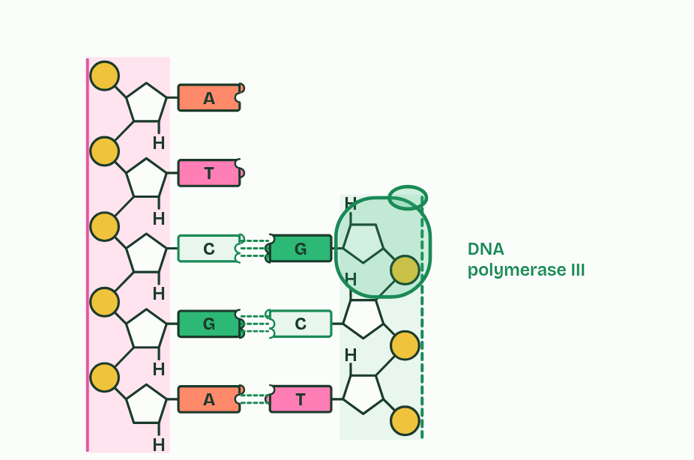
CHAPTER 10 · D1.1.9 DNA proofreading
1 / 5
Checking as it goes
DNA polymerase III adds nucleotides at the 3′ end.
Minutes 15 to 23
Notes:
Minutes 15 to 23 of 60: Checking as it goes (8 min).
The plan: Chapter 10’s figure, then chapter 10’s predict box, worked on paper.
Base pairing makes the right base far likelier than a wrong one, but now and then DNA polymerase III joins a nucleotide whose base does not pair with the template. That is a mismatch.
Proofreading deals with it. DNA polymerase III checks the nucleotide it has just added. If its base is a mismatch, the enzyme backs up, removes that nucleotide from the 3′ terminal of the new strand, adds a correctly matched one in its place, and carries on. It is the last nucleotide that gets checked because a mismatched base at the 3′ end does not pair properly, and the polymerase cannot extend well from it. That is how the mistake is caught before it is buried.
A mismatch that is left in becomes a mutation in one of the two daughter molecules after the next copying (D1.3). Accuracy matters because every cell copies billions of bases.
Accurate copying plus proofreading is how genetic continuity is kept between generations, and the rare errors that remain are where new alleles come from.
Now put the whole fork together in Run the fork, below.
Example: How good is it? Without proofreading, DNA polymerase III gets about 1 base in 100,000 wrong. Proofreading catches about 99 in 100 of those, so about 1 in 10 million slips through. (Cells have further checks after copying, which take it lower still, but they are beyond the IB guide.)

Slide 13
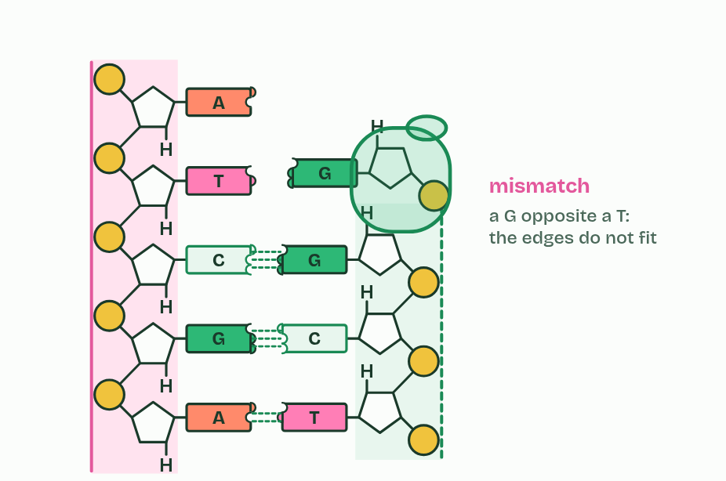
CHAPTER 10 · D1.1.9 DNA proofreading
2 / 5
Checking as it goes
Rarely, a mismatch is joined in.
Minutes 15 to 23
Notes:
Minutes 15 to 23 of 60: Checking as it goes (8 min).
The plan: Chapter 10’s figure, then chapter 10’s predict box, worked on paper.
Base pairing makes the right base far likelier than a wrong one, but now and then DNA polymerase III joins a nucleotide whose base does not pair with the template. That is a mismatch.
Proofreading deals with it. DNA polymerase III checks the nucleotide it has just added. If its base is a mismatch, the enzyme backs up, removes that nucleotide from the 3′ terminal of the new strand, adds a correctly matched one in its place, and carries on. It is the last nucleotide that gets checked because a mismatched base at the 3′ end does not pair properly, and the polymerase cannot extend well from it. That is how the mistake is caught before it is buried.
A mismatch that is left in becomes a mutation in one of the two daughter molecules after the next copying (D1.3). Accuracy matters because every cell copies billions of bases.
Accurate copying plus proofreading is how genetic continuity is kept between generations, and the rare errors that remain are where new alleles come from.
Now put the whole fork together in Run the fork, below.
Example: How good is it? Without proofreading, DNA polymerase III gets about 1 base in 100,000 wrong. Proofreading catches about 99 in 100 of those, so about 1 in 10 million slips through. (Cells have further checks after copying, which take it lower still, but they are beyond the IB guide.)

Slide 14
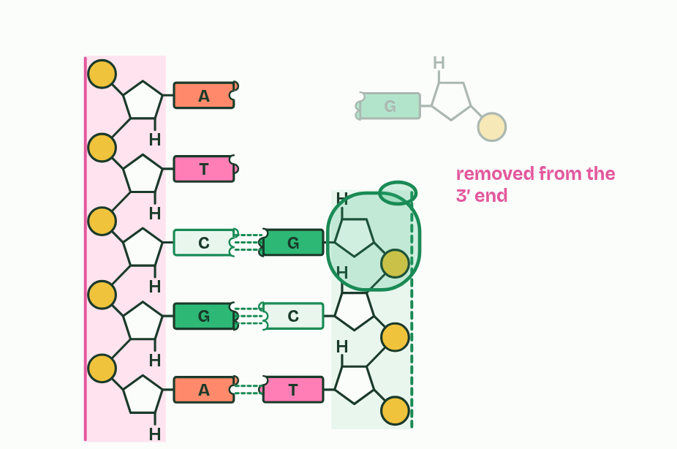
CHAPTER 10 · D1.1.9 DNA proofreading
3 / 5
Checking as it goes
It backs up and removes the mismatched nucleotide.
Minutes 15 to 23
Notes:
Minutes 15 to 23 of 60: Checking as it goes (8 min).
The plan: Chapter 10’s figure, then chapter 10’s predict box, worked on paper.
Base pairing makes the right base far likelier than a wrong one, but now and then DNA polymerase III joins a nucleotide whose base does not pair with the template. That is a mismatch.
Proofreading deals with it. DNA polymerase III checks the nucleotide it has just added. If its base is a mismatch, the enzyme backs up, removes that nucleotide from the 3′ terminal of the new strand, adds a correctly matched one in its place, and carries on. It is the last nucleotide that gets checked because a mismatched base at the 3′ end does not pair properly, and the polymerase cannot extend well from it. That is how the mistake is caught before it is buried.
A mismatch that is left in becomes a mutation in one of the two daughter molecules after the next copying (D1.3). Accuracy matters because every cell copies billions of bases.
Accurate copying plus proofreading is how genetic continuity is kept between generations, and the rare errors that remain are where new alleles come from.
Now put the whole fork together in Run the fork, below.
Example: How good is it? Without proofreading, DNA polymerase III gets about 1 base in 100,000 wrong. Proofreading catches about 99 in 100 of those, so about 1 in 10 million slips through. (Cells have further checks after copying, which take it lower still, but they are beyond the IB guide.)

Slide 15
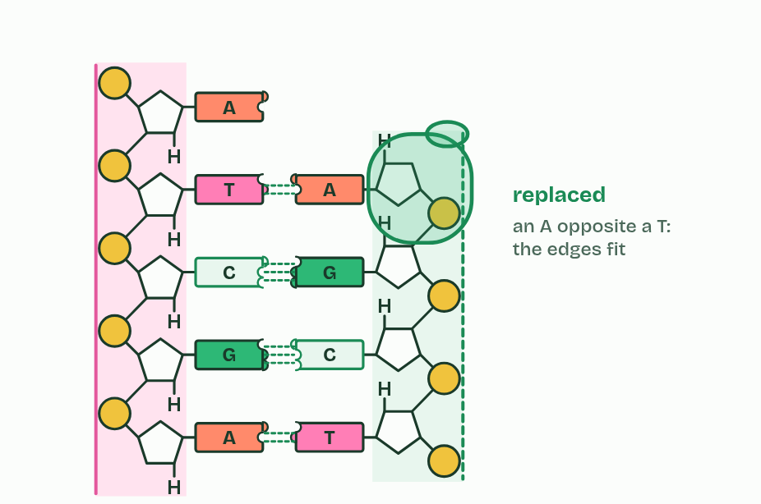
CHAPTER 10 · D1.1.9 DNA proofreading
4 / 5
Checking as it goes
It adds the correct one.
Minutes 15 to 23
Notes:
Minutes 15 to 23 of 60: Checking as it goes (8 min).
The plan: Chapter 10’s figure, then chapter 10’s predict box, worked on paper.
Base pairing makes the right base far likelier than a wrong one, but now and then DNA polymerase III joins a nucleotide whose base does not pair with the template. That is a mismatch.
Proofreading deals with it. DNA polymerase III checks the nucleotide it has just added. If its base is a mismatch, the enzyme backs up, removes that nucleotide from the 3′ terminal of the new strand, adds a correctly matched one in its place, and carries on. It is the last nucleotide that gets checked because a mismatched base at the 3′ end does not pair properly, and the polymerase cannot extend well from it. That is how the mistake is caught before it is buried.
A mismatch that is left in becomes a mutation in one of the two daughter molecules after the next copying (D1.3). Accuracy matters because every cell copies billions of bases.
Accurate copying plus proofreading is how genetic continuity is kept between generations, and the rare errors that remain are where new alleles come from.
Now put the whole fork together in Run the fork, below.
Example: How good is it? Without proofreading, DNA polymerase III gets about 1 base in 100,000 wrong. Proofreading catches about 99 in 100 of those, so about 1 in 10 million slips through. (Cells have further checks after copying, which take it lower still, but they are beyond the IB guide.)

Slide 16
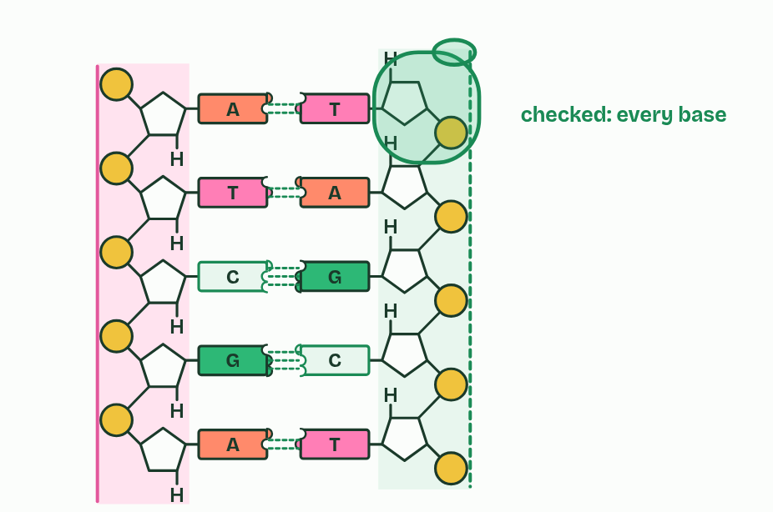
CHAPTER 10 · D1.1.9 DNA proofreading
5 / 5
Checking as it goes
Then it carries on: about 1 mistake in 10 million survives.
Minutes 15 to 23
Notes:
Minutes 15 to 23 of 60: Checking as it goes (8 min).
The plan: Chapter 10’s figure, then chapter 10’s predict box, worked on paper.
Base pairing makes the right base far likelier than a wrong one, but now and then DNA polymerase III joins a nucleotide whose base does not pair with the template. That is a mismatch.
Proofreading deals with it. DNA polymerase III checks the nucleotide it has just added. If its base is a mismatch, the enzyme backs up, removes that nucleotide from the 3′ terminal of the new strand, adds a correctly matched one in its place, and carries on. It is the last nucleotide that gets checked because a mismatched base at the 3′ end does not pair properly, and the polymerase cannot extend well from it. That is how the mistake is caught before it is buried.
A mismatch that is left in becomes a mutation in one of the two daughter molecules after the next copying (D1.3). Accuracy matters because every cell copies billions of bases.
Accurate copying plus proofreading is how genetic continuity is kept between generations, and the rare errors that remain are where new alleles come from.
Now put the whole fork together in Run the fork, below.
Example: How good is it? Without proofreading, DNA polymerase III gets about 1 base in 100,000 wrong. Proofreading catches about 99 in 100 of those, so about 1 in 10 million slips through. (Cells have further checks after copying, which take it lower still, but they are beyond the IB guide.)

Slide 17
CHAPTER 10 · D1.1.9 DNA proofreading
Checking as it goes
A mismatch is a new nucleotide whose base does not pair with the template.
DNA polymerase III backs up, removes it from the 3′ end and adds the correct one.
It checks as it builds, not afterwards.
Minutes 15 to 23
Notes:
Minutes 15 to 23 of 60: Checking as it goes (8 min).
The plan: Chapter 10’s figure, then chapter 10’s predict box, worked on paper.
Base pairing makes the right base far likelier than a wrong one, but now and then DNA polymerase III joins a nucleotide whose base does not pair with the template. That is a mismatch.
Proofreading deals with it. DNA polymerase III checks the nucleotide it has just added. If its base is a mismatch, the enzyme backs up, removes that nucleotide from the 3′ terminal of the new strand, adds a correctly matched one in its place, and carries on. It is the last nucleotide that gets checked because a mismatched base at the 3′ end does not pair properly, and the polymerase cannot extend well from it. That is how the mistake is caught before it is buried.
A mismatch that is left in becomes a mutation in one of the two daughter molecules after the next copying (D1.3). Accuracy matters because every cell copies billions of bases.
Accurate copying plus proofreading is how genetic continuity is kept between generations, and the rare errors that remain are where new alleles come from.
Now put the whole fork together in Run the fork, below.
Example: How good is it? Without proofreading, DNA polymerase III gets about 1 base in 100,000 wrong. Proofreading catches about 99 in 100 of those, so about 1 in 10 million slips through. (Cells have further checks after copying, which take it lower still, but they are beyond the IB guide.)

Slide 18
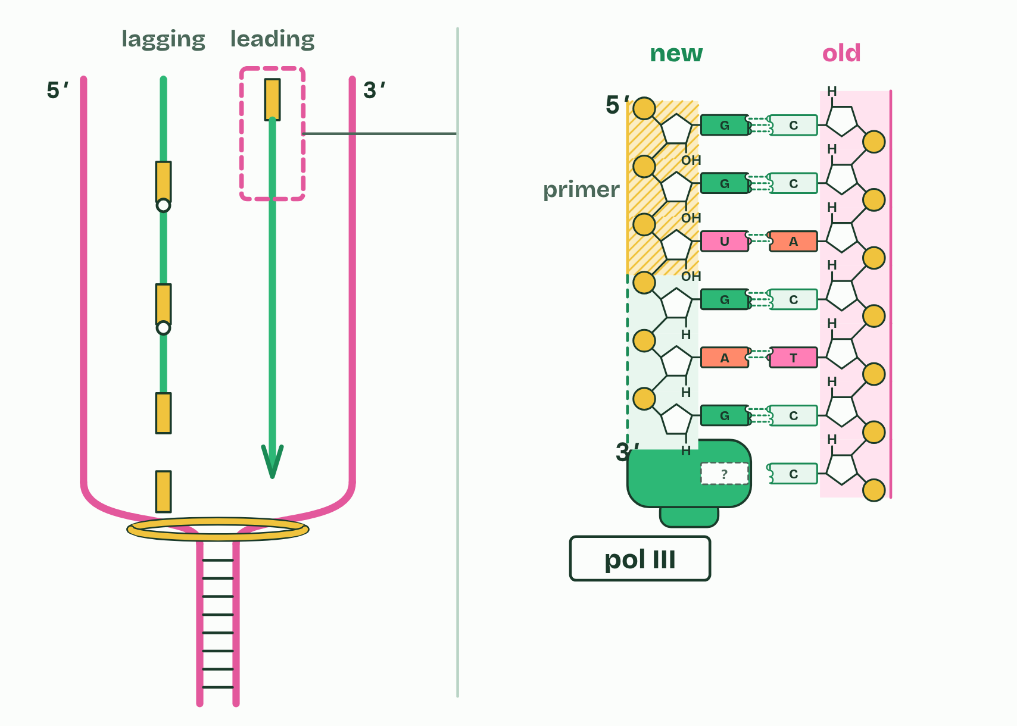
CHAPTER 10 · D1.1.9 DNA proofreading
1 / 5
Checking as it goes
One primer starts the leading strand.
Minutes 15 to 23
Notes:
Minutes 15 to 23 of 60: Checking as it goes (8 min).
The plan: Chapter 10’s figure, then chapter 10’s predict box, worked on paper.
Base pairing makes the right base far likelier than a wrong one, but now and then DNA polymerase III joins a nucleotide whose base does not pair with the template. That is a mismatch.
Proofreading deals with it. DNA polymerase III checks the nucleotide it has just added. If its base is a mismatch, the enzyme backs up, removes that nucleotide from the 3′ terminal of the new strand, adds a correctly matched one in its place, and carries on. It is the last nucleotide that gets checked because a mismatched base at the 3′ end does not pair properly, and the polymerase cannot extend well from it. That is how the mistake is caught before it is buried.
A mismatch that is left in becomes a mutation in one of the two daughter molecules after the next copying (D1.3). Accuracy matters because every cell copies billions of bases.
Accurate copying plus proofreading is how genetic continuity is kept between generations, and the rare errors that remain are where new alleles come from.
Now put the whole fork together in Run the fork, below.
Example: How good is it? Without proofreading, DNA polymerase III gets about 1 base in 100,000 wrong. Proofreading catches about 99 in 100 of those, so about 1 in 10 million slips through. (Cells have further checks after copying, which take it lower still, but they are beyond the IB guide.)

Slide 19
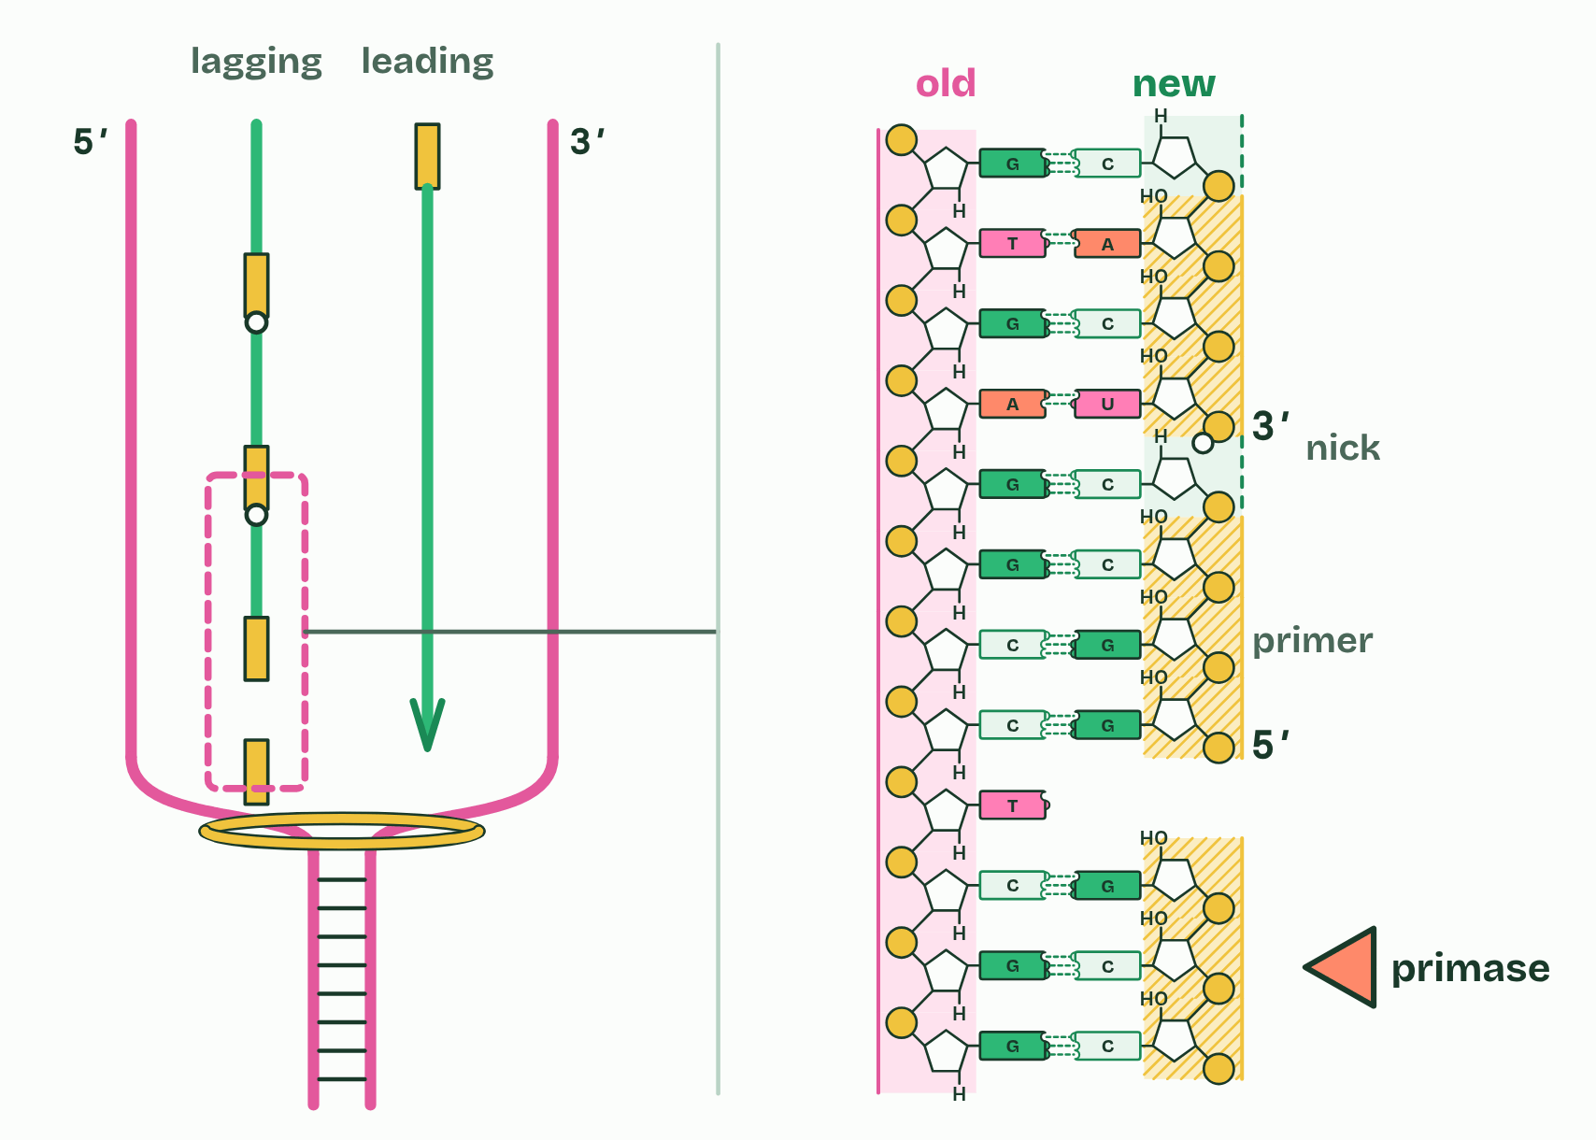
CHAPTER 10 · D1.1.9 DNA proofreading
2 / 5
Checking as it goes
On the lagging strand: a new primer for every fragment.
Minutes 15 to 23
Notes:
Minutes 15 to 23 of 60: Checking as it goes (8 min).
The plan: Chapter 10’s figure, then chapter 10’s predict box, worked on paper.
Base pairing makes the right base far likelier than a wrong one, but now and then DNA polymerase III joins a nucleotide whose base does not pair with the template. That is a mismatch.
Proofreading deals with it. DNA polymerase III checks the nucleotide it has just added. If its base is a mismatch, the enzyme backs up, removes that nucleotide from the 3′ terminal of the new strand, adds a correctly matched one in its place, and carries on. It is the last nucleotide that gets checked because a mismatched base at the 3′ end does not pair properly, and the polymerase cannot extend well from it. That is how the mistake is caught before it is buried.
A mismatch that is left in becomes a mutation in one of the two daughter molecules after the next copying (D1.3). Accuracy matters because every cell copies billions of bases.
Accurate copying plus proofreading is how genetic continuity is kept between generations, and the rare errors that remain are where new alleles come from.
Now put the whole fork together in Run the fork, below.
Example: How good is it? Without proofreading, DNA polymerase III gets about 1 base in 100,000 wrong. Proofreading catches about 99 in 100 of those, so about 1 in 10 million slips through. (Cells have further checks after copying, which take it lower still, but they are beyond the IB guide.)

Slide 20
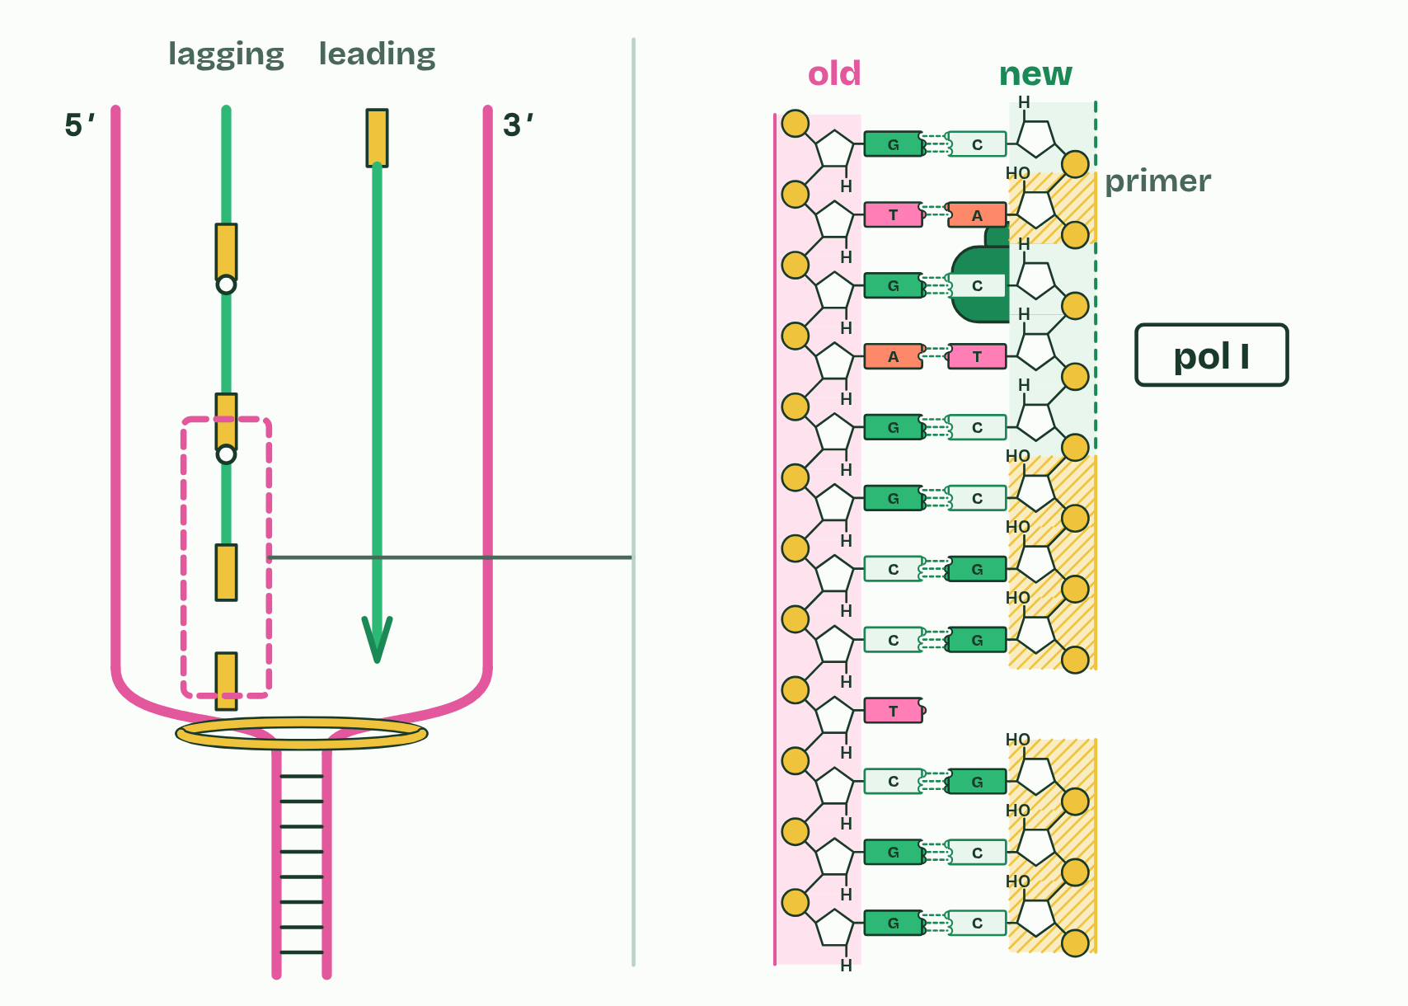
CHAPTER 10 · D1.1.9 DNA proofreading
3 / 5
Checking as it goes
DNA polymerase I swaps the RNA primer for DNA.
Minutes 15 to 23
Notes:
Minutes 15 to 23 of 60: Checking as it goes (8 min).
The plan: Chapter 10’s figure, then chapter 10’s predict box, worked on paper.
Base pairing makes the right base far likelier than a wrong one, but now and then DNA polymerase III joins a nucleotide whose base does not pair with the template. That is a mismatch.
Proofreading deals with it. DNA polymerase III checks the nucleotide it has just added. If its base is a mismatch, the enzyme backs up, removes that nucleotide from the 3′ terminal of the new strand, adds a correctly matched one in its place, and carries on. It is the last nucleotide that gets checked because a mismatched base at the 3′ end does not pair properly, and the polymerase cannot extend well from it. That is how the mistake is caught before it is buried.
A mismatch that is left in becomes a mutation in one of the two daughter molecules after the next copying (D1.3). Accuracy matters because every cell copies billions of bases.
Accurate copying plus proofreading is how genetic continuity is kept between generations, and the rare errors that remain are where new alleles come from.
Now put the whole fork together in Run the fork, below.
Example: How good is it? Without proofreading, DNA polymerase III gets about 1 base in 100,000 wrong. Proofreading catches about 99 in 100 of those, so about 1 in 10 million slips through. (Cells have further checks after copying, which take it lower still, but they are beyond the IB guide.)

Slide 21
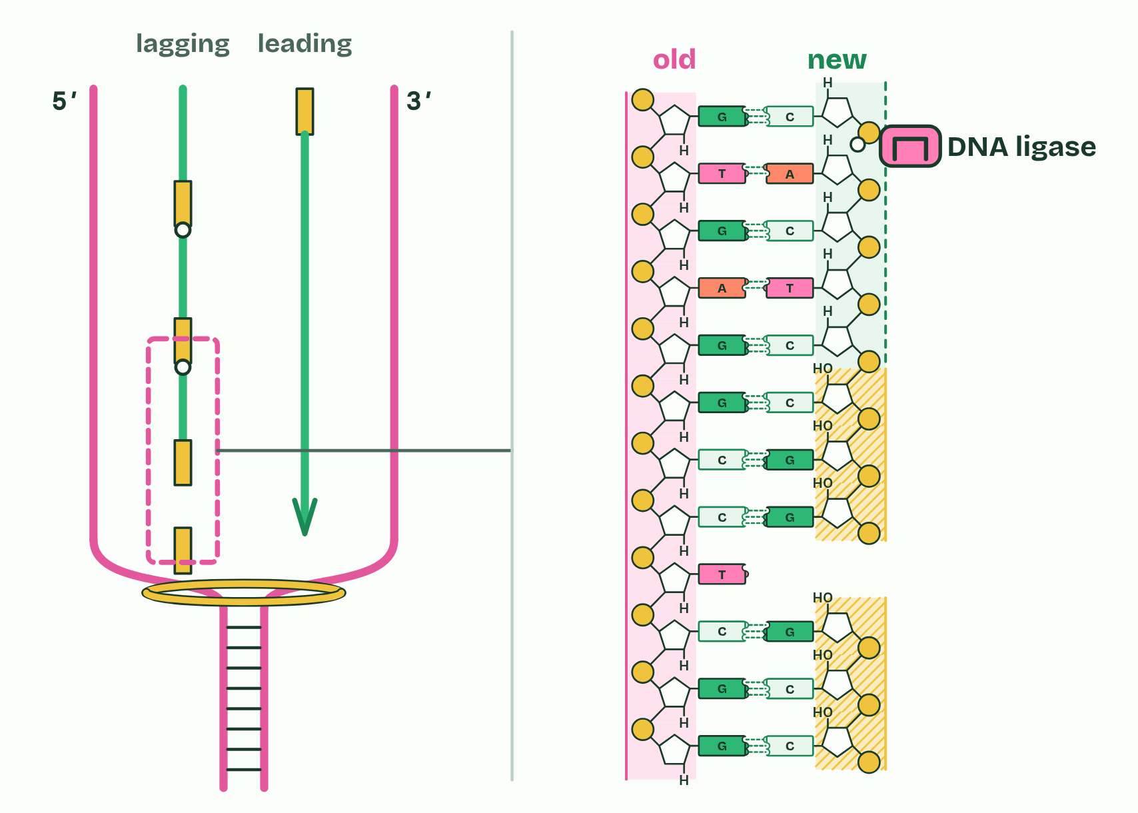
CHAPTER 10 · D1.1.9 DNA proofreading
4 / 5
Checking as it goes
DNA ligase makes the last bond in the backbone.
Minutes 15 to 23
Notes:
Minutes 15 to 23 of 60: Checking as it goes (8 min).
The plan: Chapter 10’s figure, then chapter 10’s predict box, worked on paper.
Base pairing makes the right base far likelier than a wrong one, but now and then DNA polymerase III joins a nucleotide whose base does not pair with the template. That is a mismatch.
Proofreading deals with it. DNA polymerase III checks the nucleotide it has just added. If its base is a mismatch, the enzyme backs up, removes that nucleotide from the 3′ terminal of the new strand, adds a correctly matched one in its place, and carries on. It is the last nucleotide that gets checked because a mismatched base at the 3′ end does not pair properly, and the polymerase cannot extend well from it. That is how the mistake is caught before it is buried.
A mismatch that is left in becomes a mutation in one of the two daughter molecules after the next copying (D1.3). Accuracy matters because every cell copies billions of bases.
Accurate copying plus proofreading is how genetic continuity is kept between generations, and the rare errors that remain are where new alleles come from.
Now put the whole fork together in Run the fork, below.
Example: How good is it? Without proofreading, DNA polymerase III gets about 1 base in 100,000 wrong. Proofreading catches about 99 in 100 of those, so about 1 in 10 million slips through. (Cells have further checks after copying, which take it lower still, but they are beyond the IB guide.)

Slide 22
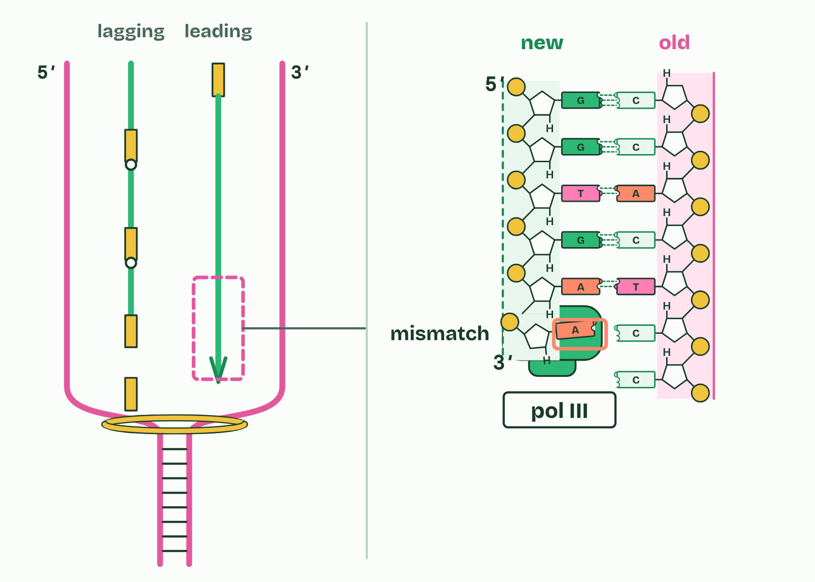
CHAPTER 10 · D1.1.9 DNA proofreading
5 / 5
Checking as it goes
A mismatch at the 3′ end: what does DNA polymerase III do next?
Minutes 15 to 23
Notes:
Minutes 15 to 23 of 60: Checking as it goes (8 min).
The plan: Chapter 10’s figure, then chapter 10’s predict box, worked on paper.
Base pairing makes the right base far likelier than a wrong one, but now and then DNA polymerase III joins a nucleotide whose base does not pair with the template. That is a mismatch.
Proofreading deals with it. DNA polymerase III checks the nucleotide it has just added. If its base is a mismatch, the enzyme backs up, removes that nucleotide from the 3′ terminal of the new strand, adds a correctly matched one in its place, and carries on. It is the last nucleotide that gets checked because a mismatched base at the 3′ end does not pair properly, and the polymerase cannot extend well from it. That is how the mistake is caught before it is buried.
A mismatch that is left in becomes a mutation in one of the two daughter molecules after the next copying (D1.3). Accuracy matters because every cell copies billions of bases.
Accurate copying plus proofreading is how genetic continuity is kept between generations, and the rare errors that remain are where new alleles come from.
Now put the whole fork together in Run the fork, below.
Example: How good is it? Without proofreading, DNA polymerase III gets about 1 base in 100,000 wrong. Proofreading catches about 99 in 100 of those, so about 1 in 10 million slips through. (Cells have further checks after copying, which take it lower still, but they are beyond the IB guide.)

Slide 23
CHAPTER 10 · D1.1.9 DNA proofreading
Checking as it goes
A mismatch is a new nucleotide whose base does not pair with the template.
DNA polymerase III backs up, removes it from the 3′ end and adds the correct one.
It checks as it builds, not afterwards.
Minutes 15 to 23
Notes:
Minutes 15 to 23 of 60: Checking as it goes (8 min).
The plan: Chapter 10’s figure, then chapter 10’s predict box, worked on paper.
Base pairing makes the right base far likelier than a wrong one, but now and then DNA polymerase III joins a nucleotide whose base does not pair with the template. That is a mismatch.
Proofreading deals with it. DNA polymerase III checks the nucleotide it has just added. If its base is a mismatch, the enzyme backs up, removes that nucleotide from the 3′ terminal of the new strand, adds a correctly matched one in its place, and carries on. It is the last nucleotide that gets checked because a mismatched base at the 3′ end does not pair properly, and the polymerase cannot extend well from it. That is how the mistake is caught before it is buried.
A mismatch that is left in becomes a mutation in one of the two daughter molecules after the next copying (D1.3). Accuracy matters because every cell copies billions of bases.
Accurate copying plus proofreading is how genetic continuity is kept between generations, and the rare errors that remain are where new alleles come from.
Now put the whole fork together in Run the fork, below.
Example: How good is it? Without proofreading, DNA polymerase III gets about 1 base in 100,000 wrong. Proofreading catches about 99 in 100 of those, so about 1 in 10 million slips through. (Cells have further checks after copying, which take it lower still, but they are beyond the IB guide.)

Slide 24
WATCH OUT
Proofreading does not check the whole strand afterwards: it removes the nucleotide just added at the 3′ end, while the strand is being built. And it is DNA polymerase III that proofreads (in the IB’s account), not polymerase I or ligase.
Minutes 15 to 23
Notes:
Minutes 15 to 23 of 60: Checking as it goes (8 min).
The plan: Chapter 10’s figure, then chapter 10’s predict box, worked on paper.
A common mistake: say it, then ask who can say why it is wrong.

Slide 25
PREDICT
Without proofreading, DNA polymerase III gets about 1 base in 100,000 wrong. With it, about 1 in 10 million. Copying a bacterial chromosome means adding about 9 million new bases. About how many mistakes would each give?
A About 45 without, and none at all with it
B About 90 without, about 1 with it
C About 1 without, about 90 with it
Minutes 15 to 23
Notes:
Minutes 15 to 23 of 60: Checking as it goes (8 min).
The plan: Chapter 10’s figure, then chapter 10’s predict box, worked on paper.
Ask for a show of hands, or mini whiteboards, before revealing. (Answer: B, on the next slide.)

Slide 26
WHAT HAPPENS
Without proofreading, DNA polymerase III gets about 1 base in 100,000 wrong. With it, about 1 in 10 million. Copying a bacterial chromosome means adding about 9 million new bases. About how many mistakes would each give?
A About 45 without, and none at all with it
B About 90 without, about 1 with it
C About 1 without, about 90 with it
9 million ÷ 100,000 is 90 mistakes a copy without proofreading, and 9 million ÷ 10 million is about 1 with it: proofreading makes copying about a hundred times more accurate. Not zero, though: the odd mismatch still gets through, which is one source of mutations.
Minutes 15 to 23
Notes:
Minutes 15 to 23 of 60: Checking as it goes (8 min).
The plan: Chapter 10’s figure, then chapter 10’s predict box, worked on paper.
Answer: B. 9 million ÷ 100,000 is 90 mistakes a copy without proofreading, and 9 million ÷ 10 million is about 1 with it: proofreading makes copying about a hundred times more accurate. Not zero, though: the odd mismatch still gets through, which is one source of mutations.

Slide 27
STEP 4
17 MIN
Run the fork, the whole fork
Each pair records its errors in every 1,000 bases and compares them with polymerase III’s.
Minutes 23 to 40
Notes:
Minutes 23 to 40 of 60: Run the fork, the whole fork (17 min).
The plan: Run the fork’s higher level rounds in pairs (chapter 10’s game). Each pair records its errors in every 1,000 bases and compares them with polymerase III’s.

Slide 28
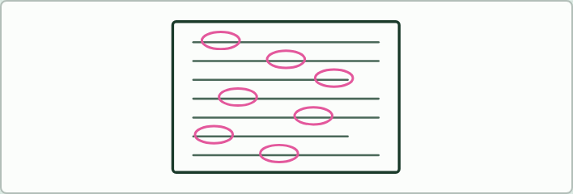
WRITING · HL
12 MIN
Where did it go wrong?
THE TASK
The question: “Describe how both new strands are built at a replication fork in a bacterium. (8 marks)” Give students this answer to correct: “Helicase splits the DNA by breaking the bonds between the sugars and phosphates. Primase adds a DNA primer to the 5&prime; end of each strand. DNA polymerase I then adds nucleotides in the 3&prime; to 5&prime; direction. The lagging strand is copied later, which is why it lags, in Okazaki fragments. Ligase removes the primers and joins the fragments. Polymerase III checks the whole strand at the end for mistakes.”There are eight errors. Helicase breaks hydrogen bonds, not the bonds between sugar and phosphate. The primer is RNA. A primer is laid where copying starts, and nucleotides are added to its 3&prime; end. It is polymerase III, not polymerase I, that adds most nucleotides. New strands grow 5&prime; to 3&prime;. The lagging strand is made at the same time as the leading strand, discontinuously. Polymerase I removes the primers, and ligase only joins. And proofreading removes the last nucleotide added, at the 3&prime; end, as the strand is built.
STUDENTS NEED
The answer printed.
Minutes 40 to 52
Notes:
Minutes 40 to 52 of 60: Where did it go wrong? (12 min).
The plan: Students hunt for the errors in a weak answer about building both new strands at a fork (Where did it go wrong?, below).
The activity: Where did it go wrong?. The question: “Describe how both new strands are built at a replication fork in a bacterium. (8 marks)” Give students this answer to correct: “Helicase splits the DNA by breaking the bonds between the sugars and phosphates. Primase adds a DNA primer to the 5&prime; end of each strand. DNA polymerase I then adds nucleotides in the 3&prime; to 5&prime; direction. The lagging strand is copied later, which is why it lags, in Okazaki fragments. Ligase removes the primers and joins the fragments. Polymerase III checks the whole strand at the end for mistakes.”There are eight errors. Helicase breaks hydrogen bonds, not the bonds between sugar and phosphate. The primer is RNA. A primer is laid where copying starts, and nucleotides are added to its 3&prime; end. It is polymerase III, not polymerase I, that adds most nucleotides. New strands grow 5&prime; to 3&prime;. The lagging strand is made at the same time as the leading strand, discontinuously. Polymerase I removes the primers, and ligase only joins. And proofreading removes the last nucleotide added, at the 3&prime; end, as the strand is built.
Needs: the answer printed.
The time: 12 minutes, minutes 40 to 52 of the plan.

Slide 29
PLENARY
Can you now...
State what DNA primase, DNA polymerase I, DNA polymerase III and DNA ligase each do (D1.1.8)
Explain how DNA polymerase III proofreads the strand it is building (D1.1.9)
Minutes 52 to 60
Notes:
Minutes 52 to 60 of 60: Exit (8 min).
The plan: “Describe the roles of four enzymes in DNA replication.” Four marks. Then set the poster and commentary for homework (Poster, then a commentary, below).
Thumbs up, sideways or down on each goal before the exit question. The goals come from the statements this lesson covers.

Slide 30
EXIT QUESTION
Before you go
“Describe the roles of four enzymes in DNA replication.”
Minutes 52 to 60
Notes:
Minutes 52 to 60 of 60: Exit (8 min).
The plan: “Describe the roles of four enzymes in DNA replication.” Four marks. Then set the poster and commentary for homework (Poster, then a commentary, below).

Slide 31

POSTER · HL
8 MIN
Poster, then a commentary
THE TASK
Homework after lesson 4. Students draw a fork on A3 with every enzyme and its job, the leading and lagging strands, Okazaki fragments, primers, and the 5&prime; and 3&prime; ends. Then they record a two-minute spoken walk-through over photos of the poster. The poster stays within the guide: no gyrase and no single-strand binding proteins.
STUDENTS NEED
A3 paper, coloured pens and a phone.
Minutes 52 to 60
Notes:
Minutes 52 to 60 of 60: Exit (8 min).
The plan: “Describe the roles of four enzymes in DNA replication.” Four marks. Then set the poster and commentary for homework (Poster, then a commentary, below).
The activity: Poster, then a commentary. Homework after lesson 4. Students draw a fork on A3 with every enzyme and its job, the leading and lagging strands, Okazaki fragments, primers, and the 5&prime; and 3&prime; ends. Then they record a two-minute spoken walk-through over photos of the poster. The poster stays within the guide: no gyrase and no single-strand binding proteins.
Needs: A3 paper, coloured pens and a phone.
The time: 8 minutes, minutes 52 to 60 of the plan.

Slide 32
PRACTISE AND REVISE
Keep going
Exam practice: a fresh paper of exam questions on D1.1 at higher level, marked as you go
The guide, with the animations and the dry lab
This lesson in the guide: 9 Four enzymes at the fork, 10 Checking as it goes
BUILD FOR YOUR CLASS
ALREADY ON THE SITE FOR D1.1
CARD SETS ON SPLYCR
Tarsia puzzle, dominoes and picture reveal on D1.1, built from its key terms and ready to print
A pub quiz with rounds on D1.1, to present or run with no projector
An escape room built from the question bank on D1.1
Quiz: DNA Replication (HL)
Quiz: DNA Replication
Revision map: D1.1 DNA replication, to fill in
Exam questions: D1.1 in the exam maker, a paper with its markscheme
Open a set to host it as a class game, or make a copy to edit.
D1.1 DNA Replication
How this was made. The course structure, the activities and the teaching choices come from my own classroom, my presentations and my years of teaching IB and AP Biology. I use Claude, an AI, to help write and build the interactive guides, lesson plans, slides and practice questions, and to draw the diagrams and code the interactives. I direct the work and review it against the IB and AP specifications before it goes live.
Minute 60: after the lesson
Notes:
Every link here is live. Set the exam practice paper for homework: it is fresh each time, marked as students go and saved to their Exam practice when they are signed in.
Exam practice: https://www.biologybybradford.com/exam-maker/sit?topics=D1.1&level=HL&paper=quiz&marks=15&src=ep
The guide: https://www.biologybybradford.com/guides/ib-biology-d1-1-dna-replication

