Slide 1
IB Biology D1.2
LESSON 1 OF 6
BY THE END YOU CAN
Protein synthesis
Explain how RNA polymerase uses one strand of a gene as a template, pairing U in the RNA with A on the template (D1.2.1, D1.2.2)
Explain why a template can be read for a lifetime without changing, and why transcription is where a gene is switched on or off (D1.2.3, D1.2.4)
Copying a gene
D1.2.1 to D1.2.4
Transcription by RNA polymerase, complementary pairing, a template that never changes and genes switched on or off
60 minutes · chapters 1, 2
Minute 0
Notes:
IB Biology D1.2, Protein synthesis. Lesson 1 of 6: Copying a gene, 60 minutes.
The plan, minute by minute (each slide's footer says where you are):
0 to 6 min (6) Do now: The kitchen
6 to 18 min (12) Transcription step by step
18 to 28 min (10) One gene, read again
28 to 40 min (12) Stepping stones
40 to 52 min (12) Improve this answer
52 to 60 min (8) Exit
What students get wrong:
Helicase unwinds DNA for transcription. RNA polymerase does it in transcription; helicase is replication's.
The mRNA is a copy of the template strand. It is complementary to the template and matches the coding strand, with U for T.
A pairs with T in transcription. A on the template pairs with U in the RNA.
Transcription uses up the gene. The template is read, not changed, and can be read again.
Different cells have different genes. Same genes, different ones transcribed.
Stretch and support:
Support: cut the figures' captions into cards to put in order, use the dotted key terms as a glossary, and give a codon table with the reading path printed on it (row, column, line).
Support: use the mnemonics (Apples Under umbrellas; Same, Swapped, Stopped) as starters.
The lesson plan to print: https://www.biologybybradford.com/guides/downloads/ib-biology-d1-2-protein-synthesis-lesson-1-plan.pdf

Slide 2
DO NOW
The kitchen
Students match eight kitchen cards to eight cell cards, then spend one minute on where the comparison breaks.
6:00
minutes
Start now: the timer is running.
Minutes 0 to 6
Notes:
Minutes 0 to 6 of 60: Do now: The kitchen (6 min).
The plan: Students match eight kitchen cards to eight cell cards (activity 1 below), then spend one minute on where the comparison breaks.
Start a 6 minute timer as they come in.

Slide 3
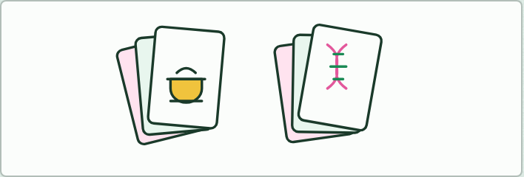
CARD MATCH
6 MIN
The kitchen
THE TASK
Eight kitchen cards (the recipe book, one recipe, the photocopier, the photocopy, the cook, the kitchen hands, the ingredients, the dish) to match with eight cell cards (the genome, a gene, RNA polymerase, mRNA, the ribosome, tRNAs, amino acids, the polypeptide). Then ask: where does it break? Push for these. A photocopy is identical, but mRNA pairs with the template and so matches the coding strand. A cook reads the whole recipe, but a ribosome reads three letters at a time. Recipes are not switched on and off.
STUDENTS NEED
Two sets of cards for each pair, printed.
Minutes 0 to 6
Notes:
Minutes 0 to 6 of 60: Do now: The kitchen (6 min).
The plan: Students match eight kitchen cards to eight cell cards (activity 1 below), then spend one minute on where the comparison breaks.
The activity: The kitchen. Eight kitchen cards (the recipe book, one recipe, the photocopier, the photocopy, the cook, the kitchen hands, the ingredients, the dish) to match with eight cell cards (the genome, a gene, RNA polymerase, mRNA, the ribosome, tRNAs, amino acids, the polypeptide). Then ask: where does it break? Push for these. A photocopy is identical, but mRNA pairs with the template and so matches the coding strand. A cook reads the whole recipe, but a ribosome reads three letters at a time. Recipes are not switched on and off.
Needs: two sets of cards for each pair, printed.
The time: 6 minutes, minutes 0 to 6 of the plan.

Slide 4
STEP 2
12 MIN
Transcription step by step
Chapter 1: Copying a gene into RNA
Minutes 6 to 18
Notes:
Minutes 6 to 18 of 60: Transcription step by step (12 min).
The plan: Chapter 1's figure on the board, step by step, with students drawing each step on mini whiteboards. Then chapter 1's predict box by vote, and Apples Under umbrellas.

Slide 5
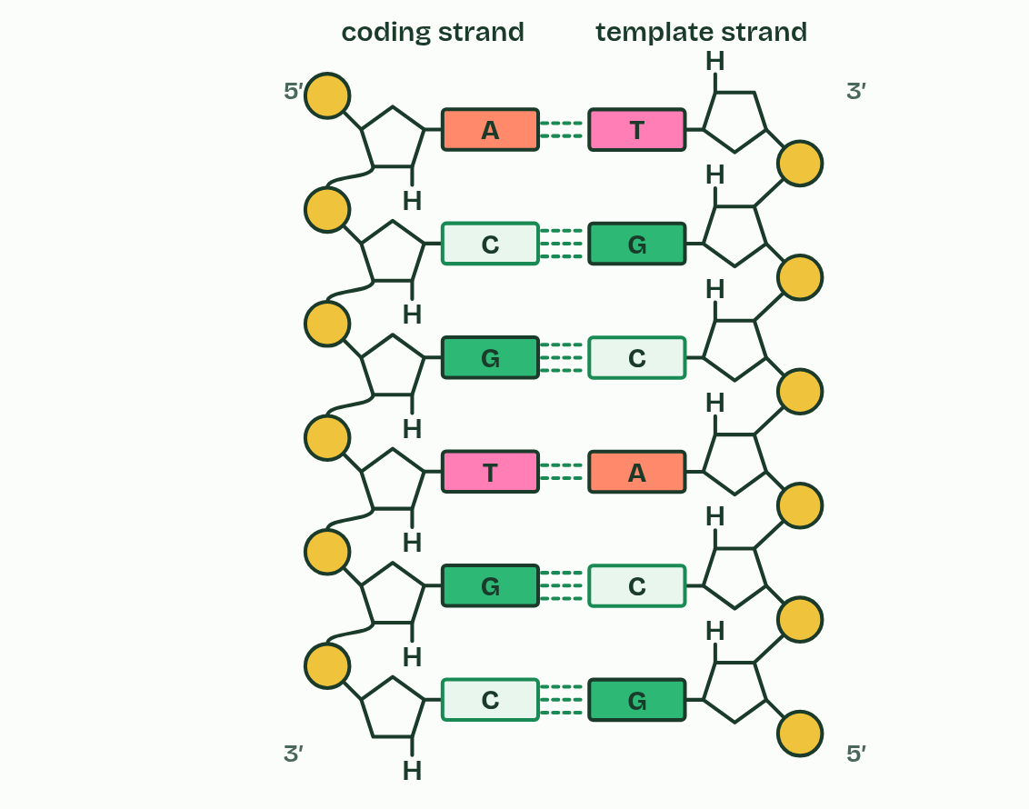
CHAPTER 1 · D1.2.1 D1.2.2 Transcription
1 / 5
Copying a gene into RNA
A gene: two strands of DNA, held by hydrogen bonds.
Minutes 6 to 18
Notes:
Minutes 6 to 18 of 60: Transcription step by step (12 min).
The plan: Chapter 1's figure on the board, step by step, with students drawing each step on mini whiteboards. Then chapter 1's predict box by vote, and Apples Under umbrellas.
A gene is a stretch of DNA whose base sequence codes for a polypeptide. Proteins are not built where the DNA is kept, so the cell first makes a working copy of the gene in RNA. Making RNA with a DNA template is transcription, and the RNA that carries a gene's message to the ribosomes is messenger RNA (mRNA). In a eukaryotic cell this happens in the nucleus; in a prokaryote, in the cytoplasm.
One enzyme does the whole job. RNA polymerase binds at the start of a gene and parts the two DNA strands over a short stretch (it needs no helicase: that enzyme unzips DNA when the whole molecule is copied, in D1.1). Free RNA nucleotides pair with the exposed bases of one strand only, the template strand. The other strand is the coding strand, because the RNA ends up with its sequence. (You may meet them called antisense and sense.) The enzyme joins each new nucleotide to the last with a covalent bond, moves on, and lets go at the end of the gene.
Complementary base pairing chooses every RNA base. A on the template takes uracil (U), T takes A, C takes G and G takes C. The pairs are held by hydrogen bonds: weak enough to form and break as the enzyme passes, but specific, because only the right base fits. That is how the sequence is copied exactly. Behind the enzyme the RNA peels away and the DNA strands pair up again.
Which way the RNA grows is chapter 8, and how the enzyme finds the start of a gene is chapter 9.

Slide 6
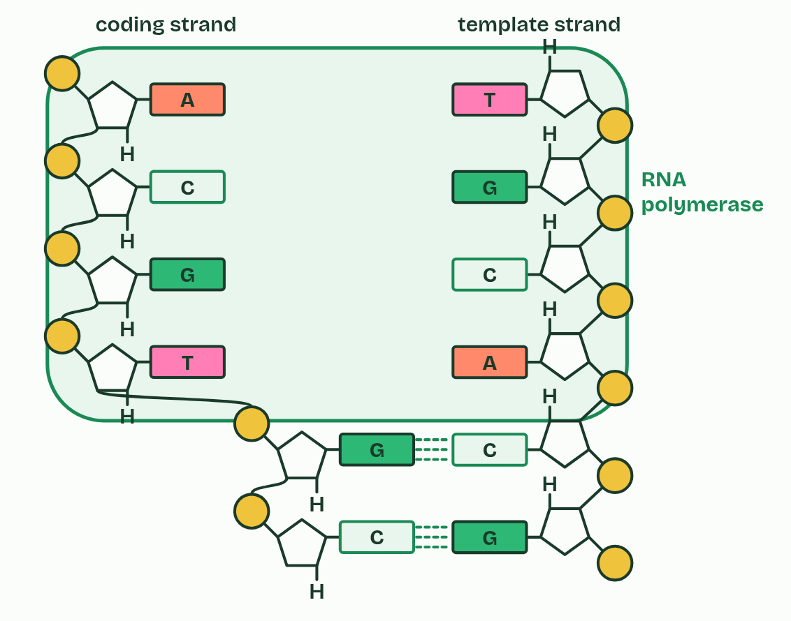
CHAPTER 1 · D1.2.1 D1.2.2 Transcription
2 / 5
Copying a gene into RNA
RNA polymerase parts the strands.
Minutes 6 to 18
Notes:
Minutes 6 to 18 of 60: Transcription step by step (12 min).
The plan: Chapter 1's figure on the board, step by step, with students drawing each step on mini whiteboards. Then chapter 1's predict box by vote, and Apples Under umbrellas.
A gene is a stretch of DNA whose base sequence codes for a polypeptide. Proteins are not built where the DNA is kept, so the cell first makes a working copy of the gene in RNA. Making RNA with a DNA template is transcription, and the RNA that carries a gene's message to the ribosomes is messenger RNA (mRNA). In a eukaryotic cell this happens in the nucleus; in a prokaryote, in the cytoplasm.
One enzyme does the whole job. RNA polymerase binds at the start of a gene and parts the two DNA strands over a short stretch (it needs no helicase: that enzyme unzips DNA when the whole molecule is copied, in D1.1). Free RNA nucleotides pair with the exposed bases of one strand only, the template strand. The other strand is the coding strand, because the RNA ends up with its sequence. (You may meet them called antisense and sense.) The enzyme joins each new nucleotide to the last with a covalent bond, moves on, and lets go at the end of the gene.
Complementary base pairing chooses every RNA base. A on the template takes uracil (U), T takes A, C takes G and G takes C. The pairs are held by hydrogen bonds: weak enough to form and break as the enzyme passes, but specific, because only the right base fits. That is how the sequence is copied exactly. Behind the enzyme the RNA peels away and the DNA strands pair up again.
Which way the RNA grows is chapter 8, and how the enzyme finds the start of a gene is chapter 9.

Slide 7
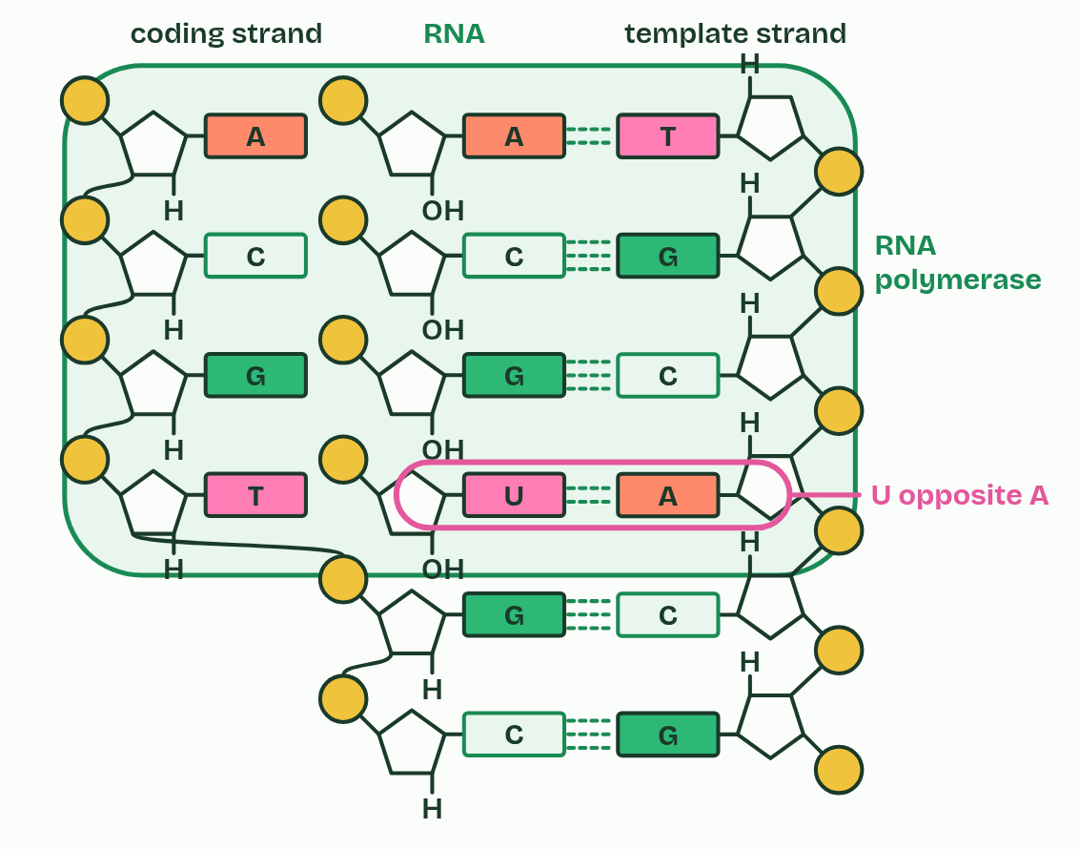
CHAPTER 1 · D1.2.1 D1.2.2 Transcription
3 / 5
Copying a gene into RNA
RNA nucleotides pair with the template strand: U opposite A.
Minutes 6 to 18
Notes:
Minutes 6 to 18 of 60: Transcription step by step (12 min).
The plan: Chapter 1's figure on the board, step by step, with students drawing each step on mini whiteboards. Then chapter 1's predict box by vote, and Apples Under umbrellas.
A gene is a stretch of DNA whose base sequence codes for a polypeptide. Proteins are not built where the DNA is kept, so the cell first makes a working copy of the gene in RNA. Making RNA with a DNA template is transcription, and the RNA that carries a gene's message to the ribosomes is messenger RNA (mRNA). In a eukaryotic cell this happens in the nucleus; in a prokaryote, in the cytoplasm.
One enzyme does the whole job. RNA polymerase binds at the start of a gene and parts the two DNA strands over a short stretch (it needs no helicase: that enzyme unzips DNA when the whole molecule is copied, in D1.1). Free RNA nucleotides pair with the exposed bases of one strand only, the template strand. The other strand is the coding strand, because the RNA ends up with its sequence. (You may meet them called antisense and sense.) The enzyme joins each new nucleotide to the last with a covalent bond, moves on, and lets go at the end of the gene.
Complementary base pairing chooses every RNA base. A on the template takes uracil (U), T takes A, C takes G and G takes C. The pairs are held by hydrogen bonds: weak enough to form and break as the enzyme passes, but specific, because only the right base fits. That is how the sequence is copied exactly. Behind the enzyme the RNA peels away and the DNA strands pair up again.
Which way the RNA grows is chapter 8, and how the enzyme finds the start of a gene is chapter 9.

Slide 8
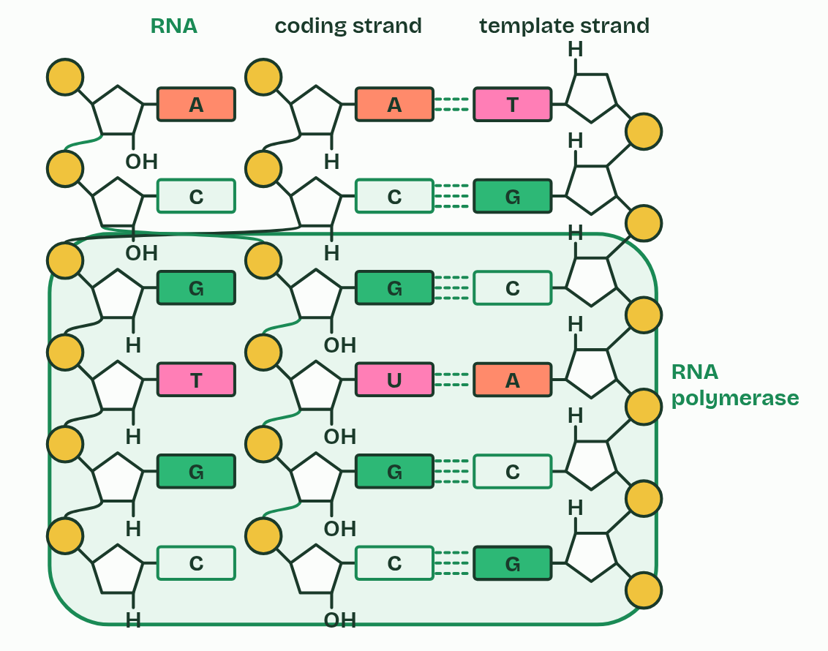
CHAPTER 1 · D1.2.1 D1.2.2 Transcription
4 / 5
Copying a gene into RNA
The enzyme joins them into a strand and moves on; the DNA closes behind it.
Minutes 6 to 18
Notes:
Minutes 6 to 18 of 60: Transcription step by step (12 min).
The plan: Chapter 1's figure on the board, step by step, with students drawing each step on mini whiteboards. Then chapter 1's predict box by vote, and Apples Under umbrellas.
A gene is a stretch of DNA whose base sequence codes for a polypeptide. Proteins are not built where the DNA is kept, so the cell first makes a working copy of the gene in RNA. Making RNA with a DNA template is transcription, and the RNA that carries a gene's message to the ribosomes is messenger RNA (mRNA). In a eukaryotic cell this happens in the nucleus; in a prokaryote, in the cytoplasm.
One enzyme does the whole job. RNA polymerase binds at the start of a gene and parts the two DNA strands over a short stretch (it needs no helicase: that enzyme unzips DNA when the whole molecule is copied, in D1.1). Free RNA nucleotides pair with the exposed bases of one strand only, the template strand. The other strand is the coding strand, because the RNA ends up with its sequence. (You may meet them called antisense and sense.) The enzyme joins each new nucleotide to the last with a covalent bond, moves on, and lets go at the end of the gene.
Complementary base pairing chooses every RNA base. A on the template takes uracil (U), T takes A, C takes G and G takes C. The pairs are held by hydrogen bonds: weak enough to form and break as the enzyme passes, but specific, because only the right base fits. That is how the sequence is copied exactly. Behind the enzyme the RNA peels away and the DNA strands pair up again.
Which way the RNA grows is chapter 8, and how the enzyme finds the start of a gene is chapter 9.

Slide 9
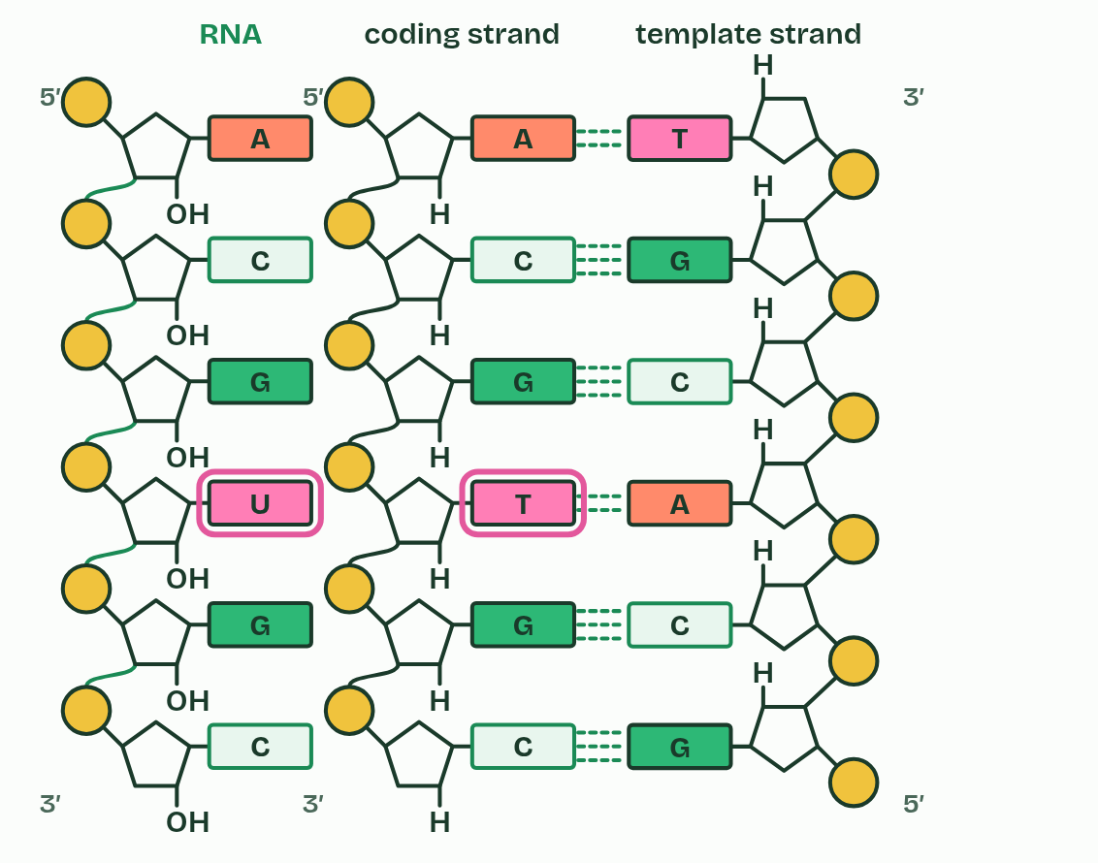
CHAPTER 1 · D1.2.1 D1.2.2 Transcription
5 / 5
Copying a gene into RNA
The RNA has the coding strand's sequence, with U in place of T.
Minutes 6 to 18
Notes:
Minutes 6 to 18 of 60: Transcription step by step (12 min).
The plan: Chapter 1's figure on the board, step by step, with students drawing each step on mini whiteboards. Then chapter 1's predict box by vote, and Apples Under umbrellas.
A gene is a stretch of DNA whose base sequence codes for a polypeptide. Proteins are not built where the DNA is kept, so the cell first makes a working copy of the gene in RNA. Making RNA with a DNA template is transcription, and the RNA that carries a gene's message to the ribosomes is messenger RNA (mRNA). In a eukaryotic cell this happens in the nucleus; in a prokaryote, in the cytoplasm.
One enzyme does the whole job. RNA polymerase binds at the start of a gene and parts the two DNA strands over a short stretch (it needs no helicase: that enzyme unzips DNA when the whole molecule is copied, in D1.1). Free RNA nucleotides pair with the exposed bases of one strand only, the template strand. The other strand is the coding strand, because the RNA ends up with its sequence. (You may meet them called antisense and sense.) The enzyme joins each new nucleotide to the last with a covalent bond, moves on, and lets go at the end of the gene.
Complementary base pairing chooses every RNA base. A on the template takes uracil (U), T takes A, C takes G and G takes C. The pairs are held by hydrogen bonds: weak enough to form and break as the enzyme passes, but specific, because only the right base fits. That is how the sequence is copied exactly. Behind the enzyme the RNA peels away and the DNA strands pair up again.
Which way the RNA grows is chapter 8, and how the enzyme finds the start of a gene is chapter 9.

Slide 10
CHAPTER 1 · D1.2.1 D1.2.2 Transcription
Copying a gene into RNA
The RNA is complementary to the template, and has the same sequence as the coding strand, with U where DNA has T.
Only the template is read. The coding strand takes no part.
Minutes 6 to 18
Notes:
Minutes 6 to 18 of 60: Transcription step by step (12 min).
The plan: Chapter 1's figure on the board, step by step, with students drawing each step on mini whiteboards. Then chapter 1's predict box by vote, and Apples Under umbrellas.
A gene is a stretch of DNA whose base sequence codes for a polypeptide. Proteins are not built where the DNA is kept, so the cell first makes a working copy of the gene in RNA. Making RNA with a DNA template is transcription, and the RNA that carries a gene's message to the ribosomes is messenger RNA (mRNA). In a eukaryotic cell this happens in the nucleus; in a prokaryote, in the cytoplasm.
One enzyme does the whole job. RNA polymerase binds at the start of a gene and parts the two DNA strands over a short stretch (it needs no helicase: that enzyme unzips DNA when the whole molecule is copied, in D1.1). Free RNA nucleotides pair with the exposed bases of one strand only, the template strand. The other strand is the coding strand, because the RNA ends up with its sequence. (You may meet them called antisense and sense.) The enzyme joins each new nucleotide to the last with a covalent bond, moves on, and lets go at the end of the gene.
Complementary base pairing chooses every RNA base. A on the template takes uracil (U), T takes A, C takes G and G takes C. The pairs are held by hydrogen bonds: weak enough to form and break as the enzyme passes, but specific, because only the right base fits. That is how the sequence is copied exactly. Behind the enzyme the RNA peels away and the DNA strands pair up again.
Which way the RNA grows is chapter 8, and how the enzyme finds the start of a gene is chapter 9.

Slide 11
REMEMBER IT
Which base pairs with which in transcription
A
U
C
G
Apples
Under
Cars
Garage
Minutes 6 to 18
Notes:
Minutes 6 to 18 of 60: Transcription step by step (12 min).
The plan: Chapter 1's figure on the board, step by step, with students drawing each step on mini whiteboards. Then chapter 1's predict box by vote, and Apples Under umbrellas.
Ask the class what each letter stands for before revealing.

Slide 12
REMEMBER IT
Which base pairs with which in transcription
A
U
C
G
Apples
Under
Cars
Garage
A on the template
U in the RNA
C on the template
G on the template
pairs with U in the RNA
uracil, where DNA has T
pairs with G in the RNA
pairs with C in the RNA
Minutes 6 to 18
Notes:
Minutes 6 to 18 of 60: Transcription step by step (12 min).
The plan: Chapter 1's figure on the board, step by step, with students drawing each step on mini whiteboards. Then chapter 1's predict box by vote, and Apples Under umbrellas.
Apples: A on the template (pairs with U in the RNA)
Under: U in the RNA (uracil, where DNA has T)
Cars: C on the template (pairs with G in the RNA)
Garage: G on the template (pairs with C in the RNA)

Slide 13
WATCH OUT
RNA polymerase, not helicase, parts the DNA in transcription. And the RNA is not a copy of the template: it is complementary to it, and matches the coding strand (with U for T).
Minutes 6 to 18
Notes:
Minutes 6 to 18 of 60: Transcription step by step (12 min).
The plan: Chapter 1's figure on the board, step by step, with students drawing each step on mini whiteboards. Then chapter 1's predict box by vote, and Apples Under umbrellas.
A common mistake: say it, then ask who can say why it is wrong.

Slide 14
PREDICT
A gene's template strand reads T A C C T G. Which RNA does RNA polymerase make from it?
A U A C C U G
B A U G G A C
C A T G G A C
Minutes 6 to 18
Notes:
Minutes 6 to 18 of 60: Transcription step by step (12 min).
The plan: Chapter 1's figure on the board, step by step, with students drawing each step on mini whiteboards. Then chapter 1's predict box by vote, and Apples Under umbrellas.
Ask for a show of hands, or mini whiteboards, before revealing. (Answer: B, on the next slide.)

Slide 15
WHAT HAPPENS
A gene's template strand reads T A C C T G. Which RNA does RNA polymerase make from it?
A U A C C U G
B A U G G A C
C A T G G A C
Each RNA base pairs with the template base opposite it: T takes A, A takes U, C takes G and G takes C. So T A C C T G gives A U G G A C. “A T G G A C” has the right pairs but uses T, which RNA never has (it is the coding strand, written as DNA). “U A C C U G” copies the template with U for T instead of pairing with it.
Minutes 6 to 18
Notes:
Minutes 6 to 18 of 60: Transcription step by step (12 min).
The plan: Chapter 1's figure on the board, step by step, with students drawing each step on mini whiteboards. Then chapter 1's predict box by vote, and Apples Under umbrellas.
Answer: B. Each RNA base pairs with the template base opposite it: T takes A, A takes U, C takes G and G takes C. So T A C C T G gives A U G G A C. “A T G G A C” has the right pairs but uses T, which RNA never has (it is the coding strand, written as DNA). “U A C C U G” copies the template with U for T instead of pairing with it.

Slide 16
STEP 3
10 MIN
One gene, read again
Then chapter 2's switch figure: why does the beta cell copy the insulin gene and the skin cell not?
Minutes 18 to 28
Notes:
Minutes 18 to 28 of 60: One gene, read again (10 min).
The plan: The transcription film, One gene, copied, after chapter 2. Then chapter 2's switch figure: why does the beta cell copy the insulin gene and the skin cell not? Finish with chapter 2's predict box, the 60-year-old nerve cell.

Slide 17
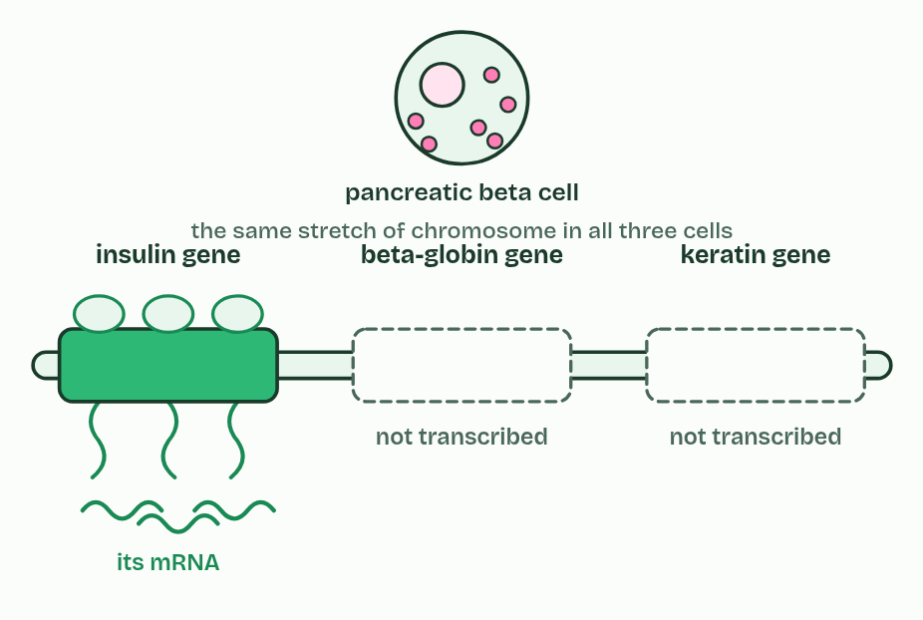
CHAPTER 2 · D1.2.3 D1.2.4 Stable templates, gene expression
1 / 3
Read for a lifetime, read when needed
Pancreatic beta cell
Minutes 18 to 28
Notes:
Minutes 18 to 28 of 60: One gene, read again (10 min).
The plan: The transcription film, One gene, copied, after chapter 2. Then chapter 2's switch figure: why does the beta cell copy the insulin gene and the skin cell not? Finish with chapter 2's predict box, the 60-year-old nerve cell.
Transcription reads the template; it does not use it up. The hydrogen bonds open for a moment and close again, the covalent backbone is never broken, and no base is changed. So one gene can be transcribed again and again, and every copy of its mRNA matches.
That matters most in somatic cells that never divide again. Most of the nerve cells in the outer layer of your brain are as old as you are, and heart muscle cells are replaced only very slowly, so the genes in each have to be read for decades. Their base sequences must be conserved: held without change for the whole life of the cell. DNA suits the job, with two strands, a strong backbone and a home in the nucleus.
Every somatic cell of one person has the same genome, yet no cell uses all of its genes. A gene is expressed when its information is used to make its product. That is gene expression, and it has two main steps: transcription copies the gene into mRNA, and translation (chapter 3) uses the mRNA to build a polypeptide. A gene that is being transcribed is switched on, and one that is not is switched off. The more often it is transcribed, the more mRNA, and the more of its protein, the cell makes. Some genes are switched on and off as conditions change. Which genes a cell transcribes is what makes it a particular kind of cell: a pancreatic beta cell transcribes the insulin gene and a skin cell does not, so each is specialised for its own job.
How a gene is switched on at its promoter is chapter 9.

Slide 18
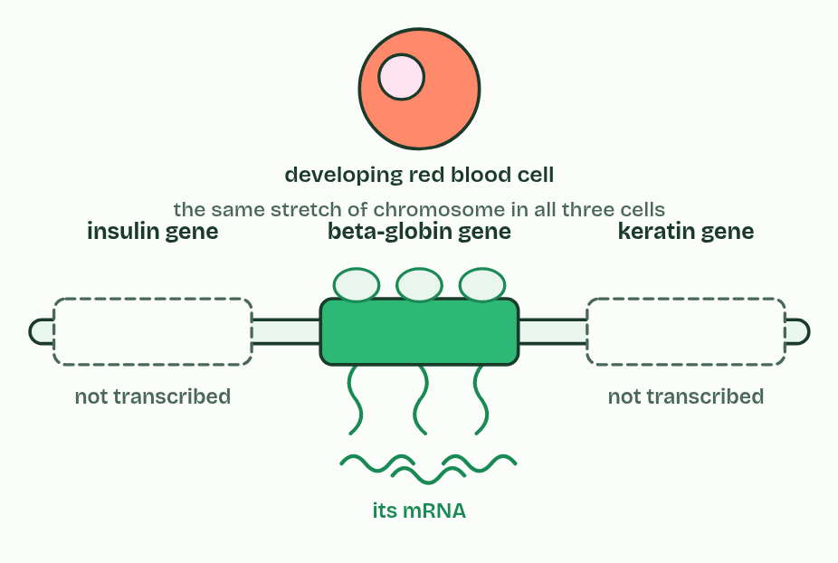
CHAPTER 2 · D1.2.3 D1.2.4 Stable templates, gene expression
2 / 3
Read for a lifetime, read when needed
Developing red blood cell
Minutes 18 to 28
Notes:
Minutes 18 to 28 of 60: One gene, read again (10 min).
The plan: The transcription film, One gene, copied, after chapter 2. Then chapter 2's switch figure: why does the beta cell copy the insulin gene and the skin cell not? Finish with chapter 2's predict box, the 60-year-old nerve cell.
Transcription reads the template; it does not use it up. The hydrogen bonds open for a moment and close again, the covalent backbone is never broken, and no base is changed. So one gene can be transcribed again and again, and every copy of its mRNA matches.
That matters most in somatic cells that never divide again. Most of the nerve cells in the outer layer of your brain are as old as you are, and heart muscle cells are replaced only very slowly, so the genes in each have to be read for decades. Their base sequences must be conserved: held without change for the whole life of the cell. DNA suits the job, with two strands, a strong backbone and a home in the nucleus.
Every somatic cell of one person has the same genome, yet no cell uses all of its genes. A gene is expressed when its information is used to make its product. That is gene expression, and it has two main steps: transcription copies the gene into mRNA, and translation (chapter 3) uses the mRNA to build a polypeptide. A gene that is being transcribed is switched on, and one that is not is switched off. The more often it is transcribed, the more mRNA, and the more of its protein, the cell makes. Some genes are switched on and off as conditions change. Which genes a cell transcribes is what makes it a particular kind of cell: a pancreatic beta cell transcribes the insulin gene and a skin cell does not, so each is specialised for its own job.
How a gene is switched on at its promoter is chapter 9.

Slide 19
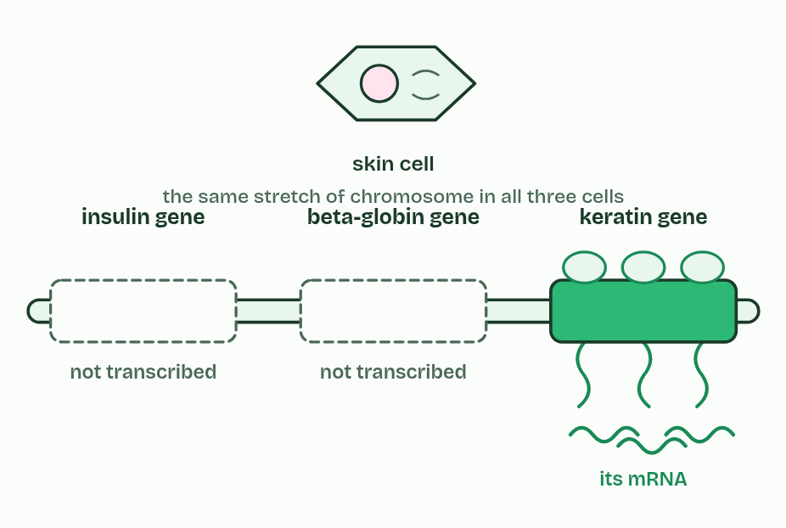
CHAPTER 2 · D1.2.3 D1.2.4 Stable templates, gene expression
3 / 3
Read for a lifetime, read when needed
Skin cell
Minutes 18 to 28
Notes:
Minutes 18 to 28 of 60: One gene, read again (10 min).
The plan: The transcription film, One gene, copied, after chapter 2. Then chapter 2's switch figure: why does the beta cell copy the insulin gene and the skin cell not? Finish with chapter 2's predict box, the 60-year-old nerve cell.
Transcription reads the template; it does not use it up. The hydrogen bonds open for a moment and close again, the covalent backbone is never broken, and no base is changed. So one gene can be transcribed again and again, and every copy of its mRNA matches.
That matters most in somatic cells that never divide again. Most of the nerve cells in the outer layer of your brain are as old as you are, and heart muscle cells are replaced only very slowly, so the genes in each have to be read for decades. Their base sequences must be conserved: held without change for the whole life of the cell. DNA suits the job, with two strands, a strong backbone and a home in the nucleus.
Every somatic cell of one person has the same genome, yet no cell uses all of its genes. A gene is expressed when its information is used to make its product. That is gene expression, and it has two main steps: transcription copies the gene into mRNA, and translation (chapter 3) uses the mRNA to build a polypeptide. A gene that is being transcribed is switched on, and one that is not is switched off. The more often it is transcribed, the more mRNA, and the more of its protein, the cell makes. Some genes are switched on and off as conditions change. Which genes a cell transcribes is what makes it a particular kind of cell: a pancreatic beta cell transcribes the insulin gene and a skin cell does not, so each is specialised for its own job.
How a gene is switched on at its promoter is chapter 9.

Slide 20
CHAPTER 2 · D1.2.3 D1.2.4 Stable templates, gene expression
Read for a lifetime, read when needed
Transcription reads a template without changing it, so one gene gives many identical mRNAs.
Not all genes are expressed in a cell at one time, and transcription is where a gene is switched on or off.
Minutes 18 to 28
Notes:
Minutes 18 to 28 of 60: One gene, read again (10 min).
The plan: The transcription film, One gene, copied, after chapter 2. Then chapter 2's switch figure: why does the beta cell copy the insulin gene and the skin cell not? Finish with chapter 2's predict box, the 60-year-old nerve cell.
Transcription reads the template; it does not use it up. The hydrogen bonds open for a moment and close again, the covalent backbone is never broken, and no base is changed. So one gene can be transcribed again and again, and every copy of its mRNA matches.
That matters most in somatic cells that never divide again. Most of the nerve cells in the outer layer of your brain are as old as you are, and heart muscle cells are replaced only very slowly, so the genes in each have to be read for decades. Their base sequences must be conserved: held without change for the whole life of the cell. DNA suits the job, with two strands, a strong backbone and a home in the nucleus.
Every somatic cell of one person has the same genome, yet no cell uses all of its genes. A gene is expressed when its information is used to make its product. That is gene expression, and it has two main steps: transcription copies the gene into mRNA, and translation (chapter 3) uses the mRNA to build a polypeptide. A gene that is being transcribed is switched on, and one that is not is switched off. The more often it is transcribed, the more mRNA, and the more of its protein, the cell makes. Some genes are switched on and off as conditions change. Which genes a cell transcribes is what makes it a particular kind of cell: a pancreatic beta cell transcribes the insulin gene and a skin cell does not, so each is specialised for its own job.
How a gene is switched on at its promoter is chapter 9.

Slide 21
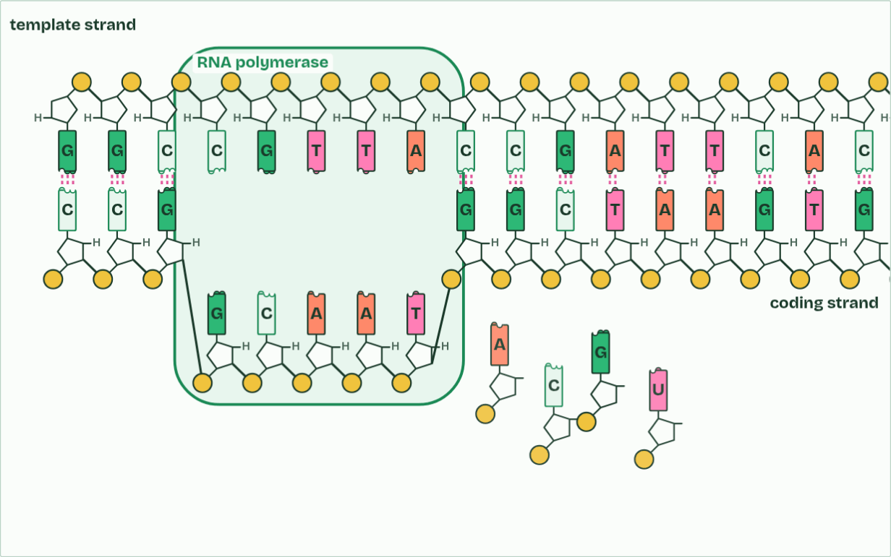
CHAPTER 2 · D1.2.3 D1.2.4 Stable templates, gene expression
RNA bases: 0
1 / 4
Read for a lifetime, read when needed
RNA polymerase unzips a short stretch of the gene: the hydrogen bonds holding its bases together give way.
Minutes 18 to 28
Notes:
Minutes 18 to 28 of 60: One gene, read again (10 min).
The plan: The transcription film, One gene, copied, after chapter 2. Then chapter 2's switch figure: why does the beta cell copy the insulin gene and the skin cell not? Finish with chapter 2's predict box, the 60-year-old nerve cell.
Transcription reads the template; it does not use it up. The hydrogen bonds open for a moment and close again, the covalent backbone is never broken, and no base is changed. So one gene can be transcribed again and again, and every copy of its mRNA matches.
That matters most in somatic cells that never divide again. Most of the nerve cells in the outer layer of your brain are as old as you are, and heart muscle cells are replaced only very slowly, so the genes in each have to be read for decades. Their base sequences must be conserved: held without change for the whole life of the cell. DNA suits the job, with two strands, a strong backbone and a home in the nucleus.
Every somatic cell of one person has the same genome, yet no cell uses all of its genes. A gene is expressed when its information is used to make its product. That is gene expression, and it has two main steps: transcription copies the gene into mRNA, and translation (chapter 3) uses the mRNA to build a polypeptide. A gene that is being transcribed is switched on, and one that is not is switched off. The more often it is transcribed, the more mRNA, and the more of its protein, the cell makes. Some genes are switched on and off as conditions change. Which genes a cell transcribes is what makes it a particular kind of cell: a pancreatic beta cell transcribes the insulin gene and a skin cell does not, so each is specialised for its own job.
How a gene is switched on at its promoter is chapter 9.
The animation "One gene, copied", paused at 5.9 s. The next slides go on through it, then play it.

Slide 22
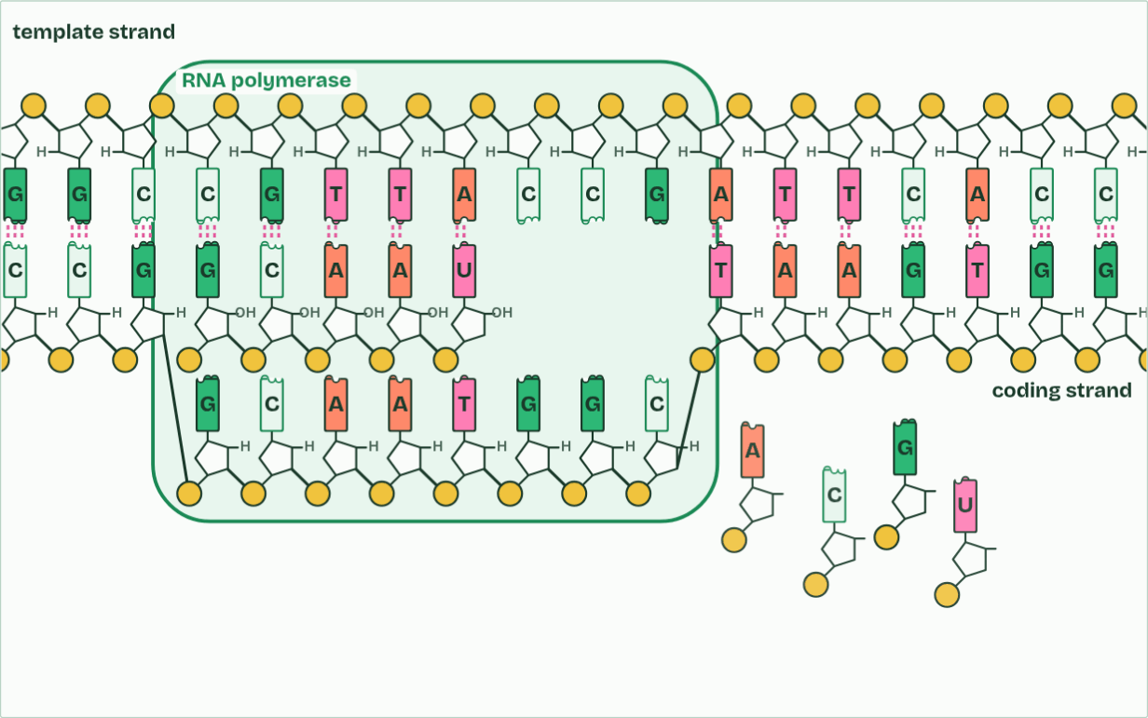
CHAPTER 2 · D1.2.3 D1.2.4 Stable templates, gene expression
RNA bases: 5
2 / 4
Read for a lifetime, read when needed
Free RNA nucleotides pair with the template by complementary base pairing, U opposite A.
Minutes 18 to 28
Notes:
Minutes 18 to 28 of 60: One gene, read again (10 min).
The plan: The transcription film, One gene, copied, after chapter 2. Then chapter 2's switch figure: why does the beta cell copy the insulin gene and the skin cell not? Finish with chapter 2's predict box, the 60-year-old nerve cell.
Transcription reads the template; it does not use it up. The hydrogen bonds open for a moment and close again, the covalent backbone is never broken, and no base is changed. So one gene can be transcribed again and again, and every copy of its mRNA matches.
That matters most in somatic cells that never divide again. Most of the nerve cells in the outer layer of your brain are as old as you are, and heart muscle cells are replaced only very slowly, so the genes in each have to be read for decades. Their base sequences must be conserved: held without change for the whole life of the cell. DNA suits the job, with two strands, a strong backbone and a home in the nucleus.
Every somatic cell of one person has the same genome, yet no cell uses all of its genes. A gene is expressed when its information is used to make its product. That is gene expression, and it has two main steps: transcription copies the gene into mRNA, and translation (chapter 3) uses the mRNA to build a polypeptide. A gene that is being transcribed is switched on, and one that is not is switched off. The more often it is transcribed, the more mRNA, and the more of its protein, the cell makes. Some genes are switched on and off as conditions change. Which genes a cell transcribes is what makes it a particular kind of cell: a pancreatic beta cell transcribes the insulin gene and a skin cell does not, so each is specialised for its own job.
How a gene is switched on at its promoter is chapter 9.
The animation "One gene, copied", paused at 11.0 s. The next slides go on through it, then play it.

Slide 23
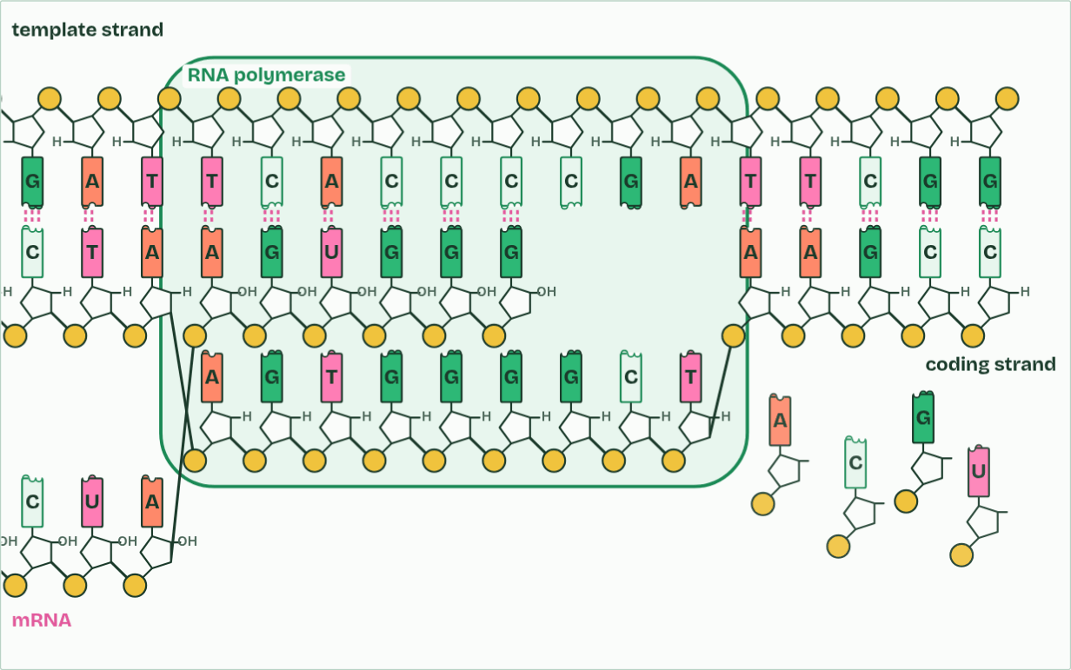
CHAPTER 2 · D1.2.3 D1.2.4 Stable templates, gene expression
RNA bases: 16
3 / 4
Read for a lifetime, read when needed
Behind the enzyme the RNA peels off and the DNA closes up again.
Minutes 18 to 28
Notes:
Minutes 18 to 28 of 60: One gene, read again (10 min).
The plan: The transcription film, One gene, copied, after chapter 2. Then chapter 2's switch figure: why does the beta cell copy the insulin gene and the skin cell not? Finish with chapter 2's predict box, the 60-year-old nerve cell.
Transcription reads the template; it does not use it up. The hydrogen bonds open for a moment and close again, the covalent backbone is never broken, and no base is changed. So one gene can be transcribed again and again, and every copy of its mRNA matches.
That matters most in somatic cells that never divide again. Most of the nerve cells in the outer layer of your brain are as old as you are, and heart muscle cells are replaced only very slowly, so the genes in each have to be read for decades. Their base sequences must be conserved: held without change for the whole life of the cell. DNA suits the job, with two strands, a strong backbone and a home in the nucleus.
Every somatic cell of one person has the same genome, yet no cell uses all of its genes. A gene is expressed when its information is used to make its product. That is gene expression, and it has two main steps: transcription copies the gene into mRNA, and translation (chapter 3) uses the mRNA to build a polypeptide. A gene that is being transcribed is switched on, and one that is not is switched off. The more often it is transcribed, the more mRNA, and the more of its protein, the cell makes. Some genes are switched on and off as conditions change. Which genes a cell transcribes is what makes it a particular kind of cell: a pancreatic beta cell transcribes the insulin gene and a skin cell does not, so each is specialised for its own job.
How a gene is switched on at its promoter is chapter 9.
The animation "One gene, copied", paused at 16.6 s. The next slides go on through it, then play it.

Slide 24
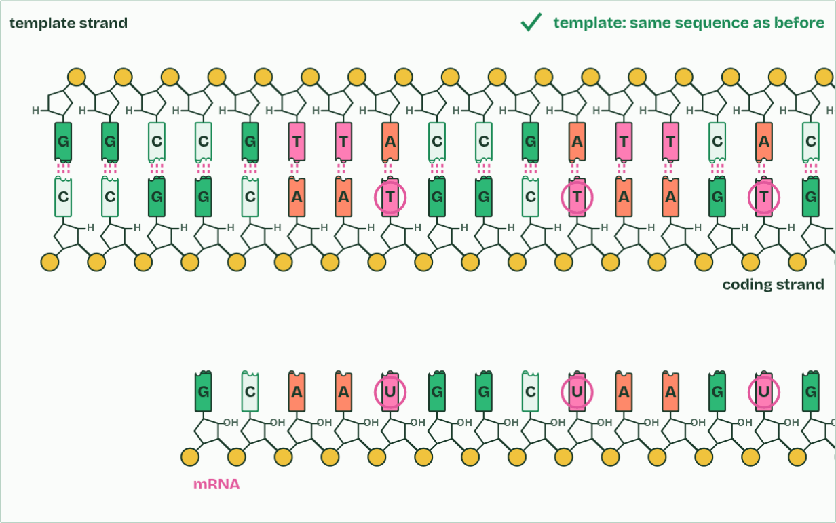
CHAPTER 2 · D1.2.3 D1.2.4 Stable templates, gene expression
mRNA made: 1
4 / 4
Read for a lifetime, read when needed
The RNA has the coding strand’s sequence, with U in place of T. The template has not changed.
Minutes 18 to 28
Notes:
Minutes 18 to 28 of 60: One gene, read again (10 min).
The plan: The transcription film, One gene, copied, after chapter 2. Then chapter 2's switch figure: why does the beta cell copy the insulin gene and the skin cell not? Finish with chapter 2's predict box, the 60-year-old nerve cell.
Transcription reads the template; it does not use it up. The hydrogen bonds open for a moment and close again, the covalent backbone is never broken, and no base is changed. So one gene can be transcribed again and again, and every copy of its mRNA matches.
That matters most in somatic cells that never divide again. Most of the nerve cells in the outer layer of your brain are as old as you are, and heart muscle cells are replaced only very slowly, so the genes in each have to be read for decades. Their base sequences must be conserved: held without change for the whole life of the cell. DNA suits the job, with two strands, a strong backbone and a home in the nucleus.
Every somatic cell of one person has the same genome, yet no cell uses all of its genes. A gene is expressed when its information is used to make its product. That is gene expression, and it has two main steps: transcription copies the gene into mRNA, and translation (chapter 3) uses the mRNA to build a polypeptide. A gene that is being transcribed is switched on, and one that is not is switched off. The more often it is transcribed, the more mRNA, and the more of its protein, the cell makes. Some genes are switched on and off as conditions change. Which genes a cell transcribes is what makes it a particular kind of cell: a pancreatic beta cell transcribes the insulin gene and a skin cell does not, so each is specialised for its own job.
How a gene is switched on at its promoter is chapter 9.
The animation "One gene, copied", paused at 21.4 s. The next slides go on through it, then play it.

Slide 25
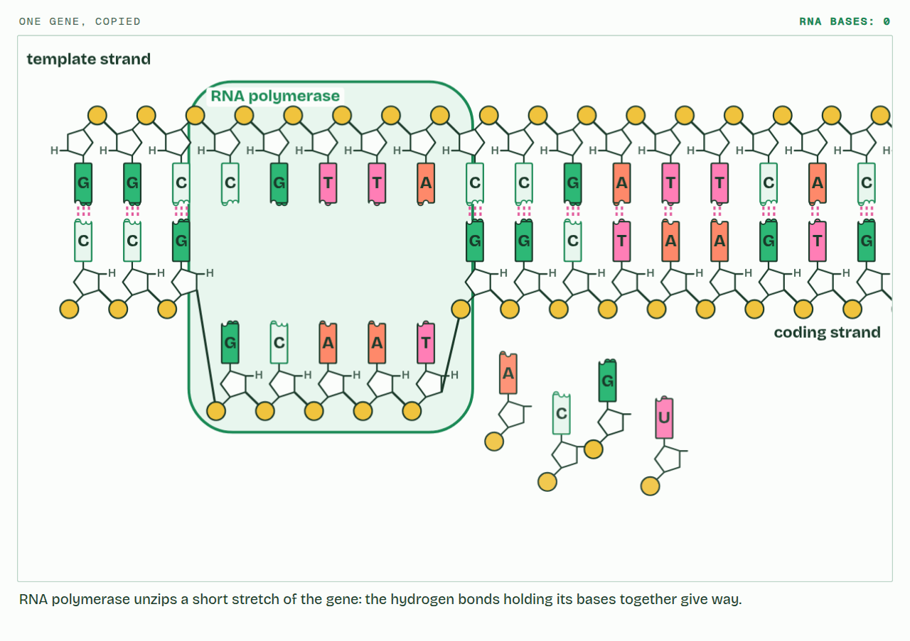
CHAPTER 2 · D1.2.3 D1.2.4 Stable templates, gene expression
PLAY IT
Read for a lifetime, read when needed
One gene, copied: click to play. It loops every 30 seconds.
Minutes 18 to 28
Notes:
Minutes 18 to 28 of 60: One gene, read again (10 min).
The plan: The transcription film, One gene, copied, after chapter 2. Then chapter 2's switch figure: why does the beta cell copy the insulin gene and the skin cell not? Finish with chapter 2's predict box, the 60-year-old nerve cell.
The video is transcription-e9217c.mp4, one loop of the animation in the guide. It plays in PowerPoint and Keynote. Google Slides does not play a video embedded in a .pptx: download transcription-e9217c.mp4 (https://www.biologybybradford.com/guides/downloads/scenes/transcription-e9217c.mp4), upload it to Google Drive, then Insert > Video > Google Drive.
In the guide the class can change it as it runs: https://www.biologybybradford.com/guides/ib-biology-d1-2-protein-synthesis#read-again
What it shows, in order:
1. RNA polymerase unzips a short stretch of the gene: the hydrogen bonds holding its bases together give way.
2. Free RNA nucleotides pair with the template by complementary base pairing, U opposite A.
3. Behind the enzyme the RNA peels off and the DNA closes up again.
4. The RNA has the coding strand’s sequence, with U in place of T. The template has not changed.

Slide 26
WATCH OUT
Different cells do not have different genes. They have the same genes and transcribe different ones.
Minutes 18 to 28
Notes:
Minutes 18 to 28 of 60: One gene, read again (10 min).
The plan: The transcription film, One gene, copied, after chapter 2. Then chapter 2's switch figure: why does the beta cell copy the insulin gene and the skin cell not? Finish with chapter 2's predict box, the 60-year-old nerve cell.
A common mistake: say it, then ask who can say why it is wrong.

Slide 27
PREDICT
A nerve cell in your brain is 60 years old and has never divided. Its genes have been transcribed all that time. What has happened to their base sequences?
A Used up at the first reading, then remade
B Read many times, and a little worn down
C Read many times, and still the same
Minutes 18 to 28
Notes:
Minutes 18 to 28 of 60: One gene, read again (10 min).
The plan: The transcription film, One gene, copied, after chapter 2. Then chapter 2's switch figure: why does the beta cell copy the insulin gene and the skin cell not? Finish with chapter 2's predict box, the 60-year-old nerve cell.
Ask for a show of hands, or mini whiteboards, before revealing. (Answer: C, on the next slide.)

Slide 28
WHAT HAPPENS
A nerve cell in your brain is 60 years old and has never divided. Its genes have been transcribed all that time. What has happened to their base sequences?
A Used up at the first reading, then remade
B Read many times, and a little worn down
C Read many times, and still the same
Transcription only opens the hydrogen bonds for a moment; it never breaks the backbone or changes a base. So a template can be read thousands of times and stay the same, which is just as well in a cell that must last a lifetime.
Minutes 18 to 28
Notes:
Minutes 18 to 28 of 60: One gene, read again (10 min).
The plan: The transcription film, One gene, copied, after chapter 2. Then chapter 2's switch figure: why does the beta cell copy the insulin gene and the skin cell not? Finish with chapter 2's predict box, the 60-year-old nerve cell.
Answer: C. Transcription only opens the hydrogen bonds for a moment; it never breaks the backbone or changes a base. So a template can be read thousands of times and stay the same, which is just as well in a cell that must last a lifetime.

Slide 29
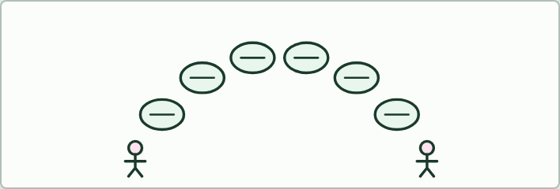
TALK
12 MIN
Stepping stones
THE TASK
Six stones on the floor or the board, each a prompt that starts a sentence: "RNA polymerase binds...", "It separates...", "Free RNA nucleotides...", "U pairs with...", "The enzyme joins...", "Behind it...". A student crosses the stones saying each sentence in full while a partner checks against chapter 1's captions, then they swap. Then do it again with the first words only.
STUDENTS NEED
Six cards or six chalk circles.
Minutes 28 to 40
Notes:
Minutes 28 to 40 of 60: Stepping stones (12 min).
The plan: Six prompts build an explanation of transcription (activity below). Pairs say it aloud, then swap roles.
The activity: Stepping stones. Six stones on the floor or the board, each a prompt that starts a sentence: "RNA polymerase binds...", "It separates...", "Free RNA nucleotides...", "U pairs with...", "The enzyme joins...", "Behind it...". A student crosses the stones saying each sentence in full while a partner checks against chapter 1's captions, then they swap. Then do it again with the first words only.
Needs: six cards or six chalk circles.
The time: 12 minutes, minutes 28 to 40 of the plan.

Slide 30

WRITING
12 MIN
Improve this answer
THE TASK
This weak answer goes on the board: "Transcription makes RNA. The enzyme unzips the DNA and bases pair up, A with T and C with G. The RNA is a copy of the DNA. It then leaves." Students underline what earns credit and mark what is vague or wrong (A pairs with U in RNA; which strand; the enzyme's name; a copy of which strand; where), then write a 5-mark version. No markscheme is shown: the class builds the points from chapter 1.
STUDENTS NEED
The answer on the board or printed.
Minutes 40 to 52
Notes:
Minutes 40 to 52 of 60: Improve this answer (12 min).
The plan: A weak answer to "Outline how mRNA is made from a gene (5 marks)", marked and rewritten (activity below).
The activity: Improve this answer. This weak answer goes on the board: "Transcription makes RNA. The enzyme unzips the DNA and bases pair up, A with T and C with G. The RNA is a copy of the DNA. It then leaves." Students underline what earns credit and mark what is vague or wrong (A pairs with U in RNA; which strand; the enzyme's name; a copy of which strand; where), then write a 5-mark version. No markscheme is shown: the class builds the points from chapter 1.
Needs: the answer on the board or printed.
The time: 12 minutes, minutes 40 to 52 of the plan.

Slide 31
PLENARY
Can you now...
Explain how RNA polymerase uses one strand of a gene as a template, pairing U in the RNA with A on the template (D1.2.1, D1.2.2)
Explain why a template can be read for a lifetime without changing, and why transcription is where a gene is switched on or off (D1.2.3, D1.2.4)
Minutes 52 to 60
Notes:
Minutes 52 to 60 of 60: Exit (8 min).
The plan: "Why can the same gene be read for 80 years without changing?" and "Where is a gene switched on or off?" One sentence each.
Thumbs up, sideways or down on each goal before the exit question. The goals come from the statements this lesson covers.

Slide 32
EXIT QUESTION
Before you go
"Why can the same gene be read for 80 years without changing?" and "Where is a gene switched on or off?"
One sentence each.
Minutes 52 to 60
Notes:
Minutes 52 to 60 of 60: Exit (8 min).
The plan: "Why can the same gene be read for 80 years without changing?" and "Where is a gene switched on or off?" One sentence each.

Slide 33
PRACTISE AND REVISE
Keep going
Exam practice: a fresh paper of exam questions on D1.2 at standard level, marked as you go
The guide, with the animations and the dry lab
This lesson in the guide: 1 Copying a gene into RNA, 2 Read for a lifetime, read when needed
BUILD FOR YOUR CLASS
ALREADY ON THE SITE FOR D1.2
CARD SETS ON SPLYCR
Tarsia puzzle, dominoes and picture reveal on D1.2, built from its key terms and ready to print
A pub quiz with rounds on D1.2, to present or run with no projector
An escape room built from the question bank on D1.2
Quiz: Protein Synthesis
Revision map: D1.2 Protein synthesis, to fill in
Exam questions: D1.2 in the exam maker, a paper with its markscheme
Open a set to host it as a class game, or make a copy to edit.
D1.2 Protein Synthesis (SL)
How this was made. The course structure, the activities and the teaching choices come from my own classroom, my presentations and my years of teaching IB and AP Biology. I use Claude, an AI, to help write and build the interactive guides, lesson plans, slides and practice questions, and to draw the diagrams and code the interactives. I direct the work and review it against the IB and AP specifications before it goes live.
Minute 60: after the lesson
Notes:
Every link here is live. Set the exam practice paper for homework: it is fresh each time, marked as students go and saved to their Exam practice when they are signed in.
Exam practice: https://www.biologybybradford.com/exam-maker/sit?topics=D1.2&level=SL&paper=quiz&marks=15&src=ep
The guide: https://www.biologybybradford.com/guides/ib-biology-d1-2-protein-synthesis

