Slide 1
IB Biology D1.2
LESSON 2 OF 6
BY THE END YOU CAN
Protein synthesis
Describe what mRNA, the two ribosome subunits and tRNA each do in translation (D1.2.5, D1.2.6)
Pair a codon with its anticodon, and explain how pairing brings the right amino acid (D1.2.7)
Explain why the code uses threes and what degenerate and universal mean, and use a codon table to deduce a polypeptide (D1.2.8, D1.2.9)
Codons and the code
D1.2.5 to D1.2.9
mRNA, ribosomes and tRNA; codons and anticodons; why the code is in threes; reading the table
60 minutes · chapters 3, 4, 5
Minute 0
Notes:
IB Biology D1.2, Protein synthesis. Lesson 2 of 6: Codons and the code, 60 minutes.
The plan, minute by minute (each slide's footer says where you are):
0 to 6 min (6) Do now
6 to 16 min (10) A ribosome at work
16 to 26 min (10) Dock the tRNA
26 to 40 min (14) Why three, and the table
40 to 54 min (14) Codon cipher
54 to 60 min (6) Exit
What students get wrong:
tRNA carries the codon. Codons are on mRNA; anticodons are on tRNA.
Anticodons contain T. tRNA is RNA: U.
Degenerate means a codon can code for two amino acids. It means an amino acid can have several codons.
The stop codon is an amino acid. It codes for none and ends the chain.
Reading the anticodons or the template in the codon table. The table is of mRNA codons.
Stretch and support:
Support: cut the figures' captions into cards to put in order, use the dotted key terms as a glossary, and give a codon table with the reading path printed on it (row, column, line).
Stretch: the code would work with fewer stop codons, or with more. Why might three stops, and degeneracy in the third base, make the code tolerant of mistakes?
The lesson plan to print: https://www.biologybybradford.com/guides/downloads/ib-biology-d1-2-protein-synthesis-lesson-2-plan.pdf

Slide 2
DO NOW
Do now
"Four letters, twenty words. How long must each word be?" on mini whiteboards, then transcribe a six-base template from lesson 1 as a warm-up.
6:00
minutes
Start now: the timer is running.
Minutes 0 to 6
Notes:
Minutes 0 to 6 of 60: Do now (6 min).
The plan: "Four letters, twenty words. How long must each word be?" on mini whiteboards, then transcribe a six-base template from lesson 1 as a warm-up.
Start a 6 minute timer as they come in.

Slide 3
STEP 2
10 MIN
A ribosome at work
Chapter 3: Three kinds of RNA build a protein
Minutes 6 to 16
Notes:
Minutes 6 to 16 of 60: A ribosome at work (10 min).
The plan: Chapter 3's explore figure on the board, with students tapping the parts in pairs. Then chapter 3's predict box.

Slide 4
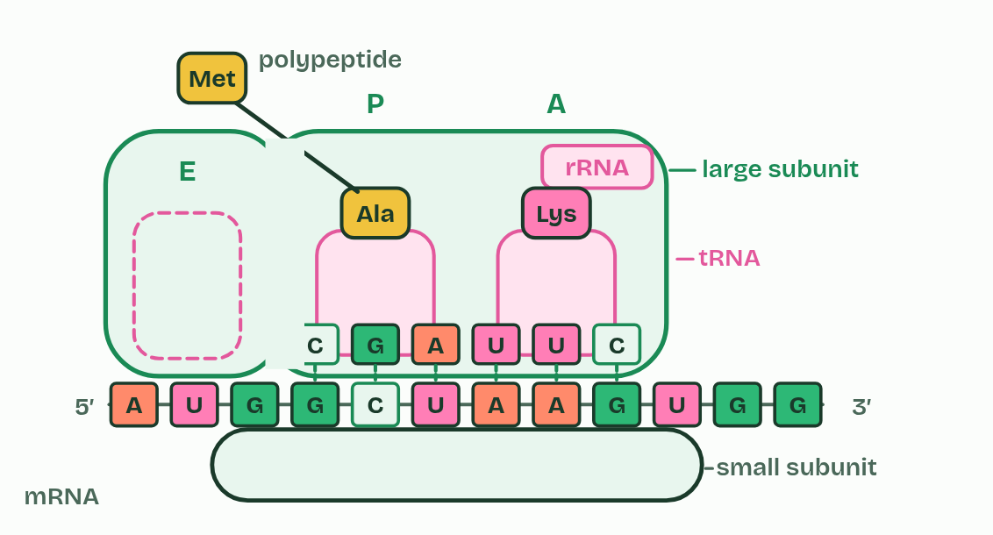
CHAPTER 3 · D1.2.5 D1.2.6 Translation
Three kinds of RNA build a protein
mRNA binds to the small subunit of the ribosome.
Two tRNAs can bind at the same time, in the large subunit.
Minutes 6 to 16
Notes:
Minutes 6 to 16 of 60: A ribosome at work (10 min).
The plan: Chapter 3's explore figure on the board, with students tapping the parts in pairs. Then chapter 3's predict box.
Translation makes a polypeptide whose order of amino acids is set by the base sequence of an mRNA. It happens at ribosomes, some free in the cytoplasm and some on the rough endoplasmic reticulum.
A ribosome is made of ribosomal RNA (rRNA) and protein, in two parts. The mRNA binds to the small subunit. The large subunit can hold two tRNAs at once, side by side, and it joins their amino acids (the rRNA is what speeds up that joining).
Transfer RNA (tRNA) molecules are short, single strands of RNA that fold back on themselves into a compact shape. Each carries one particular amino acid at one end, and has three exposed bases at the other, its anticodon, which chapter 4 is about. There are many kinds of tRNA, at least one for every amino acid.
So the three kinds of RNA share the work. The mRNA, a long single strand whose bases are read in threes, carries the message, the rRNA in the ribosome holds it and joins the amino acids, and the tRNAs bring the amino acids in. What holds the message in place, base to base, is hydrogen bonds again.
Parts of the figure:
Small subunit Holds the mRNA in place on the ribosome.
mRNA The message: the gene's base sequence, copied in the nucleus. The ribosome reads it three bases at a time.
Large subunit Holds two tRNAs at a time and joins their amino acids together.
rRNA Ribosomal RNA. With proteins, it makes up both subunits, and it is the rRNA that speeds up the joining of amino acids.
tRNA Transfer RNA. Each kind brings one particular amino acid, and has three exposed bases at its foot.
Amino acid One of 20 kinds, carried on the top end of a tRNA.
Polypeptide The growing chain of amino acids, hanging from one of the tRNAs.

Slide 5
WATCH OUT
Ribosomes do not make amino acids. They join the amino acids that tRNAs bring.
Minutes 6 to 16
Notes:
Minutes 6 to 16 of 60: A ribosome at work (10 min).
The plan: Chapter 3's explore figure on the board, with students tapping the parts in pairs. Then chapter 3's predict box.
A common mistake: say it, then ask who can say why it is wrong.

Slide 6
PREDICT
The large subunit holds two tRNAs at the same moment. Why two, and not one?
A So one brings the codon and one the amino acid
B So one amino acid can be joined to the next
C So each tRNA can check the other's anticodon
Minutes 6 to 16
Notes:
Minutes 6 to 16 of 60: A ribosome at work (10 min).
The plan: Chapter 3's explore figure on the board, with students tapping the parts in pairs. Then chapter 3's predict box.
Ask for a show of hands, or mini whiteboards, before revealing. (Answer: B, on the next slide.)

Slide 7
WHAT HAPPENS
The large subunit holds two tRNAs at the same moment. Why two, and not one?
A So one brings the codon and one the amino acid
B So one amino acid can be joined to the next
C So each tRNA can check the other's anticodon
A peptide bond joins two amino acids, so both have to be held side by side: the growing chain on one tRNA and the newly arrived amino acid on the other. Codons are on the mRNA, not on a tRNA, and tRNAs do not check each other: each one pairs with its own codon.
Minutes 6 to 16
Notes:
Minutes 6 to 16 of 60: A ribosome at work (10 min).
The plan: Chapter 3's explore figure on the board, with students tapping the parts in pairs. Then chapter 3's predict box.
Answer: B. A peptide bond joins two amino acids, so both have to be held side by side: the growing chain on one tRNA and the newly arrived amino acid on the other. Codons are on the mRNA, not on a tRNA, and tRNAs do not check each other: each one pairs with its own codon.

Slide 8
STEP 3
10 MIN
Dock the tRNA
Chapter 4: Codon meets anticodon
Minutes 16 to 26
Notes:
Minutes 16 to 26 of 60: Dock the tRNA (10 min).
The plan: Chapter 4's figure, one student at the board, then chapter 4's predict box (UGG).

Slide 9
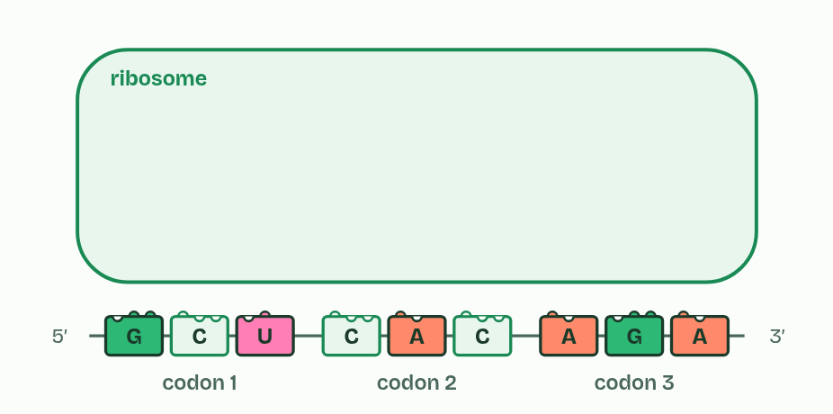
CHAPTER 4 · D1.2.7 Codons and anticodons
1 / 3
Codon meets anticodon
Three codons, a rack of tRNAs
Minutes 16 to 26
Notes:
Minutes 16 to 26 of 60: Dock the tRNA (10 min).
The plan: Chapter 4's figure, one student at the board, then chapter 4's predict box (UGG).
The mRNA is read three bases at a time. Each group of three is a codon. A tRNA carries a matching group of three exposed bases at one end, its anticodon, and one particular amino acid at the other end.
In the ribosome an anticodon pairs with a codon by complementary base pairing, held by hydrogen bonds: A with U and C with G. A tRNA whose anticodon fits stays long enough for its amino acid to be joined to the chain, and any other tRNA drifts away again. So the right amino acid arrives because the right tRNA pairs, and each kind of tRNA always carries the same amino acid, which is what keeps the code accurate.
Anticodons contain U, never T, because a tRNA is RNA. There is a neat consequence: an anticodon has the same bases as the template strand's triplet for that codon, with U where DNA has T. Take the codon GCU: its anticodon is CGA, on a tRNA that carries alanine.

Slide 10
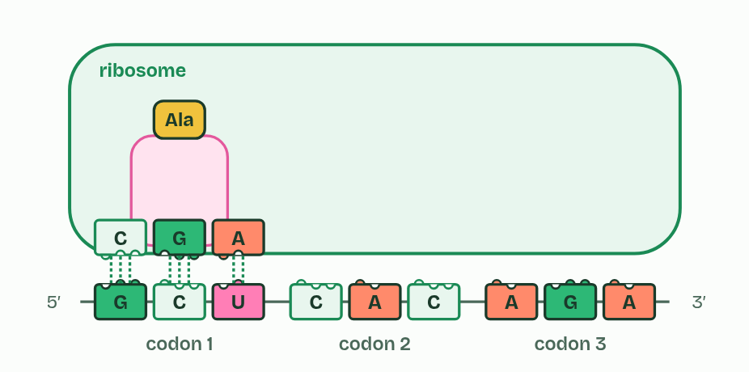
CHAPTER 4 · D1.2.7 Codons and anticodons
2 / 3
Codon meets anticodon
One tRNA docked
Minutes 16 to 26
Notes:
Minutes 16 to 26 of 60: Dock the tRNA (10 min).
The plan: Chapter 4's figure, one student at the board, then chapter 4's predict box (UGG).
The mRNA is read three bases at a time. Each group of three is a codon. A tRNA carries a matching group of three exposed bases at one end, its anticodon, and one particular amino acid at the other end.
In the ribosome an anticodon pairs with a codon by complementary base pairing, held by hydrogen bonds: A with U and C with G. A tRNA whose anticodon fits stays long enough for its amino acid to be joined to the chain, and any other tRNA drifts away again. So the right amino acid arrives because the right tRNA pairs, and each kind of tRNA always carries the same amino acid, which is what keeps the code accurate.
Anticodons contain U, never T, because a tRNA is RNA. There is a neat consequence: an anticodon has the same bases as the template strand's triplet for that codon, with U where DNA has T. Take the codon GCU: its anticodon is CGA, on a tRNA that carries alanine.

Slide 11
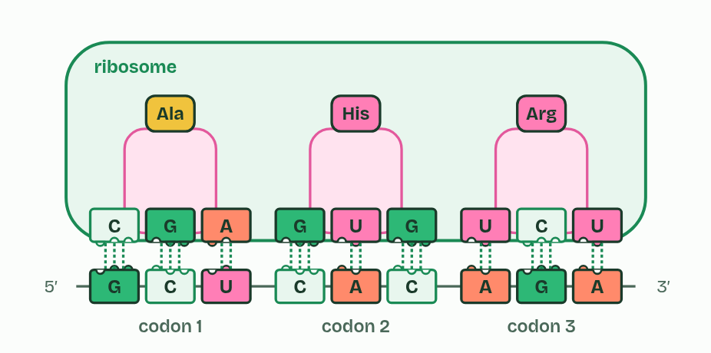
CHAPTER 4 · D1.2.7 Codons and anticodons
3 / 3
Codon meets anticodon
Each codon has found its tRNA
Minutes 16 to 26
Notes:
Minutes 16 to 26 of 60: Dock the tRNA (10 min).
The plan: Chapter 4's figure, one student at the board, then chapter 4's predict box (UGG).
The mRNA is read three bases at a time. Each group of three is a codon. A tRNA carries a matching group of three exposed bases at one end, its anticodon, and one particular amino acid at the other end.
In the ribosome an anticodon pairs with a codon by complementary base pairing, held by hydrogen bonds: A with U and C with G. A tRNA whose anticodon fits stays long enough for its amino acid to be joined to the chain, and any other tRNA drifts away again. So the right amino acid arrives because the right tRNA pairs, and each kind of tRNA always carries the same amino acid, which is what keeps the code accurate.
Anticodons contain U, never T, because a tRNA is RNA. There is a neat consequence: an anticodon has the same bases as the template strand's triplet for that codon, with U where DNA has T. Take the codon GCU: its anticodon is CGA, on a tRNA that carries alanine.

Slide 12
CHAPTER 4 · D1.2.7 Codons and anticodons
Codon meets anticodon
A codon sits on mRNA, an anticodon on tRNA.
Pairing is complementary, A with U and C with G, so a codon decides which tRNA fits.
Minutes 16 to 26
Notes:
Minutes 16 to 26 of 60: Dock the tRNA (10 min).
The plan: Chapter 4's figure, one student at the board, then chapter 4's predict box (UGG).
The mRNA is read three bases at a time. Each group of three is a codon. A tRNA carries a matching group of three exposed bases at one end, its anticodon, and one particular amino acid at the other end.
In the ribosome an anticodon pairs with a codon by complementary base pairing, held by hydrogen bonds: A with U and C with G. A tRNA whose anticodon fits stays long enough for its amino acid to be joined to the chain, and any other tRNA drifts away again. So the right amino acid arrives because the right tRNA pairs, and each kind of tRNA always carries the same amino acid, which is what keeps the code accurate.
Anticodons contain U, never T, because a tRNA is RNA. There is a neat consequence: an anticodon has the same bases as the template strand's triplet for that codon, with U where DNA has T. Take the codon GCU: its anticodon is CGA, on a tRNA that carries alanine.

Slide 13
WATCH OUT
Codons are on mRNA and anticodons are on tRNA. DNA has neither: its triplets are just triplets.
Minutes 16 to 26
Notes:
Minutes 16 to 26 of 60: Dock the tRNA (10 min).
The plan: Chapter 4's figure, one student at the board, then chapter 4's predict box (UGG).
A common mistake: say it, then ask who can say why it is wrong.

Slide 14
PREDICT
A codon reads U G G. Which anticodon pairs with it?
A A C C
B T C C
C U G G
Minutes 16 to 26
Notes:
Minutes 16 to 26 of 60: Dock the tRNA (10 min).
The plan: Chapter 4's figure, one student at the board, then chapter 4's predict box (UGG).
Ask for a show of hands, or mini whiteboards, before revealing. (Answer: A, on the next slide.)

Slide 15
WHAT HAPPENS
A codon reads U G G. Which anticodon pairs with it?
A A C C
B T C C
C U G G
Pair each base: U with A, G with C, G with C, so the anticodon is A C C. “T C C” uses T, which no RNA has, and “U G G” is the codon itself, and identical bases do not pair.
Minutes 16 to 26
Notes:
Minutes 16 to 26 of 60: Dock the tRNA (10 min).
The plan: Chapter 4's figure, one student at the board, then chapter 4's predict box (UGG).
Answer: A. Pair each base: U with A, G with C, G with C, so the anticodon is A C C. “T C C” uses T, which no RNA has, and “U G G” is the codon itself, and identical bases do not pair.

Slide 16
STEP 4
14 MIN
Why three, and the table
Chapter 5: A code written in threes
Minutes 26 to 40
Notes:
Minutes 26 to 40 of 60: Why three, and the table (14 min).
The plan: Chapter 5's first predict box, then figure 5.1's slider. Then the codon tool, The genetic code: find the amino acid with six codons and the ones with one, and define degenerate and universal from what the class found. Its Practise with the chart drill sets rounds of ten for homework, and Share this round gives the whole class the same ten questions.

Slide 17
PREDICT
Why can the code not use pairs of bases for each amino acid?
A Pairs would be read too slowly by the ribosome
B Pairs cannot form hydrogen bonds with any anticodon
C Pairs give only 16 codons for 20 amino acids
Minutes 26 to 40
Notes:
Minutes 26 to 40 of 60: Why three, and the table (14 min).
The plan: Chapter 5's first predict box, then figure 5.1's slider. Then the codon tool, The genetic code: find the amino acid with six codons and the ones with one, and define degenerate and universal from what the class found. Its Practise with the chart drill sets rounds of ten for homework, and Share this round gives the whole class the same ten questions.
Ask for a show of hands, or mini whiteboards, before revealing. (Answer: C, on the next slide.)

Slide 18
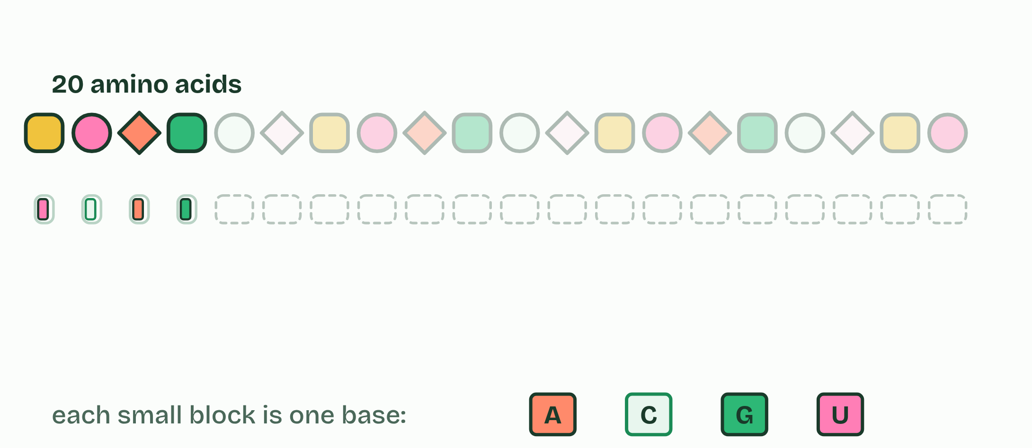
CHAPTER 5 · D1.2.8 D1.2.9 The genetic code
A code written in threes
The genetic code says which amino acid each codon stands for.
So the code is a triplet code.
The other three, UAA, UAG and UGA, are stop codons: they code for nothing and end the chain.
AUG codes for methionine and is also the start codon, where translation begins.
Minutes 26 to 40
Notes:
Minutes 26 to 40 of 60: Why three, and the table (14 min).
The plan: Chapter 5's first predict box, then figure 5.1's slider. Then the codon tool, The genetic code: find the amino acid with six codons and the ones with one, and define degenerate and universal from what the class found. Its Practise with the chart drill sets rounds of ten for homework, and Share this round gives the whole class the same ten questions.
The genetic code says which amino acid each codon stands for. A cell uses four bases and twenty amino acids. One base for each amino acid gives only 4 meanings, and two bases give 4 × 4 = 16, still too few. Three bases give 4 × 4 × 4 = 64, more than enough. So the code is a triplet code.
Of the 64 codons, 61 code for amino acids. The other three, UAA, UAG and UGA, are stop codons: they code for nothing and end the chain. AUG codes for methionine and is also the start codon, where translation begins. With 61 codons for 20 amino acids, most amino acids have more than one codon, so the code is degenerate: leucine, serine and arginine have six each, methionine and tryptophan only one. Degenerate never means ambiguous, because no codon stands for two amino acids.
The code is also universal: almost every living thing reads each codon as the same amino acid, from bacteria to people. A few small exceptions exist (the mitochondria of vertebrates, ours included, read UGA as tryptophan), but they are rare. A code this arbitrary, shared by all life, points to one common ancestor (A1.2.10). It is also why bacteria given the human insulin gene make human insulin, which is how insulin for people with diabetes is made.
In an exam you are given the table of mRNA codons: you learn how to use it, not what is in it. Read the mRNA in threes from the start codon. The first base picks the row, the second the column, and the third the line in the box. Stop at a stop codon. A coding strand reads as the mRNA with T swapped for U, but a template strand has to be paired first. Where you start sets the reading frame: start one base along and every codon changes.
Example: How we know it is threes In 1961 Francis Crick, Sydney Brenner and their colleagues added bases to a gene of a virus that infects bacteria. One extra base wrecked the gene, and so did two, but three put it right again. If the code is read in threes, three extra bases add one codon and leave the rest in step.

Slide 19
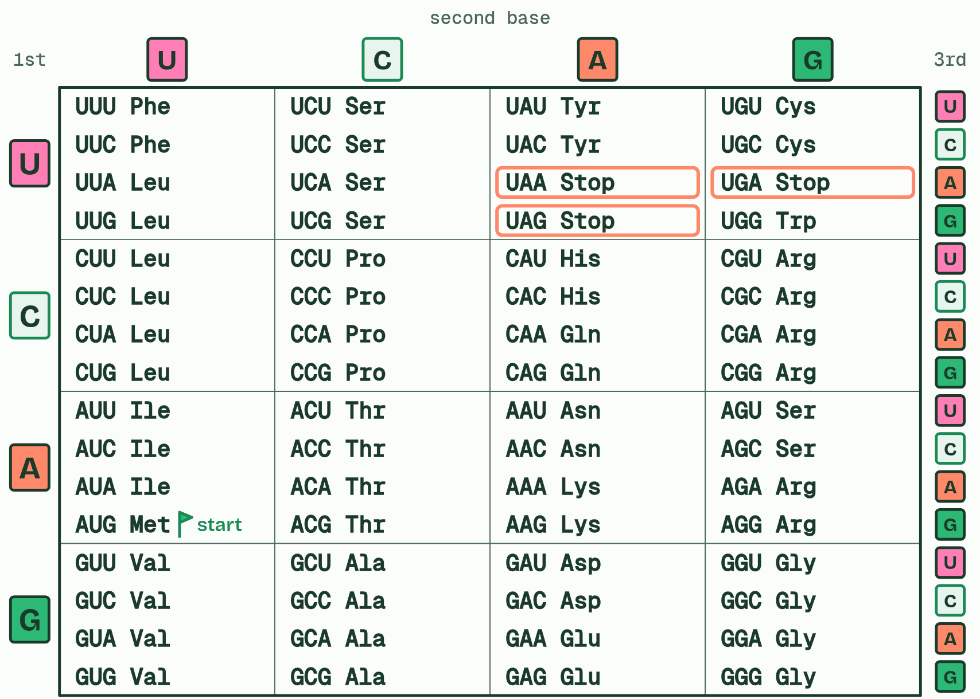
CHAPTER 5 · D1.2.8 D1.2.9 The genetic code
1 / 3
A code written in threes
The genetic code: 64 codons, read from the first base to the third.
Minutes 26 to 40
Notes:
Minutes 26 to 40 of 60: Why three, and the table (14 min).
The plan: Chapter 5's first predict box, then figure 5.1's slider. Then the codon tool, The genetic code: find the amino acid with six codons and the ones with one, and define degenerate and universal from what the class found. Its Practise with the chart drill sets rounds of ten for homework, and Share this round gives the whole class the same ten questions.
The genetic code says which amino acid each codon stands for. A cell uses four bases and twenty amino acids. One base for each amino acid gives only 4 meanings, and two bases give 4 × 4 = 16, still too few. Three bases give 4 × 4 × 4 = 64, more than enough. So the code is a triplet code.
Of the 64 codons, 61 code for amino acids. The other three, UAA, UAG and UGA, are stop codons: they code for nothing and end the chain. AUG codes for methionine and is also the start codon, where translation begins. With 61 codons for 20 amino acids, most amino acids have more than one codon, so the code is degenerate: leucine, serine and arginine have six each, methionine and tryptophan only one. Degenerate never means ambiguous, because no codon stands for two amino acids.
The code is also universal: almost every living thing reads each codon as the same amino acid, from bacteria to people. A few small exceptions exist (the mitochondria of vertebrates, ours included, read UGA as tryptophan), but they are rare. A code this arbitrary, shared by all life, points to one common ancestor (A1.2.10). It is also why bacteria given the human insulin gene make human insulin, which is how insulin for people with diabetes is made.
In an exam you are given the table of mRNA codons: you learn how to use it, not what is in it. Read the mRNA in threes from the start codon. The first base picks the row, the second the column, and the third the line in the box. Stop at a stop codon. A coding strand reads as the mRNA with T swapped for U, but a template strand has to be paired first. Where you start sets the reading frame: start one base along and every codon changes.
Example: How we know it is threes In 1961 Francis Crick, Sydney Brenner and their colleagues added bases to a gene of a virus that infects bacteria. One extra base wrecked the gene, and so did two, but three put it right again. If the code is read in threes, three extra bases add one codon and leave the rest in step.

Slide 20
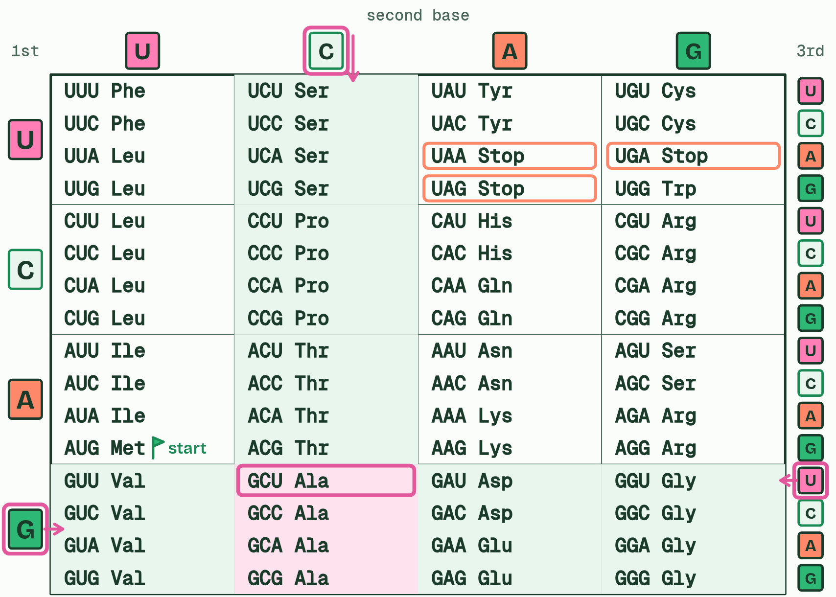
CHAPTER 5 · D1.2.8 D1.2.9 The genetic code
2 / 3
A code written in threes
Find the first base, then the second, then the third: GCU is alanine.
Minutes 26 to 40
Notes:
Minutes 26 to 40 of 60: Why three, and the table (14 min).
The plan: Chapter 5's first predict box, then figure 5.1's slider. Then the codon tool, The genetic code: find the amino acid with six codons and the ones with one, and define degenerate and universal from what the class found. Its Practise with the chart drill sets rounds of ten for homework, and Share this round gives the whole class the same ten questions.
The genetic code says which amino acid each codon stands for. A cell uses four bases and twenty amino acids. One base for each amino acid gives only 4 meanings, and two bases give 4 × 4 = 16, still too few. Three bases give 4 × 4 × 4 = 64, more than enough. So the code is a triplet code.
Of the 64 codons, 61 code for amino acids. The other three, UAA, UAG and UGA, are stop codons: they code for nothing and end the chain. AUG codes for methionine and is also the start codon, where translation begins. With 61 codons for 20 amino acids, most amino acids have more than one codon, so the code is degenerate: leucine, serine and arginine have six each, methionine and tryptophan only one. Degenerate never means ambiguous, because no codon stands for two amino acids.
The code is also universal: almost every living thing reads each codon as the same amino acid, from bacteria to people. A few small exceptions exist (the mitochondria of vertebrates, ours included, read UGA as tryptophan), but they are rare. A code this arbitrary, shared by all life, points to one common ancestor (A1.2.10). It is also why bacteria given the human insulin gene make human insulin, which is how insulin for people with diabetes is made.
In an exam you are given the table of mRNA codons: you learn how to use it, not what is in it. Read the mRNA in threes from the start codon. The first base picks the row, the second the column, and the third the line in the box. Stop at a stop codon. A coding strand reads as the mRNA with T swapped for U, but a template strand has to be paired first. Where you start sets the reading frame: start one base along and every codon changes.
Example: How we know it is threes In 1961 Francis Crick, Sydney Brenner and their colleagues added bases to a gene of a virus that infects bacteria. One extra base wrecked the gene, and so did two, but three put it right again. If the code is read in threes, three extra bases add one codon and leave the rest in step.

Slide 21
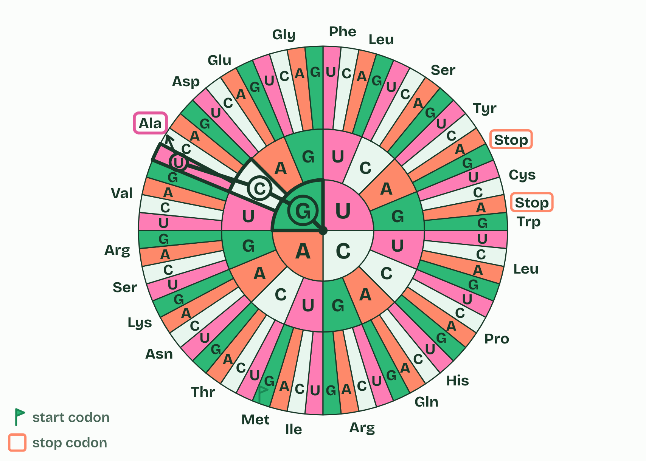
CHAPTER 5 · D1.2.8 D1.2.9 The genetic code
3 / 3
A code written in threes
The wheel holds the same code, read from the centre out.
Minutes 26 to 40
Notes:
Minutes 26 to 40 of 60: Why three, and the table (14 min).
The plan: Chapter 5's first predict box, then figure 5.1's slider. Then the codon tool, The genetic code: find the amino acid with six codons and the ones with one, and define degenerate and universal from what the class found. Its Practise with the chart drill sets rounds of ten for homework, and Share this round gives the whole class the same ten questions.
The genetic code says which amino acid each codon stands for. A cell uses four bases and twenty amino acids. One base for each amino acid gives only 4 meanings, and two bases give 4 × 4 = 16, still too few. Three bases give 4 × 4 × 4 = 64, more than enough. So the code is a triplet code.
Of the 64 codons, 61 code for amino acids. The other three, UAA, UAG and UGA, are stop codons: they code for nothing and end the chain. AUG codes for methionine and is also the start codon, where translation begins. With 61 codons for 20 amino acids, most amino acids have more than one codon, so the code is degenerate: leucine, serine and arginine have six each, methionine and tryptophan only one. Degenerate never means ambiguous, because no codon stands for two amino acids.
The code is also universal: almost every living thing reads each codon as the same amino acid, from bacteria to people. A few small exceptions exist (the mitochondria of vertebrates, ours included, read UGA as tryptophan), but they are rare. A code this arbitrary, shared by all life, points to one common ancestor (A1.2.10). It is also why bacteria given the human insulin gene make human insulin, which is how insulin for people with diabetes is made.
In an exam you are given the table of mRNA codons: you learn how to use it, not what is in it. Read the mRNA in threes from the start codon. The first base picks the row, the second the column, and the third the line in the box. Stop at a stop codon. A coding strand reads as the mRNA with T swapped for U, but a template strand has to be paired first. Where you start sets the reading frame: start one base along and every codon changes.
Example: How we know it is threes In 1961 Francis Crick, Sydney Brenner and their colleagues added bases to a gene of a virus that infects bacteria. One extra base wrecked the gene, and so did two, but three put it right again. If the code is read in threes, three extra bases add one codon and leave the rest in step.

Slide 22
CHAPTER 5 · D1.2.8 D1.2.9 The genetic code
A code written in threes
The genetic code says which amino acid each codon stands for.
So the code is a triplet code.
The other three, UAA, UAG and UGA, are stop codons: they code for nothing and end the chain.
AUG codes for methionine and is also the start codon, where translation begins.
Minutes 26 to 40
Notes:
Minutes 26 to 40 of 60: Why three, and the table (14 min).
The plan: Chapter 5's first predict box, then figure 5.1's slider. Then the codon tool, The genetic code: find the amino acid with six codons and the ones with one, and define degenerate and universal from what the class found. Its Practise with the chart drill sets rounds of ten for homework, and Share this round gives the whole class the same ten questions.
The genetic code says which amino acid each codon stands for. A cell uses four bases and twenty amino acids. One base for each amino acid gives only 4 meanings, and two bases give 4 × 4 = 16, still too few. Three bases give 4 × 4 × 4 = 64, more than enough. So the code is a triplet code.
Of the 64 codons, 61 code for amino acids. The other three, UAA, UAG and UGA, are stop codons: they code for nothing and end the chain. AUG codes for methionine and is also the start codon, where translation begins. With 61 codons for 20 amino acids, most amino acids have more than one codon, so the code is degenerate: leucine, serine and arginine have six each, methionine and tryptophan only one. Degenerate never means ambiguous, because no codon stands for two amino acids.
The code is also universal: almost every living thing reads each codon as the same amino acid, from bacteria to people. A few small exceptions exist (the mitochondria of vertebrates, ours included, read UGA as tryptophan), but they are rare. A code this arbitrary, shared by all life, points to one common ancestor (A1.2.10). It is also why bacteria given the human insulin gene make human insulin, which is how insulin for people with diabetes is made.
In an exam you are given the table of mRNA codons: you learn how to use it, not what is in it. Read the mRNA in threes from the start codon. The first base picks the row, the second the column, and the third the line in the box. Stop at a stop codon. A coding strand reads as the mRNA with T swapped for U, but a template strand has to be paired first. Where you start sets the reading frame: start one base along and every codon changes.
Example: How we know it is threes In 1961 Francis Crick, Sydney Brenner and their colleagues added bases to a gene of a virus that infects bacteria. One extra base wrecked the gene, and so did two, but three put it right again. If the code is read in threes, three extra bases add one codon and leave the rest in step.

Slide 23
WHAT HAPPENS
Why can the code not use pairs of bases for each amino acid?
A Pairs would be read too slowly by the ribosome
B Pairs cannot form hydrogen bonds with any anticodon
C Pairs give only 16 codons for 20 amino acids
With four bases, pairs make 4 × 4 = 16 different codons, and there are 20 amino acids to code for (and a stop signal as well). Triplets make 64: enough, with plenty over, which is why most amino acids have several codons.
Minutes 26 to 40
Notes:
Minutes 26 to 40 of 60: Why three, and the table (14 min).
The plan: Chapter 5's first predict box, then figure 5.1's slider. Then the codon tool, The genetic code: find the amino acid with six codons and the ones with one, and define degenerate and universal from what the class found. Its Practise with the chart drill sets rounds of ten for homework, and Share this round gives the whole class the same ten questions.
Answer: C. With four bases, pairs make 4 × 4 = 16 different codons, and there are 20 amino acids to code for (and a stop signal as well). Triplets make 64: enough, with plenty over, which is why most amino acids have several codons.

Slide 24
WATCH OUT
Degenerate means several codons for one amino acid, never one codon for several. And universal means every organism reads the code the same way, not that every organism has the same genes.
Minutes 26 to 40
Notes:
Minutes 26 to 40 of 60: Why three, and the table (14 min).
The plan: Chapter 5's first predict box, then figure 5.1's slider. Then the codon tool, The genetic code: find the amino acid with six codons and the ones with one, and define degenerate and universal from what the class found. Its Practise with the chart drill sets rounds of ten for homework, and Share this round gives the whole class the same ten questions.
A common mistake: say it, then ask who can say why it is wrong.

Slide 25
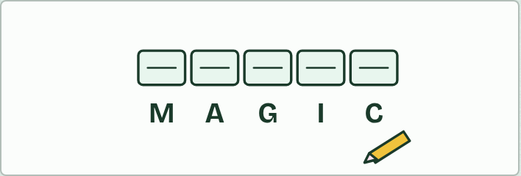
PUZZLE
14 MIN
Codon cipher
THE TASK
Pairs decode mRNA messages whose amino acids' one-letter codes spell words (print the table with one-letter codes: the codon tool, The genetic code, shows three-letter names). Every message starts with the start codon, so every word begins with M: AUG GCU GGU AUU UGU UAA reads Met-Ala-Gly-Ile-Cys, M A G I C. Words can use only the letters A, C, D, E, F, G, H, I, K, L, M, N, P, Q, R, S, T, V, W and Y, and each message ends with a stop codon. Then each pair writes a message for another pair as a coding strand (harder: as a template strand). The teacher's key: check each message with the codon tool's converter.
STUDENTS NEED
The codon tool or printed tables, and paper.
Minutes 40 to 54
Notes:
Minutes 40 to 54 of 60: Codon cipher (14 min).
The plan: Pairs decode and write messages with the codon table (activity below).
The activity: Codon cipher. Pairs decode mRNA messages whose amino acids' one-letter codes spell words (print the table with one-letter codes: the codon tool, The genetic code, shows three-letter names). Every message starts with the start codon, so every word begins with M: AUG GCU GGU AUU UGU UAA reads Met-Ala-Gly-Ile-Cys, M A G I C. Words can use only the letters A, C, D, E, F, G, H, I, K, L, M, N, P, Q, R, S, T, V, W and Y, and each message ends with a stop codon. Then each pair writes a message for another pair as a coding strand (harder: as a template strand). The teacher's key: check each message with the codon tool's converter.
Needs: the codon tool or printed tables, and paper.
The time: 14 minutes, minutes 40 to 54 of the plan.

Slide 26
PLENARY
Can you now...
Describe what mRNA, the two ribosome subunits and tRNA each do in translation (D1.2.5, D1.2.6)
Pair a codon with its anticodon, and explain how pairing brings the right amino acid (D1.2.7)
Explain why the code uses threes and what degenerate and universal mean, and use a codon table to deduce a polypeptide (D1.2.8, D1.2.9)
Minutes 54 to 60
Notes:
Minutes 54 to 60 of 60: Exit (6 min).
The plan: Chapter 5's second predict box: deduce the chain, using the table.
Thumbs up, sideways or down on each goal before the exit question. The goals come from the statements this lesson covers.

Slide 27
EXIT QUESTION
Before you go
Chapter 5's second predict box: deduce the chain, using the table.
Minutes 54 to 60
Notes:
Minutes 54 to 60 of 60: Exit (6 min).
The plan: Chapter 5's second predict box: deduce the chain, using the table.

Slide 28
PRACTISE AND REVISE
Keep going
Exam practice: a fresh paper of exam questions on D1.2 at standard level, marked as you go
The guide, with the animations and the dry lab
This lesson in the guide: 3 Three kinds of RNA build a protein, 4 Codon meets anticodon, 5 A code written in threes
BUILD FOR YOUR CLASS
ALREADY ON THE SITE FOR D1.2
CARD SETS ON SPLYCR
Tarsia puzzle, dominoes and picture reveal on D1.2, built from its key terms and ready to print
A pub quiz with rounds on D1.2, to present or run with no projector
An escape room built from the question bank on D1.2
Quiz: Protein Synthesis
Revision map: D1.2 Protein synthesis, to fill in
Exam questions: D1.2 in the exam maker, a paper with its markscheme
Open a set to host it as a class game, or make a copy to edit.
D1.2 Protein Synthesis (SL)
How this was made. The course structure, the activities and the teaching choices come from my own classroom, my presentations and my years of teaching IB and AP Biology. I use Claude, an AI, to help write and build the interactive guides, lesson plans, slides and practice questions, and to draw the diagrams and code the interactives. I direct the work and review it against the IB and AP specifications before it goes live.
Minute 60: after the lesson
Notes:
Every link here is live. Set the exam practice paper for homework: it is fresh each time, marked as students go and saved to their Exam practice when they are signed in.
Exam practice: https://www.biologybybradford.com/exam-maker/sit?topics=D1.2&level=SL&paper=quiz&marks=15&src=ep
The guide: https://www.biologybybradford.com/guides/ib-biology-d1-2-protein-synthesis

