Slide 1
IB Biology D1.2
LESSON 3 OF 6
BY THE END YOU CAN
Protein synthesis
Describe how the ribosome moves one codon at a time, joining each amino acid to the chain with a peptide bond (D1.2.10)
Explain how one base change in the haemoglobin gene causes sickle cell anaemia (D1.2.11)
Building the chain, and one base wrong
D1.2.10, D1.2.11
Elongation one codon at a time, peptide bonds, and how one substitution causes sickle cell anaemia
60 minutes · chapters 6, 7
Minute 0
Notes:
IB Biology D1.2, Protein synthesis. Lesson 3 of 6: Building the chain, and one base wrong, 60 minutes.
The plan, minute by minute (each slide's footer says where you are):
0 to 6 min (6) Do now: Translation in order
6 to 16 min (10) The elongation cycle
16 to 28 min (12) Paper ribosome
28 to 40 min (12) One base, one amino acid
40 to 52 min (12) The protein factory
52 to 60 min (8) Exit
What students get wrong:
Amino acids in the chain are held by hydrogen bonds. Peptide bonds; the hydrogen bonds are codon to anticodon.
Every mutation changes the protein. Silent substitutions do not.
Sickle cell haemoglobin cannot carry oxygen. It carries it; the harm is the fibres, the cell shape and the cells' short life.
Stretch and support:
Support: cut the figures' captions into cards to put in order, use the dotted key terms as a glossary, and give a codon table with the reading path printed on it (row, column, line).
Support: use the mnemonics (Apples Under umbrellas; Same, Swapped, Stopped) as starters.
Stretch: Reading Frame, a codon game whose last round adds insertions and deletions, a look ahead to D1.3.
Stretch: in the factory's round 5, find a single base change in the demonstration gene for each of Same, Swapped and Stopped, and explain why changes to the third base are most often silent.
The lesson plan to print: https://www.biologybybradford.com/guides/downloads/ib-biology-d1-2-protein-synthesis-lesson-3-plan.pdf

Slide 2
DO NOW
Translation in order
Eight cards put in the order a message meets them.
6:00
minutes
Start now: the timer is running.
Minutes 0 to 6
Notes:
Minutes 0 to 6 of 60: Do now: Translation in order (6 min).
The plan: Eight cards put in the order a message meets them (activity below).
Start a 6 minute timer as they come in.

Slide 3
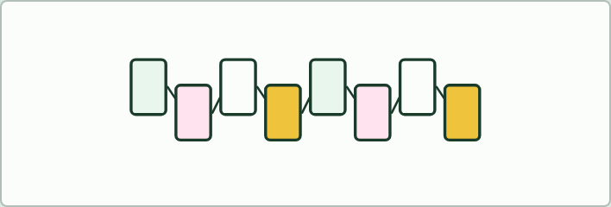
CARD SORT
6 MIN
Translation in order
THE TASK
Eight cards to put in the order a message meets them: mRNA, ribosome, codon, anticodon, tRNA, amino acid, peptide bond, polypeptide. Then one sentence linking each pair of neighbours.
STUDENTS NEED
Sets of cards.
Minutes 0 to 6
Notes:
Minutes 0 to 6 of 60: Do now: Translation in order (6 min).
The plan: Eight cards put in the order a message meets them (activity below).
The activity: Translation in order. Eight cards to put in the order a message meets them: mRNA, ribosome, codon, anticodon, tRNA, amino acid, peptide bond, polypeptide. Then one sentence linking each pair of neighbours.
Needs: sets of cards.
The time: 6 minutes, minutes 0 to 6 of the plan.

Slide 4
STEP 2
10 MIN
The elongation cycle
Chapter 6: One codon at a time
Minutes 6 to 16
Notes:
Minutes 6 to 16 of 60: The elongation cycle (10 min).
The plan: Chapter 6's step-through, then the ribosome film, One codon at a time, then chapter 6's predict box (151 codons).

Slide 5
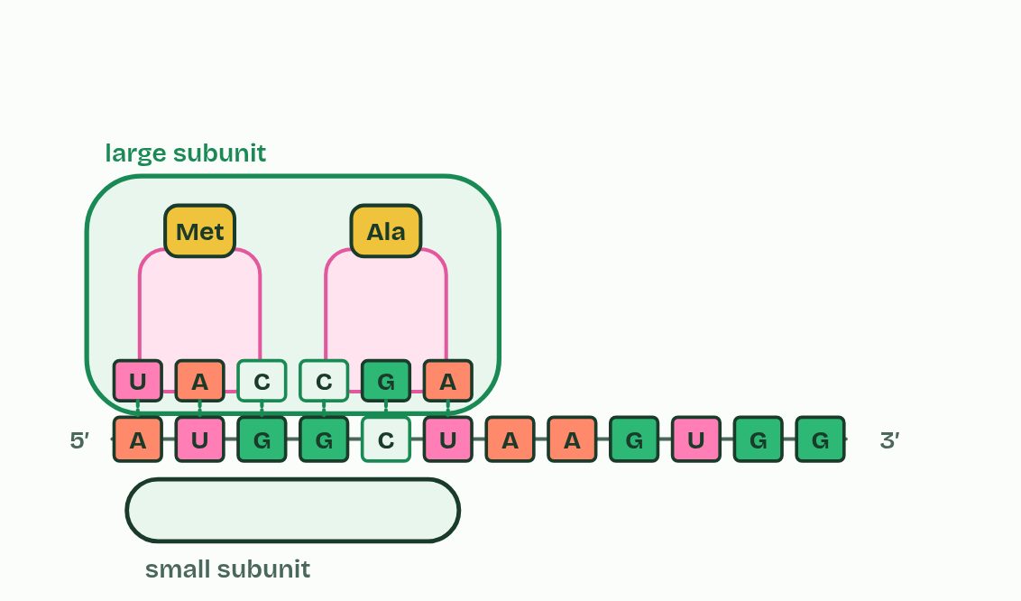
CHAPTER 6 · D1.2.10 Elongation
1 / 4
One codon at a time
The next tRNA pairs with the open codon.
Minutes 6 to 16
Notes:
Minutes 6 to 16 of 60: The elongation cycle (10 min).
The plan: Chapter 6's step-through, then the ribosome film, One codon at a time, then chapter 6's predict box (151 codons).
Once translation has started, the polypeptide grows by a cycle that repeats for every codon. This is elongation, and it is the part of translation this chapter follows. How translation starts is chapter 11.
The chain grows by one amino acid for every codon, in the order of the codons. A human ribosome adds about five amino acids a second, so a protein of 300 amino acids takes about a minute. At a stop codon no tRNA pairs, and the polypeptide is released.
Two kinds of bond do two jobs here. Hydrogen bonds hold codon and anticodon together for a moment. Peptide bonds, which are covalent, hold the chain together for good.

Slide 6
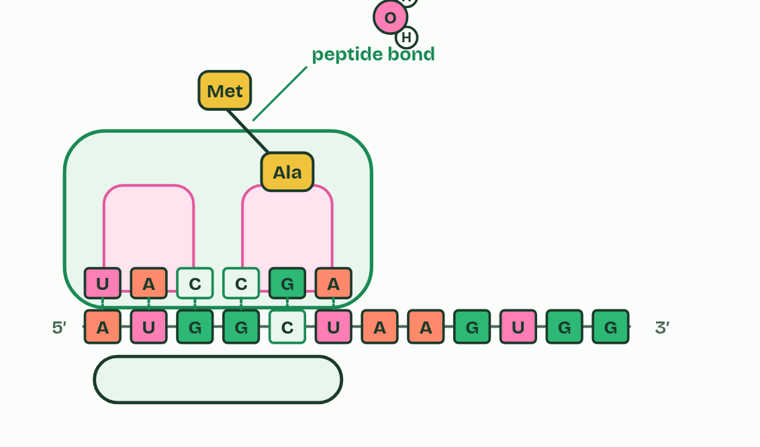
CHAPTER 6 · D1.2.10 Elongation
2 / 4
One codon at a time
A peptide bond joins the chain to its amino acid.
Minutes 6 to 16
Notes:
Minutes 6 to 16 of 60: The elongation cycle (10 min).
The plan: Chapter 6's step-through, then the ribosome film, One codon at a time, then chapter 6's predict box (151 codons).
Once translation has started, the polypeptide grows by a cycle that repeats for every codon. This is elongation, and it is the part of translation this chapter follows. How translation starts is chapter 11.
The chain grows by one amino acid for every codon, in the order of the codons. A human ribosome adds about five amino acids a second, so a protein of 300 amino acids takes about a minute. At a stop codon no tRNA pairs, and the polypeptide is released.
Two kinds of bond do two jobs here. Hydrogen bonds hold codon and anticodon together for a moment. Peptide bonds, which are covalent, hold the chain together for good.

Slide 7
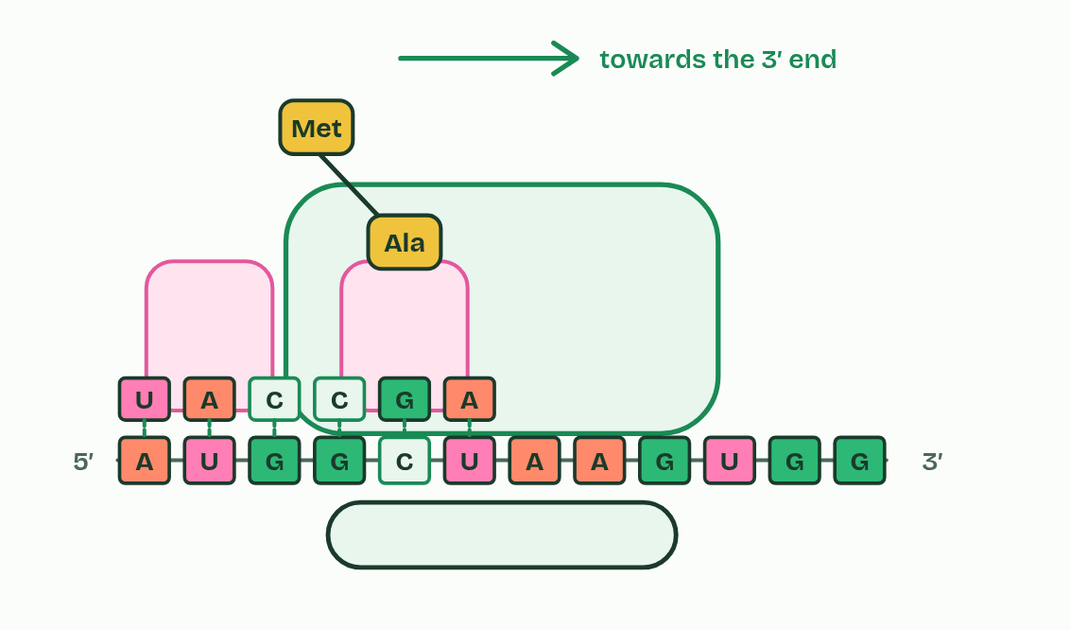
CHAPTER 6 · D1.2.10 Elongation
3 / 4
One codon at a time
The ribosome moves one codon along.
Minutes 6 to 16
Notes:
Minutes 6 to 16 of 60: The elongation cycle (10 min).
The plan: Chapter 6's step-through, then the ribosome film, One codon at a time, then chapter 6's predict box (151 codons).
Once translation has started, the polypeptide grows by a cycle that repeats for every codon. This is elongation, and it is the part of translation this chapter follows. How translation starts is chapter 11.
The chain grows by one amino acid for every codon, in the order of the codons. A human ribosome adds about five amino acids a second, so a protein of 300 amino acids takes about a minute. At a stop codon no tRNA pairs, and the polypeptide is released.
Two kinds of bond do two jobs here. Hydrogen bonds hold codon and anticodon together for a moment. Peptide bonds, which are covalent, hold the chain together for good.

Slide 8
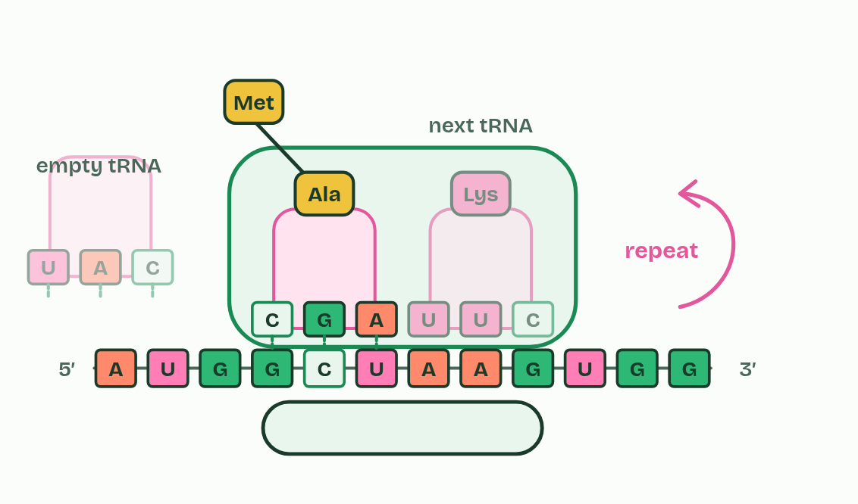
CHAPTER 6 · D1.2.10 Elongation
4 / 4
One codon at a time
The empty tRNA leaves. Repeat.
Minutes 6 to 16
Notes:
Minutes 6 to 16 of 60: The elongation cycle (10 min).
The plan: Chapter 6's step-through, then the ribosome film, One codon at a time, then chapter 6's predict box (151 codons).
Once translation has started, the polypeptide grows by a cycle that repeats for every codon. This is elongation, and it is the part of translation this chapter follows. How translation starts is chapter 11.
The chain grows by one amino acid for every codon, in the order of the codons. A human ribosome adds about five amino acids a second, so a protein of 300 amino acids takes about a minute. At a stop codon no tRNA pairs, and the polypeptide is released.
Two kinds of bond do two jobs here. Hydrogen bonds hold codon and anticodon together for a moment. Peptide bonds, which are covalent, hold the chain together for good.

Slide 9
CHAPTER 6 · D1.2.10 Elongation
One codon at a time
A tRNA whose anticodon pairs with the codon in the free place binds, bringing its amino acid.
The ribosome joins the chain to that amino acid with a peptide bond. This is a condensation reaction, so a molecule of water is released, and the chain now hangs from the newest tRNA.
The ribosome moves one codon, three bases, along the mRNA, towards its 3′ end.
The tRNA that handed over the chain leaves, free to collect another amino acid.
Minutes 6 to 16
Notes:
Minutes 6 to 16 of 60: The elongation cycle (10 min).
The plan: Chapter 6's step-through, then the ribosome film, One codon at a time, then chapter 6's predict box (151 codons).
Once translation has started, the polypeptide grows by a cycle that repeats for every codon. This is elongation, and it is the part of translation this chapter follows. How translation starts is chapter 11.
The chain grows by one amino acid for every codon, in the order of the codons. A human ribosome adds about five amino acids a second, so a protein of 300 amino acids takes about a minute. At a stop codon no tRNA pairs, and the polypeptide is released.
Two kinds of bond do two jobs here. Hydrogen bonds hold codon and anticodon together for a moment. Peptide bonds, which are covalent, hold the chain together for good.

Slide 10
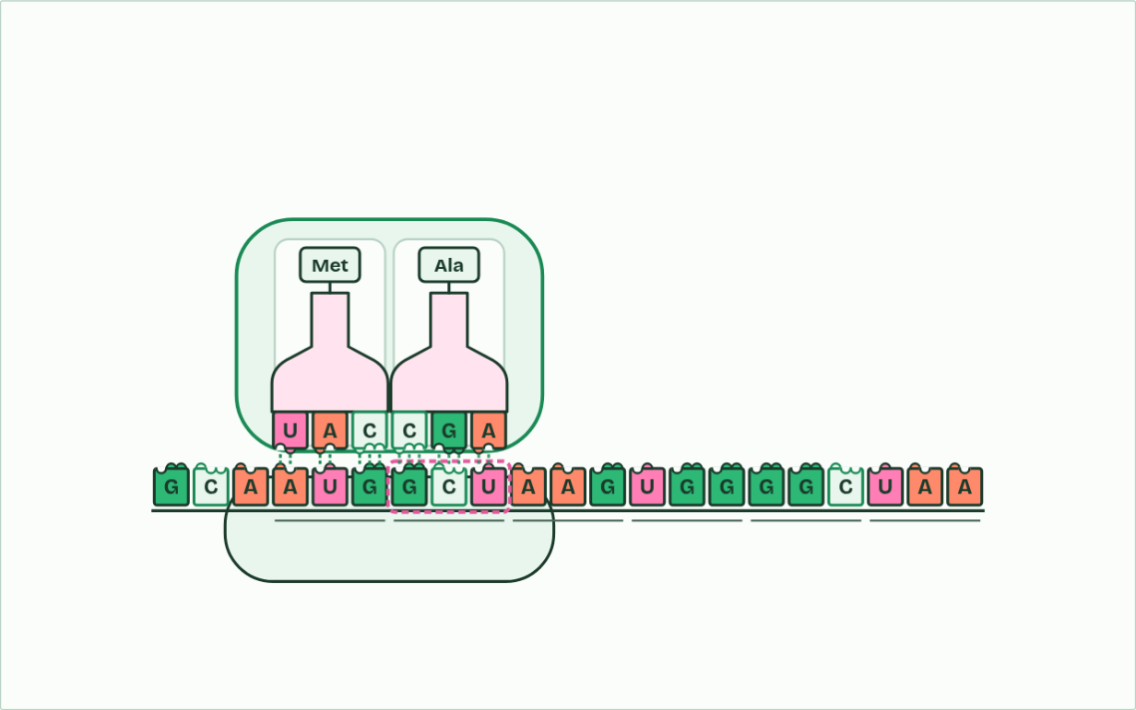
CHAPTER 6 · D1.2.10 Elongation
codon 2: GCU, Ala
1 / 4
One codon at a time
A tRNA whose anticodon pairs with the codon brings the right amino acid.
Minutes 6 to 16
Notes:
Minutes 6 to 16 of 60: The elongation cycle (10 min).
The plan: Chapter 6's step-through, then the ribosome film, One codon at a time, then chapter 6's predict box (151 codons).
Once translation has started, the polypeptide grows by a cycle that repeats for every codon. This is elongation, and it is the part of translation this chapter follows. How translation starts is chapter 11.
The chain grows by one amino acid for every codon, in the order of the codons. A human ribosome adds about five amino acids a second, so a protein of 300 amino acids takes about a minute. At a stop codon no tRNA pairs, and the polypeptide is released.
Two kinds of bond do two jobs here. Hydrogen bonds hold codon and anticodon together for a moment. Peptide bonds, which are covalent, hold the chain together for good.
The animation "One codon at a time", paused at 8.8 s. The next slides go on through it, then play it.

Slide 11
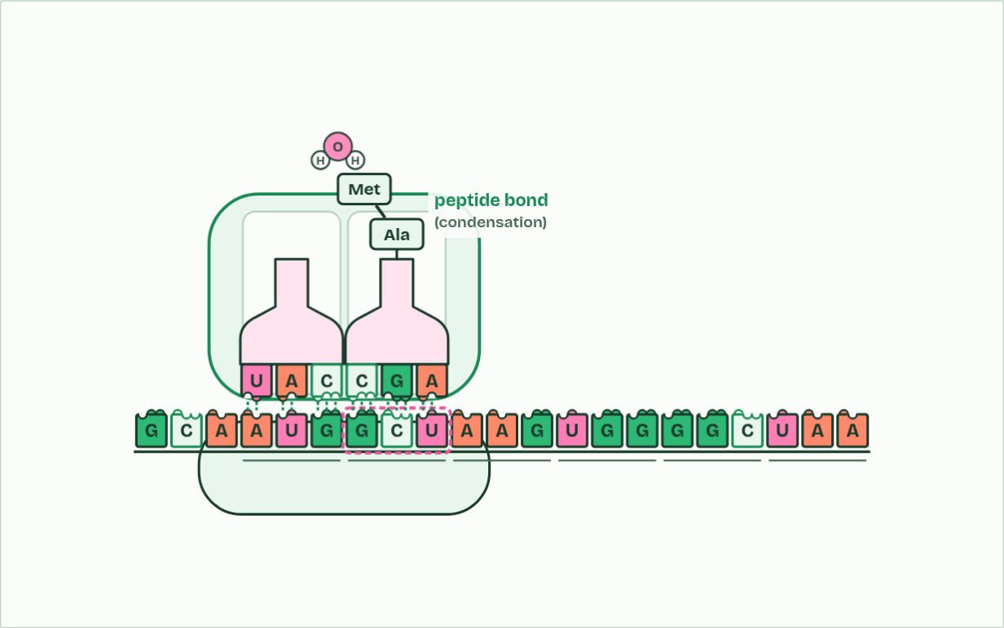
CHAPTER 6 · D1.2.10 Elongation
codon 2: GCU, Ala
2 / 4
One codon at a time
A peptide bond joins the chain to the new amino acid.
Minutes 6 to 16
Notes:
Minutes 6 to 16 of 60: The elongation cycle (10 min).
The plan: Chapter 6's step-through, then the ribosome film, One codon at a time, then chapter 6's predict box (151 codons).
Once translation has started, the polypeptide grows by a cycle that repeats for every codon. This is elongation, and it is the part of translation this chapter follows. How translation starts is chapter 11.
The chain grows by one amino acid for every codon, in the order of the codons. A human ribosome adds about five amino acids a second, so a protein of 300 amino acids takes about a minute. At a stop codon no tRNA pairs, and the polypeptide is released.
Two kinds of bond do two jobs here. Hydrogen bonds hold codon and anticodon together for a moment. Peptide bonds, which are covalent, hold the chain together for good.
The animation "One codon at a time", paused at 11.5 s. The next slides go on through it, then play it.

Slide 12
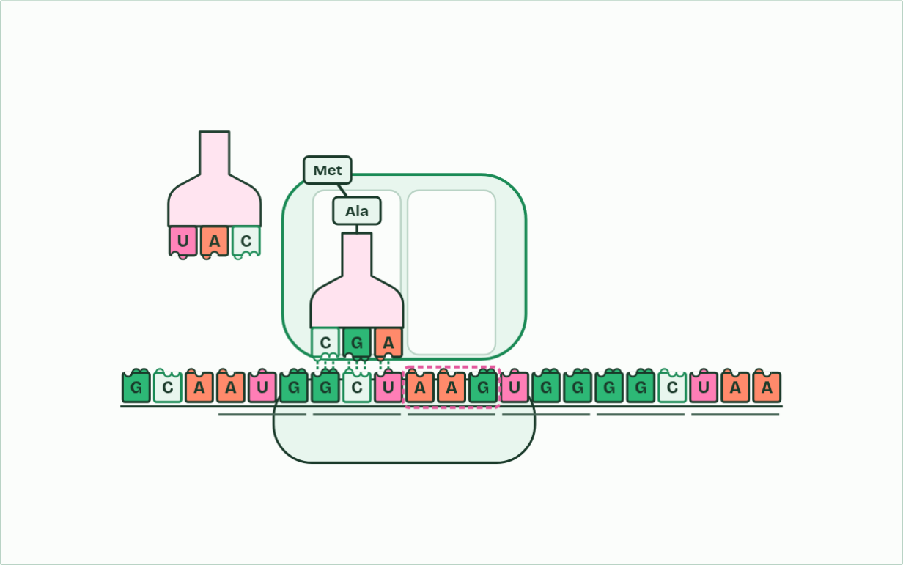
CHAPTER 6 · D1.2.10 Elongation
codon 3: AAG, Lys
3 / 4
One codon at a time
The ribosome moves along one codon, and the empty tRNA leaves to collect another amino acid.
Minutes 6 to 16
Notes:
Minutes 6 to 16 of 60: The elongation cycle (10 min).
The plan: Chapter 6's step-through, then the ribosome film, One codon at a time, then chapter 6's predict box (151 codons).
Once translation has started, the polypeptide grows by a cycle that repeats for every codon. This is elongation, and it is the part of translation this chapter follows. How translation starts is chapter 11.
The chain grows by one amino acid for every codon, in the order of the codons. A human ribosome adds about five amino acids a second, so a protein of 300 amino acids takes about a minute. At a stop codon no tRNA pairs, and the polypeptide is released.
Two kinds of bond do two jobs here. Hydrogen bonds hold codon and anticodon together for a moment. Peptide bonds, which are covalent, hold the chain together for good.
The animation "One codon at a time", paused at 14.8 s. The next slides go on through it, then play it.

Slide 13
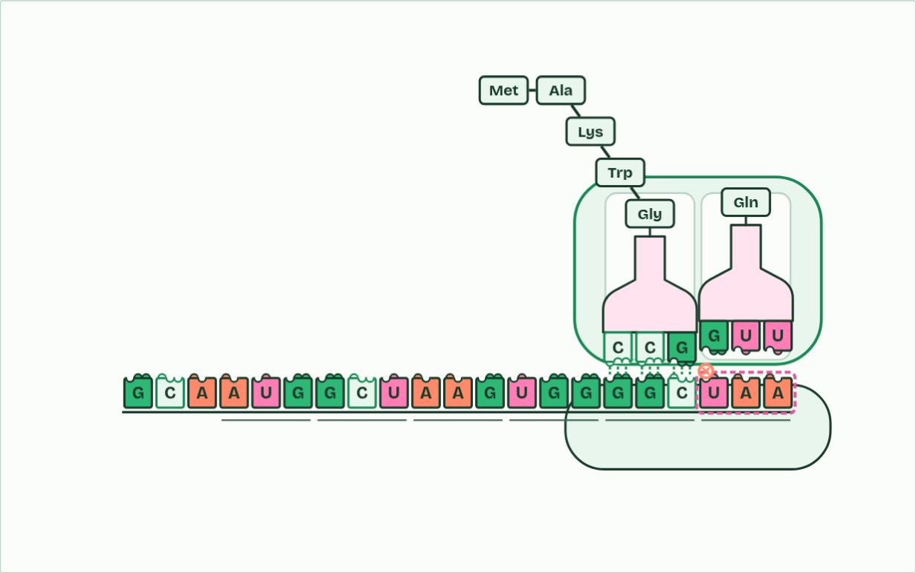
CHAPTER 6 · D1.2.10 Elongation
codon 6: UAA, stop
4 / 4
One codon at a time
At a stop codon no tRNA fits, and the polypeptide is released.
Minutes 6 to 16
Notes:
Minutes 6 to 16 of 60: The elongation cycle (10 min).
The plan: Chapter 6's step-through, then the ribosome film, One codon at a time, then chapter 6's predict box (151 codons).
Once translation has started, the polypeptide grows by a cycle that repeats for every codon. This is elongation, and it is the part of translation this chapter follows. How translation starts is chapter 11.
The chain grows by one amino acid for every codon, in the order of the codons. A human ribosome adds about five amino acids a second, so a protein of 300 amino acids takes about a minute. At a stop codon no tRNA pairs, and the polypeptide is released.
Two kinds of bond do two jobs here. Hydrogen bonds hold codon and anticodon together for a moment. Peptide bonds, which are covalent, hold the chain together for good.
The animation "One codon at a time", paused at 26.6 s. The next slides go on through it, then play it.

Slide 14
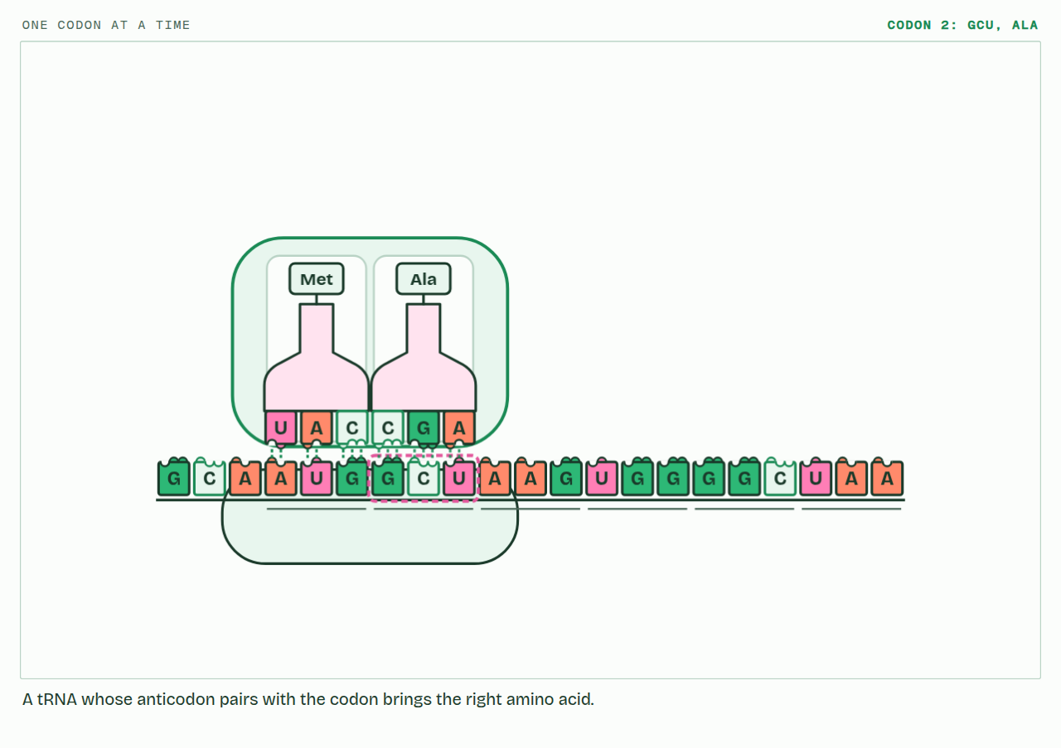
CHAPTER 6 · D1.2.10 Elongation
PLAY IT
One codon at a time
One codon at a time: click to play. It loops every 32 seconds.
Minutes 6 to 16
Notes:
Minutes 6 to 16 of 60: The elongation cycle (10 min).
The plan: Chapter 6's step-through, then the ribosome film, One codon at a time, then chapter 6's predict box (151 codons).
The video is ribosome-e9217c.mp4, one loop of the animation in the guide. It plays in PowerPoint and Keynote. Google Slides does not play a video embedded in a .pptx: download ribosome-e9217c.mp4 (https://www.biologybybradford.com/guides/downloads/scenes/ribosome-e9217c.mp4), upload it to Google Drive, then Insert > Video > Google Drive.
In the guide the class can change it as it runs: https://www.biologybybradford.com/guides/ib-biology-d1-2-protein-synthesis#elongation
What it shows, in order:
1. A tRNA whose anticodon pairs with the codon brings the right amino acid.
2. A peptide bond joins the chain to the new amino acid.
3. The ribosome moves along one codon, and the empty tRNA leaves to collect another amino acid.
4. At a stop codon no tRNA fits, and the polypeptide is released.

Slide 15
WATCH OUT
Amino acids in the chain are joined by peptide bonds, not hydrogen bonds. The hydrogen bonds are between codon and anticodon, and they break as each tRNA leaves.
Minutes 6 to 16
Notes:
Minutes 6 to 16 of 60: The elongation cycle (10 min).
The plan: Chapter 6's step-through, then the ribosome film, One codon at a time, then chapter 6's predict box (151 codons).
A common mistake: say it, then ask who can say why it is wrong.

Slide 16
PREDICT
A polypeptide is 150 amino acids long. How many codons did the ribosome read to make it, counting the codon that ended it?
A 150
B 151
C 450
Minutes 6 to 16
Notes:
Minutes 6 to 16 of 60: The elongation cycle (10 min).
The plan: Chapter 6's step-through, then the ribosome film, One codon at a time, then chapter 6's predict box (151 codons).
Ask for a show of hands, or mini whiteboards, before revealing. (Answer: B, on the next slide.)

Slide 17
WHAT HAPPENS
A polypeptide is 150 amino acids long. How many codons did the ribosome read to make it, counting the codon that ended it?
A 150
B 151
C 450
One codon for each amino acid, 150, plus the stop codon that ended the chain: 151. That is 453 bases of mRNA. 450 is the number of bases for the 150 amino acids alone, not the number of codons.
Minutes 6 to 16
Notes:
Minutes 6 to 16 of 60: The elongation cycle (10 min).
The plan: Chapter 6's step-through, then the ribosome film, One codon at a time, then chapter 6's predict box (151 codons).
Answer: B. One codon for each amino acid, 150, plus the stop codon that ended the chain: 151. That is 453 bases of mRNA. 450 is the number of bases for the 150 amino acids alone, not the number of codons.

Slide 18
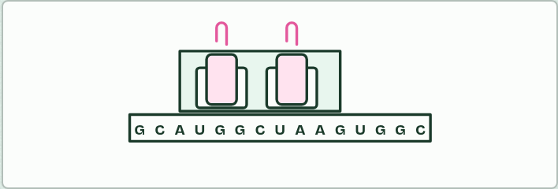
MODEL
12 MIN
Paper ribosome
THE TASK
A long mRNA strip (the demonstration gene of chapters 1 to 7, printed in codons), a ribosome card with two windows cut in it, and tRNA cards with the anticodon at the foot and an amino acid on a paper clip at the top. Groups slide the ribosome one codon at a time, dock the tRNA, move the paper clips onto the newest one, and send the empty tRNA back. Then ask what the model leaves out, and what it gets wrong: it has no energy, nothing forces the right tRNA to arrive, real bonds are chemical, and a ribosome is made of RNA and protein.
STUDENTS NEED
Printed strips and cards, scissors, paper clips.
Minutes 16 to 28
Notes:
Minutes 16 to 28 of 60: Paper ribosome (12 min).
The plan: Groups slide the paper ribosome along a paper mRNA, ending on the model's limits (activity below).
The activity: Paper ribosome. A long mRNA strip (the demonstration gene of chapters 1 to 7, printed in codons), a ribosome card with two windows cut in it, and tRNA cards with the anticodon at the foot and an amino acid on a paper clip at the top. Groups slide the ribosome one codon at a time, dock the tRNA, move the paper clips onto the newest one, and send the empty tRNA back. Then ask what the model leaves out, and what it gets wrong: it has no energy, nothing forces the right tRNA to arrive, real bonds are chemical, and a ribosome is made of RNA and protein.
Needs: printed strips and cards, scissors, paper clips.
The time: 12 minutes, minutes 16 to 28 of the plan.

Slide 19
STEP 4
12 MIN
One base, one amino acid
Chapter 7: One base, one amino acid
Minutes 28 to 40
Notes:
Minutes 28 to 40 of 60: One base, one amino acid (12 min).
The plan: Chapter 7's predict box (GAA to GAG) first, then figure 7.1, Fold a protein (make the sickle cell change, fold both and make a second copy of each) and Same, Swapped, Stopped. Then Sort the substitutions.

Slide 20
PREDICT
In a gene, one base changes so that an mRNA codon GAA becomes GAG. What happens to the polypeptide?
A Glu is replaced by another amino acid
B The chain stops at that codon
C No change: GAG also codes for Glu
Minutes 28 to 40
Notes:
Minutes 28 to 40 of 60: One base, one amino acid (12 min).
The plan: Chapter 7's predict box (GAA to GAG) first, then figure 7.1, Fold a protein (make the sickle cell change, fold both and make a second copy of each) and Same, Swapped, Stopped. Then Sort the substitutions.
Ask for a show of hands, or mini whiteboards, before revealing. (Answer: C, on the next slide.)

Slide 21
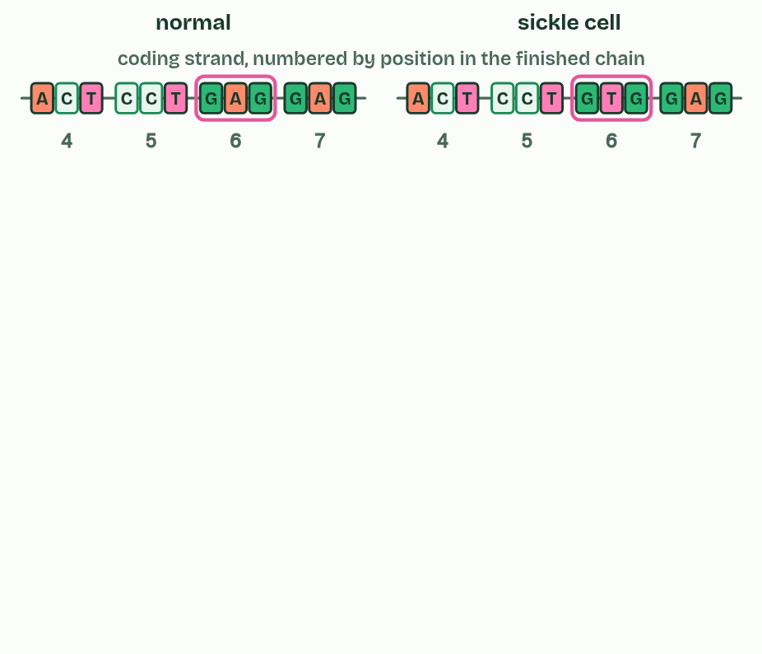
CHAPTER 7 · D1.2.11 Mutations that change protein structure
1 / 5
One base, one amino acid
One base differs in the gene for haemoglobin's beta chain.
Minutes 28 to 40
Notes:
Minutes 28 to 40 of 60: One base, one amino acid (12 min).
The plan: Chapter 7's predict box (GAA to GAG) first, then figure 7.1, Fold a protein (make the sickle cell change, fold both and make a second copy of each) and Same, Swapped, Stopped. Then Sort the substitutions.
A mutation is a change in the base sequence of a gene. A point mutation changes one base, and the commonest kind is a base substitution: one base swapped for another, which changes one codon. What that does to the polypeptide depends on the new codon. If it stands for the same amino acid, the mutation is silent, which the code's degeneracy allows. If it stands for a different amino acid, it is missense. If it is a stop codon, it is nonsense, and the chain ends early, usually too short to work.
Sickle cell anaemia is the guide's example of a point mutation that changes a protein. Haemoglobin carries oxygen in red blood cells. In the gene for its beta chain, codon 6 on the coding strand changes from GAG to GTG (on the template strand, CTC becomes CAC), so the mRNA codon changes from GAG to GUG and glutamic acid (Glu) becomes valine (Val). (The positions are counted from the first amino acid of the finished chain, which is valine, because the starting methionine is removed.
One amino acid matters because of where it sits. Glu is charged and hydrophilic, and Val is non-polar. Position 6 lies on the outside of the haemoglobin molecule, so the valine makes a non-polar patch there that sticks to a pocket on a neighbouring molecule. When oxygen is low, the molecules join into long stiff fibres that bend red blood cells into sickle shapes. The sickled cells block small blood vessels, which causes pain and damage to organs, and they are destroyed early, so the person has too few red blood cells, which is sickle cell anaemia. The haemoglobin itself still carries oxygen: the harm comes from the fibres, and from the cells' shape and short life.

Slide 22
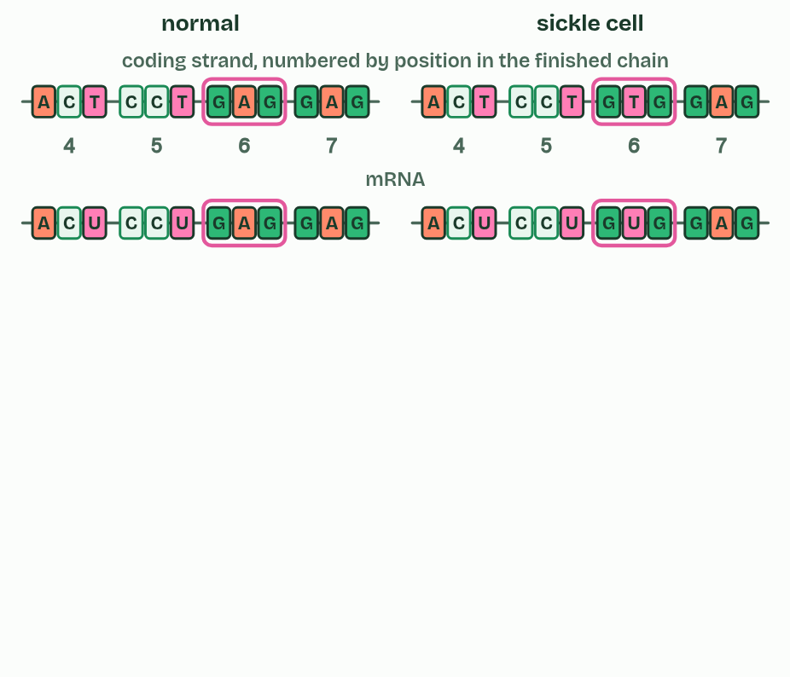
CHAPTER 7 · D1.2.11 Mutations that change protein structure
2 / 5
One base, one amino acid
So one codon in the mRNA differs.
Minutes 28 to 40
Notes:
Minutes 28 to 40 of 60: One base, one amino acid (12 min).
The plan: Chapter 7's predict box (GAA to GAG) first, then figure 7.1, Fold a protein (make the sickle cell change, fold both and make a second copy of each) and Same, Swapped, Stopped. Then Sort the substitutions.
A mutation is a change in the base sequence of a gene. A point mutation changes one base, and the commonest kind is a base substitution: one base swapped for another, which changes one codon. What that does to the polypeptide depends on the new codon. If it stands for the same amino acid, the mutation is silent, which the code's degeneracy allows. If it stands for a different amino acid, it is missense. If it is a stop codon, it is nonsense, and the chain ends early, usually too short to work.
Sickle cell anaemia is the guide's example of a point mutation that changes a protein. Haemoglobin carries oxygen in red blood cells. In the gene for its beta chain, codon 6 on the coding strand changes from GAG to GTG (on the template strand, CTC becomes CAC), so the mRNA codon changes from GAG to GUG and glutamic acid (Glu) becomes valine (Val). (The positions are counted from the first amino acid of the finished chain, which is valine, because the starting methionine is removed.
One amino acid matters because of where it sits. Glu is charged and hydrophilic, and Val is non-polar. Position 6 lies on the outside of the haemoglobin molecule, so the valine makes a non-polar patch there that sticks to a pocket on a neighbouring molecule. When oxygen is low, the molecules join into long stiff fibres that bend red blood cells into sickle shapes. The sickled cells block small blood vessels, which causes pain and damage to organs, and they are destroyed early, so the person has too few red blood cells, which is sickle cell anaemia. The haemoglobin itself still carries oxygen: the harm comes from the fibres, and from the cells' shape and short life.

Slide 23
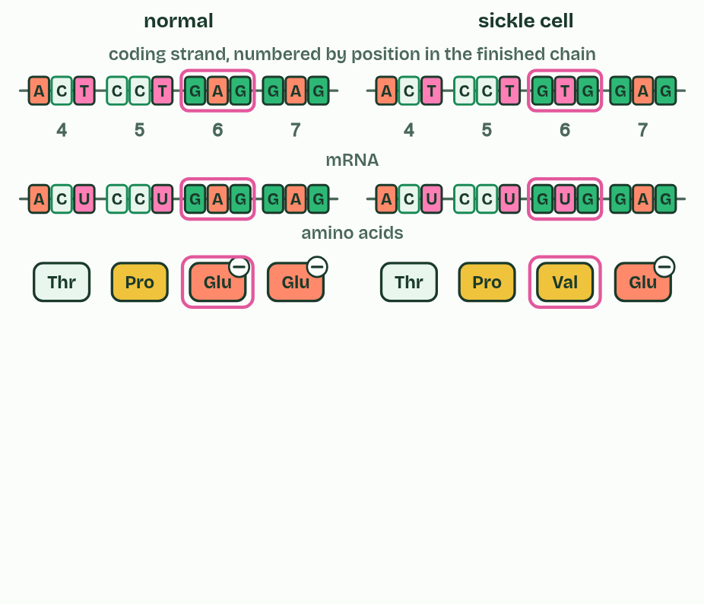
CHAPTER 7 · D1.2.11 Mutations that change protein structure
3 / 5
One base, one amino acid
So one amino acid differs: valine for glutamic acid.
Minutes 28 to 40
Notes:
Minutes 28 to 40 of 60: One base, one amino acid (12 min).
The plan: Chapter 7's predict box (GAA to GAG) first, then figure 7.1, Fold a protein (make the sickle cell change, fold both and make a second copy of each) and Same, Swapped, Stopped. Then Sort the substitutions.
A mutation is a change in the base sequence of a gene. A point mutation changes one base, and the commonest kind is a base substitution: one base swapped for another, which changes one codon. What that does to the polypeptide depends on the new codon. If it stands for the same amino acid, the mutation is silent, which the code's degeneracy allows. If it stands for a different amino acid, it is missense. If it is a stop codon, it is nonsense, and the chain ends early, usually too short to work.
Sickle cell anaemia is the guide's example of a point mutation that changes a protein. Haemoglobin carries oxygen in red blood cells. In the gene for its beta chain, codon 6 on the coding strand changes from GAG to GTG (on the template strand, CTC becomes CAC), so the mRNA codon changes from GAG to GUG and glutamic acid (Glu) becomes valine (Val). (The positions are counted from the first amino acid of the finished chain, which is valine, because the starting methionine is removed.
One amino acid matters because of where it sits. Glu is charged and hydrophilic, and Val is non-polar. Position 6 lies on the outside of the haemoglobin molecule, so the valine makes a non-polar patch there that sticks to a pocket on a neighbouring molecule. When oxygen is low, the molecules join into long stiff fibres that bend red blood cells into sickle shapes. The sickled cells block small blood vessels, which causes pain and damage to organs, and they are destroyed early, so the person has too few red blood cells, which is sickle cell anaemia. The haemoglobin itself still carries oxygen: the harm comes from the fibres, and from the cells' shape and short life.

Slide 24
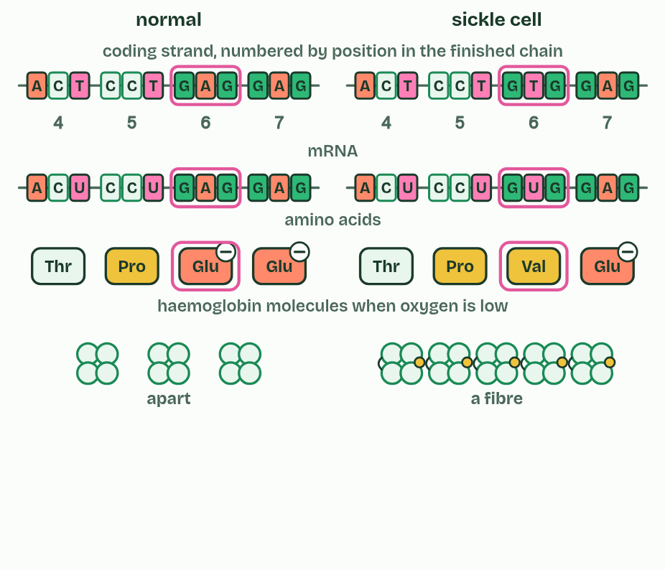
CHAPTER 7 · D1.2.11 Mutations that change protein structure
4 / 5
One base, one amino acid
The non-polar valine makes the molecules stick into fibres.
Minutes 28 to 40
Notes:
Minutes 28 to 40 of 60: One base, one amino acid (12 min).
The plan: Chapter 7's predict box (GAA to GAG) first, then figure 7.1, Fold a protein (make the sickle cell change, fold both and make a second copy of each) and Same, Swapped, Stopped. Then Sort the substitutions.
A mutation is a change in the base sequence of a gene. A point mutation changes one base, and the commonest kind is a base substitution: one base swapped for another, which changes one codon. What that does to the polypeptide depends on the new codon. If it stands for the same amino acid, the mutation is silent, which the code's degeneracy allows. If it stands for a different amino acid, it is missense. If it is a stop codon, it is nonsense, and the chain ends early, usually too short to work.
Sickle cell anaemia is the guide's example of a point mutation that changes a protein. Haemoglobin carries oxygen in red blood cells. In the gene for its beta chain, codon 6 on the coding strand changes from GAG to GTG (on the template strand, CTC becomes CAC), so the mRNA codon changes from GAG to GUG and glutamic acid (Glu) becomes valine (Val). (The positions are counted from the first amino acid of the finished chain, which is valine, because the starting methionine is removed.
One amino acid matters because of where it sits. Glu is charged and hydrophilic, and Val is non-polar. Position 6 lies on the outside of the haemoglobin molecule, so the valine makes a non-polar patch there that sticks to a pocket on a neighbouring molecule. When oxygen is low, the molecules join into long stiff fibres that bend red blood cells into sickle shapes. The sickled cells block small blood vessels, which causes pain and damage to organs, and they are destroyed early, so the person has too few red blood cells, which is sickle cell anaemia. The haemoglobin itself still carries oxygen: the harm comes from the fibres, and from the cells' shape and short life.

Slide 25
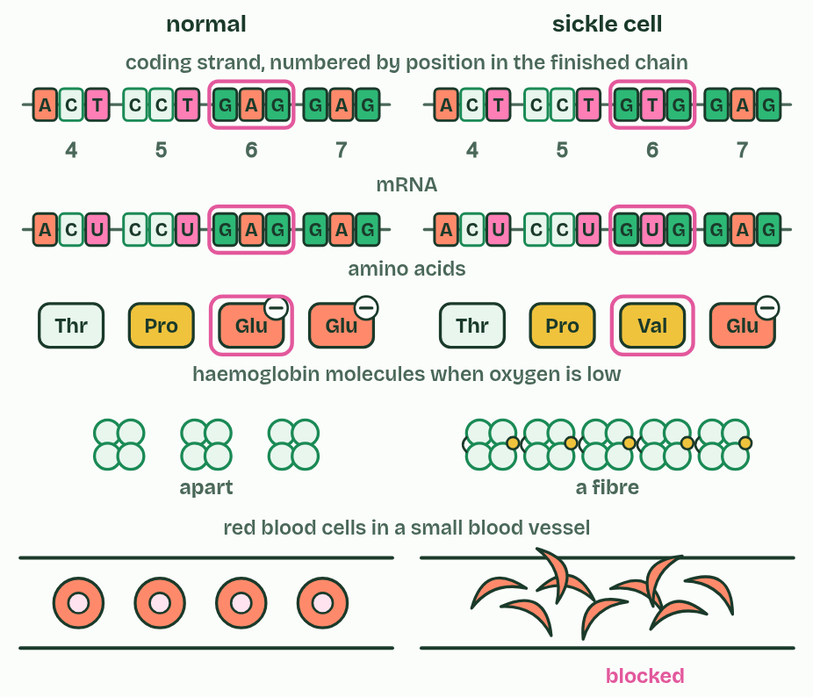
CHAPTER 7 · D1.2.11 Mutations that change protein structure
5 / 5
One base, one amino acid
Fibres bend the cells into sickles that block small vessels.
Minutes 28 to 40
Notes:
Minutes 28 to 40 of 60: One base, one amino acid (12 min).
The plan: Chapter 7's predict box (GAA to GAG) first, then figure 7.1, Fold a protein (make the sickle cell change, fold both and make a second copy of each) and Same, Swapped, Stopped. Then Sort the substitutions.
A mutation is a change in the base sequence of a gene. A point mutation changes one base, and the commonest kind is a base substitution: one base swapped for another, which changes one codon. What that does to the polypeptide depends on the new codon. If it stands for the same amino acid, the mutation is silent, which the code's degeneracy allows. If it stands for a different amino acid, it is missense. If it is a stop codon, it is nonsense, and the chain ends early, usually too short to work.
Sickle cell anaemia is the guide's example of a point mutation that changes a protein. Haemoglobin carries oxygen in red blood cells. In the gene for its beta chain, codon 6 on the coding strand changes from GAG to GTG (on the template strand, CTC becomes CAC), so the mRNA codon changes from GAG to GUG and glutamic acid (Glu) becomes valine (Val). (The positions are counted from the first amino acid of the finished chain, which is valine, because the starting methionine is removed.
One amino acid matters because of where it sits. Glu is charged and hydrophilic, and Val is non-polar. Position 6 lies on the outside of the haemoglobin molecule, so the valine makes a non-polar patch there that sticks to a pocket on a neighbouring molecule. When oxygen is low, the molecules join into long stiff fibres that bend red blood cells into sickle shapes. The sickled cells block small blood vessels, which causes pain and damage to organs, and they are destroyed early, so the person has too few red blood cells, which is sickle cell anaemia. The haemoglobin itself still carries oxygen: the harm comes from the fibres, and from the cells' shape and short life.

Slide 26
CHAPTER 7 · D1.2.11 Mutations that change protein structure
One base, one amino acid
A mutation is a change in the base sequence of a gene.
A point mutation changes one base, and the commonest kind is a base substitution: one base swapped for another, which changes one codon.
If it stands for the same amino acid, the mutation is silent, which the code's degeneracy allows.
If it stands for a different amino acid, it is missense.
Minutes 28 to 40
Notes:
Minutes 28 to 40 of 60: One base, one amino acid (12 min).
The plan: Chapter 7's predict box (GAA to GAG) first, then figure 7.1, Fold a protein (make the sickle cell change, fold both and make a second copy of each) and Same, Swapped, Stopped. Then Sort the substitutions.
A mutation is a change in the base sequence of a gene. A point mutation changes one base, and the commonest kind is a base substitution: one base swapped for another, which changes one codon. What that does to the polypeptide depends on the new codon. If it stands for the same amino acid, the mutation is silent, which the code's degeneracy allows. If it stands for a different amino acid, it is missense. If it is a stop codon, it is nonsense, and the chain ends early, usually too short to work.
Sickle cell anaemia is the guide's example of a point mutation that changes a protein. Haemoglobin carries oxygen in red blood cells. In the gene for its beta chain, codon 6 on the coding strand changes from GAG to GTG (on the template strand, CTC becomes CAC), so the mRNA codon changes from GAG to GUG and glutamic acid (Glu) becomes valine (Val). (The positions are counted from the first amino acid of the finished chain, which is valine, because the starting methionine is removed.
One amino acid matters because of where it sits. Glu is charged and hydrophilic, and Val is non-polar. Position 6 lies on the outside of the haemoglobin molecule, so the valine makes a non-polar patch there that sticks to a pocket on a neighbouring molecule. When oxygen is low, the molecules join into long stiff fibres that bend red blood cells into sickle shapes. The sickled cells block small blood vessels, which causes pain and damage to organs, and they are destroyed early, so the person has too few red blood cells, which is sickle cell anaemia. The haemoglobin itself still carries oxygen: the harm comes from the fibres, and from the cells' shape and short life.

Slide 27
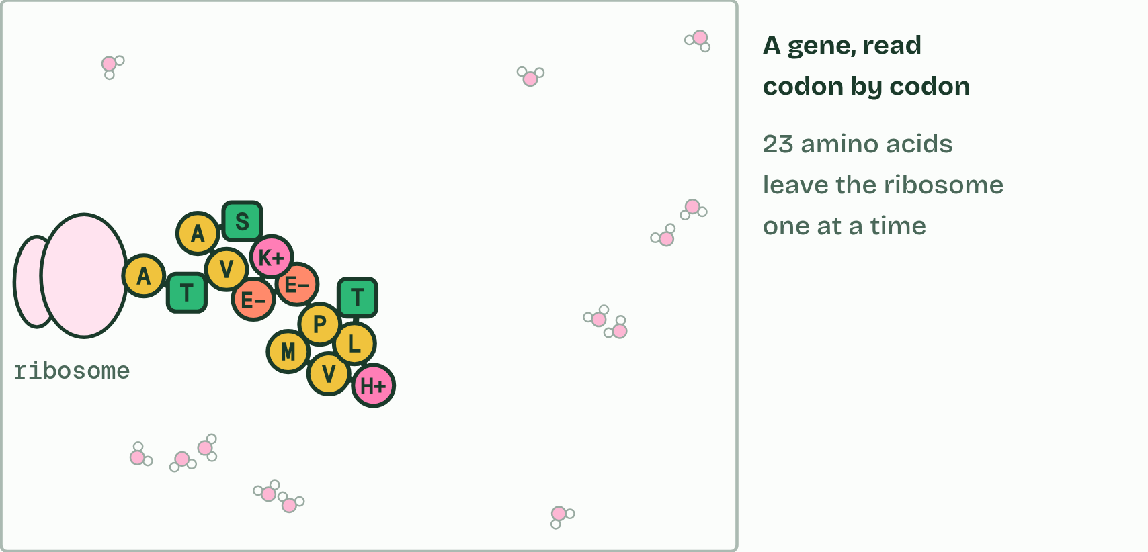
CHAPTER 7 · D1.2.11 Mutations that change protein structure
1 / 2
One base, one amino acid
The gene is transcribed and translated: Its 23 amino acids are joined by 22 peptide bonds: one of 20²³ (about 8 × 10²⁹) possible chains this long. A ribosome makes the chain one amino acid at a time, and it starts to fold as it comes out.
Minutes 28 to 40
Notes:
Minutes 28 to 40 of 60: One base, one amino acid (12 min).
The plan: Chapter 7's predict box (GAA to GAG) first, then figure 7.1, Fold a protein (make the sickle cell change, fold both and make a second copy of each) and Same, Swapped, Stopped. Then Sort the substitutions.
A mutation is a change in the base sequence of a gene. A point mutation changes one base, and the commonest kind is a base substitution: one base swapped for another, which changes one codon. What that does to the polypeptide depends on the new codon. If it stands for the same amino acid, the mutation is silent, which the code's degeneracy allows. If it stands for a different amino acid, it is missense. If it is a stop codon, it is nonsense, and the chain ends early, usually too short to work.
Sickle cell anaemia is the guide's example of a point mutation that changes a protein. Haemoglobin carries oxygen in red blood cells. In the gene for its beta chain, codon 6 on the coding strand changes from GAG to GTG (on the template strand, CTC becomes CAC), so the mRNA codon changes from GAG to GUG and glutamic acid (Glu) becomes valine (Val). (The positions are counted from the first amino acid of the finished chain, which is valine, because the starting methionine is removed.
One amino acid matters because of where it sits. Glu is charged and hydrophilic, and Val is non-polar. Position 6 lies on the outside of the haemoglobin molecule, so the valine makes a non-polar patch there that sticks to a pocket on a neighbouring molecule. When oxygen is low, the molecules join into long stiff fibres that bend red blood cells into sickle shapes. The sickled cells block small blood vessels, which causes pain and damage to organs, and they are destroyed early, so the person has too few red blood cells, which is sickle cell anaemia. The haemoglobin itself still carries oxygen: the harm comes from the fibres, and from the cells' shape and short life.

Slide 28
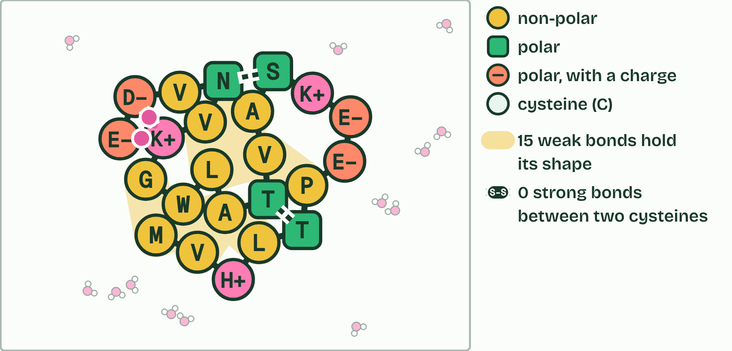
CHAPTER 7 · D1.2.11 Mutations that change protein structure
2 / 2
One base, one amino acid
It folds into a shape of its own, held by weak bonds between its side chains.
Minutes 28 to 40
Notes:
Minutes 28 to 40 of 60: One base, one amino acid (12 min).
The plan: Chapter 7's predict box (GAA to GAG) first, then figure 7.1, Fold a protein (make the sickle cell change, fold both and make a second copy of each) and Same, Swapped, Stopped. Then Sort the substitutions.
A mutation is a change in the base sequence of a gene. A point mutation changes one base, and the commonest kind is a base substitution: one base swapped for another, which changes one codon. What that does to the polypeptide depends on the new codon. If it stands for the same amino acid, the mutation is silent, which the code's degeneracy allows. If it stands for a different amino acid, it is missense. If it is a stop codon, it is nonsense, and the chain ends early, usually too short to work.
Sickle cell anaemia is the guide's example of a point mutation that changes a protein. Haemoglobin carries oxygen in red blood cells. In the gene for its beta chain, codon 6 on the coding strand changes from GAG to GTG (on the template strand, CTC becomes CAC), so the mRNA codon changes from GAG to GUG and glutamic acid (Glu) becomes valine (Val). (The positions are counted from the first amino acid of the finished chain, which is valine, because the starting methionine is removed.
One amino acid matters because of where it sits. Glu is charged and hydrophilic, and Val is non-polar. Position 6 lies on the outside of the haemoglobin molecule, so the valine makes a non-polar patch there that sticks to a pocket on a neighbouring molecule. When oxygen is low, the molecules join into long stiff fibres that bend red blood cells into sickle shapes. The sickled cells block small blood vessels, which causes pain and damage to organs, and they are destroyed early, so the person has too few red blood cells, which is sickle cell anaemia. The haemoglobin itself still carries oxygen: the harm comes from the fibres, and from the cells' shape and short life.

Slide 29
CHAPTER 7 · D1.2.11 Mutations that change protein structure
One base, one amino acid
A mutation is a change in the base sequence of a gene.
A point mutation changes one base, and the commonest kind is a base substitution: one base swapped for another, which changes one codon.
If it stands for the same amino acid, the mutation is silent, which the code's degeneracy allows.
If it stands for a different amino acid, it is missense.
Minutes 28 to 40
Notes:
Minutes 28 to 40 of 60: One base, one amino acid (12 min).
The plan: Chapter 7's predict box (GAA to GAG) first, then figure 7.1, Fold a protein (make the sickle cell change, fold both and make a second copy of each) and Same, Swapped, Stopped. Then Sort the substitutions.
A mutation is a change in the base sequence of a gene. A point mutation changes one base, and the commonest kind is a base substitution: one base swapped for another, which changes one codon. What that does to the polypeptide depends on the new codon. If it stands for the same amino acid, the mutation is silent, which the code's degeneracy allows. If it stands for a different amino acid, it is missense. If it is a stop codon, it is nonsense, and the chain ends early, usually too short to work.
Sickle cell anaemia is the guide's example of a point mutation that changes a protein. Haemoglobin carries oxygen in red blood cells. In the gene for its beta chain, codon 6 on the coding strand changes from GAG to GTG (on the template strand, CTC becomes CAC), so the mRNA codon changes from GAG to GUG and glutamic acid (Glu) becomes valine (Val). (The positions are counted from the first amino acid of the finished chain, which is valine, because the starting methionine is removed.
One amino acid matters because of where it sits. Glu is charged and hydrophilic, and Val is non-polar. Position 6 lies on the outside of the haemoglobin molecule, so the valine makes a non-polar patch there that sticks to a pocket on a neighbouring molecule. When oxygen is low, the molecules join into long stiff fibres that bend red blood cells into sickle shapes. The sickled cells block small blood vessels, which causes pain and damage to organs, and they are destroyed early, so the person has too few red blood cells, which is sickle cell anaemia. The haemoglobin itself still carries oxygen: the harm comes from the fibres, and from the cells' shape and short life.

Slide 30
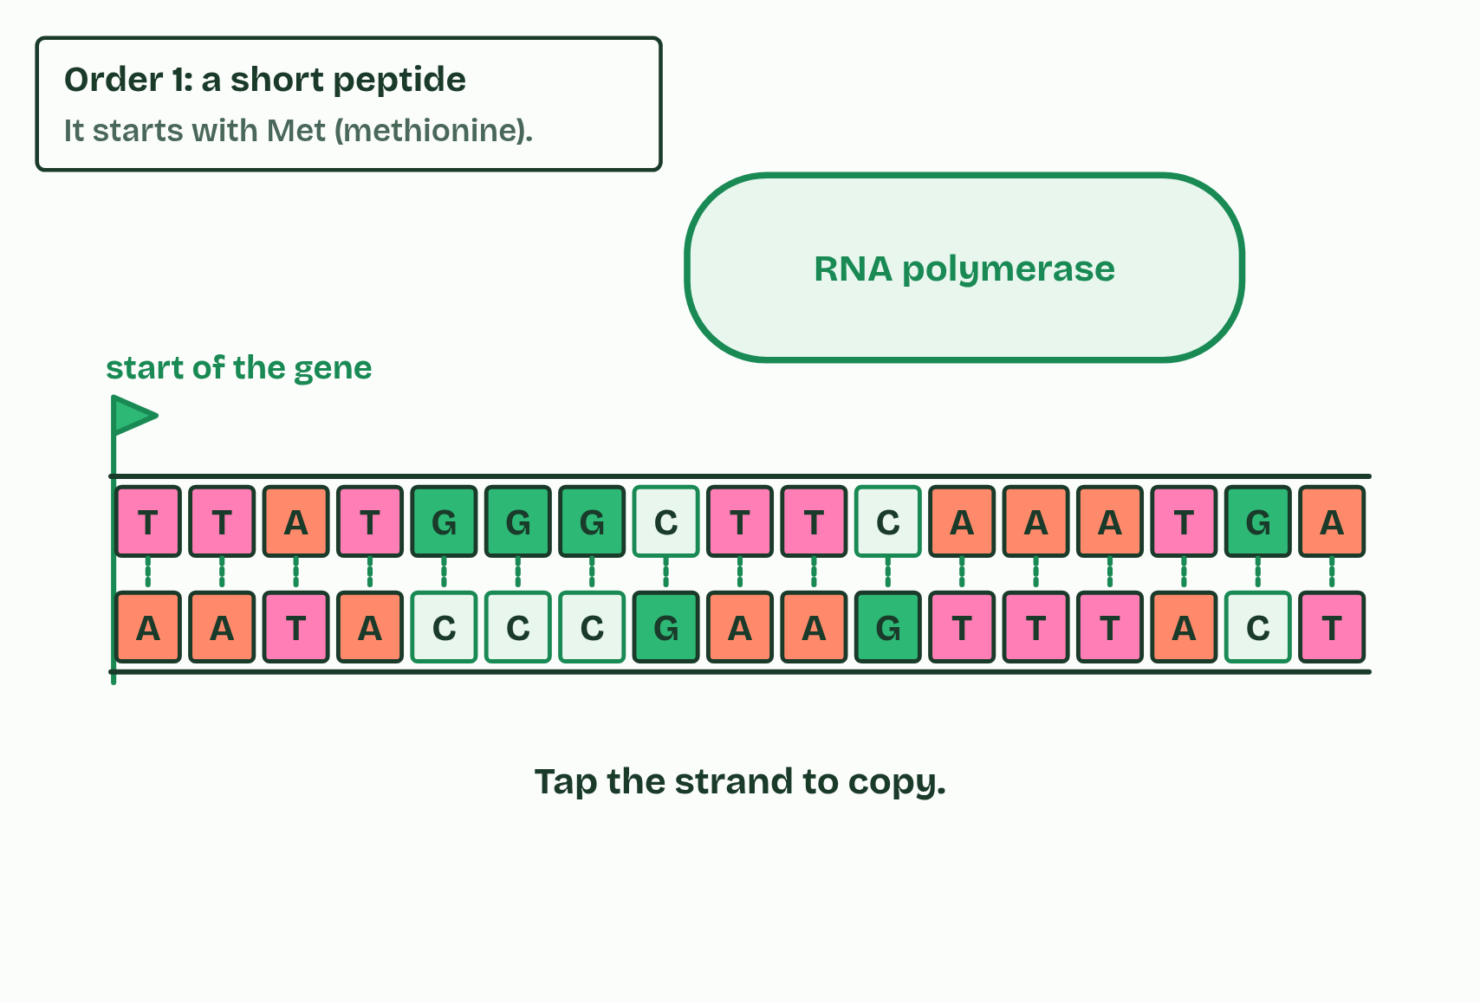
CHAPTER 7 · D1.2.11 Mutations that change protein structure
1 / 4
One base, one amino acid
Which strand will you copy?
Minutes 28 to 40
Notes:
Minutes 28 to 40 of 60: One base, one amino acid (12 min).
The plan: Chapter 7's predict box (GAA to GAG) first, then figure 7.1, Fold a protein (make the sickle cell change, fold both and make a second copy of each) and Same, Swapped, Stopped. Then Sort the substitutions.
A mutation is a change in the base sequence of a gene. A point mutation changes one base, and the commonest kind is a base substitution: one base swapped for another, which changes one codon. What that does to the polypeptide depends on the new codon. If it stands for the same amino acid, the mutation is silent, which the code's degeneracy allows. If it stands for a different amino acid, it is missense. If it is a stop codon, it is nonsense, and the chain ends early, usually too short to work.
Sickle cell anaemia is the guide's example of a point mutation that changes a protein. Haemoglobin carries oxygen in red blood cells. In the gene for its beta chain, codon 6 on the coding strand changes from GAG to GTG (on the template strand, CTC becomes CAC), so the mRNA codon changes from GAG to GUG and glutamic acid (Glu) becomes valine (Val). (The positions are counted from the first amino acid of the finished chain, which is valine, because the starting methionine is removed.
One amino acid matters because of where it sits. Glu is charged and hydrophilic, and Val is non-polar. Position 6 lies on the outside of the haemoglobin molecule, so the valine makes a non-polar patch there that sticks to a pocket on a neighbouring molecule. When oxygen is low, the molecules join into long stiff fibres that bend red blood cells into sickle shapes. The sickled cells block small blood vessels, which causes pain and damage to organs, and they are destroyed early, so the person has too few red blood cells, which is sickle cell anaemia. The haemoglobin itself still carries oxygen: the harm comes from the fibres, and from the cells' shape and short life.

Slide 31
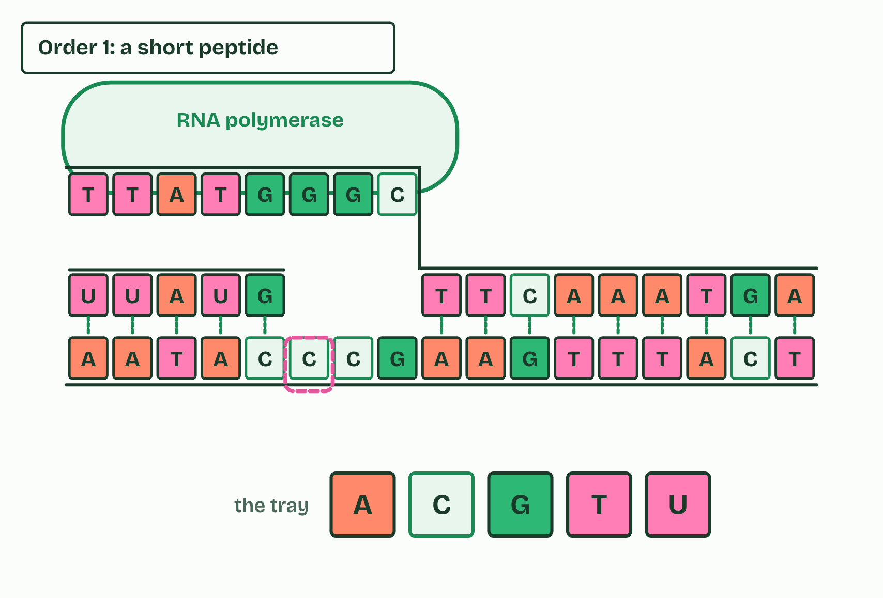
CHAPTER 7 · D1.2.11 Mutations that change protein structure
2 / 4
One base, one amino acid
Pick the base that pairs: RNA has U, not T.
Minutes 28 to 40
Notes:
Minutes 28 to 40 of 60: One base, one amino acid (12 min).
The plan: Chapter 7's predict box (GAA to GAG) first, then figure 7.1, Fold a protein (make the sickle cell change, fold both and make a second copy of each) and Same, Swapped, Stopped. Then Sort the substitutions.
A mutation is a change in the base sequence of a gene. A point mutation changes one base, and the commonest kind is a base substitution: one base swapped for another, which changes one codon. What that does to the polypeptide depends on the new codon. If it stands for the same amino acid, the mutation is silent, which the code's degeneracy allows. If it stands for a different amino acid, it is missense. If it is a stop codon, it is nonsense, and the chain ends early, usually too short to work.
Sickle cell anaemia is the guide's example of a point mutation that changes a protein. Haemoglobin carries oxygen in red blood cells. In the gene for its beta chain, codon 6 on the coding strand changes from GAG to GTG (on the template strand, CTC becomes CAC), so the mRNA codon changes from GAG to GUG and glutamic acid (Glu) becomes valine (Val). (The positions are counted from the first amino acid of the finished chain, which is valine, because the starting methionine is removed.
One amino acid matters because of where it sits. Glu is charged and hydrophilic, and Val is non-polar. Position 6 lies on the outside of the haemoglobin molecule, so the valine makes a non-polar patch there that sticks to a pocket on a neighbouring molecule. When oxygen is low, the molecules join into long stiff fibres that bend red blood cells into sickle shapes. The sickled cells block small blood vessels, which causes pain and damage to organs, and they are destroyed early, so the person has too few red blood cells, which is sickle cell anaemia. The haemoglobin itself still carries oxygen: the harm comes from the fibres, and from the cells' shape and short life.

Slide 32
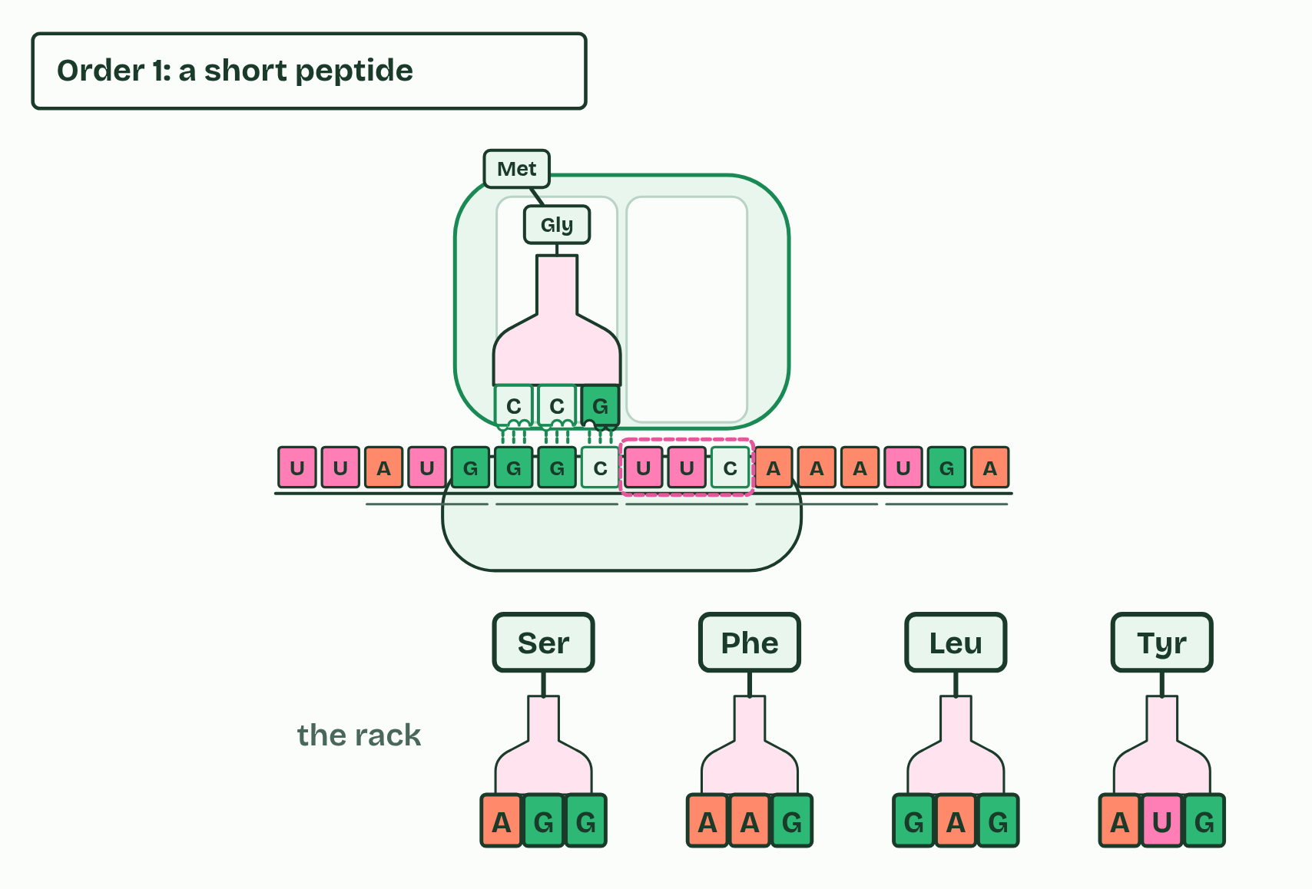
CHAPTER 7 · D1.2.11 Mutations that change protein structure
3 / 4
One base, one amino acid
Which tRNA’s anticodon pairs with this codon?
Minutes 28 to 40
Notes:
Minutes 28 to 40 of 60: One base, one amino acid (12 min).
The plan: Chapter 7's predict box (GAA to GAG) first, then figure 7.1, Fold a protein (make the sickle cell change, fold both and make a second copy of each) and Same, Swapped, Stopped. Then Sort the substitutions.
A mutation is a change in the base sequence of a gene. A point mutation changes one base, and the commonest kind is a base substitution: one base swapped for another, which changes one codon. What that does to the polypeptide depends on the new codon. If it stands for the same amino acid, the mutation is silent, which the code's degeneracy allows. If it stands for a different amino acid, it is missense. If it is a stop codon, it is nonsense, and the chain ends early, usually too short to work.
Sickle cell anaemia is the guide's example of a point mutation that changes a protein. Haemoglobin carries oxygen in red blood cells. In the gene for its beta chain, codon 6 on the coding strand changes from GAG to GTG (on the template strand, CTC becomes CAC), so the mRNA codon changes from GAG to GUG and glutamic acid (Glu) becomes valine (Val). (The positions are counted from the first amino acid of the finished chain, which is valine, because the starting methionine is removed.
One amino acid matters because of where it sits. Glu is charged and hydrophilic, and Val is non-polar. Position 6 lies on the outside of the haemoglobin molecule, so the valine makes a non-polar patch there that sticks to a pocket on a neighbouring molecule. When oxygen is low, the molecules join into long stiff fibres that bend red blood cells into sickle shapes. The sickled cells block small blood vessels, which causes pain and damage to organs, and they are destroyed early, so the person has too few red blood cells, which is sickle cell anaemia. The haemoglobin itself still carries oxygen: the harm comes from the fibres, and from the cells' shape and short life.

Slide 33
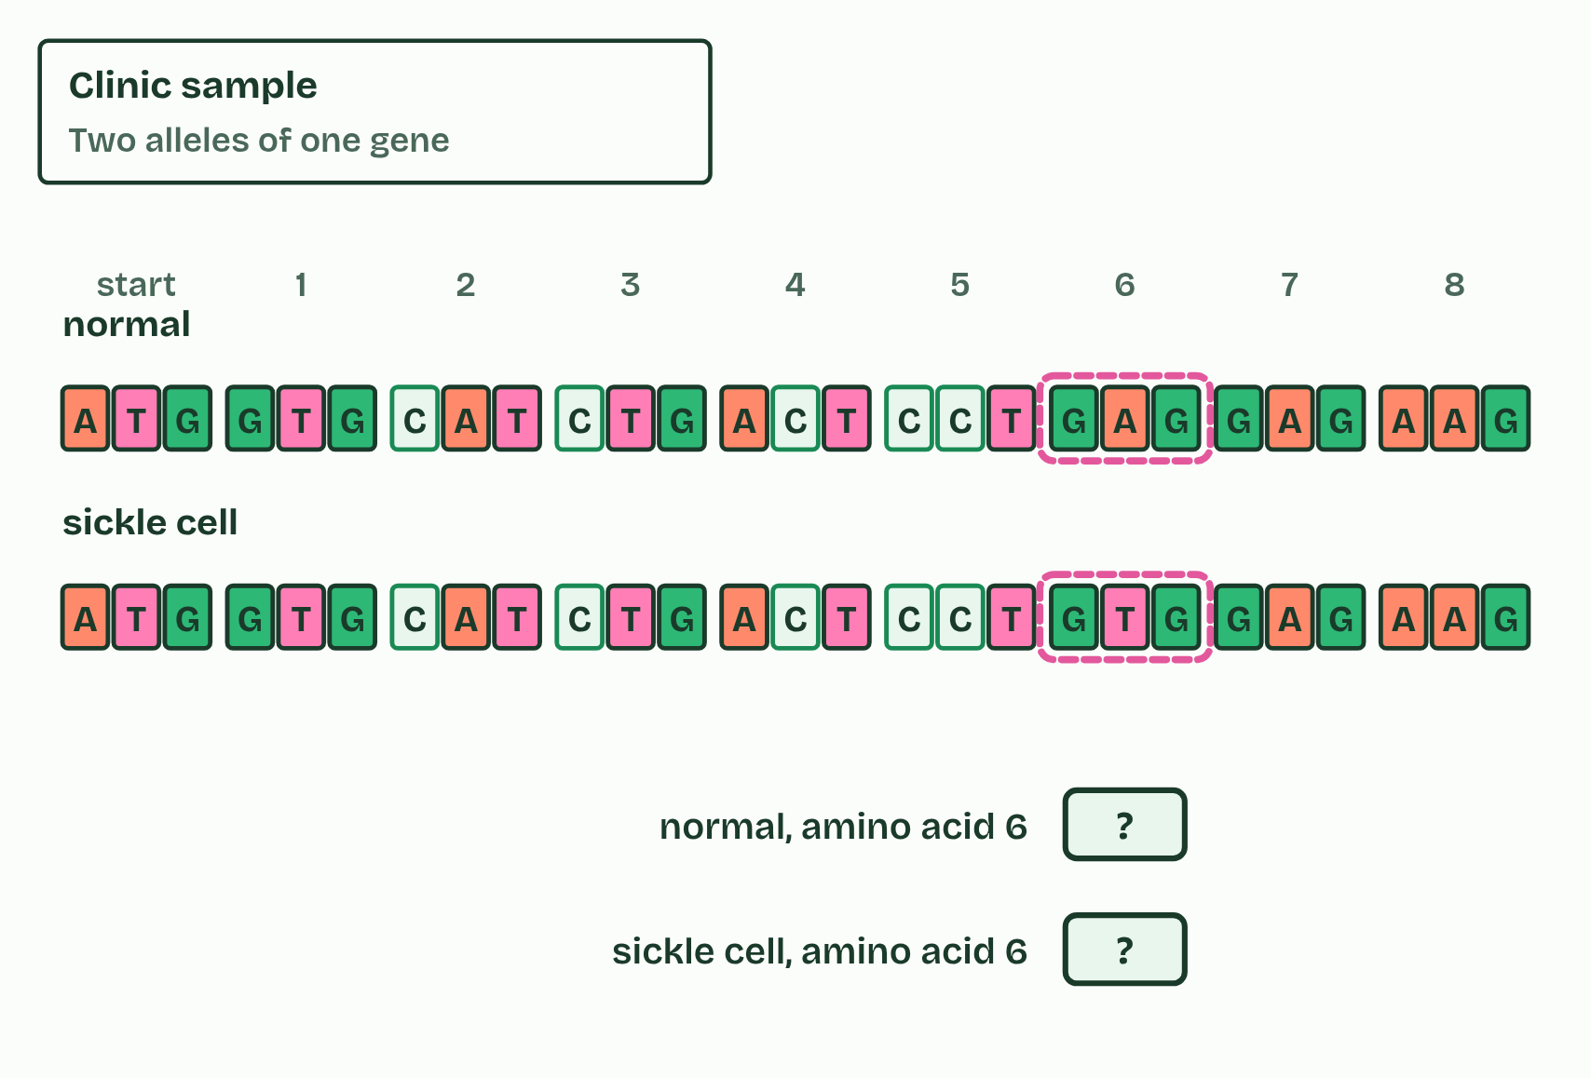
CHAPTER 7 · D1.2.11 Mutations that change protein structure
4 / 4
One base, one amino acid
One base differs. What does it do to the protein?
Minutes 28 to 40
Notes:
Minutes 28 to 40 of 60: One base, one amino acid (12 min).
The plan: Chapter 7's predict box (GAA to GAG) first, then figure 7.1, Fold a protein (make the sickle cell change, fold both and make a second copy of each) and Same, Swapped, Stopped. Then Sort the substitutions.
A mutation is a change in the base sequence of a gene. A point mutation changes one base, and the commonest kind is a base substitution: one base swapped for another, which changes one codon. What that does to the polypeptide depends on the new codon. If it stands for the same amino acid, the mutation is silent, which the code's degeneracy allows. If it stands for a different amino acid, it is missense. If it is a stop codon, it is nonsense, and the chain ends early, usually too short to work.
Sickle cell anaemia is the guide's example of a point mutation that changes a protein. Haemoglobin carries oxygen in red blood cells. In the gene for its beta chain, codon 6 on the coding strand changes from GAG to GTG (on the template strand, CTC becomes CAC), so the mRNA codon changes from GAG to GUG and glutamic acid (Glu) becomes valine (Val). (The positions are counted from the first amino acid of the finished chain, which is valine, because the starting methionine is removed.
One amino acid matters because of where it sits. Glu is charged and hydrophilic, and Val is non-polar. Position 6 lies on the outside of the haemoglobin molecule, so the valine makes a non-polar patch there that sticks to a pocket on a neighbouring molecule. When oxygen is low, the molecules join into long stiff fibres that bend red blood cells into sickle shapes. The sickled cells block small blood vessels, which causes pain and damage to organs, and they are destroyed early, so the person has too few red blood cells, which is sickle cell anaemia. The haemoglobin itself still carries oxygen: the harm comes from the fibres, and from the cells' shape and short life.

Slide 34
CHAPTER 7 · D1.2.11 Mutations that change protein structure
One base, one amino acid
A mutation is a change in the base sequence of a gene.
A point mutation changes one base, and the commonest kind is a base substitution: one base swapped for another, which changes one codon.
If it stands for the same amino acid, the mutation is silent, which the code's degeneracy allows.
If it stands for a different amino acid, it is missense.
Minutes 28 to 40
Notes:
Minutes 28 to 40 of 60: One base, one amino acid (12 min).
The plan: Chapter 7's predict box (GAA to GAG) first, then figure 7.1, Fold a protein (make the sickle cell change, fold both and make a second copy of each) and Same, Swapped, Stopped. Then Sort the substitutions.
A mutation is a change in the base sequence of a gene. A point mutation changes one base, and the commonest kind is a base substitution: one base swapped for another, which changes one codon. What that does to the polypeptide depends on the new codon. If it stands for the same amino acid, the mutation is silent, which the code's degeneracy allows. If it stands for a different amino acid, it is missense. If it is a stop codon, it is nonsense, and the chain ends early, usually too short to work.
Sickle cell anaemia is the guide's example of a point mutation that changes a protein. Haemoglobin carries oxygen in red blood cells. In the gene for its beta chain, codon 6 on the coding strand changes from GAG to GTG (on the template strand, CTC becomes CAC), so the mRNA codon changes from GAG to GUG and glutamic acid (Glu) becomes valine (Val). (The positions are counted from the first amino acid of the finished chain, which is valine, because the starting methionine is removed.
One amino acid matters because of where it sits. Glu is charged and hydrophilic, and Val is non-polar. Position 6 lies on the outside of the haemoglobin molecule, so the valine makes a non-polar patch there that sticks to a pocket on a neighbouring molecule. When oxygen is low, the molecules join into long stiff fibres that bend red blood cells into sickle shapes. The sickled cells block small blood vessels, which causes pain and damage to organs, and they are destroyed early, so the person has too few red blood cells, which is sickle cell anaemia. The haemoglobin itself still carries oxygen: the harm comes from the fibres, and from the cells' shape and short life.

Slide 35
WHAT HAPPENS
In a gene, one base changes so that an mRNA codon GAA becomes GAG. What happens to the polypeptide?
A Glu is replaced by another amino acid
B The chain stops at that codon
C No change: GAG also codes for Glu
GAA and GAG both code for glutamic acid (the code is degenerate), so the polypeptide is the same: a silent mutation. Compare the sickle cell change, GAG to GUG, where the second base changes and Glu becomes Val.
Minutes 28 to 40
Notes:
Minutes 28 to 40 of 60: One base, one amino acid (12 min).
The plan: Chapter 7's predict box (GAA to GAG) first, then figure 7.1, Fold a protein (make the sickle cell change, fold both and make a second copy of each) and Same, Swapped, Stopped. Then Sort the substitutions.
Answer: C. GAA and GAG both code for glutamic acid (the code is degenerate), so the polypeptide is the same: a silent mutation. Compare the sickle cell change, GAG to GUG, where the second base changes and Glu becomes Val.

Slide 36
WATCH OUT
A mutation changes the gene, not the protein directly: the changed protein follows from the changed codon. And not every substitution changes the protein.
Minutes 28 to 40
Notes:
Minutes 28 to 40 of 60: One base, one amino acid (12 min).
The plan: Chapter 7's predict box (GAA to GAG) first, then figure 7.1, Fold a protein (make the sickle cell change, fold both and make a second copy of each) and Same, Swapped, Stopped. Then Sort the substitutions.
A common mistake: say it, then ask who can say why it is wrong.

Slide 37
REMEMBER IT
What a substitution can do
S
S
S
Same
Swapped
Stopped
Minutes 28 to 40
Notes:
Minutes 28 to 40 of 60: One base, one amino acid (12 min).
The plan: Chapter 7's predict box (GAA to GAG) first, then figure 7.1, Fold a protein (make the sickle cell change, fold both and make a second copy of each) and Same, Swapped, Stopped. Then Sort the substitutions.
Ask the class what each letter stands for before revealing.

Slide 38
REMEMBER IT
What a substitution can do
S
S
S
Same
Swapped
Stopped
Silent
Missense
Nonsense
the same amino acid
a different amino acid
a stop codon: the chain ends early
Minutes 28 to 40
Notes:
Minutes 28 to 40 of 60: One base, one amino acid (12 min).
The plan: Chapter 7's predict box (GAA to GAG) first, then figure 7.1, Fold a protein (make the sickle cell change, fold both and make a second copy of each) and Same, Swapped, Stopped. Then Sort the substitutions.
Same: Silent (the same amino acid)
Swapped: Missense (a different amino acid)
Stopped: Nonsense (a stop codon: the chain ends early)

Slide 39
GAME
12 MIN
The protein factory
THE TASK
One device per pair.
STUDENTS NEED
One device per pair.
Minutes 40 to 52
Notes:
Minutes 40 to 52 of 60: The protein factory (12 min).
The plan: In pairs, on a device each: rounds 1, 3 and 4 (round 2 and round 5 for homework).
The activity: The protein factory. One device per pair.
Needs: one device per pair.
The time: 12 minutes, minutes 40 to 52 of the plan.

Slide 40
PLENARY
Can you now...
Describe how the ribosome moves one codon at a time, joining each amino acid to the chain with a peptide bond (D1.2.10)
Explain how one base change in the haemoglobin gene causes sickle cell anaemia (D1.2.11)
Minutes 52 to 60
Notes:
Minutes 52 to 60 of 60: Exit (8 min).
The plan: A short written question on translation or elongation from the D1.2 exam maker (in Practise and revise), marked in pairs against its markscheme.
Thumbs up, sideways or down on each goal before the exit question. The goals come from the statements this lesson covers.

Slide 41
EXIT QUESTION
Before you go
A short written question on translation or elongation from the D1.2 exam maker, marked in pairs against its markscheme.
Minutes 52 to 60
Notes:
Minutes 52 to 60 of 60: Exit (8 min).
The plan: A short written question on translation or elongation from the D1.2 exam maker (in Practise and revise), marked in pairs against its markscheme.

Slide 42
PRACTISE AND REVISE
Keep going
Exam practice: a fresh paper of exam questions on D1.2 at standard level, marked as you go
The guide, with the animations and the dry lab
This lesson in the guide: 6 One codon at a time, 7 One base, one amino acid
BUILD FOR YOUR CLASS
ALREADY ON THE SITE FOR D1.2
CARD SETS ON SPLYCR
Tarsia puzzle, dominoes and picture reveal on D1.2, built from its key terms and ready to print
A pub quiz with rounds on D1.2, to present or run with no projector
An escape room built from the question bank on D1.2
Quiz: Protein Synthesis
Revision map: D1.2 Protein synthesis, to fill in
Exam questions: D1.2 in the exam maker, a paper with its markscheme
Open a set to host it as a class game, or make a copy to edit.
D1.2 Protein Synthesis (SL)
How this was made. The course structure, the activities and the teaching choices come from my own classroom, my presentations and my years of teaching IB and AP Biology. I use Claude, an AI, to help write and build the interactive guides, lesson plans, slides and practice questions, and to draw the diagrams and code the interactives. I direct the work and review it against the IB and AP specifications before it goes live.
Minute 60: after the lesson
Notes:
Every link here is live. Set the exam practice paper for homework: it is fresh each time, marked as students go and saved to their Exam practice when they are signed in.
Exam practice: https://www.biologybybradford.com/exam-maker/sit?topics=D1.2&level=SL&paper=quiz&marks=15&src=ep
The guide: https://www.biologybybradford.com/guides/ib-biology-d1-2-protein-synthesis

