Slide 1
IB Biology D1.2
LESSON 4 OF 6
HL
BY THE END YOU CAN
Protein synthesis
Explain what 5′ to 3′ means for transcription and for translation (D1.2.12)
Explain how transcription factors start transcription at a promoter, and name four kinds of DNA that code for no polypeptide (D1.2.13, D1.2.14)
Direction, promoters and non-coding DNA
D1.2.12 to D1.2.14
The direction of transcription and translation, transcription factors at the promoter, and DNA that codes for no polypeptide
60 minutes · chapters 8, 9
Minute 0
Notes:
IB Biology D1.2, Protein synthesis. Lesson 4 of 6: Direction, promoters and non-coding DNA (higher level), 60 minutes.
The plan, minute by minute (each slide's footer says where you are):
0 to 6 min (6) Do now
6 to 16 min (10) Which way it runs
16 to 34 min (18) Gene expression simulation
34 to 42 min (8) Switch the gene on
42 to 54 min (12) What is in a genome?
54 to 60 min (6) Exit
What students get wrong:
The ribosome reads 3′ to 5′. 5′ to 3′; it is the template that is read 3′ to 5′ in transcription.
The promoter is the TATA box, and it is transcribed. The promoter is a region, not transcribed; a TATA box is one sequence found in many.
Non-coding DNA is junk, or is never transcribed. It has jobs; introns and rRNA and tRNA genes are transcribed.
Stretch and support:
Support: play the factory's "Let the cell do it" on the board before pairs try a round.
The lesson plan to print: https://www.biologybybradford.com/guides/downloads/ib-biology-d1-2-protein-synthesis-lesson-4-plan.pdf

Slide 2
DO NOW
Do now
Chapter 8's predict box (3′-TACAAGCGT-5′) on mini whiteboards.
6:00
minutes
Start now: the timer is running.
Minutes 0 to 6
Notes:
Minutes 0 to 6 of 60: Do now (6 min).
The plan: Chapter 8's predict box (3′-TACAAGCGT-5′) on mini whiteboards.
Start a 6 minute timer as they come in.

Slide 3
PREDICT
A template strand reads 3′-TACAAGCGT-5′. Written 5′ to 3′, what is the mRNA?
A 5′-ACGCUUGUA-3′
B 5′-AUGUUCGCA-3′
C 5′-UACAAGCGU-3′
Minutes 0 to 6
Notes:
Minutes 0 to 6 of 60: Do now (6 min).
The plan: Chapter 8's predict box (3′-TACAAGCGT-5′) on mini whiteboards.
Ask for a show of hands, or mini whiteboards, before revealing. (Answer: B, on the next slide.)

Slide 4
WHAT HAPPENS
A template strand reads 3′-TACAAGCGT-5′. Written 5′ to 3′, what is the mRNA?
A 5′-ACGCUUGUA-3′
B 5′-AUGUUCGCA-3′
C 5′-UACAAGCGU-3′
Pair each base, keeping the template's order: T A C A A G C G T gives A U G U U C G C A. The template runs 3′ to 5′, so the mRNA opposite it runs 5′ to 3′: 5′-AUGUUCGCA-3′ (it starts with the start codon). “5′-ACGCUUGUA-3′” has the right bases written backwards, and “5′-UACAAGCGU-3′” copies the template instead of pairing with it.
Minutes 0 to 6
Notes:
Minutes 0 to 6 of 60: Do now (6 min).
The plan: Chapter 8's predict box (3′-TACAAGCGT-5′) on mini whiteboards.
Answer: B. Pair each base, keeping the template's order: T A C A A G C G T gives A U G U U C G C A. The template runs 3′ to 5′, so the mRNA opposite it runs 5′ to 3′: 5′-AUGUUCGCA-3′ (it starts with the start codon). “5′-ACGCUUGUA-3′” has the right bases written backwards, and “5′-UACAAGCGU-3′” copies the template instead of pairing with it.

Slide 5
STEP 2
10 MIN
Which way it runs
Students add 5′ and 3′ labels and two arrows to their lesson 1 drawing.
Minutes 6 to 16
Notes:
Minutes 6 to 16 of 60: Which way it runs (10 min).
The plan: Chapter 8's figure. Students add 5′ and 3′ labels and two arrows to their lesson 1 drawing.

Slide 6
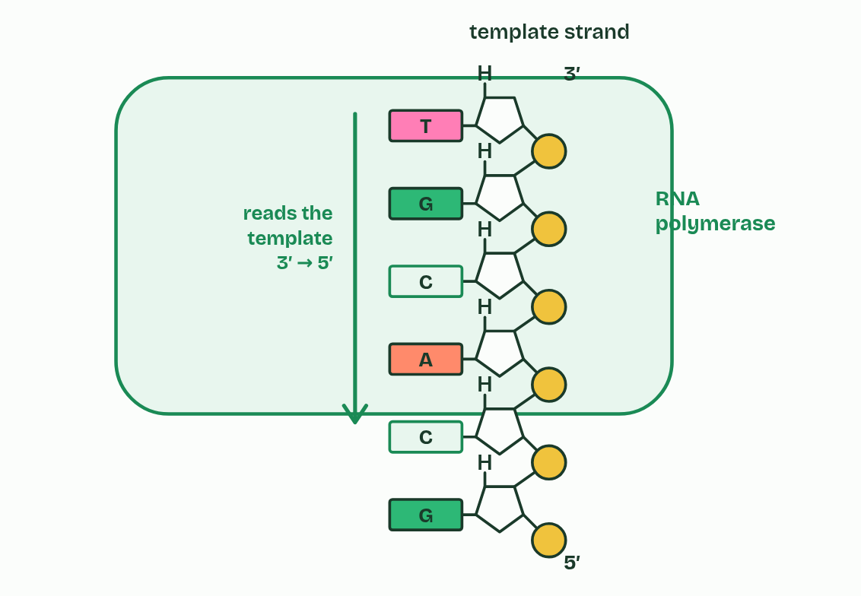
CHAPTER 8 · D1.2.12 Directionality
1 / 4
Five prime to three prime, both times
The polymerase reads the template 3′ to 5′.
Minutes 6 to 16
Notes:
Minutes 6 to 16 of 60: Which way it runs (10 min).
The plan: Chapter 8's figure. Students add 5′ and 3′ labels and two arrows to their lesson 1 drawing.
From A1.2 you know that the carbons of a nucleotide's sugar are numbered 1′ to 5′. A strand has a 5′ end, where the last nucleotide has a phosphate on its carbon 5′, and a 3′ end, where the last nucleotide has a free OH on its carbon 3′. So every strand has a direction.
5′ to 3′ transcription means that RNA polymerase joins the 5′ phosphate of each incoming RNA nucleotide to the 3′ OH at the end of the growing RNA (the sugar is ribose, because this is RNA). The new link is a covalent bond, the same sugar-phosphate bond that forms the backbone of a strand (A1.2). A nucleotide can only be added at the 3′ end, so the RNA is built from its 5′ end to its 3′ end. The template runs the opposite way to the RNA, so the polymerase reads the template 3′ to 5′. The coding strand runs the same way as the RNA, which is why its sequence, written 5′ to 3′, matches the mRNA's.
Translation runs 5′ to 3′ too. The ribosome starts near the mRNA's 5′ end and moves towards its 3′ end, so the codons are read in that order, and the first amino acid of the polypeptide comes from the codon nearest the 5′ end. Direction matters: read the other way, the same bases make different codons and a different polypeptide, and the start codon is found only by moving 5′ to 3′ from the 5′ end (chapter 11). By convention a sequence is written 5′ to 3′, left to right, unless it is labelled otherwise.

Slide 7
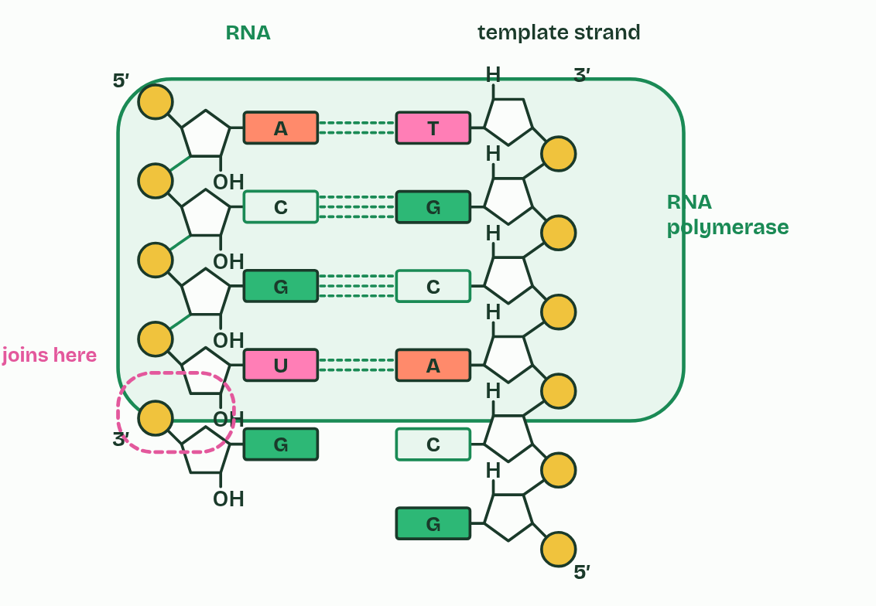
CHAPTER 8 · D1.2.12 Directionality
2 / 4
Five prime to three prime, both times
Each new nucleotide joins the RNA's 3′ end.
Minutes 6 to 16
Notes:
Minutes 6 to 16 of 60: Which way it runs (10 min).
The plan: Chapter 8's figure. Students add 5′ and 3′ labels and two arrows to their lesson 1 drawing.
From A1.2 you know that the carbons of a nucleotide's sugar are numbered 1′ to 5′. A strand has a 5′ end, where the last nucleotide has a phosphate on its carbon 5′, and a 3′ end, where the last nucleotide has a free OH on its carbon 3′. So every strand has a direction.
5′ to 3′ transcription means that RNA polymerase joins the 5′ phosphate of each incoming RNA nucleotide to the 3′ OH at the end of the growing RNA (the sugar is ribose, because this is RNA). The new link is a covalent bond, the same sugar-phosphate bond that forms the backbone of a strand (A1.2). A nucleotide can only be added at the 3′ end, so the RNA is built from its 5′ end to its 3′ end. The template runs the opposite way to the RNA, so the polymerase reads the template 3′ to 5′. The coding strand runs the same way as the RNA, which is why its sequence, written 5′ to 3′, matches the mRNA's.
Translation runs 5′ to 3′ too. The ribosome starts near the mRNA's 5′ end and moves towards its 3′ end, so the codons are read in that order, and the first amino acid of the polypeptide comes from the codon nearest the 5′ end. Direction matters: read the other way, the same bases make different codons and a different polypeptide, and the start codon is found only by moving 5′ to 3′ from the 5′ end (chapter 11). By convention a sequence is written 5′ to 3′, left to right, unless it is labelled otherwise.

Slide 8
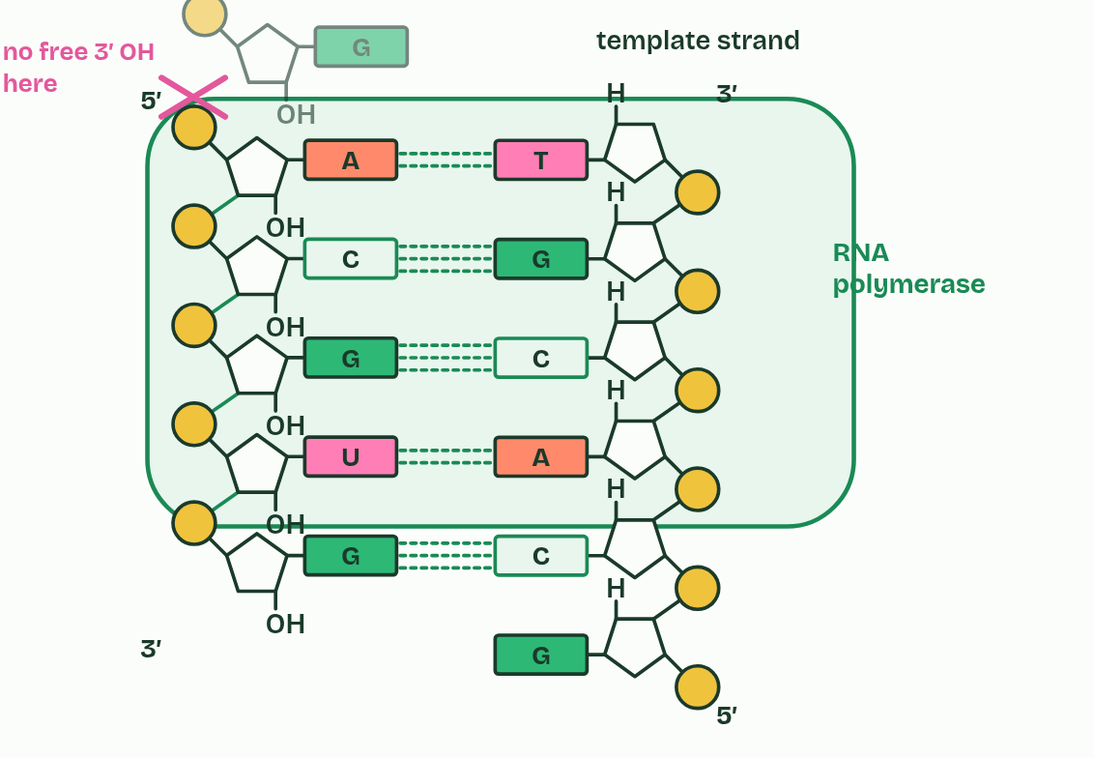
CHAPTER 8 · D1.2.12 Directionality
3 / 4
Five prime to three prime, both times
Nothing can join at the 5′ end.
Minutes 6 to 16
Notes:
Minutes 6 to 16 of 60: Which way it runs (10 min).
The plan: Chapter 8's figure. Students add 5′ and 3′ labels and two arrows to their lesson 1 drawing.
From A1.2 you know that the carbons of a nucleotide's sugar are numbered 1′ to 5′. A strand has a 5′ end, where the last nucleotide has a phosphate on its carbon 5′, and a 3′ end, where the last nucleotide has a free OH on its carbon 3′. So every strand has a direction.
5′ to 3′ transcription means that RNA polymerase joins the 5′ phosphate of each incoming RNA nucleotide to the 3′ OH at the end of the growing RNA (the sugar is ribose, because this is RNA). The new link is a covalent bond, the same sugar-phosphate bond that forms the backbone of a strand (A1.2). A nucleotide can only be added at the 3′ end, so the RNA is built from its 5′ end to its 3′ end. The template runs the opposite way to the RNA, so the polymerase reads the template 3′ to 5′. The coding strand runs the same way as the RNA, which is why its sequence, written 5′ to 3′, matches the mRNA's.
Translation runs 5′ to 3′ too. The ribosome starts near the mRNA's 5′ end and moves towards its 3′ end, so the codons are read in that order, and the first amino acid of the polypeptide comes from the codon nearest the 5′ end. Direction matters: read the other way, the same bases make different codons and a different polypeptide, and the start codon is found only by moving 5′ to 3′ from the 5′ end (chapter 11). By convention a sequence is written 5′ to 3′, left to right, unless it is labelled otherwise.

Slide 9
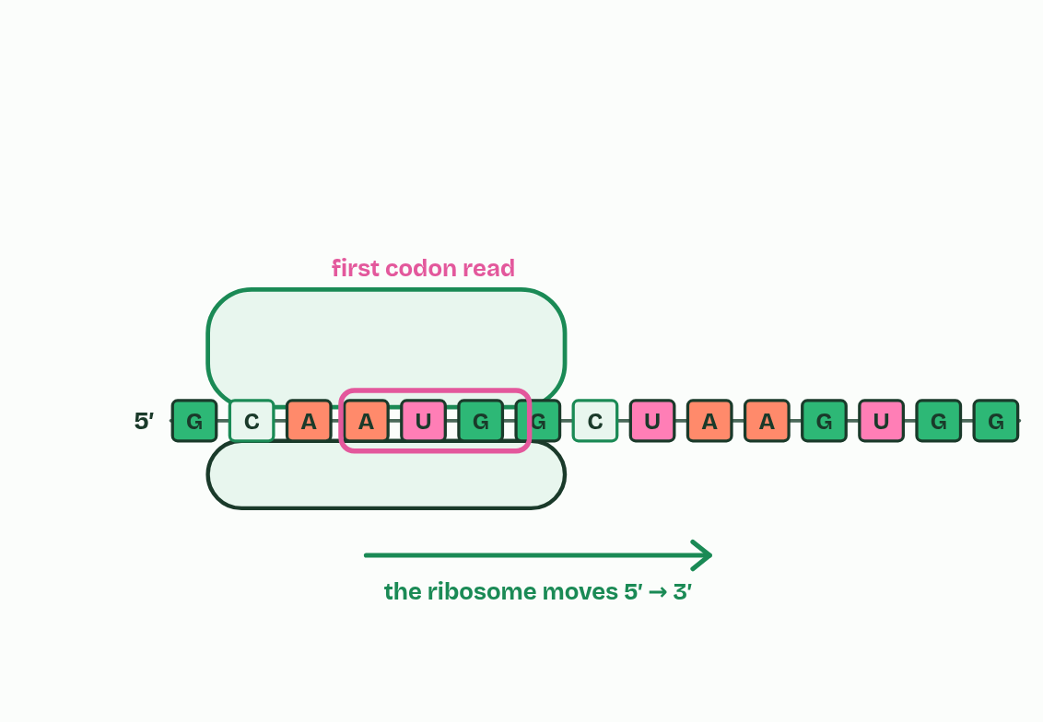
CHAPTER 8 · D1.2.12 Directionality
4 / 4
Five prime to three prime, both times
The ribosome reads the mRNA 5′ to 3′ too.
Minutes 6 to 16
Notes:
Minutes 6 to 16 of 60: Which way it runs (10 min).
The plan: Chapter 8's figure. Students add 5′ and 3′ labels and two arrows to their lesson 1 drawing.
From A1.2 you know that the carbons of a nucleotide's sugar are numbered 1′ to 5′. A strand has a 5′ end, where the last nucleotide has a phosphate on its carbon 5′, and a 3′ end, where the last nucleotide has a free OH on its carbon 3′. So every strand has a direction.
5′ to 3′ transcription means that RNA polymerase joins the 5′ phosphate of each incoming RNA nucleotide to the 3′ OH at the end of the growing RNA (the sugar is ribose, because this is RNA). The new link is a covalent bond, the same sugar-phosphate bond that forms the backbone of a strand (A1.2). A nucleotide can only be added at the 3′ end, so the RNA is built from its 5′ end to its 3′ end. The template runs the opposite way to the RNA, so the polymerase reads the template 3′ to 5′. The coding strand runs the same way as the RNA, which is why its sequence, written 5′ to 3′, matches the mRNA's.
Translation runs 5′ to 3′ too. The ribosome starts near the mRNA's 5′ end and moves towards its 3′ end, so the codons are read in that order, and the first amino acid of the polypeptide comes from the codon nearest the 5′ end. Direction matters: read the other way, the same bases make different codons and a different polypeptide, and the start codon is found only by moving 5′ to 3′ from the 5′ end (chapter 11). By convention a sequence is written 5′ to 3′, left to right, unless it is labelled otherwise.

Slide 10
CHAPTER 8 · D1.2.12 Directionality
Five prime to three prime, both times
A strand has a 5′ end, where the last nucleotide has a phosphate on its carbon 5′, and a 3′ end, where the last nucleotide has a free OH on its carbon 3′.
5′ to 3′ transcription means that RNA polymerase joins the 5′ phosphate of each incoming RNA nucleotide to the 3′ OH at the end of the growing RNA (the sugar is ribose, because this is RNA).
A nucleotide can only be added at the 3′ end, so the RNA is built from its 5′ end to its 3′ end.
The coding strand runs the same way as the RNA, which is why its sequence, written 5′ to 3′, matches the mRNA's.
Minutes 6 to 16
Notes:
Minutes 6 to 16 of 60: Which way it runs (10 min).
The plan: Chapter 8's figure. Students add 5′ and 3′ labels and two arrows to their lesson 1 drawing.
From A1.2 you know that the carbons of a nucleotide's sugar are numbered 1′ to 5′. A strand has a 5′ end, where the last nucleotide has a phosphate on its carbon 5′, and a 3′ end, where the last nucleotide has a free OH on its carbon 3′. So every strand has a direction.
5′ to 3′ transcription means that RNA polymerase joins the 5′ phosphate of each incoming RNA nucleotide to the 3′ OH at the end of the growing RNA (the sugar is ribose, because this is RNA). The new link is a covalent bond, the same sugar-phosphate bond that forms the backbone of a strand (A1.2). A nucleotide can only be added at the 3′ end, so the RNA is built from its 5′ end to its 3′ end. The template runs the opposite way to the RNA, so the polymerase reads the template 3′ to 5′. The coding strand runs the same way as the RNA, which is why its sequence, written 5′ to 3′, matches the mRNA's.
Translation runs 5′ to 3′ too. The ribosome starts near the mRNA's 5′ end and moves towards its 3′ end, so the codons are read in that order, and the first amino acid of the polypeptide comes from the codon nearest the 5′ end. Direction matters: read the other way, the same bases make different codons and a different polypeptide, and the start codon is found only by moving 5′ to 3′ from the 5′ end (chapter 11). By convention a sequence is written 5′ to 3′, left to right, unless it is labelled otherwise.

Slide 11
WATCH OUT
5′ and 3′ name carbons of the sugar. The polymerase moves along the template from its 3′ end towards its 5′ end, while the RNA it makes grows 5′ to 3′: two directions, one movement.
Minutes 6 to 16
Notes:
Minutes 6 to 16 of 60: Which way it runs (10 min).
The plan: Chapter 8's figure. Students add 5′ and 3′ labels and two arrows to their lesson 1 drawing.
A common mistake: say it, then ask who can say why it is wrong.

Slide 12

SIMULATION · HL
18 MIN
Gene expression simulation
THE TASK
The free Gene Expression Essentials simulation from PhET, with these questions. What must be on the regulatory region before RNA polymerase will transcribe the gene? What does a positive transcription factor do, and what does a negative one do? Why would a cell destroy its mRNA? Which slider on the mRNA screen changes the rate most? What does "affinity" mean here? Land on this: the regulatory region in the simulation stands for the promoter, and the factors decide whether a gene is read.
STUDENTS NEED
Laptops or tablets (it runs in a browser).
Minutes 16 to 34
Notes:
Minutes 16 to 34 of 60: Gene expression simulation (18 min).
The plan: Pairs work through the simulation and its questions (activity below).
The activity: Gene expression simulation. The free Gene Expression Essentials simulation from PhET, with these questions. What must be on the regulatory region before RNA polymerase will transcribe the gene? What does a positive transcription factor do, and what does a negative one do? Why would a cell destroy its mRNA? Which slider on the mRNA screen changes the rate most? What does "affinity" mean here? Land on this: the regulatory region in the simulation stands for the promoter, and the factors decide whether a gene is read.
Needs: laptops or tablets (it runs in a browser).
The time: 18 minutes, minutes 16 to 34 of the plan.

Slide 13
STEP 4
8 MIN
Switch the gene on
Chapter 9: Where a gene starts, and DNA that codes for nothing
Minutes 34 to 42
Notes:
Minutes 34 to 42 of 60: Switch the gene on (8 min).
The plan: Chapter 9's switch figure, then chapter 9's predict box (the tRNA gene).

Slide 14
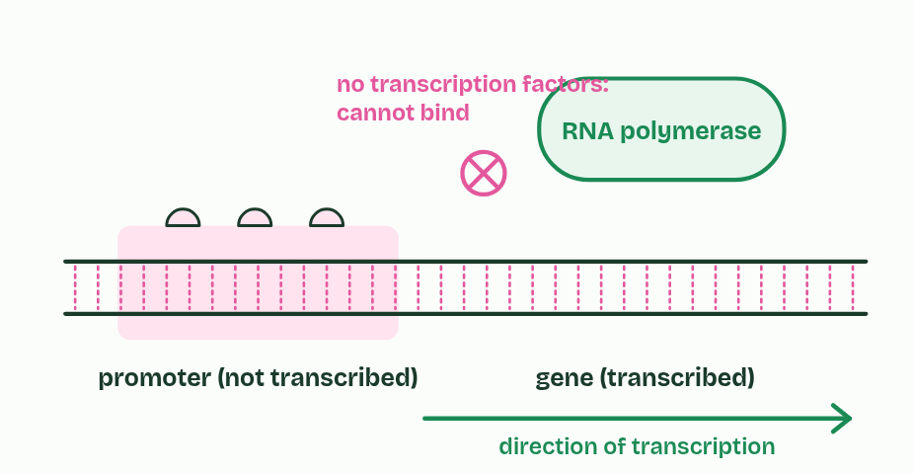
CHAPTER 9 · D1.2.13 D1.2.14 Promoters and non-coding DNA
1 / 2
Where a gene starts, and DNA that codes for nothing
Absent
Minutes 34 to 42
Notes:
Minutes 34 to 42 of 60: Switch the gene on (8 min).
The plan: Chapter 9's switch figure, then chapter 9's predict box (the tRNA gene).
The promoter is a stretch of DNA just before the part of a gene that is transcribed. It is not transcribed itself. It is where transcription starts. Transcription factors are proteins that attach to the promoter, and RNA polymerase can bind and start only when the right ones are in place (you do not have to name any). Which factors a cell makes decides which of its genes are transcribed: that is the switch from chapter 2. Some factors promote transcription and others block it. The promoter is a whole region, not one named sequence.
Non-coding sequences are stretches of DNA that code for no polypeptide. In humans only about 1 to 2% of the genome codes for polypeptides, and the rest includes:
Non-coding does not mean useless. Every one of these has a job, and none of them codes for a polypeptide.

Slide 15
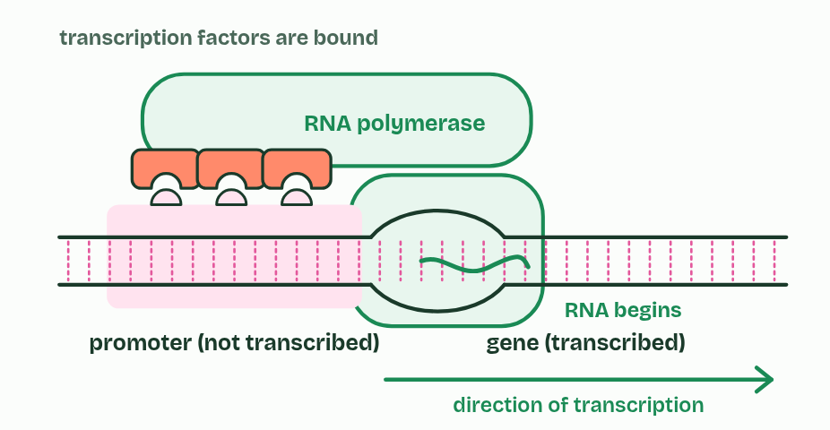
CHAPTER 9 · D1.2.13 D1.2.14 Promoters and non-coding DNA
2 / 2
Where a gene starts, and DNA that codes for nothing
Present
Minutes 34 to 42
Notes:
Minutes 34 to 42 of 60: Switch the gene on (8 min).
The plan: Chapter 9's switch figure, then chapter 9's predict box (the tRNA gene).
The promoter is a stretch of DNA just before the part of a gene that is transcribed. It is not transcribed itself. It is where transcription starts. Transcription factors are proteins that attach to the promoter, and RNA polymerase can bind and start only when the right ones are in place (you do not have to name any). Which factors a cell makes decides which of its genes are transcribed: that is the switch from chapter 2. Some factors promote transcription and others block it. The promoter is a whole region, not one named sequence.
Non-coding sequences are stretches of DNA that code for no polypeptide. In humans only about 1 to 2% of the genome codes for polypeptides, and the rest includes:
Non-coding does not mean useless. Every one of these has a job, and none of them codes for a polypeptide.

Slide 16
CHAPTER 9 · D1.2.13 D1.2.14 Promoters and non-coding DNA
Where a gene starts, and DNA that codes for nothing
regulators of gene expression: promoters, and other sequences where factors bind;
introns: stretches inside a gene that are transcribed but cut out of the RNA (chapter 10);
telomeres: repeats of a short sequence (TTAGGG in humans) at each end of a chromosome, which protect the genes near the ends when the DNA is copied;
genes for rRNA and tRNA: they are transcribed, and the RNA is the product. It is never translated.
Minutes 34 to 42
Notes:
Minutes 34 to 42 of 60: Switch the gene on (8 min).
The plan: Chapter 9's switch figure, then chapter 9's predict box (the tRNA gene).
The promoter is a stretch of DNA just before the part of a gene that is transcribed. It is not transcribed itself. It is where transcription starts. Transcription factors are proteins that attach to the promoter, and RNA polymerase can bind and start only when the right ones are in place (you do not have to name any). Which factors a cell makes decides which of its genes are transcribed: that is the switch from chapter 2. Some factors promote transcription and others block it. The promoter is a whole region, not one named sequence.
Non-coding sequences are stretches of DNA that code for no polypeptide. In humans only about 1 to 2% of the genome codes for polypeptides, and the rest includes:
Non-coding does not mean useless. Every one of these has a job, and none of them codes for a polypeptide.

Slide 17
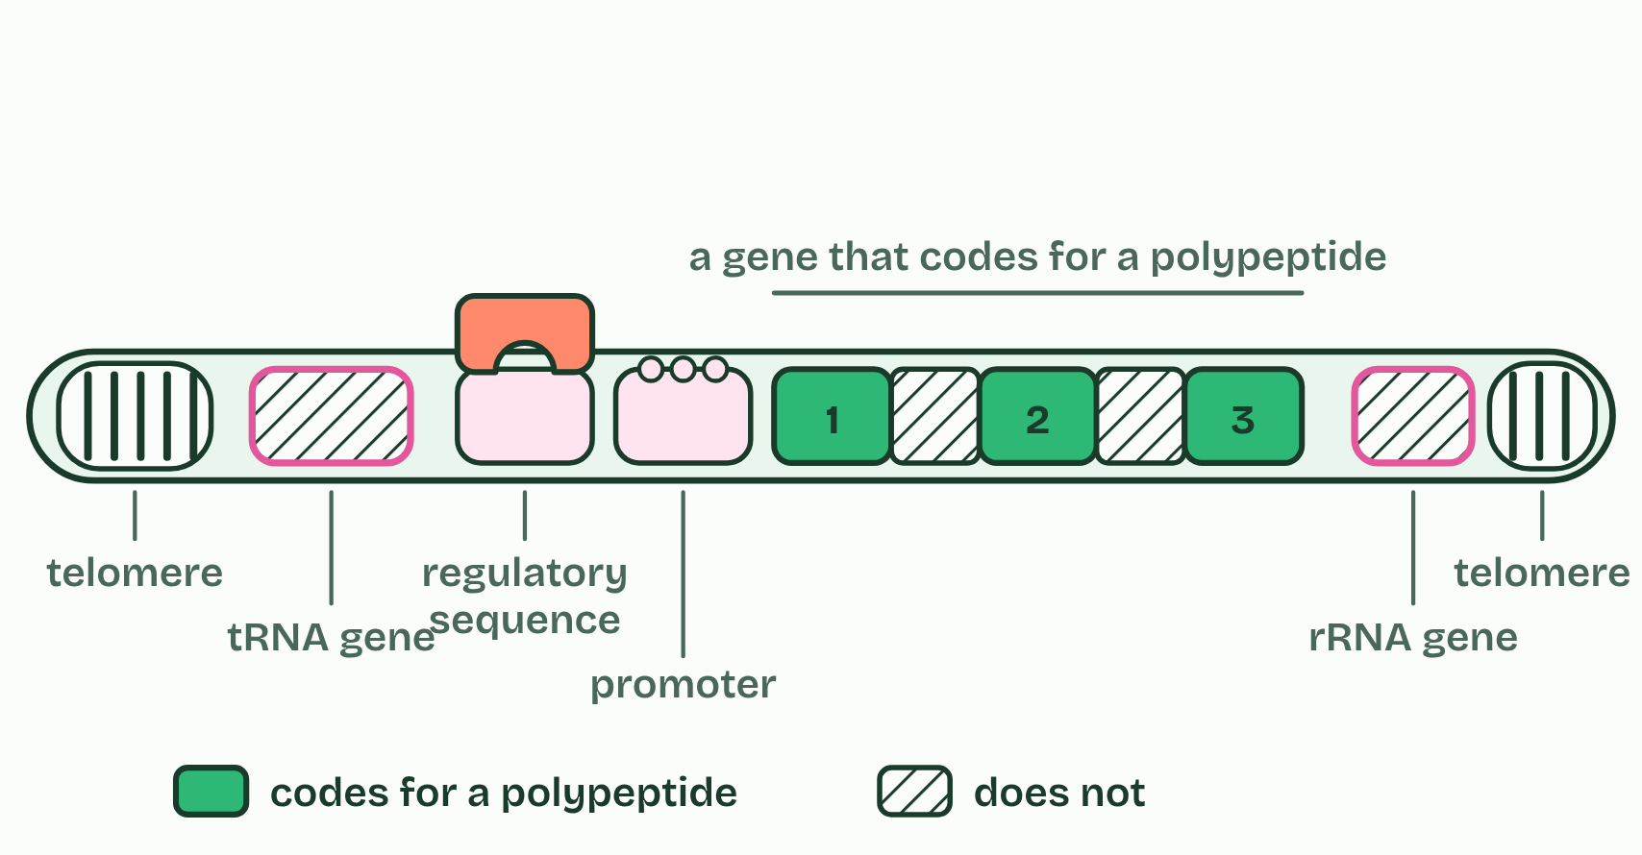
CHAPTER 9 · D1.2.13 D1.2.14 Promoters and non-coding DNA
Where a gene starts, and DNA that codes for nothing
regulators of gene expression: promoters, and other sequences where factors bind;
introns: stretches inside a gene that are transcribed but cut out of the RNA (chapter 10);
telomeres: repeats of a short sequence (TTAGGG in humans) at each end of a chromosome, which protect the genes near the ends when the DNA is copied;
genes for rRNA and tRNA: they are transcribed, and the RNA is the product. It is never translated.
Minutes 34 to 42
Notes:
Minutes 34 to 42 of 60: Switch the gene on (8 min).
The plan: Chapter 9's switch figure, then chapter 9's predict box (the tRNA gene).
The promoter is a stretch of DNA just before the part of a gene that is transcribed. It is not transcribed itself. It is where transcription starts. Transcription factors are proteins that attach to the promoter, and RNA polymerase can bind and start only when the right ones are in place (you do not have to name any). Which factors a cell makes decides which of its genes are transcribed: that is the switch from chapter 2. Some factors promote transcription and others block it. The promoter is a whole region, not one named sequence.
Non-coding sequences are stretches of DNA that code for no polypeptide. In humans only about 1 to 2% of the genome codes for polypeptides, and the rest includes:
Non-coding does not mean useless. Every one of these has a job, and none of them codes for a polypeptide.
Parts of the figure:
Telomere Many repeats of a short sequence (TTAGGG in humans) at each end of a chromosome. They protect the genes near the end from being lost when the DNA is copied, and code for no polypeptide.
tRNA gene Transcribed into tRNA, which is never translated: the RNA is the product. It is a gene, but it codes for no polypeptide.
Regulatory sequence Another stretch where transcription factors bind and change how often the gene is transcribed. It is not transcribed.
Promoter Where transcription factors and RNA polymerase bind, just before the gene. It is not transcribed.
Exon Transcribed and kept in the mRNA: it codes for part of the polypeptide.
Intron Transcribed, then cut out of the RNA before it is used. It codes for nothing.
Exon Transcribed and kept in the mRNA: it codes for part of the polypeptide.
Intron Transcribed, then cut out of the RNA before it is used. It codes for nothing.
Exon Transcribed and kept in the mRNA: it codes for part of the polypeptide.
rRNA gene Transcribed into rRNA, which makes up the ribosomes. It is never translated.
Telomere Many repeats of a short sequence (TTAGGG in humans) at each end of a chromosome. They protect the genes near the end from being lost when the DNA is copied, and code for no polypeptide.

Slide 18
WATCH OUT
Non-coding is not the same as not transcribed. Introns and the genes for rRNA and tRNA are transcribed, while the promoter is not, and is never part of the mRNA. Telomeres code for no polypeptide.
Minutes 34 to 42
Notes:
Minutes 34 to 42 of 60: Switch the gene on (8 min).
The plan: Chapter 9's switch figure, then chapter 9's predict box (the tRNA gene).
A common mistake: say it, then ask who can say why it is wrong.

Slide 19
PREDICT
A gene for a tRNA is transcribed in every cell, but its RNA is never translated. Is it coding or non-coding DNA?
A Non-coding: its RNA is the product
B Coding: anything transcribed counts as coding
C Coding: a tRNA carries amino acids, so it codes
Minutes 34 to 42
Notes:
Minutes 34 to 42 of 60: Switch the gene on (8 min).
The plan: Chapter 9's switch figure, then chapter 9's predict box (the tRNA gene).
Ask for a show of hands, or mini whiteboards, before revealing. (Answer: A, on the next slide.)

Slide 20
WHAT HAPPENS
A gene for a tRNA is transcribed in every cell, but its RNA is never translated. Is it coding or non-coding DNA?
A Non-coding: its RNA is the product
B Coding: anything transcribed counts as coding
C Coding: a tRNA carries amino acids, so it codes
“Coding” here means coding for a polypeptide. A tRNA gene is transcribed, and the tRNA itself does the job: no polypeptide is ever made from it. So it is non-coding DNA, even though it is a gene and is transcribed. The same is true of rRNA genes.
Minutes 34 to 42
Notes:
Minutes 34 to 42 of 60: Switch the gene on (8 min).
The plan: Chapter 9's switch figure, then chapter 9's predict box (the tRNA gene).
Answer: A. “Coding” here means coding for a polypeptide. A tRNA gene is transcribed, and the tRNA itself does the job: no polypeptide is ever made from it. So it is non-coding DNA, even though it is a gene and is transcribed. The same is true of rRNA genes.

Slide 21

DATA · HL
12 MIN
What is in a genome?
THE TASK
Pairs estimate, then shade, a 100-square grid for the human genome: protein-coding exons, introns, regulators, rRNA and tRNA genes, telomeres, and other. Then compare with the real figures: about 1 to 2% codes for protein (chapter 9), and introns make up roughly a quarter or more of the genome. The point is the size of the coding share, not exact numbers for the rest.
STUDENTS NEED
Printed grids and coloured pencils.
Minutes 42 to 54
Notes:
Minutes 42 to 54 of 60: What is in a genome? (12 min).
The plan: Pairs estimate and shade a 100-square grid, then check it against chapter 9's chromosome figure (activity below).
The activity: What is in a genome?. Pairs estimate, then shade, a 100-square grid for the human genome: protein-coding exons, introns, regulators, rRNA and tRNA genes, telomeres, and other. Then compare with the real figures: about 1 to 2% codes for protein (chapter 9), and introns make up roughly a quarter or more of the genome. The point is the size of the coding share, not exact numbers for the rest.
Needs: printed grids and coloured pencils.
The time: 12 minutes, minutes 42 to 54 of the plan.

Slide 22
PLENARY
Can you now...
Explain what 5′ to 3′ means for transcription and for translation (D1.2.12)
Explain how transcription factors start transcription at a promoter, and name four kinds of DNA that code for no polypeptide (D1.2.13, D1.2.14)
Minutes 54 to 60
Notes:
Minutes 54 to 60 of 60: Exit (6 min).
The plan: "Name four kinds of non-coding DNA and say what each does."
Thumbs up, sideways or down on each goal before the exit question. The goals come from the statements this lesson covers.

Slide 23
EXIT QUESTION
Before you go
"Name four kinds of non-coding DNA and say what each does."
Minutes 54 to 60
Notes:
Minutes 54 to 60 of 60: Exit (6 min).
The plan: "Name four kinds of non-coding DNA and say what each does."

Slide 24
PRACTISE AND REVISE
Keep going
Exam practice: a fresh paper of exam questions on D1.2 at higher level, marked as you go
The guide, with the animations and the dry lab
This lesson in the guide: 8 Five prime to three prime, both times, 9 Where a gene starts, and DNA that codes for nothing
BUILD FOR YOUR CLASS
ALREADY ON THE SITE FOR D1.2
CARD SETS ON SPLYCR
Tarsia puzzle, dominoes and picture reveal on D1.2, built from its key terms and ready to print
A pub quiz with rounds on D1.2, to present or run with no projector
An escape room built from the question bank on D1.2
Quiz: Protein Synthesis (HL)
Quiz: Protein Synthesis
Revision map: D1.2 Protein synthesis, to fill in
Exam questions: D1.2 in the exam maker, a paper with its markscheme
Open a set to host it as a class game, or make a copy to edit.
D1.2 Protein Synthesis (SL)
D1.2 Protein Synthesis (HL)
How this was made. The course structure, the activities and the teaching choices come from my own classroom, my presentations and my years of teaching IB and AP Biology. I use Claude, an AI, to help write and build the interactive guides, lesson plans, slides and practice questions, and to draw the diagrams and code the interactives. I direct the work and review it against the IB and AP specifications before it goes live.
Minute 60: after the lesson
Notes:
Every link here is live. Set the exam practice paper for homework: it is fresh each time, marked as students go and saved to their Exam practice when they are signed in.
Exam practice: https://www.biologybybradford.com/exam-maker/sit?topics=D1.2&level=HL&paper=quiz&marks=15&src=ep
The guide: https://www.biologybybradford.com/guides/ib-biology-d1-2-protein-synthesis

