Slide 1
IB Biology D1.2
LESSON 5 OF 6
HL
BY THE END YOU CAN
Protein synthesis
Describe how pre-mRNA is capped, tailed and spliced, and how alternative splicing makes several polypeptides from one gene (D1.2.15, D1.2.16)
Describe how translation starts, and what the A, P and E sites do (D1.2.17)
Processing and starting translation
D1.2.15 to D1.2.17
Caps, tails and splicing, one gene giving several polypeptides, and how translation starts
60 minutes · chapters 10, 11
Minute 0
Notes:
IB Biology D1.2, Protein synthesis. Lesson 5 of 6: Processing and starting translation (higher level), 60 minutes.
The plan, minute by minute (each slide's footer says where you are):
0 to 6 min (6) Do now
6 to 18 min (12) Capped, cut and tailed
18 to 30 min (12) Paper splice
30 to 42 min (12) Starting the chain
42 to 54 min (12) Be the ribosome
54 to 60 min (6) Exit
What students get wrong:
Introns are cut out of the DNA. Out of the RNA.
The initiator tRNA binds the A site. The P site.
The large subunit binds first. The small subunit binds the mRNA first.
Stretch and support:
Stretch: how many mature mRNAs could a gene with six exons make if exons 2 to 5 are each optional? (2⁴ = 16.) Why might a cell want that?
Support: play the factory's "Let the cell do it" on the board before pairs try a round.
The lesson plan to print: https://www.biologybybradford.com/guides/downloads/ib-biology-d1-2-protein-synthesis-lesson-5-plan.pdf

Slide 2
DO NOW
Do now
"List what must happen to pre-mRNA before it leaves the nucleus, and why."
6:00
minutes
Start now: the timer is running.
Minutes 0 to 6
Notes:
Minutes 0 to 6 of 60: Do now (6 min).
The plan: "List what must happen to pre-mRNA before it leaves the nucleus, and why." Cold call, then the board.
Start a 6 minute timer as they come in.

Slide 3
STEP 2
12 MIN
Capped, cut and tailed
Chapter 10: Capped, cut and tailed
Minutes 6 to 18
Notes:
Minutes 6 to 18 of 60: Capped, cut and tailed (12 min).
The plan: Chapter 10's step-through, then the HL transcription film, From promoter to mature mRNA (try its Cap and tail switch). Then chapter 10's predict box (four exons) and Introns stay In, Exons Exit.

Slide 4
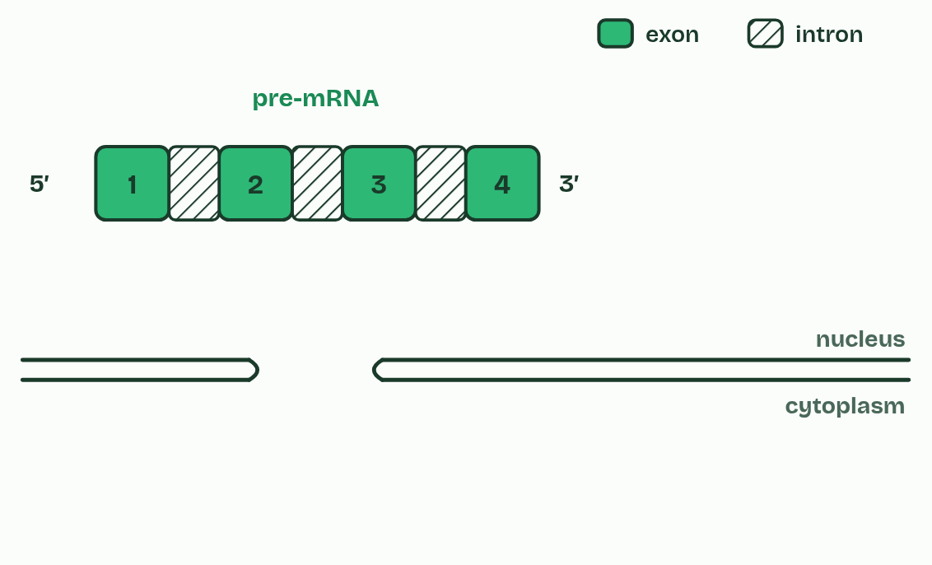
CHAPTER 10 · D1.2.15 D1.2.16 RNA processing and alternative splicing
1 / 5
Capped, cut and tailed
Pre-mRNA: exons and introns.
Minutes 6 to 18
Notes:
Minutes 6 to 18 of 60: Capped, cut and tailed (12 min).
The plan: Chapter 10's step-through, then the HL transcription film, From promoter to mature mRNA (try its Cap and tail switch). Then chapter 10's predict box (four exons) and Introns stay In, Exons Exit.
In a eukaryotic cell, the RNA that RNA polymerase makes from a protein-coding gene is pre-mRNA. It is changed in the nucleus before it leaves, a stage called post-transcriptional modification, and the result is mature mRNA.
In splicing, the introns are cut out and the exons joined end to end, so the mature mRNA carries only sequence that codes for the polypeptide. The cut-out introns are broken down in the nucleus. The two ends are protected as well. A 5′ cap, a modified guanine nucleotide, is added to the 5′ end, and a poly-A tail, a long run of adenine nucleotides (often about 200), to the 3′ end.
The reason is that enzymes in the cytoplasm break RNA down from its ends. The cap and the tail protect, and so stabilise, the mRNA, which then lasts long enough to be translated many times. The cap also helps the ribosome find the mRNA's 5′ end (chapter 11). Prokaryotes do not cap, tail or splice their mRNA in this way (most of their genes have no introns), and with no nucleus, translation can start before transcription has ended.
Alternative splicing: in many genes, which exons are kept can vary. Leave an exon out, or keep a different one, and the mature mRNA codes for a different polypeptide. So one gene can code for several polypeptides, and a cell's set of proteins is much larger than its number of genes: about 20,000 human protein-coding genes make many more proteins than that. You need no named example, and the gene in figure 10.2 is invented.

Slide 5
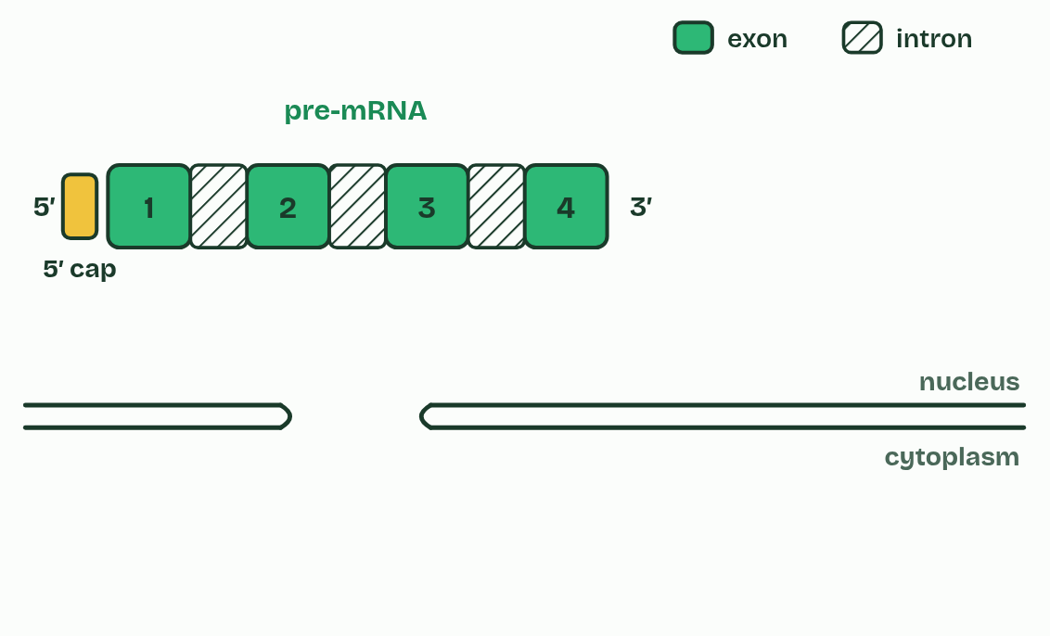
CHAPTER 10 · D1.2.15 D1.2.16 RNA processing and alternative splicing
2 / 5
Capped, cut and tailed
A 5′ cap is added.
Minutes 6 to 18
Notes:
Minutes 6 to 18 of 60: Capped, cut and tailed (12 min).
The plan: Chapter 10's step-through, then the HL transcription film, From promoter to mature mRNA (try its Cap and tail switch). Then chapter 10's predict box (four exons) and Introns stay In, Exons Exit.
In a eukaryotic cell, the RNA that RNA polymerase makes from a protein-coding gene is pre-mRNA. It is changed in the nucleus before it leaves, a stage called post-transcriptional modification, and the result is mature mRNA.
In splicing, the introns are cut out and the exons joined end to end, so the mature mRNA carries only sequence that codes for the polypeptide. The cut-out introns are broken down in the nucleus. The two ends are protected as well. A 5′ cap, a modified guanine nucleotide, is added to the 5′ end, and a poly-A tail, a long run of adenine nucleotides (often about 200), to the 3′ end.
The reason is that enzymes in the cytoplasm break RNA down from its ends. The cap and the tail protect, and so stabilise, the mRNA, which then lasts long enough to be translated many times. The cap also helps the ribosome find the mRNA's 5′ end (chapter 11). Prokaryotes do not cap, tail or splice their mRNA in this way (most of their genes have no introns), and with no nucleus, translation can start before transcription has ended.
Alternative splicing: in many genes, which exons are kept can vary. Leave an exon out, or keep a different one, and the mature mRNA codes for a different polypeptide. So one gene can code for several polypeptides, and a cell's set of proteins is much larger than its number of genes: about 20,000 human protein-coding genes make many more proteins than that. You need no named example, and the gene in figure 10.2 is invented.

Slide 6
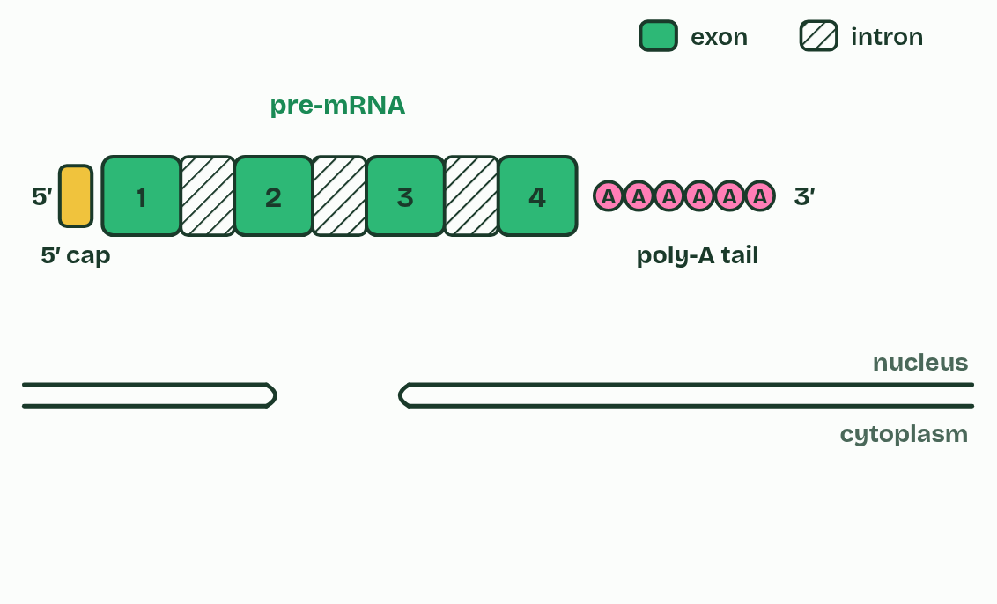
CHAPTER 10 · D1.2.15 D1.2.16 RNA processing and alternative splicing
3 / 5
Capped, cut and tailed
A poly-A tail is added.
Minutes 6 to 18
Notes:
Minutes 6 to 18 of 60: Capped, cut and tailed (12 min).
The plan: Chapter 10's step-through, then the HL transcription film, From promoter to mature mRNA (try its Cap and tail switch). Then chapter 10's predict box (four exons) and Introns stay In, Exons Exit.
In a eukaryotic cell, the RNA that RNA polymerase makes from a protein-coding gene is pre-mRNA. It is changed in the nucleus before it leaves, a stage called post-transcriptional modification, and the result is mature mRNA.
In splicing, the introns are cut out and the exons joined end to end, so the mature mRNA carries only sequence that codes for the polypeptide. The cut-out introns are broken down in the nucleus. The two ends are protected as well. A 5′ cap, a modified guanine nucleotide, is added to the 5′ end, and a poly-A tail, a long run of adenine nucleotides (often about 200), to the 3′ end.
The reason is that enzymes in the cytoplasm break RNA down from its ends. The cap and the tail protect, and so stabilise, the mRNA, which then lasts long enough to be translated many times. The cap also helps the ribosome find the mRNA's 5′ end (chapter 11). Prokaryotes do not cap, tail or splice their mRNA in this way (most of their genes have no introns), and with no nucleus, translation can start before transcription has ended.
Alternative splicing: in many genes, which exons are kept can vary. Leave an exon out, or keep a different one, and the mature mRNA codes for a different polypeptide. So one gene can code for several polypeptides, and a cell's set of proteins is much larger than its number of genes: about 20,000 human protein-coding genes make many more proteins than that. You need no named example, and the gene in figure 10.2 is invented.

Slide 7
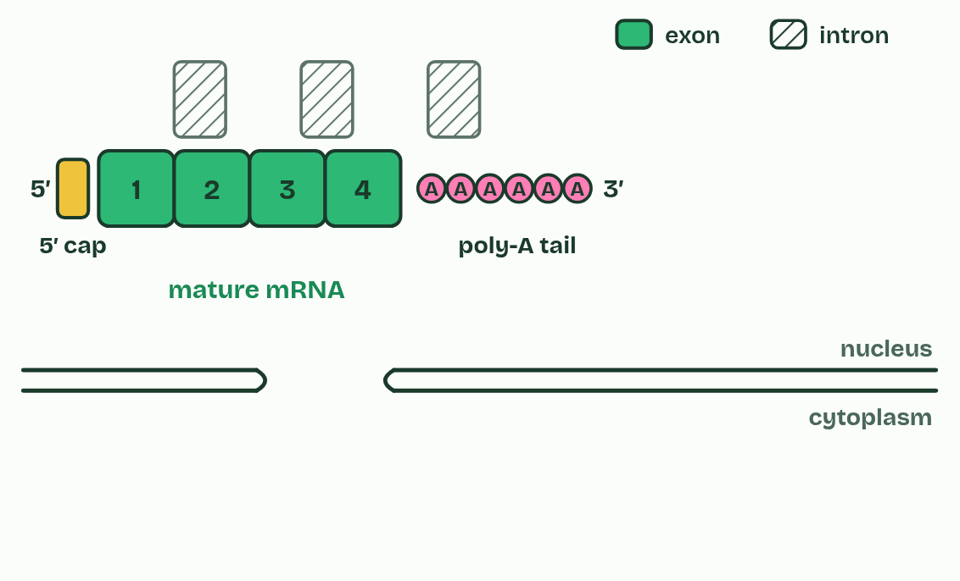
CHAPTER 10 · D1.2.15 D1.2.16 RNA processing and alternative splicing
4 / 5
Capped, cut and tailed
Introns are cut out and the exons spliced together.
Minutes 6 to 18
Notes:
Minutes 6 to 18 of 60: Capped, cut and tailed (12 min).
The plan: Chapter 10's step-through, then the HL transcription film, From promoter to mature mRNA (try its Cap and tail switch). Then chapter 10's predict box (four exons) and Introns stay In, Exons Exit.
In a eukaryotic cell, the RNA that RNA polymerase makes from a protein-coding gene is pre-mRNA. It is changed in the nucleus before it leaves, a stage called post-transcriptional modification, and the result is mature mRNA.
In splicing, the introns are cut out and the exons joined end to end, so the mature mRNA carries only sequence that codes for the polypeptide. The cut-out introns are broken down in the nucleus. The two ends are protected as well. A 5′ cap, a modified guanine nucleotide, is added to the 5′ end, and a poly-A tail, a long run of adenine nucleotides (often about 200), to the 3′ end.
The reason is that enzymes in the cytoplasm break RNA down from its ends. The cap and the tail protect, and so stabilise, the mRNA, which then lasts long enough to be translated many times. The cap also helps the ribosome find the mRNA's 5′ end (chapter 11). Prokaryotes do not cap, tail or splice their mRNA in this way (most of their genes have no introns), and with no nucleus, translation can start before transcription has ended.
Alternative splicing: in many genes, which exons are kept can vary. Leave an exon out, or keep a different one, and the mature mRNA codes for a different polypeptide. So one gene can code for several polypeptides, and a cell's set of proteins is much larger than its number of genes: about 20,000 human protein-coding genes make many more proteins than that. You need no named example, and the gene in figure 10.2 is invented.

Slide 8
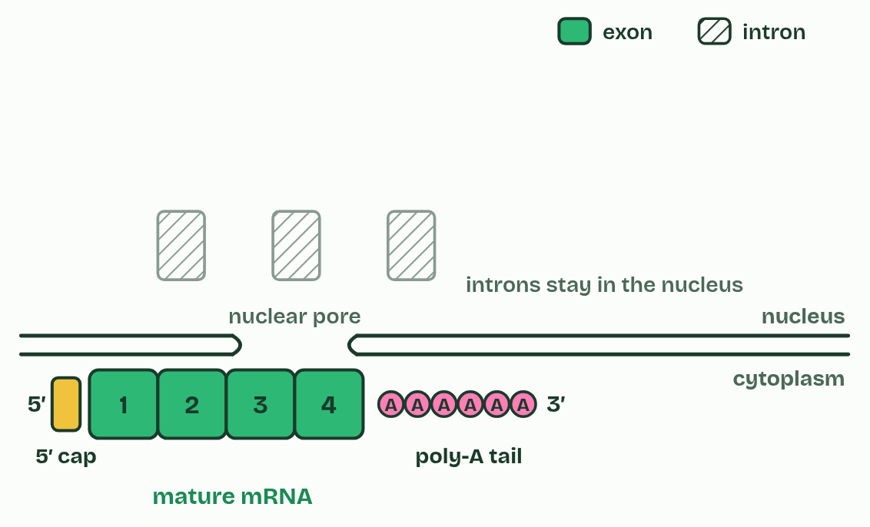
CHAPTER 10 · D1.2.15 D1.2.16 RNA processing and alternative splicing
5 / 5
Capped, cut and tailed
Mature mRNA leaves the nucleus.
Minutes 6 to 18
Notes:
Minutes 6 to 18 of 60: Capped, cut and tailed (12 min).
The plan: Chapter 10's step-through, then the HL transcription film, From promoter to mature mRNA (try its Cap and tail switch). Then chapter 10's predict box (four exons) and Introns stay In, Exons Exit.
In a eukaryotic cell, the RNA that RNA polymerase makes from a protein-coding gene is pre-mRNA. It is changed in the nucleus before it leaves, a stage called post-transcriptional modification, and the result is mature mRNA.
In splicing, the introns are cut out and the exons joined end to end, so the mature mRNA carries only sequence that codes for the polypeptide. The cut-out introns are broken down in the nucleus. The two ends are protected as well. A 5′ cap, a modified guanine nucleotide, is added to the 5′ end, and a poly-A tail, a long run of adenine nucleotides (often about 200), to the 3′ end.
The reason is that enzymes in the cytoplasm break RNA down from its ends. The cap and the tail protect, and so stabilise, the mRNA, which then lasts long enough to be translated many times. The cap also helps the ribosome find the mRNA's 5′ end (chapter 11). Prokaryotes do not cap, tail or splice their mRNA in this way (most of their genes have no introns), and with no nucleus, translation can start before transcription has ended.
Alternative splicing: in many genes, which exons are kept can vary. Leave an exon out, or keep a different one, and the mature mRNA codes for a different polypeptide. So one gene can code for several polypeptides, and a cell's set of proteins is much larger than its number of genes: about 20,000 human protein-coding genes make many more proteins than that. You need no named example, and the gene in figure 10.2 is invented.

Slide 9
CHAPTER 10 · D1.2.15 D1.2.16 RNA processing and alternative splicing
Capped, cut and tailed
In a eukaryotic cell, the RNA that RNA polymerase makes from a protein-coding gene is pre-mRNA.
It is changed in the nucleus before it leaves, a stage called post-transcriptional modification, and the result is mature mRNA.
In splicing, the introns are cut out and the exons joined end to end, so the mature mRNA carries only sequence that codes for the polypeptide.
A 5′ cap, a modified guanine nucleotide, is added to the 5′ end, and a poly-A tail, a long run of adenine nucleotides (often about 200), to the 3′ end.
Minutes 6 to 18
Notes:
Minutes 6 to 18 of 60: Capped, cut and tailed (12 min).
The plan: Chapter 10's step-through, then the HL transcription film, From promoter to mature mRNA (try its Cap and tail switch). Then chapter 10's predict box (four exons) and Introns stay In, Exons Exit.
In a eukaryotic cell, the RNA that RNA polymerase makes from a protein-coding gene is pre-mRNA. It is changed in the nucleus before it leaves, a stage called post-transcriptional modification, and the result is mature mRNA.
In splicing, the introns are cut out and the exons joined end to end, so the mature mRNA carries only sequence that codes for the polypeptide. The cut-out introns are broken down in the nucleus. The two ends are protected as well. A 5′ cap, a modified guanine nucleotide, is added to the 5′ end, and a poly-A tail, a long run of adenine nucleotides (often about 200), to the 3′ end.
The reason is that enzymes in the cytoplasm break RNA down from its ends. The cap and the tail protect, and so stabilise, the mRNA, which then lasts long enough to be translated many times. The cap also helps the ribosome find the mRNA's 5′ end (chapter 11). Prokaryotes do not cap, tail or splice their mRNA in this way (most of their genes have no introns), and with no nucleus, translation can start before transcription has ended.
Alternative splicing: in many genes, which exons are kept can vary. Leave an exon out, or keep a different one, and the mature mRNA codes for a different polypeptide. So one gene can code for several polypeptides, and a cell's set of proteins is much larger than its number of genes: about 20,000 human protein-coding genes make many more proteins than that. You need no named example, and the gene in figure 10.2 is invented.

Slide 10
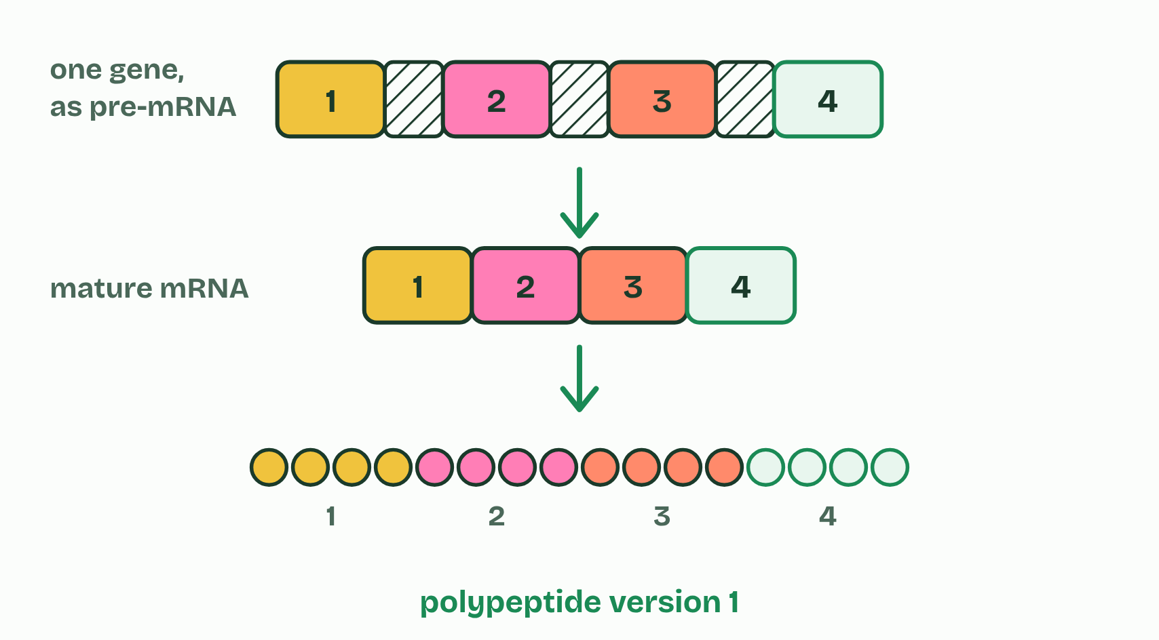
CHAPTER 10 · D1.2.15 D1.2.16 RNA processing and alternative splicing
1 / 2
Capped, cut and tailed
All four exons
Minutes 6 to 18
Notes:
Minutes 6 to 18 of 60: Capped, cut and tailed (12 min).
The plan: Chapter 10's step-through, then the HL transcription film, From promoter to mature mRNA (try its Cap and tail switch). Then chapter 10's predict box (four exons) and Introns stay In, Exons Exit.
In a eukaryotic cell, the RNA that RNA polymerase makes from a protein-coding gene is pre-mRNA. It is changed in the nucleus before it leaves, a stage called post-transcriptional modification, and the result is mature mRNA.
In splicing, the introns are cut out and the exons joined end to end, so the mature mRNA carries only sequence that codes for the polypeptide. The cut-out introns are broken down in the nucleus. The two ends are protected as well. A 5′ cap, a modified guanine nucleotide, is added to the 5′ end, and a poly-A tail, a long run of adenine nucleotides (often about 200), to the 3′ end.
The reason is that enzymes in the cytoplasm break RNA down from its ends. The cap and the tail protect, and so stabilise, the mRNA, which then lasts long enough to be translated many times. The cap also helps the ribosome find the mRNA's 5′ end (chapter 11). Prokaryotes do not cap, tail or splice their mRNA in this way (most of their genes have no introns), and with no nucleus, translation can start before transcription has ended.
Alternative splicing: in many genes, which exons are kept can vary. Leave an exon out, or keep a different one, and the mature mRNA codes for a different polypeptide. So one gene can code for several polypeptides, and a cell's set of proteins is much larger than its number of genes: about 20,000 human protein-coding genes make many more proteins than that. You need no named example, and the gene in figure 10.2 is invented.

Slide 11
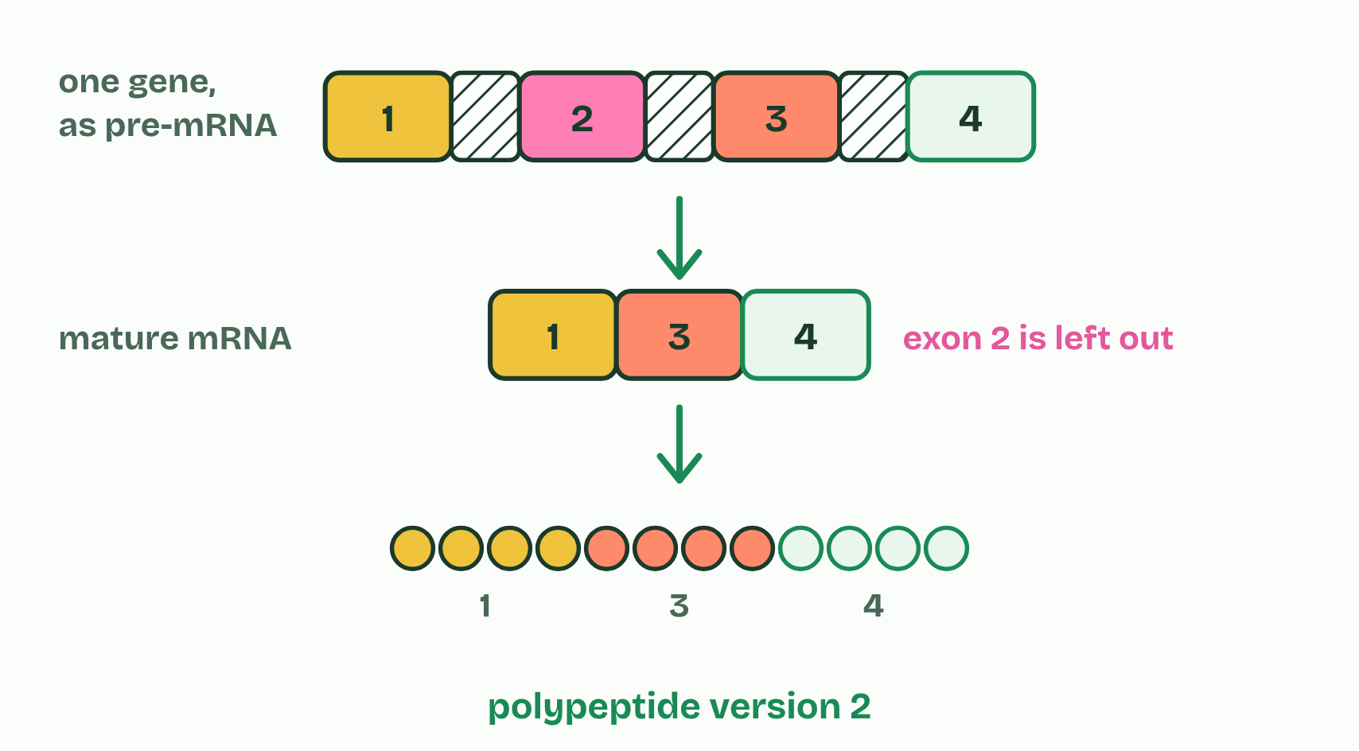
CHAPTER 10 · D1.2.15 D1.2.16 RNA processing and alternative splicing
2 / 2
Capped, cut and tailed
Leave out exon 2
Minutes 6 to 18
Notes:
Minutes 6 to 18 of 60: Capped, cut and tailed (12 min).
The plan: Chapter 10's step-through, then the HL transcription film, From promoter to mature mRNA (try its Cap and tail switch). Then chapter 10's predict box (four exons) and Introns stay In, Exons Exit.
In a eukaryotic cell, the RNA that RNA polymerase makes from a protein-coding gene is pre-mRNA. It is changed in the nucleus before it leaves, a stage called post-transcriptional modification, and the result is mature mRNA.
In splicing, the introns are cut out and the exons joined end to end, so the mature mRNA carries only sequence that codes for the polypeptide. The cut-out introns are broken down in the nucleus. The two ends are protected as well. A 5′ cap, a modified guanine nucleotide, is added to the 5′ end, and a poly-A tail, a long run of adenine nucleotides (often about 200), to the 3′ end.
The reason is that enzymes in the cytoplasm break RNA down from its ends. The cap and the tail protect, and so stabilise, the mRNA, which then lasts long enough to be translated many times. The cap also helps the ribosome find the mRNA's 5′ end (chapter 11). Prokaryotes do not cap, tail or splice their mRNA in this way (most of their genes have no introns), and with no nucleus, translation can start before transcription has ended.
Alternative splicing: in many genes, which exons are kept can vary. Leave an exon out, or keep a different one, and the mature mRNA codes for a different polypeptide. So one gene can code for several polypeptides, and a cell's set of proteins is much larger than its number of genes: about 20,000 human protein-coding genes make many more proteins than that. You need no named example, and the gene in figure 10.2 is invented.

Slide 12
CHAPTER 10 · D1.2.15 D1.2.16 RNA processing and alternative splicing
Capped, cut and tailed
In a eukaryotic cell, the RNA that RNA polymerase makes from a protein-coding gene is pre-mRNA.
It is changed in the nucleus before it leaves, a stage called post-transcriptional modification, and the result is mature mRNA.
In splicing, the introns are cut out and the exons joined end to end, so the mature mRNA carries only sequence that codes for the polypeptide.
A 5′ cap, a modified guanine nucleotide, is added to the 5′ end, and a poly-A tail, a long run of adenine nucleotides (often about 200), to the 3′ end.
Minutes 6 to 18
Notes:
Minutes 6 to 18 of 60: Capped, cut and tailed (12 min).
The plan: Chapter 10's step-through, then the HL transcription film, From promoter to mature mRNA (try its Cap and tail switch). Then chapter 10's predict box (four exons) and Introns stay In, Exons Exit.
In a eukaryotic cell, the RNA that RNA polymerase makes from a protein-coding gene is pre-mRNA. It is changed in the nucleus before it leaves, a stage called post-transcriptional modification, and the result is mature mRNA.
In splicing, the introns are cut out and the exons joined end to end, so the mature mRNA carries only sequence that codes for the polypeptide. The cut-out introns are broken down in the nucleus. The two ends are protected as well. A 5′ cap, a modified guanine nucleotide, is added to the 5′ end, and a poly-A tail, a long run of adenine nucleotides (often about 200), to the 3′ end.
The reason is that enzymes in the cytoplasm break RNA down from its ends. The cap and the tail protect, and so stabilise, the mRNA, which then lasts long enough to be translated many times. The cap also helps the ribosome find the mRNA's 5′ end (chapter 11). Prokaryotes do not cap, tail or splice their mRNA in this way (most of their genes have no introns), and with no nucleus, translation can start before transcription has ended.
Alternative splicing: in many genes, which exons are kept can vary. Leave an exon out, or keep a different one, and the mature mRNA codes for a different polypeptide. So one gene can code for several polypeptides, and a cell's set of proteins is much larger than its number of genes: about 20,000 human protein-coding genes make many more proteins than that. You need no named example, and the gene in figure 10.2 is invented.

Slide 13
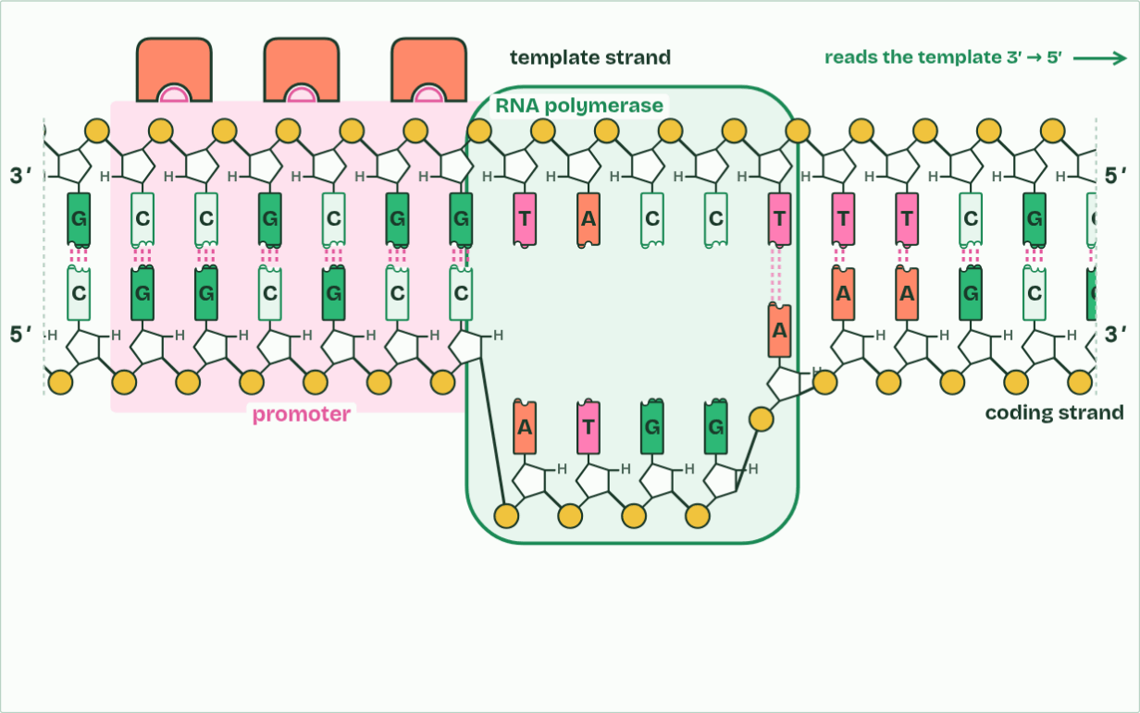
CHAPTER 10 · D1.2.15 D1.2.16 RNA processing and alternative splicing
starting
1 / 6
Capped, cut and tailed
Transcription factors bind the promoter. Only then can RNA polymerase bind and begin.
Minutes 6 to 18
Notes:
Minutes 6 to 18 of 60: Capped, cut and tailed (12 min).
The plan: Chapter 10's step-through, then the HL transcription film, From promoter to mature mRNA (try its Cap and tail switch). Then chapter 10's predict box (four exons) and Introns stay In, Exons Exit.
In a eukaryotic cell, the RNA that RNA polymerase makes from a protein-coding gene is pre-mRNA. It is changed in the nucleus before it leaves, a stage called post-transcriptional modification, and the result is mature mRNA.
In splicing, the introns are cut out and the exons joined end to end, so the mature mRNA carries only sequence that codes for the polypeptide. The cut-out introns are broken down in the nucleus. The two ends are protected as well. A 5′ cap, a modified guanine nucleotide, is added to the 5′ end, and a poly-A tail, a long run of adenine nucleotides (often about 200), to the 3′ end.
The reason is that enzymes in the cytoplasm break RNA down from its ends. The cap and the tail protect, and so stabilise, the mRNA, which then lasts long enough to be translated many times. The cap also helps the ribosome find the mRNA's 5′ end (chapter 11). Prokaryotes do not cap, tail or splice their mRNA in this way (most of their genes have no introns), and with no nucleus, translation can start before transcription has ended.
Alternative splicing: in many genes, which exons are kept can vary. Leave an exon out, or keep a different one, and the mature mRNA codes for a different polypeptide. So one gene can code for several polypeptides, and a cell's set of proteins is much larger than its number of genes: about 20,000 human protein-coding genes make many more proteins than that. You need no named example, and the gene in figure 10.2 is invented.
The animation "From promoter to mature mRNA", paused at 7.2 s. The next slides go on through it, then play it.

Slide 14
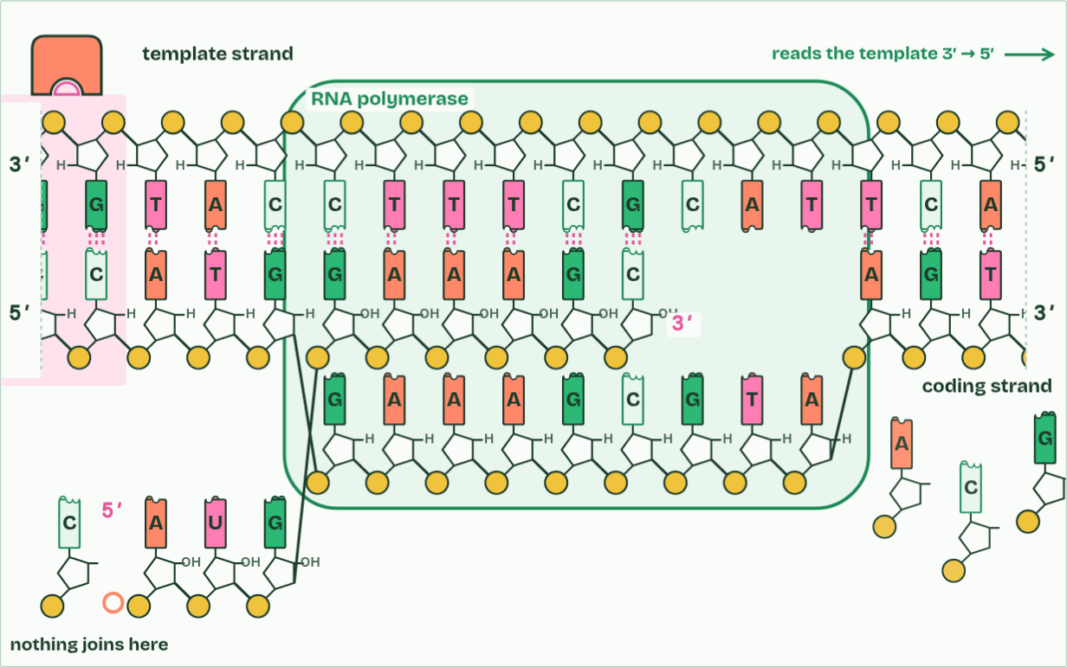
CHAPTER 10 · D1.2.15 D1.2.16 RNA processing and alternative splicing
5′ → 3′
2 / 6
Capped, cut and tailed
The RNA grows 5′ to 3′: every new nucleotide joins its 3′ end.
Minutes 6 to 18
Notes:
Minutes 6 to 18 of 60: Capped, cut and tailed (12 min).
The plan: Chapter 10's step-through, then the HL transcription film, From promoter to mature mRNA (try its Cap and tail switch). Then chapter 10's predict box (four exons) and Introns stay In, Exons Exit.
In a eukaryotic cell, the RNA that RNA polymerase makes from a protein-coding gene is pre-mRNA. It is changed in the nucleus before it leaves, a stage called post-transcriptional modification, and the result is mature mRNA.
In splicing, the introns are cut out and the exons joined end to end, so the mature mRNA carries only sequence that codes for the polypeptide. The cut-out introns are broken down in the nucleus. The two ends are protected as well. A 5′ cap, a modified guanine nucleotide, is added to the 5′ end, and a poly-A tail, a long run of adenine nucleotides (often about 200), to the 3′ end.
The reason is that enzymes in the cytoplasm break RNA down from its ends. The cap and the tail protect, and so stabilise, the mRNA, which then lasts long enough to be translated many times. The cap also helps the ribosome find the mRNA's 5′ end (chapter 11). Prokaryotes do not cap, tail or splice their mRNA in this way (most of their genes have no introns), and with no nucleus, translation can start before transcription has ended.
Alternative splicing: in many genes, which exons are kept can vary. Leave an exon out, or keep a different one, and the mature mRNA codes for a different polypeptide. So one gene can code for several polypeptides, and a cell's set of proteins is much larger than its number of genes: about 20,000 human protein-coding genes make many more proteins than that. You need no named example, and the gene in figure 10.2 is invented.
The animation "From promoter to mature mRNA", paused at 12.6 s. The next slides go on through it, then play it.

Slide 15
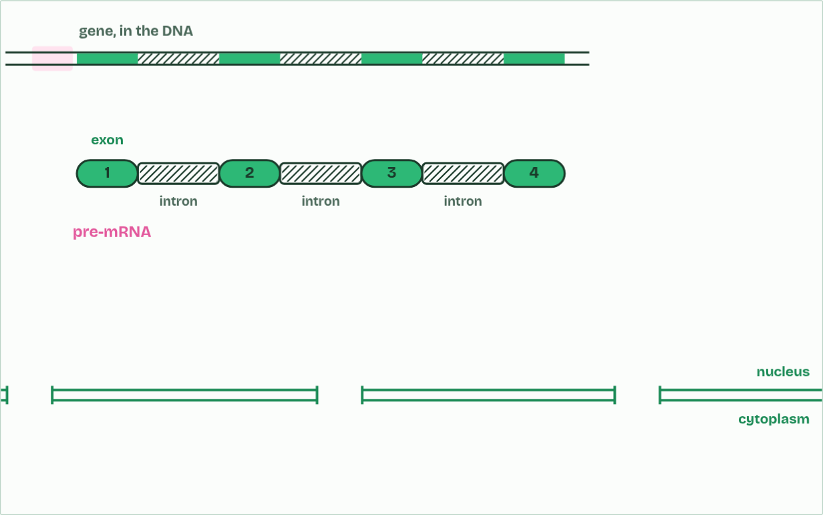
CHAPTER 10 · D1.2.15 D1.2.16 RNA processing and alternative splicing
pre-mRNA
3 / 6
Capped, cut and tailed
In a eukaryote the first RNA is pre-mRNA: exons, with introns between them.
Minutes 6 to 18
Notes:
Minutes 6 to 18 of 60: Capped, cut and tailed (12 min).
The plan: Chapter 10's step-through, then the HL transcription film, From promoter to mature mRNA (try its Cap and tail switch). Then chapter 10's predict box (four exons) and Introns stay In, Exons Exit.
In a eukaryotic cell, the RNA that RNA polymerase makes from a protein-coding gene is pre-mRNA. It is changed in the nucleus before it leaves, a stage called post-transcriptional modification, and the result is mature mRNA.
In splicing, the introns are cut out and the exons joined end to end, so the mature mRNA carries only sequence that codes for the polypeptide. The cut-out introns are broken down in the nucleus. The two ends are protected as well. A 5′ cap, a modified guanine nucleotide, is added to the 5′ end, and a poly-A tail, a long run of adenine nucleotides (often about 200), to the 3′ end.
The reason is that enzymes in the cytoplasm break RNA down from its ends. The cap and the tail protect, and so stabilise, the mRNA, which then lasts long enough to be translated many times. The cap also helps the ribosome find the mRNA's 5′ end (chapter 11). Prokaryotes do not cap, tail or splice their mRNA in this way (most of their genes have no introns), and with no nucleus, translation can start before transcription has ended.
Alternative splicing: in many genes, which exons are kept can vary. Leave an exon out, or keep a different one, and the mature mRNA codes for a different polypeptide. So one gene can code for several polypeptides, and a cell's set of proteins is much larger than its number of genes: about 20,000 human protein-coding genes make many more proteins than that. You need no named example, and the gene in figure 10.2 is invented.
The animation "From promoter to mature mRNA", paused at 21.3 s. The next slides go on through it, then play it.

Slide 16
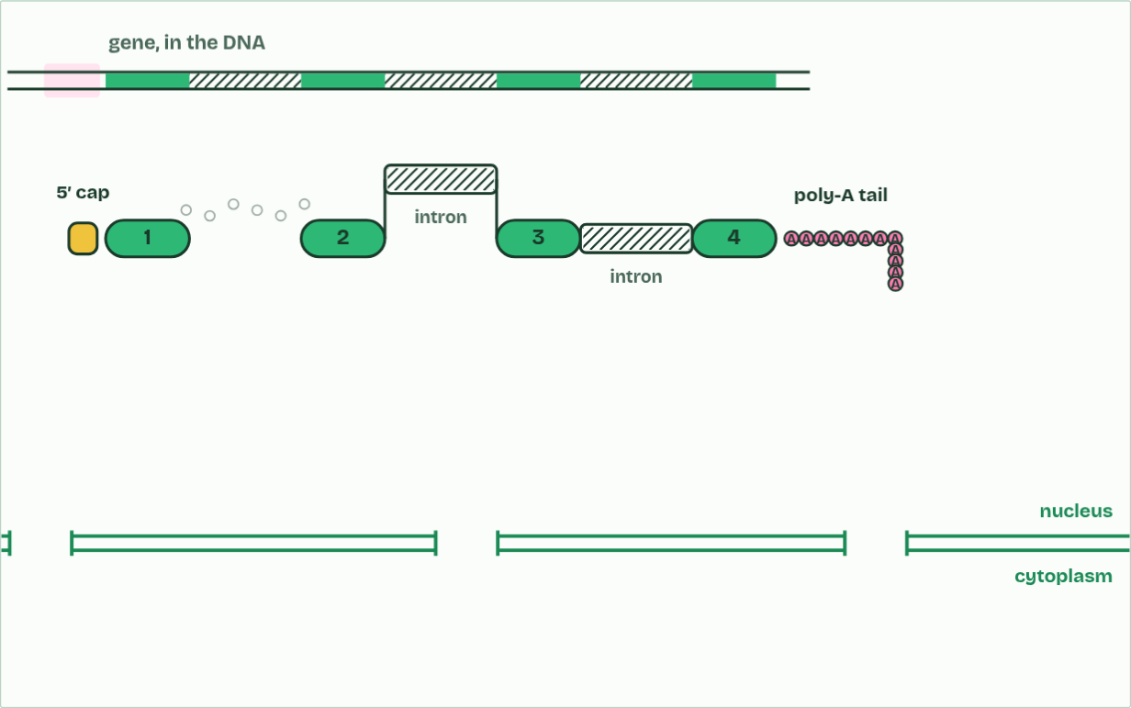
CHAPTER 10 · D1.2.15 D1.2.16 RNA processing and alternative splicing
processing
4 / 6
Capped, cut and tailed
A 5′ cap and a poly-A tail are added. The introns are cut out and the exons spliced together.
Minutes 6 to 18
Notes:
Minutes 6 to 18 of 60: Capped, cut and tailed (12 min).
The plan: Chapter 10's step-through, then the HL transcription film, From promoter to mature mRNA (try its Cap and tail switch). Then chapter 10's predict box (four exons) and Introns stay In, Exons Exit.
In a eukaryotic cell, the RNA that RNA polymerase makes from a protein-coding gene is pre-mRNA. It is changed in the nucleus before it leaves, a stage called post-transcriptional modification, and the result is mature mRNA.
In splicing, the introns are cut out and the exons joined end to end, so the mature mRNA carries only sequence that codes for the polypeptide. The cut-out introns are broken down in the nucleus. The two ends are protected as well. A 5′ cap, a modified guanine nucleotide, is added to the 5′ end, and a poly-A tail, a long run of adenine nucleotides (often about 200), to the 3′ end.
The reason is that enzymes in the cytoplasm break RNA down from its ends. The cap and the tail protect, and so stabilise, the mRNA, which then lasts long enough to be translated many times. The cap also helps the ribosome find the mRNA's 5′ end (chapter 11). Prokaryotes do not cap, tail or splice their mRNA in this way (most of their genes have no introns), and with no nucleus, translation can start before transcription has ended.
Alternative splicing: in many genes, which exons are kept can vary. Leave an exon out, or keep a different one, and the mature mRNA codes for a different polypeptide. So one gene can code for several polypeptides, and a cell's set of proteins is much larger than its number of genes: about 20,000 human protein-coding genes make many more proteins than that. You need no named example, and the gene in figure 10.2 is invented.
The animation "From promoter to mature mRNA", paused at 28.4 s. The next slides go on through it, then play it.

Slide 17
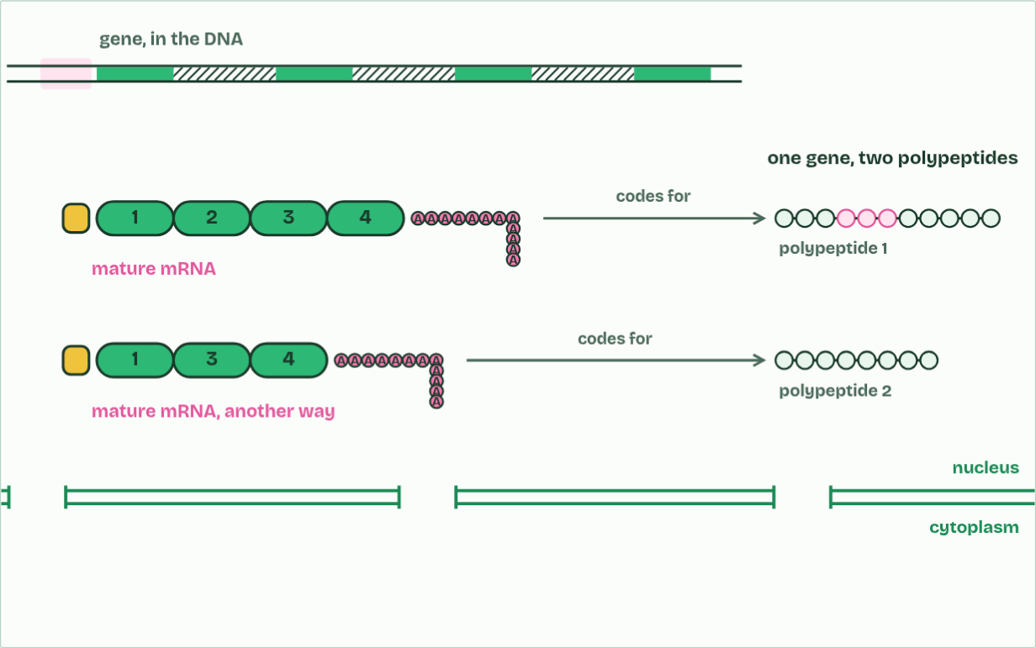
CHAPTER 10 · D1.2.15 D1.2.16 RNA processing and alternative splicing
mature mRNA
5 / 6
Capped, cut and tailed
Spliced another way, the same gene gives a different polypeptide.
Minutes 6 to 18
Notes:
Minutes 6 to 18 of 60: Capped, cut and tailed (12 min).
The plan: Chapter 10's step-through, then the HL transcription film, From promoter to mature mRNA (try its Cap and tail switch). Then chapter 10's predict box (four exons) and Introns stay In, Exons Exit.
In a eukaryotic cell, the RNA that RNA polymerase makes from a protein-coding gene is pre-mRNA. It is changed in the nucleus before it leaves, a stage called post-transcriptional modification, and the result is mature mRNA.
In splicing, the introns are cut out and the exons joined end to end, so the mature mRNA carries only sequence that codes for the polypeptide. The cut-out introns are broken down in the nucleus. The two ends are protected as well. A 5′ cap, a modified guanine nucleotide, is added to the 5′ end, and a poly-A tail, a long run of adenine nucleotides (often about 200), to the 3′ end.
The reason is that enzymes in the cytoplasm break RNA down from its ends. The cap and the tail protect, and so stabilise, the mRNA, which then lasts long enough to be translated many times. The cap also helps the ribosome find the mRNA's 5′ end (chapter 11). Prokaryotes do not cap, tail or splice their mRNA in this way (most of their genes have no introns), and with no nucleus, translation can start before transcription has ended.
Alternative splicing: in many genes, which exons are kept can vary. Leave an exon out, or keep a different one, and the mature mRNA codes for a different polypeptide. So one gene can code for several polypeptides, and a cell's set of proteins is much larger than its number of genes: about 20,000 human protein-coding genes make many more proteins than that. You need no named example, and the gene in figure 10.2 is invented.
The animation "From promoter to mature mRNA", paused at 38.8 s. The next slides go on through it, then play it.

Slide 18
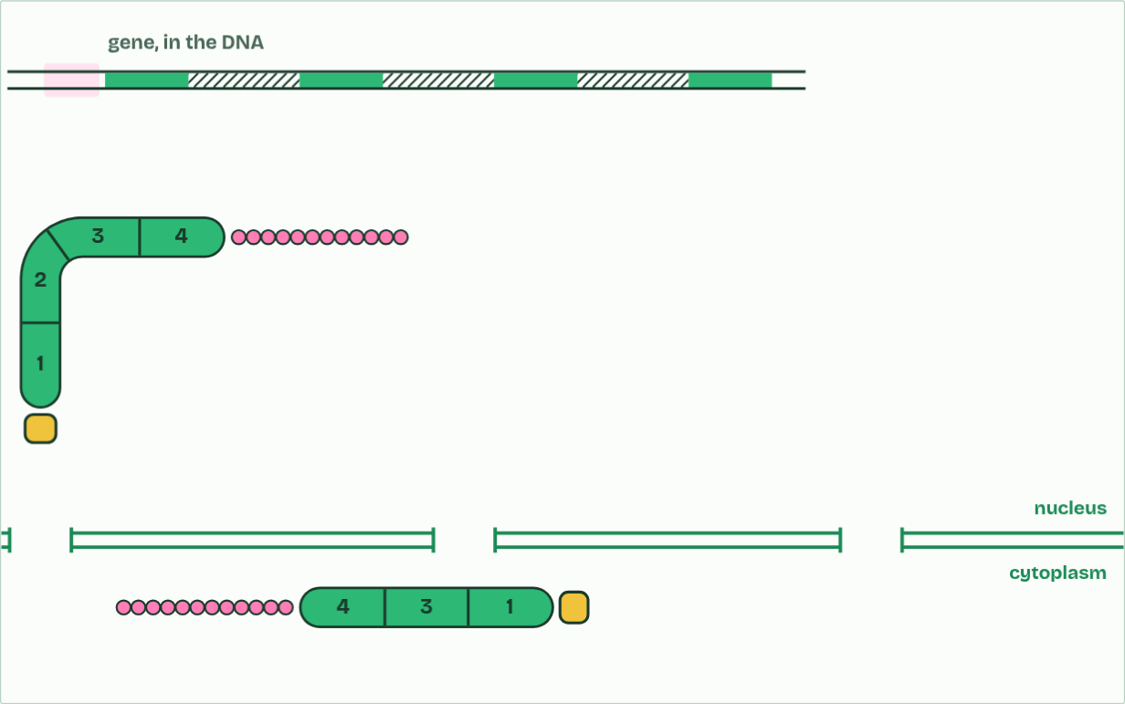
CHAPTER 10 · D1.2.15 D1.2.16 RNA processing and alternative splicing
mature mRNA
6 / 6
Capped, cut and tailed
Capped, tailed and spliced, the mature mRNA leaves the nucleus.
Minutes 6 to 18
Notes:
Minutes 6 to 18 of 60: Capped, cut and tailed (12 min).
The plan: Chapter 10's step-through, then the HL transcription film, From promoter to mature mRNA (try its Cap and tail switch). Then chapter 10's predict box (four exons) and Introns stay In, Exons Exit.
In a eukaryotic cell, the RNA that RNA polymerase makes from a protein-coding gene is pre-mRNA. It is changed in the nucleus before it leaves, a stage called post-transcriptional modification, and the result is mature mRNA.
In splicing, the introns are cut out and the exons joined end to end, so the mature mRNA carries only sequence that codes for the polypeptide. The cut-out introns are broken down in the nucleus. The two ends are protected as well. A 5′ cap, a modified guanine nucleotide, is added to the 5′ end, and a poly-A tail, a long run of adenine nucleotides (often about 200), to the 3′ end.
The reason is that enzymes in the cytoplasm break RNA down from its ends. The cap and the tail protect, and so stabilise, the mRNA, which then lasts long enough to be translated many times. The cap also helps the ribosome find the mRNA's 5′ end (chapter 11). Prokaryotes do not cap, tail or splice their mRNA in this way (most of their genes have no introns), and with no nucleus, translation can start before transcription has ended.
Alternative splicing: in many genes, which exons are kept can vary. Leave an exon out, or keep a different one, and the mature mRNA codes for a different polypeptide. So one gene can code for several polypeptides, and a cell's set of proteins is much larger than its number of genes: about 20,000 human protein-coding genes make many more proteins than that. You need no named example, and the gene in figure 10.2 is invented.
The animation "From promoter to mature mRNA", paused at 43.6 s. The next slides go on through it, then play it.

Slide 19
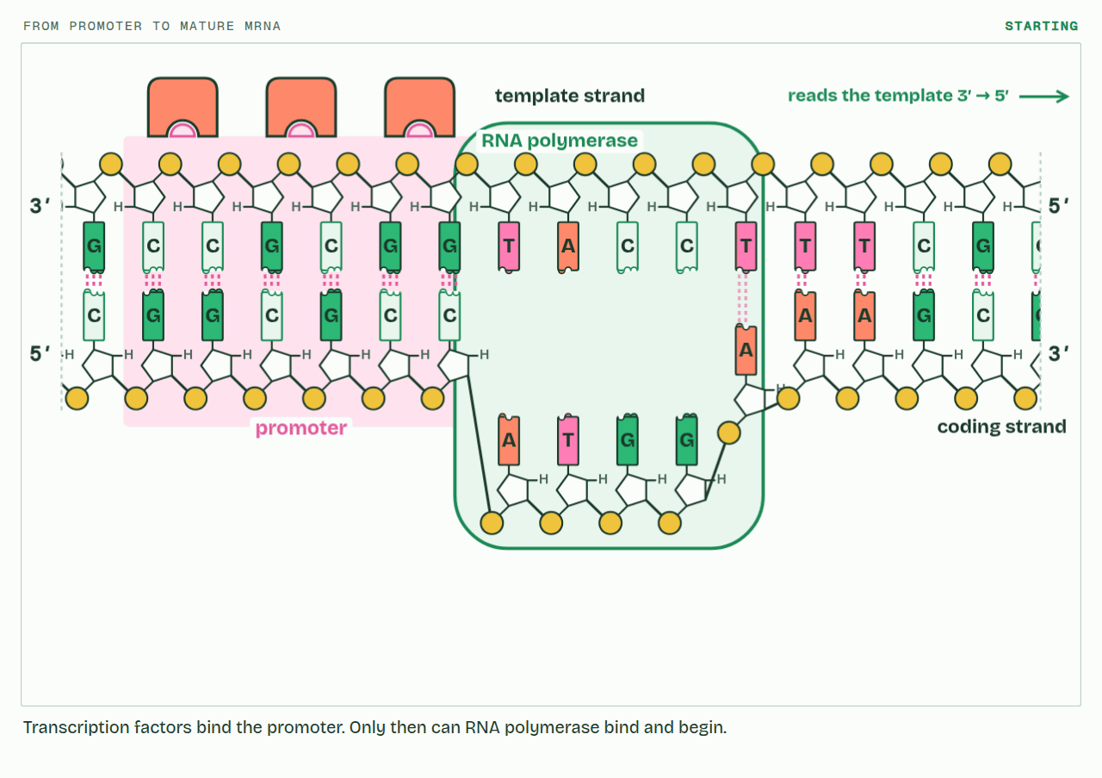
CHAPTER 10 · D1.2.15 D1.2.16 RNA processing and alternative splicing
PLAY IT
Capped, cut and tailed
From promoter to mature mRNA: click to play. It loops every 46 seconds.
Minutes 6 to 18
Notes:
Minutes 6 to 18 of 60: Capped, cut and tailed (12 min).
The plan: Chapter 10's step-through, then the HL transcription film, From promoter to mature mRNA (try its Cap and tail switch). Then chapter 10's predict box (four exons) and Introns stay In, Exons Exit.
The video is transcription-f1d54b.mp4, one loop of the animation in the guide. It plays in PowerPoint and Keynote. Google Slides does not play a video embedded in a .pptx: download transcription-f1d54b.mp4 (https://www.biologybybradford.com/guides/downloads/scenes/transcription-f1d54b.mp4), upload it to Google Drive, then Insert > Video > Google Drive.
In the guide the class can change it as it runs: https://www.biologybybradford.com/guides/ib-biology-d1-2-protein-synthesis#processing
What it shows, in order:
1. Transcription factors bind the promoter. Only then can RNA polymerase bind and begin.
2. The RNA grows 5′ to 3′: every new nucleotide joins its 3′ end.
3. In a eukaryote the first RNA is pre-mRNA: exons, with introns between them.
4. A 5′ cap and a poly-A tail are added. The introns are cut out and the exons spliced together.
5. Spliced another way, the same gene gives a different polypeptide.
6. Capped, tailed and spliced, the mature mRNA leaves the nucleus.

Slide 20
REMEMBER IT
Introns and exons
I
E
In
Exit
Minutes 6 to 18
Notes:
Minutes 6 to 18 of 60: Capped, cut and tailed (12 min).
The plan: Chapter 10's step-through, then the HL transcription film, From promoter to mature mRNA (try its Cap and tail switch). Then chapter 10's predict box (four exons) and Introns stay In, Exons Exit.
Ask the class what each letter stands for before revealing.

Slide 21
REMEMBER IT
Introns and exons
I
E
In
Exit
Introns
Exons
cut out and broken down in the nucleus
joined, and leave in the mature mRNA
Minutes 6 to 18
Notes:
Minutes 6 to 18 of 60: Capped, cut and tailed (12 min).
The plan: Chapter 10's step-through, then the HL transcription film, From promoter to mature mRNA (try its Cap and tail switch). Then chapter 10's predict box (four exons) and Introns stay In, Exons Exit.
In: Introns (cut out and broken down in the nucleus)
Exit: Exons (joined, and leave in the mature mRNA)

Slide 22
WATCH OUT
Introns are cut out of the RNA, not out of the gene: the DNA keeps them. And alternative splicing changes which exons are kept, not the gene's sequence.
Minutes 6 to 18
Notes:
Minutes 6 to 18 of 60: Capped, cut and tailed (12 min).
The plan: Chapter 10's step-through, then the HL transcription film, From promoter to mature mRNA (try its Cap and tail switch). Then chapter 10's predict box (four exons) and Introns stay In, Exons Exit.
A common mistake: say it, then ask who can say why it is wrong.

Slide 23
PREDICT
A gene has four exons. Exons 1 and 4 are always kept, and exons 2 and 3 can each be kept or left out. How many different mature mRNAs can it make?
A 2
B 8
C 4
Minutes 6 to 18
Notes:
Minutes 6 to 18 of 60: Capped, cut and tailed (12 min).
The plan: Chapter 10's step-through, then the HL transcription film, From promoter to mature mRNA (try its Cap and tail switch). Then chapter 10's predict box (four exons) and Introns stay In, Exons Exit.
Ask for a show of hands, or mini whiteboards, before revealing. (Answer: C, on the next slide.)

Slide 24
WHAT HAPPENS
A gene has four exons. Exons 1 and 4 are always kept, and exons 2 and 3 can each be kept or left out. How many different mature mRNAs can it make?
A 2
B 8
C 4
1-2-3-4, 1-2-4, 1-3-4 and 1-4: each of the two optional exons is in or out, so 2 × 2 = 4. That is four polypeptides from one gene, without a single change to the DNA.
Minutes 6 to 18
Notes:
Minutes 6 to 18 of 60: Capped, cut and tailed (12 min).
The plan: Chapter 10's step-through, then the HL transcription film, From promoter to mature mRNA (try its Cap and tail switch). Then chapter 10's predict box (four exons) and Introns stay In, Exons Exit.
Answer: C. 1-2-3-4, 1-2-4, 1-3-4 and 1-4: each of the two optional exons is in or out, so 2 × 2 = 4. That is four polypeptides from one gene, without a single change to the DNA.

Slide 25
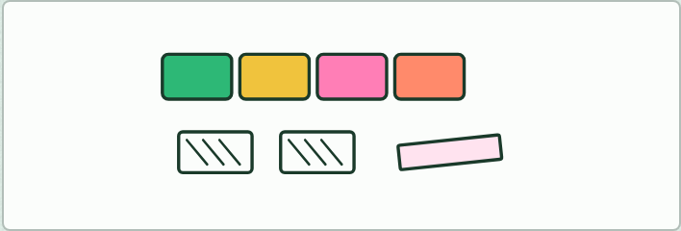
MODEL · HL
12 MIN
Paper splice
THE TASK
A paper pre-mRNA (the factory's split gene, printed in codons with exons and introns coloured), a paper cap and a tail. Students cut out the introns, tape the exons together, add the cap and the tail, then translate with the codon tool, The genetic code. Two groups splice differently (one leaves out exon 2) and compare their chains. Then leave intron 1 in and translate it: what happens?
STUDENTS NEED
Printed strips, scissors and tape.
Minutes 18 to 30
Notes:
Minutes 18 to 30 of 60: Paper splice (12 min).
The plan: Students splice a paper pre-mRNA two ways and translate both (activity below).
The activity: Paper splice. A paper pre-mRNA (the factory's split gene, printed in codons with exons and introns coloured), a paper cap and a tail. Students cut out the introns, tape the exons together, add the cap and the tail, then translate with the codon tool, The genetic code. Two groups splice differently (one leaves out exon 2) and compare their chains. Then leave intron 1 in and translate it: what happens?
Needs: printed strips, scissors and tape.
The time: 12 minutes, minutes 18 to 30 of the plan.

Slide 26
STEP 4
12 MIN
Starting the chain
Chapter 11: Starting the chain
Minutes 30 to 42
Notes:
Minutes 30 to 42 of 60: Starting the chain (12 min).
The plan: Chapter 11's predict box (which site holds the chain) first, then the step-through and the HL ribosome film, Start, then A, P and E, then Arrive, Pass, Exit.

Slide 27
PREDICT
The first peptide bond has just formed, joining methionine to the second amino acid. Before the ribosome moves, which site holds the tRNA carrying both amino acids?
A A site
B P site
C E site
Minutes 30 to 42
Notes:
Minutes 30 to 42 of 60: Starting the chain (12 min).
The plan: Chapter 11's predict box (which site holds the chain) first, then the step-through and the HL ribosome film, Start, then A, P and E, then Arrive, Pass, Exit.
Ask for a show of hands, or mini whiteboards, before revealing. (Answer: A, on the next slide.)

Slide 28
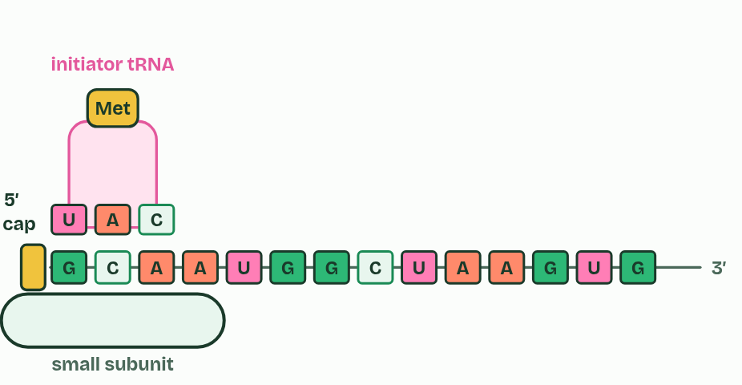
CHAPTER 11 · D1.2.17 Initiation of translation
1 / 6
Starting the chain
The small subunit attaches at the mRNA's 5′ end.
Minutes 30 to 42
Notes:
Minutes 30 to 42 of 60: Starting the chain (12 min).
The plan: Chapter 11's predict box (which site holds the chain) first, then the step-through and the HL ribosome film, Start, then A, P and E, then Arrive, Pass, Exit.
Initiation is how translation starts. It happens in this order:
The large subunit has three places for tRNAs, and they are used all through elongation. The A site is where each new tRNA arrives with its amino acid. The P site holds the tRNA carrying the growing chain, which is joined by a peptide bond to the amino acid in the A site. The E site is where an empty tRNA goes when the ribosome moves one codon, and where it leaves from. After each move the tRNA that carried the chain is in the P site, and the A site is free over the next codon.
Every new polypeptide begins with methionine, because the start codon codes for it, but in many proteins that methionine is removed afterwards. Haemoglobin's beta chain, for example, begins with valine in the finished protein, which is why chapter 7 counted from there.

Slide 29
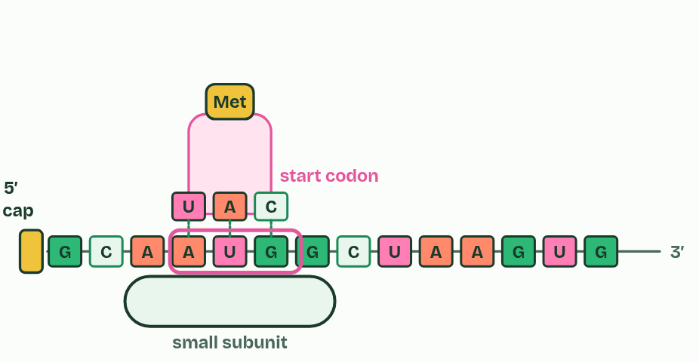
CHAPTER 11 · D1.2.17 Initiation of translation
2 / 6
Starting the chain
It moves to the start codon, AUG, where the initiator tRNA pairs.
Minutes 30 to 42
Notes:
Minutes 30 to 42 of 60: Starting the chain (12 min).
The plan: Chapter 11's predict box (which site holds the chain) first, then the step-through and the HL ribosome film, Start, then A, P and E, then Arrive, Pass, Exit.
Initiation is how translation starts. It happens in this order:
The large subunit has three places for tRNAs, and they are used all through elongation. The A site is where each new tRNA arrives with its amino acid. The P site holds the tRNA carrying the growing chain, which is joined by a peptide bond to the amino acid in the A site. The E site is where an empty tRNA goes when the ribosome moves one codon, and where it leaves from. After each move the tRNA that carried the chain is in the P site, and the A site is free over the next codon.
Every new polypeptide begins with methionine, because the start codon codes for it, but in many proteins that methionine is removed afterwards. Haemoglobin's beta chain, for example, begins with valine in the finished protein, which is why chapter 7 counted from there.

Slide 30
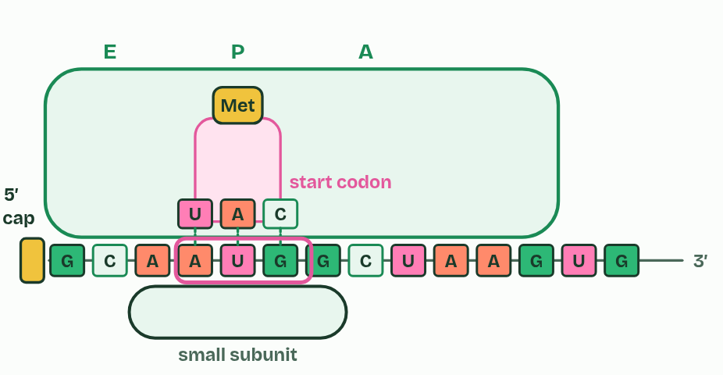
CHAPTER 11 · D1.2.17 Initiation of translation
3 / 6
Starting the chain
The large subunit joins: the initiator tRNA is in the P site.
Minutes 30 to 42
Notes:
Minutes 30 to 42 of 60: Starting the chain (12 min).
The plan: Chapter 11's predict box (which site holds the chain) first, then the step-through and the HL ribosome film, Start, then A, P and E, then Arrive, Pass, Exit.
Initiation is how translation starts. It happens in this order:
The large subunit has three places for tRNAs, and they are used all through elongation. The A site is where each new tRNA arrives with its amino acid. The P site holds the tRNA carrying the growing chain, which is joined by a peptide bond to the amino acid in the A site. The E site is where an empty tRNA goes when the ribosome moves one codon, and where it leaves from. After each move the tRNA that carried the chain is in the P site, and the A site is free over the next codon.
Every new polypeptide begins with methionine, because the start codon codes for it, but in many proteins that methionine is removed afterwards. Haemoglobin's beta chain, for example, begins with valine in the finished protein, which is why chapter 7 counted from there.

Slide 31
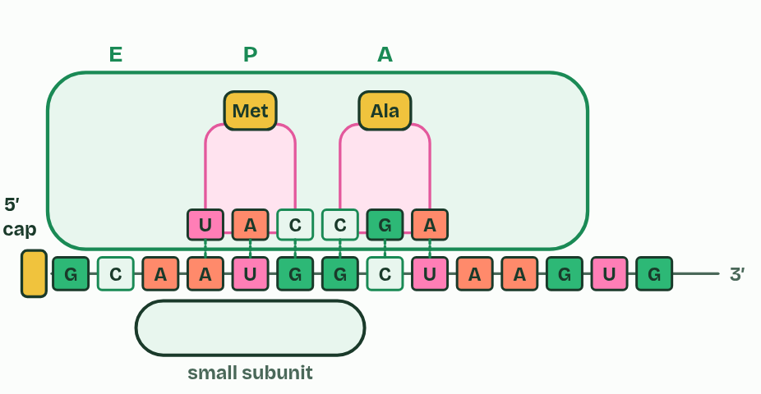
CHAPTER 11 · D1.2.17 Initiation of translation
4 / 6
Starting the chain
The next tRNA arrives in the A site.
Minutes 30 to 42
Notes:
Minutes 30 to 42 of 60: Starting the chain (12 min).
The plan: Chapter 11's predict box (which site holds the chain) first, then the step-through and the HL ribosome film, Start, then A, P and E, then Arrive, Pass, Exit.
Initiation is how translation starts. It happens in this order:
The large subunit has three places for tRNAs, and they are used all through elongation. The A site is where each new tRNA arrives with its amino acid. The P site holds the tRNA carrying the growing chain, which is joined by a peptide bond to the amino acid in the A site. The E site is where an empty tRNA goes when the ribosome moves one codon, and where it leaves from. After each move the tRNA that carried the chain is in the P site, and the A site is free over the next codon.
Every new polypeptide begins with methionine, because the start codon codes for it, but in many proteins that methionine is removed afterwards. Haemoglobin's beta chain, for example, begins with valine in the finished protein, which is why chapter 7 counted from there.

Slide 32
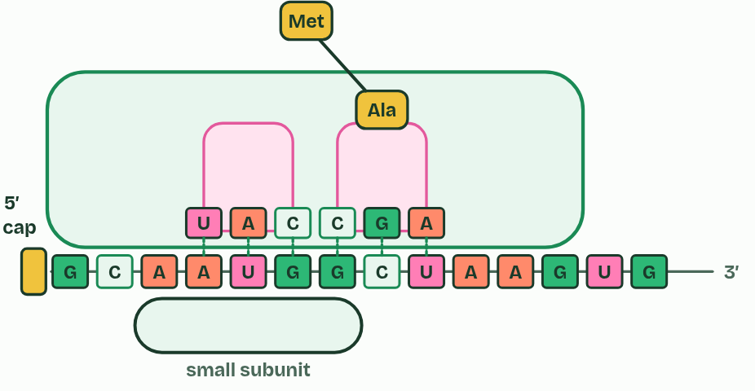
CHAPTER 11 · D1.2.17 Initiation of translation
5 / 6
Starting the chain
A peptide bond joins the two amino acids.
Minutes 30 to 42
Notes:
Minutes 30 to 42 of 60: Starting the chain (12 min).
The plan: Chapter 11's predict box (which site holds the chain) first, then the step-through and the HL ribosome film, Start, then A, P and E, then Arrive, Pass, Exit.
Initiation is how translation starts. It happens in this order:
The large subunit has three places for tRNAs, and they are used all through elongation. The A site is where each new tRNA arrives with its amino acid. The P site holds the tRNA carrying the growing chain, which is joined by a peptide bond to the amino acid in the A site. The E site is where an empty tRNA goes when the ribosome moves one codon, and where it leaves from. After each move the tRNA that carried the chain is in the P site, and the A site is free over the next codon.
Every new polypeptide begins with methionine, because the start codon codes for it, but in many proteins that methionine is removed afterwards. Haemoglobin's beta chain, for example, begins with valine in the finished protein, which is why chapter 7 counted from there.

Slide 33
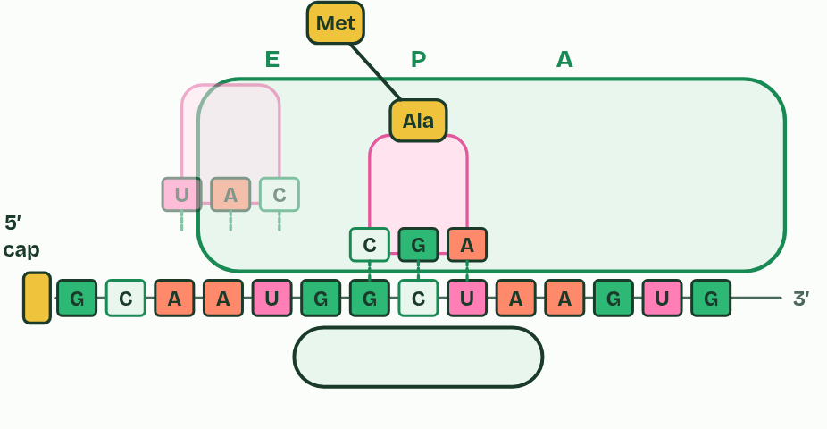
CHAPTER 11 · D1.2.17 Initiation of translation
6 / 6
Starting the chain
The ribosome moves one codon; the empty tRNA leaves from the E site.
Minutes 30 to 42
Notes:
Minutes 30 to 42 of 60: Starting the chain (12 min).
The plan: Chapter 11's predict box (which site holds the chain) first, then the step-through and the HL ribosome film, Start, then A, P and E, then Arrive, Pass, Exit.
Initiation is how translation starts. It happens in this order:
The large subunit has three places for tRNAs, and they are used all through elongation. The A site is where each new tRNA arrives with its amino acid. The P site holds the tRNA carrying the growing chain, which is joined by a peptide bond to the amino acid in the A site. The E site is where an empty tRNA goes when the ribosome moves one codon, and where it leaves from. After each move the tRNA that carried the chain is in the P site, and the A site is free over the next codon.
Every new polypeptide begins with methionine, because the start codon codes for it, but in many proteins that methionine is removed afterwards. Haemoglobin's beta chain, for example, begins with valine in the finished protein, which is why chapter 7 counted from there.

Slide 34
CHAPTER 11 · D1.2.17 Initiation of translation
Starting the chain
the small subunit attaches to the mRNA at its 5′ terminal, its 5′ end (in eukaryotes the 5′ cap helps);
it moves along the mRNA, 5′ to 3′, to the first AUG, the start codon (the short stretch before it is not translated);
the initiator tRNA, anticodon UAC, carrying methionine, pairs with AUG;
the large subunit joins, so the ribosome is complete, with the initiator tRNA in the P site;
another tRNA, matching the next codon, binds in the A site.
Minutes 30 to 42
Notes:
Minutes 30 to 42 of 60: Starting the chain (12 min).
The plan: Chapter 11's predict box (which site holds the chain) first, then the step-through and the HL ribosome film, Start, then A, P and E, then Arrive, Pass, Exit.
Initiation is how translation starts. It happens in this order:
The large subunit has three places for tRNAs, and they are used all through elongation. The A site is where each new tRNA arrives with its amino acid. The P site holds the tRNA carrying the growing chain, which is joined by a peptide bond to the amino acid in the A site. The E site is where an empty tRNA goes when the ribosome moves one codon, and where it leaves from. After each move the tRNA that carried the chain is in the P site, and the A site is free over the next codon.
Every new polypeptide begins with methionine, because the start codon codes for it, but in many proteins that methionine is removed afterwards. Haemoglobin's beta chain, for example, begins with valine in the finished protein, which is why chapter 7 counted from there.

Slide 35
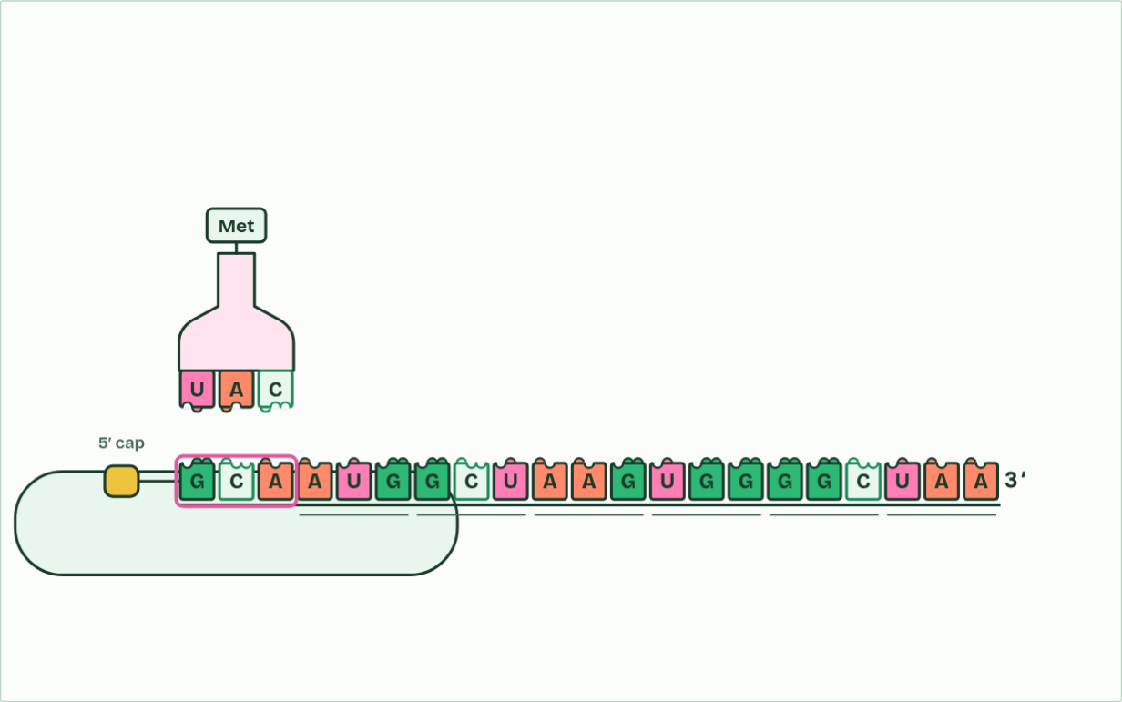
CHAPTER 11 · D1.2.17 Initiation of translation
small subunit at the 5′ end
1 / 6
Starting the chain
The small subunit attaches to the mRNA at its 5′ end.
Minutes 30 to 42
Notes:
Minutes 30 to 42 of 60: Starting the chain (12 min).
The plan: Chapter 11's predict box (which site holds the chain) first, then the step-through and the HL ribosome film, Start, then A, P and E, then Arrive, Pass, Exit.
Initiation is how translation starts. It happens in this order:
The large subunit has three places for tRNAs, and they are used all through elongation. The A site is where each new tRNA arrives with its amino acid. The P site holds the tRNA carrying the growing chain, which is joined by a peptide bond to the amino acid in the A site. The E site is where an empty tRNA goes when the ribosome moves one codon, and where it leaves from. After each move the tRNA that carried the chain is in the P site, and the A site is free over the next codon.
Every new polypeptide begins with methionine, because the start codon codes for it, but in many proteins that methionine is removed afterwards. Haemoglobin's beta chain, for example, begins with valine in the finished protein, which is why chapter 7 counted from there.
The animation "Start, then A, P and E", paused at 3.5 s. The next slides go on through it, then play it.

Slide 36
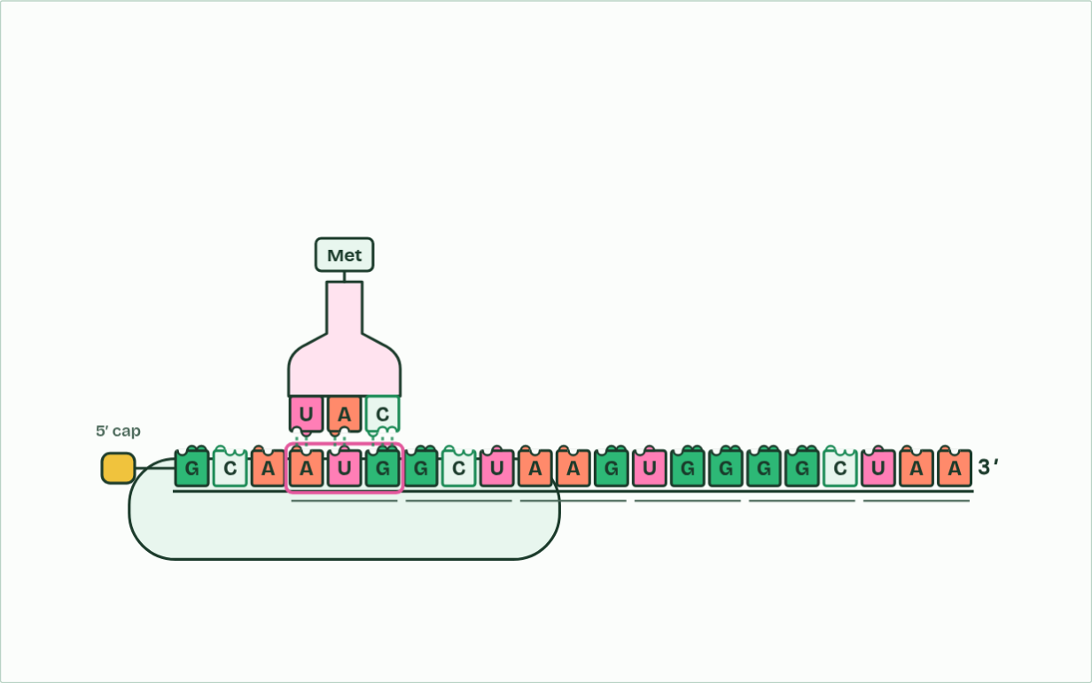
CHAPTER 11 · D1.2.17 Initiation of translation
under the subunit: AUG
2 / 6
Starting the chain
It moves towards the 3′ end until it reaches the start codon, AUG. The initiator tRNA pairs with it.
Minutes 30 to 42
Notes:
Minutes 30 to 42 of 60: Starting the chain (12 min).
The plan: Chapter 11's predict box (which site holds the chain) first, then the step-through and the HL ribosome film, Start, then A, P and E, then Arrive, Pass, Exit.
Initiation is how translation starts. It happens in this order:
The large subunit has three places for tRNAs, and they are used all through elongation. The A site is where each new tRNA arrives with its amino acid. The P site holds the tRNA carrying the growing chain, which is joined by a peptide bond to the amino acid in the A site. The E site is where an empty tRNA goes when the ribosome moves one codon, and where it leaves from. After each move the tRNA that carried the chain is in the P site, and the A site is free over the next codon.
Every new polypeptide begins with methionine, because the start codon codes for it, but in many proteins that methionine is removed afterwards. Haemoglobin's beta chain, for example, begins with valine in the finished protein, which is why chapter 7 counted from there.
The animation "Start, then A, P and E", paused at 8.9 s. The next slides go on through it, then play it.

Slide 37
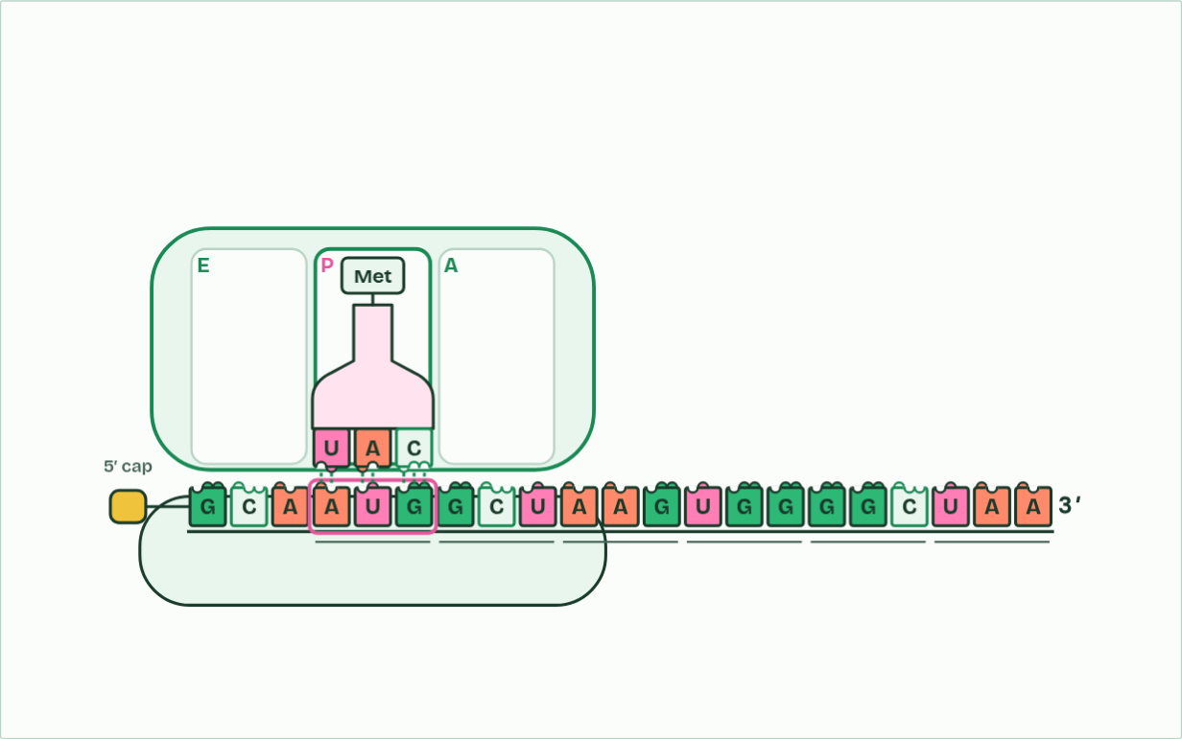
CHAPTER 11 · D1.2.17 Initiation of translation
codon 1: AUG, Met, P site
3 / 6
Starting the chain
The large subunit joins. The initiator tRNA sits in the P site.
Minutes 30 to 42
Notes:
Minutes 30 to 42 of 60: Starting the chain (12 min).
The plan: Chapter 11's predict box (which site holds the chain) first, then the step-through and the HL ribosome film, Start, then A, P and E, then Arrive, Pass, Exit.
Initiation is how translation starts. It happens in this order:
The large subunit has three places for tRNAs, and they are used all through elongation. The A site is where each new tRNA arrives with its amino acid. The P site holds the tRNA carrying the growing chain, which is joined by a peptide bond to the amino acid in the A site. The E site is where an empty tRNA goes when the ribosome moves one codon, and where it leaves from. After each move the tRNA that carried the chain is in the P site, and the A site is free over the next codon.
Every new polypeptide begins with methionine, because the start codon codes for it, but in many proteins that methionine is removed afterwards. Haemoglobin's beta chain, for example, begins with valine in the finished protein, which is why chapter 7 counted from there.
The animation "Start, then A, P and E", paused at 11.5 s. The next slides go on through it, then play it.

Slide 38
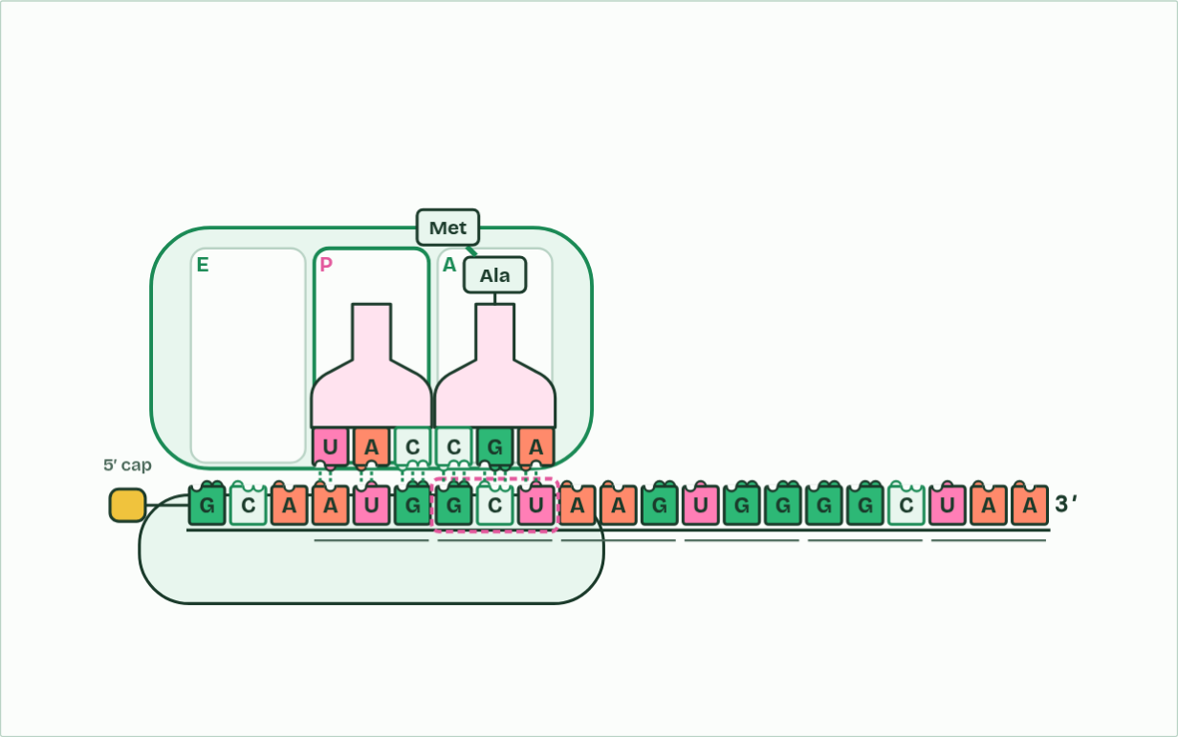
CHAPTER 11 · D1.2.17 Initiation of translation
codon 2: GCU, Ala, A site
4 / 6
Starting the chain
Another tRNA arrives in the A site. A peptide bond joins methionine to its amino acid.
Minutes 30 to 42
Notes:
Minutes 30 to 42 of 60: Starting the chain (12 min).
The plan: Chapter 11's predict box (which site holds the chain) first, then the step-through and the HL ribosome film, Start, then A, P and E, then Arrive, Pass, Exit.
Initiation is how translation starts. It happens in this order:
The large subunit has three places for tRNAs, and they are used all through elongation. The A site is where each new tRNA arrives with its amino acid. The P site holds the tRNA carrying the growing chain, which is joined by a peptide bond to the amino acid in the A site. The E site is where an empty tRNA goes when the ribosome moves one codon, and where it leaves from. After each move the tRNA that carried the chain is in the P site, and the A site is free over the next codon.
Every new polypeptide begins with methionine, because the start codon codes for it, but in many proteins that methionine is removed afterwards. Haemoglobin's beta chain, for example, begins with valine in the finished protein, which is why chapter 7 counted from there.
The animation "Start, then A, P and E", paused at 15.0 s. The next slides go on through it, then play it.

Slide 39
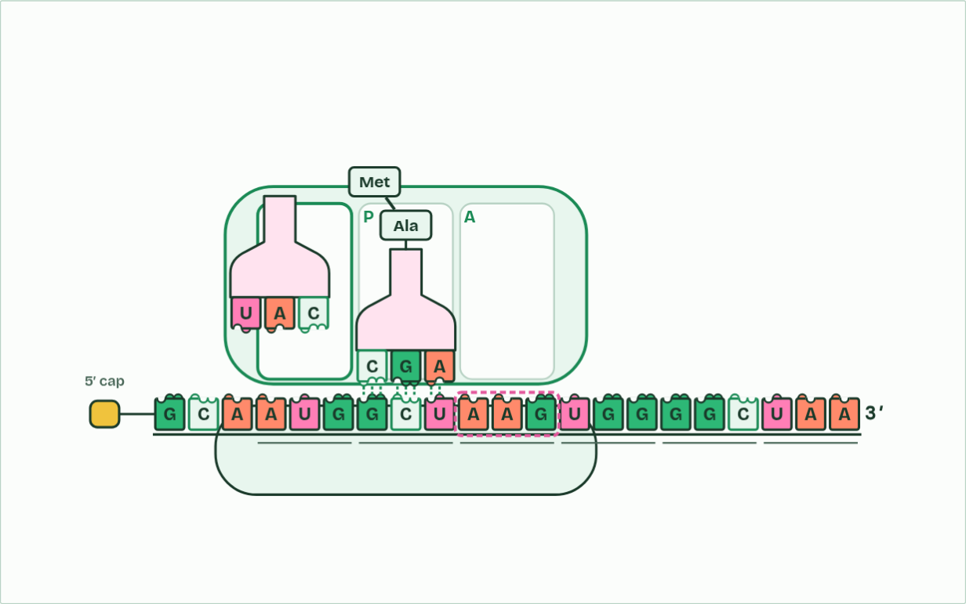
CHAPTER 11 · D1.2.17 Initiation of translation
codon 3: AAG, Lys, A site
5 / 6
Starting the chain
The ribosome moves one codon. The empty tRNA leaves from the E site; the chain’s tRNA is now in P.
Minutes 30 to 42
Notes:
Minutes 30 to 42 of 60: Starting the chain (12 min).
The plan: Chapter 11's predict box (which site holds the chain) first, then the step-through and the HL ribosome film, Start, then A, P and E, then Arrive, Pass, Exit.
Initiation is how translation starts. It happens in this order:
The large subunit has three places for tRNAs, and they are used all through elongation. The A site is where each new tRNA arrives with its amino acid. The P site holds the tRNA carrying the growing chain, which is joined by a peptide bond to the amino acid in the A site. The E site is where an empty tRNA goes when the ribosome moves one codon, and where it leaves from. After each move the tRNA that carried the chain is in the P site, and the A site is free over the next codon.
Every new polypeptide begins with methionine, because the start codon codes for it, but in many proteins that methionine is removed afterwards. Haemoglobin's beta chain, for example, begins with valine in the finished protein, which is why chapter 7 counted from there.
The animation "Start, then A, P and E", paused at 19.0 s. The next slides go on through it, then play it.

Slide 40
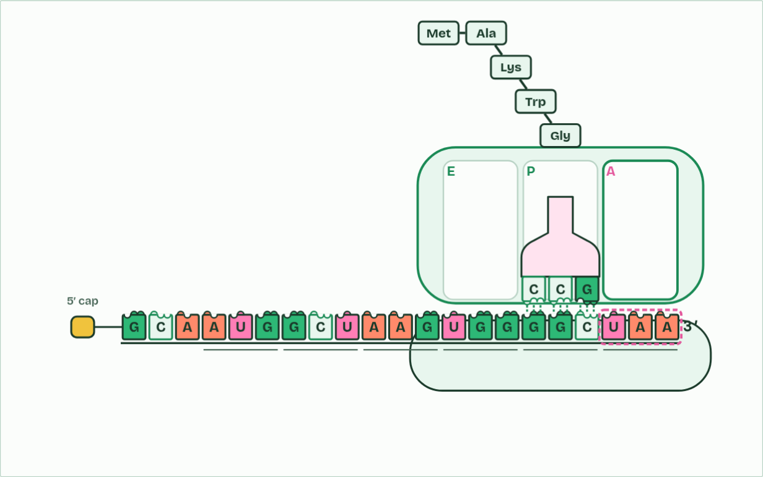
CHAPTER 11 · D1.2.17 Initiation of translation
codon 6: UAA, stop, A site
6 / 6
Starting the chain
At the stop codon the chain is released and the subunits come apart.
Minutes 30 to 42
Notes:
Minutes 30 to 42 of 60: Starting the chain (12 min).
The plan: Chapter 11's predict box (which site holds the chain) first, then the step-through and the HL ribosome film, Start, then A, P and E, then Arrive, Pass, Exit.
Initiation is how translation starts. It happens in this order:
The large subunit has three places for tRNAs, and they are used all through elongation. The A site is where each new tRNA arrives with its amino acid. The P site holds the tRNA carrying the growing chain, which is joined by a peptide bond to the amino acid in the A site. The E site is where an empty tRNA goes when the ribosome moves one codon, and where it leaves from. After each move the tRNA that carried the chain is in the P site, and the A site is free over the next codon.
Every new polypeptide begins with methionine, because the start codon codes for it, but in many proteins that methionine is removed afterwards. Haemoglobin's beta chain, for example, begins with valine in the finished protein, which is why chapter 7 counted from there.
The animation "Start, then A, P and E", paused at 39.0 s. The next slides go on through it, then play it.

Slide 41
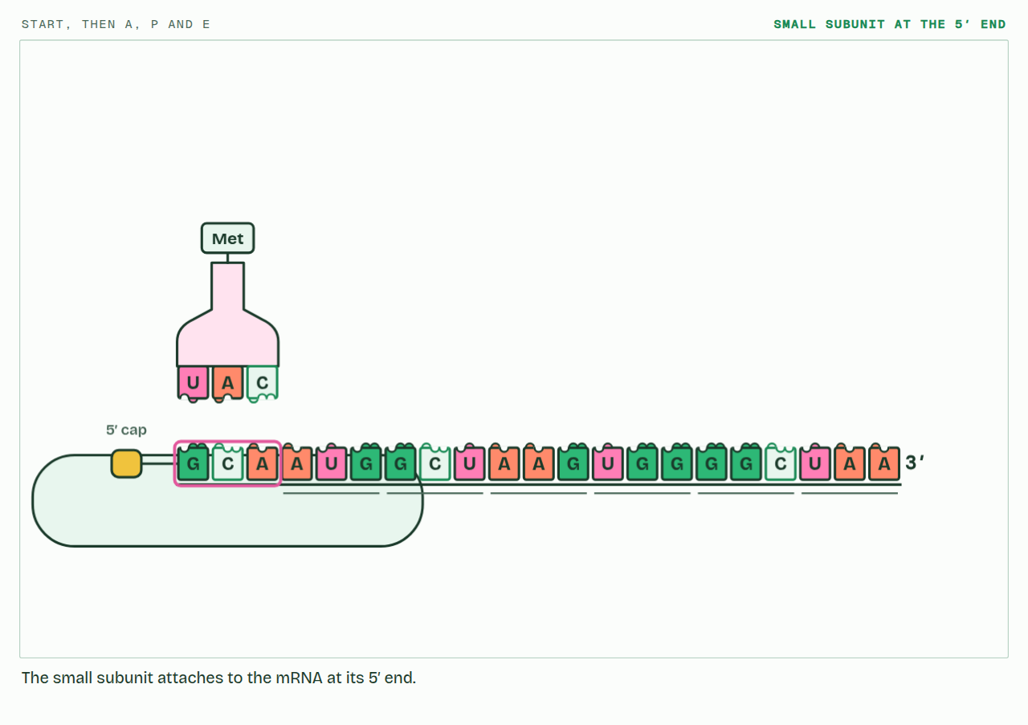
CHAPTER 11 · D1.2.17 Initiation of translation
PLAY IT
Starting the chain
Start, then A, P and E: click to play. It loops every 44 seconds.
Minutes 30 to 42
Notes:
Minutes 30 to 42 of 60: Starting the chain (12 min).
The plan: Chapter 11's predict box (which site holds the chain) first, then the step-through and the HL ribosome film, Start, then A, P and E, then Arrive, Pass, Exit.
The video is ribosome-f1d54b.mp4, one loop of the animation in the guide. It plays in PowerPoint and Keynote. Google Slides does not play a video embedded in a .pptx: download ribosome-f1d54b.mp4 (https://www.biologybybradford.com/guides/downloads/scenes/ribosome-f1d54b.mp4), upload it to Google Drive, then Insert > Video > Google Drive.
In the guide the class can change it as it runs: https://www.biologybybradford.com/guides/ib-biology-d1-2-protein-synthesis#initiation
What it shows, in order:
1. The small subunit attaches to the mRNA at its 5′ end.
2. It moves towards the 3′ end until it reaches the start codon, AUG. The initiator tRNA pairs with it.
3. The large subunit joins. The initiator tRNA sits in the P site.
4. Another tRNA arrives in the A site. A peptide bond joins methionine to its amino acid.
5. The ribosome moves one codon. The empty tRNA leaves from the E site; the chain’s tRNA is now in P.
6. At the stop codon the chain is released and the subunits come apart.

Slide 42
WHAT HAPPENS
The first peptide bond has just formed, joining methionine to the second amino acid. Before the ribosome moves, which site holds the tRNA carrying both amino acids?
A A site
B P site
C E site
The bond joins methionine to the amino acid on the tRNA in the A site, so the two-amino-acid chain now hangs from that tRNA, still in the A site. The tRNA in the P site is empty. Only when the ribosome moves one codon does the chain's tRNA shift into the P site and the empty one into the E site.
Minutes 30 to 42
Notes:
Minutes 30 to 42 of 60: Starting the chain (12 min).
The plan: Chapter 11's predict box (which site holds the chain) first, then the step-through and the HL ribosome film, Start, then A, P and E, then Arrive, Pass, Exit.
Answer: A. The bond joins methionine to the amino acid on the tRNA in the A site, so the two-amino-acid chain now hangs from that tRNA, still in the A site. The tRNA in the P site is empty. Only when the ribosome moves one codon does the chain's tRNA shift into the P site and the empty one into the E site.

Slide 43
WATCH OUT
The initiator tRNA starts in the P site, not the A site. Every other tRNA enters at the A site and reaches the P site only when the ribosome moves. And the small subunit binds the mRNA first, the large subunit after it.
Minutes 30 to 42
Notes:
Minutes 30 to 42 of 60: Starting the chain (12 min).
The plan: Chapter 11's predict box (which site holds the chain) first, then the step-through and the HL ribosome film, Start, then A, P and E, then Arrive, Pass, Exit.
A common mistake: say it, then ask who can say why it is wrong.

Slide 44
REMEMBER IT
The three sites
A
P
E
Arrive
Pass
Exit
Minutes 30 to 42
Notes:
Minutes 30 to 42 of 60: Starting the chain (12 min).
The plan: Chapter 11's predict box (which site holds the chain) first, then the step-through and the HL ribosome film, Start, then A, P and E, then Arrive, Pass, Exit.
Ask the class what each letter stands for before revealing.

Slide 45
REMEMBER IT
The three sites
A
P
E
Arrive
Pass
Exit
A site
P site
E site
a loaded tRNA arrives
holds the chain and passes it on
the empty tRNA leaves
Minutes 30 to 42
Notes:
Minutes 30 to 42 of 60: Starting the chain (12 min).
The plan: Chapter 11's predict box (which site holds the chain) first, then the step-through and the HL ribosome film, Start, then A, P and E, then Arrive, Pass, Exit.
Arrive: A site (a loaded tRNA arrives)
Pass: P site (holds the chain and passes it on)
Exit: E site (the empty tRNA leaves)

Slide 46
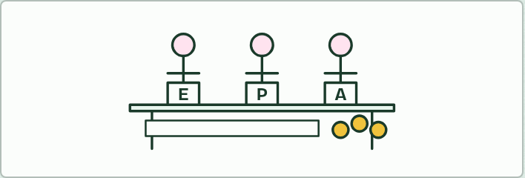
ROLE PLAY · HL
12 MIN
Be the ribosome
THE TASK
Three students stand as the E, P and A sites behind a bench, with an mRNA strip of codons on the bench (the demonstration gene with its leader). Others are tRNAs holding anticodon cards and an amino acid bead (or a coloured cube). The small subunit (one student with a card) starts at the 5′ end and walks to AUG, the initiator tRNA steps into P, the large subunit (the three sites) arrives, tRNAs arrive at A, the chain of beads is passed from P to A, everyone shifts one codon, and the empty tRNA leaves from E. The class calls each move.
STUDENTS NEED
A bench, a codon strip, anticodon cards and beads on string.
Minutes 42 to 54
Notes:
Minutes 42 to 54 of 60: Be the ribosome (12 min).
The plan: A role play of initiation and elongation (activity below).
The activity: Be the ribosome. Three students stand as the E, P and A sites behind a bench, with an mRNA strip of codons on the bench (the demonstration gene with its leader). Others are tRNAs holding anticodon cards and an amino acid bead (or a coloured cube). The small subunit (one student with a card) starts at the 5′ end and walks to AUG, the initiator tRNA steps into P, the large subunit (the three sites) arrives, tRNAs arrive at A, the chain of beads is passed from P to A, everyone shifts one codon, and the empty tRNA leaves from E. The class calls each move.
Needs: a bench, a codon strip, anticodon cards and beads on string.
The time: 12 minutes, minutes 42 to 54 of the plan.

Slide 47
PLENARY
Can you now...
Describe how pre-mRNA is capped, tailed and spliced, and how alternative splicing makes several polypeptides from one gene (D1.2.15, D1.2.16)
Describe how translation starts, and what the A, P and E sites do (D1.2.17)
Minutes 54 to 60
Notes:
Minutes 54 to 60 of 60: Exit (6 min).
The plan: "Explain why translation must start from the 5′ end of the mRNA", or the D1.2 exam maker's 4-mark question on the initiation of translation.
Thumbs up, sideways or down on each goal before the exit question. The goals come from the statements this lesson covers.

Slide 48
EXIT QUESTION
Before you go
"Explain why translation must start from the 5′ end of the mRNA", or the D1.2 exam maker's 4-mark question on the initiation of translation.
Minutes 54 to 60
Notes:
Minutes 54 to 60 of 60: Exit (6 min).
The plan: "Explain why translation must start from the 5′ end of the mRNA", or the D1.2 exam maker's 4-mark question on the initiation of translation.

Slide 49
PRACTISE AND REVISE
Keep going
Exam practice: a fresh paper of exam questions on D1.2 at higher level, marked as you go
The guide, with the animations and the dry lab
This lesson in the guide: 10 Capped, cut and tailed, 11 Starting the chain
BUILD FOR YOUR CLASS
ALREADY ON THE SITE FOR D1.2
CARD SETS ON SPLYCR
Tarsia puzzle, dominoes and picture reveal on D1.2, built from its key terms and ready to print
A pub quiz with rounds on D1.2, to present or run with no projector
An escape room built from the question bank on D1.2
Quiz: Protein Synthesis (HL)
Quiz: Protein Synthesis
Revision map: D1.2 Protein synthesis, to fill in
Exam questions: D1.2 in the exam maker, a paper with its markscheme
Open a set to host it as a class game, or make a copy to edit.
D1.2 Protein Synthesis (SL)
D1.2 Protein Synthesis (HL)
How this was made. The course structure, the activities and the teaching choices come from my own classroom, my presentations and my years of teaching IB and AP Biology. I use Claude, an AI, to help write and build the interactive guides, lesson plans, slides and practice questions, and to draw the diagrams and code the interactives. I direct the work and review it against the IB and AP specifications before it goes live.
Minute 60: after the lesson
Notes:
Every link here is live. Set the exam practice paper for homework: it is fresh each time, marked as students go and saved to their Exam practice when they are signed in.
Exam practice: https://www.biologybybradford.com/exam-maker/sit?topics=D1.2&level=HL&paper=quiz&marks=15&src=ep
The guide: https://www.biologybybradford.com/guides/ib-biology-d1-2-protein-synthesis

