Slide 1
IB Biology D1.2
LESSON 6 OF 6
HL
BY THE END YOU CAN
Protein synthesis
Explain how pre-proinsulin becomes insulin, and why proteasomes keep breaking proteins down (D1.2.18, D1.2.19)
Finishing, recycling, and the whole factory
D1.2.18, D1.2.19
Pre-proinsulin to insulin, proteasomes and a working proteome, then the whole process in the protein factory
60 minutes · chapter 12
Minute 0
Notes:
IB Biology D1.2, Protein synthesis. Lesson 6 of 6: Finishing, recycling, and the whole factory (higher level), 60 minutes.
The plan, minute by minute (each slide's footer says where you are):
0 to 6 min (6) Do now
6 to 18 min (12) Pre-proinsulin to insulin
18 to 26 min (8) Proteasomes
26 to 42 min (16) The protein factory
42 to 54 min (12) An extended question
54 to 60 min (6) Exit
What students get wrong:
Proteasomes only remove faulty proteins. They also clear proteins no longer needed, and the amino acids are reused.
Insulin is made as two separate chains. One chain, cut twice.
Stretch and support:
Stretch: why might cells make insulin as a longer chain and cut it, rather than as two chains? (One gene, and one folding step that lines the disulfide bonds up correctly.)
Stretch: the ribosome and the proteasome in the Molecule of the Month pages of PDB-101 (RCSB), to see the real shapes.
Support: play the factory's "Let the cell do it" on the board before pairs try a round.
The lesson plan to print: https://www.biologybybradford.com/guides/downloads/ib-biology-d1-2-protein-synthesis-lesson-6-plan.pdf

Slide 2
DO NOW
Do now
"Is a polypeptide a protein?"
6:00
minutes
Start now: the timer is running.
Minutes 0 to 6
Notes:
Minutes 0 to 6 of 60: Do now (6 min).
The plan: "Is a polypeptide a protein?" A vote, then one reason each side.
Start a 6 minute timer as they come in.

Slide 3
STEP 2
12 MIN
Pre-proinsulin to insulin
Chapter 12: Finished, then recycled
Minutes 6 to 18
Notes:
Minutes 6 to 18 of 60: Pre-proinsulin to insulin (12 min).
The plan: Chapter 12's step-through of the two stages, with its first predict box (59 amino acids).

Slide 4
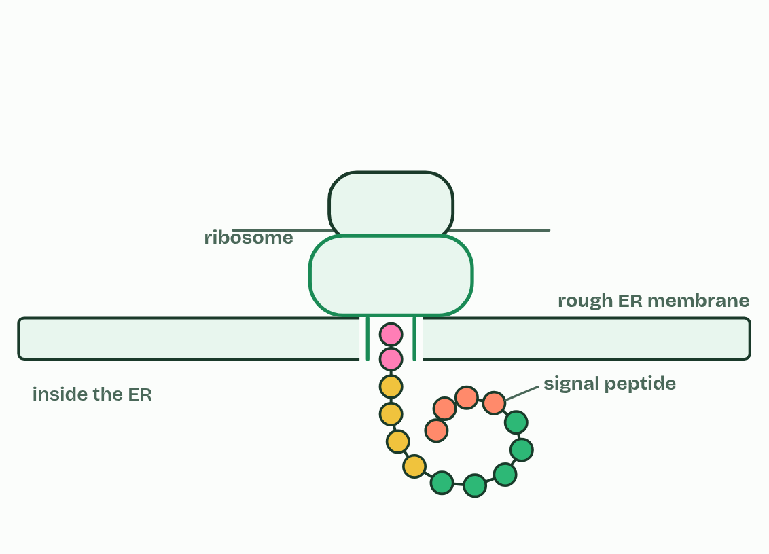
CHAPTER 12 · D1.2.18 D1.2.19 Modification and proteasomes
1 / 5
Finished, then recycled
Pre-proinsulin: a signal peptide sends it into the rough ER.
Minutes 6 to 18
Notes:
Minutes 6 to 18 of 60: Pre-proinsulin to insulin (12 min).
The plan: Chapter 12's step-through of the two stages, with its first predict box (59 amino acids).
Many polypeptides cannot work as they come off the ribosome. They are modified first, which is called post-translational modification: they are cut, folded and bonded, or given extra groups such as sugars or phosphates. Insulin is the guide's example, and it is made in two stages.
It starts as pre-proinsulin, 110 amino acids long, which begins with a signal peptide of 24 amino acids. The signal peptide sends the ribosome to the rough ER, so the chain is threaded into the ER as it is made. In stage 1, in the rough ER, the signal peptide is cut off, leaving proinsulin (86 amino acids). Proinsulin folds, and three disulfide bonds form: two join what will become the B chain to the A chain, and one lies within the A chain. In stage 2, in the Golgi apparatus and the vesicles that bud from it, enzymes cut out the middle section, the C-peptide, leaving insulin: an A chain of 21 amino acids and a B chain of 30, held together by two disulfide bonds. Insulin is stored in vesicles until it is released (what it does is D3.3).
Cells break proteins down as well. A proteasome is a barrel-shaped complex of proteins, in the cytoplasm and the nucleus, that hydrolyses the peptide bonds of a protein into short pieces, which other enzymes then split into single amino acids for the cell to use again in building new proteins. A protein is marked for breakdown with a small protein tag. Damaged and misfolded proteins carry one, and so do healthy proteins the cell no longer needs. A protein's life may be minutes or months.
The proteome is all the proteins a cell makes. Keeping it working needs constant breakdown and synthesis: broken proteins are cleared away, and the amount of each protein can change quickly when the cell needs something new. The protein factory after chapter 7 has orders for this chapter too, when the page is at higher level.

Slide 5
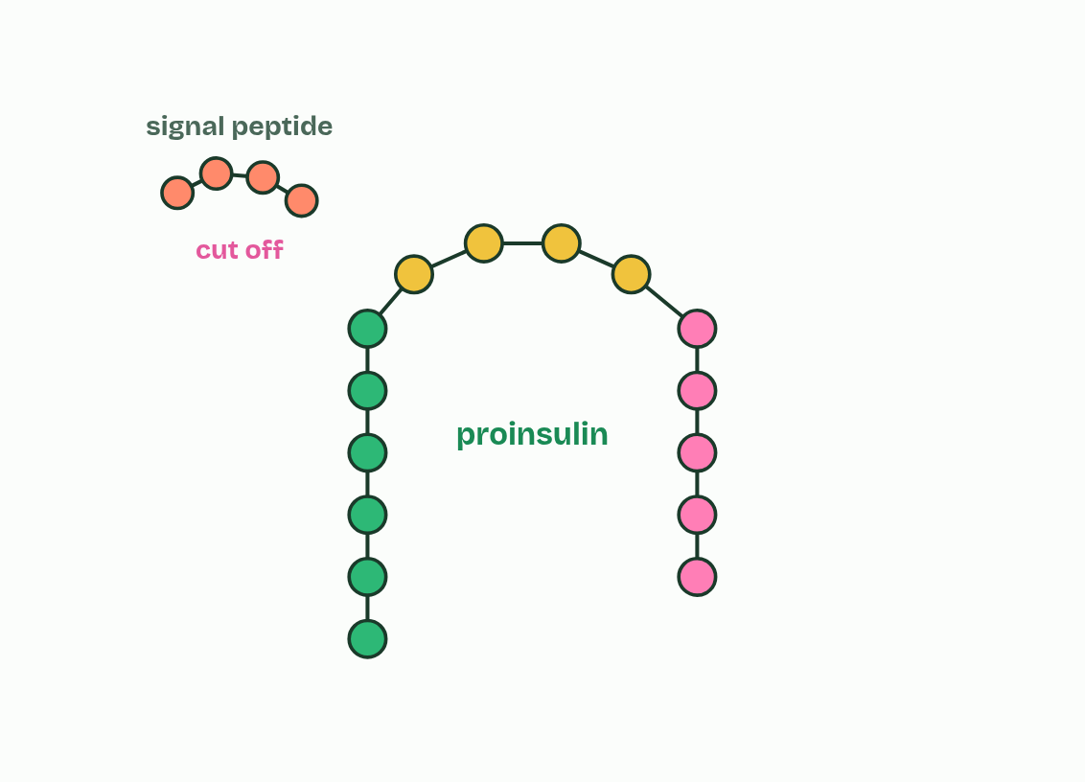
CHAPTER 12 · D1.2.18 D1.2.19 Modification and proteasomes
2 / 5
Finished, then recycled
Stage 1: the signal peptide is cut off, leaving proinsulin.
Minutes 6 to 18
Notes:
Minutes 6 to 18 of 60: Pre-proinsulin to insulin (12 min).
The plan: Chapter 12's step-through of the two stages, with its first predict box (59 amino acids).
Many polypeptides cannot work as they come off the ribosome. They are modified first, which is called post-translational modification: they are cut, folded and bonded, or given extra groups such as sugars or phosphates. Insulin is the guide's example, and it is made in two stages.
It starts as pre-proinsulin, 110 amino acids long, which begins with a signal peptide of 24 amino acids. The signal peptide sends the ribosome to the rough ER, so the chain is threaded into the ER as it is made. In stage 1, in the rough ER, the signal peptide is cut off, leaving proinsulin (86 amino acids). Proinsulin folds, and three disulfide bonds form: two join what will become the B chain to the A chain, and one lies within the A chain. In stage 2, in the Golgi apparatus and the vesicles that bud from it, enzymes cut out the middle section, the C-peptide, leaving insulin: an A chain of 21 amino acids and a B chain of 30, held together by two disulfide bonds. Insulin is stored in vesicles until it is released (what it does is D3.3).
Cells break proteins down as well. A proteasome is a barrel-shaped complex of proteins, in the cytoplasm and the nucleus, that hydrolyses the peptide bonds of a protein into short pieces, which other enzymes then split into single amino acids for the cell to use again in building new proteins. A protein is marked for breakdown with a small protein tag. Damaged and misfolded proteins carry one, and so do healthy proteins the cell no longer needs. A protein's life may be minutes or months.
The proteome is all the proteins a cell makes. Keeping it working needs constant breakdown and synthesis: broken proteins are cleared away, and the amount of each protein can change quickly when the cell needs something new. The protein factory after chapter 7 has orders for this chapter too, when the page is at higher level.

Slide 6
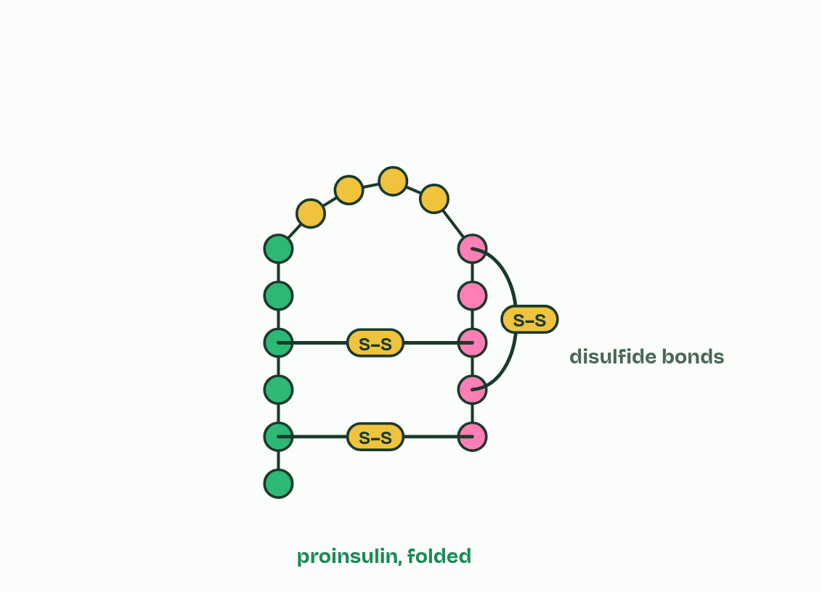
CHAPTER 12 · D1.2.18 D1.2.19 Modification and proteasomes
3 / 5
Finished, then recycled
Proinsulin folds and disulfide bonds form.
Minutes 6 to 18
Notes:
Minutes 6 to 18 of 60: Pre-proinsulin to insulin (12 min).
The plan: Chapter 12's step-through of the two stages, with its first predict box (59 amino acids).
Many polypeptides cannot work as they come off the ribosome. They are modified first, which is called post-translational modification: they are cut, folded and bonded, or given extra groups such as sugars or phosphates. Insulin is the guide's example, and it is made in two stages.
It starts as pre-proinsulin, 110 amino acids long, which begins with a signal peptide of 24 amino acids. The signal peptide sends the ribosome to the rough ER, so the chain is threaded into the ER as it is made. In stage 1, in the rough ER, the signal peptide is cut off, leaving proinsulin (86 amino acids). Proinsulin folds, and three disulfide bonds form: two join what will become the B chain to the A chain, and one lies within the A chain. In stage 2, in the Golgi apparatus and the vesicles that bud from it, enzymes cut out the middle section, the C-peptide, leaving insulin: an A chain of 21 amino acids and a B chain of 30, held together by two disulfide bonds. Insulin is stored in vesicles until it is released (what it does is D3.3).
Cells break proteins down as well. A proteasome is a barrel-shaped complex of proteins, in the cytoplasm and the nucleus, that hydrolyses the peptide bonds of a protein into short pieces, which other enzymes then split into single amino acids for the cell to use again in building new proteins. A protein is marked for breakdown with a small protein tag. Damaged and misfolded proteins carry one, and so do healthy proteins the cell no longer needs. A protein's life may be minutes or months.
The proteome is all the proteins a cell makes. Keeping it working needs constant breakdown and synthesis: broken proteins are cleared away, and the amount of each protein can change quickly when the cell needs something new. The protein factory after chapter 7 has orders for this chapter too, when the page is at higher level.

Slide 7
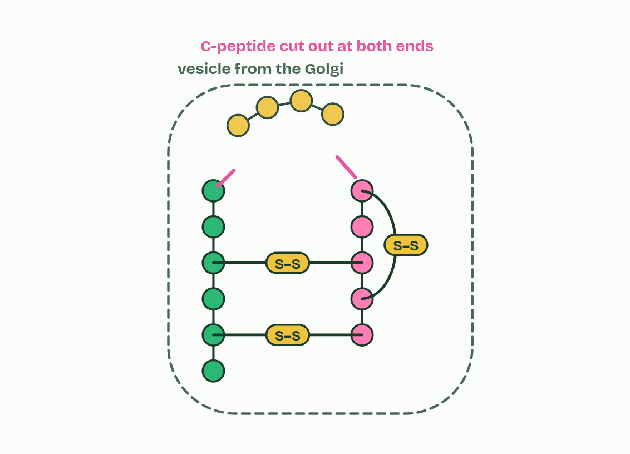
CHAPTER 12 · D1.2.18 D1.2.19 Modification and proteasomes
4 / 5
Finished, then recycled
Stage 2: the C-peptide is cut out.
Minutes 6 to 18
Notes:
Minutes 6 to 18 of 60: Pre-proinsulin to insulin (12 min).
The plan: Chapter 12's step-through of the two stages, with its first predict box (59 amino acids).
Many polypeptides cannot work as they come off the ribosome. They are modified first, which is called post-translational modification: they are cut, folded and bonded, or given extra groups such as sugars or phosphates. Insulin is the guide's example, and it is made in two stages.
It starts as pre-proinsulin, 110 amino acids long, which begins with a signal peptide of 24 amino acids. The signal peptide sends the ribosome to the rough ER, so the chain is threaded into the ER as it is made. In stage 1, in the rough ER, the signal peptide is cut off, leaving proinsulin (86 amino acids). Proinsulin folds, and three disulfide bonds form: two join what will become the B chain to the A chain, and one lies within the A chain. In stage 2, in the Golgi apparatus and the vesicles that bud from it, enzymes cut out the middle section, the C-peptide, leaving insulin: an A chain of 21 amino acids and a B chain of 30, held together by two disulfide bonds. Insulin is stored in vesicles until it is released (what it does is D3.3).
Cells break proteins down as well. A proteasome is a barrel-shaped complex of proteins, in the cytoplasm and the nucleus, that hydrolyses the peptide bonds of a protein into short pieces, which other enzymes then split into single amino acids for the cell to use again in building new proteins. A protein is marked for breakdown with a small protein tag. Damaged and misfolded proteins carry one, and so do healthy proteins the cell no longer needs. A protein's life may be minutes or months.
The proteome is all the proteins a cell makes. Keeping it working needs constant breakdown and synthesis: broken proteins are cleared away, and the amount of each protein can change quickly when the cell needs something new. The protein factory after chapter 7 has orders for this chapter too, when the page is at higher level.

Slide 8
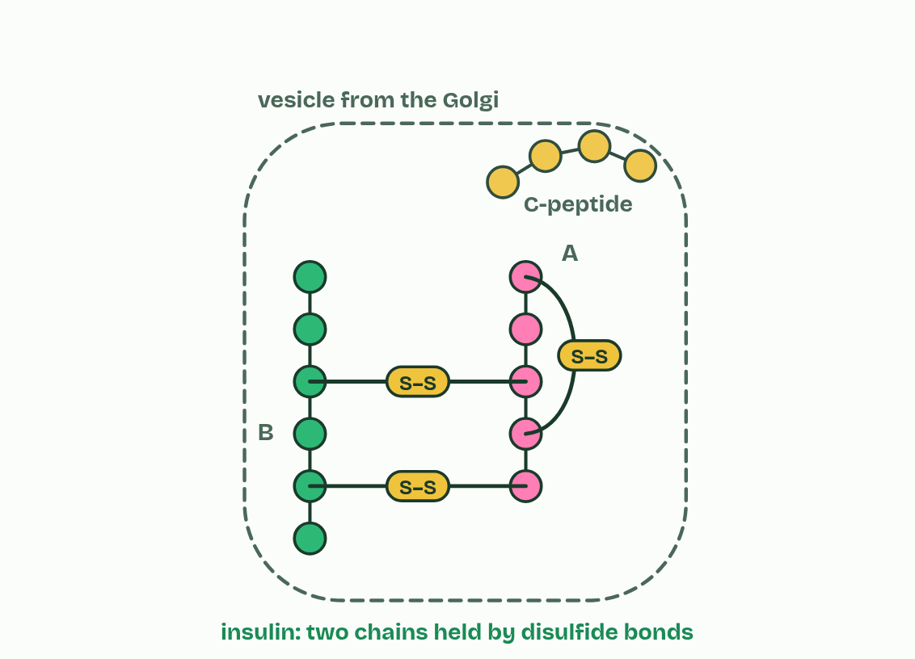
CHAPTER 12 · D1.2.18 D1.2.19 Modification and proteasomes
5 / 5
Finished, then recycled
Insulin: two chains held by disulfide bonds.
Minutes 6 to 18
Notes:
Minutes 6 to 18 of 60: Pre-proinsulin to insulin (12 min).
The plan: Chapter 12's step-through of the two stages, with its first predict box (59 amino acids).
Many polypeptides cannot work as they come off the ribosome. They are modified first, which is called post-translational modification: they are cut, folded and bonded, or given extra groups such as sugars or phosphates. Insulin is the guide's example, and it is made in two stages.
It starts as pre-proinsulin, 110 amino acids long, which begins with a signal peptide of 24 amino acids. The signal peptide sends the ribosome to the rough ER, so the chain is threaded into the ER as it is made. In stage 1, in the rough ER, the signal peptide is cut off, leaving proinsulin (86 amino acids). Proinsulin folds, and three disulfide bonds form: two join what will become the B chain to the A chain, and one lies within the A chain. In stage 2, in the Golgi apparatus and the vesicles that bud from it, enzymes cut out the middle section, the C-peptide, leaving insulin: an A chain of 21 amino acids and a B chain of 30, held together by two disulfide bonds. Insulin is stored in vesicles until it is released (what it does is D3.3).
Cells break proteins down as well. A proteasome is a barrel-shaped complex of proteins, in the cytoplasm and the nucleus, that hydrolyses the peptide bonds of a protein into short pieces, which other enzymes then split into single amino acids for the cell to use again in building new proteins. A protein is marked for breakdown with a small protein tag. Damaged and misfolded proteins carry one, and so do healthy proteins the cell no longer needs. A protein's life may be minutes or months.
The proteome is all the proteins a cell makes. Keeping it working needs constant breakdown and synthesis: broken proteins are cleared away, and the amount of each protein can change quickly when the cell needs something new. The protein factory after chapter 7 has orders for this chapter too, when the page is at higher level.

Slide 9
CHAPTER 12 · D1.2.18 D1.2.19 Modification and proteasomes
Finished, then recycled
They are modified first, which is called post-translational modification: they are cut, folded and bonded, or given extra groups such as sugars or phosphates.
It starts as pre-proinsulin, 110 amino acids long, which begins with a signal peptide of 24 amino acids.
The signal peptide sends the ribosome to the rough ER, so the chain is threaded into the ER as it is made.
In stage 1, in the rough ER, the signal peptide is cut off, leaving proinsulin (86 amino acids).
Minutes 6 to 18
Notes:
Minutes 6 to 18 of 60: Pre-proinsulin to insulin (12 min).
The plan: Chapter 12's step-through of the two stages, with its first predict box (59 amino acids).
Many polypeptides cannot work as they come off the ribosome. They are modified first, which is called post-translational modification: they are cut, folded and bonded, or given extra groups such as sugars or phosphates. Insulin is the guide's example, and it is made in two stages.
It starts as pre-proinsulin, 110 amino acids long, which begins with a signal peptide of 24 amino acids. The signal peptide sends the ribosome to the rough ER, so the chain is threaded into the ER as it is made. In stage 1, in the rough ER, the signal peptide is cut off, leaving proinsulin (86 amino acids). Proinsulin folds, and three disulfide bonds form: two join what will become the B chain to the A chain, and one lies within the A chain. In stage 2, in the Golgi apparatus and the vesicles that bud from it, enzymes cut out the middle section, the C-peptide, leaving insulin: an A chain of 21 amino acids and a B chain of 30, held together by two disulfide bonds. Insulin is stored in vesicles until it is released (what it does is D3.3).
Cells break proteins down as well. A proteasome is a barrel-shaped complex of proteins, in the cytoplasm and the nucleus, that hydrolyses the peptide bonds of a protein into short pieces, which other enzymes then split into single amino acids for the cell to use again in building new proteins. A protein is marked for breakdown with a small protein tag. Damaged and misfolded proteins carry one, and so do healthy proteins the cell no longer needs. A protein's life may be minutes or months.
The proteome is all the proteins a cell makes. Keeping it working needs constant breakdown and synthesis: broken proteins are cleared away, and the amount of each protein can change quickly when the cell needs something new. The protein factory after chapter 7 has orders for this chapter too, when the page is at higher level.

Slide 10
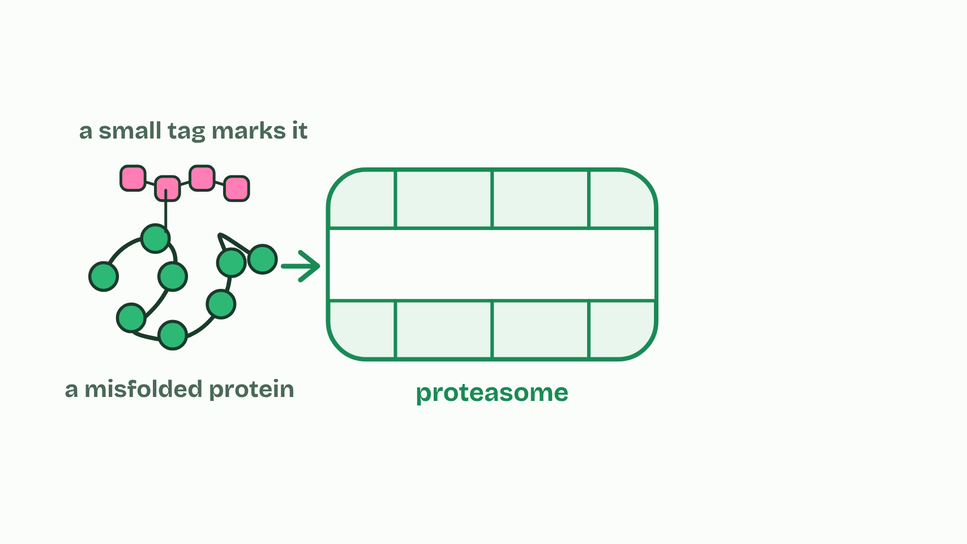
CHAPTER 12 · D1.2.18 D1.2.19 Modification and proteasomes
1 / 3
Finished, then recycled
A tagged protein reaches a proteasome.
Minutes 6 to 18
Notes:
Minutes 6 to 18 of 60: Pre-proinsulin to insulin (12 min).
The plan: Chapter 12's step-through of the two stages, with its first predict box (59 amino acids).
Many polypeptides cannot work as they come off the ribosome. They are modified first, which is called post-translational modification: they are cut, folded and bonded, or given extra groups such as sugars or phosphates. Insulin is the guide's example, and it is made in two stages.
It starts as pre-proinsulin, 110 amino acids long, which begins with a signal peptide of 24 amino acids. The signal peptide sends the ribosome to the rough ER, so the chain is threaded into the ER as it is made. In stage 1, in the rough ER, the signal peptide is cut off, leaving proinsulin (86 amino acids). Proinsulin folds, and three disulfide bonds form: two join what will become the B chain to the A chain, and one lies within the A chain. In stage 2, in the Golgi apparatus and the vesicles that bud from it, enzymes cut out the middle section, the C-peptide, leaving insulin: an A chain of 21 amino acids and a B chain of 30, held together by two disulfide bonds. Insulin is stored in vesicles until it is released (what it does is D3.3).
Cells break proteins down as well. A proteasome is a barrel-shaped complex of proteins, in the cytoplasm and the nucleus, that hydrolyses the peptide bonds of a protein into short pieces, which other enzymes then split into single amino acids for the cell to use again in building new proteins. A protein is marked for breakdown with a small protein tag. Damaged and misfolded proteins carry one, and so do healthy proteins the cell no longer needs. A protein's life may be minutes or months.
The proteome is all the proteins a cell makes. Keeping it working needs constant breakdown and synthesis: broken proteins are cleared away, and the amount of each protein can change quickly when the cell needs something new. The protein factory after chapter 7 has orders for this chapter too, when the page is at higher level.

Slide 11
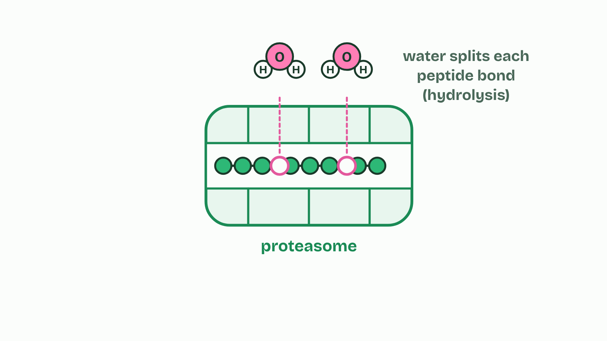
CHAPTER 12 · D1.2.18 D1.2.19 Modification and proteasomes
2 / 3
Finished, then recycled
Its peptide bonds are hydrolysed.
Minutes 6 to 18
Notes:
Minutes 6 to 18 of 60: Pre-proinsulin to insulin (12 min).
The plan: Chapter 12's step-through of the two stages, with its first predict box (59 amino acids).
Many polypeptides cannot work as they come off the ribosome. They are modified first, which is called post-translational modification: they are cut, folded and bonded, or given extra groups such as sugars or phosphates. Insulin is the guide's example, and it is made in two stages.
It starts as pre-proinsulin, 110 amino acids long, which begins with a signal peptide of 24 amino acids. The signal peptide sends the ribosome to the rough ER, so the chain is threaded into the ER as it is made. In stage 1, in the rough ER, the signal peptide is cut off, leaving proinsulin (86 amino acids). Proinsulin folds, and three disulfide bonds form: two join what will become the B chain to the A chain, and one lies within the A chain. In stage 2, in the Golgi apparatus and the vesicles that bud from it, enzymes cut out the middle section, the C-peptide, leaving insulin: an A chain of 21 amino acids and a B chain of 30, held together by two disulfide bonds. Insulin is stored in vesicles until it is released (what it does is D3.3).
Cells break proteins down as well. A proteasome is a barrel-shaped complex of proteins, in the cytoplasm and the nucleus, that hydrolyses the peptide bonds of a protein into short pieces, which other enzymes then split into single amino acids for the cell to use again in building new proteins. A protein is marked for breakdown with a small protein tag. Damaged and misfolded proteins carry one, and so do healthy proteins the cell no longer needs. A protein's life may be minutes or months.
The proteome is all the proteins a cell makes. Keeping it working needs constant breakdown and synthesis: broken proteins are cleared away, and the amount of each protein can change quickly when the cell needs something new. The protein factory after chapter 7 has orders for this chapter too, when the page is at higher level.

Slide 12
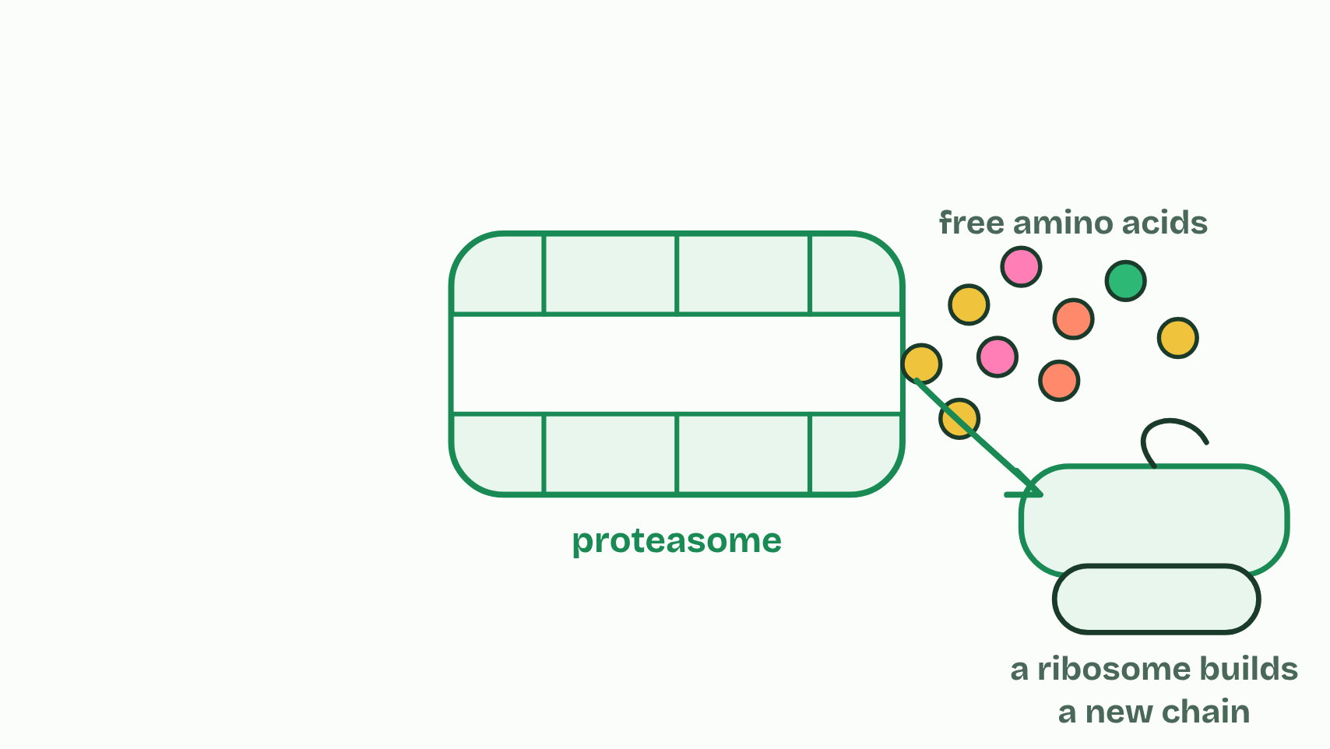
CHAPTER 12 · D1.2.18 D1.2.19 Modification and proteasomes
3 / 3
Finished, then recycled
The amino acids are used again to build new proteins.
Minutes 6 to 18
Notes:
Minutes 6 to 18 of 60: Pre-proinsulin to insulin (12 min).
The plan: Chapter 12's step-through of the two stages, with its first predict box (59 amino acids).
Many polypeptides cannot work as they come off the ribosome. They are modified first, which is called post-translational modification: they are cut, folded and bonded, or given extra groups such as sugars or phosphates. Insulin is the guide's example, and it is made in two stages.
It starts as pre-proinsulin, 110 amino acids long, which begins with a signal peptide of 24 amino acids. The signal peptide sends the ribosome to the rough ER, so the chain is threaded into the ER as it is made. In stage 1, in the rough ER, the signal peptide is cut off, leaving proinsulin (86 amino acids). Proinsulin folds, and three disulfide bonds form: two join what will become the B chain to the A chain, and one lies within the A chain. In stage 2, in the Golgi apparatus and the vesicles that bud from it, enzymes cut out the middle section, the C-peptide, leaving insulin: an A chain of 21 amino acids and a B chain of 30, held together by two disulfide bonds. Insulin is stored in vesicles until it is released (what it does is D3.3).
Cells break proteins down as well. A proteasome is a barrel-shaped complex of proteins, in the cytoplasm and the nucleus, that hydrolyses the peptide bonds of a protein into short pieces, which other enzymes then split into single amino acids for the cell to use again in building new proteins. A protein is marked for breakdown with a small protein tag. Damaged and misfolded proteins carry one, and so do healthy proteins the cell no longer needs. A protein's life may be minutes or months.
The proteome is all the proteins a cell makes. Keeping it working needs constant breakdown and synthesis: broken proteins are cleared away, and the amount of each protein can change quickly when the cell needs something new. The protein factory after chapter 7 has orders for this chapter too, when the page is at higher level.

Slide 13
CHAPTER 12 · D1.2.18 D1.2.19 Modification and proteasomes
Finished, then recycled
They are modified first, which is called post-translational modification: they are cut, folded and bonded, or given extra groups such as sugars or phosphates.
It starts as pre-proinsulin, 110 amino acids long, which begins with a signal peptide of 24 amino acids.
The signal peptide sends the ribosome to the rough ER, so the chain is threaded into the ER as it is made.
In stage 1, in the rough ER, the signal peptide is cut off, leaving proinsulin (86 amino acids).
Minutes 6 to 18
Notes:
Minutes 6 to 18 of 60: Pre-proinsulin to insulin (12 min).
The plan: Chapter 12's step-through of the two stages, with its first predict box (59 amino acids).
Many polypeptides cannot work as they come off the ribosome. They are modified first, which is called post-translational modification: they are cut, folded and bonded, or given extra groups such as sugars or phosphates. Insulin is the guide's example, and it is made in two stages.
It starts as pre-proinsulin, 110 amino acids long, which begins with a signal peptide of 24 amino acids. The signal peptide sends the ribosome to the rough ER, so the chain is threaded into the ER as it is made. In stage 1, in the rough ER, the signal peptide is cut off, leaving proinsulin (86 amino acids). Proinsulin folds, and three disulfide bonds form: two join what will become the B chain to the A chain, and one lies within the A chain. In stage 2, in the Golgi apparatus and the vesicles that bud from it, enzymes cut out the middle section, the C-peptide, leaving insulin: an A chain of 21 amino acids and a B chain of 30, held together by two disulfide bonds. Insulin is stored in vesicles until it is released (what it does is D3.3).
Cells break proteins down as well. A proteasome is a barrel-shaped complex of proteins, in the cytoplasm and the nucleus, that hydrolyses the peptide bonds of a protein into short pieces, which other enzymes then split into single amino acids for the cell to use again in building new proteins. A protein is marked for breakdown with a small protein tag. Damaged and misfolded proteins carry one, and so do healthy proteins the cell no longer needs. A protein's life may be minutes or months.
The proteome is all the proteins a cell makes. Keeping it working needs constant breakdown and synthesis: broken proteins are cleared away, and the amount of each protein can change quickly when the cell needs something new. The protein factory after chapter 7 has orders for this chapter too, when the page is at higher level.

Slide 14
PREDICT
Insulin's two chains are 21 and 30 amino acids long, and pre-proinsulin is 110. How many amino acids are cut away in all?
A 80
B 59
C 51
Minutes 6 to 18
Notes:
Minutes 6 to 18 of 60: Pre-proinsulin to insulin (12 min).
The plan: Chapter 12's step-through of the two stages, with its first predict box (59 amino acids).
Ask for a show of hands, or mini whiteboards, before revealing. (Answer: B, on the next slide.)

Slide 15
WHAT HAPPENS
Insulin's two chains are 21 and 30 amino acids long, and pre-proinsulin is 110. How many amino acids are cut away in all?
A 80
B 59
C 51
21 + 30 = 51 amino acids stay in insulin, so 110 − 51 = 59 are cut away: the signal peptide (24) in the ER, then the C-peptide (31) and four more at its ends in the Golgi vesicles.
Minutes 6 to 18
Notes:
Minutes 6 to 18 of 60: Pre-proinsulin to insulin (12 min).
The plan: Chapter 12's step-through of the two stages, with its first predict box (59 amino acids).
Answer: B. 21 + 30 = 51 amino acids stay in insulin, so 110 − 51 = 59 are cut away: the signal peptide (24) in the ER, then the C-peptide (31) and four more at its ends in the Golgi vesicles. (51 is what is kept, and 80 is 110 − 30, forgetting the A chain.)

Slide 16
WATCH OUT
A polypeptide straight off the ribosome is not always a working protein. And proteasomes do not only destroy faulty proteins: they also clear healthy ones the cell no longer needs.
Minutes 6 to 18
Notes:
Minutes 6 to 18 of 60: Pre-proinsulin to insulin (12 min).
The plan: Chapter 12's step-through of the two stages, with its first predict box (59 amino acids).
A common mistake: say it, then ask who can say why it is wrong.

Slide 17
STEP 3
8 MIN
Proteasomes
Chapter 12's proteasome figure and its second predict box (is it wasteful?), then the proteome in one sentence.
Minutes 18 to 26
Notes:
Minutes 18 to 26 of 60: Proteasomes (8 min).
The plan: Chapter 12's proteasome figure and its second predict box (is it wasteful?), then the proteome in one sentence.

Slide 18
GAME
16 MIN
The protein factory
THE TASK
One device per pair. The standard level rounds are for lesson 3 and the higher level rounds for lesson 6; its record downloads as a CSV for a class comparison.
STUDENTS NEED
One device per pair.
Minutes 26 to 42
Notes:
Minutes 26 to 42 of 60: The protein factory (16 min).
The plan: In pairs, the higher level orders: rounds 6 to 10.
The activity: The protein factory. One device per pair. The standard level rounds are for lesson 3 and the higher level rounds for lesson 6; its record downloads as a CSV for a class comparison.
Needs: one device per pair.
The time: 16 minutes, minutes 26 to 42 of the plan.

Slide 19
STEP 5
12 MIN
An extended question
A timed extended question on D1.2 from the exam maker (higher level), peer-marked against its markscheme.
Minutes 42 to 54
Notes:
Minutes 42 to 54 of 60: An extended question (12 min).
The plan: A timed extended question on D1.2 from the exam maker (higher level), peer-marked against its markscheme.

Slide 20
PLENARY
Can you now...
Explain how pre-proinsulin becomes insulin, and why proteasomes keep breaking proteins down (D1.2.18, D1.2.19)
Minutes 54 to 60
Notes:
Minutes 54 to 60 of 60: Exit (6 min).
The plan: One sentence answering each guiding question.
Thumbs up, sideways or down on each goal before the exit question. The goals come from the statements this lesson covers.

Slide 21
EXIT QUESTION
Before you go
One sentence answering each guiding question.
Minutes 54 to 60
Notes:
Minutes 54 to 60 of 60: Exit (6 min).
The plan: One sentence answering each guiding question.

Slide 22
PRACTISE AND REVISE
Keep going
Exam practice: a fresh paper of exam questions on D1.2 at higher level, marked as you go
The guide, with the animations and the dry lab
This lesson in the guide: 12 Finished, then recycled
BUILD FOR YOUR CLASS
ALREADY ON THE SITE FOR D1.2
CARD SETS ON SPLYCR
Tarsia puzzle, dominoes and picture reveal on D1.2, built from its key terms and ready to print
A pub quiz with rounds on D1.2, to present or run with no projector
An escape room built from the question bank on D1.2
Quiz: Protein Synthesis (HL)
Quiz: Protein Synthesis
Revision map: D1.2 Protein synthesis, to fill in
Exam questions: D1.2 in the exam maker, a paper with its markscheme
Open a set to host it as a class game, or make a copy to edit.
D1.2 Protein Synthesis (SL)
D1.2 Protein Synthesis (HL)
How this was made. The course structure, the activities and the teaching choices come from my own classroom, my presentations and my years of teaching IB and AP Biology. I use Claude, an AI, to help write and build the interactive guides, lesson plans, slides and practice questions, and to draw the diagrams and code the interactives. I direct the work and review it against the IB and AP specifications before it goes live.
Minute 60: after the lesson
Notes:
Every link here is live. Set the exam practice paper for homework: it is fresh each time, marked as students go and saved to their Exam practice when they are signed in.
Exam practice: https://www.biologybybradford.com/exam-maker/sit?topics=D1.2&level=HL&paper=quiz&marks=15&src=ep
The guide: https://www.biologybybradford.com/guides/ib-biology-d1-2-protein-synthesis

