Slide 1
IB Biology D3.2
LESSON 1 OF 8
BY THE END YOU CAN
Inheritance
Explain how meiosis halves the chromosome number to make haploid gametes, and how fusion gives a diploid zygote (D3.2.1)
Describe how a genetic cross is made in flowering plants, using the terms P generation, F1 generation, F2 generation and Punnett grid (D3.2.2)
Define genotype, and use homozygous, heterozygous, gene and allele correctly (D3.2.3)
Explain how phenotype comes from genotype and the environment, with examples of each (D3.2.4)
Halving, crossing and the genotype
D3.2.1 to D3.2.4
Meiosis as halving and fertilisation as doubling, how a cross in flowering plants is made and described, and the difference between genotype and phenotype
60 minutes · chapters 1, 2, 3
Minute 0
Notes:
IB Biology D3.2, Inheritance. Lesson 1 of 8: Halving, crossing and the genotype, 60 minutes.
The plan, minute by minute (each slide's footer says where you are):
0 to 6 min (6) Do now: how many chromosomes?
6 to 18 min (12) Halve, then fuse
18 to 28 min (10) Halve and fuse: the model
28 to 40 min (12) Making a cross
40 to 55 min (15) Gene, allele, genotype, phenotype
55 to 60 min (5) Exit
What students get wrong:
"Dominant means common or strong." A dominant allele is one that shows in the heterozygote. Many dominant alleles are rare, and some harmful ones are dominant.
Gene and allele are the same. A gene is a stretch of DNA that codes for a polypeptide; alleles are its versions. Ask "which gene, and which allele of it?".
"A Punnett grid predicts exactly." It gives a probability for each child. Four children from Yy by Yy need not include a green one. Use the coins.
Stretch and support:
Support: give each figure's captions as a cut-up storyboard to put in order, and let students tap the dotted words as a glossary.
Stretch: a pea plant has 7 pairs of chromosomes. How many different gametes can one plant make from the way the pairs line up, ignoring crossing over? 2 to the power 7, which is 128.
The lesson plan to print: https://www.biologybybradford.com/guides/downloads/ib-biology-d3-2-inheritance-lesson-1-plan.pdf

Slide 2
DO NOW
How many chromosomes?
Chapter 1's first predict box.
Students answer on mini whiteboards before the options appear on the screen: how many chromosomes in a human sperm, and in the zygote?
6:00
minutes
Start now: the timer is running.
Minutes 0 to 6
Notes:
Minutes 0 to 6 of 60: Do now: how many chromosomes? (6 min).
The plan: Chapter 1's first predict box. Students answer on mini whiteboards before the options appear on the screen: how many chromosomes in a human sperm, and in the zygote? Keep the boards up. Ask what would happen if gametes were made by ordinary division.
Start a 6 minute timer as they come in.

Slide 3
PREDICT
A human body cell has 46 chromosomes. How many chromosomes are in a sperm, and how many in the zygote it helps to form?
A 46 in the sperm and 92 in the zygote, because each gamete keeps a full set
B 23 in the sperm and 46 in the zygote
C 23 in the sperm and 23 in the zygote, as the two sets are shared out
Minutes 0 to 6
Notes:
Minutes 0 to 6 of 60: Do now: how many chromosomes? (6 min).
The plan: Chapter 1's first predict box. Students answer on mini whiteboards before the options appear on the screen: how many chromosomes in a human sperm, and in the zygote? Keep the boards up. Ask what would happen if gametes were made by ordinary division.
Ask for a show of hands, or mini whiteboards, before revealing. (Answer: B, on the next slide.)

Slide 4
WHAT HAPPENS
A human body cell has 46 chromosomes. How many chromosomes are in a sperm, and how many in the zygote it helps to form?
A 46 in the sperm and 92 in the zygote, because each gamete keeps a full set
B 23 in the sperm and 46 in the zygote
C 23 in the sperm and 23 in the zygote, as the two sets are shared out
23 and 46. Meiosis halves the number, so a sperm is haploid with one chromosome from each of the 23 pairs. The zygote gets 23 from the sperm and 23 from the egg, so it is diploid again. If gametes were made by an ordinary division, the number would double every generation.
Minutes 0 to 6
Notes:
Minutes 0 to 6 of 60: Do now: how many chromosomes? (6 min).
The plan: Chapter 1's first predict box. Students answer on mini whiteboards before the options appear on the screen: how many chromosomes in a human sperm, and in the zygote? Keep the boards up. Ask what would happen if gametes were made by ordinary division.
Answer: B. 23 and 46. Meiosis halves the number, so a sperm is haploid with one chromosome from each of the 23 pairs. The zygote gets 23 from the sperm and 23 from the egg, so it is diploid again. If gametes were made by an ordinary division, the number would double every generation.

Slide 5
STEP 2
12 MIN
Halve, then fuse
Students sketch a cell with two chromosome pairs, then the four gametes it can make, then the zygote.
Land on the linking question: what processes involve doubling and halving?
Minutes 6 to 18
Notes:
Minutes 6 to 18 of 60: Halve, then fuse (12 min).
The plan: Chapter 1's film, paused at each stage. Students sketch a cell with two chromosome pairs, then the four gametes it can make, then the zygote. Land on the linking question: what processes involve doubling and halving? Meiosis halves the number, fertilisation doubles it.

Slide 6
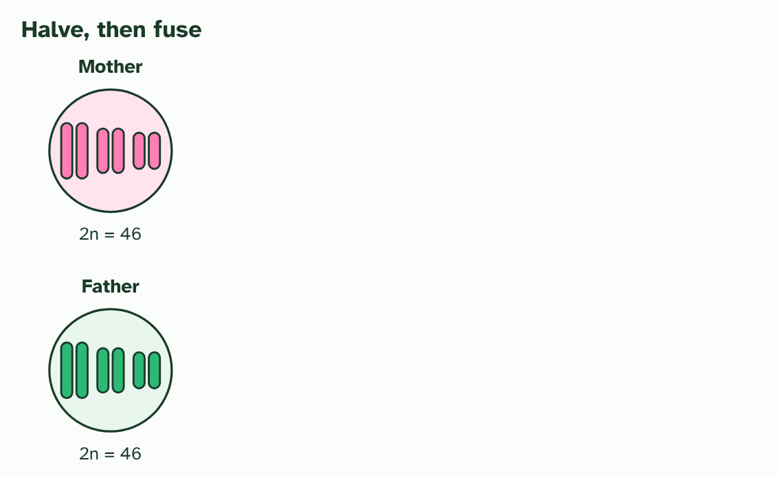
CHAPTER 1 · D3.2.1 Halving and doubling
1 / 4
Halve, then fuse
Two parents, each with diploid body cells (2n = 46). Three of the 23 pairs are drawn.
Minutes 6 to 18
Notes:
Minutes 6 to 18 of 60: Halve, then fuse (12 min).
The plan: Chapter 1's film, paused at each stage. Students sketch a cell with two chromosome pairs, then the four gametes it can make, then the zygote. Land on the linking question: what processes involve doubling and halving? Meiosis halves the number, fertilisation doubles it.
Your body cells hold two copies of every chromosome, one set from each parent. A cell like that is diploid. A human body cell has 46 chromosomes, written 2n = 46. Most of them are autosomes, so a diploid cell has two copies of each autosomal gene: one on each chromosome of a pair.
If a child simply received all the chromosomes of both parents, the number would double every generation. Life avoids this by halving first. Special cells divide by meiosis to make gametes, and each gamete gets one chromosome from every pair. A cell with a single set is haploid. In humans, n = 23.
Then fertilisation joins two gametes. Their nuclei fuse to make a zygote, which is diploid again, with one set from each parent. Halve, then double: that is the loop that carries genes from one generation to the next.
This pattern is common to all eukaryotes with a sexual life cycle. You, a pea plant, a mushroom and a fruit fly all make haploid gametes and fuse them to form a diploid zygote. The details of the life cycle differ from group to group, but the loop is the same.
Example: Linking question What biological processes involve doubling and halving? Here it is the chromosome number: meiosis halves it and fertilisation doubles it. The same idea returns in D2.1 (cell and nuclear division), where cells divide, and in D1.1 (DNA replication), where the DNA doubles before they do.

Slide 7
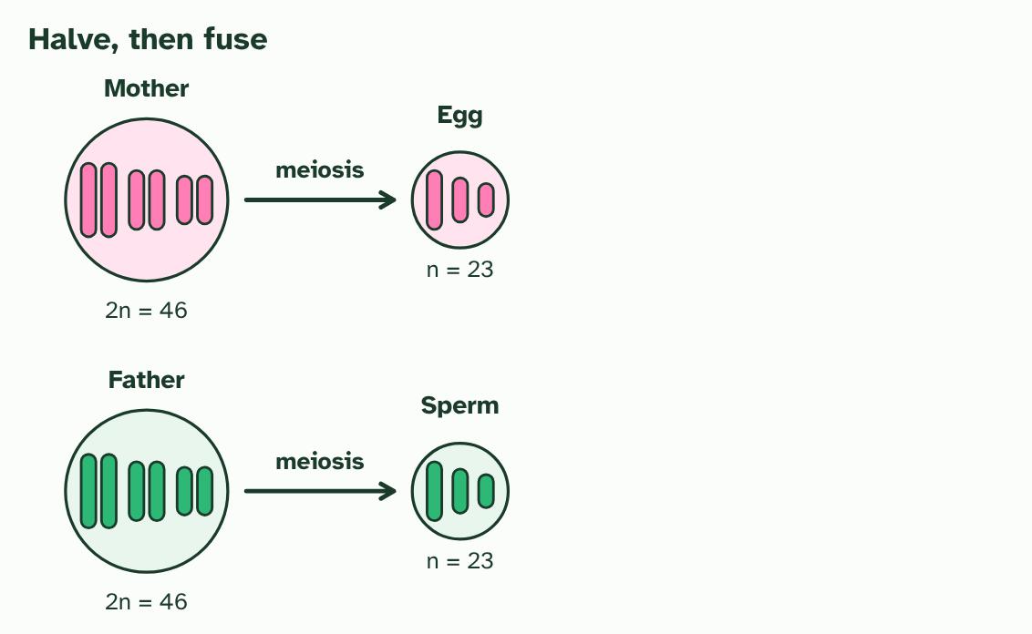
CHAPTER 1 · D3.2.1 Halving and doubling
2 / 4
Halve, then fuse
Meiosis makes gametes with one chromosome from each pair: an egg and a sperm, each haploid (n = 23).
Minutes 6 to 18
Notes:
Minutes 6 to 18 of 60: Halve, then fuse (12 min).
The plan: Chapter 1's film, paused at each stage. Students sketch a cell with two chromosome pairs, then the four gametes it can make, then the zygote. Land on the linking question: what processes involve doubling and halving? Meiosis halves the number, fertilisation doubles it.
Your body cells hold two copies of every chromosome, one set from each parent. A cell like that is diploid. A human body cell has 46 chromosomes, written 2n = 46. Most of them are autosomes, so a diploid cell has two copies of each autosomal gene: one on each chromosome of a pair.
If a child simply received all the chromosomes of both parents, the number would double every generation. Life avoids this by halving first. Special cells divide by meiosis to make gametes, and each gamete gets one chromosome from every pair. A cell with a single set is haploid. In humans, n = 23.
Then fertilisation joins two gametes. Their nuclei fuse to make a zygote, which is diploid again, with one set from each parent. Halve, then double: that is the loop that carries genes from one generation to the next.
This pattern is common to all eukaryotes with a sexual life cycle. You, a pea plant, a mushroom and a fruit fly all make haploid gametes and fuse them to form a diploid zygote. The details of the life cycle differ from group to group, but the loop is the same.
Example: Linking question What biological processes involve doubling and halving? Here it is the chromosome number: meiosis halves it and fertilisation doubles it. The same idea returns in D2.1 (cell and nuclear division), where cells divide, and in D1.1 (DNA replication), where the DNA doubles before they do.

Slide 8
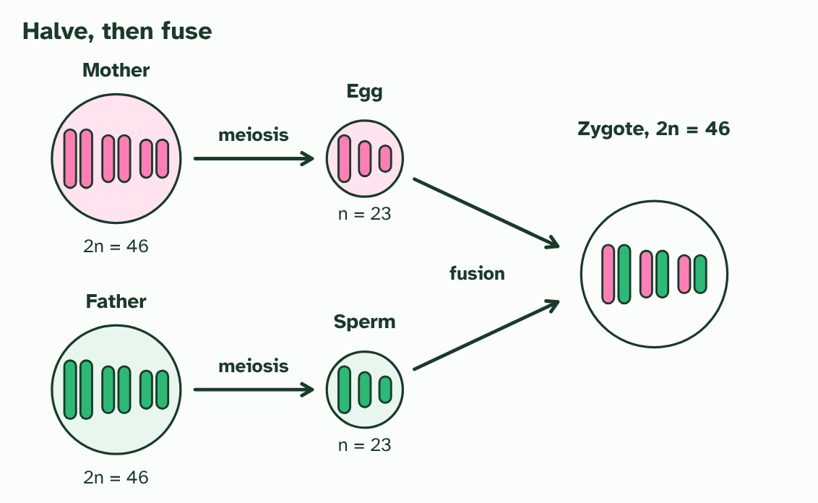
CHAPTER 1 · D3.2.1 Halving and doubling
3 / 4
Halve, then fuse
Fusion of the two gametes makes a zygote. It is diploid again, with one set from each parent.
Minutes 6 to 18
Notes:
Minutes 6 to 18 of 60: Halve, then fuse (12 min).
The plan: Chapter 1's film, paused at each stage. Students sketch a cell with two chromosome pairs, then the four gametes it can make, then the zygote. Land on the linking question: what processes involve doubling and halving? Meiosis halves the number, fertilisation doubles it.
Your body cells hold two copies of every chromosome, one set from each parent. A cell like that is diploid. A human body cell has 46 chromosomes, written 2n = 46. Most of them are autosomes, so a diploid cell has two copies of each autosomal gene: one on each chromosome of a pair.
If a child simply received all the chromosomes of both parents, the number would double every generation. Life avoids this by halving first. Special cells divide by meiosis to make gametes, and each gamete gets one chromosome from every pair. A cell with a single set is haploid. In humans, n = 23.
Then fertilisation joins two gametes. Their nuclei fuse to make a zygote, which is diploid again, with one set from each parent. Halve, then double: that is the loop that carries genes from one generation to the next.
This pattern is common to all eukaryotes with a sexual life cycle. You, a pea plant, a mushroom and a fruit fly all make haploid gametes and fuse them to form a diploid zygote. The details of the life cycle differ from group to group, but the loop is the same.
Example: Linking question What biological processes involve doubling and halving? Here it is the chromosome number: meiosis halves it and fertilisation doubles it. The same idea returns in D2.1 (cell and nuclear division), where cells divide, and in D1.1 (DNA replication), where the DNA doubles before they do.

Slide 9
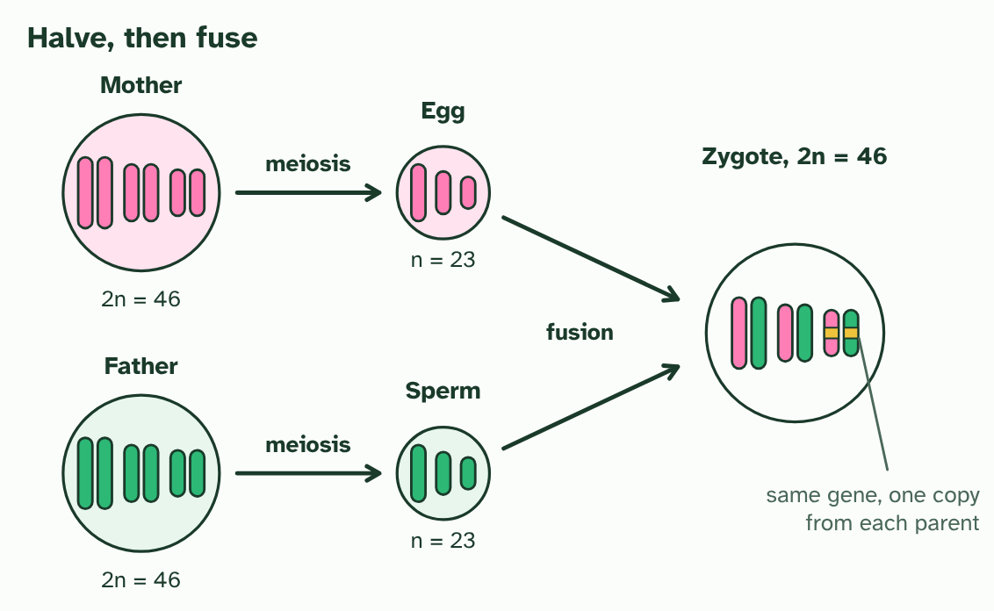
CHAPTER 1 · D3.2.1 Halving and doubling
4 / 4
Halve, then fuse
In the zygote, a pair of chromosomes carries the same gene twice, one copy from each parent.
Minutes 6 to 18
Notes:
Minutes 6 to 18 of 60: Halve, then fuse (12 min).
The plan: Chapter 1's film, paused at each stage. Students sketch a cell with two chromosome pairs, then the four gametes it can make, then the zygote. Land on the linking question: what processes involve doubling and halving? Meiosis halves the number, fertilisation doubles it.
Your body cells hold two copies of every chromosome, one set from each parent. A cell like that is diploid. A human body cell has 46 chromosomes, written 2n = 46. Most of them are autosomes, so a diploid cell has two copies of each autosomal gene: one on each chromosome of a pair.
If a child simply received all the chromosomes of both parents, the number would double every generation. Life avoids this by halving first. Special cells divide by meiosis to make gametes, and each gamete gets one chromosome from every pair. A cell with a single set is haploid. In humans, n = 23.
Then fertilisation joins two gametes. Their nuclei fuse to make a zygote, which is diploid again, with one set from each parent. Halve, then double: that is the loop that carries genes from one generation to the next.
This pattern is common to all eukaryotes with a sexual life cycle. You, a pea plant, a mushroom and a fruit fly all make haploid gametes and fuse them to form a diploid zygote. The details of the life cycle differ from group to group, but the loop is the same.
Example: Linking question What biological processes involve doubling and halving? Here it is the chromosome number: meiosis halves it and fertilisation doubles it. The same idea returns in D2.1 (cell and nuclear division), where cells divide, and in D1.1 (DNA replication), where the DNA doubles before they do.

Slide 10
CHAPTER 1 · D3.2.1 Halving and doubling
Halve, then fuse
A cell like that is diploid.
Most of them are autosomes, so a diploid cell has two copies of each autosomal gene: one on each chromosome of a pair.
Special cells divide by meiosis to make gametes, and each gamete gets one chromosome from every pair.
A cell with a single set is haploid.
Minutes 6 to 18
Notes:
Minutes 6 to 18 of 60: Halve, then fuse (12 min).
The plan: Chapter 1's film, paused at each stage. Students sketch a cell with two chromosome pairs, then the four gametes it can make, then the zygote. Land on the linking question: what processes involve doubling and halving? Meiosis halves the number, fertilisation doubles it.
Your body cells hold two copies of every chromosome, one set from each parent. A cell like that is diploid. A human body cell has 46 chromosomes, written 2n = 46. Most of them are autosomes, so a diploid cell has two copies of each autosomal gene: one on each chromosome of a pair.
If a child simply received all the chromosomes of both parents, the number would double every generation. Life avoids this by halving first. Special cells divide by meiosis to make gametes, and each gamete gets one chromosome from every pair. A cell with a single set is haploid. In humans, n = 23.
Then fertilisation joins two gametes. Their nuclei fuse to make a zygote, which is diploid again, with one set from each parent. Halve, then double: that is the loop that carries genes from one generation to the next.
This pattern is common to all eukaryotes with a sexual life cycle. You, a pea plant, a mushroom and a fruit fly all make haploid gametes and fuse them to form a diploid zygote. The details of the life cycle differ from group to group, but the loop is the same.
Example: Linking question What biological processes involve doubling and halving? Here it is the chromosome number: meiosis halves it and fertilisation doubles it. The same idea returns in D2.1 (cell and nuclear division), where cells divide, and in D1.1 (DNA replication), where the DNA doubles before they do.

Slide 11
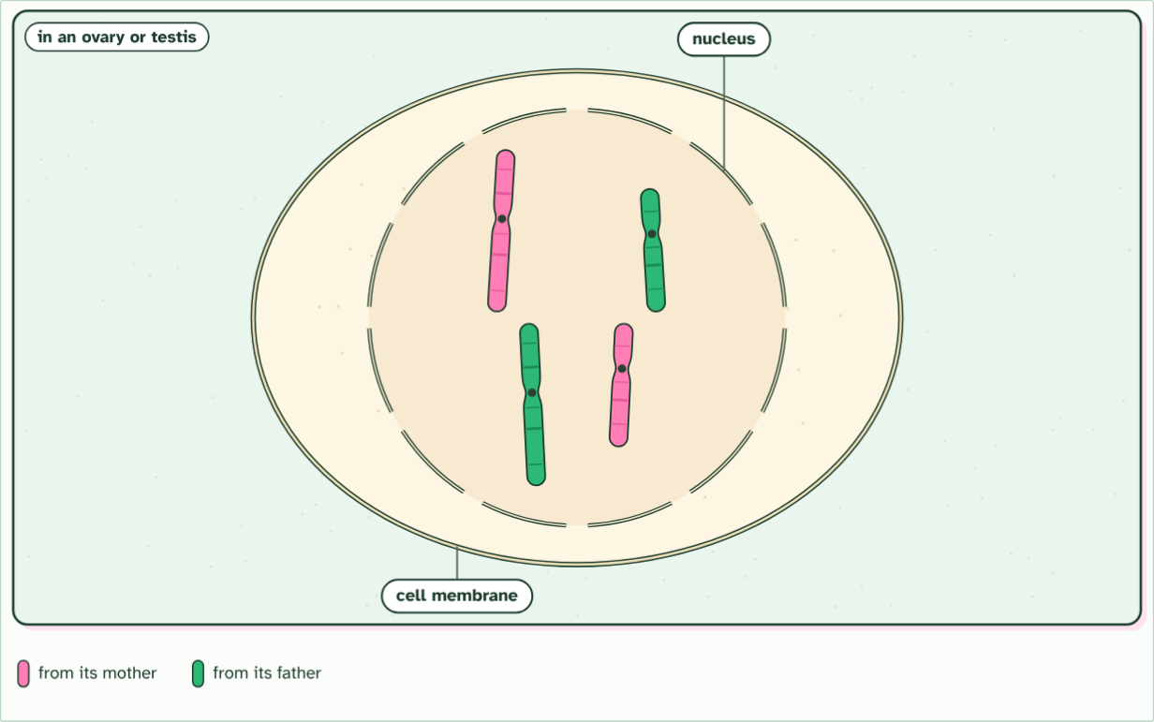
CHAPTER 1 · D3.2.1 Halving and doubling
diploid cell, 2n = 4
1 / 9
Halve, then fuse
A diploid cell of a parent. Its chromosomes are in pairs: one of each pair came from its mother (pink), one from its father (green).
Minutes 6 to 18
Notes:
Minutes 6 to 18 of 60: Halve, then fuse (12 min).
The plan: Chapter 1's film, paused at each stage. Students sketch a cell with two chromosome pairs, then the four gametes it can make, then the zygote. Land on the linking question: what processes involve doubling and halving? Meiosis halves the number, fertilisation doubles it.
Your body cells hold two copies of every chromosome, one set from each parent. A cell like that is diploid. A human body cell has 46 chromosomes, written 2n = 46. Most of them are autosomes, so a diploid cell has two copies of each autosomal gene: one on each chromosome of a pair.
If a child simply received all the chromosomes of both parents, the number would double every generation. Life avoids this by halving first. Special cells divide by meiosis to make gametes, and each gamete gets one chromosome from every pair. A cell with a single set is haploid. In humans, n = 23.
Then fertilisation joins two gametes. Their nuclei fuse to make a zygote, which is diploid again, with one set from each parent. Halve, then double: that is the loop that carries genes from one generation to the next.
This pattern is common to all eukaryotes with a sexual life cycle. You, a pea plant, a mushroom and a fruit fly all make haploid gametes and fuse them to form a diploid zygote. The details of the life cycle differ from group to group, but the loop is the same.
Example: Linking question What biological processes involve doubling and halving? Here it is the chromosome number: meiosis halves it and fertilisation doubles it. The same idea returns in D2.1 (cell and nuclear division), where cells divide, and in D1.1 (DNA replication), where the DNA doubles before they do.
The animation "Watch it happen: halving, then fusing", paused at 2.8 s. The next slides go on through it, then play it.

Slide 12
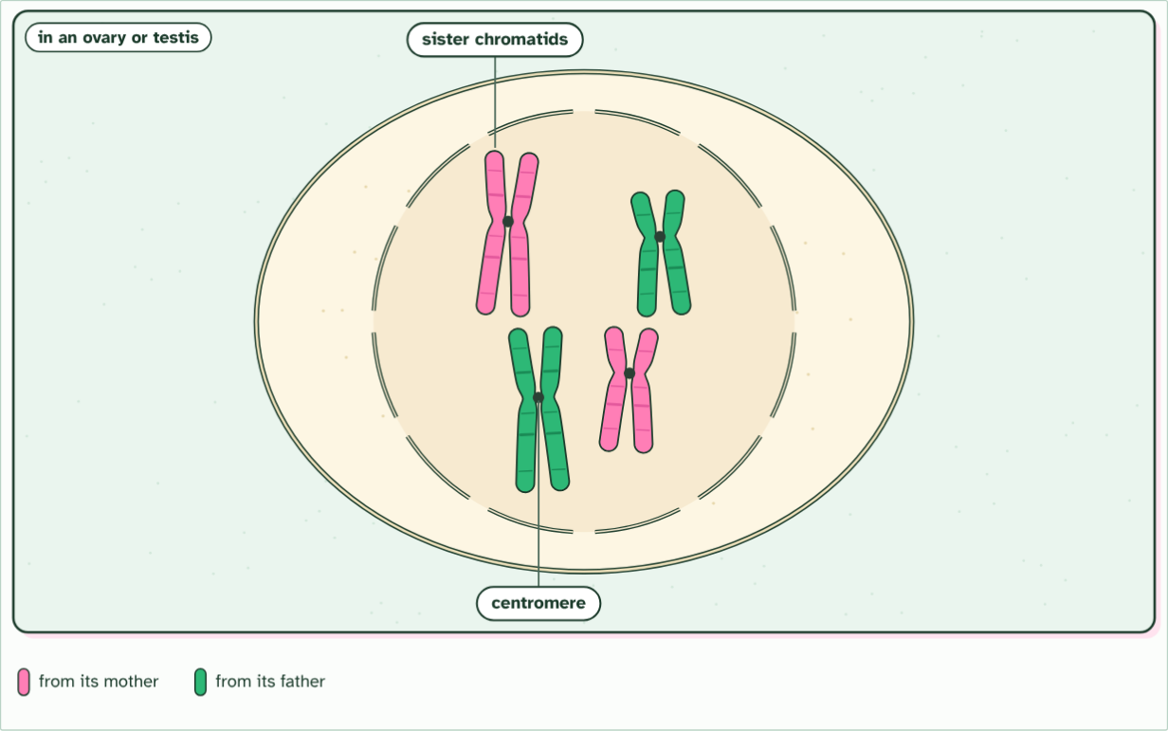
CHAPTER 1 · D3.2.1 Halving and doubling
2n = 4, DNA copied
2 / 9
Halve, then fuse
First the DNA is copied: each chromosome becomes two identical sister chromatids, joined at a centromere.
Minutes 6 to 18
Notes:
Minutes 6 to 18 of 60: Halve, then fuse (12 min).
The plan: Chapter 1's film, paused at each stage. Students sketch a cell with two chromosome pairs, then the four gametes it can make, then the zygote. Land on the linking question: what processes involve doubling and halving? Meiosis halves the number, fertilisation doubles it.
Your body cells hold two copies of every chromosome, one set from each parent. A cell like that is diploid. A human body cell has 46 chromosomes, written 2n = 46. Most of them are autosomes, so a diploid cell has two copies of each autosomal gene: one on each chromosome of a pair.
If a child simply received all the chromosomes of both parents, the number would double every generation. Life avoids this by halving first. Special cells divide by meiosis to make gametes, and each gamete gets one chromosome from every pair. A cell with a single set is haploid. In humans, n = 23.
Then fertilisation joins two gametes. Their nuclei fuse to make a zygote, which is diploid again, with one set from each parent. Halve, then double: that is the loop that carries genes from one generation to the next.
This pattern is common to all eukaryotes with a sexual life cycle. You, a pea plant, a mushroom and a fruit fly all make haploid gametes and fuse them to form a diploid zygote. The details of the life cycle differ from group to group, but the loop is the same.
Example: Linking question What biological processes involve doubling and halving? Here it is the chromosome number: meiosis halves it and fertilisation doubles it. The same idea returns in D2.1 (cell and nuclear division), where cells divide, and in D1.1 (DNA replication), where the DNA doubles before they do.
The animation "Watch it happen: halving, then fusing", paused at 6.9 s. The next slides go on through it, then play it.

Slide 13
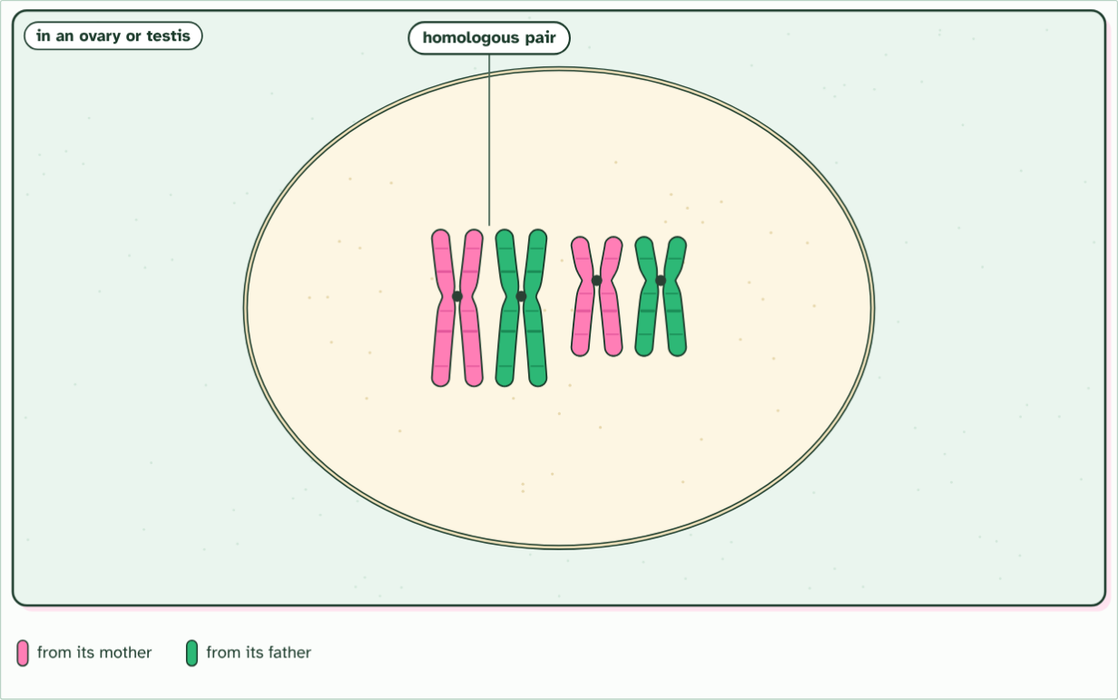
CHAPTER 1 · D3.2.1 Halving and doubling
2n = 4, DNA copied
3 / 9
Halve, then fuse
The nucleus breaks down and each chromosome lies beside its partner: a homologous pair, with the same genes in the same order.
Minutes 6 to 18
Notes:
Minutes 6 to 18 of 60: Halve, then fuse (12 min).
The plan: Chapter 1's film, paused at each stage. Students sketch a cell with two chromosome pairs, then the four gametes it can make, then the zygote. Land on the linking question: what processes involve doubling and halving? Meiosis halves the number, fertilisation doubles it.
Your body cells hold two copies of every chromosome, one set from each parent. A cell like that is diploid. A human body cell has 46 chromosomes, written 2n = 46. Most of them are autosomes, so a diploid cell has two copies of each autosomal gene: one on each chromosome of a pair.
If a child simply received all the chromosomes of both parents, the number would double every generation. Life avoids this by halving first. Special cells divide by meiosis to make gametes, and each gamete gets one chromosome from every pair. A cell with a single set is haploid. In humans, n = 23.
Then fertilisation joins two gametes. Their nuclei fuse to make a zygote, which is diploid again, with one set from each parent. Halve, then double: that is the loop that carries genes from one generation to the next.
This pattern is common to all eukaryotes with a sexual life cycle. You, a pea plant, a mushroom and a fruit fly all make haploid gametes and fuse them to form a diploid zygote. The details of the life cycle differ from group to group, but the loop is the same.
Example: Linking question What biological processes involve doubling and halving? Here it is the chromosome number: meiosis halves it and fertilisation doubles it. The same idea returns in D2.1 (cell and nuclear division), where cells divide, and in D1.1 (DNA replication), where the DNA doubles before they do.
The animation "Watch it happen: halving, then fusing", paused at 12.2 s. The next slides go on through it, then play it.

Slide 14
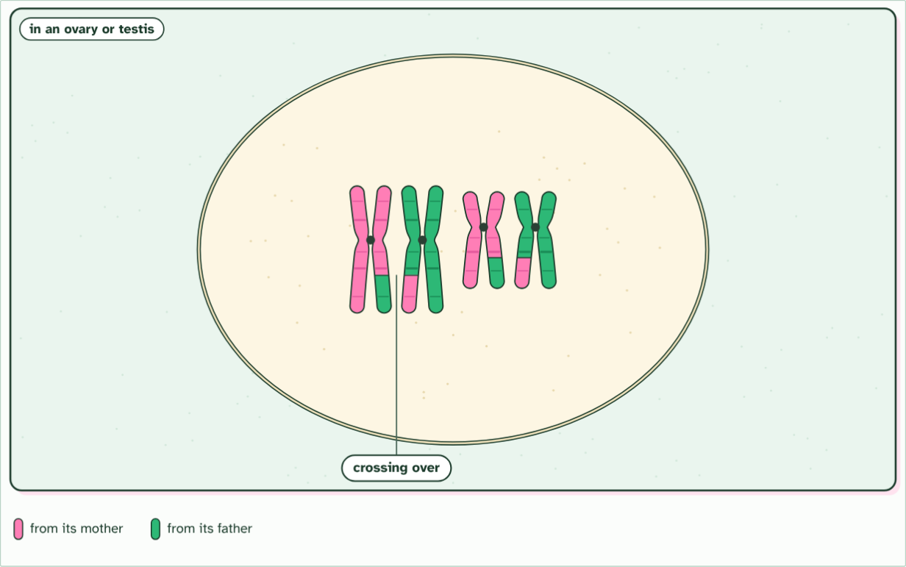
CHAPTER 1 · D3.2.1 Halving and doubling
2n = 4, DNA copied
4 / 9
Halve, then fuse
Crossing over: chromatids of a pair swap matching sections, making new mixes of the mother's and the father's alleles.
Minutes 6 to 18
Notes:
Minutes 6 to 18 of 60: Halve, then fuse (12 min).
The plan: Chapter 1's film, paused at each stage. Students sketch a cell with two chromosome pairs, then the four gametes it can make, then the zygote. Land on the linking question: what processes involve doubling and halving? Meiosis halves the number, fertilisation doubles it.
Your body cells hold two copies of every chromosome, one set from each parent. A cell like that is diploid. A human body cell has 46 chromosomes, written 2n = 46. Most of them are autosomes, so a diploid cell has two copies of each autosomal gene: one on each chromosome of a pair.
If a child simply received all the chromosomes of both parents, the number would double every generation. Life avoids this by halving first. Special cells divide by meiosis to make gametes, and each gamete gets one chromosome from every pair. A cell with a single set is haploid. In humans, n = 23.
Then fertilisation joins two gametes. Their nuclei fuse to make a zygote, which is diploid again, with one set from each parent. Halve, then double: that is the loop that carries genes from one generation to the next.
This pattern is common to all eukaryotes with a sexual life cycle. You, a pea plant, a mushroom and a fruit fly all make haploid gametes and fuse them to form a diploid zygote. The details of the life cycle differ from group to group, but the loop is the same.
Example: Linking question What biological processes involve doubling and halving? Here it is the chromosome number: meiosis halves it and fertilisation doubles it. The same idea returns in D2.1 (cell and nuclear division), where cells divide, and in D1.1 (DNA replication), where the DNA doubles before they do.
The animation "Watch it happen: halving, then fusing", paused at 17.3 s. The next slides go on through it, then play it.

Slide 15
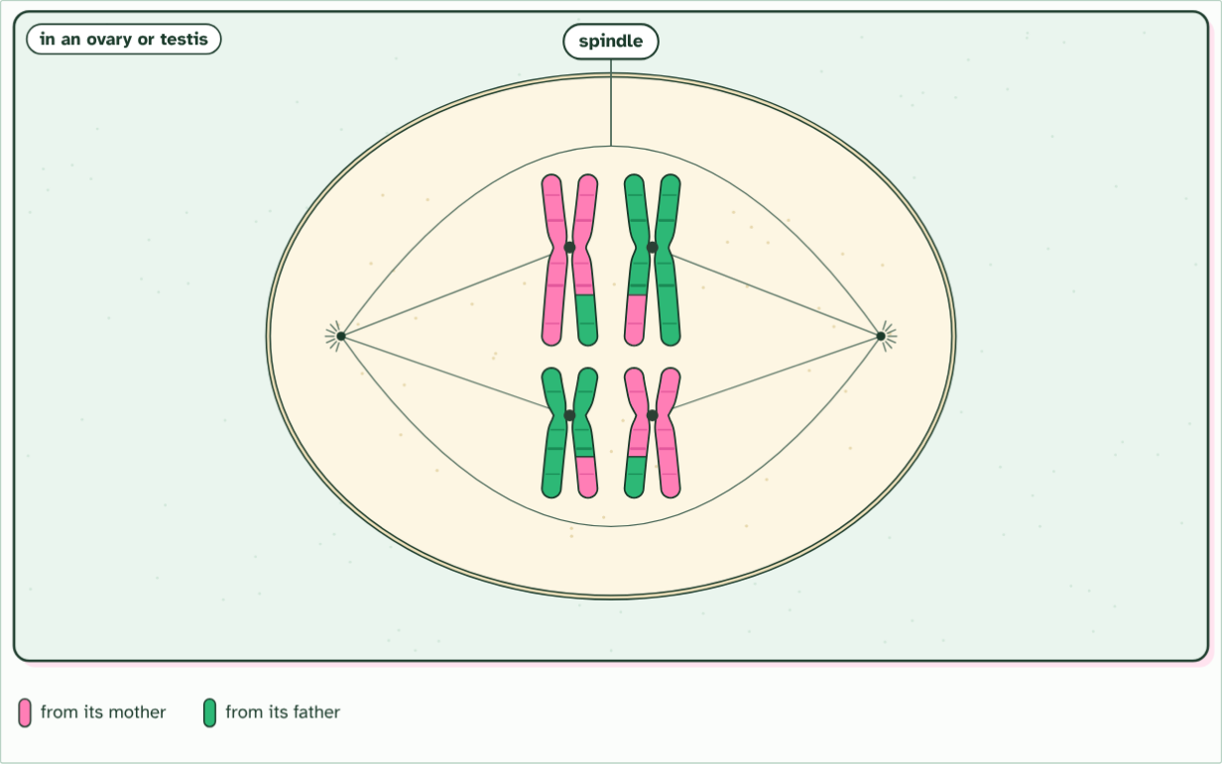
CHAPTER 1 · D3.2.1 Halving and doubling
2n = 4, DNA copied
5 / 9
Halve, then fuse
A spindle forms and the pairs line up across the middle. Which way round each pair lies is down to chance: random orientation.
Minutes 6 to 18
Notes:
Minutes 6 to 18 of 60: Halve, then fuse (12 min).
The plan: Chapter 1's film, paused at each stage. Students sketch a cell with two chromosome pairs, then the four gametes it can make, then the zygote. Land on the linking question: what processes involve doubling and halving? Meiosis halves the number, fertilisation doubles it.
Your body cells hold two copies of every chromosome, one set from each parent. A cell like that is diploid. A human body cell has 46 chromosomes, written 2n = 46. Most of them are autosomes, so a diploid cell has two copies of each autosomal gene: one on each chromosome of a pair.
If a child simply received all the chromosomes of both parents, the number would double every generation. Life avoids this by halving first. Special cells divide by meiosis to make gametes, and each gamete gets one chromosome from every pair. A cell with a single set is haploid. In humans, n = 23.
Then fertilisation joins two gametes. Their nuclei fuse to make a zygote, which is diploid again, with one set from each parent. Halve, then double: that is the loop that carries genes from one generation to the next.
This pattern is common to all eukaryotes with a sexual life cycle. You, a pea plant, a mushroom and a fruit fly all make haploid gametes and fuse them to form a diploid zygote. The details of the life cycle differ from group to group, but the loop is the same.
Example: Linking question What biological processes involve doubling and halving? Here it is the chromosome number: meiosis halves it and fertilisation doubles it. The same idea returns in D2.1 (cell and nuclear division), where cells divide, and in D1.1 (DNA replication), where the DNA doubles before they do.
The animation "Watch it happen: halving, then fusing", paused at 23.3 s. The next slides go on through it, then play it.

Slide 16
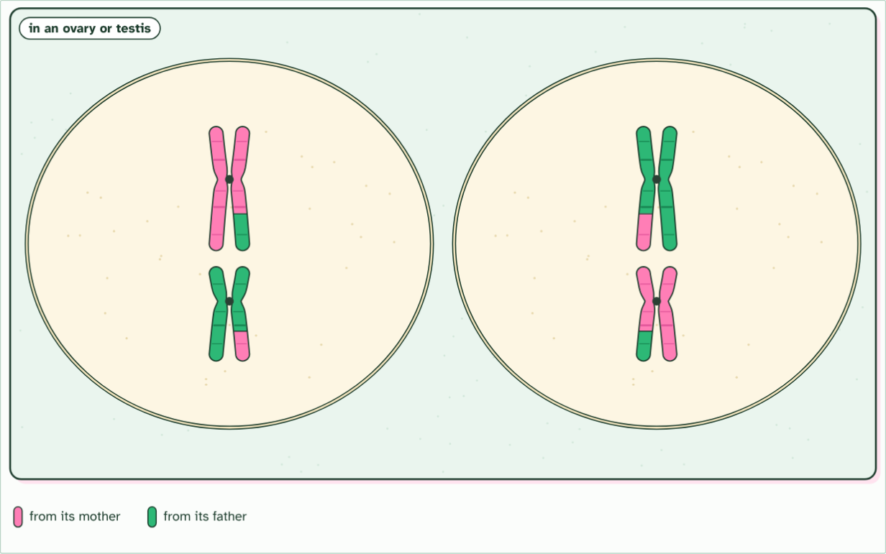
CHAPTER 1 · D3.2.1 Halving and doubling
2 cells, n = 2
6 / 9
Halve, then fuse
Meiosis I: one chromosome of each pair is pulled to each end, and the cell divides. Each new cell has half the number of chromosomes.
Minutes 6 to 18
Notes:
Minutes 6 to 18 of 60: Halve, then fuse (12 min).
The plan: Chapter 1's film, paused at each stage. Students sketch a cell with two chromosome pairs, then the four gametes it can make, then the zygote. Land on the linking question: what processes involve doubling and halving? Meiosis halves the number, fertilisation doubles it.
Your body cells hold two copies of every chromosome, one set from each parent. A cell like that is diploid. A human body cell has 46 chromosomes, written 2n = 46. Most of them are autosomes, so a diploid cell has two copies of each autosomal gene: one on each chromosome of a pair.
If a child simply received all the chromosomes of both parents, the number would double every generation. Life avoids this by halving first. Special cells divide by meiosis to make gametes, and each gamete gets one chromosome from every pair. A cell with a single set is haploid. In humans, n = 23.
Then fertilisation joins two gametes. Their nuclei fuse to make a zygote, which is diploid again, with one set from each parent. Halve, then double: that is the loop that carries genes from one generation to the next.
This pattern is common to all eukaryotes with a sexual life cycle. You, a pea plant, a mushroom and a fruit fly all make haploid gametes and fuse them to form a diploid zygote. The details of the life cycle differ from group to group, but the loop is the same.
Example: Linking question What biological processes involve doubling and halving? Here it is the chromosome number: meiosis halves it and fertilisation doubles it. The same idea returns in D2.1 (cell and nuclear division), where cells divide, and in D1.1 (DNA replication), where the DNA doubles before they do.
The animation "Watch it happen: halving, then fusing", paused at 30.0 s. The next slides go on through it, then play it.

Slide 17
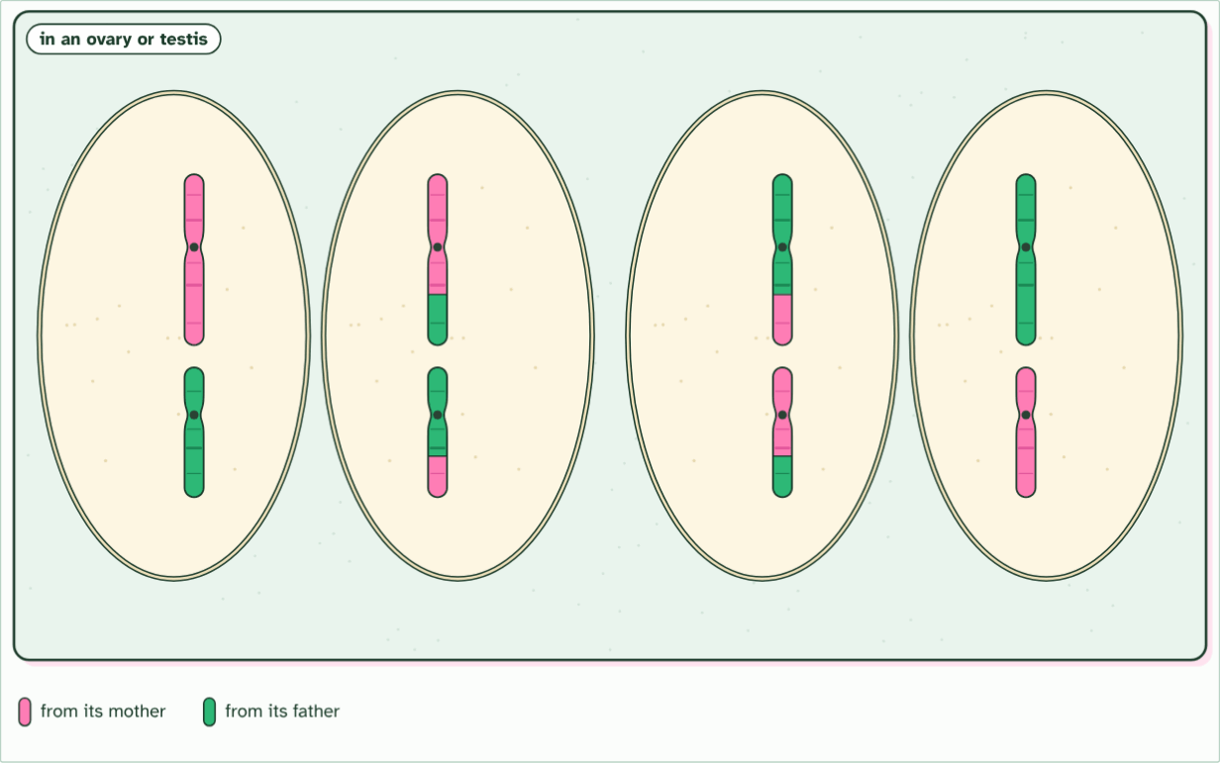
CHAPTER 1 · D3.2.1 Halving and doubling
4 cells, n = 2
7 / 9
Halve, then fuse
Meiosis II: in each cell the sister chromatids are pulled apart, and both cells divide again.
Minutes 6 to 18
Notes:
Minutes 6 to 18 of 60: Halve, then fuse (12 min).
The plan: Chapter 1's film, paused at each stage. Students sketch a cell with two chromosome pairs, then the four gametes it can make, then the zygote. Land on the linking question: what processes involve doubling and halving? Meiosis halves the number, fertilisation doubles it.
Your body cells hold two copies of every chromosome, one set from each parent. A cell like that is diploid. A human body cell has 46 chromosomes, written 2n = 46. Most of them are autosomes, so a diploid cell has two copies of each autosomal gene: one on each chromosome of a pair.
If a child simply received all the chromosomes of both parents, the number would double every generation. Life avoids this by halving first. Special cells divide by meiosis to make gametes, and each gamete gets one chromosome from every pair. A cell with a single set is haploid. In humans, n = 23.
Then fertilisation joins two gametes. Their nuclei fuse to make a zygote, which is diploid again, with one set from each parent. Halve, then double: that is the loop that carries genes from one generation to the next.
This pattern is common to all eukaryotes with a sexual life cycle. You, a pea plant, a mushroom and a fruit fly all make haploid gametes and fuse them to form a diploid zygote. The details of the life cycle differ from group to group, but the loop is the same.
Example: Linking question What biological processes involve doubling and halving? Here it is the chromosome number: meiosis halves it and fertilisation doubles it. The same idea returns in D2.1 (cell and nuclear division), where cells divide, and in D1.1 (DNA replication), where the DNA doubles before they do.
The animation "Watch it happen: halving, then fusing", paused at 36.1 s. The next slides go on through it, then play it.

Slide 18
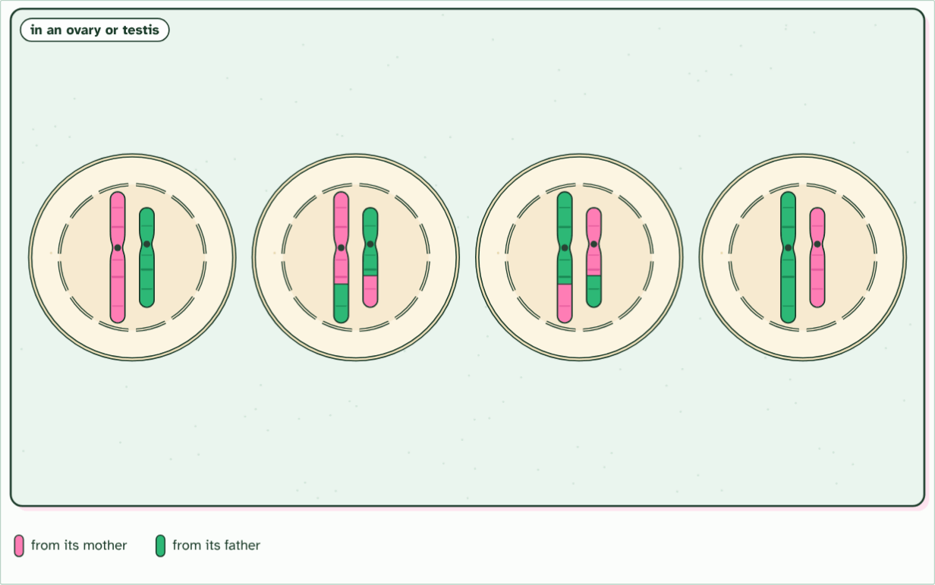
CHAPTER 1 · D3.2.1 Halving and doubling
4 gametes, n = 2
8 / 9
Halve, then fuse
Four haploid gametes, each with one chromosome of every pair, and no two alike.
Minutes 6 to 18
Notes:
Minutes 6 to 18 of 60: Halve, then fuse (12 min).
The plan: Chapter 1's film, paused at each stage. Students sketch a cell with two chromosome pairs, then the four gametes it can make, then the zygote. Land on the linking question: what processes involve doubling and halving? Meiosis halves the number, fertilisation doubles it.
Your body cells hold two copies of every chromosome, one set from each parent. A cell like that is diploid. A human body cell has 46 chromosomes, written 2n = 46. Most of them are autosomes, so a diploid cell has two copies of each autosomal gene: one on each chromosome of a pair.
If a child simply received all the chromosomes of both parents, the number would double every generation. Life avoids this by halving first. Special cells divide by meiosis to make gametes, and each gamete gets one chromosome from every pair. A cell with a single set is haploid. In humans, n = 23.
Then fertilisation joins two gametes. Their nuclei fuse to make a zygote, which is diploid again, with one set from each parent. Halve, then double: that is the loop that carries genes from one generation to the next.
This pattern is common to all eukaryotes with a sexual life cycle. You, a pea plant, a mushroom and a fruit fly all make haploid gametes and fuse them to form a diploid zygote. The details of the life cycle differ from group to group, but the loop is the same.
Example: Linking question What biological processes involve doubling and halving? Here it is the chromosome number: meiosis halves it and fertilisation doubles it. The same idea returns in D2.1 (cell and nuclear division), where cells divide, and in D1.1 (DNA replication), where the DNA doubles before they do.
The animation "Watch it happen: halving, then fusing", paused at 41.1 s. The next slides go on through it, then play it.

Slide 19
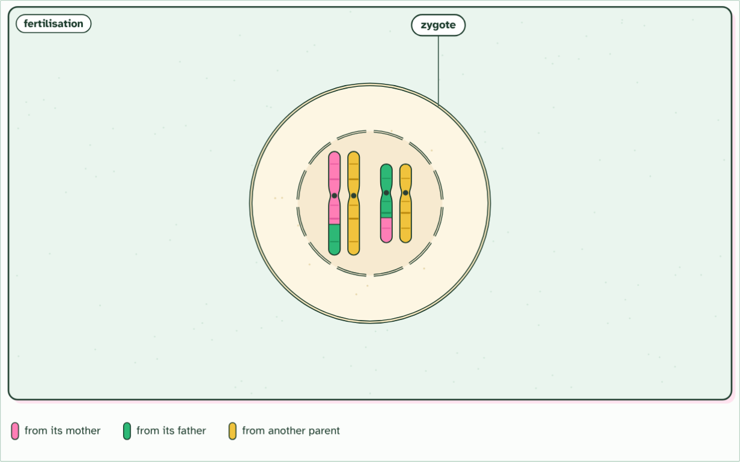
CHAPTER 1 · D3.2.1 Halving and doubling
zygote, 2n = 4
9 / 9
Halve, then fuse
Fertilisation: the gamete fuses with one from another parent (yellow). The zygote is diploid again, with one of each pair from each parent.
Minutes 6 to 18
Notes:
Minutes 6 to 18 of 60: Halve, then fuse (12 min).
The plan: Chapter 1's film, paused at each stage. Students sketch a cell with two chromosome pairs, then the four gametes it can make, then the zygote. Land on the linking question: what processes involve doubling and halving? Meiosis halves the number, fertilisation doubles it.
Your body cells hold two copies of every chromosome, one set from each parent. A cell like that is diploid. A human body cell has 46 chromosomes, written 2n = 46. Most of them are autosomes, so a diploid cell has two copies of each autosomal gene: one on each chromosome of a pair.
If a child simply received all the chromosomes of both parents, the number would double every generation. Life avoids this by halving first. Special cells divide by meiosis to make gametes, and each gamete gets one chromosome from every pair. A cell with a single set is haploid. In humans, n = 23.
Then fertilisation joins two gametes. Their nuclei fuse to make a zygote, which is diploid again, with one set from each parent. Halve, then double: that is the loop that carries genes from one generation to the next.
This pattern is common to all eukaryotes with a sexual life cycle. You, a pea plant, a mushroom and a fruit fly all make haploid gametes and fuse them to form a diploid zygote. The details of the life cycle differ from group to group, but the loop is the same.
Example: Linking question What biological processes involve doubling and halving? Here it is the chromosome number: meiosis halves it and fertilisation doubles it. The same idea returns in D2.1 (cell and nuclear division), where cells divide, and in D1.1 (DNA replication), where the DNA doubles before they do.
The animation "Watch it happen: halving, then fusing", paused at 50.9 s. The next slides go on through it, then play it.

Slide 20
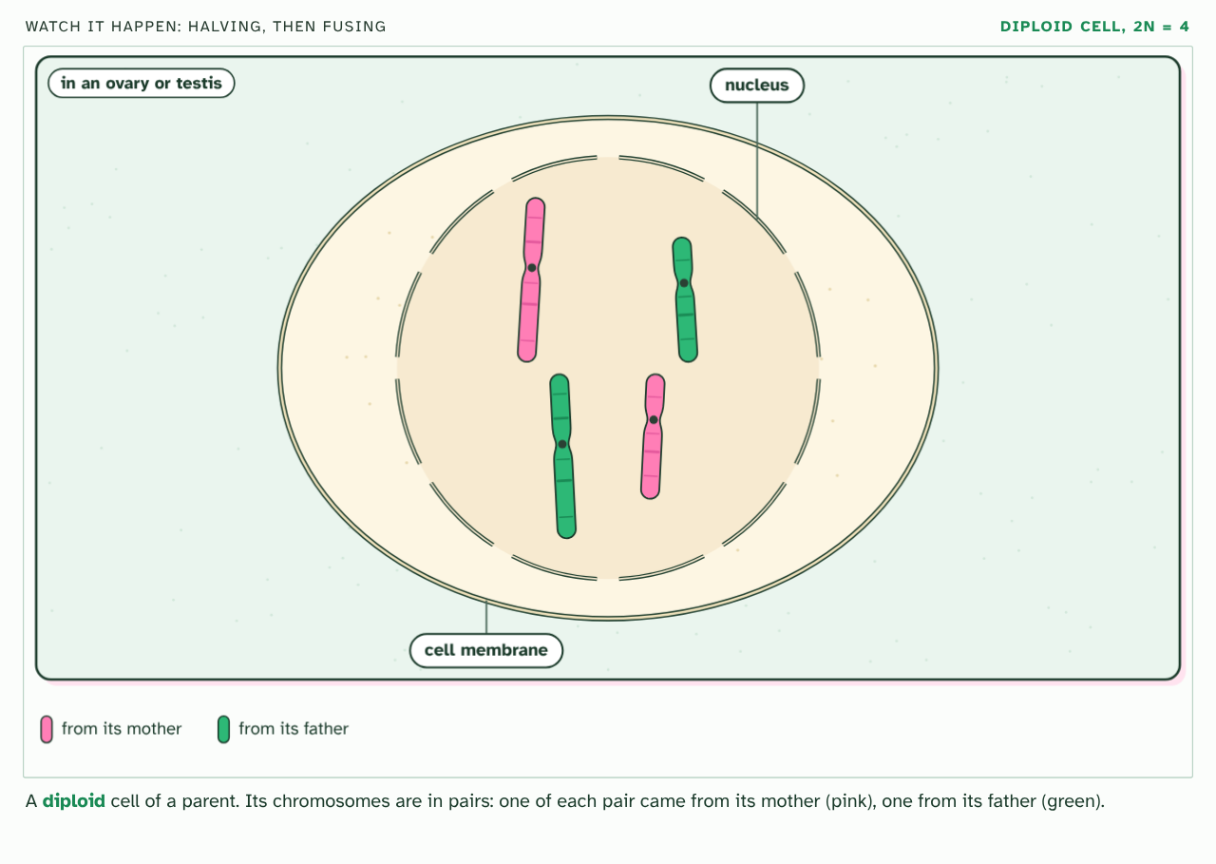
CHAPTER 1 · D3.2.1 Halving and doubling
PLAY IT
Halve, then fuse
Watch it happen: halving, then fusing: click to play. It loops every 52 seconds.
Minutes 6 to 18
Notes:
Minutes 6 to 18 of 60: Halve, then fuse (12 min).
The plan: Chapter 1's film, paused at each stage. Students sketch a cell with two chromosome pairs, then the four gametes it can make, then the zygote. Land on the linking question: what processes involve doubling and halving? Meiosis halves the number, fertilisation doubles it.
The video is meiosis-8b1d7a.mp4, one loop of the animation in the guide. It plays in PowerPoint and Keynote. Google Slides does not play a video embedded in a .pptx: download meiosis-8b1d7a.mp4 (https://www.biologybybradford.com/guides/downloads/scenes/meiosis-8b1d7a.mp4), upload it to Google Drive, then Insert > Video > Google Drive.
In the guide the class can change it as it runs: https://www.biologybybradford.com/guides/ib-biology-d3-2-inheritance#halve
What it shows, in order:
1. A diploid cell of a parent. Its chromosomes are in pairs: one of each pair came from its mother (pink), one from its father (green).
2. First the DNA is copied: each chromosome becomes two identical sister chromatids, joined at a centromere.
3. The nucleus breaks down and each chromosome lies beside its partner: a homologous pair, with the same genes in the same order.
4. Crossing over: chromatids of a pair swap matching sections, making new mixes of the mother's and the father's alleles.
5. A spindle forms and the pairs line up across the middle. Which way round each pair lies is down to chance: random orientation.
6. Meiosis I: one chromosome of each pair is pulled to each end, and the cell divides. Each new cell has half the number of chromosomes.
7. Meiosis II: in each cell the sister chromatids are pulled apart, and both cells divide again.
8. Four haploid gametes, each with one chromosome of every pair, and no two alike.
9. Fertilisation: the gamete fuses with one from another parent (yellow). The zygote is diploid again, with one of each pair from each parent.

Slide 21
WATCH OUT
A gamete is not "half a cell". It is a whole cell with half the number of chromosomes. And a parent does not pass both of its copies of a gene to a gamete: it passes one.
Minutes 6 to 18
Notes:
Minutes 6 to 18 of 60: Halve, then fuse (12 min).
The plan: Chapter 1's film, paused at each stage. Students sketch a cell with two chromosome pairs, then the four gametes it can make, then the zygote. Land on the linking question: what processes involve doubling and halving? Meiosis halves the number, fertilisation doubles it.
A common mistake: say it, then ask who can say why it is wrong.

Slide 22

MODEL
10 MIN
Halve and fuse
THE TASK
Each student has two cards for one chromosome pair, one pink (from the mother) and one green (from the father), and a coin. Heads, the pink card goes into the gamete; tails, the green one. Two students then bring their gametes together to make a zygote. Repeat with two pairs, using two coins. Tally on the board how many zygotes have both pink, both green, or one of each. Ask why a parent never passes both cards.
STUDENTS NEED
Coins, pink and green cards (two for each pair of chromosomes), a tally table on the board.
Minutes 18 to 28
Notes:
Minutes 18 to 28 of 60: Halve and fuse: the model (10 min).
The plan: The activity below. Each pair makes gametes by flipping a coin for each chromosome pair, then fuses with another pair. Tally the zygotes on the board and ask why two gametes from the same parent are never quite the same.
The activity: Halve and fuse. Each student has two cards for one chromosome pair, one pink (from the mother) and one green (from the father), and a coin. Heads, the pink card goes into the gamete; tails, the green one. Two students then bring their gametes together to make a zygote. Repeat with two pairs, using two coins. Tally on the board how many zygotes have both pink, both green, or one of each. Ask why a parent never passes both cards.
Needs: coins, pink and green cards (two for each pair of chromosomes), a tally table on the board.
The time: 10 minutes, minutes 18 to 28 of the plan.

Slide 23
STEP 4
12 MIN
Making a cross
Students write the words pollen, anther, stigma, ovary, P, F1 and F2 on a flower outline.
Turn over the Remember it tiles for the generations.
Minutes 28 to 40
Notes:
Minutes 28 to 40 of 60: Making a cross (12 min).
The plan: Chapter 2's figure, one step at a time, then its predict box on the forgotten anthers. Students write the words pollen, anther, stigma, ovary, P, F1 and F2 on a flower outline. Turn over the Remember it tiles for the generations.

Slide 24
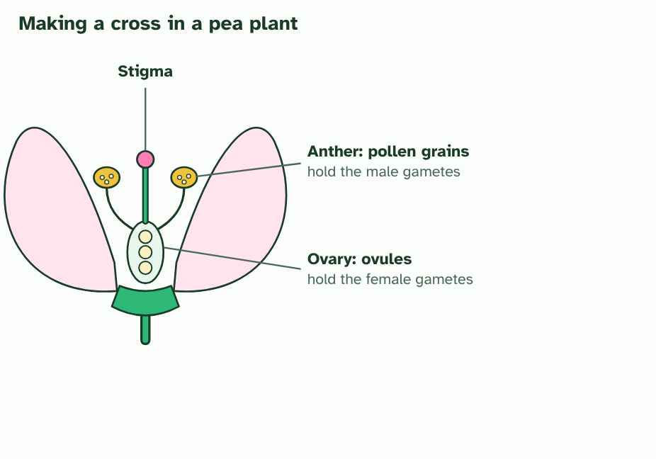
CHAPTER 2 · D3.2.2 Genetic crosses in flowering plants
1 / 5
How to make a cross
A pea flower makes both kinds of gamete. Pollen forms in the anthers and holds the male gametes. The ovules in the ovary hold the female gametes.
Minutes 28 to 40
Notes:
Minutes 28 to 40 of 60: Making a cross (12 min).
The plan: Chapter 2's figure, one step at a time, then its predict box on the forgotten anthers. Students write the words pollen, anther, stigma, ovary, P, F1 and F2 on a flower outline. Turn over the Remember it tiles for the generations.
To study inheritance you need to know the parents, so you choose them and then count the offspring. That is a genetic cross. Flowering plants are good for it: you can control which plants breed, and the seeds are ready within weeks.
The male gametes are in pollen, which forms in the anthers. The female gametes are in the ovules, inside the ovary at the base of the flower. A pollen grain has to reach the stigma before it can fertilise an ovule, so a cross needs pollination.
Pea plants add a twist. One flower makes both pollen and ovules, so it can pollinate itself: self-fertilisation. To make a cross on purpose you remove the anthers from the flower that will receive pollen, before it can pollinate itself, and carry pollen from the other plant to its stigma.
Crosses are described in generations. The two parents you choose are the P generation. Parents that are true-breeding give the F1 generation (F is for filial, meaning of a son or daughter). Let the F1 plants pollinate each other, or themselves, and you get the F2 generation. A Punnett grid predicts what the F2 should look like. The letters in the grid are versions of a gene, which chapter 3 explains.
Example: Crosses are not only for laboratories. Breeders cross plants to join the useful traits of two varieties, such as the disease resistance of one with the yield of another, and to make new varieties of ornamental flowers.

Slide 25
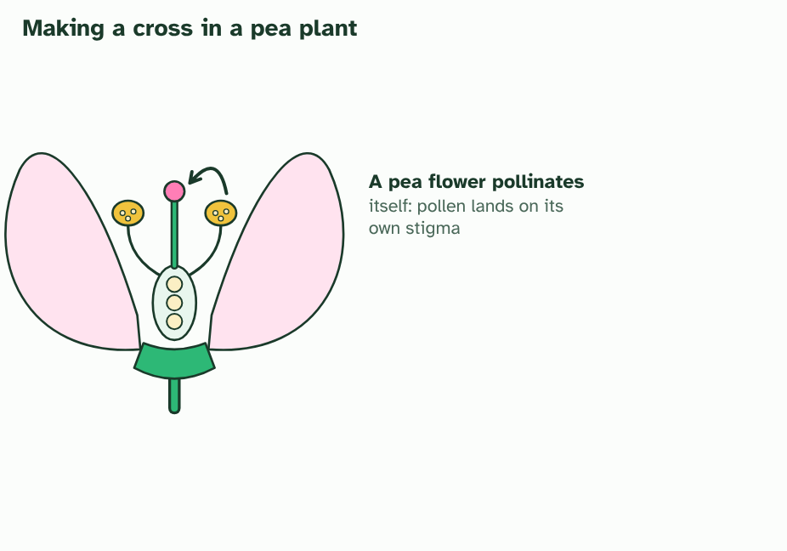
CHAPTER 2 · D3.2.2 Genetic crosses in flowering plants
2 / 5
How to make a cross
Left alone, a pea flower pollinates itself: its pollen reaches its own stigma.
Minutes 28 to 40
Notes:
Minutes 28 to 40 of 60: Making a cross (12 min).
The plan: Chapter 2's figure, one step at a time, then its predict box on the forgotten anthers. Students write the words pollen, anther, stigma, ovary, P, F1 and F2 on a flower outline. Turn over the Remember it tiles for the generations.
To study inheritance you need to know the parents, so you choose them and then count the offspring. That is a genetic cross. Flowering plants are good for it: you can control which plants breed, and the seeds are ready within weeks.
The male gametes are in pollen, which forms in the anthers. The female gametes are in the ovules, inside the ovary at the base of the flower. A pollen grain has to reach the stigma before it can fertilise an ovule, so a cross needs pollination.
Pea plants add a twist. One flower makes both pollen and ovules, so it can pollinate itself: self-fertilisation. To make a cross on purpose you remove the anthers from the flower that will receive pollen, before it can pollinate itself, and carry pollen from the other plant to its stigma.
Crosses are described in generations. The two parents you choose are the P generation. Parents that are true-breeding give the F1 generation (F is for filial, meaning of a son or daughter). Let the F1 plants pollinate each other, or themselves, and you get the F2 generation. A Punnett grid predicts what the F2 should look like. The letters in the grid are versions of a gene, which chapter 3 explains.
Example: Crosses are not only for laboratories. Breeders cross plants to join the useful traits of two varieties, such as the disease resistance of one with the yield of another, and to make new varieties of ornamental flowers.

Slide 26
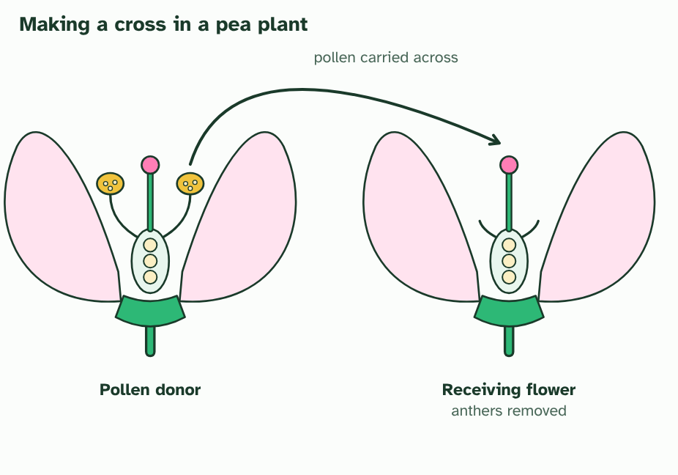
CHAPTER 2 · D3.2.2 Genetic crosses in flowering plants
3 / 5
How to make a cross
For a cross, the anthers are removed from the receiving flower, and pollen is carried from the donor to its stigma.
Minutes 28 to 40
Notes:
Minutes 28 to 40 of 60: Making a cross (12 min).
The plan: Chapter 2's figure, one step at a time, then its predict box on the forgotten anthers. Students write the words pollen, anther, stigma, ovary, P, F1 and F2 on a flower outline. Turn over the Remember it tiles for the generations.
To study inheritance you need to know the parents, so you choose them and then count the offspring. That is a genetic cross. Flowering plants are good for it: you can control which plants breed, and the seeds are ready within weeks.
The male gametes are in pollen, which forms in the anthers. The female gametes are in the ovules, inside the ovary at the base of the flower. A pollen grain has to reach the stigma before it can fertilise an ovule, so a cross needs pollination.
Pea plants add a twist. One flower makes both pollen and ovules, so it can pollinate itself: self-fertilisation. To make a cross on purpose you remove the anthers from the flower that will receive pollen, before it can pollinate itself, and carry pollen from the other plant to its stigma.
Crosses are described in generations. The two parents you choose are the P generation. Parents that are true-breeding give the F1 generation (F is for filial, meaning of a son or daughter). Let the F1 plants pollinate each other, or themselves, and you get the F2 generation. A Punnett grid predicts what the F2 should look like. The letters in the grid are versions of a gene, which chapter 3 explains.
Example: Crosses are not only for laboratories. Breeders cross plants to join the useful traits of two varieties, such as the disease resistance of one with the yield of another, and to make new varieties of ornamental flowers.

Slide 27
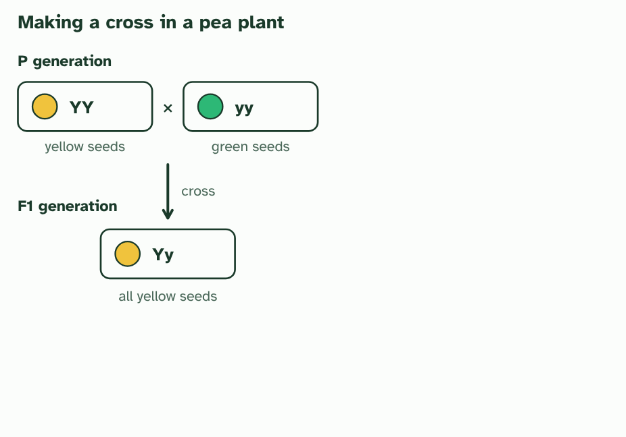
CHAPTER 2 · D3.2.2 Genetic crosses in flowering plants
4 / 5
How to make a cross
Cross two true-breeding parents (the P generation). Every seed of the F1 generation has one allele from each parent.
Minutes 28 to 40
Notes:
Minutes 28 to 40 of 60: Making a cross (12 min).
The plan: Chapter 2's figure, one step at a time, then its predict box on the forgotten anthers. Students write the words pollen, anther, stigma, ovary, P, F1 and F2 on a flower outline. Turn over the Remember it tiles for the generations.
To study inheritance you need to know the parents, so you choose them and then count the offspring. That is a genetic cross. Flowering plants are good for it: you can control which plants breed, and the seeds are ready within weeks.
The male gametes are in pollen, which forms in the anthers. The female gametes are in the ovules, inside the ovary at the base of the flower. A pollen grain has to reach the stigma before it can fertilise an ovule, so a cross needs pollination.
Pea plants add a twist. One flower makes both pollen and ovules, so it can pollinate itself: self-fertilisation. To make a cross on purpose you remove the anthers from the flower that will receive pollen, before it can pollinate itself, and carry pollen from the other plant to its stigma.
Crosses are described in generations. The two parents you choose are the P generation. Parents that are true-breeding give the F1 generation (F is for filial, meaning of a son or daughter). Let the F1 plants pollinate each other, or themselves, and you get the F2 generation. A Punnett grid predicts what the F2 should look like. The letters in the grid are versions of a gene, which chapter 3 explains.
Example: Crosses are not only for laboratories. Breeders cross plants to join the useful traits of two varieties, such as the disease resistance of one with the yield of another, and to make new varieties of ornamental flowers.

Slide 28
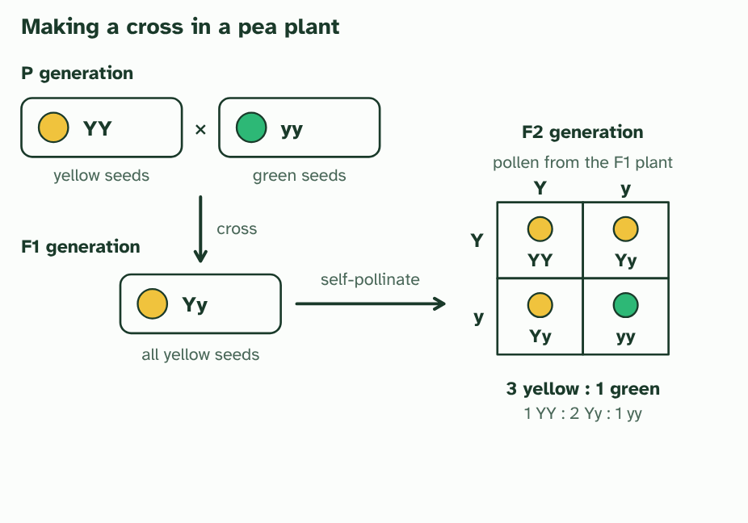
CHAPTER 2 · D3.2.2 Genetic crosses in flowering plants
5 / 5
How to make a cross
Let the F1 plants self-pollinate to make the F2 generation. The Punnett grid shows every way their gametes can combine: 3 yellow seeds for every 1 green.
Minutes 28 to 40
Notes:
Minutes 28 to 40 of 60: Making a cross (12 min).
The plan: Chapter 2's figure, one step at a time, then its predict box on the forgotten anthers. Students write the words pollen, anther, stigma, ovary, P, F1 and F2 on a flower outline. Turn over the Remember it tiles for the generations.
To study inheritance you need to know the parents, so you choose them and then count the offspring. That is a genetic cross. Flowering plants are good for it: you can control which plants breed, and the seeds are ready within weeks.
The male gametes are in pollen, which forms in the anthers. The female gametes are in the ovules, inside the ovary at the base of the flower. A pollen grain has to reach the stigma before it can fertilise an ovule, so a cross needs pollination.
Pea plants add a twist. One flower makes both pollen and ovules, so it can pollinate itself: self-fertilisation. To make a cross on purpose you remove the anthers from the flower that will receive pollen, before it can pollinate itself, and carry pollen from the other plant to its stigma.
Crosses are described in generations. The two parents you choose are the P generation. Parents that are true-breeding give the F1 generation (F is for filial, meaning of a son or daughter). Let the F1 plants pollinate each other, or themselves, and you get the F2 generation. A Punnett grid predicts what the F2 should look like. The letters in the grid are versions of a gene, which chapter 3 explains.
Example: Crosses are not only for laboratories. Breeders cross plants to join the useful traits of two varieties, such as the disease resistance of one with the yield of another, and to make new varieties of ornamental flowers.

Slide 29
CHAPTER 2 · D3.2.2 Genetic crosses in flowering plants
How to make a cross
The male gametes are in pollen, which forms in the anthers.
A pollen grain has to reach the stigma before it can fertilise an ovule, so a cross needs pollination.
One flower makes both pollen and ovules, so it can pollinate itself: self-fertilisation.
To make a cross on purpose you remove the anthers from the flower that will receive pollen, before it can pollinate itself, and carry pollen from the other plant to its stigma.
Minutes 28 to 40
Notes:
Minutes 28 to 40 of 60: Making a cross (12 min).
The plan: Chapter 2's figure, one step at a time, then its predict box on the forgotten anthers. Students write the words pollen, anther, stigma, ovary, P, F1 and F2 on a flower outline. Turn over the Remember it tiles for the generations.
To study inheritance you need to know the parents, so you choose them and then count the offspring. That is a genetic cross. Flowering plants are good for it: you can control which plants breed, and the seeds are ready within weeks.
The male gametes are in pollen, which forms in the anthers. The female gametes are in the ovules, inside the ovary at the base of the flower. A pollen grain has to reach the stigma before it can fertilise an ovule, so a cross needs pollination.
Pea plants add a twist. One flower makes both pollen and ovules, so it can pollinate itself: self-fertilisation. To make a cross on purpose you remove the anthers from the flower that will receive pollen, before it can pollinate itself, and carry pollen from the other plant to its stigma.
Crosses are described in generations. The two parents you choose are the P generation. Parents that are true-breeding give the F1 generation (F is for filial, meaning of a son or daughter). Let the F1 plants pollinate each other, or themselves, and you get the F2 generation. A Punnett grid predicts what the F2 should look like. The letters in the grid are versions of a gene, which chapter 3 explains.
Example: Crosses are not only for laboratories. Breeders cross plants to join the useful traits of two varieties, such as the disease resistance of one with the yield of another, and to make new varieties of ornamental flowers.

Slide 30
PREDICT
A student wants to cross a purple-flowered pea plant with a white-flowered one, but forgets to remove the anthers from the white plant. What is likely to happen?
A Some seeds will come from self-fertilisation, so not all will be from the cross
B The flower will be sterile, because a flower with both kinds of gamete cannot set seed
C Every seed will be purple, because pollen from another plant always beats the plant’s own
Minutes 28 to 40
Notes:
Minutes 28 to 40 of 60: Making a cross (12 min).
The plan: Chapter 2's figure, one step at a time, then its predict box on the forgotten anthers. Students write the words pollen, anther, stigma, ovary, P, F1 and F2 on a flower outline. Turn over the Remember it tiles for the generations.
Ask for a show of hands, or mini whiteboards, before revealing. (Answer: A, on the next slide.)

Slide 31
WHAT HAPPENS
A student wants to cross a purple-flowered pea plant with a white-flowered one, but forgets to remove the anthers from the white plant. What is likely to happen?
A Some seeds will come from self-fertilisation, so not all will be from the cross
B The flower will be sterile, because a flower with both kinds of gamete cannot set seed
C Every seed will be purple, because pollen from another plant always beats the plant’s own
Some seeds will come from self-fertilisation. A pea flower makes both pollen and ovules and normally pollinates itself, so unless the anthers are removed early, its own pollen can fertilise some of the ovules. The offspring would be a mixture of crossed and self-fertilised seeds, and the results would be hard to read.
Minutes 28 to 40
Notes:
Minutes 28 to 40 of 60: Making a cross (12 min).
The plan: Chapter 2's figure, one step at a time, then its predict box on the forgotten anthers. Students write the words pollen, anther, stigma, ovary, P, F1 and F2 on a flower outline. Turn over the Remember it tiles for the generations.
Answer: A. Some seeds will come from self-fertilisation. A pea flower makes both pollen and ovules and normally pollinates itself, so unless the anthers are removed early, its own pollen can fertilise some of the ovules. The offspring would be a mixture of crossed and self-fertilised seeds, and the results would be hard to read.

Slide 32
REMEMBER IT
The generations of a cross
P
F
F
Parents
First
Follows
Minutes 28 to 40
Notes:
Minutes 28 to 40 of 60: Making a cross (12 min).
The plan: Chapter 2's figure, one step at a time, then its predict box on the forgotten anthers. Students write the words pollen, anther, stigma, ovary, P, F1 and F2 on a flower outline. Turn over the Remember it tiles for the generations.
Ask the class what each letter stands for before revealing.

Slide 33
REMEMBER IT
The generations of a cross
P
F
F
Parents
First
Follows
P generation
F1 generation
F2 generation
the plants you choose to cross
their offspring
the offspring of two F1 plants
Minutes 28 to 40
Notes:
Minutes 28 to 40 of 60: Making a cross (12 min).
The plan: Chapter 2's figure, one step at a time, then its predict box on the forgotten anthers. Students write the words pollen, anther, stigma, ovary, P, F1 and F2 on a flower outline. Turn over the Remember it tiles for the generations.
Parents: P generation (the plants you choose to cross)
First: F1 generation (their offspring)
Follows: F2 generation (the offspring of two F1 plants)

Slide 34
WATCH OUT
A Punnett grid gives chances, not promises. It predicts the proportions you should expect in a large number of offspring, not exactly which seeds you will get.
Minutes 28 to 40
Notes:
Minutes 28 to 40 of 60: Making a cross (12 min).
The plan: Chapter 2's figure, one step at a time, then its predict box on the forgotten anthers. Students write the words pollen, anther, stigma, ovary, P, F1 and F2 on a flower outline. Turn over the Remember it tiles for the generations.
A common mistake: say it, then ask who can say why it is wrong.

Slide 35
STEP 5
15 MIN
Gene, allele, genotype, phenotype
Then the card sort below: is each trait set by genotype only, environment only, or both?
Do not rush the gene against allele distinction.
Minutes 40 to 55
Notes:
Minutes 40 to 55 of 60: Gene, allele, genotype, phenotype (15 min).
The plan: Chapter 3's figure and predict boxes. Then the card sort below: is each trait set by genotype only, environment only, or both? Ask students to defend any card the class splits on. Do not rush the gene against allele distinction: say "versions of a gene".

Slide 36
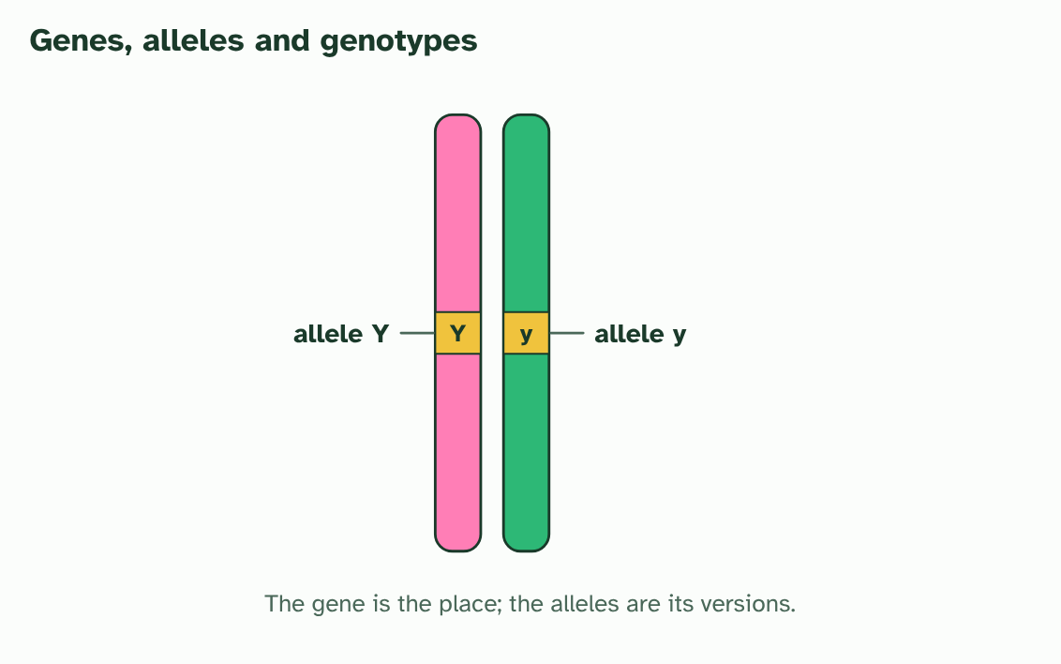
CHAPTER 3 · D3.2.3 D3.2.4 Genotype and phenotype
1 / 3
Genes, alleles and the traits you see
A pair of homologous chromosomes. The gene is one place on the chromosome. Each chromosome carries one allele of it, here Y and y.
Minutes 40 to 55
Notes:
Minutes 40 to 55 of 60: Gene, allele, genotype, phenotype (15 min).
The plan: Chapter 3's figure and predict boxes. Then the card sort below: is each trait set by genotype only, environment only, or both? Ask students to defend any card the class splits on. Do not rush the gene against allele distinction: say "versions of a gene".
A gene is a length of DNA at one place on a chromosome. Different versions of the same gene are alleles. The seed colour gene in peas is a single place on one chromosome, and its alleles are one for yellow seeds (Y) and one for green (y). Keep the two words apart: a gene is the place, an allele is the version.
You are diploid, so you have two alleles of every autosomal gene, one on each chromosome of a pair. The pair of alleles is your genotype for that gene. If the two alleles are the same, you are homozygous (YY or yy). If they differ, you are heterozygous (Yy).
Your phenotype is what can be observed: the colour of a seed, your blood group, your height, even your behaviour. It comes from the genotype and the environment. Some traits depend on the genotype only, some on the environment only, and many on both.
Example: In humans: genotype only, ABO blood group (diet and exercise cannot change it). Environment only, a scar from a cut, or a language you have learned. Both, adult height (genes set a range, and nutrition and health decide where you land in it) and skin colour (which also depends on how much sun you get).

Slide 37
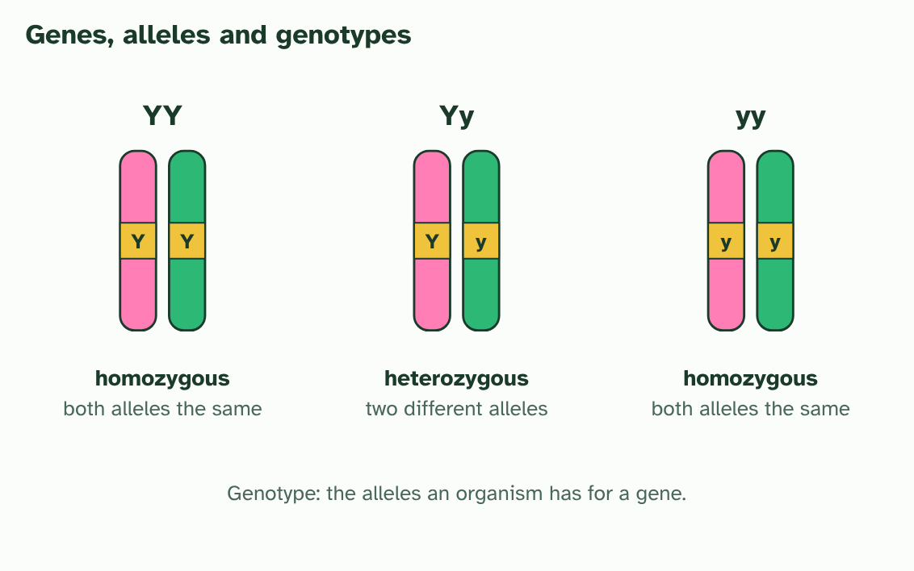
CHAPTER 3 · D3.2.3 D3.2.4 Genotype and phenotype
2 / 3
Genes, alleles and the traits you see
The two alleles make the genotype. Two the same is homozygous. Two different is heterozygous.
Minutes 40 to 55
Notes:
Minutes 40 to 55 of 60: Gene, allele, genotype, phenotype (15 min).
The plan: Chapter 3's figure and predict boxes. Then the card sort below: is each trait set by genotype only, environment only, or both? Ask students to defend any card the class splits on. Do not rush the gene against allele distinction: say "versions of a gene".
A gene is a length of DNA at one place on a chromosome. Different versions of the same gene are alleles. The seed colour gene in peas is a single place on one chromosome, and its alleles are one for yellow seeds (Y) and one for green (y). Keep the two words apart: a gene is the place, an allele is the version.
You are diploid, so you have two alleles of every autosomal gene, one on each chromosome of a pair. The pair of alleles is your genotype for that gene. If the two alleles are the same, you are homozygous (YY or yy). If they differ, you are heterozygous (Yy).
Your phenotype is what can be observed: the colour of a seed, your blood group, your height, even your behaviour. It comes from the genotype and the environment. Some traits depend on the genotype only, some on the environment only, and many on both.
Example: In humans: genotype only, ABO blood group (diet and exercise cannot change it). Environment only, a scar from a cut, or a language you have learned. Both, adult height (genes set a range, and nutrition and health decide where you land in it) and skin colour (which also depends on how much sun you get).

Slide 38
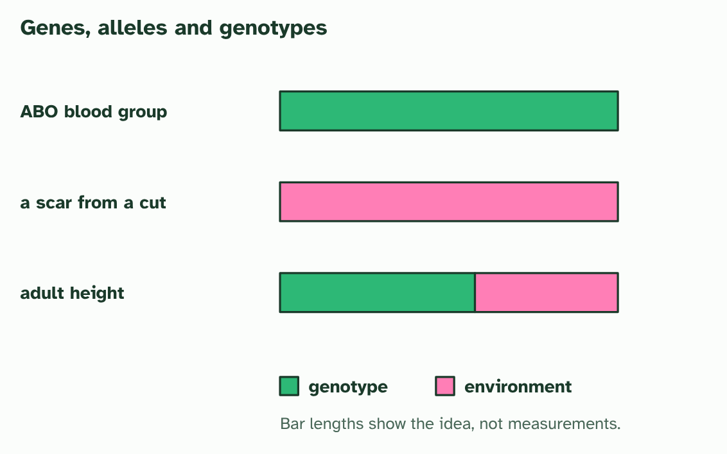
CHAPTER 3 · D3.2.3 D3.2.4 Genotype and phenotype
3 / 3
Genes, alleles and the traits you see
The phenotype comes from the genotype, the environment, or both: blood group, a scar and height.
Minutes 40 to 55
Notes:
Minutes 40 to 55 of 60: Gene, allele, genotype, phenotype (15 min).
The plan: Chapter 3's figure and predict boxes. Then the card sort below: is each trait set by genotype only, environment only, or both? Ask students to defend any card the class splits on. Do not rush the gene against allele distinction: say "versions of a gene".
A gene is a length of DNA at one place on a chromosome. Different versions of the same gene are alleles. The seed colour gene in peas is a single place on one chromosome, and its alleles are one for yellow seeds (Y) and one for green (y). Keep the two words apart: a gene is the place, an allele is the version.
You are diploid, so you have two alleles of every autosomal gene, one on each chromosome of a pair. The pair of alleles is your genotype for that gene. If the two alleles are the same, you are homozygous (YY or yy). If they differ, you are heterozygous (Yy).
Your phenotype is what can be observed: the colour of a seed, your blood group, your height, even your behaviour. It comes from the genotype and the environment. Some traits depend on the genotype only, some on the environment only, and many on both.
Example: In humans: genotype only, ABO blood group (diet and exercise cannot change it). Environment only, a scar from a cut, or a language you have learned. Both, adult height (genes set a range, and nutrition and health decide where you land in it) and skin colour (which also depends on how much sun you get).

Slide 39
CHAPTER 3 · D3.2.3 D3.2.4 Genotype and phenotype
Genes, alleles and the traits you see
A gene is a length of DNA at one place on a chromosome.
Different versions of the same gene are alleles.
The seed colour gene in peas is a single place on one chromosome, and its alleles are one for yellow seeds (Y) and one for green (y).
Keep the two words apart: a gene is the place, an allele is the version.
Minutes 40 to 55
Notes:
Minutes 40 to 55 of 60: Gene, allele, genotype, phenotype (15 min).
The plan: Chapter 3's figure and predict boxes. Then the card sort below: is each trait set by genotype only, environment only, or both? Ask students to defend any card the class splits on. Do not rush the gene against allele distinction: say "versions of a gene".
A gene is a length of DNA at one place on a chromosome. Different versions of the same gene are alleles. The seed colour gene in peas is a single place on one chromosome, and its alleles are one for yellow seeds (Y) and one for green (y). Keep the two words apart: a gene is the place, an allele is the version.
You are diploid, so you have two alleles of every autosomal gene, one on each chromosome of a pair. The pair of alleles is your genotype for that gene. If the two alleles are the same, you are homozygous (YY or yy). If they differ, you are heterozygous (Yy).
Your phenotype is what can be observed: the colour of a seed, your blood group, your height, even your behaviour. It comes from the genotype and the environment. Some traits depend on the genotype only, some on the environment only, and many on both.
Example: In humans: genotype only, ABO blood group (diet and exercise cannot change it). Environment only, a scar from a cut, or a language you have learned. Both, adult height (genes set a range, and nutrition and health decide where you land in it) and skin colour (which also depends on how much sun you get).

Slide 40
PREDICT
Two plants have the same genotype for every gene, but one grows much taller because it was given more water and fertiliser. What does this show?
A The taller plant must have a different set of alleles from the other
B The environment affects the phenotype as well as the genotype
C Fertiliser changes the alleles inside every cell of the plant
Minutes 40 to 55
Notes:
Minutes 40 to 55 of 60: Gene, allele, genotype, phenotype (15 min).
The plan: Chapter 3's figure and predict boxes. Then the card sort below: is each trait set by genotype only, environment only, or both? Ask students to defend any card the class splits on. Do not rush the gene against allele distinction: say "versions of a gene".
Ask for a show of hands, or mini whiteboards, before revealing. (Answer: B, on the next slide.)

Slide 41
WHAT HAPPENS
Two plants have the same genotype for every gene, but one grows much taller because it was given more water and fertiliser. What does this show?
A The taller plant must have a different set of alleles from the other
B The environment affects the phenotype as well as the genotype
C Fertiliser changes the alleles inside every cell of the plant
The environment affects the phenotype as well as the genotype. The two plants have the same alleles, so the difference in height comes from the conditions they grew in. Fertiliser does not change the alleles in the plant’s cells.
Minutes 40 to 55
Notes:
Minutes 40 to 55 of 60: Gene, allele, genotype, phenotype (15 min).
The plan: Chapter 3's figure and predict boxes. Then the card sort below: is each trait set by genotype only, environment only, or both? Ask students to defend any card the class splits on. Do not rush the gene against allele distinction: say "versions of a gene".
Answer: B. The environment affects the phenotype as well as the genotype. The two plants have the same alleles, so the difference in height comes from the conditions they grew in. Fertiliser does not change the alleles in the plant’s cells.

Slide 42
WATCH OUT
There is no "gene for yellow seeds". There is a gene for seed colour, and the Y allele of it makes the seed yellow. A gene has alleles; a trait is made by a genotype.
Minutes 40 to 55
Notes:
Minutes 40 to 55 of 60: Gene, allele, genotype, phenotype (15 min).
The plan: Chapter 3's figure and predict boxes. Then the card sort below: is each trait set by genotype only, environment only, or both? Ask students to defend any card the class splits on. Do not rush the gene against allele distinction: say "versions of a gene".
A common mistake: say it, then ask who can say why it is wrong.

Slide 43

CARD SORT
15 MIN
Genes, environment or both?
THE TASK
Twelve trait cards for pairs, sorted into three piles: set by genotype only, by environment only, and by both. Use blood group, a scar, a tattoo, height, the shape of earlobes, a tan, speaking a language, body mass, the colour of eyes and a broken arm, with two of your own. Some cards invite argument; that is the point. For each card in the third pile, name the gene and name the environmental factor. Expect disagreement over height and body mass; both belong in the third pile.
STUDENTS NEED
Printed cards, one set per pair.
Minutes 40 to 55
Notes:
Minutes 40 to 55 of 60: Gene, allele, genotype, phenotype (15 min).
The plan: Chapter 3's figure and predict boxes. Then the card sort below: is each trait set by genotype only, environment only, or both? Ask students to defend any card the class splits on. Do not rush the gene against allele distinction: say "versions of a gene".
The activity: Genes, environment or both?. Twelve trait cards for pairs, sorted into three piles: set by genotype only, by environment only, and by both. Use blood group, a scar, a tattoo, height, the shape of earlobes, a tan, speaking a language, body mass, the colour of eyes and a broken arm, with two of your own. Some cards invite argument; that is the point. For each card in the third pile, name the gene and name the environmental factor. Expect disagreement over height and body mass; both belong in the third pile.
Needs: printed cards, one set per pair.
The time: 15 minutes, minutes 40 to 55 of the plan.

Slide 44
PLENARY
Can you now...
Explain how meiosis halves the chromosome number to make haploid gametes, and how fusion gives a diploid zygote (D3.2.1)
Describe how a genetic cross is made in flowering plants, using the terms P generation, F1 generation, F2 generation and Punnett grid (D3.2.2)
Define genotype, and use homozygous, heterozygous, gene and allele correctly (D3.2.3)
Explain how phenotype comes from genotype and the environment, with examples of each (D3.2.4)
Minutes 55 to 60
Notes:
Minutes 55 to 60 of 60: Exit (5 min).
The plan: Write a sentence using homozygous and a sentence using heterozygous, each for the pea seed shape gene. Collect on the way out.
Thumbs up, sideways or down on each goal before the exit question. The goals come from the statements this lesson covers.

Slide 45
EXIT QUESTION
Before you go
Write a sentence using homozygous and a sentence using heterozygous, each for the pea seed shape gene.
Minutes 55 to 60
Notes:
Minutes 55 to 60 of 60: Exit (5 min).
The plan: Write a sentence using homozygous and a sentence using heterozygous, each for the pea seed shape gene. Collect on the way out.

Slide 46
PRACTISE AND REVISE
Keep going
Exam practice: a fresh paper of exam questions on D3.2 at standard level, marked as you go
The guide, with the animations and the dry lab
This lesson in the guide: 1 Halve, then fuse, 2 How to make a cross, 3 Genes, alleles and the traits you see
BUILD FOR YOUR CLASS
ALREADY ON THE SITE FOR D3.2
CARD SETS ON SPLYCR
Tarsia puzzle, dominoes and picture reveal on D3.2, built from its key terms and ready to print
A pub quiz with rounds on D3.2, to present or run with no projector
An escape room built from the question bank on D3.2
Lesson: Linked Genes & Chi-Squared
Lesson: Dihybrid Crosses & Test Crosses
Lesson: Inheritance
Summary doodle: Inheritance
Quiz: Inheritance
Revision map: D3.2 Inheritance, to fill in
Exam questions: D3.2 in the exam maker, a paper with its markscheme
Open a set to host it as a class game, or make a copy to edit.
D3.2 Inheritance
How this was made. The course structure, the activities and the teaching choices come from my own classroom, my presentations and my years of teaching IB and AP Biology. I use Claude, an AI, to help write and build the interactive guides, lesson plans, slides and practice questions, and to draw the diagrams and code the interactives. I direct the work and review it against the IB and AP specifications before it goes live.
Minute 60: after the lesson
Notes:
Every link here is live. Set the exam practice paper for homework: it is fresh each time, marked as students go and saved to their Exam practice when they are signed in.
Exam practice: https://www.biologybybradford.com/exam-maker/sit?topics=D3.2&level=SL&paper=quiz&marks=15&src=ep
The guide: https://www.biologybybradford.com/guides/ib-biology-d3-2-inheritance

