Slide 1
IB Biology D3.2
LESSON 2 OF 8
BY THE END YOU CAN
Inheritance
Predict the effects of dominant and recessive alleles on phenotype (D3.2.5)
Explain phenotypic plasticity as a change in gene expression, not in the genes themselves (D3.2.6)
Explain phenylketonuria as a disease caused by a recessive allele (D3.2.7)
Dominance, plasticity and PKU
D3.2.5 to D3.2.7
Why a heterozygote can look like one homozygote, how the environment changes which genes are expressed, and phenylketonuria as a disease of a recessive allele
60 minutes · chapters 4, 5, 6
Minute 0
Notes:
IB Biology D3.2, Inheritance. Lesson 2 of 8: Dominance, plasticity and PKU, 60 minutes.
The plan, minute by minute (each slide's footer says where you are):
0 to 5 min (5) Do now
5 to 20 min (15) Dominant and recessive, and the grid
20 to 32 min (12) Same genes, different outcomes
32 to 52 min (20) One faulty enzyme: PKU
52 to 60 min (8) Exit
What students get wrong:
"Dominant means common or strong." A dominant allele is one that shows in the heterozygote. Many dominant alleles are rare, and some harmful ones are dominant.
"Recessive alleles disappear." A recessive allele stays in a heterozygote, hidden, and can come back in a later generation. Return to PKU carriers.
"A Punnett grid predicts exactly." It gives a probability for each child. Four children from Yy by Yy need not include a green one. Use the coins.
Plasticity is inheritance of acquired characteristics. A plant that grows tall in the shade does not give its seeds taller genes. The same alleles are expressed differently in a different environment.
Stretch and support:
Support: give each figure's captions as a cut-up storyboard to put in order, and let students tap the dotted words as a glossary.
Support: a Punnett grid with the gametes already written in for the first two crosses.
Stretch: why can a recessive disease stay common in a population even though the affected cannot easily have children? Link to the carriers in chapter 6.
The lesson plan to print: https://www.biologybybradford.com/guides/downloads/ib-biology-d3-2-inheritance-lesson-2-plan.pdf

Slide 2
DO NOW
Do now
Chapter 4's first predict box.
5:00
minutes
Start now: the timer is running.
Minutes 0 to 5
Notes:
Minutes 0 to 5 of 60: Do now (5 min).
The plan: Chapter 4's first predict box. Vote with fingers (1, 2 or 3) for the option, then reveal. Leave the votes on the board for the figure.
Start a 5 minute timer as they come in.

Slide 3
PREDICT
Two yellow-seeded pea plants are crossed, and some of their offspring have green seeds. What must be true of both parents?
A Both are homozygous YY, and the green seeds arose by chance
B Both are heterozygous Yy: each carries a hidden y allele
C One is YY and the other is Yy, so a green seed can appear
Minutes 0 to 5
Notes:
Minutes 0 to 5 of 60: Do now (5 min).
The plan: Chapter 4's first predict box. Vote with fingers (1, 2 or 3) for the option, then reveal. Leave the votes on the board for the figure.
Ask for a show of hands, or mini whiteboards, before revealing. (Answer: B, on the next slide.)

Slide 4
WHAT HAPPENS
Two yellow-seeded pea plants are crossed, and some of their offspring have green seeds. What must be true of both parents?
A Both are homozygous YY, and the green seeds arose by chance
B Both are heterozygous Yy: each carries a hidden y allele
C One is YY and the other is Yy, so a green seed can appear
Both are Yy. A green seed is yy, so each parent must have given it a y. A parent that shows the dominant trait yet carries y must be heterozygous. A YY parent has no y to give, so one YY parent could never produce a green seed.
Minutes 0 to 5
Notes:
Minutes 0 to 5 of 60: Do now (5 min).
The plan: Chapter 4's first predict box. Vote with fingers (1, 2 or 3) for the option, then reveal. Leave the votes on the board for the figure.
Answer: B. Both are Yy. A green seed is yy, so each parent must have given it a y. A parent that shows the dominant trait yet carries y must be heterozygous. A YY parent has no y to give, so one YY parent could never produce a green seed.

Slide 5
STEP 2
15 MIN
Dominant and recessive, and the grid
Students predict each result before the grid fills in.
Minutes 5 to 20
Notes:
Minutes 5 to 20 of 60: Dominant and recessive, and the grid (15 min).
The plan: Chapter 4's figure and the cross builder under it. Students predict each result before the grid fills in. Then the practice below, in pairs: six crosses, each set out with gametes, grid, genotype ratio and phenotype ratio.

Slide 6
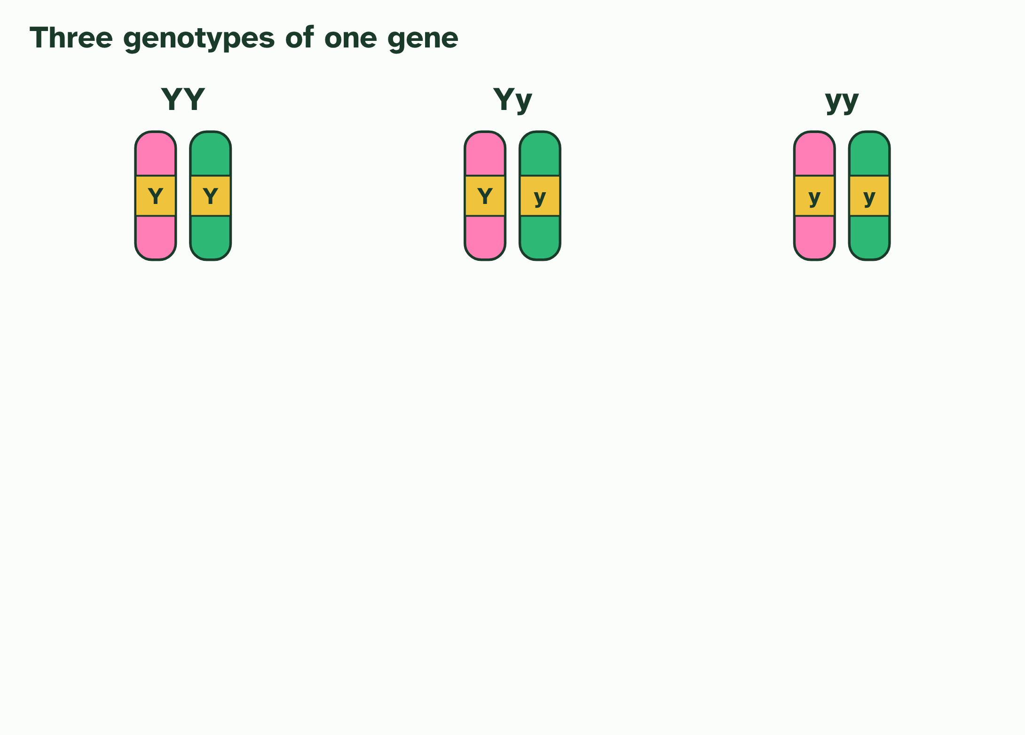
CHAPTER 4 · D3.2.5 Dominant and recessive alleles
1 / 3
Dominant and recessive alleles
Three genotypes of the seed colour gene: two homozygous and one heterozygous.
Minutes 5 to 20
Notes:
Minutes 5 to 20 of 60: Dominant and recessive, and the grid (15 min).
The plan: Chapter 4's figure and the cross builder under it. Students predict each result before the grid fills in. Then the practice below, in pairs: six crosses, each set out with gametes, grid, genotype ratio and phenotype ratio.
In Mendel's peas, a cross between a yellow-seeded plant and a green-seeded one gave an F1 in which every seed was yellow. The green trait had not vanished: about a quarter of the F2 seeds were green. Something was hiding it.
A dominant allele shows its effect when it is present, in one copy or in two. A recessive allele shows only when there is no dominant allele alongside it. So YY and Yy have the same phenotype, yellow, and only yy is green. By convention, a capital letter is the dominant allele and a small letter the recessive one.
Why is one copy enough? An allele works through the protein its gene makes. For many genes, a recessive allele is a version that does not make a working protein. A heterozygote has one working copy, and for many genes one working copy makes enough protein to give the trait. A homozygous recessive has no working copy, and the trait changes. There is no single mechanism for all genes, but this is the usual reason.

Slide 7
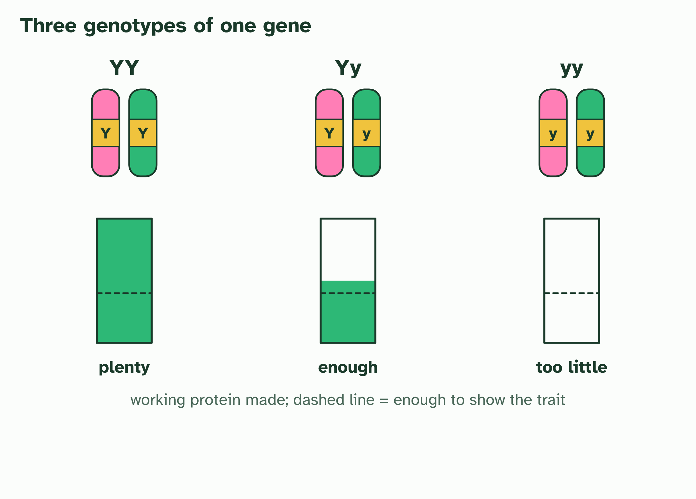
CHAPTER 4 · D3.2.5 Dominant and recessive alleles
2 / 3
Dominant and recessive alleles
Each gene makes a protein. A Y allele makes a working one, and one working copy makes enough to give the trait. With no working copy, the trait changes.
Minutes 5 to 20
Notes:
Minutes 5 to 20 of 60: Dominant and recessive, and the grid (15 min).
The plan: Chapter 4's figure and the cross builder under it. Students predict each result before the grid fills in. Then the practice below, in pairs: six crosses, each set out with gametes, grid, genotype ratio and phenotype ratio.
In Mendel's peas, a cross between a yellow-seeded plant and a green-seeded one gave an F1 in which every seed was yellow. The green trait had not vanished: about a quarter of the F2 seeds were green. Something was hiding it.
A dominant allele shows its effect when it is present, in one copy or in two. A recessive allele shows only when there is no dominant allele alongside it. So YY and Yy have the same phenotype, yellow, and only yy is green. By convention, a capital letter is the dominant allele and a small letter the recessive one.
Why is one copy enough? An allele works through the protein its gene makes. For many genes, a recessive allele is a version that does not make a working protein. A heterozygote has one working copy, and for many genes one working copy makes enough protein to give the trait. A homozygous recessive has no working copy, and the trait changes. There is no single mechanism for all genes, but this is the usual reason.

Slide 8
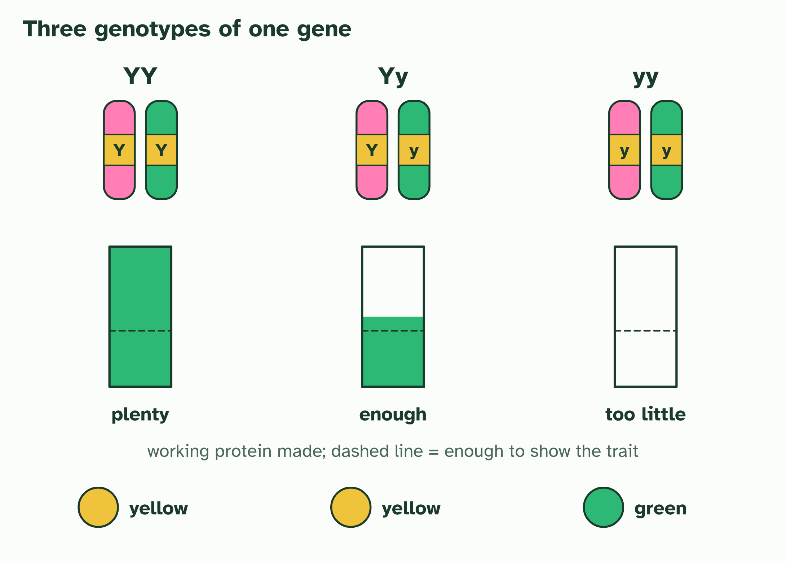
CHAPTER 4 · D3.2.5 Dominant and recessive alleles
3 / 3
Dominant and recessive alleles
The phenotypes: YY and Yy are both yellow, so the dominant allele shows in a heterozygote. Only yy is green.
Minutes 5 to 20
Notes:
Minutes 5 to 20 of 60: Dominant and recessive, and the grid (15 min).
The plan: Chapter 4's figure and the cross builder under it. Students predict each result before the grid fills in. Then the practice below, in pairs: six crosses, each set out with gametes, grid, genotype ratio and phenotype ratio.
In Mendel's peas, a cross between a yellow-seeded plant and a green-seeded one gave an F1 in which every seed was yellow. The green trait had not vanished: about a quarter of the F2 seeds were green. Something was hiding it.
A dominant allele shows its effect when it is present, in one copy or in two. A recessive allele shows only when there is no dominant allele alongside it. So YY and Yy have the same phenotype, yellow, and only yy is green. By convention, a capital letter is the dominant allele and a small letter the recessive one.
Why is one copy enough? An allele works through the protein its gene makes. For many genes, a recessive allele is a version that does not make a working protein. A heterozygote has one working copy, and for many genes one working copy makes enough protein to give the trait. A homozygous recessive has no working copy, and the trait changes. There is no single mechanism for all genes, but this is the usual reason.

Slide 9
CHAPTER 4 · D3.2.5 Dominant and recessive alleles
Dominant and recessive alleles
A dominant allele shows its effect when it is present, in one copy or in two.
A recessive allele shows only when there is no dominant allele alongside it.
By convention, a capital letter is the dominant allele and a small letter the recessive one.
For many genes, a recessive allele is a version that does not make a working protein.
Minutes 5 to 20
Notes:
Minutes 5 to 20 of 60: Dominant and recessive, and the grid (15 min).
The plan: Chapter 4's figure and the cross builder under it. Students predict each result before the grid fills in. Then the practice below, in pairs: six crosses, each set out with gametes, grid, genotype ratio and phenotype ratio.
In Mendel's peas, a cross between a yellow-seeded plant and a green-seeded one gave an F1 in which every seed was yellow. The green trait had not vanished: about a quarter of the F2 seeds were green. Something was hiding it.
A dominant allele shows its effect when it is present, in one copy or in two. A recessive allele shows only when there is no dominant allele alongside it. So YY and Yy have the same phenotype, yellow, and only yy is green. By convention, a capital letter is the dominant allele and a small letter the recessive one.
Why is one copy enough? An allele works through the protein its gene makes. For many genes, a recessive allele is a version that does not make a working protein. A heterozygote has one working copy, and for many genes one working copy makes enough protein to give the trait. A homozygous recessive has no working copy, and the trait changes. There is no single mechanism for all genes, but this is the usual reason.

Slide 10
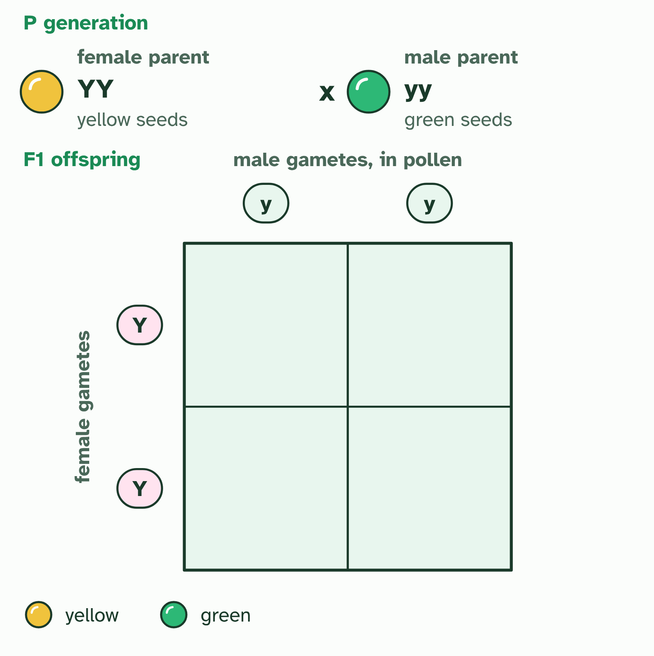
CHAPTER 4 · D3.2.5 Dominant and recessive alleles
1 / 2
Dominant and recessive alleles
Each parent makes gametes by meiosis, one allele of each gene in each. The female parent's go down the side of the Punnett grid, the male parent's along the top.
Minutes 5 to 20
Notes:
Minutes 5 to 20 of 60: Dominant and recessive, and the grid (15 min).
The plan: Chapter 4's figure and the cross builder under it. Students predict each result before the grid fills in. Then the practice below, in pairs: six crosses, each set out with gametes, grid, genotype ratio and phenotype ratio.
In Mendel's peas, a cross between a yellow-seeded plant and a green-seeded one gave an F1 in which every seed was yellow. The green trait had not vanished: about a quarter of the F2 seeds were green. Something was hiding it.
A dominant allele shows its effect when it is present, in one copy or in two. A recessive allele shows only when there is no dominant allele alongside it. So YY and Yy have the same phenotype, yellow, and only yy is green. By convention, a capital letter is the dominant allele and a small letter the recessive one.
Why is one copy enough? An allele works through the protein its gene makes. For many genes, a recessive allele is a version that does not make a working protein. A heterozygote has one working copy, and for many genes one working copy makes enough protein to give the trait. A homozygous recessive has no working copy, and the trait changes. There is no single mechanism for all genes, but this is the usual reason.

Slide 11
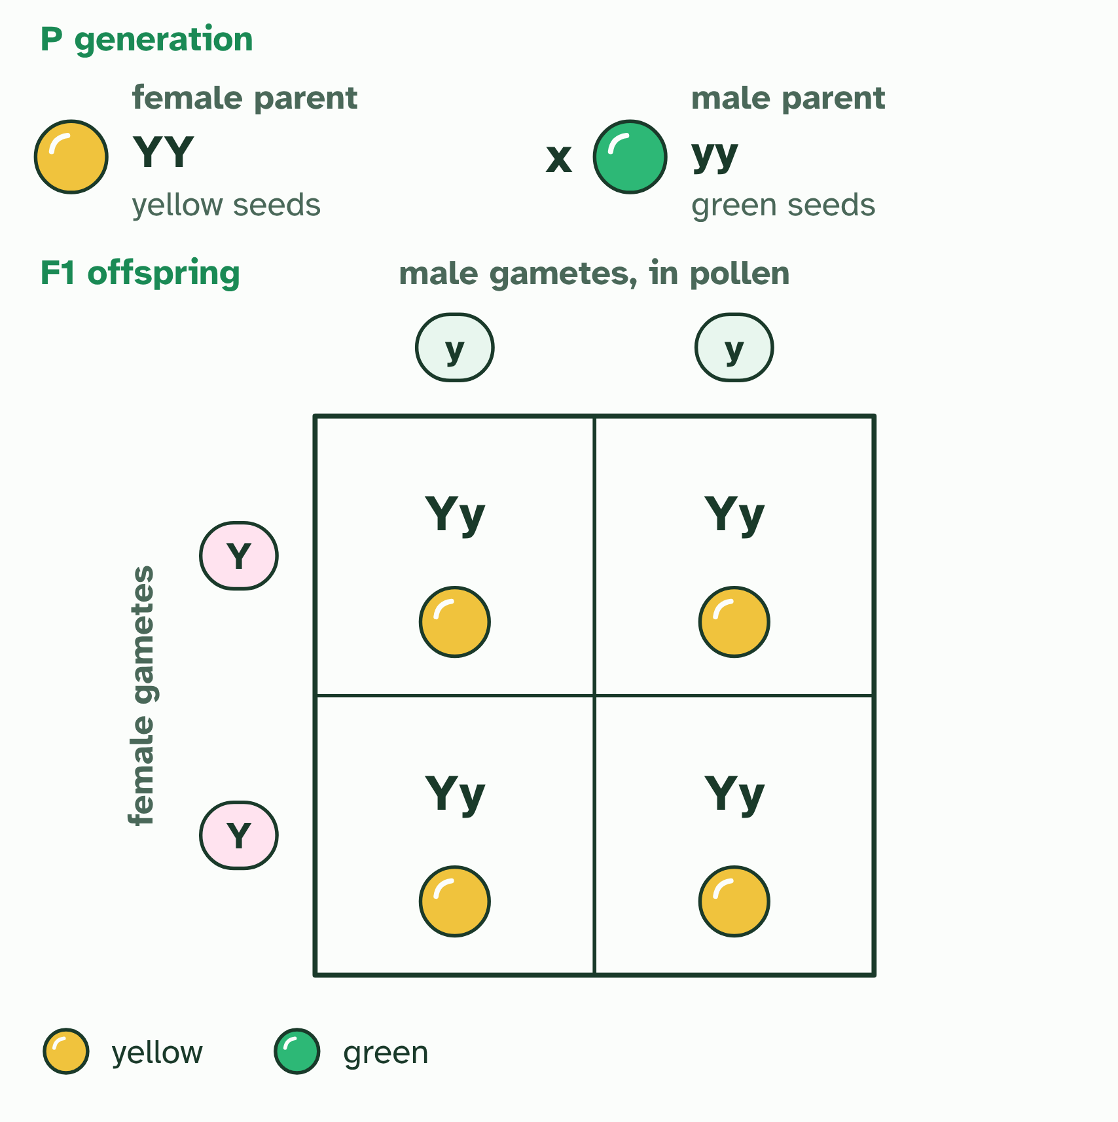
CHAPTER 4 · D3.2.5 Dominant and recessive alleles
2 / 2
Dominant and recessive alleles
Each cell joins one gamete from each parent: a possible offspring, every cell as likely as the next. The F1: genotypes all Yy; phenotypes all yellow.
Minutes 5 to 20
Notes:
Minutes 5 to 20 of 60: Dominant and recessive, and the grid (15 min).
The plan: Chapter 4's figure and the cross builder under it. Students predict each result before the grid fills in. Then the practice below, in pairs: six crosses, each set out with gametes, grid, genotype ratio and phenotype ratio.
In Mendel's peas, a cross between a yellow-seeded plant and a green-seeded one gave an F1 in which every seed was yellow. The green trait had not vanished: about a quarter of the F2 seeds were green. Something was hiding it.
A dominant allele shows its effect when it is present, in one copy or in two. A recessive allele shows only when there is no dominant allele alongside it. So YY and Yy have the same phenotype, yellow, and only yy is green. By convention, a capital letter is the dominant allele and a small letter the recessive one.
Why is one copy enough? An allele works through the protein its gene makes. For many genes, a recessive allele is a version that does not make a working protein. A heterozygote has one working copy, and for many genes one working copy makes enough protein to give the trait. A homozygous recessive has no working copy, and the trait changes. There is no single mechanism for all genes, but this is the usual reason.

Slide 12
CHAPTER 4 · D3.2.5 Dominant and recessive alleles
Dominant and recessive alleles
A dominant allele shows its effect when it is present, in one copy or in two.
A recessive allele shows only when there is no dominant allele alongside it.
By convention, a capital letter is the dominant allele and a small letter the recessive one.
For many genes, a recessive allele is a version that does not make a working protein.
Minutes 5 to 20
Notes:
Minutes 5 to 20 of 60: Dominant and recessive, and the grid (15 min).
The plan: Chapter 4's figure and the cross builder under it. Students predict each result before the grid fills in. Then the practice below, in pairs: six crosses, each set out with gametes, grid, genotype ratio and phenotype ratio.
In Mendel's peas, a cross between a yellow-seeded plant and a green-seeded one gave an F1 in which every seed was yellow. The green trait had not vanished: about a quarter of the F2 seeds were green. Something was hiding it.
A dominant allele shows its effect when it is present, in one copy or in two. A recessive allele shows only when there is no dominant allele alongside it. So YY and Yy have the same phenotype, yellow, and only yy is green. By convention, a capital letter is the dominant allele and a small letter the recessive one.
Why is one copy enough? An allele works through the protein its gene makes. For many genes, a recessive allele is a version that does not make a working protein. A heterozygote has one working copy, and for many genes one working copy makes enough protein to give the trait. A homozygous recessive has no working copy, and the trait changes. There is no single mechanism for all genes, but this is the usual reason.

Slide 13
WATCH OUT
Dominant does not mean common, strong or better. Some dominant alleles are rare, and some cause disease. Dominant only describes what shows in a heterozygote. Recessive alleles do not fade away either: in a heterozygote they are still there, and they can reappear in a later generation.
Minutes 5 to 20
Notes:
Minutes 5 to 20 of 60: Dominant and recessive, and the grid (15 min).
The plan: Chapter 4's figure and the cross builder under it. Students predict each result before the grid fills in. Then the practice below, in pairs: six crosses, each set out with gametes, grid, genotype ratio and phenotype ratio.
A common mistake: say it, then ask who can say why it is wrong.

Slide 14

PRACTICE
15 MIN
Six crosses
THE TASK
Six crosses, each with two parents, the gametes, a Punnett grid, the genotype ratio and the phenotype ratio. Use pea seed colour (Y yellow dominant, y green): (1) YY by yy. All Yy, all yellow. (2) Yy by yy. 1 Yy: 1 yy, 1 yellow: 1 green. (3) Yy by Yy. 1 YY: 2 Yy: 1 yy, 3 yellow: 1 green. (4) yy by yy. All green. (5) A yellow plant by a green gave 18 yellow and 20 green offspring: what was the yellow parent? Yy. (6) Two yellow plants gave some green offspring: give the genotypes of both parents and the chance of a green seed. Both Yy; one in four. Finish by asking what would be different if you counted 8 offspring instead of 800.
STUDENTS NEED
Mini whiteboards or squared paper.
Minutes 5 to 20
Notes:
Minutes 5 to 20 of 60: Dominant and recessive, and the grid (15 min).
The plan: Chapter 4's figure and the cross builder under it. Students predict each result before the grid fills in. Then the practice below, in pairs: six crosses, each set out with gametes, grid, genotype ratio and phenotype ratio.
The activity: Six crosses. Six crosses, each with two parents, the gametes, a Punnett grid, the genotype ratio and the phenotype ratio. Use pea seed colour (Y yellow dominant, y green): (1) YY by yy. All Yy, all yellow. (2) Yy by yy. 1 Yy : 1 yy, 1 yellow : 1 green. (3) Yy by Yy. 1 YY : 2 Yy : 1 yy, 3 yellow : 1 green. (4) yy by yy. All green. (5) A yellow plant by a green gave 18 yellow and 20 green offspring: what was the yellow parent? Yy. (6) Two yellow plants gave some green offspring: give the genotypes of both parents and the chance of a green seed. Both Yy; one in four. Finish by asking what would be different if you counted 8 offspring instead of 800.
Needs: mini whiteboards or squared paper.
The time: 15 minutes, minutes 5 to 20 of the plan.

Slide 15
STEP 3
12 MIN
Same genes, different outcomes
Ask: do the two trays have the same genes?
Land on "the genes were the same; what differed was which were expressed".
Minutes 20 to 32
Notes:
Minutes 20 to 32 of 60: Same genes, different outcomes (12 min).
The plan: Chapter 5's figure. Show the cress seedlings, or photographs of them, from the practical below (set up the week before, or use the photographs on the card). Ask: do the two trays have the same genes? Land on "the genes were the same; what differed was which were expressed".

Slide 16
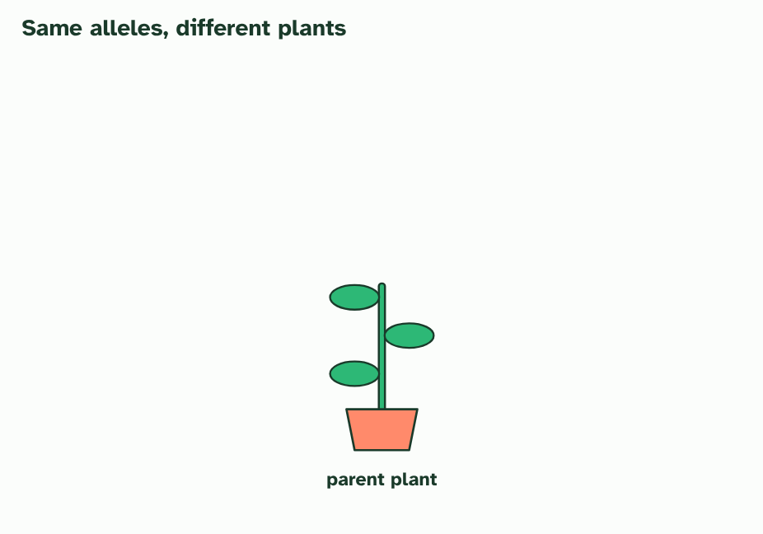
CHAPTER 5 · D3.2.6 Phenotypic plasticity
1 / 4
Same genes, different outcomes
One parent plant, with its alleles.
Minutes 20 to 32
Notes:
Minutes 20 to 32 of 60: Same genes, different outcomes (12 min).
The plan: Chapter 5's figure. Show the cress seedlings, or photographs of them, from the practical below (set up the week before, or use the photographs on the card). Ask: do the two trays have the same genes? Land on "the genes were the same; what differed was which were expressed".
Genotype is not destiny. One individual, with one set of alleles, can develop different traits in different conditions, and the change often suits the conditions. That is phenotypic plasticity.
Take two cuttings from one plant. They have identical alleles. Grow one in full sun and the other in shade. A shaded plant tends to grow taller, with longer gaps between its leaves and broader leaves, reaching for light. The sunlit plant stays shorter and sturdier. Neither plant changed its genotype.
The difference is in gene expression: which genes are switched on, where, and how strongly. Light conditions change the pattern, so the same DNA builds a different body. The base sequence has not changed, which means plasticity is not a mutation.
Because the alleles are the same, the change can be reversible during the life of the individual: move the shaded plant into the sun, and its new growth comes in short and sturdy, like the sun plant's. Growth that has already happened stays as it was.
Example: Your skin tans in strong sun and fades again afterwards, with no change in your DNA. An Arctic hare's coat is white in winter and darker in summer, so the same animal is camouflaged in each season.

Slide 17
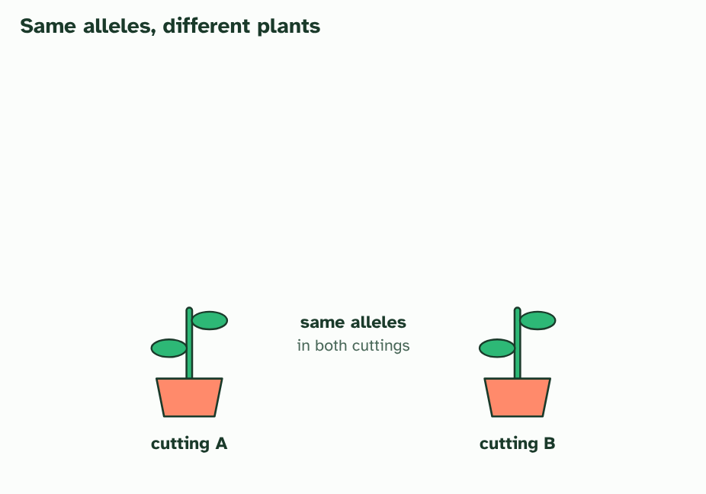
CHAPTER 5 · D3.2.6 Phenotypic plasticity
2 / 4
Same genes, different outcomes
Two cuttings from it carry exactly the same alleles.
Minutes 20 to 32
Notes:
Minutes 20 to 32 of 60: Same genes, different outcomes (12 min).
The plan: Chapter 5's figure. Show the cress seedlings, or photographs of them, from the practical below (set up the week before, or use the photographs on the card). Ask: do the two trays have the same genes? Land on "the genes were the same; what differed was which were expressed".
Genotype is not destiny. One individual, with one set of alleles, can develop different traits in different conditions, and the change often suits the conditions. That is phenotypic plasticity.
Take two cuttings from one plant. They have identical alleles. Grow one in full sun and the other in shade. A shaded plant tends to grow taller, with longer gaps between its leaves and broader leaves, reaching for light. The sunlit plant stays shorter and sturdier. Neither plant changed its genotype.
The difference is in gene expression: which genes are switched on, where, and how strongly. Light conditions change the pattern, so the same DNA builds a different body. The base sequence has not changed, which means plasticity is not a mutation.
Because the alleles are the same, the change can be reversible during the life of the individual: move the shaded plant into the sun, and its new growth comes in short and sturdy, like the sun plant's. Growth that has already happened stays as it was.
Example: Your skin tans in strong sun and fades again afterwards, with no change in your DNA. An Arctic hare's coat is white in winter and darker in summer, so the same animal is camouflaged in each season.

Slide 18
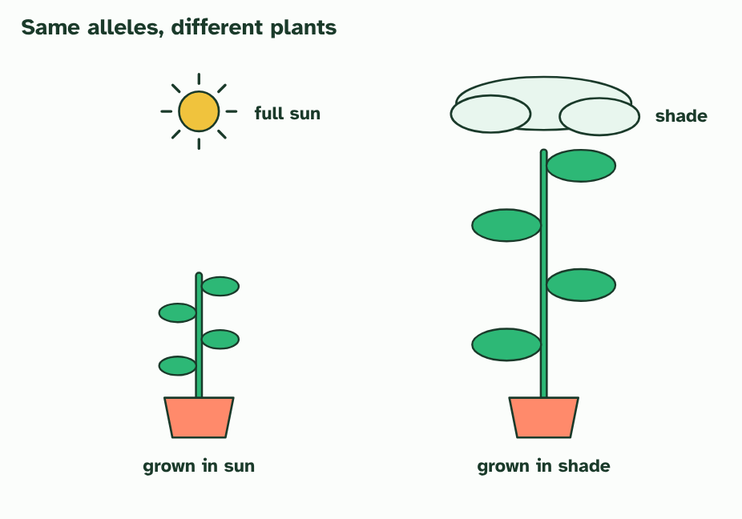
CHAPTER 5 · D3.2.6 Phenotypic plasticity
3 / 4
Same genes, different outcomes
One cutting grows in sun and one in shade. Same alleles, but different gene expression makes a short, sturdy plant and a tall one with broad leaves.
Minutes 20 to 32
Notes:
Minutes 20 to 32 of 60: Same genes, different outcomes (12 min).
The plan: Chapter 5's figure. Show the cress seedlings, or photographs of them, from the practical below (set up the week before, or use the photographs on the card). Ask: do the two trays have the same genes? Land on "the genes were the same; what differed was which were expressed".
Genotype is not destiny. One individual, with one set of alleles, can develop different traits in different conditions, and the change often suits the conditions. That is phenotypic plasticity.
Take two cuttings from one plant. They have identical alleles. Grow one in full sun and the other in shade. A shaded plant tends to grow taller, with longer gaps between its leaves and broader leaves, reaching for light. The sunlit plant stays shorter and sturdier. Neither plant changed its genotype.
The difference is in gene expression: which genes are switched on, where, and how strongly. Light conditions change the pattern, so the same DNA builds a different body. The base sequence has not changed, which means plasticity is not a mutation.
Because the alleles are the same, the change can be reversible during the life of the individual: move the shaded plant into the sun, and its new growth comes in short and sturdy, like the sun plant's. Growth that has already happened stays as it was.
Example: Your skin tans in strong sun and fades again afterwards, with no change in your DNA. An Arctic hare's coat is white in winter and darker in summer, so the same animal is camouflaged in each season.

Slide 19
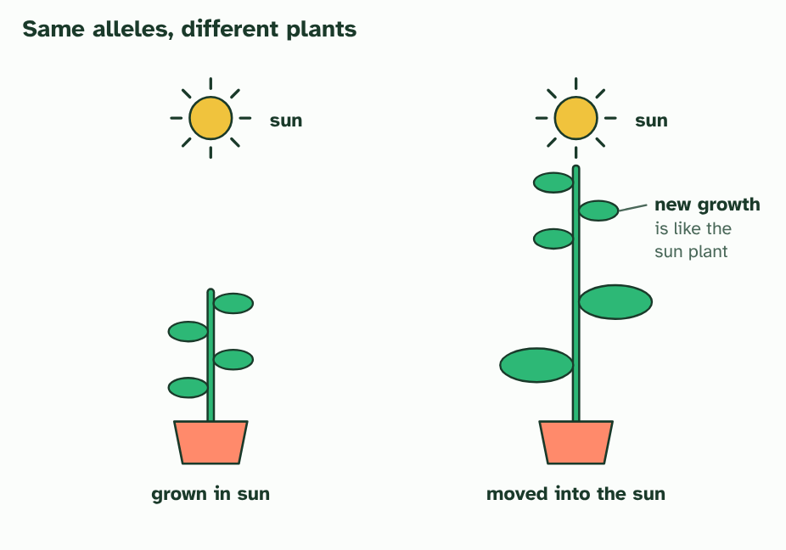
CHAPTER 5 · D3.2.6 Phenotypic plasticity
4 / 4
Same genes, different outcomes
Move the shaded plant into the sun, and its new growth comes in like the sun plant’s. The change is reversible, and the alleles never changed.
Minutes 20 to 32
Notes:
Minutes 20 to 32 of 60: Same genes, different outcomes (12 min).
The plan: Chapter 5's figure. Show the cress seedlings, or photographs of them, from the practical below (set up the week before, or use the photographs on the card). Ask: do the two trays have the same genes? Land on "the genes were the same; what differed was which were expressed".
Genotype is not destiny. One individual, with one set of alleles, can develop different traits in different conditions, and the change often suits the conditions. That is phenotypic plasticity.
Take two cuttings from one plant. They have identical alleles. Grow one in full sun and the other in shade. A shaded plant tends to grow taller, with longer gaps between its leaves and broader leaves, reaching for light. The sunlit plant stays shorter and sturdier. Neither plant changed its genotype.
The difference is in gene expression: which genes are switched on, where, and how strongly. Light conditions change the pattern, so the same DNA builds a different body. The base sequence has not changed, which means plasticity is not a mutation.
Because the alleles are the same, the change can be reversible during the life of the individual: move the shaded plant into the sun, and its new growth comes in short and sturdy, like the sun plant's. Growth that has already happened stays as it was.
Example: Your skin tans in strong sun and fades again afterwards, with no change in your DNA. An Arctic hare's coat is white in winter and darker in summer, so the same animal is camouflaged in each season.

Slide 20
CHAPTER 5 · D3.2.6 Phenotypic plasticity
Same genes, different outcomes
One individual, with one set of alleles, can develop different traits in different conditions, and the change often suits the conditions. That is phenotypic plasticity.
The difference is in gene expression: which genes are switched on, where, and how strongly.
Take two cuttings from one plant.
Minutes 20 to 32
Notes:
Minutes 20 to 32 of 60: Same genes, different outcomes (12 min).
The plan: Chapter 5's figure. Show the cress seedlings, or photographs of them, from the practical below (set up the week before, or use the photographs on the card). Ask: do the two trays have the same genes? Land on "the genes were the same; what differed was which were expressed".
Genotype is not destiny. One individual, with one set of alleles, can develop different traits in different conditions, and the change often suits the conditions. That is phenotypic plasticity.
Take two cuttings from one plant. They have identical alleles. Grow one in full sun and the other in shade. A shaded plant tends to grow taller, with longer gaps between its leaves and broader leaves, reaching for light. The sunlit plant stays shorter and sturdier. Neither plant changed its genotype.
The difference is in gene expression: which genes are switched on, where, and how strongly. Light conditions change the pattern, so the same DNA builds a different body. The base sequence has not changed, which means plasticity is not a mutation.
Because the alleles are the same, the change can be reversible during the life of the individual: move the shaded plant into the sun, and its new growth comes in short and sturdy, like the sun plant's. Growth that has already happened stays as it was.
Example: Your skin tans in strong sun and fades again afterwards, with no change in your DNA. An Arctic hare's coat is white in winter and darker in summer, so the same animal is camouflaged in each season.

Slide 21
PREDICT
Two clones grow differently, one in sun and one in shade. What explains the difference?
A One seedling has mutated and now has different alleles
B The light changed how their genes were expressed
C The shaded seedling lost the alleles for sturdy growth
Minutes 20 to 32
Notes:
Minutes 20 to 32 of 60: Same genes, different outcomes (12 min).
The plan: Chapter 5's figure. Show the cress seedlings, or photographs of them, from the practical below (set up the week before, or use the photographs on the card). Ask: do the two trays have the same genes? Land on "the genes were the same; what differed was which were expressed".
Ask for a show of hands, or mini whiteboards, before revealing. (Answer: B, on the next slide.)

Slide 22
WHAT HAPPENS
Two clones grow differently, one in sun and one in shade. What explains the difference?
A One seedling has mutated and now has different alleles
B The light changed how their genes were expressed
C The shaded seedling lost the alleles for sturdy growth
The light changed how their genes were expressed. Clones start with identical alleles, and nothing in this story changes them. The environment changes which genes are switched on and how strongly, and that changes the phenotype.
Minutes 20 to 32
Notes:
Minutes 20 to 32 of 60: Same genes, different outcomes (12 min).
The plan: Chapter 5's figure. Show the cress seedlings, or photographs of them, from the practical below (set up the week before, or use the photographs on the card). Ask: do the two trays have the same genes? Land on "the genes were the same; what differed was which were expressed".
Answer: B. The light changed how their genes were expressed. Clones start with identical alleles, and nothing in this story changes them. The environment changes which genes are switched on and how strongly, and that changes the phenotype.

Slide 23
WATCH OUT
A plastic change is not passed to the next generation through the alleles: the shaded plant's seeds do not inherit its stretching. The individual does not choose to change either. The capacity to respond is itself in the genotype, and the environment triggers it.
Minutes 20 to 32
Notes:
Minutes 20 to 32 of 60: Same genes, different outcomes (12 min).
The plan: Chapter 5's figure. Show the cress seedlings, or photographs of them, from the practical below (set up the week before, or use the photographs on the card). Ask: do the two trays have the same genes? Land on "the genes were the same; what differed was which were expressed".
A common mistake: say it, then ask who can say why it is wrong.

Slide 24
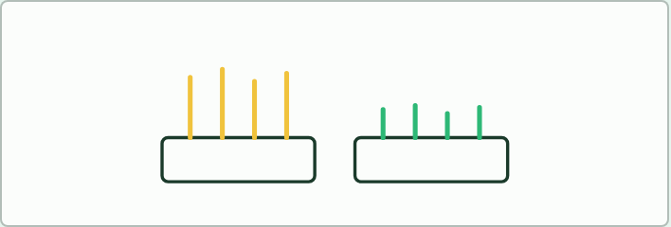
PRACTICAL
12 MIN
Cress in the dark and the light
THE TASK
Sow cress seeds in two trays of damp cotton wool. Put one on a windowsill and the other in a cupboard, and water both. After a week, students record height, colour and leaf size, then answer: the seeds were from one packet, so why do the trays differ? Move the pale tray into the light and watch it for three days. Which parts of the seedling change, and which parts do not? Link to chapter 5: expression changes, the alleles do not. Photographs on the board are an acceptable substitute if no cupboard is free.
STUDENTS NEED
Cress seeds, trays, cotton wool, a dark cupboard and a windowsill, a ruler; set up a week ahead.
Minutes 20 to 32
Notes:
Minutes 20 to 32 of 60: Same genes, different outcomes (12 min).
The plan: Chapter 5's figure. Show the cress seedlings, or photographs of them, from the practical below (set up the week before, or use the photographs on the card). Ask: do the two trays have the same genes? Land on "the genes were the same; what differed was which were expressed".
The activity: Cress in the dark and the light. Sow cress seeds in two trays of damp cotton wool. Put one on a windowsill and the other in a cupboard, and water both. After a week, students record height, colour and leaf size, then answer: the seeds were from one packet, so why do the trays differ? Move the pale tray into the light and watch it for three days. Which parts of the seedling change, and which parts do not? Link to chapter 5: expression changes, the alleles do not. Photographs on the board are an acceptable substitute if no cupboard is free.
Needs: cress seeds, trays, cotton wool, a dark cupboard and a windowsill, a ruler; set up a week ahead.
The time: 12 minutes, minutes 20 to 32 of the plan.

Slide 25
STEP 4
20 MIN
One faulty enzyme: PKU
Chapter 6: One faulty enzyme: PKU
Case cards: PKU in the family
Minutes 32 to 52
Notes:
Minutes 32 to 52 of 60: One faulty enzyme: PKU (20 min).
The plan: Chapter 6's figure, step by step, then the two-carrier cross at the board. Then the case cards below, in groups: each card describes a family and asks for the chance that a child has PKU. Finish with screening and diet.

Slide 26
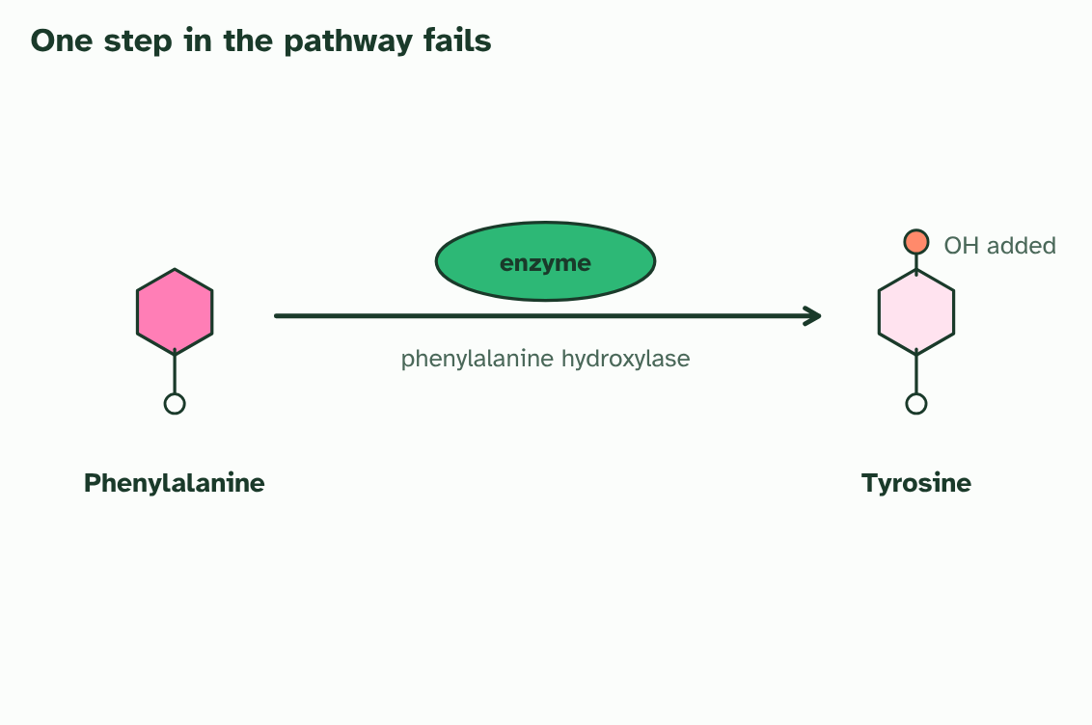
CHAPTER 6 · D3.2.7 Phenylketonuria: a recessive disease
1 / 4
One faulty enzyme: PKU
In a person with a working allele, the enzyme converts phenylalanine to tyrosine, which has one extra OH group.
Minutes 32 to 52
Notes:
Minutes 32 to 52 of 60: One faulty enzyme: PKU (20 min).
The plan: Chapter 6's figure, step by step, then the two-carrier cross at the board. Then the case cards below, in groups: each card describes a family and asks for the chance that a child has PKU. Finish with screening and diet.
Phenylketonuria (PKU) is a human disease caused by a recessive allele of an autosomal gene. The gene codes for an enzyme, phenylalanine hydroxylase, which converts the amino acid phenylalanine into another amino acid, tyrosine.
A person with at least one working allele makes enough enzyme. A person who is homozygous for the faulty allele makes none that works. Phenylalanine from food cannot be converted, so it builds up, and in a baby the high levels can damage the developing brain.
Because the allele is recessive, a person with one working and one faulty allele has no symptoms. That person is a carrier. Two carrier parents have a 1 in 4 chance of a child with PKU each time they have a baby, and most carriers do not know that they are one.
PKU shows genotype and environment working together. The genotype cannot be changed, but the environment can. Babies are screened soon after birth, and a child found to have PKU is given a diet low in phenylalanine, which protects the developing brain. The phenotype depends on the diet as well as on the alleles.
Example: Two carriers, Nn × Nn. Each makes N and n gametes in equal numbers. The offspring are NN (1 in 4), Nn (2 in 4) and nn (1 in 4). Only nn has PKU. Of the children who do not have PKU, two in three are carriers.

Slide 27
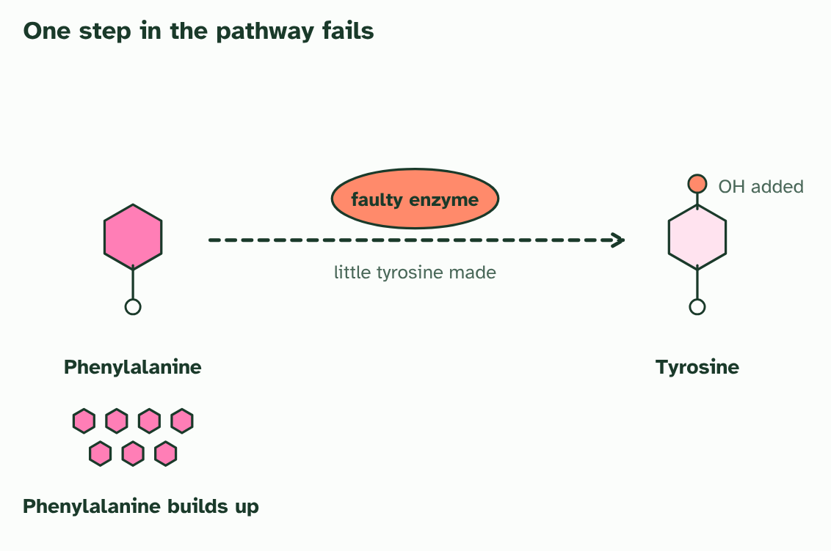
CHAPTER 6 · D3.2.7 Phenylketonuria: a recessive disease
2 / 4
One faulty enzyme: PKU
In a person with two faulty alleles the enzyme does not work. Little tyrosine is made and phenylalanine builds up.
Minutes 32 to 52
Notes:
Minutes 32 to 52 of 60: One faulty enzyme: PKU (20 min).
The plan: Chapter 6's figure, step by step, then the two-carrier cross at the board. Then the case cards below, in groups: each card describes a family and asks for the chance that a child has PKU. Finish with screening and diet.
Phenylketonuria (PKU) is a human disease caused by a recessive allele of an autosomal gene. The gene codes for an enzyme, phenylalanine hydroxylase, which converts the amino acid phenylalanine into another amino acid, tyrosine.
A person with at least one working allele makes enough enzyme. A person who is homozygous for the faulty allele makes none that works. Phenylalanine from food cannot be converted, so it builds up, and in a baby the high levels can damage the developing brain.
Because the allele is recessive, a person with one working and one faulty allele has no symptoms. That person is a carrier. Two carrier parents have a 1 in 4 chance of a child with PKU each time they have a baby, and most carriers do not know that they are one.
PKU shows genotype and environment working together. The genotype cannot be changed, but the environment can. Babies are screened soon after birth, and a child found to have PKU is given a diet low in phenylalanine, which protects the developing brain. The phenotype depends on the diet as well as on the alleles.
Example: Two carriers, Nn × Nn. Each makes N and n gametes in equal numbers. The offspring are NN (1 in 4), Nn (2 in 4) and nn (1 in 4). Only nn has PKU. Of the children who do not have PKU, two in three are carriers.

Slide 28
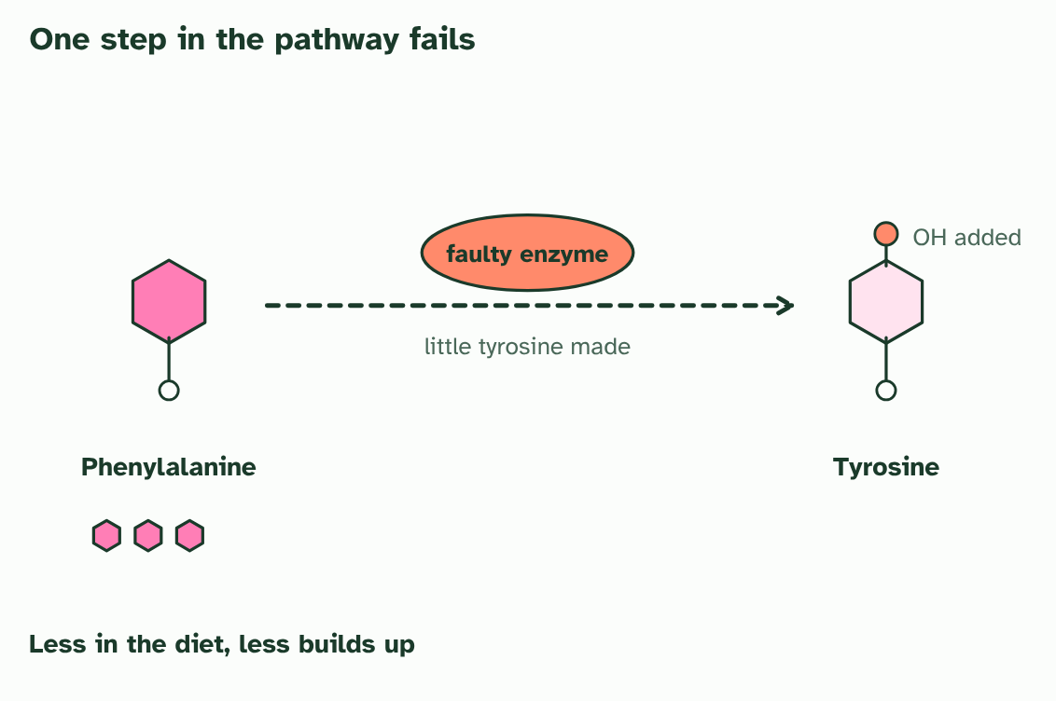
CHAPTER 6 · D3.2.7 Phenylketonuria: a recessive disease
3 / 4
One faulty enzyme: PKU
A diet low in phenylalanine gives the body less to build up. The genotype is the same, and the phenotype changes.
Minutes 32 to 52
Notes:
Minutes 32 to 52 of 60: One faulty enzyme: PKU (20 min).
The plan: Chapter 6's figure, step by step, then the two-carrier cross at the board. Then the case cards below, in groups: each card describes a family and asks for the chance that a child has PKU. Finish with screening and diet.
Phenylketonuria (PKU) is a human disease caused by a recessive allele of an autosomal gene. The gene codes for an enzyme, phenylalanine hydroxylase, which converts the amino acid phenylalanine into another amino acid, tyrosine.
A person with at least one working allele makes enough enzyme. A person who is homozygous for the faulty allele makes none that works. Phenylalanine from food cannot be converted, so it builds up, and in a baby the high levels can damage the developing brain.
Because the allele is recessive, a person with one working and one faulty allele has no symptoms. That person is a carrier. Two carrier parents have a 1 in 4 chance of a child with PKU each time they have a baby, and most carriers do not know that they are one.
PKU shows genotype and environment working together. The genotype cannot be changed, but the environment can. Babies are screened soon after birth, and a child found to have PKU is given a diet low in phenylalanine, which protects the developing brain. The phenotype depends on the diet as well as on the alleles.
Example: Two carriers, Nn × Nn. Each makes N and n gametes in equal numbers. The offspring are NN (1 in 4), Nn (2 in 4) and nn (1 in 4). Only nn has PKU. Of the children who do not have PKU, two in three are carriers.

Slide 29
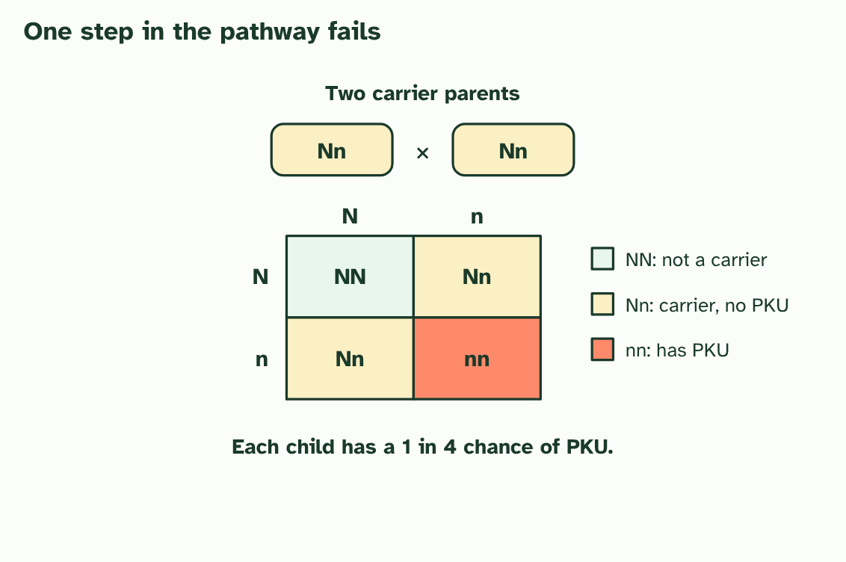
CHAPTER 6 · D3.2.7 Phenylketonuria: a recessive disease
4 / 4
One faulty enzyme: PKU
Two carrier parents (Nn): each child has a 1 in 4 chance of nn, so of PKU.
Minutes 32 to 52
Notes:
Minutes 32 to 52 of 60: One faulty enzyme: PKU (20 min).
The plan: Chapter 6's figure, step by step, then the two-carrier cross at the board. Then the case cards below, in groups: each card describes a family and asks for the chance that a child has PKU. Finish with screening and diet.
Phenylketonuria (PKU) is a human disease caused by a recessive allele of an autosomal gene. The gene codes for an enzyme, phenylalanine hydroxylase, which converts the amino acid phenylalanine into another amino acid, tyrosine.
A person with at least one working allele makes enough enzyme. A person who is homozygous for the faulty allele makes none that works. Phenylalanine from food cannot be converted, so it builds up, and in a baby the high levels can damage the developing brain.
Because the allele is recessive, a person with one working and one faulty allele has no symptoms. That person is a carrier. Two carrier parents have a 1 in 4 chance of a child with PKU each time they have a baby, and most carriers do not know that they are one.
PKU shows genotype and environment working together. The genotype cannot be changed, but the environment can. Babies are screened soon after birth, and a child found to have PKU is given a diet low in phenylalanine, which protects the developing brain. The phenotype depends on the diet as well as on the alleles.
Example: Two carriers, Nn × Nn. Each makes N and n gametes in equal numbers. The offspring are NN (1 in 4), Nn (2 in 4) and nn (1 in 4). Only nn has PKU. Of the children who do not have PKU, two in three are carriers.

Slide 30
CHAPTER 6 · D3.2.7 Phenylketonuria: a recessive disease
One faulty enzyme: PKU
Phenylketonuria (PKU) is a human disease caused by a recessive allele of an autosomal gene.
Because the allele is recessive, a person with one working and one faulty allele has no symptoms. That person is a carrier.
Two carrier parents have a 1 in 4 chance of a child with PKU each time they have a baby, and most carriers do not know that they are one.
Minutes 32 to 52
Notes:
Minutes 32 to 52 of 60: One faulty enzyme: PKU (20 min).
The plan: Chapter 6's figure, step by step, then the two-carrier cross at the board. Then the case cards below, in groups: each card describes a family and asks for the chance that a child has PKU. Finish with screening and diet.
Phenylketonuria (PKU) is a human disease caused by a recessive allele of an autosomal gene. The gene codes for an enzyme, phenylalanine hydroxylase, which converts the amino acid phenylalanine into another amino acid, tyrosine.
A person with at least one working allele makes enough enzyme. A person who is homozygous for the faulty allele makes none that works. Phenylalanine from food cannot be converted, so it builds up, and in a baby the high levels can damage the developing brain.
Because the allele is recessive, a person with one working and one faulty allele has no symptoms. That person is a carrier. Two carrier parents have a 1 in 4 chance of a child with PKU each time they have a baby, and most carriers do not know that they are one.
PKU shows genotype and environment working together. The genotype cannot be changed, but the environment can. Babies are screened soon after birth, and a child found to have PKU is given a diet low in phenylalanine, which protects the developing brain. The phenotype depends on the diet as well as on the alleles.
Example: Two carriers, Nn × Nn. Each makes N and n gametes in equal numbers. The offspring are NN (1 in 4), Nn (2 in 4) and nn (1 in 4). Only nn has PKU. Of the children who do not have PKU, two in three are carriers.

Slide 31
PREDICT
Two parents do not have PKU, but their first child does. What is the chance that their second child has PKU?
A 1 in 2, because one of the two parents must be affected
B None, because the first child used up the recessive alleles
C 1 in 4, because both parents must be carriers
Minutes 32 to 52
Notes:
Minutes 32 to 52 of 60: One faulty enzyme: PKU (20 min).
The plan: Chapter 6's figure, step by step, then the two-carrier cross at the board. Then the case cards below, in groups: each card describes a family and asks for the chance that a child has PKU. Finish with screening and diet.
Ask for a show of hands, or mini whiteboards, before revealing. (Answer: C, on the next slide.)

Slide 32
WHAT HAPPENS
Two parents do not have PKU, but their first child does. What is the chance that their second child has PKU?
A 1 in 2, because one of the two parents must be affected
B None, because the first child used up the recessive alleles
C 1 in 4, because both parents must be carriers
1 in 4. The child is nn, so each unaffected parent must be Nn. Two Nn parents have a 1 in 4 chance of nn for every child. Alleles are not used up: each new baby is made from fresh gametes.
Minutes 32 to 52
Notes:
Minutes 32 to 52 of 60: One faulty enzyme: PKU (20 min).
The plan: Chapter 6's figure, step by step, then the two-carrier cross at the board. Then the case cards below, in groups: each card describes a family and asks for the chance that a child has PKU. Finish with screening and diet.
Answer: C. 1 in 4. The child is nn, so each unaffected parent must be Nn. Two Nn parents have a 1 in 4 chance of nn for every child. Alleles are not used up: each new baby is made from fresh gametes.

Slide 33
WATCH OUT
The chance is 1 in 4 for each child, every time. One child with PKU does not make the next three safe.
Minutes 32 to 52
Notes:
Minutes 32 to 52 of 60: One faulty enzyme: PKU (20 min).
The plan: Chapter 6's figure, step by step, then the two-carrier cross at the board. Then the case cards below, in groups: each card describes a family and asks for the chance that a child has PKU. Finish with screening and diet.
A common mistake: say it, then ask who can say why it is wrong.

Slide 34

CASE CARDS
20 MIN
PKU in the family
THE TASK
Six cards, each a short invented family: two unaffected parents and a child with PKU; two parents who both have PKU; one parent who is a carrier and one who has two normal alleles; and so on. Groups set out the genotype of each parent with N for the normal allele and n for the PKU allele, draw the cross, and give the chance of a child with PKU. Add a question about how the disease would be found at birth and what a family does about it. Keep every card invented and avoid naming real people.
STUDENTS NEED
Printed cards, one set per group.
Minutes 32 to 52
Notes:
Minutes 32 to 52 of 60: One faulty enzyme: PKU (20 min).
The plan: Chapter 6's figure, step by step, then the two-carrier cross at the board. Then the case cards below, in groups: each card describes a family and asks for the chance that a child has PKU. Finish with screening and diet.
The activity: PKU in the family. Six cards, each a short invented family: two unaffected parents and a child with PKU; two parents who both have PKU; one parent who is a carrier and one who has two normal alleles; and so on. Groups set out the genotype of each parent with N for the normal allele and n for the PKU allele, draw the cross, and give the chance of a child with PKU. Add a question about how the disease would be found at birth and what a family does about it. Keep every card invented and avoid naming real people.
Needs: printed cards, one set per group.
The time: 20 minutes, minutes 32 to 52 of the plan.

Slide 35
PLENARY
Can you now...
Predict the effects of dominant and recessive alleles on phenotype (D3.2.5)
Explain phenotypic plasticity as a change in gene expression, not in the genes themselves (D3.2.6)
Explain phenylketonuria as a disease caused by a recessive allele (D3.2.7)
Minutes 52 to 60
Notes:
Minutes 52 to 60 of 60: Exit (8 min).
The plan: On a slip: the chance that the child of two carriers is a carrier, and the chance that it has PKU. Then one sentence on why a low phenylalanine diet helps.
Thumbs up, sideways or down on each goal before the exit question. The goals come from the statements this lesson covers.

Slide 36
EXIT QUESTION
Before you go
On a slip: the chance that the child of two carriers is a carrier, and the chance that it has PKU.
Minutes 52 to 60
Notes:
Minutes 52 to 60 of 60: Exit (8 min).
The plan: On a slip: the chance that the child of two carriers is a carrier, and the chance that it has PKU. Then one sentence on why a low phenylalanine diet helps.

Slide 37
PRACTISE AND REVISE
Keep going
Exam practice: a fresh paper of exam questions on D3.2 at standard level, marked as you go
The guide, with the animations and the dry lab
This lesson in the guide: 4 Dominant and recessive alleles, 5 Same genes, different outcomes, 6 One faulty enzyme: PKU
BUILD FOR YOUR CLASS
ALREADY ON THE SITE FOR D3.2
CARD SETS ON SPLYCR
Tarsia puzzle, dominoes and picture reveal on D3.2, built from its key terms and ready to print
A pub quiz with rounds on D3.2, to present or run with no projector
An escape room built from the question bank on D3.2
Lesson: Linked Genes & Chi-Squared
Lesson: Dihybrid Crosses & Test Crosses
Lesson: Inheritance
Summary doodle: Inheritance
Quiz: Inheritance
Revision map: D3.2 Inheritance, to fill in
Exam questions: D3.2 in the exam maker, a paper with its markscheme
Open a set to host it as a class game, or make a copy to edit.
D3.2 Inheritance
How this was made. The course structure, the activities and the teaching choices come from my own classroom, my presentations and my years of teaching IB and AP Biology. I use Claude, an AI, to help write and build the interactive guides, lesson plans, slides and practice questions, and to draw the diagrams and code the interactives. I direct the work and review it against the IB and AP specifications before it goes live.
Minute 60: after the lesson
Notes:
Every link here is live. Set the exam practice paper for homework: it is fresh each time, marked as students go and saved to their Exam practice when they are signed in.
Exam practice: https://www.biologybybradford.com/exam-maker/sit?topics=D3.2&level=SL&paper=quiz&marks=15&src=ep
The guide: https://www.biologybybradford.com/guides/ib-biology-d3-2-inheritance

