Slide 1
IB Biology D3.2
LESSON 3 OF 8
BY THE END YOU CAN
Inheritance
Describe single-nucleotide polymorphisms and multiple alleles in a gene pool (D3.2.8)
Use the ABO blood groups to show how multiple alleles are inherited (D3.2.9)
Distinguish incomplete dominance from codominance (D3.2.10)
Explain sex determination in humans and the inheritance of genes on the sex chromosomes (D3.2.11)
Use haemophilia to explain a sex-linked genetic disorder (D3.2.12)
Many alleles, codominance and sex linkage
D3.2.8 to D3.2.12
Single-nucleotide polymorphisms and multiple alleles, the ABO blood groups, incomplete dominance and codominance, and the inheritance of genes on the sex chromosomes
60 minutes · chapters 7, 8, 9
Minute 0
Notes:
IB Biology D3.2, Inheritance. Lesson 3 of 8: Many alleles, codominance and sex linkage, 60 minutes.
The plan, minute by minute (each slide's footer says where you are):
0 to 5 min (5) Do now
5 to 15 min (10) Spot the SNP
15 to 27 min (12) ABO and the baby swap
27 to 37 min (10) Neither wins, or both do
37 to 55 min (18) X, Y and sex
55 to 60 min (5) Exit
What students get wrong:
Incomplete dominance is "blending". The red and white alleles are not mixed up or lost: they come apart again in the next generation, so red and white can reappear.
"An individual has three ABO alleles." A person has two of the three alleles in the population, one from each parent. Three is the number in the gene pool.
A son can inherit an X-linked condition from his father. A father gives his son a Y chromosome. The son's X comes from his mother.
"Every X-linked condition affects only boys." Daughters can be affected, but need two copies of the recessive allele.
Stretch and support:
Support: give each figure's captions as a cut-up storyboard to put in order, and let students tap the dotted words as a glossary.
Support: a table of the four ABO phenotypes and their genotypes on the desk.
Stretch: a woman has blood group A and a child with blood group O. What can you say for certain about her genotype, and about the father's?
The lesson plan to print: https://www.biologybybradford.com/guides/downloads/ib-biology-d3-2-inheritance-lesson-3-plan.pdf

Slide 2
DO NOW
Do now
Chapter 7's first predict box.
5:00
minutes
Start now: the timer is running.
Minutes 0 to 5
Notes:
Minutes 0 to 5 of 60: Do now (5 min).
The plan: Chapter 7's first predict box. Ask students to write down what they think determines their blood group, then compare to the figure.
Start a 5 minute timer as they come in.

Slide 3
PREDICT
A man with blood group AB (IAIB) and a woman with group O (ii) have children. Which groups are possible?
A A, B, AB and O
B AB and O only
C A and B only
Minutes 0 to 5
Notes:
Minutes 0 to 5 of 60: Do now (5 min).
The plan: Chapter 7's first predict box. Ask students to write down what they think determines their blood group, then compare to the figure.
Ask for a show of hands, or mini whiteboards, before revealing. (Answer: C, on the next slide.)

Slide 4
WHAT HAPPENS
A man with blood group AB (IAIB) and a woman with group O (ii) have children. Which groups are possible?
A A, B, AB and O
B AB and O only
C A and B only
A and B only. The man's gametes carry IA or IB. The woman's all carry i. So every child is IAi (group A) or IBi (group B). Neither AB nor O can occur, even though the parents are AB and O.
Minutes 0 to 5
Notes:
Minutes 0 to 5 of 60: Do now (5 min).
The plan: Chapter 7's first predict box. Ask students to write down what they think determines their blood group, then compare to the figure.
Answer: C. A and B only. The man's gametes carry IA or IB. The woman's all carry i. So every child is IAi (group A) or IBi (group B). Neither AB nor O can occur, even though the parents are AB and O.

Slide 5
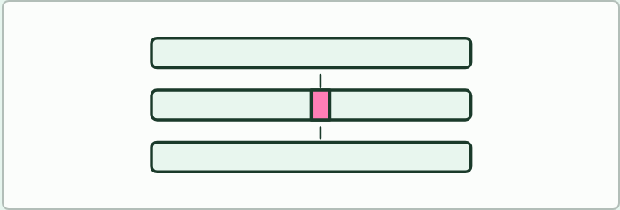
PUZZLE
10 MIN
Spot the SNP
THE TASK
Three strips of invented DNA, about 30 letters each, from three people. Pairs lay them over each other, ring the letters that differ, and count them. Ask: what is a single-nucleotide polymorphism? Then, for each difference: does it change a codon, and does the change alter the amino acid? Use the codon table. Close with the point that a SNP is a difference found in at least 1 percent of the population, and so is not simply any mutation.
STUDENTS NEED
Printed strips, a codon table.
Minutes 5 to 15
Notes:
Minutes 5 to 15 of 60: Spot the SNP (10 min).
The plan: Chapter 7's figure on SNPs, then the DNA strip activity below. Students find the single-letter differences and say which differences change the polypeptide and which do not.
The activity: Spot the SNP. Three strips of invented DNA, about 30 letters each, from three people. Pairs lay them over each other, ring the letters that differ, and count them. Ask: what is a single-nucleotide polymorphism? Then, for each difference: does it change a codon, and does the change alter the amino acid? Use the codon table. Close with the point that a SNP is a difference found in at least 1 percent of the population, and so is not simply any mutation.
Needs: printed strips, a codon table.
The time: 10 minutes, minutes 5 to 15 of the plan.

Slide 6
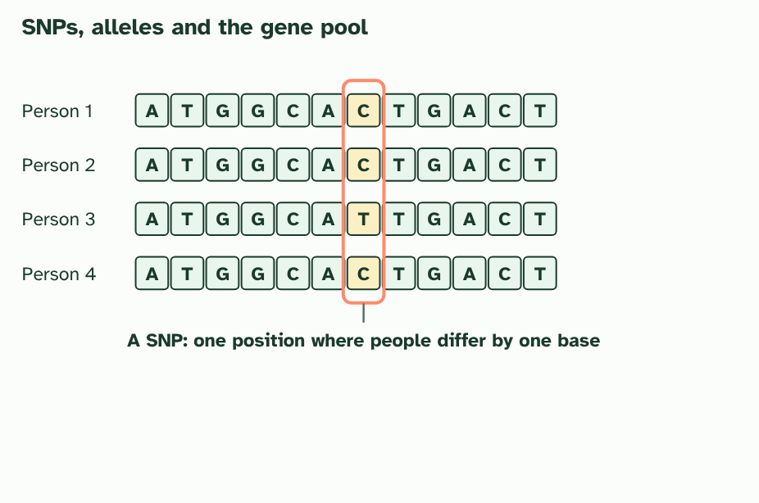
CHAPTER 7 · D3.2.8 D3.2.9 SNPs, multiple alleles and ABO blood groups
1 / 4
Many alleles, not just two
DNA from four people at one place. They differ at a single base: a SNP.
Minutes 5 to 15
Notes:
Minutes 5 to 15 of 60: Spot the SNP (10 min).
The plan: Chapter 7's figure on SNPs, then the DNA strip activity below. Students find the single-letter differences and say which differences change the polypeptide and which do not.
So far every gene had two alleles. In a population, a gene can have many. New alleles arise by mutation, and alleles of one gene usually differ by only one or a few bases. A place in the genome where people differ by a single base, and where each version is common enough to count (often taken as more than 1 in 100), is a single-nucleotide polymorphism, or SNP ("snip").
All the alleles of all the genes in a population make up its gene pool. A gene can have any number of alleles in the gene pool, but you are diploid, so you inherit only two of them: one from each parent. Different people carry different pairs.
The ABO blood group is the textbook example. One gene has three alleles: IA, IB and i. IA and IB each lead to a different marker (an antigen) on the surface of red blood cells, and i leads to neither. Both IA and IB are dominant to i. Three alleles make six genotypes and four blood groups; what happens when IA meets IB is the subject of chapter 8.
Example: A parent of group A (IAi) and a parent of group B (IBi) can have children of any of the four groups: IAIB (AB), IAi (A), IBi (B) or ii (O).

Slide 7
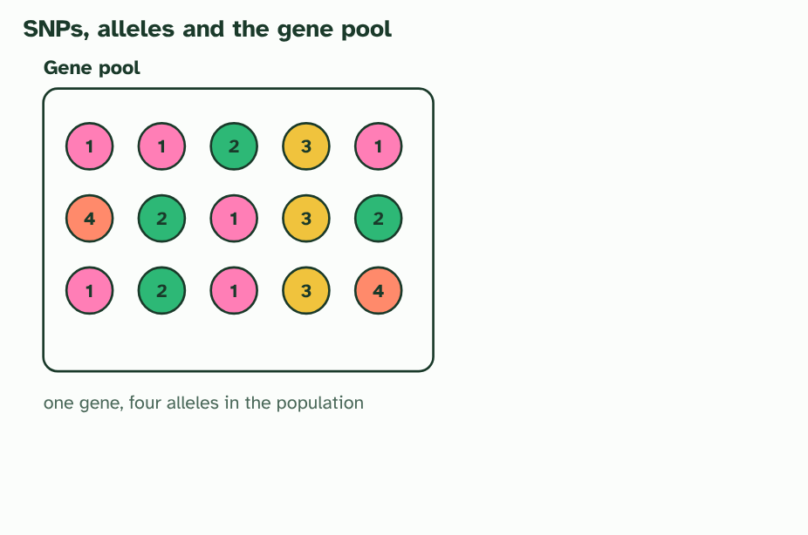
CHAPTER 7 · D3.2.8 D3.2.9 SNPs, multiple alleles and ABO blood groups
2 / 4
Many alleles, not just two
Across a whole population a gene can have many alleles. The gene pool holds them all.
Minutes 5 to 15
Notes:
Minutes 5 to 15 of 60: Spot the SNP (10 min).
The plan: Chapter 7's figure on SNPs, then the DNA strip activity below. Students find the single-letter differences and say which differences change the polypeptide and which do not.
So far every gene had two alleles. In a population, a gene can have many. New alleles arise by mutation, and alleles of one gene usually differ by only one or a few bases. A place in the genome where people differ by a single base, and where each version is common enough to count (often taken as more than 1 in 100), is a single-nucleotide polymorphism, or SNP ("snip").
All the alleles of all the genes in a population make up its gene pool. A gene can have any number of alleles in the gene pool, but you are diploid, so you inherit only two of them: one from each parent. Different people carry different pairs.
The ABO blood group is the textbook example. One gene has three alleles: IA, IB and i. IA and IB each lead to a different marker (an antigen) on the surface of red blood cells, and i leads to neither. Both IA and IB are dominant to i. Three alleles make six genotypes and four blood groups; what happens when IA meets IB is the subject of chapter 8.
Example: A parent of group A (IAi) and a parent of group B (IBi) can have children of any of the four groups: IAIB (AB), IAi (A), IBi (B) or ii (O).

Slide 8
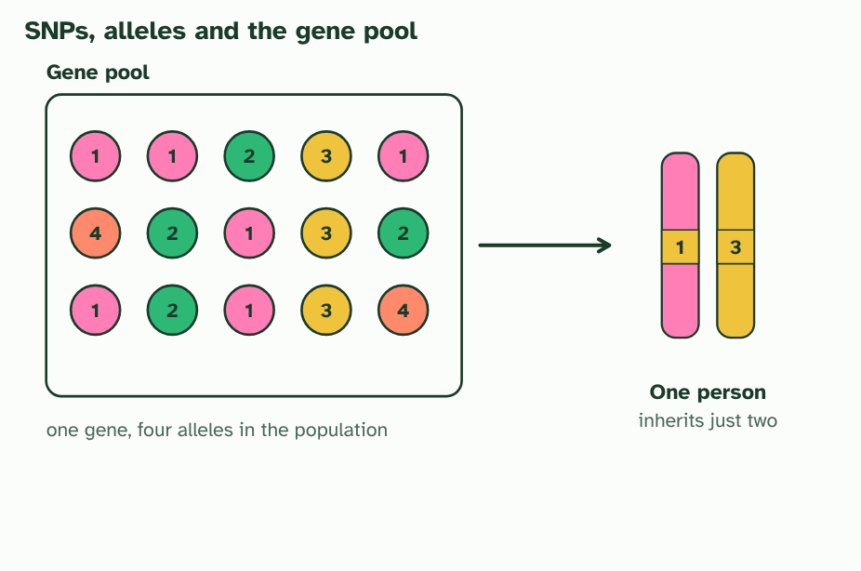
CHAPTER 7 · D3.2.8 D3.2.9 SNPs, multiple alleles and ABO blood groups
3 / 4
Many alleles, not just two
Each person inherits just two of them.
Minutes 5 to 15
Notes:
Minutes 5 to 15 of 60: Spot the SNP (10 min).
The plan: Chapter 7's figure on SNPs, then the DNA strip activity below. Students find the single-letter differences and say which differences change the polypeptide and which do not.
So far every gene had two alleles. In a population, a gene can have many. New alleles arise by mutation, and alleles of one gene usually differ by only one or a few bases. A place in the genome where people differ by a single base, and where each version is common enough to count (often taken as more than 1 in 100), is a single-nucleotide polymorphism, or SNP ("snip").
All the alleles of all the genes in a population make up its gene pool. A gene can have any number of alleles in the gene pool, but you are diploid, so you inherit only two of them: one from each parent. Different people carry different pairs.
The ABO blood group is the textbook example. One gene has three alleles: IA, IB and i. IA and IB each lead to a different marker (an antigen) on the surface of red blood cells, and i leads to neither. Both IA and IB are dominant to i. Three alleles make six genotypes and four blood groups; what happens when IA meets IB is the subject of chapter 8.
Example: A parent of group A (IAi) and a parent of group B (IBi) can have children of any of the four groups: IAIB (AB), IAi (A), IBi (B) or ii (O).

Slide 9
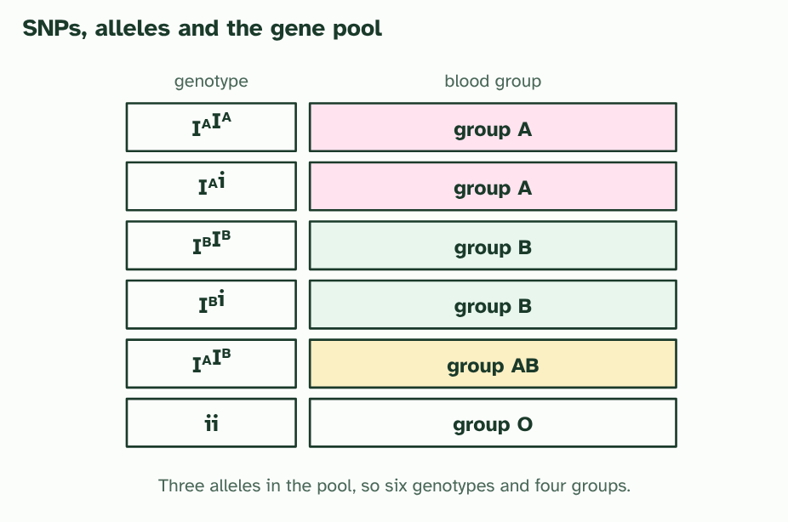
CHAPTER 7 · D3.2.8 D3.2.9 SNPs, multiple alleles and ABO blood groups
4 / 4
Many alleles, not just two
ABO: three alleles in the pool give six genotypes and four blood groups.
Minutes 5 to 15
Notes:
Minutes 5 to 15 of 60: Spot the SNP (10 min).
The plan: Chapter 7's figure on SNPs, then the DNA strip activity below. Students find the single-letter differences and say which differences change the polypeptide and which do not.
So far every gene had two alleles. In a population, a gene can have many. New alleles arise by mutation, and alleles of one gene usually differ by only one or a few bases. A place in the genome where people differ by a single base, and where each version is common enough to count (often taken as more than 1 in 100), is a single-nucleotide polymorphism, or SNP ("snip").
All the alleles of all the genes in a population make up its gene pool. A gene can have any number of alleles in the gene pool, but you are diploid, so you inherit only two of them: one from each parent. Different people carry different pairs.
The ABO blood group is the textbook example. One gene has three alleles: IA, IB and i. IA and IB each lead to a different marker (an antigen) on the surface of red blood cells, and i leads to neither. Both IA and IB are dominant to i. Three alleles make six genotypes and four blood groups; what happens when IA meets IB is the subject of chapter 8.
Example: A parent of group A (IAi) and a parent of group B (IBi) can have children of any of the four groups: IAIB (AB), IAi (A), IBi (B) or ii (O).

Slide 10
CHAPTER 7 · D3.2.8 D3.2.9 SNPs, multiple alleles and ABO blood groups
Many alleles, not just two
A place in the genome where people differ by a single base, and where each version is common enough to count (often taken as more than 1 in 100), is a single-nucleotide polymorphism, or SNP ("snip").
All the alleles of all the genes in a population make up its gene pool.
A gene can have any number of alleles in the gene pool, but you are diploid, so you inherit only two of them: one from each parent.
The ABO blood group is the textbook example.
Minutes 5 to 15
Notes:
Minutes 5 to 15 of 60: Spot the SNP (10 min).
The plan: Chapter 7's figure on SNPs, then the DNA strip activity below. Students find the single-letter differences and say which differences change the polypeptide and which do not.
So far every gene had two alleles. In a population, a gene can have many. New alleles arise by mutation, and alleles of one gene usually differ by only one or a few bases. A place in the genome where people differ by a single base, and where each version is common enough to count (often taken as more than 1 in 100), is a single-nucleotide polymorphism, or SNP ("snip").
All the alleles of all the genes in a population make up its gene pool. A gene can have any number of alleles in the gene pool, but you are diploid, so you inherit only two of them: one from each parent. Different people carry different pairs.
The ABO blood group is the textbook example. One gene has three alleles: IA, IB and i. IA and IB each lead to a different marker (an antigen) on the surface of red blood cells, and i leads to neither. Both IA and IB are dominant to i. Three alleles make six genotypes and four blood groups; what happens when IA meets IB is the subject of chapter 8.
Example: A parent of group A (IAi) and a parent of group B (IBi) can have children of any of the four groups: IAIB (AB), IAi (A), IBi (B) or ii (O).

Slide 11
WATCH OUT
A person never has three ABO alleles. The gene pool has three; each person has two. And group O is not "no gene": the i allele is a real allele, and a person with ii has two copies of it.
Minutes 5 to 15
Notes:
Minutes 5 to 15 of 60: Spot the SNP (10 min).
The plan: Chapter 7's figure on SNPs, then the DNA strip activity below. Students find the single-letter differences and say which differences change the polypeptide and which do not.
A common mistake: say it, then ask who can say why it is wrong.

Slide 12
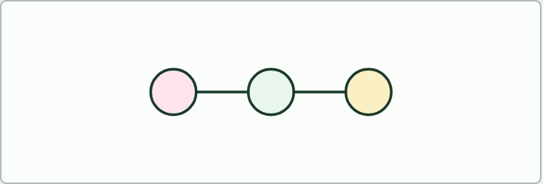
CASE CARDS
12 MIN
The baby swap
THE TASK
Six hospital cases: one baby, two possible parents, and their blood groups. Could the baby belong to them? (1) Mother A, father B, baby O. Possible, if both are heterozygous. (2) Mother O, father O, baby AB. Not possible. (3) Mother AB, father O, baby A. Possible. (4) Mother AB, father AB, baby O. Not possible. (5) Mother B, father A, baby AB. Possible. (6) Mother O, father AB, baby O. Not possible. Students write each possible genotype pair and the cross before they answer, and say which result would rule out a pair for certain.
STUDENTS NEED
Printed cards, one set per pair.
Minutes 15 to 27
Notes:
Minutes 15 to 27 of 60: ABO and the baby swap (12 min).
The plan: The ABO table in chapter 7 and the Remember it tiles. Then the hospital cases below: could this baby belong to these parents? Insist on genotypes written out with the I and i symbols.
The activity: The baby swap. Six hospital cases: one baby, two possible parents, and their blood groups. Could the baby belong to them? (1) Mother A, father B, baby O. Possible, if both are heterozygous. (2) Mother O, father O, baby AB. Not possible. (3) Mother AB, father O, baby A. Possible. (4) Mother AB, father AB, baby O. Not possible. (5) Mother B, father A, baby AB. Possible. (6) Mother O, father AB, baby O. Not possible. Students write each possible genotype pair and the cross before they answer, and say which result would rule out a pair for certain.
Needs: printed cards, one set per pair.
The time: 12 minutes, minutes 15 to 27 of the plan.

Slide 13
REMEMBER IT
The four blood groups
A
B
B
O
Apple
Banana
Both
Orange
Minutes 15 to 27
Notes:
Minutes 15 to 27 of 60: ABO and the baby swap (12 min).
The plan: The ABO table in chapter 7 and the Remember it tiles. Then the hospital cases below: could this baby belong to these parents? Insist on genotypes written out with the I and i symbols.
Ask the class what each letter stands for before revealing.

Slide 14
REMEMBER IT
The four blood groups
A
B
B
O
Apple
Banana
Both
Orange
Group A
Group B
Group AB
Group O
IAIA or IAi
IBIB or IBi
IAIB, with both markers
ii, with neither marker
Minutes 15 to 27
Notes:
Minutes 15 to 27 of 60: ABO and the baby swap (12 min).
The plan: The ABO table in chapter 7 and the Remember it tiles. Then the hospital cases below: could this baby belong to these parents? Insist on genotypes written out with the I and i symbols.
Apple: Group A (IAIA or IAi)
Banana: Group B (IBIB or IBi)
Both: Group AB (IAIB, with both markers)
Orange: Group O (ii, with neither marker)

Slide 15
STEP 4
10 MIN
Neither wins, or both do
Students put the two flower crosses side by side and name the pattern in each.
Ask: what is the difference between the heterozygote that is a blend and the one that shows both?
Minutes 27 to 37
Notes:
Minutes 27 to 37 of 60: Neither wins, or both do (10 min).
The plan: Chapter 8's figure. Students put the two flower crosses side by side and name the pattern in each. Ask: what is the difference between the heterozygote that is a blend and the one that shows both?

Slide 16
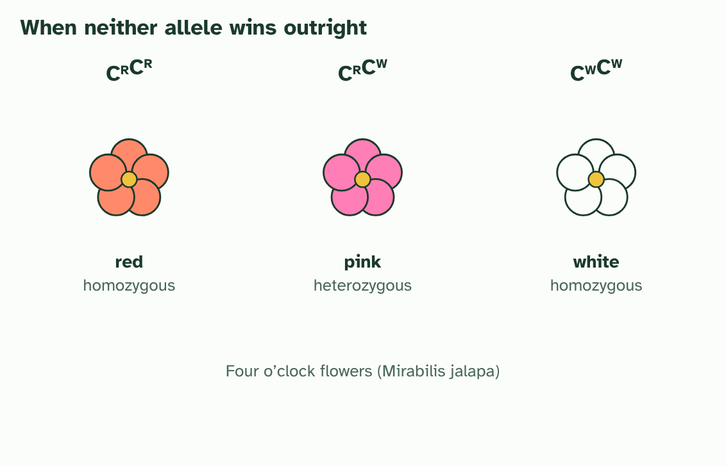
CHAPTER 8 · D3.2.10 Incomplete dominance and codominance
1 / 3
Neither wins, or both do
Incomplete dominance in four o’clocks: red (CRCR), pink (CRCW) and white (CWCW). The heterozygote is intermediate.
Minutes 27 to 37
Notes:
Minutes 27 to 37 of 60: Neither wins, or both do (10 min).
The plan: Chapter 8's figure. Students put the two flower crosses side by side and name the pattern in each. Ask: what is the difference between the heterozygote that is a blend and the one that shows both?
Dominance is not the only pattern. Sometimes a heterozygote looks like neither homozygote. Two patterns are worth telling apart, and the difference is in the phenotype.
In incomplete dominance the heterozygote has an intermediate phenotype. The standard example is the four o'clock plant, Mirabilis jalapa, also called the marvel of Peru. The alleles are written CR (red) and CW (white). CRCR plants are red, CWCW white and CRCW pink. Cross two pink plants and you get red, pink and white in the ratio 1 : 2 : 1, so here the phenotype ratio matches the genotype ratio.
In codominance both alleles are expressed fully, and the heterozygote has a dual phenotype. The AB blood group is the example: a person with IAIB makes both the A marker and the B marker on every red blood cell. Neither allele hides the other, and nothing is in between: both are there.

Slide 17
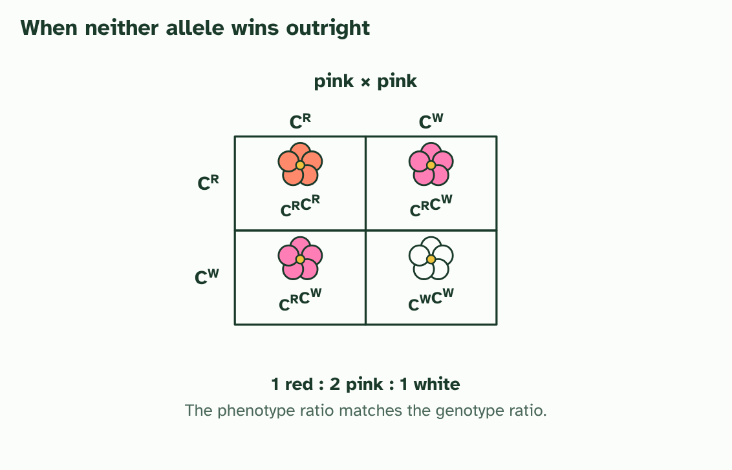
CHAPTER 8 · D3.2.10 Incomplete dominance and codominance
2 / 3
Neither wins, or both do
Cross two pink plants and the offspring are 1 red : 2 pink : 1 white. The phenotype ratio matches the genotype ratio, and red and white reappear.
Minutes 27 to 37
Notes:
Minutes 27 to 37 of 60: Neither wins, or both do (10 min).
The plan: Chapter 8's figure. Students put the two flower crosses side by side and name the pattern in each. Ask: what is the difference between the heterozygote that is a blend and the one that shows both?
Dominance is not the only pattern. Sometimes a heterozygote looks like neither homozygote. Two patterns are worth telling apart, and the difference is in the phenotype.
In incomplete dominance the heterozygote has an intermediate phenotype. The standard example is the four o'clock plant, Mirabilis jalapa, also called the marvel of Peru. The alleles are written CR (red) and CW (white). CRCR plants are red, CWCW white and CRCW pink. Cross two pink plants and you get red, pink and white in the ratio 1 : 2 : 1, so here the phenotype ratio matches the genotype ratio.
In codominance both alleles are expressed fully, and the heterozygote has a dual phenotype. The AB blood group is the example: a person with IAIB makes both the A marker and the B marker on every red blood cell. Neither allele hides the other, and nothing is in between: both are there.

Slide 18
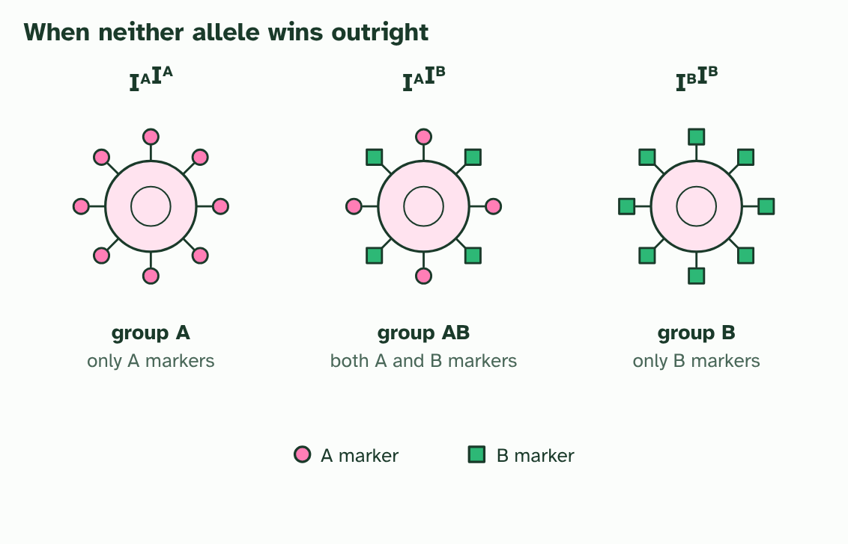
CHAPTER 8 · D3.2.10 Incomplete dominance and codominance
3 / 3
Neither wins, or both do
Codominance in blood: a red blood cell of group AB carries both markers, so the heterozygote has a dual phenotype.
Minutes 27 to 37
Notes:
Minutes 27 to 37 of 60: Neither wins, or both do (10 min).
The plan: Chapter 8's figure. Students put the two flower crosses side by side and name the pattern in each. Ask: what is the difference between the heterozygote that is a blend and the one that shows both?
Dominance is not the only pattern. Sometimes a heterozygote looks like neither homozygote. Two patterns are worth telling apart, and the difference is in the phenotype.
In incomplete dominance the heterozygote has an intermediate phenotype. The standard example is the four o'clock plant, Mirabilis jalapa, also called the marvel of Peru. The alleles are written CR (red) and CW (white). CRCR plants are red, CWCW white and CRCW pink. Cross two pink plants and you get red, pink and white in the ratio 1 : 2 : 1, so here the phenotype ratio matches the genotype ratio.
In codominance both alleles are expressed fully, and the heterozygote has a dual phenotype. The AB blood group is the example: a person with IAIB makes both the A marker and the B marker on every red blood cell. Neither allele hides the other, and nothing is in between: both are there.

Slide 19
CHAPTER 8 · D3.2.10 Incomplete dominance and codominance
Neither wins, or both do
Complete dominance: the heterozygote looks like one homozygote.
Incomplete dominance: the heterozygote is in between.
Codominance: the heterozygote shows both at once.
Minutes 27 to 37
Notes:
Minutes 27 to 37 of 60: Neither wins, or both do (10 min).
The plan: Chapter 8's figure. Students put the two flower crosses side by side and name the pattern in each. Ask: what is the difference between the heterozygote that is a blend and the one that shows both?
Dominance is not the only pattern. Sometimes a heterozygote looks like neither homozygote. Two patterns are worth telling apart, and the difference is in the phenotype.
In incomplete dominance the heterozygote has an intermediate phenotype. The standard example is the four o'clock plant, Mirabilis jalapa, also called the marvel of Peru. The alleles are written CR (red) and CW (white). CRCR plants are red, CWCW white and CRCW pink. Cross two pink plants and you get red, pink and white in the ratio 1 : 2 : 1, so here the phenotype ratio matches the genotype ratio.
In codominance both alleles are expressed fully, and the heterozygote has a dual phenotype. The AB blood group is the example: a person with IAIB makes both the A marker and the B marker on every red blood cell. Neither allele hides the other, and nothing is in between: both are there.

Slide 20
PREDICT
A red four o’clock plant is crossed with a white one. What colour are the F1 flowers?
A All red, since red is dominant
B Half red and half white
C All pink
Minutes 27 to 37
Notes:
Minutes 27 to 37 of 60: Neither wins, or both do (10 min).
The plan: Chapter 8's figure. Students put the two flower crosses side by side and name the pattern in each. Ask: what is the difference between the heterozygote that is a blend and the one that shows both?
Ask for a show of hands, or mini whiteboards, before revealing. (Answer: C, on the next slide.)

Slide 21
WHAT HAPPENS
A red four o’clock plant is crossed with a white one. What colour are the F1 flowers?
A All red, since red is dominant
B Half red and half white
C All pink
All pink. Every F1 plant is CRCW, a heterozygote, and in incomplete dominance the heterozygote is intermediate. Crossing two of these pink plants then gives 1 red : 2 pink : 1 white.
Minutes 27 to 37
Notes:
Minutes 27 to 37 of 60: Neither wins, or both do (10 min).
The plan: Chapter 8's figure. Students put the two flower crosses side by side and name the pattern in each. Ask: what is the difference between the heterozygote that is a blend and the one that shows both?
Answer: C. All pink. Every F1 plant is CRCW, a heterozygote, and in incomplete dominance the heterozygote is intermediate. Crossing two of these pink plants then gives 1 red : 2 pink : 1 white.

Slide 22
WATCH OUT
Incomplete dominance is not blending. If the red and white alleles mixed like paints, pink plants could never give red or white again. They do, in the F2, because each allele stays whole and separates in the gametes.
Minutes 27 to 37
Notes:
Minutes 27 to 37 of 60: Neither wins, or both do (10 min).
The plan: Chapter 8's figure. Students put the two flower crosses side by side and name the pattern in each. Ask: what is the difference between the heterozygote that is a blend and the one that shows both?
A common mistake: say it, then ask who can say why it is wrong.

Slide 23
STEP 5
18 MIN
X, Y and sex
Students set out X and Y with their superscripts, read the sons and daughters of each cross, and say what fraction of each sex is affected.
Minutes 37 to 55
Notes:
Minutes 37 to 55 of 60: X, Y and sex (18 min).
The plan: Chapter 9's figure and the crosses below. Students set out X and Y with their superscripts, read the sons and daughters of each cross, and say what fraction of each sex is affected.

Slide 24
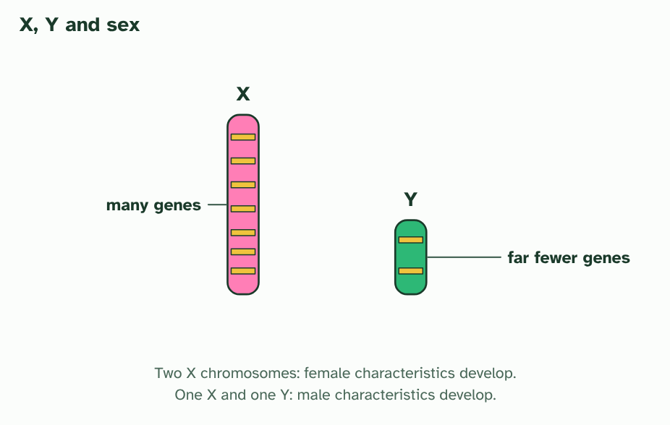
CHAPTER 9 · D3.2.11 D3.2.12 Sex determination and sex linkage
1 / 3
X, Y and sex
The X is big and carries many genes. The Y is small and carries far fewer. Two Xs develop female, an X and a Y develop male.
Minutes 37 to 55
Notes:
Minutes 37 to 55 of 60: X, Y and sex (18 min).
The plan: Chapter 9's figure and the crosses below. Students set out X and Y with their superscripts, read the sons and daughters of each cross, and say what fraction of each sex is affected.
Most of your 23 pairs of chromosomes are autosomes, matching pairs. The last pair is different. Human females have two X chromosomes (XX). Males have one X and a smaller Y (XY). Every egg carries an X. A sperm carries an X or a Y, so the sperm decides: an X sperm makes an XX zygote, which develops female-typical characteristics, and a Y sperm makes an XY zygote, which develops male-typical ones. Half the sperm carry each, so about half of children are girls. The Y chromosome carries genes that start the development of male characteristics.
The X and the Y are very unequal. The X carries far more genes than the Y, and most of them have nothing to do with sex. A sex-linked gene is one that sits on a sex chromosome, and in practice nearly all of them are on the X. A male has only one X, so a recessive allele on it always shows: there is no second allele on the Y to mask it. A female has two Xs and can be a carrier.
Haemophilia is the standard example. A recessive allele on the X means a protein needed to clot blood is missing or faulty, so even small cuts can bleed for a long time. Write the alleles as superscripts on an uppercase X: XH (normal clotting) and Xh (haemophilia). A girl XHXh is a carrier. A boy XhY has haemophilia, because he has no other X. The Y gets no letter, because it has no allele of this gene.
Example: Red-green colour blindness is another X-linked recessive condition, so it is more common in males than in females.

Slide 25
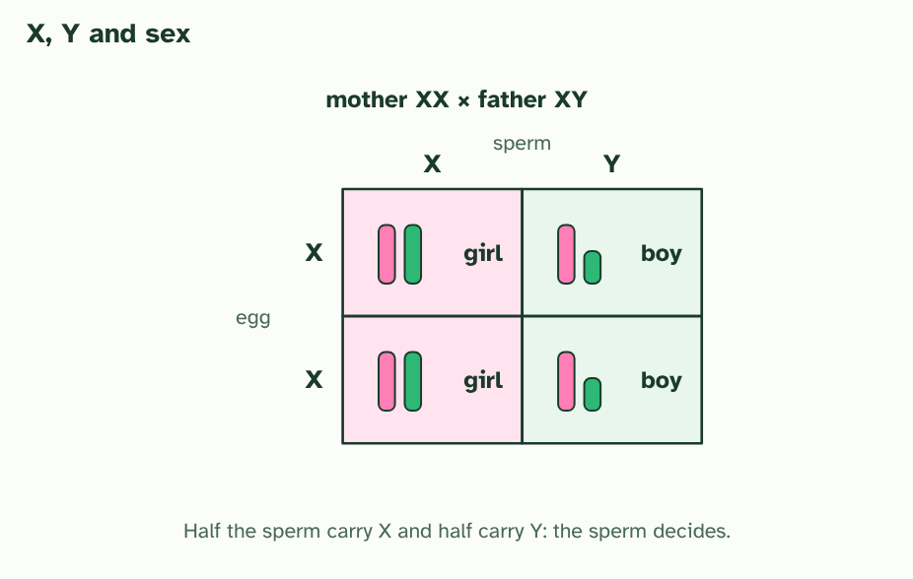
CHAPTER 9 · D3.2.11 D3.2.12 Sex determination and sex linkage
2 / 3
X, Y and sex
Every egg carries an X. A sperm carries X or Y, so the sperm decides the sex: half girls, half boys.
Minutes 37 to 55
Notes:
Minutes 37 to 55 of 60: X, Y and sex (18 min).
The plan: Chapter 9's figure and the crosses below. Students set out X and Y with their superscripts, read the sons and daughters of each cross, and say what fraction of each sex is affected.
Most of your 23 pairs of chromosomes are autosomes, matching pairs. The last pair is different. Human females have two X chromosomes (XX). Males have one X and a smaller Y (XY). Every egg carries an X. A sperm carries an X or a Y, so the sperm decides: an X sperm makes an XX zygote, which develops female-typical characteristics, and a Y sperm makes an XY zygote, which develops male-typical ones. Half the sperm carry each, so about half of children are girls. The Y chromosome carries genes that start the development of male characteristics.
The X and the Y are very unequal. The X carries far more genes than the Y, and most of them have nothing to do with sex. A sex-linked gene is one that sits on a sex chromosome, and in practice nearly all of them are on the X. A male has only one X, so a recessive allele on it always shows: there is no second allele on the Y to mask it. A female has two Xs and can be a carrier.
Haemophilia is the standard example. A recessive allele on the X means a protein needed to clot blood is missing or faulty, so even small cuts can bleed for a long time. Write the alleles as superscripts on an uppercase X: XH (normal clotting) and Xh (haemophilia). A girl XHXh is a carrier. A boy XhY has haemophilia, because he has no other X. The Y gets no letter, because it has no allele of this gene.
Example: Red-green colour blindness is another X-linked recessive condition, so it is more common in males than in females.

Slide 26
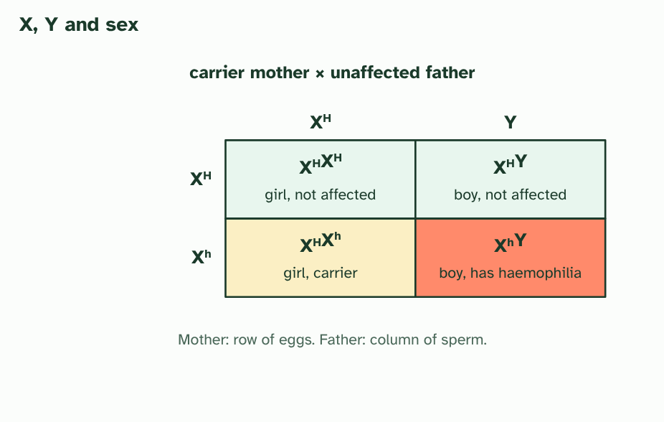
CHAPTER 9 · D3.2.11 D3.2.12 Sex determination and sex linkage
3 / 3
X, Y and sex
Haemophilia: a carrier mother (XHXh) and an unaffected father (XHY). Half the sons have haemophilia and half the daughters are carriers. No daughter is affected.
Minutes 37 to 55
Notes:
Minutes 37 to 55 of 60: X, Y and sex (18 min).
The plan: Chapter 9's figure and the crosses below. Students set out X and Y with their superscripts, read the sons and daughters of each cross, and say what fraction of each sex is affected.
Most of your 23 pairs of chromosomes are autosomes, matching pairs. The last pair is different. Human females have two X chromosomes (XX). Males have one X and a smaller Y (XY). Every egg carries an X. A sperm carries an X or a Y, so the sperm decides: an X sperm makes an XX zygote, which develops female-typical characteristics, and a Y sperm makes an XY zygote, which develops male-typical ones. Half the sperm carry each, so about half of children are girls. The Y chromosome carries genes that start the development of male characteristics.
The X and the Y are very unequal. The X carries far more genes than the Y, and most of them have nothing to do with sex. A sex-linked gene is one that sits on a sex chromosome, and in practice nearly all of them are on the X. A male has only one X, so a recessive allele on it always shows: there is no second allele on the Y to mask it. A female has two Xs and can be a carrier.
Haemophilia is the standard example. A recessive allele on the X means a protein needed to clot blood is missing or faulty, so even small cuts can bleed for a long time. Write the alleles as superscripts on an uppercase X: XH (normal clotting) and Xh (haemophilia). A girl XHXh is a carrier. A boy XhY has haemophilia, because he has no other X. The Y gets no letter, because it has no allele of this gene.
Example: Red-green colour blindness is another X-linked recessive condition, so it is more common in males than in females.

Slide 27
CHAPTER 9 · D3.2.11 D3.2.12 Sex determination and sex linkage
X, Y and sex
A sex-linked gene is one that sits on a sex chromosome, and in practice nearly all of them are on the X.
Haemophilia is the standard example.
Write the alleles as superscripts on an uppercase X: XH (normal clotting) and Xh (haemophilia).
A boy XhY has haemophilia, because he has no other X.
Minutes 37 to 55
Notes:
Minutes 37 to 55 of 60: X, Y and sex (18 min).
The plan: Chapter 9's figure and the crosses below. Students set out X and Y with their superscripts, read the sons and daughters of each cross, and say what fraction of each sex is affected.
Most of your 23 pairs of chromosomes are autosomes, matching pairs. The last pair is different. Human females have two X chromosomes (XX). Males have one X and a smaller Y (XY). Every egg carries an X. A sperm carries an X or a Y, so the sperm decides: an X sperm makes an XX zygote, which develops female-typical characteristics, and a Y sperm makes an XY zygote, which develops male-typical ones. Half the sperm carry each, so about half of children are girls. The Y chromosome carries genes that start the development of male characteristics.
The X and the Y are very unequal. The X carries far more genes than the Y, and most of them have nothing to do with sex. A sex-linked gene is one that sits on a sex chromosome, and in practice nearly all of them are on the X. A male has only one X, so a recessive allele on it always shows: there is no second allele on the Y to mask it. A female has two Xs and can be a carrier.
Haemophilia is the standard example. A recessive allele on the X means a protein needed to clot blood is missing or faulty, so even small cuts can bleed for a long time. Write the alleles as superscripts on an uppercase X: XH (normal clotting) and Xh (haemophilia). A girl XHXh is a carrier. A boy XhY has haemophilia, because he has no other X. The Y gets no letter, because it has no allele of this gene.
Example: Red-green colour blindness is another X-linked recessive condition, so it is more common in males than in females.

Slide 28
PREDICT
A man with haemophilia (XhY) and a woman who is not a carrier (XHXH) have children. What are the children like?
A All sons have haemophilia; all daughters are unaffected
B Half the sons and half the daughters have haemophilia
C All daughters are carriers; all sons are unaffected
Minutes 37 to 55
Notes:
Minutes 37 to 55 of 60: X, Y and sex (18 min).
The plan: Chapter 9's figure and the crosses below. Students set out X and Y with their superscripts, read the sons and daughters of each cross, and say what fraction of each sex is affected.
Ask for a show of hands, or mini whiteboards, before revealing. (Answer: C, on the next slide.)

Slide 29
WHAT HAPPENS
A man with haemophilia (XhY) and a woman who is not a carrier (XHXH) have children. What are the children like?
A All sons have haemophilia; all daughters are unaffected
B Half the sons and half the daughters have haemophilia
C All daughters are carriers; all sons are unaffected
All daughters are carriers and all sons are unaffected. Every daughter gets her father’s Xh and her mother’s XH, so she is a carrier. Every son gets the father’s Y and the mother’s XH, so he is unaffected.
Minutes 37 to 55
Notes:
Minutes 37 to 55 of 60: X, Y and sex (18 min).
The plan: Chapter 9's figure and the crosses below. Students set out X and Y with their superscripts, read the sons and daughters of each cross, and say what fraction of each sex is affected.
Answer: C. All daughters are carriers and all sons are unaffected. Every daughter gets her father’s Xh and her mother’s XH, so she is a carrier. Every son gets the father’s Y and the mother’s XH, so he is unaffected.

Slide 30
WATCH OUT
A father cannot pass an X-linked allele to his son. A son gets his Y from his father and his X from his mother. A father does pass his X to every daughter.
Minutes 37 to 55
Notes:
Minutes 37 to 55 of 60: X, Y and sex (18 min).
The plan: Chapter 9's figure and the crosses below. Students set out X and Y with their superscripts, read the sons and daughters of each cross, and say what fraction of each sex is affected.
A common mistake: say it, then ask who can say why it is wrong.

Slide 31

PRACTICE
18 MIN
Colour blindness and haemophilia
THE TASK
Four crosses. Use X with a superscript for each allele: X^H and X^h for haemophilia. (1) A carrier mother by an unaffected father. Half the sons affected, no daughters affected, half the daughters carriers. (2) An affected father by a mother who is not a carrier. No sons affected, all daughters carriers. (3) An affected father by a carrier mother. Half the sons and half the daughters affected. (4) An unaffected father by a mother who is not a carrier. No affected children and no carriers. Repeat (1) and (2) for red-green colour blindness, which is also carried on the X chromosome. Ask why a son cannot inherit an X-linked condition from his father.
STUDENTS NEED
Mini whiteboards.
Minutes 37 to 55
Notes:
Minutes 37 to 55 of 60: X, Y and sex (18 min).
The plan: Chapter 9's figure and the crosses below. Students set out X and Y with their superscripts, read the sons and daughters of each cross, and say what fraction of each sex is affected.
The activity: Colour blindness and haemophilia. Four crosses. Use X with a superscript for each allele: X^H and X^h for haemophilia. (1) A carrier mother by an unaffected father. Half the sons affected, no daughters affected, half the daughters carriers. (2) An affected father by a mother who is not a carrier. No sons affected, all daughters carriers. (3) An affected father by a carrier mother. Half the sons and half the daughters affected. (4) An unaffected father by a mother who is not a carrier. No affected children and no carriers. Repeat (1) and (2) for red-green colour blindness, which is also carried on the X chromosome. Ask why a son cannot inherit an X-linked condition from his father.
Needs: mini whiteboards.
The time: 18 minutes, minutes 37 to 55 of the plan.

Slide 32
PLENARY
Can you now...
Describe single-nucleotide polymorphisms and multiple alleles in a gene pool (D3.2.8)
Use the ABO blood groups to show how multiple alleles are inherited (D3.2.9)
Distinguish incomplete dominance from codominance (D3.2.10)
Explain sex determination in humans and the inheritance of genes on the sex chromosomes (D3.2.11)
Use haemophilia to explain a sex-linked genetic disorder (D3.2.12)
Minutes 55 to 60
Notes:
Minutes 55 to 60 of 60: Exit (5 min).
The plan: A father with haemophilia and a mother who is not a carrier: write the cross and the chance that a son or a daughter is affected. Collect.
Thumbs up, sideways or down on each goal before the exit question. The goals come from the statements this lesson covers.

Slide 33
EXIT QUESTION
Before you go
A father with haemophilia and a mother who is not a carrier: write the cross and the chance that a son or a daughter is affected.
Minutes 55 to 60
Notes:
Minutes 55 to 60 of 60: Exit (5 min).
The plan: A father with haemophilia and a mother who is not a carrier: write the cross and the chance that a son or a daughter is affected. Collect.

Slide 34
PRACTISE AND REVISE
Keep going
Exam practice: a fresh paper of exam questions on D3.2 at standard level, marked as you go
The guide, with the animations and the dry lab
This lesson in the guide: 7 Many alleles, not just two, 8 Neither wins, or both do, 9 X, Y and sex
BUILD FOR YOUR CLASS
ALREADY ON THE SITE FOR D3.2
CARD SETS ON SPLYCR
Tarsia puzzle, dominoes and picture reveal on D3.2, built from its key terms and ready to print
A pub quiz with rounds on D3.2, to present or run with no projector
An escape room built from the question bank on D3.2
Lesson: Linked Genes & Chi-Squared
Lesson: Dihybrid Crosses & Test Crosses
Lesson: Inheritance
Summary doodle: Inheritance
Quiz: Inheritance
Revision map: D3.2 Inheritance, to fill in
Exam questions: D3.2 in the exam maker, a paper with its markscheme
Open a set to host it as a class game, or make a copy to edit.
D3.2 Inheritance
How this was made. The course structure, the activities and the teaching choices come from my own classroom, my presentations and my years of teaching IB and AP Biology. I use Claude, an AI, to help write and build the interactive guides, lesson plans, slides and practice questions, and to draw the diagrams and code the interactives. I direct the work and review it against the IB and AP specifications before it goes live.
Minute 60: after the lesson
Notes:
Every link here is live. Set the exam practice paper for homework: it is fresh each time, marked as students go and saved to their Exam practice when they are signed in.
Exam practice: https://www.biologybybradford.com/exam-maker/sit?topics=D3.2&level=SL&paper=quiz&marks=15&src=ep
The guide: https://www.biologybybradford.com/guides/ib-biology-d3-2-inheritance

