Slide 1
IB Biology D3.2
LESSON 4 OF 8
BY THE END YOU CAN
Inheritance
Use pedigree charts to deduce patterns of inheritance of genetic disorders (D3.2.13)
Reading a family tree
D3.2.13
Using a pedigree chart to deduce whether a condition is dominant or recessive and autosomal or sex-linked, and reasoning from some cases to a general pattern
60 minutes · chapter 10
Minute 0
Notes:
IB Biology D3.2, Inheritance. Lesson 4 of 8: Reading a family tree, 60 minutes.
The plan, minute by minute (each slide's footer says where you are):
0 to 5 min (5) Do now: the symbols
5 to 17 min (12) The rules of thumb
17 to 25 min (8) Test your hunch
25 to 45 min (20) Pedigree puzzles
45 to 55 min (10) Why close relatives?
55 to 60 min (5) Exit
What students get wrong:
"A carrier shows the condition." A carrier of a recessive allele has the normal phenotype. Ask what a pedigree can and cannot tell you about the carriers.
"A big family with a condition means it is dominant." Check the rule of thumb about unaffected parents with an affected child first.
Stretch and support:
Support: a pedigree with the rules of thumb already ticked against it, to be copied for the next.
Stretch: why can a pedigree never prove that a condition is X-linked, though it can rule it out? Ask for an example.
The lesson plan to print: https://www.biologybybradford.com/guides/downloads/ib-biology-d3-2-inheritance-lesson-4-plan.pdf

Slide 2
DO NOW
The symbols
Draw squares, circles, shading and the lines for mating and children on the board for a made-up family of three generations.
Students write what each symbol means, then the carrier status you can be sure of.
5:00
minutes
Start now: the timer is running.
Minutes 0 to 5
Notes:
Minutes 0 to 5 of 60: Do now: the symbols (5 min).
The plan: Draw squares, circles, shading and the lines for mating and children on the board for a made-up family of three generations. Students write what each symbol means, then the carrier status you can be sure of.
Start a 5 minute timer as they come in.

Slide 3
STEP 2
12 MIN
The rules of thumb
Ask students to say each rule aloud as a sentence ("two parents without it have a child with it, so it is recessive").
Minutes 5 to 17
Notes:
Minutes 5 to 17 of 60: The rules of thumb (12 min).
The plan: Chapter 10's figure and the Remember it tiles. Ask students to say each rule aloud as a sentence ("two parents without it have a child with it, so it is recessive").

Slide 4
REMEMBER IT
Four clues for reading a pedigree
Q
L
D
B
Quiet
Loud
Dad
Boys
Minutes 5 to 17
Notes:
Minutes 5 to 17 of 60: The rules of thumb (12 min).
The plan: Chapter 10's figure and the Remember it tiles. Ask students to say each rule aloud as a sentence ("two parents without it have a child with it, so it is recessive").
Ask the class what each letter stands for before revealing.

Slide 5
REMEMBER IT
Four clues for reading a pedigree
Q
L
D
B
Quiet
Loud
Dad
Boys
Unaffected parents, affected child
Affected parents, unaffected child
Affected daughter, unaffected father
Mostly sons, skipping generations
recessive: both parents carry the allele
dominant: both parents carry a recessive allele
not X-linked recessive
suggests X-linked recessive
Minutes 5 to 17
Notes:
Minutes 5 to 17 of 60: The rules of thumb (12 min).
The plan: Chapter 10's figure and the Remember it tiles. Ask students to say each rule aloud as a sentence ("two parents without it have a child with it, so it is recessive").
Quiet: Unaffected parents, affected child (recessive: both parents carry the allele)
Loud: Affected parents, unaffected child (dominant: both parents carry a recessive allele)
Dad: Affected daughter, unaffected father (not X-linked recessive)
Boys: Mostly sons, skipping generations (suggests X-linked recessive)

Slide 6
STEP 3
8 MIN
Test your hunch
Students choose a pattern, then see which are ruled out and why.
Minutes 17 to 25
Notes:
Minutes 17 to 25 of 60: Test your hunch (8 min).
The plan: The pedigree tool in chapter 10, the first two families. Students choose a pattern, then see which are ruled out and why. Do not move on until each pair can say the reason.

Slide 7
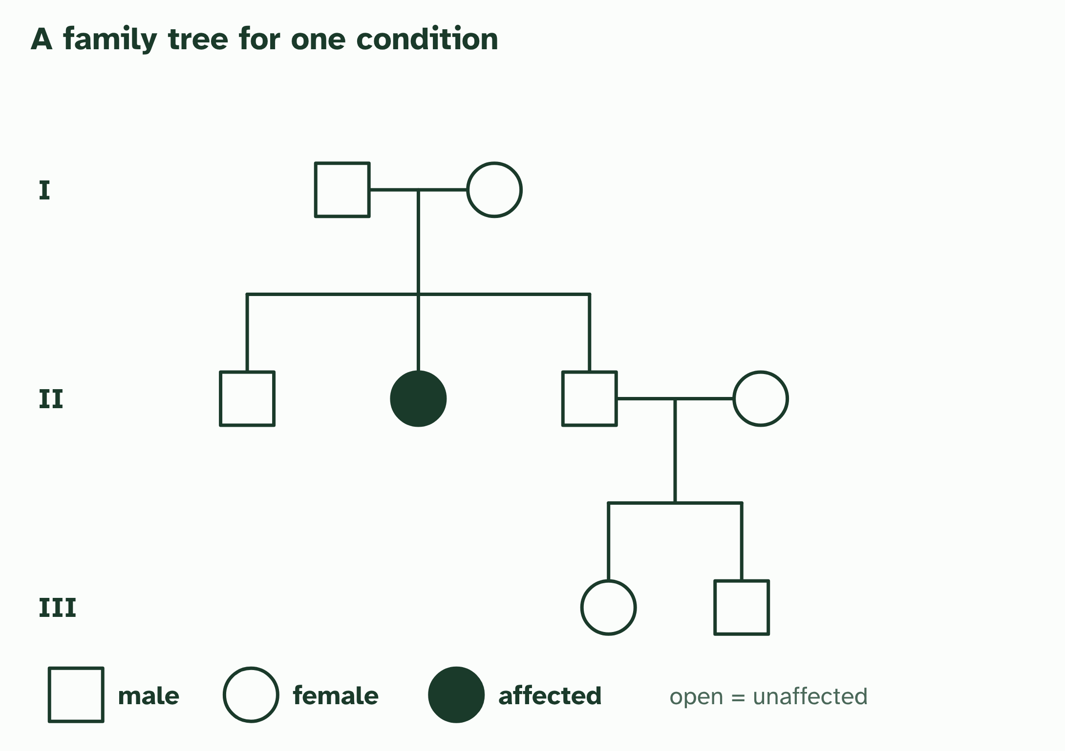
CHAPTER 10 · D3.2.13 Pedigree charts
1 / 3
Reading a family tree
The key: squares are males, circles are females, filled symbols are affected. A line across joins a couple, and lines down lead to their children.
Minutes 17 to 25
Notes:
Minutes 17 to 25 of 60: Test your hunch (8 min).
The plan: The pedigree tool in chapter 10, the first two families. Students choose a pattern, then see which are ruled out and why. Do not move on until each pair can say the reason.
A pedigree chart follows a trait through a family. Squares are males and circles are females. A filled shape means the person has the condition, and a line across joins a couple, with their children below. Generations are numbered I, II, III from the top.
You cannot cross people to see what happens, so you read the pattern instead. The aim is to work out whether the condition is dominant or recessive, and whether the gene is autosomal or on the X. Some patterns settle it. Others leave more than one possibility.
Chart reading uses two kinds of reasoning. Looking over the family and deciding "this pattern fits a recessive trait" is inductive reasoning: you generalise from the cases you can see. Once you have the pattern, you use deductive reasoning to find the genotype of a particular person: if the trait is recessive, an affected woman must be nn, and her unaffected parents must both be Nn.
Pedigrees also explain a rule found in many societies, that close relatives may not marry. Relatives share alleles they inherited from common ancestors. If a harmful recessive allele runs in a family, two relatives are more likely to carry the same one, so their children are more likely to be homozygous recessive and have the condition. That is the genetic basis only; the rule has other roots too.
Example: Nature of science Scientists draw general conclusions by inductive reasoning: they base a theory on some of the cases, not all. A pattern deduced from part of a pedigree is a theory, and it then lets you deduce the genotypes of particular people. Keep the two kinds of reasoning apart in your answers.

Slide 8
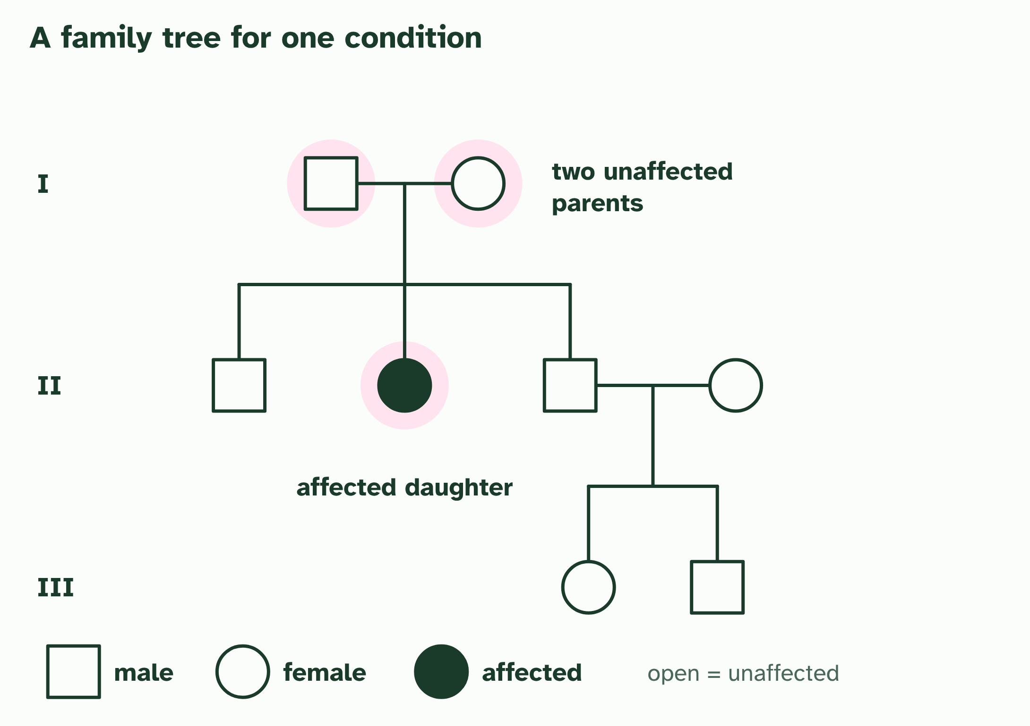
CHAPTER 10 · D3.2.13 Pedigree charts
2 / 3
Reading a family tree
Two unaffected parents (generation I) have an affected daughter (generation II). The condition was hidden in both parents.
Minutes 17 to 25
Notes:
Minutes 17 to 25 of 60: Test your hunch (8 min).
The plan: The pedigree tool in chapter 10, the first two families. Students choose a pattern, then see which are ruled out and why. Do not move on until each pair can say the reason.
A pedigree chart follows a trait through a family. Squares are males and circles are females. A filled shape means the person has the condition, and a line across joins a couple, with their children below. Generations are numbered I, II, III from the top.
You cannot cross people to see what happens, so you read the pattern instead. The aim is to work out whether the condition is dominant or recessive, and whether the gene is autosomal or on the X. Some patterns settle it. Others leave more than one possibility.
Chart reading uses two kinds of reasoning. Looking over the family and deciding "this pattern fits a recessive trait" is inductive reasoning: you generalise from the cases you can see. Once you have the pattern, you use deductive reasoning to find the genotype of a particular person: if the trait is recessive, an affected woman must be nn, and her unaffected parents must both be Nn.
Pedigrees also explain a rule found in many societies, that close relatives may not marry. Relatives share alleles they inherited from common ancestors. If a harmful recessive allele runs in a family, two relatives are more likely to carry the same one, so their children are more likely to be homozygous recessive and have the condition. That is the genetic basis only; the rule has other roots too.
Example: Nature of science Scientists draw general conclusions by inductive reasoning: they base a theory on some of the cases, not all. A pattern deduced from part of a pedigree is a theory, and it then lets you deduce the genotypes of particular people. Keep the two kinds of reasoning apart in your answers.

Slide 9
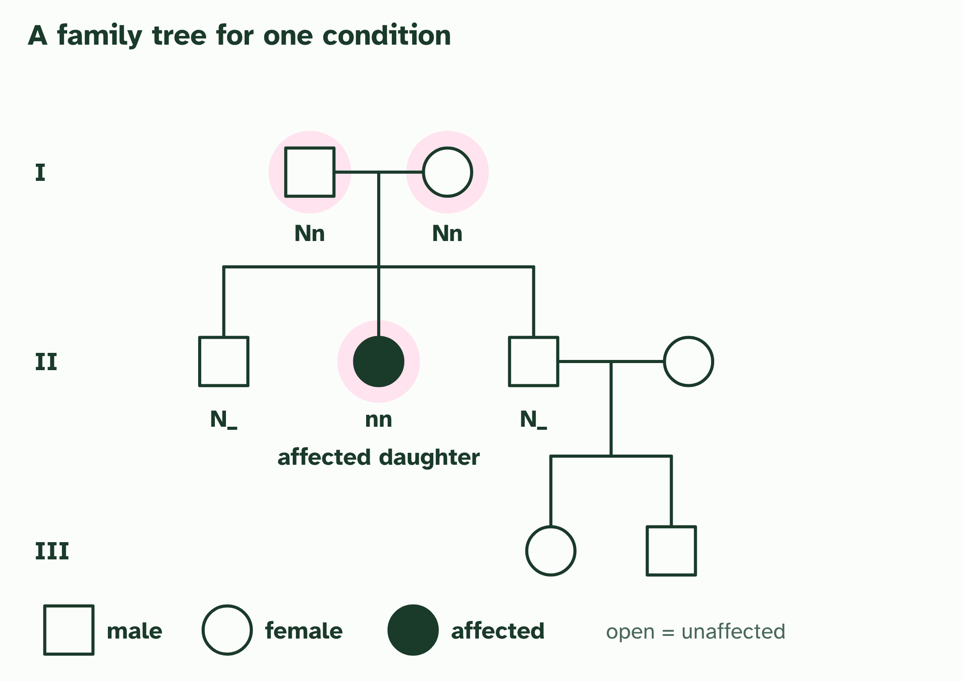
CHAPTER 10 · D3.2.13 Pedigree charts
3 / 3
Reading a family tree
Deducing the genotypes: a recessive condition needs nn in the daughter and one n from each parent, so both parents are Nn.
Minutes 17 to 25
Notes:
Minutes 17 to 25 of 60: Test your hunch (8 min).
The plan: The pedigree tool in chapter 10, the first two families. Students choose a pattern, then see which are ruled out and why. Do not move on until each pair can say the reason.
A pedigree chart follows a trait through a family. Squares are males and circles are females. A filled shape means the person has the condition, and a line across joins a couple, with their children below. Generations are numbered I, II, III from the top.
You cannot cross people to see what happens, so you read the pattern instead. The aim is to work out whether the condition is dominant or recessive, and whether the gene is autosomal or on the X. Some patterns settle it. Others leave more than one possibility.
Chart reading uses two kinds of reasoning. Looking over the family and deciding "this pattern fits a recessive trait" is inductive reasoning: you generalise from the cases you can see. Once you have the pattern, you use deductive reasoning to find the genotype of a particular person: if the trait is recessive, an affected woman must be nn, and her unaffected parents must both be Nn.
Pedigrees also explain a rule found in many societies, that close relatives may not marry. Relatives share alleles they inherited from common ancestors. If a harmful recessive allele runs in a family, two relatives are more likely to carry the same one, so their children are more likely to be homozygous recessive and have the condition. That is the genetic basis only; the rule has other roots too.
Example: Nature of science Scientists draw general conclusions by inductive reasoning: they base a theory on some of the cases, not all. A pattern deduced from part of a pedigree is a theory, and it then lets you deduce the genotypes of particular people. Keep the two kinds of reasoning apart in your answers.

Slide 10
CHAPTER 10 · D3.2.13 Pedigree charts
Reading a family tree
A pedigree chart follows a trait through a family.
Looking over the family and deciding "this pattern fits a recessive trait" is inductive reasoning: you generalise from the cases you can see.
Once you have the pattern, you use deductive reasoning to find the genotype of a particular person: if the trait is recessive, an affected woman must be nn, and her unaffected parents must both be Nn.
Minutes 17 to 25
Notes:
Minutes 17 to 25 of 60: Test your hunch (8 min).
The plan: The pedigree tool in chapter 10, the first two families. Students choose a pattern, then see which are ruled out and why. Do not move on until each pair can say the reason.
A pedigree chart follows a trait through a family. Squares are males and circles are females. A filled shape means the person has the condition, and a line across joins a couple, with their children below. Generations are numbered I, II, III from the top.
You cannot cross people to see what happens, so you read the pattern instead. The aim is to work out whether the condition is dominant or recessive, and whether the gene is autosomal or on the X. Some patterns settle it. Others leave more than one possibility.
Chart reading uses two kinds of reasoning. Looking over the family and deciding "this pattern fits a recessive trait" is inductive reasoning: you generalise from the cases you can see. Once you have the pattern, you use deductive reasoning to find the genotype of a particular person: if the trait is recessive, an affected woman must be nn, and her unaffected parents must both be Nn.
Pedigrees also explain a rule found in many societies, that close relatives may not marry. Relatives share alleles they inherited from common ancestors. If a harmful recessive allele runs in a family, two relatives are more likely to carry the same one, so their children are more likely to be homozygous recessive and have the condition. That is the genetic basis only; the rule has other roots too.
Example: Nature of science Scientists draw general conclusions by inductive reasoning: they base a theory on some of the cases, not all. A pattern deduced from part of a pedigree is a theory, and it then lets you deduce the genotypes of particular people. Keep the two kinds of reasoning apart in your answers.

Slide 11
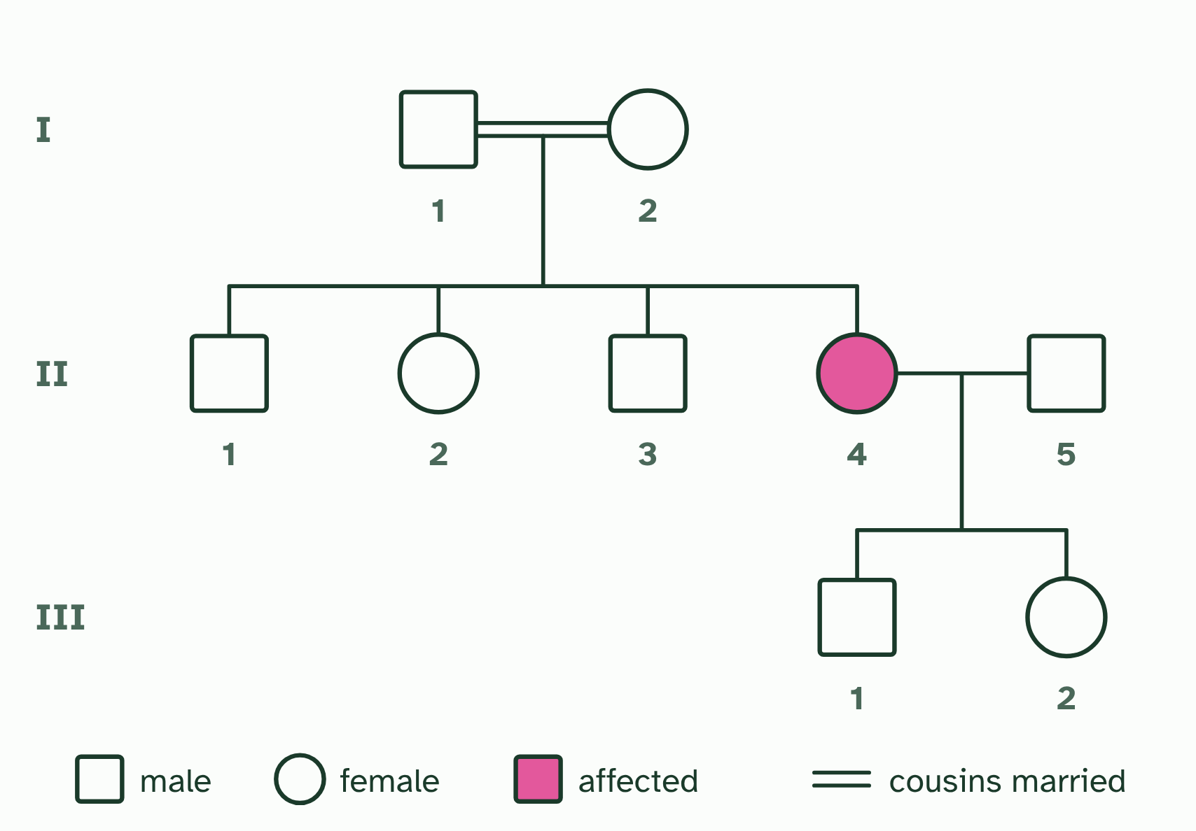
CHAPTER 10 · D3.2.13 Pedigree charts
1 / 2
Reading a family tree
A condition no one in the family had heard of appears in a daughter. Her parents are first cousins. Squares are men, circles women; a filled symbol is affected. Roman numerals number the generations.
Minutes 17 to 25
Notes:
Minutes 17 to 25 of 60: Test your hunch (8 min).
The plan: The pedigree tool in chapter 10, the first two families. Students choose a pattern, then see which are ruled out and why. Do not move on until each pair can say the reason.
A pedigree chart follows a trait through a family. Squares are males and circles are females. A filled shape means the person has the condition, and a line across joins a couple, with their children below. Generations are numbered I, II, III from the top.
You cannot cross people to see what happens, so you read the pattern instead. The aim is to work out whether the condition is dominant or recessive, and whether the gene is autosomal or on the X. Some patterns settle it. Others leave more than one possibility.
Chart reading uses two kinds of reasoning. Looking over the family and deciding "this pattern fits a recessive trait" is inductive reasoning: you generalise from the cases you can see. Once you have the pattern, you use deductive reasoning to find the genotype of a particular person: if the trait is recessive, an affected woman must be nn, and her unaffected parents must both be Nn.
Pedigrees also explain a rule found in many societies, that close relatives may not marry. Relatives share alleles they inherited from common ancestors. If a harmful recessive allele runs in a family, two relatives are more likely to carry the same one, so their children are more likely to be homozygous recessive and have the condition. That is the genetic basis only; the rule has other roots too.
Example: Nature of science Scientists draw general conclusions by inductive reasoning: they base a theory on some of the cases, not all. A pattern deduced from part of a pedigree is a theory, and it then lets you deduce the genotypes of particular people. Keep the two kinds of reasoning apart in your answers.

Slide 12
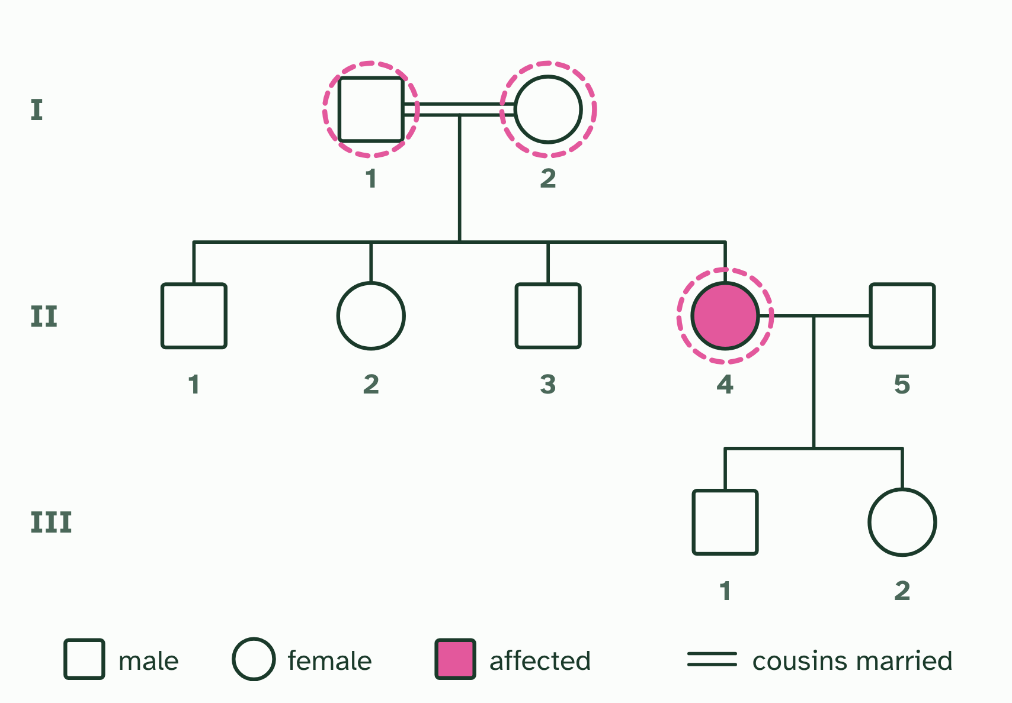
CHAPTER 10 · D3.2.13 Pedigree charts
2 / 2
Reading a family tree
Look first at I-1, I-2 and II-4, ringed: they rule out at least one way of inheriting. Which patterns could give this tree, and which are ruled out?
Minutes 17 to 25
Notes:
Minutes 17 to 25 of 60: Test your hunch (8 min).
The plan: The pedigree tool in chapter 10, the first two families. Students choose a pattern, then see which are ruled out and why. Do not move on until each pair can say the reason.
A pedigree chart follows a trait through a family. Squares are males and circles are females. A filled shape means the person has the condition, and a line across joins a couple, with their children below. Generations are numbered I, II, III from the top.
You cannot cross people to see what happens, so you read the pattern instead. The aim is to work out whether the condition is dominant or recessive, and whether the gene is autosomal or on the X. Some patterns settle it. Others leave more than one possibility.
Chart reading uses two kinds of reasoning. Looking over the family and deciding "this pattern fits a recessive trait" is inductive reasoning: you generalise from the cases you can see. Once you have the pattern, you use deductive reasoning to find the genotype of a particular person: if the trait is recessive, an affected woman must be nn, and her unaffected parents must both be Nn.
Pedigrees also explain a rule found in many societies, that close relatives may not marry. Relatives share alleles they inherited from common ancestors. If a harmful recessive allele runs in a family, two relatives are more likely to carry the same one, so their children are more likely to be homozygous recessive and have the condition. That is the genetic basis only; the rule has other roots too.
Example: Nature of science Scientists draw general conclusions by inductive reasoning: they base a theory on some of the cases, not all. A pattern deduced from part of a pedigree is a theory, and it then lets you deduce the genotypes of particular people. Keep the two kinds of reasoning apart in your answers.

Slide 13
CHAPTER 10 · D3.2.13 Pedigree charts
Reading a family tree
A pedigree chart follows a trait through a family.
Looking over the family and deciding "this pattern fits a recessive trait" is inductive reasoning: you generalise from the cases you can see.
Once you have the pattern, you use deductive reasoning to find the genotype of a particular person: if the trait is recessive, an affected woman must be nn, and her unaffected parents must both be Nn.
Minutes 17 to 25
Notes:
Minutes 17 to 25 of 60: Test your hunch (8 min).
The plan: The pedigree tool in chapter 10, the first two families. Students choose a pattern, then see which are ruled out and why. Do not move on until each pair can say the reason.
A pedigree chart follows a trait through a family. Squares are males and circles are females. A filled shape means the person has the condition, and a line across joins a couple, with their children below. Generations are numbered I, II, III from the top.
You cannot cross people to see what happens, so you read the pattern instead. The aim is to work out whether the condition is dominant or recessive, and whether the gene is autosomal or on the X. Some patterns settle it. Others leave more than one possibility.
Chart reading uses two kinds of reasoning. Looking over the family and deciding "this pattern fits a recessive trait" is inductive reasoning: you generalise from the cases you can see. Once you have the pattern, you use deductive reasoning to find the genotype of a particular person: if the trait is recessive, an affected woman must be nn, and her unaffected parents must both be Nn.
Pedigrees also explain a rule found in many societies, that close relatives may not marry. Relatives share alleles they inherited from common ancestors. If a harmful recessive allele runs in a family, two relatives are more likely to carry the same one, so their children are more likely to be homozygous recessive and have the condition. That is the genetic basis only; the rule has other roots too.
Example: Nature of science Scientists draw general conclusions by inductive reasoning: they base a theory on some of the cases, not all. A pattern deduced from part of a pedigree is a theory, and it then lets you deduce the genotypes of particular people. Keep the two kinds of reasoning apart in your answers.

Slide 14
PREDICT
In a pedigree, two unaffected parents have an affected daughter. Which statement is correct?
A It is dominant, because it appeared in the child and in the family
B It is X-linked dominant, because the affected child is female
C It is recessive and autosomal, so both parents carry it
Minutes 17 to 25
Notes:
Minutes 17 to 25 of 60: Test your hunch (8 min).
The plan: The pedigree tool in chapter 10, the first two families. Students choose a pattern, then see which are ruled out and why. Do not move on until each pair can say the reason.
Ask for a show of hands, or mini whiteboards, before revealing. (Answer: C, on the next slide.)

Slide 15
WHAT HAPPENS
In a pedigree, two unaffected parents have an affected daughter. Which statement is correct?
A It is dominant, because it appeared in the child and in the family
B It is X-linked dominant, because the affected child is female
C It is recessive and autosomal, so both parents carry it
Recessive and autosomal. Unaffected parents with an affected child must both carry a hidden recessive allele. And an affected daughter with an unaffected father rules out an X-linked recessive condition, because she would need an affected father to get the X allele from him.
Minutes 17 to 25
Notes:
Minutes 17 to 25 of 60: Test your hunch (8 min).
The plan: The pedigree tool in chapter 10, the first two families. Students choose a pattern, then see which are ruled out and why. Do not move on until each pair can say the reason.
Answer: C. Recessive and autosomal. Unaffected parents with an affected child must both carry a hidden recessive allele. And an affected daughter with an unaffected father rules out an X-linked recessive condition, because she would need an affected father to get the X allele from him.

Slide 16
WATCH OUT
A pattern that fits is not proof. A small family may fit more than one inheritance pattern, so say "consistent with" unless the chart rules the others out.
Minutes 17 to 25
Notes:
Minutes 17 to 25 of 60: Test your hunch (8 min).
The plan: The pedigree tool in chapter 10, the first two families. Students choose a pattern, then see which are ruled out and why. Do not move on until each pair can say the reason.
A common mistake: say it, then ask who can say why it is wrong.

Slide 17

PUZZLE
20 MIN
Pedigree puzzles
THE TASK
Five invented pedigrees of increasing difficulty, each with a condition and a question: which patterns of inheritance are possible, and which can you rule out? Start with one where two unaffected parents have an affected child (recessive for certain, but autosomal or X-linked?), and finish with one that supports only one pattern. Students must give the line of reasoning in a sentence. Add a version with a deliberately ambiguous pedigree, and ask what extra information would settle it.
STUDENTS NEED
Printed pedigrees, coloured pencils.
Minutes 25 to 45
Notes:
Minutes 25 to 45 of 60: Pedigree puzzles (20 min).
The plan: The puzzles below in pairs, then the card sort of inductive and deductive steps. Walk round for the common slip: calling a recessive condition dominant because the family is large.
The activity: Pedigree puzzles. Five invented pedigrees of increasing difficulty, each with a condition and a question: which patterns of inheritance are possible, and which can you rule out? Start with one where two unaffected parents have an affected child (recessive for certain, but autosomal or X-linked?), and finish with one that supports only one pattern. Students must give the line of reasoning in a sentence. Add a version with a deliberately ambiguous pedigree, and ask what extra information would settle it.
Needs: printed pedigrees, coloured pencils.
The time: 20 minutes, minutes 25 to 45 of the plan.

Slide 18
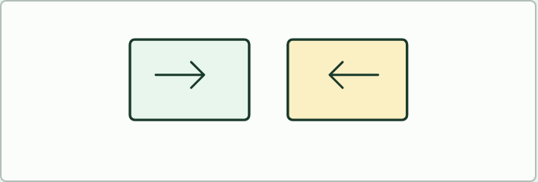
CARD SORT
IF THERE IS TIME
Inductive or deductive?
THE TASK
Eight statements from a pedigree investigation, for pairs to sort. Inductive, from particular cases to a general rule: "Every affected child so far has unaffected parents, so the condition is probably recessive." Deductive, from the rule to a particular case: "The condition is recessive, so the unaffected mother of an affected child must be a carrier." Ask which kind is more certain and why a rule reached by induction is only a theory until tested.
STUDENTS NEED
Printed cards, one set per pair.
Minutes 25 to 45
Notes:
Minutes 25 to 45 of 60: Pedigree puzzles (20 min).
The plan: The puzzles below in pairs, then the card sort of inductive and deductive steps. Walk round for the common slip: calling a recessive condition dominant because the family is large.
The activity: Inductive or deductive?. Eight statements from a pedigree investigation, for pairs to sort. Inductive, from particular cases to a general rule: "Every affected child so far has unaffected parents, so the condition is probably recessive." Deductive, from the rule to a particular case: "The condition is recessive, so the unaffected mother of an affected child must be a carrier." Ask which kind is more certain and why a rule reached by induction is only a theory until tested.
Needs: printed cards, one set per pair.
The plan sets no time of its own for this activity: use it in this step, in place of part of it, or for homework.

Slide 19
STEP 5
10 MIN
Why close relatives?
The genetic basis only: relatives are more likely to carry the same rare recessive allele, so a child of cousins has a higher chance of two copies.
Minutes 45 to 55
Notes:
Minutes 45 to 55 of 60: Why close relatives? (10 min).
The plan: The genetic basis only: relatives are more likely to carry the same rare recessive allele, so a child of cousins has a higher chance of two copies. Return to the PKU cross. Keep the discussion on the genetics and treat the social reasons as outside the course.

Slide 20
PLENARY
Can you now...
Use pedigree charts to deduce patterns of inheritance of genetic disorders (D3.2.13)
Minutes 55 to 60
Notes:
Minutes 55 to 60 of 60: Exit (5 min).
The plan: The one pedigree rule that is most useful to you, and a pedigree on which it works. Collect.
Thumbs up, sideways or down on each goal before the exit question. The goals come from the statements this lesson covers.

Slide 21
EXIT QUESTION
Before you go
The one pedigree rule that is most useful to you, and a pedigree on which it works.
Minutes 55 to 60
Notes:
Minutes 55 to 60 of 60: Exit (5 min).
The plan: The one pedigree rule that is most useful to you, and a pedigree on which it works. Collect.

Slide 22
PRACTISE AND REVISE
Keep going
Exam practice: a fresh paper of exam questions on D3.2 at standard level, marked as you go
The guide, with the animations and the dry lab
This lesson in the guide: 10 Reading a family tree
BUILD FOR YOUR CLASS
ALREADY ON THE SITE FOR D3.2
CARD SETS ON SPLYCR
Tarsia puzzle, dominoes and picture reveal on D3.2, built from its key terms and ready to print
A pub quiz with rounds on D3.2, to present or run with no projector
An escape room built from the question bank on D3.2
Lesson: Linked Genes & Chi-Squared
Lesson: Dihybrid Crosses & Test Crosses
Lesson: Inheritance
Summary doodle: Inheritance
Quiz: Inheritance
Revision map: D3.2 Inheritance, to fill in
Exam questions: D3.2 in the exam maker, a paper with its markscheme
Open a set to host it as a class game, or make a copy to edit.
D3.2 Inheritance
How this was made. The course structure, the activities and the teaching choices come from my own classroom, my presentations and my years of teaching IB and AP Biology. I use Claude, an AI, to help write and build the interactive guides, lesson plans, slides and practice questions, and to draw the diagrams and code the interactives. I direct the work and review it against the IB and AP specifications before it goes live.
Minute 60: after the lesson
Notes:
Every link here is live. Set the exam practice paper for homework: it is fresh each time, marked as students go and saved to their Exam practice when they are signed in.
Exam practice: https://www.biologybybradford.com/exam-maker/sit?topics=D3.2&level=SL&paper=quiz&marks=15&src=ep
The guide: https://www.biologybybradford.com/guides/ib-biology-d3-2-inheritance

