Slide 1
IB Biology D3.2
LESSON 5 OF 8
BY THE END YOU CAN
Inheritance
Explain continuous variation as the result of polygenic inheritance and the environment (D3.2.14)
Draw and read box-and-whisker plots for a continuous variable such as student height (D3.2.15)
A spread, not a few types
D3.2.14 and D3.2.15
Continuous variation from polygenic inheritance and the environment, and drawing and reading box-and-whisker plots
60 minutes · chapters 11, 12
Minute 0
Notes:
IB Biology D3.2, Inheritance. Lesson 5 of 8: A spread, not a few types, 60 minutes.
The plan, minute by minute (each slide's footer says where you are):
0 to 5 min (5) Do now
5 to 20 min (15) The six-coin model
20 to 30 min (10) Discrete and continuous
30 to 52 min (22) Box-and-whisker plots
52 to 60 min (8) Exit and linking question
What students get wrong:
Continuous variation is only caused by the environment. Several genes, each with a small effect, give a smooth spread even before the environment adds to it.
Outliers should be deleted. A box plot marks them so the reader can see them. Remove one only if you can show it was a mistake.
Stretch and support:
Support: step-by-step boxes for finding the median and quartiles, with a worked example.
Stretch: how might you tell a hill-shaped spread caused by the environment from one caused by several genes? Think about family data.
The lesson plan to print: https://www.biologybybradford.com/guides/downloads/ib-biology-d3-2-inheritance-lesson-5-plan.pdf

Slide 2
DO NOW
Do now
Where does your height fall, compared with the class?
Students put a sticky note on an anonymous number line.
Do they sit in two groups or form a hill?
Why?
5:00
minutes
Start now: the timer is running.
Minutes 0 to 5
Notes:
Minutes 0 to 5 of 60: Do now (5 min).
The plan: Where does your height fall, compared with the class? Students put a sticky note on an anonymous number line. Do they sit in two groups or form a hill? Why?
Start a 5 minute timer as they come in.

Slide 3
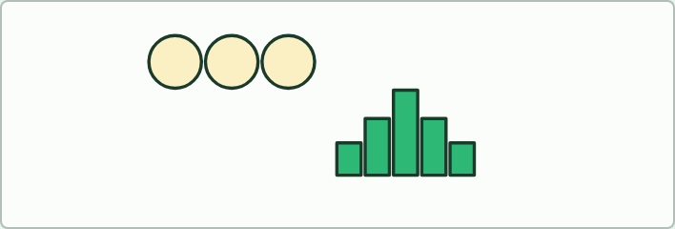
MODEL
15 MIN
The six-coin model
THE TASK
Each student has six coins, one for each of six genes. Heads is an allele that adds one unit of pigment, tails adds none. Flip all six, count the heads, and add a mark to the class bar chart (0 to 6). Then try again with one coin, and with the six coins plus a second round in which "sun" adds or removes one unit for a random half of the students. What shape does the chart have each time? Link to skin colour: many genes, each with a small effect, plus the environment.
STUDENTS NEED
Six coins per student, a class tally chart.
Minutes 5 to 20
Notes:
Minutes 5 to 20 of 60: The six-coin model (15 min).
The plan: The activity below. Each student flips six coins to build a "genotype" for a polygenic trait and the class builds the bar chart of totals. Compare with one coin and the two groups it gives.
The activity: The six-coin model. Each student has six coins, one for each of six genes. Heads is an allele that adds one unit of pigment, tails adds none. Flip all six, count the heads, and add a mark to the class bar chart (0 to 6). Then try again with one coin, and with the six coins plus a second round in which "sun" adds or removes one unit for a random half of the students. What shape does the chart have each time? Link to skin colour: many genes, each with a small effect, plus the environment.
Needs: six coins per student, a class tally chart.
The time: 15 minutes, minutes 5 to 20 of the plan.

Slide 4
STEP 3
10 MIN
Discrete and continuous
Students sort the traits on the card.
Minutes 20 to 30
Notes:
Minutes 20 to 30 of 60: Discrete and continuous (10 min).
The plan: Chapter 11's figure. Students sort the traits on the card: blood group, tongue rolling, height, skin colour, hand span, number of petals. Ask what skin colour needs, besides several genes, to give a smooth spread.

Slide 5
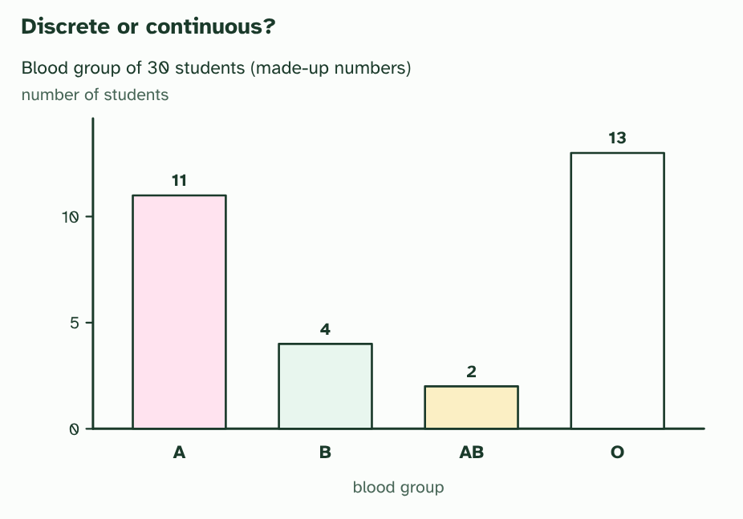
CHAPTER 11 · D3.2.14 Continuous variation
1 / 3
A spread, not a few types
Discrete variation: the bars are separate, because nobody is halfway between two blood groups.
Minutes 20 to 30
Notes:
Minutes 20 to 30 of 60: Discrete and continuous (10 min).
The plan: Chapter 11's figure. Students sort the traits on the card: blood group, tongue rolling, height, skin colour, hand span, number of petals. Ask what skin colour needs, besides several genes, to give a smooth spread.
Some traits come in a few clear types. ABO blood group is A, B, AB or O, and nobody is halfway. That is discrete variation, and it usually comes from one gene with a few alleles. Other traits, such as height, skin colour or the mass of a seed, form a smooth range with every value in between. That is continuous variation.
What makes the difference? Two things, often together. A trait can be polygenic: controlled by several genes whose small effects add up. With one gene you get a few types. With many genes you get many combinations of alleles and a smooth spread. And the environment blurs the steps further, because it nudges every genotype a little up or down.
Human skin colour is the standard example. The amount of the pigment melanin depends on several genes, and also on sun exposure. The figure uses a very simple model: six alleles, each making the skin a little lighter or a little darker, like six coins. Most combinations land near the middle, and the extremes are rare. The real picture has more genes with unequal effects, but the pattern is the same: a smooth spread with most people near the middle.
You describe the middle of such data with three numbers. The mean is the sum divided by the number of values. The median is the middle value when they are in order. The mode is the most frequent value.
Example: Five heights in centimetres: 150, 158, 160, 160 and 182. The mean is 810 ÷ 5 = 162, the median is 160 and the mode is 160. One tall value pulls the mean up but leaves the median where it was.

Slide 6
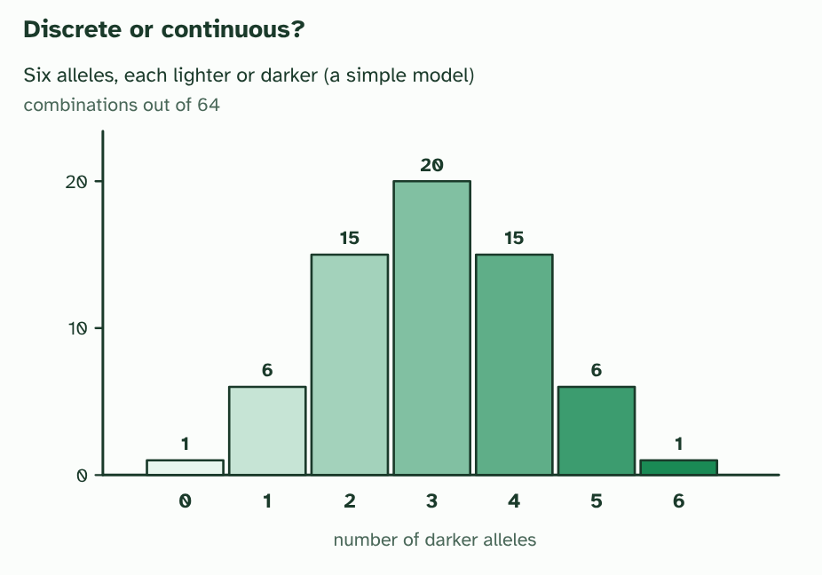
CHAPTER 11 · D3.2.14 Continuous variation
2 / 3
A spread, not a few types
A simple model of a polygenic trait: six alleles, each lighter or darker. Combinations with three darker alleles are commonest, and the extremes are rare.
Minutes 20 to 30
Notes:
Minutes 20 to 30 of 60: Discrete and continuous (10 min).
The plan: Chapter 11's figure. Students sort the traits on the card: blood group, tongue rolling, height, skin colour, hand span, number of petals. Ask what skin colour needs, besides several genes, to give a smooth spread.
Some traits come in a few clear types. ABO blood group is A, B, AB or O, and nobody is halfway. That is discrete variation, and it usually comes from one gene with a few alleles. Other traits, such as height, skin colour or the mass of a seed, form a smooth range with every value in between. That is continuous variation.
What makes the difference? Two things, often together. A trait can be polygenic: controlled by several genes whose small effects add up. With one gene you get a few types. With many genes you get many combinations of alleles and a smooth spread. And the environment blurs the steps further, because it nudges every genotype a little up or down.
Human skin colour is the standard example. The amount of the pigment melanin depends on several genes, and also on sun exposure. The figure uses a very simple model: six alleles, each making the skin a little lighter or a little darker, like six coins. Most combinations land near the middle, and the extremes are rare. The real picture has more genes with unequal effects, but the pattern is the same: a smooth spread with most people near the middle.
You describe the middle of such data with three numbers. The mean is the sum divided by the number of values. The median is the middle value when they are in order. The mode is the most frequent value.
Example: Five heights in centimetres: 150, 158, 160, 160 and 182. The mean is 810 ÷ 5 = 162, the median is 160 and the mode is 160. One tall value pulls the mean up but leaves the median where it was.

Slide 7
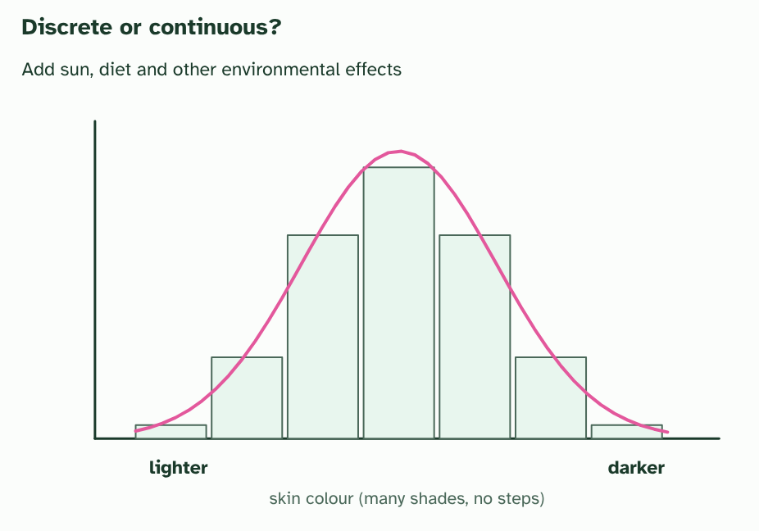
CHAPTER 11 · D3.2.14 Continuous variation
3 / 3
A spread, not a few types
Add the environment and the steps blur into a smooth, continuous spread.
Minutes 20 to 30
Notes:
Minutes 20 to 30 of 60: Discrete and continuous (10 min).
The plan: Chapter 11's figure. Students sort the traits on the card: blood group, tongue rolling, height, skin colour, hand span, number of petals. Ask what skin colour needs, besides several genes, to give a smooth spread.
Some traits come in a few clear types. ABO blood group is A, B, AB or O, and nobody is halfway. That is discrete variation, and it usually comes from one gene with a few alleles. Other traits, such as height, skin colour or the mass of a seed, form a smooth range with every value in between. That is continuous variation.
What makes the difference? Two things, often together. A trait can be polygenic: controlled by several genes whose small effects add up. With one gene you get a few types. With many genes you get many combinations of alleles and a smooth spread. And the environment blurs the steps further, because it nudges every genotype a little up or down.
Human skin colour is the standard example. The amount of the pigment melanin depends on several genes, and also on sun exposure. The figure uses a very simple model: six alleles, each making the skin a little lighter or a little darker, like six coins. Most combinations land near the middle, and the extremes are rare. The real picture has more genes with unequal effects, but the pattern is the same: a smooth spread with most people near the middle.
You describe the middle of such data with three numbers. The mean is the sum divided by the number of values. The median is the middle value when they are in order. The mode is the most frequent value.
Example: Five heights in centimetres: 150, 158, 160, 160 and 182. The mean is 810 ÷ 5 = 162, the median is 160 and the mode is 160. One tall value pulls the mean up but leaves the median where it was.

Slide 8
CHAPTER 11 · D3.2.14 Continuous variation
A spread, not a few types
ABO blood group is A, B, AB or O, and nobody is halfway. That is discrete variation, and it usually comes from one gene with a few alleles.
Other traits, such as height, skin colour or the mass of a seed, form a smooth range with every value in between. That is continuous variation.
A trait can be polygenic: controlled by several genes whose small effects add up.
Minutes 20 to 30
Notes:
Minutes 20 to 30 of 60: Discrete and continuous (10 min).
The plan: Chapter 11's figure. Students sort the traits on the card: blood group, tongue rolling, height, skin colour, hand span, number of petals. Ask what skin colour needs, besides several genes, to give a smooth spread.
Some traits come in a few clear types. ABO blood group is A, B, AB or O, and nobody is halfway. That is discrete variation, and it usually comes from one gene with a few alleles. Other traits, such as height, skin colour or the mass of a seed, form a smooth range with every value in between. That is continuous variation.
What makes the difference? Two things, often together. A trait can be polygenic: controlled by several genes whose small effects add up. With one gene you get a few types. With many genes you get many combinations of alleles and a smooth spread. And the environment blurs the steps further, because it nudges every genotype a little up or down.
Human skin colour is the standard example. The amount of the pigment melanin depends on several genes, and also on sun exposure. The figure uses a very simple model: six alleles, each making the skin a little lighter or a little darker, like six coins. Most combinations land near the middle, and the extremes are rare. The real picture has more genes with unequal effects, but the pattern is the same: a smooth spread with most people near the middle.
You describe the middle of such data with three numbers. The mean is the sum divided by the number of values. The median is the middle value when they are in order. The mode is the most frequent value.
Example: Five heights in centimetres: 150, 158, 160, 160 and 182. The mean is 810 ÷ 5 = 162, the median is 160 and the mode is 160. One tall value pulls the mean up but leaves the median where it was.

Slide 9
PREDICT
Which of these shows discrete variation?
A The heights of all the students in a class
B The blood groups of students in a class
C The masses of seeds taken from one plant
Minutes 20 to 30
Notes:
Minutes 20 to 30 of 60: Discrete and continuous (10 min).
The plan: Chapter 11's figure. Students sort the traits on the card: blood group, tongue rolling, height, skin colour, hand span, number of petals. Ask what skin colour needs, besides several genes, to give a smooth spread.
Ask for a show of hands, or mini whiteboards, before revealing. (Answer: B, on the next slide.)

Slide 10
WHAT HAPPENS
Which of these shows discrete variation?
A The heights of all the students in a class
B The blood groups of students in a class
C The masses of seeds taken from one plant
The blood groups. Every student is A, B, AB or O, with nothing in between, so the variation falls into separate categories. Height and seed mass can take any value in a range, which is continuous variation.
Minutes 20 to 30
Notes:
Minutes 20 to 30 of 60: Discrete and continuous (10 min).
The plan: Chapter 11's figure. Students sort the traits on the card: blood group, tongue rolling, height, skin colour, hand span, number of petals. Ask what skin colour needs, besides several genes, to give a smooth spread.
Answer: B. The blood groups. Every student is A, B, AB or O, with nothing in between, so the variation falls into separate categories. Height and seed mass can take any value in a range, which is continuous variation.

Slide 11
WATCH OUT
Continuous does not mean "not genetic". Height is strongly affected by genes. And polygenic does not mean "no dominance": each of the genes can still have dominant and recessive alleles.
Minutes 20 to 30
Notes:
Minutes 20 to 30 of 60: Discrete and continuous (10 min).
The plan: Chapter 11's figure. Students sort the traits on the card: blood group, tongue rolling, height, skin colour, hand span, number of petals. Ask what skin colour needs, besides several genes, to give a smooth spread.
A common mistake: say it, then ask who can say why it is wrong.

Slide 12
STEP 4
22 MIN
Box-and-whisker plots
Chapter 12: Showing a spread with a box plot
Data task: Hand spans and box plots
Minutes 30 to 52
Notes:
Minutes 30 to 52 of 60: Box-and-whisker plots (22 min).
The plan: Chapter 12's figure and the box plot tool. Then the hand span task below: collect anonymous measurements, find the median and quartiles, draw the plot by hand and check it with the tool. Ask which values are outliers and what the 1.5 times IQR rule says.

Slide 13
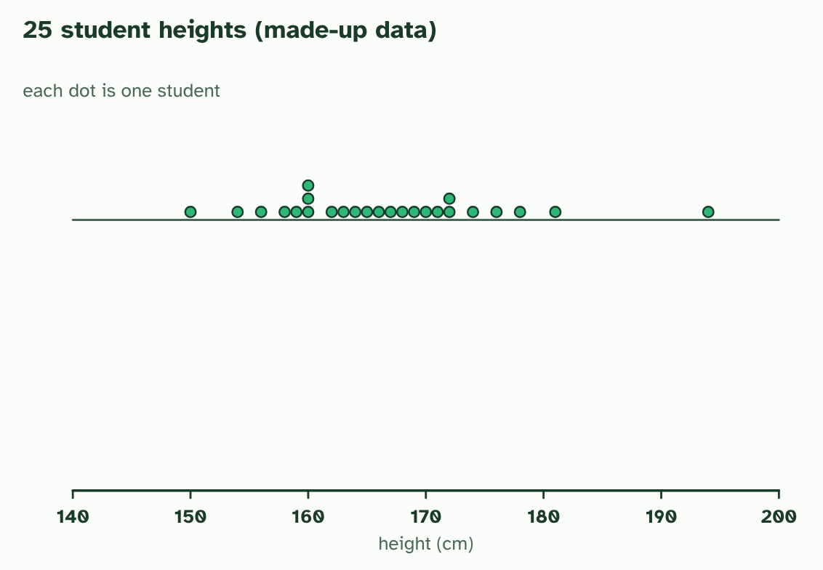
CHAPTER 12 · D3.2.15 Box-and-whisker plots
1 / 4
Showing a spread with a box plot
25 student heights, one dot each (made up). Where is the middle, and how spread out are they?
Minutes 30 to 52
Notes:
Minutes 30 to 52 of 60: Box-and-whisker plots (22 min).
The plan: Chapter 12's figure and the box plot tool. Then the hand span task below: collect anonymous measurements, find the median and quartiles, draw the plot by hand and check it with the tool. Ask which values are outliers and what the 1.5 times IQR rule says.
A graph of continuous data should show the middle and the spread. A box-and-whisker plot does it with six aspects of the data: the minimum, the first quartile, the median, the third quartile, the maximum and any outliers.
Put the values in order. The median splits them in half. The quartiles split each half again: a quarter of the values are below Q1 and a quarter are above Q3. The box runs from Q1 to Q3 with the median marked inside, so half of all the data are in the box. The length of the box, Q3 − Q1, is the interquartile range (IQR). Calculators and spreadsheets work out quartiles by slightly different rules, so use the rule you are given.
A value is an outlier if it is more than 1.5 × IQR above Q3 or below Q1. In the figure the IQR is 172 − 160 = 12, so the fences are at 160 − 18 = 142 and 172 + 18 = 190. The whiskers run to the lowest and highest values inside the fences, 150 and 181, and the 194 cm student is plotted on their own.
Example: For the 25 made-up heights: median 166 cm, mean 166.8 cm (to one decimal place), mode 160 cm and range 44 cm (150 to 194). The one outlier pulls the mean a little above the median.

Slide 14
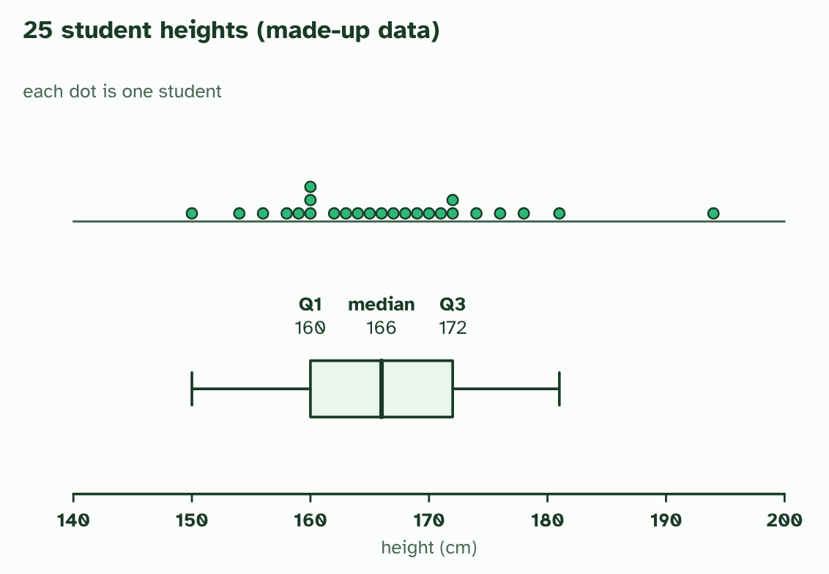
CHAPTER 12 · D3.2.15 Box-and-whisker plots
2 / 4
Showing a spread with a box plot
The box runs from Q1 to Q3 with the median marked. The whiskers run to the smallest and largest values that are not outliers.
Minutes 30 to 52
Notes:
Minutes 30 to 52 of 60: Box-and-whisker plots (22 min).
The plan: Chapter 12's figure and the box plot tool. Then the hand span task below: collect anonymous measurements, find the median and quartiles, draw the plot by hand and check it with the tool. Ask which values are outliers and what the 1.5 times IQR rule says.
A graph of continuous data should show the middle and the spread. A box-and-whisker plot does it with six aspects of the data: the minimum, the first quartile, the median, the third quartile, the maximum and any outliers.
Put the values in order. The median splits them in half. The quartiles split each half again: a quarter of the values are below Q1 and a quarter are above Q3. The box runs from Q1 to Q3 with the median marked inside, so half of all the data are in the box. The length of the box, Q3 − Q1, is the interquartile range (IQR). Calculators and spreadsheets work out quartiles by slightly different rules, so use the rule you are given.
A value is an outlier if it is more than 1.5 × IQR above Q3 or below Q1. In the figure the IQR is 172 − 160 = 12, so the fences are at 160 − 18 = 142 and 172 + 18 = 190. The whiskers run to the lowest and highest values inside the fences, 150 and 181, and the 194 cm student is plotted on their own.
Example: For the 25 made-up heights: median 166 cm, mean 166.8 cm (to one decimal place), mode 160 cm and range 44 cm (150 to 194). The one outlier pulls the mean a little above the median.

Slide 15
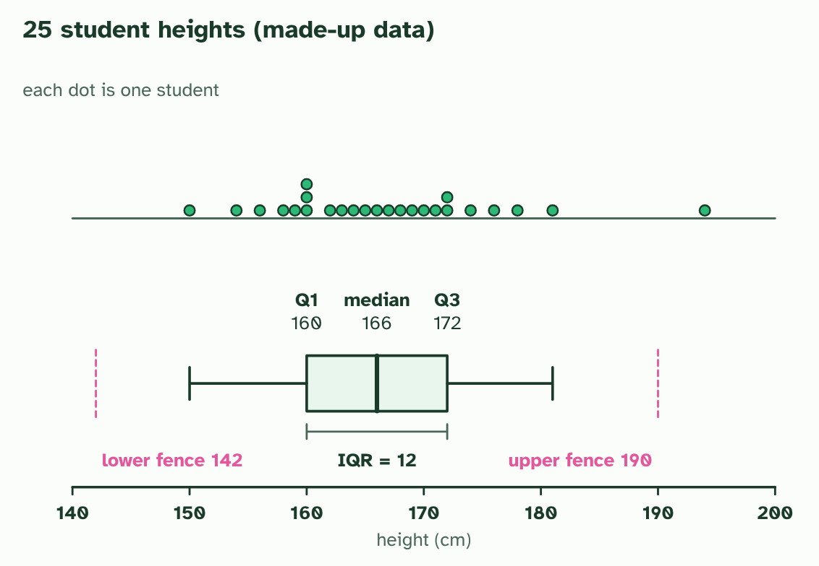
CHAPTER 12 · D3.2.15 Box-and-whisker plots
3 / 4
Showing a spread with a box plot
IQR = 172 − 160 = 12. The fences lie 1.5 × IQR beyond the box, at 142 and 190.
Minutes 30 to 52
Notes:
Minutes 30 to 52 of 60: Box-and-whisker plots (22 min).
The plan: Chapter 12's figure and the box plot tool. Then the hand span task below: collect anonymous measurements, find the median and quartiles, draw the plot by hand and check it with the tool. Ask which values are outliers and what the 1.5 times IQR rule says.
A graph of continuous data should show the middle and the spread. A box-and-whisker plot does it with six aspects of the data: the minimum, the first quartile, the median, the third quartile, the maximum and any outliers.
Put the values in order. The median splits them in half. The quartiles split each half again: a quarter of the values are below Q1 and a quarter are above Q3. The box runs from Q1 to Q3 with the median marked inside, so half of all the data are in the box. The length of the box, Q3 − Q1, is the interquartile range (IQR). Calculators and spreadsheets work out quartiles by slightly different rules, so use the rule you are given.
A value is an outlier if it is more than 1.5 × IQR above Q3 or below Q1. In the figure the IQR is 172 − 160 = 12, so the fences are at 160 − 18 = 142 and 172 + 18 = 190. The whiskers run to the lowest and highest values inside the fences, 150 and 181, and the 194 cm student is plotted on their own.
Example: For the 25 made-up heights: median 166 cm, mean 166.8 cm (to one decimal place), mode 160 cm and range 44 cm (150 to 194). The one outlier pulls the mean a little above the median.

Slide 16
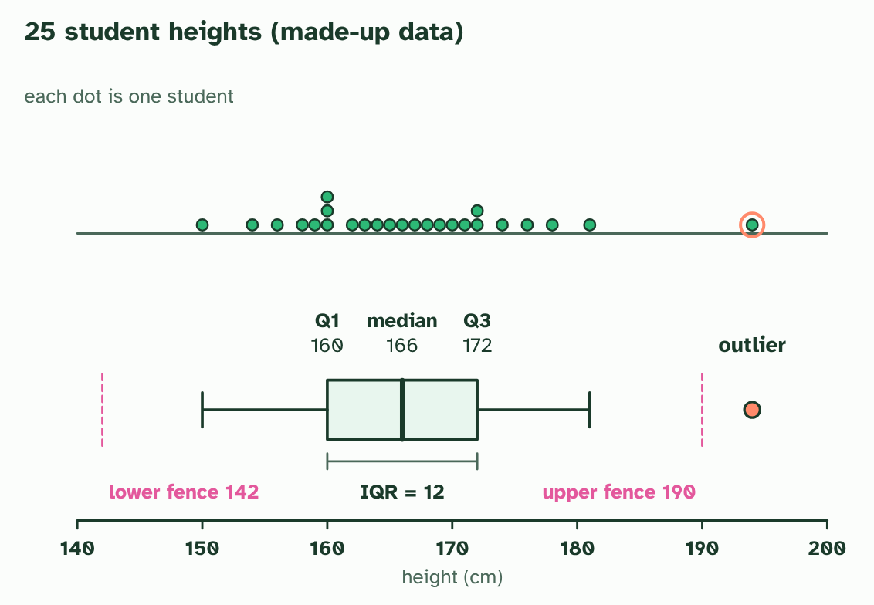
CHAPTER 12 · D3.2.15 Box-and-whisker plots
4 / 4
Showing a spread with a box plot
A value beyond a fence is an outlier: 194 is above 190, so it is plotted on its own.
Minutes 30 to 52
Notes:
Minutes 30 to 52 of 60: Box-and-whisker plots (22 min).
The plan: Chapter 12's figure and the box plot tool. Then the hand span task below: collect anonymous measurements, find the median and quartiles, draw the plot by hand and check it with the tool. Ask which values are outliers and what the 1.5 times IQR rule says.
A graph of continuous data should show the middle and the spread. A box-and-whisker plot does it with six aspects of the data: the minimum, the first quartile, the median, the third quartile, the maximum and any outliers.
Put the values in order. The median splits them in half. The quartiles split each half again: a quarter of the values are below Q1 and a quarter are above Q3. The box runs from Q1 to Q3 with the median marked inside, so half of all the data are in the box. The length of the box, Q3 − Q1, is the interquartile range (IQR). Calculators and spreadsheets work out quartiles by slightly different rules, so use the rule you are given.
A value is an outlier if it is more than 1.5 × IQR above Q3 or below Q1. In the figure the IQR is 172 − 160 = 12, so the fences are at 160 − 18 = 142 and 172 + 18 = 190. The whiskers run to the lowest and highest values inside the fences, 150 and 181, and the 194 cm student is plotted on their own.
Example: For the 25 made-up heights: median 166 cm, mean 166.8 cm (to one decimal place), mode 160 cm and range 44 cm (150 to 194). The one outlier pulls the mean a little above the median.

Slide 17
CHAPTER 12 · D3.2.15 Box-and-whisker plots
Showing a spread with a box plot
A box-and-whisker plot does it with six aspects of the data: the minimum, the first quartile, the median, the third quartile, the maximum and any outliers.
The quartiles split each half again: a quarter of the values are below Q1 and a quarter are above Q3.
The length of the box, Q3 − Q1, is the interquartile range (IQR).
Calculators and spreadsheets work out quartiles by slightly different rules, so use the rule you are given.
Minutes 30 to 52
Notes:
Minutes 30 to 52 of 60: Box-and-whisker plots (22 min).
The plan: Chapter 12's figure and the box plot tool. Then the hand span task below: collect anonymous measurements, find the median and quartiles, draw the plot by hand and check it with the tool. Ask which values are outliers and what the 1.5 times IQR rule says.
A graph of continuous data should show the middle and the spread. A box-and-whisker plot does it with six aspects of the data: the minimum, the first quartile, the median, the third quartile, the maximum and any outliers.
Put the values in order. The median splits them in half. The quartiles split each half again: a quarter of the values are below Q1 and a quarter are above Q3. The box runs from Q1 to Q3 with the median marked inside, so half of all the data are in the box. The length of the box, Q3 − Q1, is the interquartile range (IQR). Calculators and spreadsheets work out quartiles by slightly different rules, so use the rule you are given.
A value is an outlier if it is more than 1.5 × IQR above Q3 or below Q1. In the figure the IQR is 172 − 160 = 12, so the fences are at 160 − 18 = 142 and 172 + 18 = 190. The whiskers run to the lowest and highest values inside the fences, 150 and 181, and the 194 cm student is plotted on their own.
Example: For the 25 made-up heights: median 166 cm, mean 166.8 cm (to one decimal place), mode 160 cm and range 44 cm (150 to 194). The one outlier pulls the mean a little above the median.

Slide 18
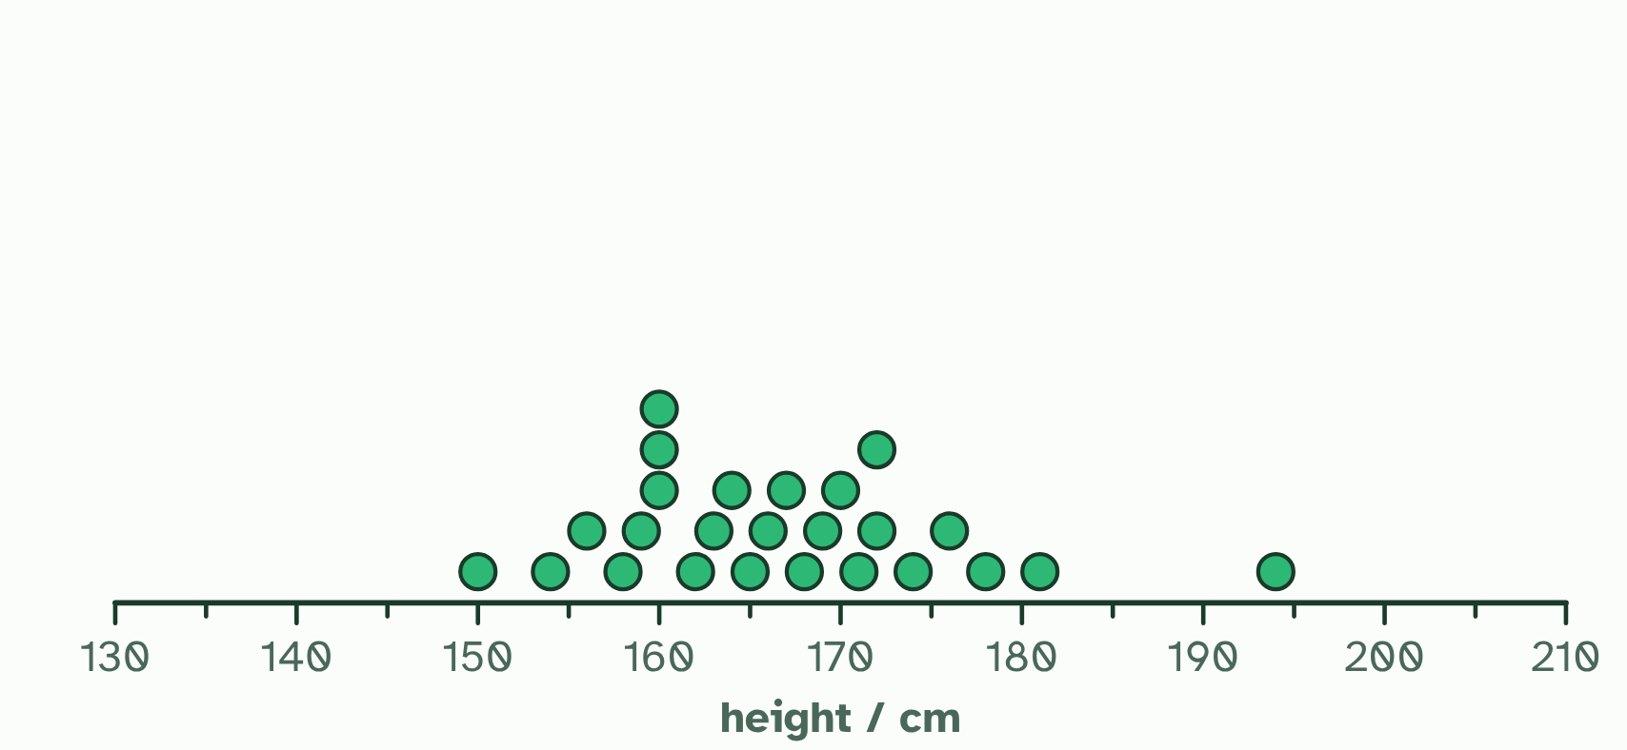
CHAPTER 12 · D3.2.15 Box-and-whisker plots
1 / 2
Showing a spread with a box plot
Heights of 25 students in one class (made-up data). Height varies continuously: each dot is one student, and the values spread out with most near the middle.
Minutes 30 to 52
Notes:
Minutes 30 to 52 of 60: Box-and-whisker plots (22 min).
The plan: Chapter 12's figure and the box plot tool. Then the hand span task below: collect anonymous measurements, find the median and quartiles, draw the plot by hand and check it with the tool. Ask which values are outliers and what the 1.5 times IQR rule says.
A graph of continuous data should show the middle and the spread. A box-and-whisker plot does it with six aspects of the data: the minimum, the first quartile, the median, the third quartile, the maximum and any outliers.
Put the values in order. The median splits them in half. The quartiles split each half again: a quarter of the values are below Q1 and a quarter are above Q3. The box runs from Q1 to Q3 with the median marked inside, so half of all the data are in the box. The length of the box, Q3 − Q1, is the interquartile range (IQR). Calculators and spreadsheets work out quartiles by slightly different rules, so use the rule you are given.
A value is an outlier if it is more than 1.5 × IQR above Q3 or below Q1. In the figure the IQR is 172 − 160 = 12, so the fences are at 160 − 18 = 142 and 172 + 18 = 190. The whiskers run to the lowest and highest values inside the fences, 150 and 181, and the 194 cm student is plotted on their own.
Example: For the 25 made-up heights: median 166 cm, mean 166.8 cm (to one decimal place), mode 160 cm and range 44 cm (150 to 194). The one outlier pulls the mean a little above the median.

Slide 19
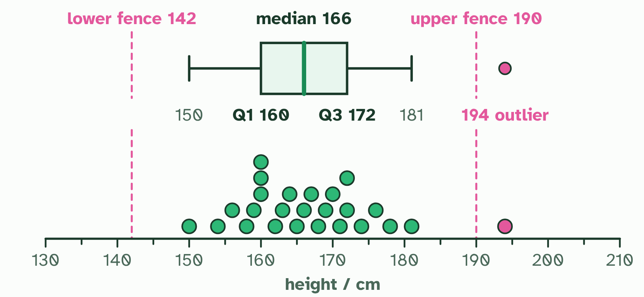
CHAPTER 12 · D3.2.15 Box-and-whisker plots
2 / 2
Showing a spread with a box plot
The box runs from Q1 (160) to Q3 (172) with the median (166) inside; the whiskers reach the furthest values within 1.5 x IQR of the box (the dashed fences, 142 and 190). Beyond them, 194 is an outlier.
Minutes 30 to 52
Notes:
Minutes 30 to 52 of 60: Box-and-whisker plots (22 min).
The plan: Chapter 12's figure and the box plot tool. Then the hand span task below: collect anonymous measurements, find the median and quartiles, draw the plot by hand and check it with the tool. Ask which values are outliers and what the 1.5 times IQR rule says.
A graph of continuous data should show the middle and the spread. A box-and-whisker plot does it with six aspects of the data: the minimum, the first quartile, the median, the third quartile, the maximum and any outliers.
Put the values in order. The median splits them in half. The quartiles split each half again: a quarter of the values are below Q1 and a quarter are above Q3. The box runs from Q1 to Q3 with the median marked inside, so half of all the data are in the box. The length of the box, Q3 − Q1, is the interquartile range (IQR). Calculators and spreadsheets work out quartiles by slightly different rules, so use the rule you are given.
A value is an outlier if it is more than 1.5 × IQR above Q3 or below Q1. In the figure the IQR is 172 − 160 = 12, so the fences are at 160 − 18 = 142 and 172 + 18 = 190. The whiskers run to the lowest and highest values inside the fences, 150 and 181, and the 194 cm student is plotted on their own.
Example: For the 25 made-up heights: median 166 cm, mean 166.8 cm (to one decimal place), mode 160 cm and range 44 cm (150 to 194). The one outlier pulls the mean a little above the median.

Slide 20
CHAPTER 12 · D3.2.15 Box-and-whisker plots
Showing a spread with a box plot
A box-and-whisker plot does it with six aspects of the data: the minimum, the first quartile, the median, the third quartile, the maximum and any outliers.
The quartiles split each half again: a quarter of the values are below Q1 and a quarter are above Q3.
The length of the box, Q3 − Q1, is the interquartile range (IQR).
Calculators and spreadsheets work out quartiles by slightly different rules, so use the rule you are given.
Minutes 30 to 52
Notes:
Minutes 30 to 52 of 60: Box-and-whisker plots (22 min).
The plan: Chapter 12's figure and the box plot tool. Then the hand span task below: collect anonymous measurements, find the median and quartiles, draw the plot by hand and check it with the tool. Ask which values are outliers and what the 1.5 times IQR rule says.
A graph of continuous data should show the middle and the spread. A box-and-whisker plot does it with six aspects of the data: the minimum, the first quartile, the median, the third quartile, the maximum and any outliers.
Put the values in order. The median splits them in half. The quartiles split each half again: a quarter of the values are below Q1 and a quarter are above Q3. The box runs from Q1 to Q3 with the median marked inside, so half of all the data are in the box. The length of the box, Q3 − Q1, is the interquartile range (IQR). Calculators and spreadsheets work out quartiles by slightly different rules, so use the rule you are given.
A value is an outlier if it is more than 1.5 × IQR above Q3 or below Q1. In the figure the IQR is 172 − 160 = 12, so the fences are at 160 − 18 = 142 and 172 + 18 = 190. The whiskers run to the lowest and highest values inside the fences, 150 and 181, and the 194 cm student is plotted on their own.
Example: For the 25 made-up heights: median 166 cm, mean 166.8 cm (to one decimal place), mode 160 cm and range 44 cm (150 to 194). The one outlier pulls the mean a little above the median.

Slide 21
PREDICT
In a box plot, what fraction of the data lie inside the box?
A One quarter
B One half
C All of it, except the outliers
Minutes 30 to 52
Notes:
Minutes 30 to 52 of 60: Box-and-whisker plots (22 min).
The plan: Chapter 12's figure and the box plot tool. Then the hand span task below: collect anonymous measurements, find the median and quartiles, draw the plot by hand and check it with the tool. Ask which values are outliers and what the 1.5 times IQR rule says.
Ask for a show of hands, or mini whiteboards, before revealing. (Answer: B, on the next slide.)

Slide 22
WHAT HAPPENS
In a box plot, what fraction of the data lie inside the box?
A One quarter
B One half
C All of it, except the outliers
One half. The box runs from the first quartile to the third quartile, and a quarter of the data are below the first quartile and a quarter above the third, so the middle half is in the box.
Minutes 30 to 52
Notes:
Minutes 30 to 52 of 60: Box-and-whisker plots (22 min).
The plan: Chapter 12's figure and the box plot tool. Then the hand span task below: collect anonymous measurements, find the median and quartiles, draw the plot by hand and check it with the tool. Ask which values are outliers and what the 1.5 times IQR rule says.
Answer: B. One half. The box runs from the first quartile to the third quartile, and a quarter of the data are below the first quartile and a quarter above the third, so the middle half is in the box.

Slide 23
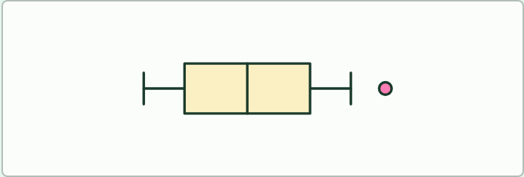
DATA TASK
22 MIN
Hand spans and box plots
THE TASK
Students measure their hand span in centimetres and write the number on a slip, with no names. Pool the numbers on the board, then in groups find the median and the quartiles, work out the interquartile range, and set the fences at 1.5 times the range above Q3 and below Q1. Draw the box-and-whisker plot by hand, mark any outlier, and check against the box plot tool. Ask what a plot tells you that a mean does not. Offer a second data set (an invented one of 25 heights) to test the rule on a clear outlier.
STUDENTS NEED
Rulers, squared paper, a pooled table on the board.
Minutes 30 to 52
Notes:
Minutes 30 to 52 of 60: Box-and-whisker plots (22 min).
The plan: Chapter 12's figure and the box plot tool. Then the hand span task below: collect anonymous measurements, find the median and quartiles, draw the plot by hand and check it with the tool. Ask which values are outliers and what the 1.5 times IQR rule says.
The activity: Hand spans and box plots. Students measure their hand span in centimetres and write the number on a slip, with no names. Pool the numbers on the board, then in groups find the median and the quartiles, work out the interquartile range, and set the fences at 1.5 times the range above Q3 and below Q1. Draw the box-and-whisker plot by hand, mark any outlier, and check against the box plot tool. Ask what a plot tells you that a mean does not. Offer a second data set (an invented one of 25 heights) to test the rule on a clear outlier.
Needs: rulers, squared paper, a pooled table on the board.
The time: 22 minutes, minutes 30 to 52 of the plan.

Slide 24
PLENARY
Can you now...
Explain continuous variation as the result of polygenic inheritance and the environment (D3.2.14)
Draw and read box-and-whisker plots for a continuous variable such as student height (D3.2.15)
Minutes 52 to 60
Notes:
Minutes 52 to 60 of 60: Exit and linking question (8 min).
The plan: What are the principles of effective sampling? Ask for two: a large enough sample, and one chosen so it represents the population. Then one sentence on why a class is a poor sample of all students.
Thumbs up, sideways or down on each goal before the exit question. The goals come from the statements this lesson covers.

Slide 25
EXIT QUESTION
And linking question
What are the principles of effective sampling?
Minutes 52 to 60
Notes:
Minutes 52 to 60 of 60: Exit and linking question (8 min).
The plan: What are the principles of effective sampling? Ask for two: a large enough sample, and one chosen so it represents the population. Then one sentence on why a class is a poor sample of all students.

Slide 26
PRACTISE AND REVISE
Keep going
Exam practice: a fresh paper of exam questions on D3.2 at standard level, marked as you go
The guide, with the animations and the dry lab
This lesson in the guide: 11 A spread, not a few types, 12 Showing a spread with a box plot
BUILD FOR YOUR CLASS
ALREADY ON THE SITE FOR D3.2
CARD SETS ON SPLYCR
Tarsia puzzle, dominoes and picture reveal on D3.2, built from its key terms and ready to print
A pub quiz with rounds on D3.2, to present or run with no projector
An escape room built from the question bank on D3.2
Lesson: Linked Genes & Chi-Squared
Lesson: Dihybrid Crosses & Test Crosses
Lesson: Inheritance
Summary doodle: Inheritance
Quiz: Inheritance
Revision map: D3.2 Inheritance, to fill in
Exam questions: D3.2 in the exam maker, a paper with its markscheme
Open a set to host it as a class game, or make a copy to edit.
D3.2 Inheritance
How this was made. The course structure, the activities and the teaching choices come from my own classroom, my presentations and my years of teaching IB and AP Biology. I use Claude, an AI, to help write and build the interactive guides, lesson plans, slides and practice questions, and to draw the diagrams and code the interactives. I direct the work and review it against the IB and AP specifications before it goes live.
Minute 60: after the lesson
Notes:
Every link here is live. Set the exam practice paper for homework: it is fresh each time, marked as students go and saved to their Exam practice when they are signed in.
Exam practice: https://www.biologybybradford.com/exam-maker/sit?topics=D3.2&level=SL&paper=quiz&marks=15&src=ep
The guide: https://www.biologybybradford.com/guides/ib-biology-d3-2-inheritance

