Slide 1
IB Biology D3.2
LESSON 6 OF 8
HL
BY THE END YOU CAN
Inheritance
Explain segregation and independent assortment of unlinked genes in meiosis (D3.2.16)
Use Punnett grids to predict genotypic and phenotypic ratios in dihybrid crosses of unlinked autosomal genes (D3.2.17)
Two genes at once
D3.2.16 and D3.2.17
Segregation and independent assortment of unlinked genes, and the Punnett grid for a dihybrid cross
60 minutes · chapter 13
Minute 0
Notes:
IB Biology D3.2, Inheritance. Lesson 6 of 8: Two genes at once (higher level), 60 minutes.
The plan, minute by minute (each slide's footer says where you are):
0 to 6 min (6) Do now
6 to 18 min (12) Watch the line-up
18 to 30 min (12) Gametes with two coins
30 to 50 min (20) The grid
50 to 60 min (10) Exam practice
What students get wrong:
"Two genes always assort independently." Only genes on different chromosomes, or far apart on one, do.
Stretch and support:
Support: the four gametes of a double heterozygote written out for the first two examples.
Stretch: in an F2 of 9 : 3 : 3 : 1, count seed colour on its own and then seed shape on its own. What ratio does each gene give, and what does that tell you? Each gives 3 : 1: the genes are sorted independently, so each still behaves as in a one-gene cross.
The lesson plan to print: https://www.biologybybradford.com/guides/downloads/ib-biology-d3-2-inheritance-lesson-6-plan.pdf

Slide 2
DO NOW
Do now
A pea plant is heterozygous for seed colour and seed shape.
List every kind of gamete it could make.
Students get 2 or 4; take a vote and keep it up.
6:00
minutes
Start now: the timer is running.
Minutes 0 to 6
Notes:
Minutes 0 to 6 of 60: Do now (6 min).
The plan: A pea plant is heterozygous for seed colour and seed shape. List every kind of gamete it could make. Students get 2 or 4; take a vote and keep it up.
Start a 6 minute timer as they come in.

Slide 3
STEP 2
12 MIN
Watch the line-up
Chapter 13: Two genes at once
Minutes 6 to 18
Notes:
Minutes 6 to 18 of 60: Watch the line-up (12 min).
The plan: Chapter 13's meiosis film at higher level. Pause at the line-up and show both ways the pairs can face. Define segregation and independent assortment, and note the nature of science point: the second law holds only for unlinked genes.

Slide 4
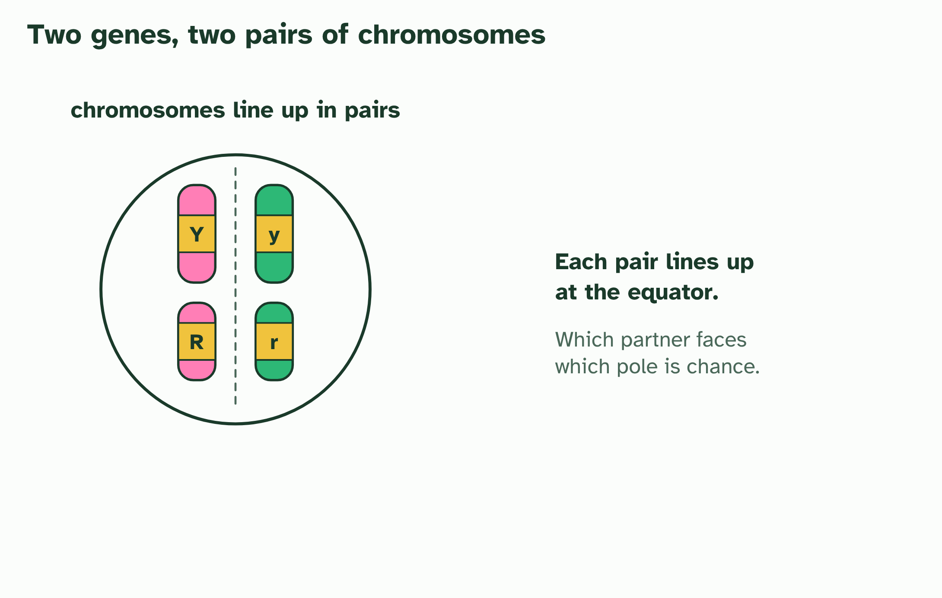
CHAPTER 13 · D3.2.16 D3.2.17 Segregation, independent assortment and dihybrid crosses
1 / 5
Two genes at once
In meiosis I each pair of homologous chromosomes lines up at the equator, and the partners go to opposite poles.
Minutes 6 to 18
Notes:
Minutes 6 to 18 of 60: Watch the line-up (12 min).
The plan: Chapter 13's meiosis film at higher level. Pause at the line-up and show both ways the pairs can face. Define segregation and independent assortment, and note the nature of science point: the second law holds only for unlinked genes.
A dihybrid cross follows two genes. The question is whether the alleles of the two genes travel together or separately. Take Mendel's two seed genes: colour (Y yellow, y green) and shape (R round, r wrinkled).
First, one gene. In meiosis I the two chromosomes of a homologous pair go to opposite poles, so the two alleles of a gene end up in different gametes: each gamete gets one. That is segregation.
Now two genes on different chromosomes. In meiosis I each pair lines up on the equator and faces the poles one way or the other, independently of every other pair. A YyRr parent can send Y with R and y with r, or Y with r and y with R. Both are equally likely, so it makes four kinds of gamete, YR, Yr, yR and yr, in equal numbers. This is independent assortment.
Cross two YyRr plants. Each makes four kinds of gamete, so a 4 × 4 Punnett grid gives 16 equally likely combinations. Count the phenotypes: 9 yellow round, 3 yellow wrinkled, 3 green round and 1 green wrinkled. That is 9 : 3 : 3 : 1. It is the product of two 3 : 1 ratios: (3 yellow : 1 green) × (3 round : 1 wrinkled). Cross a double heterozygote YyRr with a double recessive yyrr and the recessive parent adds only yr, so the offspring show the heterozygote's four gametes: 1 : 1 : 1 : 1.
Example: Steps (1) Write both parents' genotypes. (2) Write each parent's gametes: one allele of each gene, so a YyRr parent gives YR, Yr, yR and yr. (3) Put one parent's gametes along the top and the other's down the side, and fill in the grid. (4) Count the phenotypes, remembering that capitals show.

Slide 5
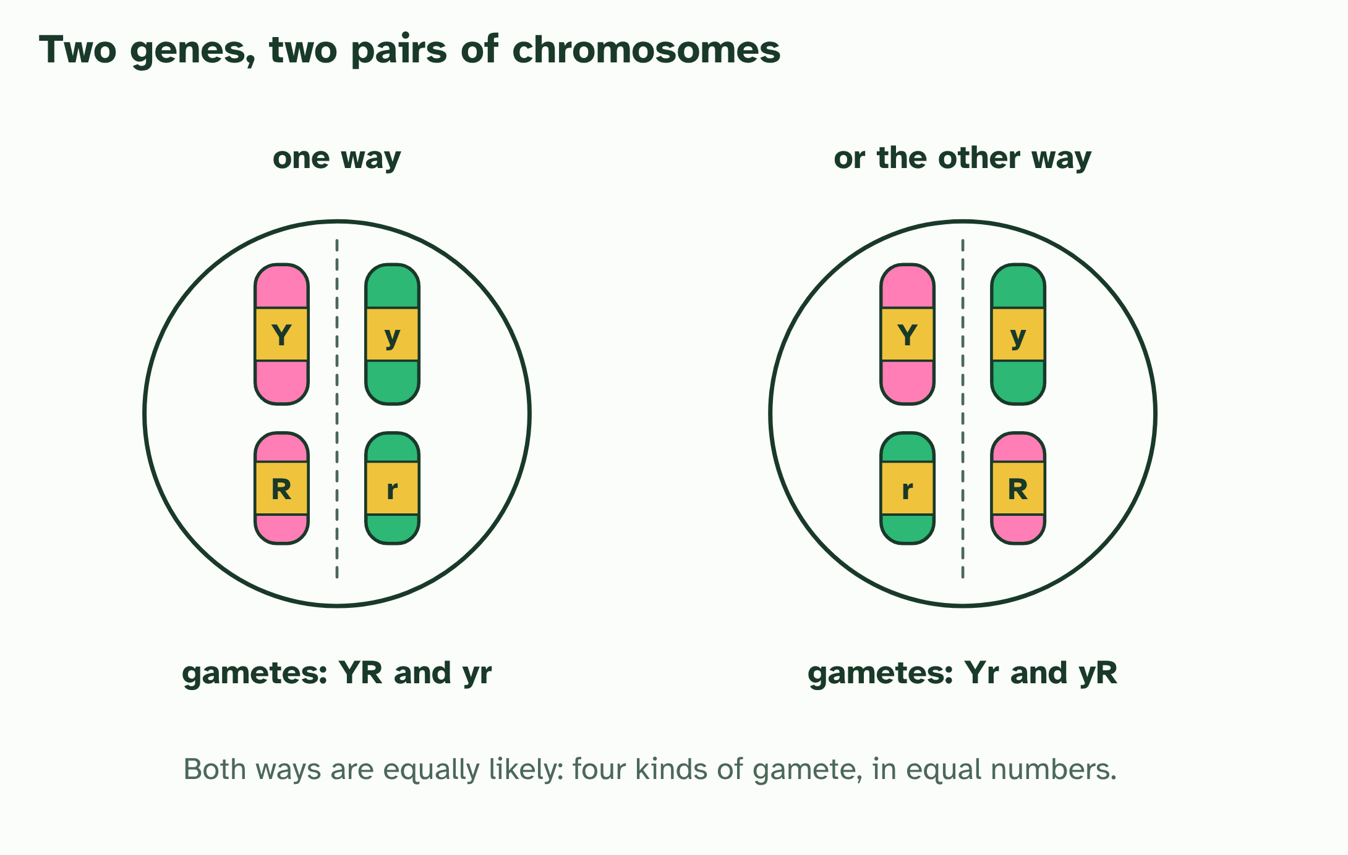
CHAPTER 13 · D3.2.16 D3.2.17 Segregation, independent assortment and dihybrid crosses
2 / 5
Two genes at once
The pairs line up either way round, independently. Two equally likely ways give four kinds of gamete: YR, yr, Yr and yR.
Minutes 6 to 18
Notes:
Minutes 6 to 18 of 60: Watch the line-up (12 min).
The plan: Chapter 13's meiosis film at higher level. Pause at the line-up and show both ways the pairs can face. Define segregation and independent assortment, and note the nature of science point: the second law holds only for unlinked genes.
A dihybrid cross follows two genes. The question is whether the alleles of the two genes travel together or separately. Take Mendel's two seed genes: colour (Y yellow, y green) and shape (R round, r wrinkled).
First, one gene. In meiosis I the two chromosomes of a homologous pair go to opposite poles, so the two alleles of a gene end up in different gametes: each gamete gets one. That is segregation.
Now two genes on different chromosomes. In meiosis I each pair lines up on the equator and faces the poles one way or the other, independently of every other pair. A YyRr parent can send Y with R and y with r, or Y with r and y with R. Both are equally likely, so it makes four kinds of gamete, YR, Yr, yR and yr, in equal numbers. This is independent assortment.
Cross two YyRr plants. Each makes four kinds of gamete, so a 4 × 4 Punnett grid gives 16 equally likely combinations. Count the phenotypes: 9 yellow round, 3 yellow wrinkled, 3 green round and 1 green wrinkled. That is 9 : 3 : 3 : 1. It is the product of two 3 : 1 ratios: (3 yellow : 1 green) × (3 round : 1 wrinkled). Cross a double heterozygote YyRr with a double recessive yyrr and the recessive parent adds only yr, so the offspring show the heterozygote's four gametes: 1 : 1 : 1 : 1.
Example: Steps (1) Write both parents' genotypes. (2) Write each parent's gametes: one allele of each gene, so a YyRr parent gives YR, Yr, yR and yr. (3) Put one parent's gametes along the top and the other's down the side, and fill in the grid. (4) Count the phenotypes, remembering that capitals show.

Slide 6
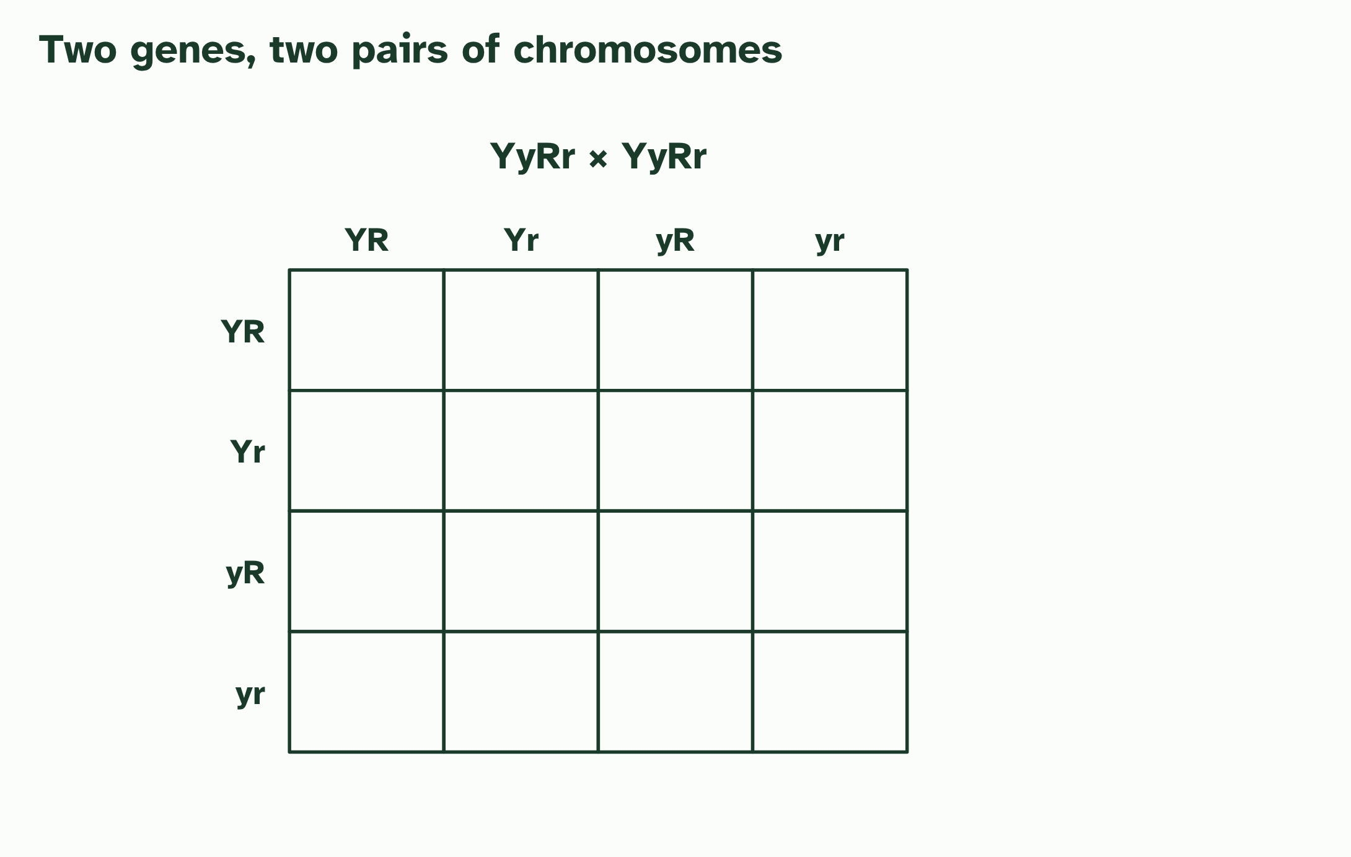
CHAPTER 13 · D3.2.16 D3.2.17 Segregation, independent assortment and dihybrid crosses
3 / 5
Two genes at once
A YyRr × YyRr cross: put each parent’s four kinds of gamete along the sides of a 4 × 4 grid.
Minutes 6 to 18
Notes:
Minutes 6 to 18 of 60: Watch the line-up (12 min).
The plan: Chapter 13's meiosis film at higher level. Pause at the line-up and show both ways the pairs can face. Define segregation and independent assortment, and note the nature of science point: the second law holds only for unlinked genes.
A dihybrid cross follows two genes. The question is whether the alleles of the two genes travel together or separately. Take Mendel's two seed genes: colour (Y yellow, y green) and shape (R round, r wrinkled).
First, one gene. In meiosis I the two chromosomes of a homologous pair go to opposite poles, so the two alleles of a gene end up in different gametes: each gamete gets one. That is segregation.
Now two genes on different chromosomes. In meiosis I each pair lines up on the equator and faces the poles one way or the other, independently of every other pair. A YyRr parent can send Y with R and y with r, or Y with r and y with R. Both are equally likely, so it makes four kinds of gamete, YR, Yr, yR and yr, in equal numbers. This is independent assortment.
Cross two YyRr plants. Each makes four kinds of gamete, so a 4 × 4 Punnett grid gives 16 equally likely combinations. Count the phenotypes: 9 yellow round, 3 yellow wrinkled, 3 green round and 1 green wrinkled. That is 9 : 3 : 3 : 1. It is the product of two 3 : 1 ratios: (3 yellow : 1 green) × (3 round : 1 wrinkled). Cross a double heterozygote YyRr with a double recessive yyrr and the recessive parent adds only yr, so the offspring show the heterozygote's four gametes: 1 : 1 : 1 : 1.
Example: Steps (1) Write both parents' genotypes. (2) Write each parent's gametes: one allele of each gene, so a YyRr parent gives YR, Yr, yR and yr. (3) Put one parent's gametes along the top and the other's down the side, and fill in the grid. (4) Count the phenotypes, remembering that capitals show.

Slide 7
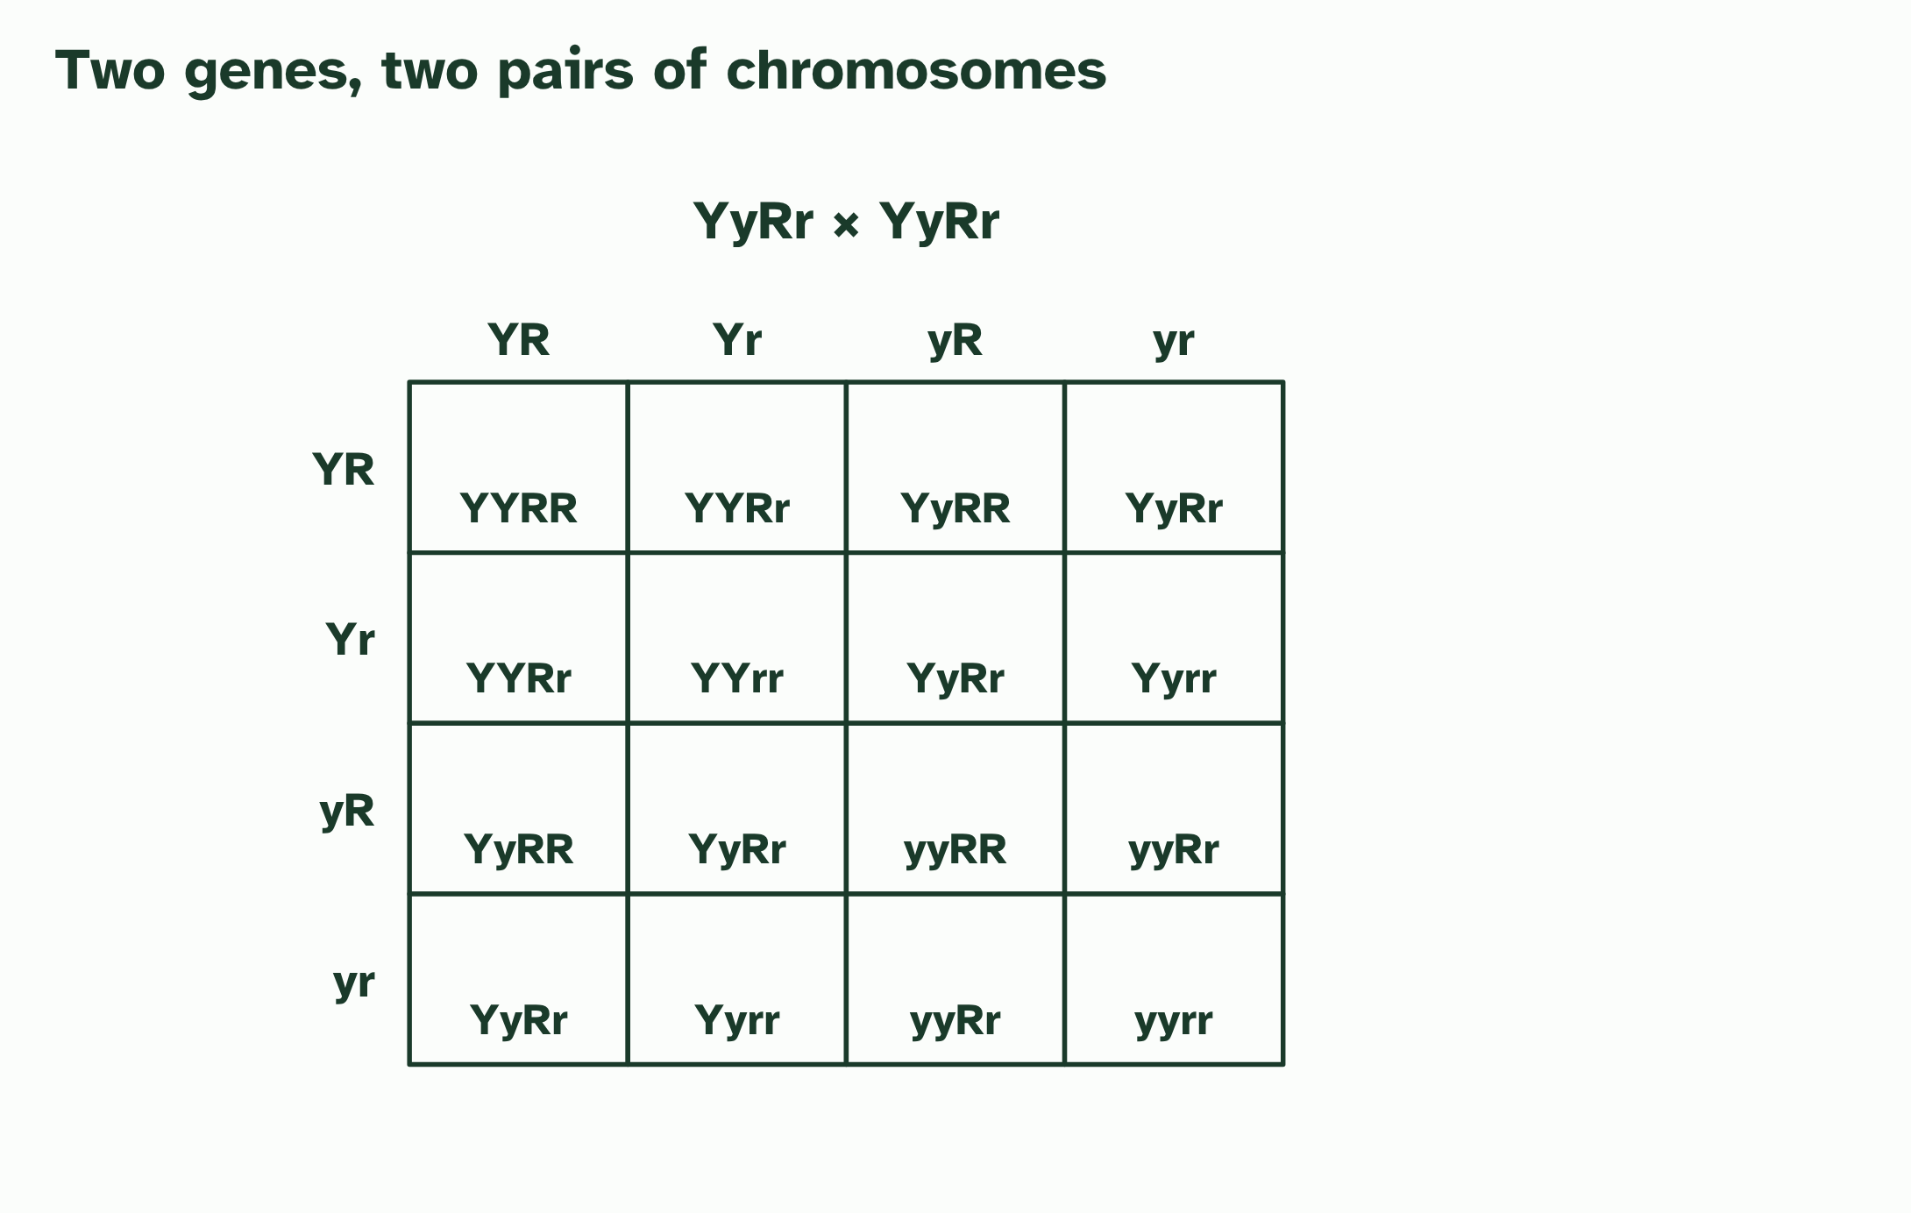
CHAPTER 13 · D3.2.16 D3.2.17 Segregation, independent assortment and dihybrid crosses
4 / 5
Two genes at once
Fill in the 16 genotypes, each equally likely.
Minutes 6 to 18
Notes:
Minutes 6 to 18 of 60: Watch the line-up (12 min).
The plan: Chapter 13's meiosis film at higher level. Pause at the line-up and show both ways the pairs can face. Define segregation and independent assortment, and note the nature of science point: the second law holds only for unlinked genes.
A dihybrid cross follows two genes. The question is whether the alleles of the two genes travel together or separately. Take Mendel's two seed genes: colour (Y yellow, y green) and shape (R round, r wrinkled).
First, one gene. In meiosis I the two chromosomes of a homologous pair go to opposite poles, so the two alleles of a gene end up in different gametes: each gamete gets one. That is segregation.
Now two genes on different chromosomes. In meiosis I each pair lines up on the equator and faces the poles one way or the other, independently of every other pair. A YyRr parent can send Y with R and y with r, or Y with r and y with R. Both are equally likely, so it makes four kinds of gamete, YR, Yr, yR and yr, in equal numbers. This is independent assortment.
Cross two YyRr plants. Each makes four kinds of gamete, so a 4 × 4 Punnett grid gives 16 equally likely combinations. Count the phenotypes: 9 yellow round, 3 yellow wrinkled, 3 green round and 1 green wrinkled. That is 9 : 3 : 3 : 1. It is the product of two 3 : 1 ratios: (3 yellow : 1 green) × (3 round : 1 wrinkled). Cross a double heterozygote YyRr with a double recessive yyrr and the recessive parent adds only yr, so the offspring show the heterozygote's four gametes: 1 : 1 : 1 : 1.
Example: Steps (1) Write both parents' genotypes. (2) Write each parent's gametes: one allele of each gene, so a YyRr parent gives YR, Yr, yR and yr. (3) Put one parent's gametes along the top and the other's down the side, and fill in the grid. (4) Count the phenotypes, remembering that capitals show.

Slide 8
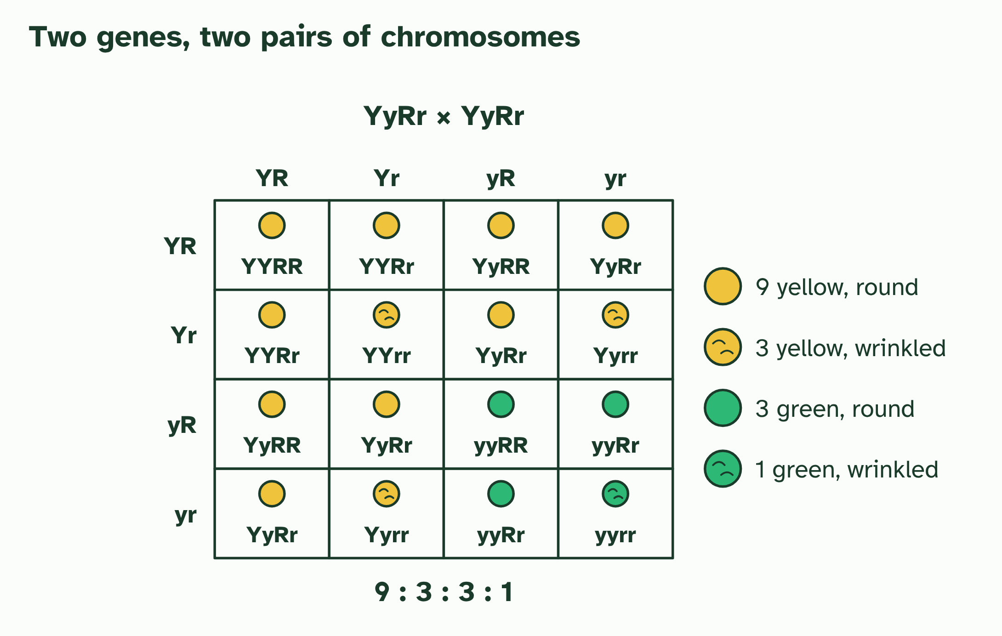
CHAPTER 13 · D3.2.16 D3.2.17 Segregation, independent assortment and dihybrid crosses
5 / 5
Two genes at once
Read off the phenotypes: 9 : 3 : 3 : 1.
Minutes 6 to 18
Notes:
Minutes 6 to 18 of 60: Watch the line-up (12 min).
The plan: Chapter 13's meiosis film at higher level. Pause at the line-up and show both ways the pairs can face. Define segregation and independent assortment, and note the nature of science point: the second law holds only for unlinked genes.
A dihybrid cross follows two genes. The question is whether the alleles of the two genes travel together or separately. Take Mendel's two seed genes: colour (Y yellow, y green) and shape (R round, r wrinkled).
First, one gene. In meiosis I the two chromosomes of a homologous pair go to opposite poles, so the two alleles of a gene end up in different gametes: each gamete gets one. That is segregation.
Now two genes on different chromosomes. In meiosis I each pair lines up on the equator and faces the poles one way or the other, independently of every other pair. A YyRr parent can send Y with R and y with r, or Y with r and y with R. Both are equally likely, so it makes four kinds of gamete, YR, Yr, yR and yr, in equal numbers. This is independent assortment.
Cross two YyRr plants. Each makes four kinds of gamete, so a 4 × 4 Punnett grid gives 16 equally likely combinations. Count the phenotypes: 9 yellow round, 3 yellow wrinkled, 3 green round and 1 green wrinkled. That is 9 : 3 : 3 : 1. It is the product of two 3 : 1 ratios: (3 yellow : 1 green) × (3 round : 1 wrinkled). Cross a double heterozygote YyRr with a double recessive yyrr and the recessive parent adds only yr, so the offspring show the heterozygote's four gametes: 1 : 1 : 1 : 1.
Example: Steps (1) Write both parents' genotypes. (2) Write each parent's gametes: one allele of each gene, so a YyRr parent gives YR, Yr, yR and yr. (3) Put one parent's gametes along the top and the other's down the side, and fill in the grid. (4) Count the phenotypes, remembering that capitals show.

Slide 9
CHAPTER 13 · D3.2.16 D3.2.17 Segregation, independent assortment and dihybrid crosses
Two genes at once
A dihybrid cross follows two genes.
In meiosis I the two chromosomes of a homologous pair go to opposite poles, so the two alleles of a gene end up in different gametes: each gamete gets one. That is segregation.
Both are equally likely, so it makes four kinds of gamete, YR, Yr, yR and yr, in equal numbers. This is independent assortment.
Minutes 6 to 18
Notes:
Minutes 6 to 18 of 60: Watch the line-up (12 min).
The plan: Chapter 13's meiosis film at higher level. Pause at the line-up and show both ways the pairs can face. Define segregation and independent assortment, and note the nature of science point: the second law holds only for unlinked genes.
A dihybrid cross follows two genes. The question is whether the alleles of the two genes travel together or separately. Take Mendel's two seed genes: colour (Y yellow, y green) and shape (R round, r wrinkled).
First, one gene. In meiosis I the two chromosomes of a homologous pair go to opposite poles, so the two alleles of a gene end up in different gametes: each gamete gets one. That is segregation.
Now two genes on different chromosomes. In meiosis I each pair lines up on the equator and faces the poles one way or the other, independently of every other pair. A YyRr parent can send Y with R and y with r, or Y with r and y with R. Both are equally likely, so it makes four kinds of gamete, YR, Yr, yR and yr, in equal numbers. This is independent assortment.
Cross two YyRr plants. Each makes four kinds of gamete, so a 4 × 4 Punnett grid gives 16 equally likely combinations. Count the phenotypes: 9 yellow round, 3 yellow wrinkled, 3 green round and 1 green wrinkled. That is 9 : 3 : 3 : 1. It is the product of two 3 : 1 ratios: (3 yellow : 1 green) × (3 round : 1 wrinkled). Cross a double heterozygote YyRr with a double recessive yyrr and the recessive parent adds only yr, so the offspring show the heterozygote's four gametes: 1 : 1 : 1 : 1.
Example: Steps (1) Write both parents' genotypes. (2) Write each parent's gametes: one allele of each gene, so a YyRr parent gives YR, Yr, yR and yr. (3) Put one parent's gametes along the top and the other's down the side, and fill in the grid. (4) Count the phenotypes, remembering that capitals show.

Slide 10
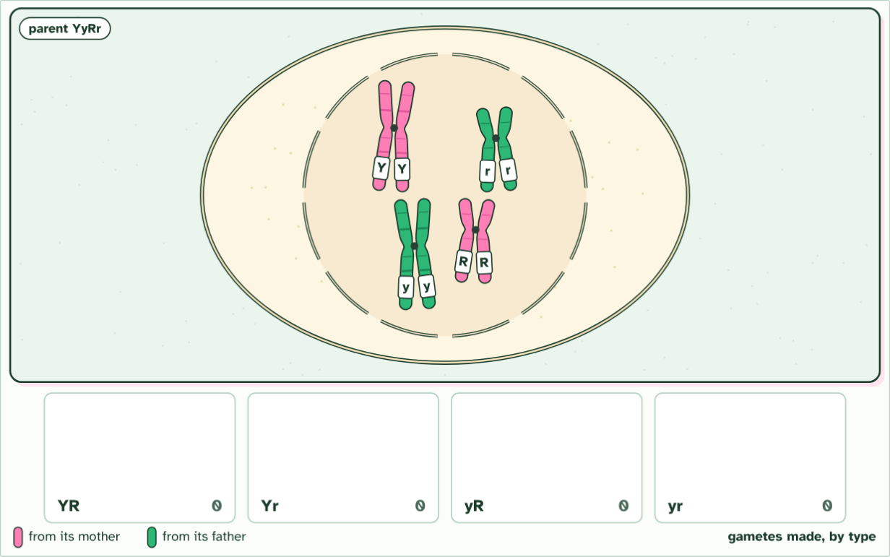
CHAPTER 13 · D3.2.16 D3.2.17 Segregation, independent assortment and dihybrid crosses
cell 1 of 2
1 / 9
Two genes at once
One cell of an YyRr parent, its DNA already copied. Gene Y is on one pair of chromosomes and gene R on another: capitals from its mother (pink), lower case from its father (green).
Minutes 6 to 18
Notes:
Minutes 6 to 18 of 60: Watch the line-up (12 min).
The plan: Chapter 13's meiosis film at higher level. Pause at the line-up and show both ways the pairs can face. Define segregation and independent assortment, and note the nature of science point: the second law holds only for unlinked genes.
A dihybrid cross follows two genes. The question is whether the alleles of the two genes travel together or separately. Take Mendel's two seed genes: colour (Y yellow, y green) and shape (R round, r wrinkled).
First, one gene. In meiosis I the two chromosomes of a homologous pair go to opposite poles, so the two alleles of a gene end up in different gametes: each gamete gets one. That is segregation.
Now two genes on different chromosomes. In meiosis I each pair lines up on the equator and faces the poles one way or the other, independently of every other pair. A YyRr parent can send Y with R and y with r, or Y with r and y with R. Both are equally likely, so it makes four kinds of gamete, YR, Yr, yR and yr, in equal numbers. This is independent assortment.
Cross two YyRr plants. Each makes four kinds of gamete, so a 4 × 4 Punnett grid gives 16 equally likely combinations. Count the phenotypes: 9 yellow round, 3 yellow wrinkled, 3 green round and 1 green wrinkled. That is 9 : 3 : 3 : 1. It is the product of two 3 : 1 ratios: (3 yellow : 1 green) × (3 round : 1 wrinkled). Cross a double heterozygote YyRr with a double recessive yyrr and the recessive parent adds only yr, so the offspring show the heterozygote's four gametes: 1 : 1 : 1 : 1.
Example: Steps (1) Write both parents' genotypes. (2) Write each parent's gametes: one allele of each gene, so a YyRr parent gives YR, Yr, yR and yr. (3) Put one parent's gametes along the top and the other's down the side, and fill in the grid. (4) Count the phenotypes, remembering that capitals show.
The animation "Watch it happen: two genes line up independently", paused at 2.0 s. The next slides go on through it, then play it.

Slide 11
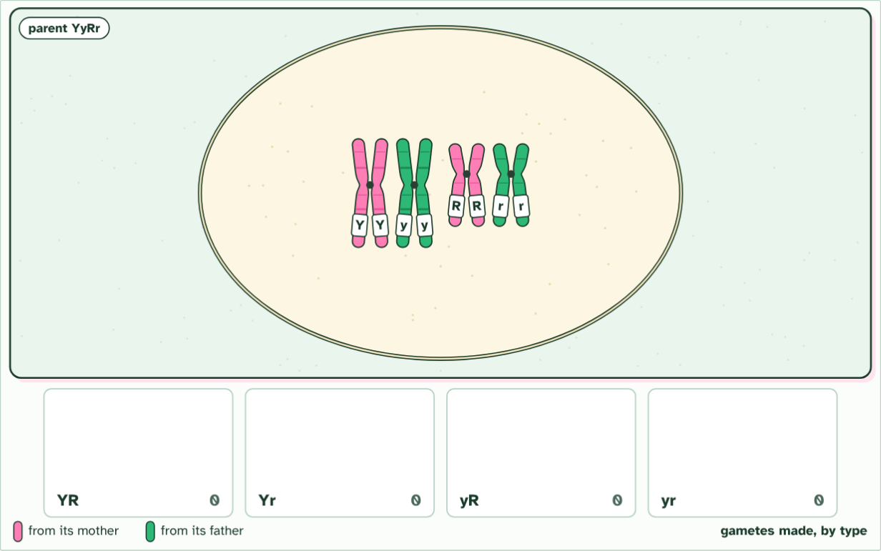
CHAPTER 13 · D3.2.16 D3.2.17 Segregation, independent assortment and dihybrid crosses
cell 1 of 2
2 / 9
Two genes at once
Each chromosome pairs with its homologue, so the two alleles of each gene lie side by side.
Minutes 6 to 18
Notes:
Minutes 6 to 18 of 60: Watch the line-up (12 min).
The plan: Chapter 13's meiosis film at higher level. Pause at the line-up and show both ways the pairs can face. Define segregation and independent assortment, and note the nature of science point: the second law holds only for unlinked genes.
A dihybrid cross follows two genes. The question is whether the alleles of the two genes travel together or separately. Take Mendel's two seed genes: colour (Y yellow, y green) and shape (R round, r wrinkled).
First, one gene. In meiosis I the two chromosomes of a homologous pair go to opposite poles, so the two alleles of a gene end up in different gametes: each gamete gets one. That is segregation.
Now two genes on different chromosomes. In meiosis I each pair lines up on the equator and faces the poles one way or the other, independently of every other pair. A YyRr parent can send Y with R and y with r, or Y with r and y with R. Both are equally likely, so it makes four kinds of gamete, YR, Yr, yR and yr, in equal numbers. This is independent assortment.
Cross two YyRr plants. Each makes four kinds of gamete, so a 4 × 4 Punnett grid gives 16 equally likely combinations. Count the phenotypes: 9 yellow round, 3 yellow wrinkled, 3 green round and 1 green wrinkled. That is 9 : 3 : 3 : 1. It is the product of two 3 : 1 ratios: (3 yellow : 1 green) × (3 round : 1 wrinkled). Cross a double heterozygote YyRr with a double recessive yyrr and the recessive parent adds only yr, so the offspring show the heterozygote's four gametes: 1 : 1 : 1 : 1.
Example: Steps (1) Write both parents' genotypes. (2) Write each parent's gametes: one allele of each gene, so a YyRr parent gives YR, Yr, yR and yr. (3) Put one parent's gametes along the top and the other's down the side, and fill in the grid. (4) Count the phenotypes, remembering that capitals show.
The animation "Watch it happen: two genes line up independently", paused at 7.7 s. The next slides go on through it, then play it.

Slide 12
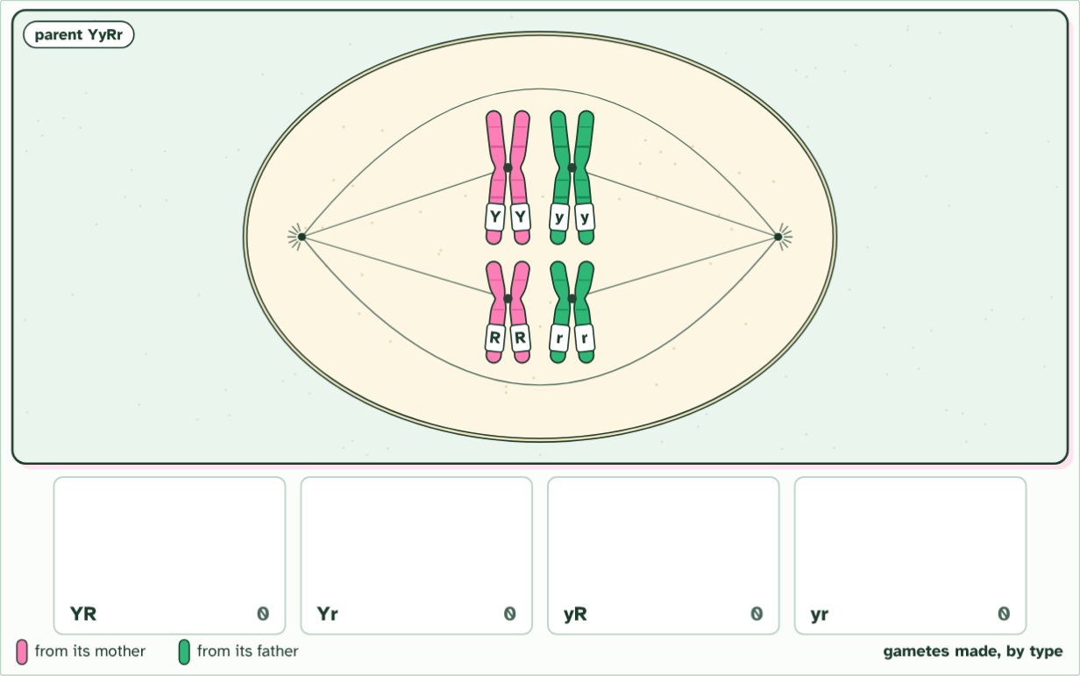
CHAPTER 13 · D3.2.16 D3.2.17 Segregation, independent assortment and dihybrid crosses
cell 1 of 2
3 / 9
Two genes at once
The pairs line up. In this cell both pink chromosomes face the same end, so Y will go with R, and y with r.
Minutes 6 to 18
Notes:
Minutes 6 to 18 of 60: Watch the line-up (12 min).
The plan: Chapter 13's meiosis film at higher level. Pause at the line-up and show both ways the pairs can face. Define segregation and independent assortment, and note the nature of science point: the second law holds only for unlinked genes.
A dihybrid cross follows two genes. The question is whether the alleles of the two genes travel together or separately. Take Mendel's two seed genes: colour (Y yellow, y green) and shape (R round, r wrinkled).
First, one gene. In meiosis I the two chromosomes of a homologous pair go to opposite poles, so the two alleles of a gene end up in different gametes: each gamete gets one. That is segregation.
Now two genes on different chromosomes. In meiosis I each pair lines up on the equator and faces the poles one way or the other, independently of every other pair. A YyRr parent can send Y with R and y with r, or Y with r and y with R. Both are equally likely, so it makes four kinds of gamete, YR, Yr, yR and yr, in equal numbers. This is independent assortment.
Cross two YyRr plants. Each makes four kinds of gamete, so a 4 × 4 Punnett grid gives 16 equally likely combinations. Count the phenotypes: 9 yellow round, 3 yellow wrinkled, 3 green round and 1 green wrinkled. That is 9 : 3 : 3 : 1. It is the product of two 3 : 1 ratios: (3 yellow : 1 green) × (3 round : 1 wrinkled). Cross a double heterozygote YyRr with a double recessive yyrr and the recessive parent adds only yr, so the offspring show the heterozygote's four gametes: 1 : 1 : 1 : 1.
Example: Steps (1) Write both parents' genotypes. (2) Write each parent's gametes: one allele of each gene, so a YyRr parent gives YR, Yr, yR and yr. (3) Put one parent's gametes along the top and the other's down the side, and fill in the grid. (4) Count the phenotypes, remembering that capitals show.
The animation "Watch it happen: two genes line up independently", paused at 12.5 s. The next slides go on through it, then play it.

Slide 13
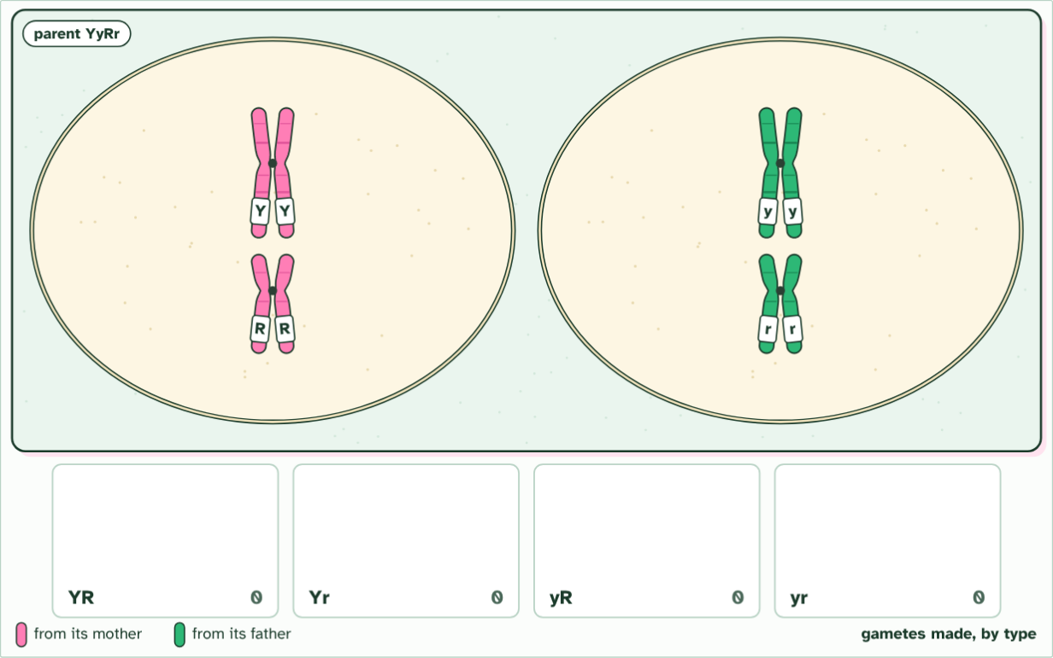
CHAPTER 13 · D3.2.16 D3.2.17 Segregation, independent assortment and dihybrid crosses
cell 1 of 2
4 / 9
Two genes at once
Segregation: in meiosis I the alleles of each gene separate, Y from y and R from r.
Minutes 6 to 18
Notes:
Minutes 6 to 18 of 60: Watch the line-up (12 min).
The plan: Chapter 13's meiosis film at higher level. Pause at the line-up and show both ways the pairs can face. Define segregation and independent assortment, and note the nature of science point: the second law holds only for unlinked genes.
A dihybrid cross follows two genes. The question is whether the alleles of the two genes travel together or separately. Take Mendel's two seed genes: colour (Y yellow, y green) and shape (R round, r wrinkled).
First, one gene. In meiosis I the two chromosomes of a homologous pair go to opposite poles, so the two alleles of a gene end up in different gametes: each gamete gets one. That is segregation.
Now two genes on different chromosomes. In meiosis I each pair lines up on the equator and faces the poles one way or the other, independently of every other pair. A YyRr parent can send Y with R and y with r, or Y with r and y with R. Both are equally likely, so it makes four kinds of gamete, YR, Yr, yR and yr, in equal numbers. This is independent assortment.
Cross two YyRr plants. Each makes four kinds of gamete, so a 4 × 4 Punnett grid gives 16 equally likely combinations. Count the phenotypes: 9 yellow round, 3 yellow wrinkled, 3 green round and 1 green wrinkled. That is 9 : 3 : 3 : 1. It is the product of two 3 : 1 ratios: (3 yellow : 1 green) × (3 round : 1 wrinkled). Cross a double heterozygote YyRr with a double recessive yyrr and the recessive parent adds only yr, so the offspring show the heterozygote's four gametes: 1 : 1 : 1 : 1.
Example: Steps (1) Write both parents' genotypes. (2) Write each parent's gametes: one allele of each gene, so a YyRr parent gives YR, Yr, yR and yr. (3) Put one parent's gametes along the top and the other's down the side, and fill in the grid. (4) Count the phenotypes, remembering that capitals show.
The animation "Watch it happen: two genes line up independently", paused at 19.0 s. The next slides go on through it, then play it.

Slide 14
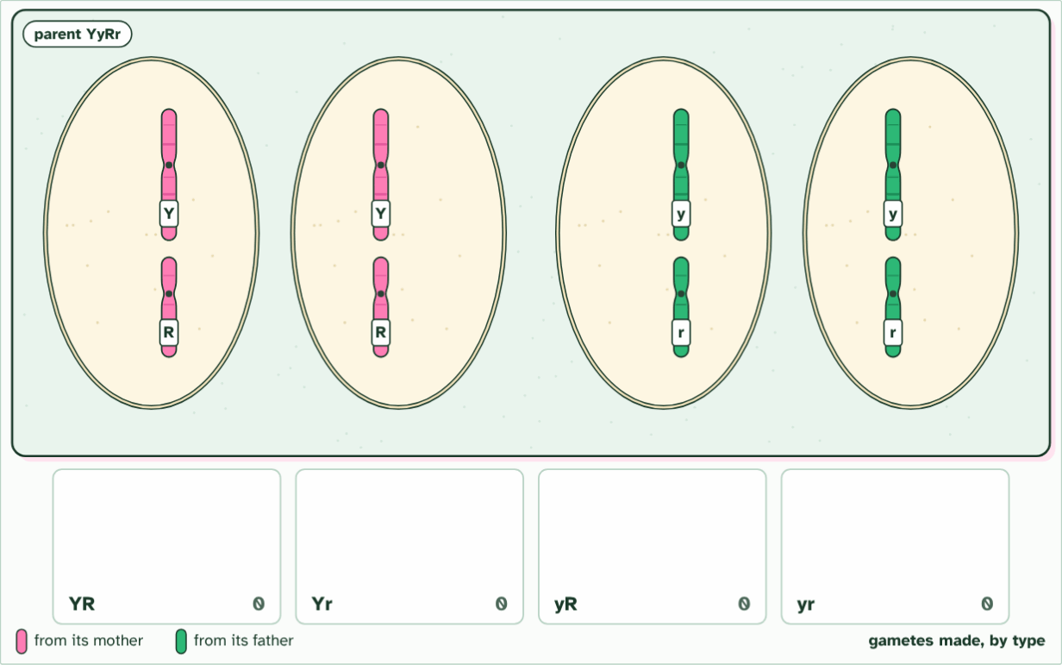
CHAPTER 13 · D3.2.16 D3.2.17 Segregation, independent assortment and dihybrid crosses
cell 1 of 2
5 / 9
Two genes at once
Meiosis II separates the sister chromatids, which carry the same alleles.
Minutes 6 to 18
Notes:
Minutes 6 to 18 of 60: Watch the line-up (12 min).
The plan: Chapter 13's meiosis film at higher level. Pause at the line-up and show both ways the pairs can face. Define segregation and independent assortment, and note the nature of science point: the second law holds only for unlinked genes.
A dihybrid cross follows two genes. The question is whether the alleles of the two genes travel together or separately. Take Mendel's two seed genes: colour (Y yellow, y green) and shape (R round, r wrinkled).
First, one gene. In meiosis I the two chromosomes of a homologous pair go to opposite poles, so the two alleles of a gene end up in different gametes: each gamete gets one. That is segregation.
Now two genes on different chromosomes. In meiosis I each pair lines up on the equator and faces the poles one way or the other, independently of every other pair. A YyRr parent can send Y with R and y with r, or Y with r and y with R. Both are equally likely, so it makes four kinds of gamete, YR, Yr, yR and yr, in equal numbers. This is independent assortment.
Cross two YyRr plants. Each makes four kinds of gamete, so a 4 × 4 Punnett grid gives 16 equally likely combinations. Count the phenotypes: 9 yellow round, 3 yellow wrinkled, 3 green round and 1 green wrinkled. That is 9 : 3 : 3 : 1. It is the product of two 3 : 1 ratios: (3 yellow : 1 green) × (3 round : 1 wrinkled). Cross a double heterozygote YyRr with a double recessive yyrr and the recessive parent adds only yr, so the offspring show the heterozygote's four gametes: 1 : 1 : 1 : 1.
Example: Steps (1) Write both parents' genotypes. (2) Write each parent's gametes: one allele of each gene, so a YyRr parent gives YR, Yr, yR and yr. (3) Put one parent's gametes along the top and the other's down the side, and fill in the grid. (4) Count the phenotypes, remembering that capitals show.
The animation "Watch it happen: two genes line up independently", paused at 24.6 s. The next slides go on through it, then play it.

Slide 15
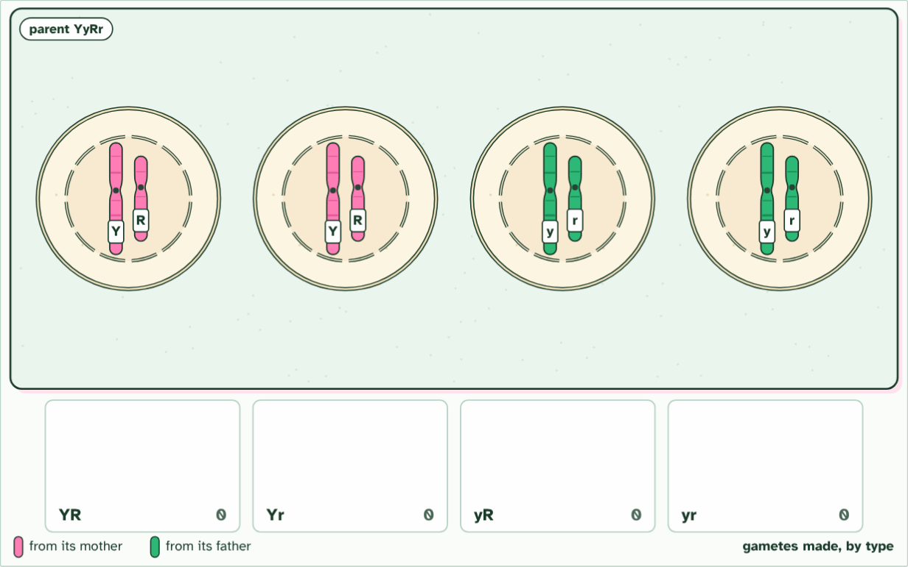
CHAPTER 13 · D3.2.16 D3.2.17 Segregation, independent assortment and dihybrid crosses
cell 1 of 2
6 / 9
Two genes at once
This cell makes two kinds of gamete: YR and yr.
Minutes 6 to 18
Notes:
Minutes 6 to 18 of 60: Watch the line-up (12 min).
The plan: Chapter 13's meiosis film at higher level. Pause at the line-up and show both ways the pairs can face. Define segregation and independent assortment, and note the nature of science point: the second law holds only for unlinked genes.
A dihybrid cross follows two genes. The question is whether the alleles of the two genes travel together or separately. Take Mendel's two seed genes: colour (Y yellow, y green) and shape (R round, r wrinkled).
First, one gene. In meiosis I the two chromosomes of a homologous pair go to opposite poles, so the two alleles of a gene end up in different gametes: each gamete gets one. That is segregation.
Now two genes on different chromosomes. In meiosis I each pair lines up on the equator and faces the poles one way or the other, independently of every other pair. A YyRr parent can send Y with R and y with r, or Y with r and y with R. Both are equally likely, so it makes four kinds of gamete, YR, Yr, yR and yr, in equal numbers. This is independent assortment.
Cross two YyRr plants. Each makes four kinds of gamete, so a 4 × 4 Punnett grid gives 16 equally likely combinations. Count the phenotypes: 9 yellow round, 3 yellow wrinkled, 3 green round and 1 green wrinkled. That is 9 : 3 : 3 : 1. It is the product of two 3 : 1 ratios: (3 yellow : 1 green) × (3 round : 1 wrinkled). Cross a double heterozygote YyRr with a double recessive yyrr and the recessive parent adds only yr, so the offspring show the heterozygote's four gametes: 1 : 1 : 1 : 1.
Example: Steps (1) Write both parents' genotypes. (2) Write each parent's gametes: one allele of each gene, so a YyRr parent gives YR, Yr, yR and yr. (3) Put one parent's gametes along the top and the other's down the side, and fill in the grid. (4) Count the phenotypes, remembering that capitals show.
The animation "Watch it happen: two genes line up independently", paused at 27.9 s. The next slides go on through it, then play it.

Slide 16
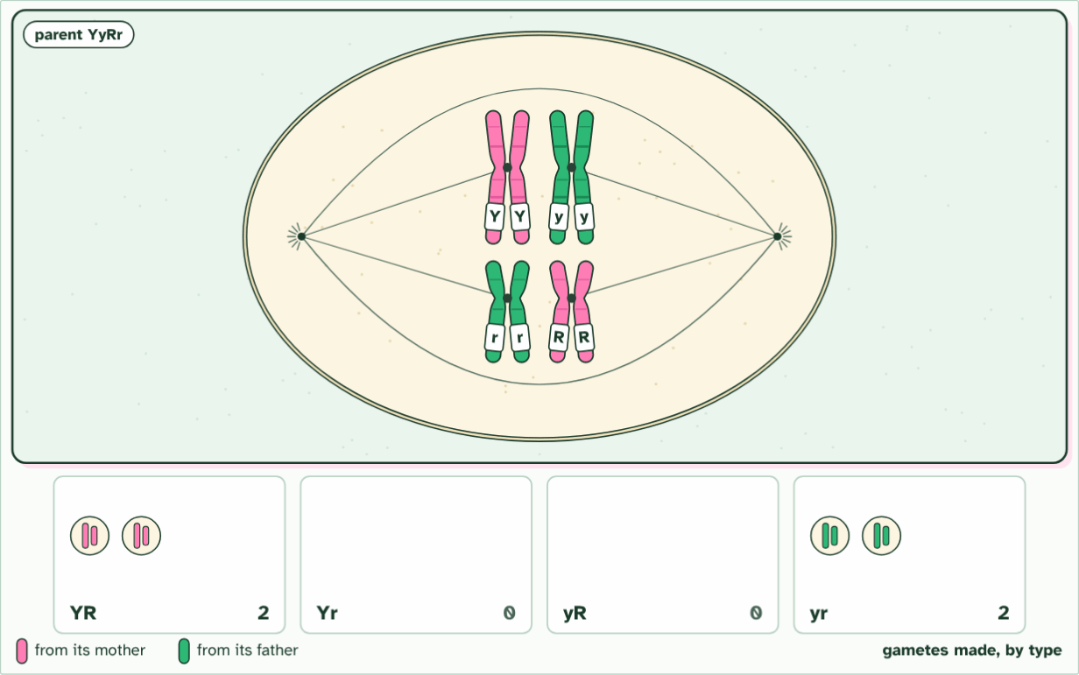
CHAPTER 13 · D3.2.16 D3.2.17 Segregation, independent assortment and dihybrid crosses
cell 2 of 2
7 / 9
Two genes at once
In another cell the pairs line up the other way round: now Y goes with r, and y with R.
Minutes 6 to 18
Notes:
Minutes 6 to 18 of 60: Watch the line-up (12 min).
The plan: Chapter 13's meiosis film at higher level. Pause at the line-up and show both ways the pairs can face. Define segregation and independent assortment, and note the nature of science point: the second law holds only for unlinked genes.
A dihybrid cross follows two genes. The question is whether the alleles of the two genes travel together or separately. Take Mendel's two seed genes: colour (Y yellow, y green) and shape (R round, r wrinkled).
First, one gene. In meiosis I the two chromosomes of a homologous pair go to opposite poles, so the two alleles of a gene end up in different gametes: each gamete gets one. That is segregation.
Now two genes on different chromosomes. In meiosis I each pair lines up on the equator and faces the poles one way or the other, independently of every other pair. A YyRr parent can send Y with R and y with r, or Y with r and y with R. Both are equally likely, so it makes four kinds of gamete, YR, Yr, yR and yr, in equal numbers. This is independent assortment.
Cross two YyRr plants. Each makes four kinds of gamete, so a 4 × 4 Punnett grid gives 16 equally likely combinations. Count the phenotypes: 9 yellow round, 3 yellow wrinkled, 3 green round and 1 green wrinkled. That is 9 : 3 : 3 : 1. It is the product of two 3 : 1 ratios: (3 yellow : 1 green) × (3 round : 1 wrinkled). Cross a double heterozygote YyRr with a double recessive yyrr and the recessive parent adds only yr, so the offspring show the heterozygote's four gametes: 1 : 1 : 1 : 1.
Example: Steps (1) Write both parents' genotypes. (2) Write each parent's gametes: one allele of each gene, so a YyRr parent gives YR, Yr, yR and yr. (3) Put one parent's gametes along the top and the other's down the side, and fill in the grid. (4) Count the phenotypes, remembering that capitals show.
The animation "Watch it happen: two genes line up independently", paused at 33.1 s. The next slides go on through it, then play it.

Slide 17
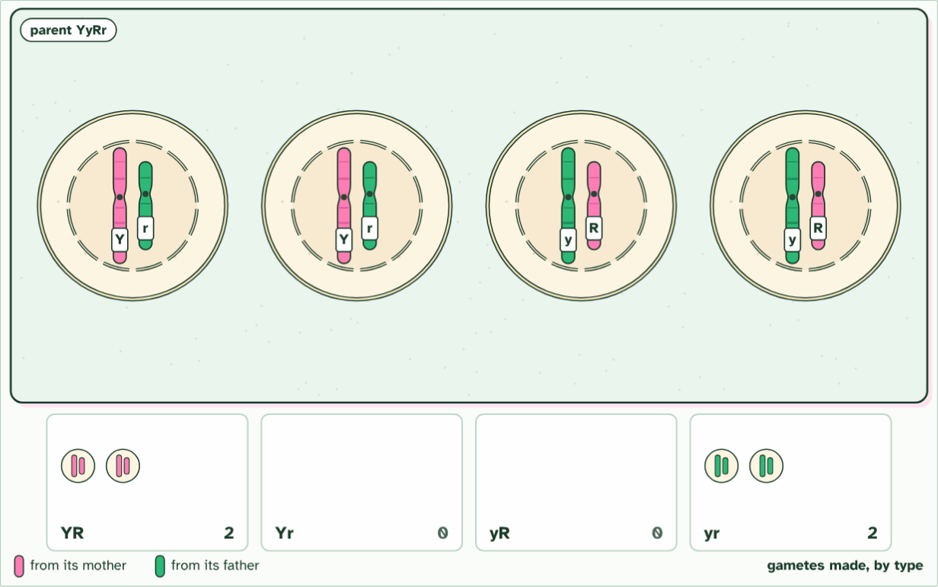
CHAPTER 13 · D3.2.16 D3.2.17 Segregation, independent assortment and dihybrid crosses
cell 2 of 2
8 / 9
Two genes at once
That cell makes Yr and yR gametes.
Minutes 6 to 18
Notes:
Minutes 6 to 18 of 60: Watch the line-up (12 min).
The plan: Chapter 13's meiosis film at higher level. Pause at the line-up and show both ways the pairs can face. Define segregation and independent assortment, and note the nature of science point: the second law holds only for unlinked genes.
A dihybrid cross follows two genes. The question is whether the alleles of the two genes travel together or separately. Take Mendel's two seed genes: colour (Y yellow, y green) and shape (R round, r wrinkled).
First, one gene. In meiosis I the two chromosomes of a homologous pair go to opposite poles, so the two alleles of a gene end up in different gametes: each gamete gets one. That is segregation.
Now two genes on different chromosomes. In meiosis I each pair lines up on the equator and faces the poles one way or the other, independently of every other pair. A YyRr parent can send Y with R and y with r, or Y with r and y with R. Both are equally likely, so it makes four kinds of gamete, YR, Yr, yR and yr, in equal numbers. This is independent assortment.
Cross two YyRr plants. Each makes four kinds of gamete, so a 4 × 4 Punnett grid gives 16 equally likely combinations. Count the phenotypes: 9 yellow round, 3 yellow wrinkled, 3 green round and 1 green wrinkled. That is 9 : 3 : 3 : 1. It is the product of two 3 : 1 ratios: (3 yellow : 1 green) × (3 round : 1 wrinkled). Cross a double heterozygote YyRr with a double recessive yyrr and the recessive parent adds only yr, so the offspring show the heterozygote's four gametes: 1 : 1 : 1 : 1.
Example: Steps (1) Write both parents' genotypes. (2) Write each parent's gametes: one allele of each gene, so a YyRr parent gives YR, Yr, yR and yr. (3) Put one parent's gametes along the top and the other's down the side, and fill in the grid. (4) Count the phenotypes, remembering that capitals show.
The animation "Watch it happen: two genes line up independently", paused at 42.1 s. The next slides go on through it, then play it.

Slide 18
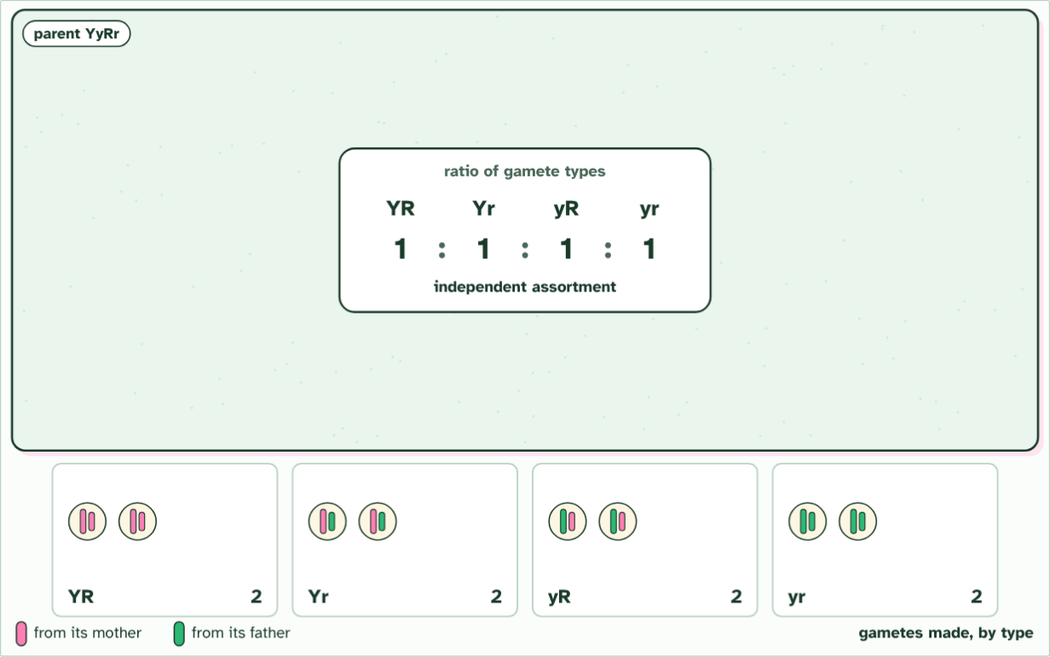
CHAPTER 13 · D3.2.16 D3.2.17 Segregation, independent assortment and dihybrid crosses
8 gametes made
9 / 9
Two genes at once
Both line-ups are equally likely, so the four types are made in equal numbers, 1 : 1 : 1 : 1. This is independent assortment.
Minutes 6 to 18
Notes:
Minutes 6 to 18 of 60: Watch the line-up (12 min).
The plan: Chapter 13's meiosis film at higher level. Pause at the line-up and show both ways the pairs can face. Define segregation and independent assortment, and note the nature of science point: the second law holds only for unlinked genes.
A dihybrid cross follows two genes. The question is whether the alleles of the two genes travel together or separately. Take Mendel's two seed genes: colour (Y yellow, y green) and shape (R round, r wrinkled).
First, one gene. In meiosis I the two chromosomes of a homologous pair go to opposite poles, so the two alleles of a gene end up in different gametes: each gamete gets one. That is segregation.
Now two genes on different chromosomes. In meiosis I each pair lines up on the equator and faces the poles one way or the other, independently of every other pair. A YyRr parent can send Y with R and y with r, or Y with r and y with R. Both are equally likely, so it makes four kinds of gamete, YR, Yr, yR and yr, in equal numbers. This is independent assortment.
Cross two YyRr plants. Each makes four kinds of gamete, so a 4 × 4 Punnett grid gives 16 equally likely combinations. Count the phenotypes: 9 yellow round, 3 yellow wrinkled, 3 green round and 1 green wrinkled. That is 9 : 3 : 3 : 1. It is the product of two 3 : 1 ratios: (3 yellow : 1 green) × (3 round : 1 wrinkled). Cross a double heterozygote YyRr with a double recessive yyrr and the recessive parent adds only yr, so the offspring show the heterozygote's four gametes: 1 : 1 : 1 : 1.
Example: Steps (1) Write both parents' genotypes. (2) Write each parent's gametes: one allele of each gene, so a YyRr parent gives YR, Yr, yR and yr. (3) Put one parent's gametes along the top and the other's down the side, and fill in the grid. (4) Count the phenotypes, remembering that capitals show.
The animation "Watch it happen: two genes line up independently", paused at 47.6 s. The next slides go on through it, then play it.

Slide 19
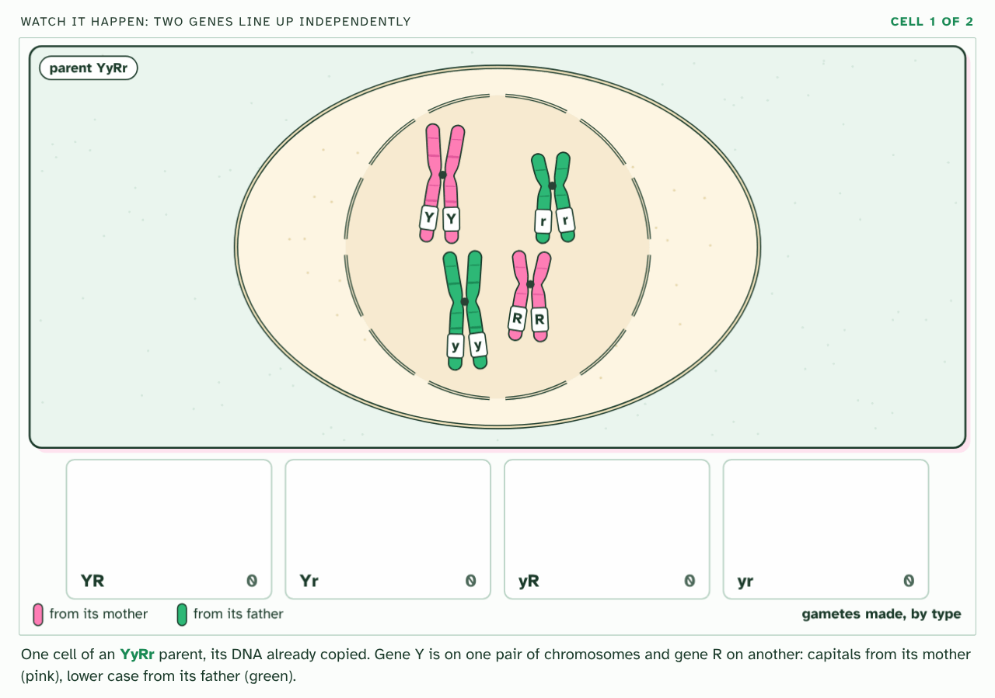
CHAPTER 13 · D3.2.16 D3.2.17 Segregation, independent assortment and dihybrid crosses
PLAY IT
Two genes at once
Watch it happen: two genes line up independently: click to play. It loops every 51 seconds.
Minutes 6 to 18
Notes:
Minutes 6 to 18 of 60: Watch the line-up (12 min).
The plan: Chapter 13's meiosis film at higher level. Pause at the line-up and show both ways the pairs can face. Define segregation and independent assortment, and note the nature of science point: the second law holds only for unlinked genes.
The video is meiosis-3fd234.mp4, one loop of the animation in the guide. It plays in PowerPoint and Keynote. Google Slides does not play a video embedded in a .pptx: download meiosis-3fd234.mp4 (https://www.biologybybradford.com/guides/downloads/scenes/meiosis-3fd234.mp4), upload it to Google Drive, then Insert > Video > Google Drive.
In the guide the class can change it as it runs: https://www.biologybybradford.com/guides/ib-biology-d3-2-inheritance#dihybrid
What it shows, in order:
1. One cell of an YyRr parent, its DNA already copied. Gene Y is on one pair of chromosomes and gene R on another: capitals from its mother (pink), lower case from its father (green).
2. Each chromosome pairs with its homologue, so the two alleles of each gene lie side by side.
3. The pairs line up. In this cell both pink chromosomes face the same end, so Y will go with R, and y with r.
4. Segregation: in meiosis I the alleles of each gene separate, Y from y and R from r.
5. Meiosis II separates the sister chromatids, which carry the same alleles.
6. This cell makes two kinds of gamete: YR and yr.
7. In another cell the pairs line up the other way round: now Y goes with r, and y with R.
8. That cell makes Yr and yR gametes.
9. Both line-ups are equally likely, so the four types are made in equal numbers, 1 : 1 : 1 : 1. This is independent assortment.

Slide 20
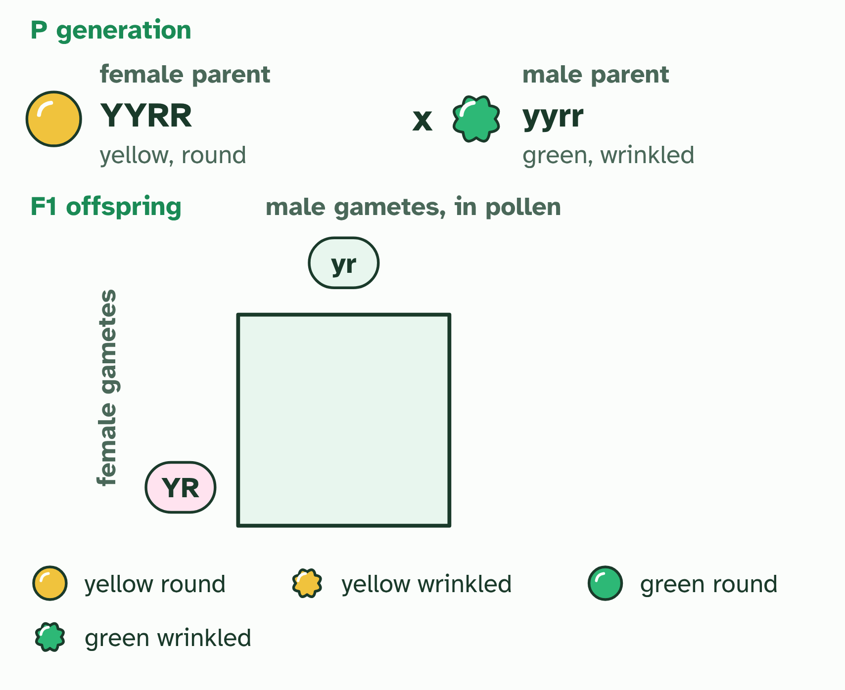
CHAPTER 13 · D3.2.16 D3.2.17 Segregation, independent assortment and dihybrid crosses
1 / 2
Two genes at once
Each parent makes gametes by meiosis, one allele of each gene in each. The female parent's go down the side of the Punnett grid, the male parent's along the top.
Minutes 6 to 18
Notes:
Minutes 6 to 18 of 60: Watch the line-up (12 min).
The plan: Chapter 13's meiosis film at higher level. Pause at the line-up and show both ways the pairs can face. Define segregation and independent assortment, and note the nature of science point: the second law holds only for unlinked genes.
A dihybrid cross follows two genes. The question is whether the alleles of the two genes travel together or separately. Take Mendel's two seed genes: colour (Y yellow, y green) and shape (R round, r wrinkled).
First, one gene. In meiosis I the two chromosomes of a homologous pair go to opposite poles, so the two alleles of a gene end up in different gametes: each gamete gets one. That is segregation.
Now two genes on different chromosomes. In meiosis I each pair lines up on the equator and faces the poles one way or the other, independently of every other pair. A YyRr parent can send Y with R and y with r, or Y with r and y with R. Both are equally likely, so it makes four kinds of gamete, YR, Yr, yR and yr, in equal numbers. This is independent assortment.
Cross two YyRr plants. Each makes four kinds of gamete, so a 4 × 4 Punnett grid gives 16 equally likely combinations. Count the phenotypes: 9 yellow round, 3 yellow wrinkled, 3 green round and 1 green wrinkled. That is 9 : 3 : 3 : 1. It is the product of two 3 : 1 ratios: (3 yellow : 1 green) × (3 round : 1 wrinkled). Cross a double heterozygote YyRr with a double recessive yyrr and the recessive parent adds only yr, so the offspring show the heterozygote's four gametes: 1 : 1 : 1 : 1.
Example: Steps (1) Write both parents' genotypes. (2) Write each parent's gametes: one allele of each gene, so a YyRr parent gives YR, Yr, yR and yr. (3) Put one parent's gametes along the top and the other's down the side, and fill in the grid. (4) Count the phenotypes, remembering that capitals show.

Slide 21
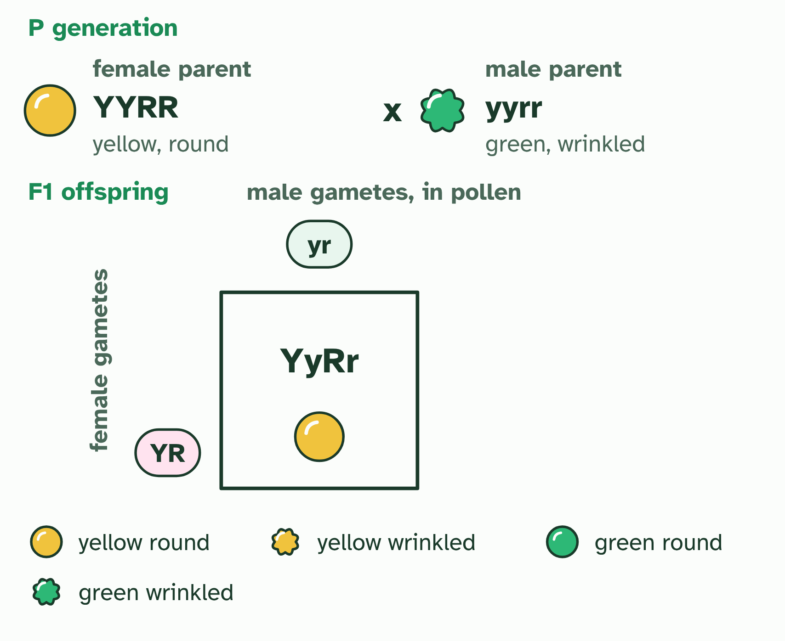
CHAPTER 13 · D3.2.16 D3.2.17 Segregation, independent assortment and dihybrid crosses
2 / 2
Two genes at once
Each cell joins one gamete from each parent: a possible offspring, every cell as likely as the next. The F1: genotypes all YyRr; phenotypes all yellow round.
Minutes 6 to 18
Notes:
Minutes 6 to 18 of 60: Watch the line-up (12 min).
The plan: Chapter 13's meiosis film at higher level. Pause at the line-up and show both ways the pairs can face. Define segregation and independent assortment, and note the nature of science point: the second law holds only for unlinked genes.
A dihybrid cross follows two genes. The question is whether the alleles of the two genes travel together or separately. Take Mendel's two seed genes: colour (Y yellow, y green) and shape (R round, r wrinkled).
First, one gene. In meiosis I the two chromosomes of a homologous pair go to opposite poles, so the two alleles of a gene end up in different gametes: each gamete gets one. That is segregation.
Now two genes on different chromosomes. In meiosis I each pair lines up on the equator and faces the poles one way or the other, independently of every other pair. A YyRr parent can send Y with R and y with r, or Y with r and y with R. Both are equally likely, so it makes four kinds of gamete, YR, Yr, yR and yr, in equal numbers. This is independent assortment.
Cross two YyRr plants. Each makes four kinds of gamete, so a 4 × 4 Punnett grid gives 16 equally likely combinations. Count the phenotypes: 9 yellow round, 3 yellow wrinkled, 3 green round and 1 green wrinkled. That is 9 : 3 : 3 : 1. It is the product of two 3 : 1 ratios: (3 yellow : 1 green) × (3 round : 1 wrinkled). Cross a double heterozygote YyRr with a double recessive yyrr and the recessive parent adds only yr, so the offspring show the heterozygote's four gametes: 1 : 1 : 1 : 1.
Example: Steps (1) Write both parents' genotypes. (2) Write each parent's gametes: one allele of each gene, so a YyRr parent gives YR, Yr, yR and yr. (3) Put one parent's gametes along the top and the other's down the side, and fill in the grid. (4) Count the phenotypes, remembering that capitals show.

Slide 22
CHAPTER 13 · D3.2.16 D3.2.17 Segregation, independent assortment and dihybrid crosses
Two genes at once
A dihybrid cross follows two genes.
In meiosis I the two chromosomes of a homologous pair go to opposite poles, so the two alleles of a gene end up in different gametes: each gamete gets one. That is segregation.
Both are equally likely, so it makes four kinds of gamete, YR, Yr, yR and yr, in equal numbers. This is independent assortment.
Minutes 6 to 18
Notes:
Minutes 6 to 18 of 60: Watch the line-up (12 min).
The plan: Chapter 13's meiosis film at higher level. Pause at the line-up and show both ways the pairs can face. Define segregation and independent assortment, and note the nature of science point: the second law holds only for unlinked genes.
A dihybrid cross follows two genes. The question is whether the alleles of the two genes travel together or separately. Take Mendel's two seed genes: colour (Y yellow, y green) and shape (R round, r wrinkled).
First, one gene. In meiosis I the two chromosomes of a homologous pair go to opposite poles, so the two alleles of a gene end up in different gametes: each gamete gets one. That is segregation.
Now two genes on different chromosomes. In meiosis I each pair lines up on the equator and faces the poles one way or the other, independently of every other pair. A YyRr parent can send Y with R and y with r, or Y with r and y with R. Both are equally likely, so it makes four kinds of gamete, YR, Yr, yR and yr, in equal numbers. This is independent assortment.
Cross two YyRr plants. Each makes four kinds of gamete, so a 4 × 4 Punnett grid gives 16 equally likely combinations. Count the phenotypes: 9 yellow round, 3 yellow wrinkled, 3 green round and 1 green wrinkled. That is 9 : 3 : 3 : 1. It is the product of two 3 : 1 ratios: (3 yellow : 1 green) × (3 round : 1 wrinkled). Cross a double heterozygote YyRr with a double recessive yyrr and the recessive parent adds only yr, so the offspring show the heterozygote's four gametes: 1 : 1 : 1 : 1.
Example: Steps (1) Write both parents' genotypes. (2) Write each parent's gametes: one allele of each gene, so a YyRr parent gives YR, Yr, yR and yr. (3) Put one parent's gametes along the top and the other's down the side, and fill in the grid. (4) Count the phenotypes, remembering that capitals show.

Slide 23
PREDICT
A plant YyRr is crossed with a plant yyrr. What proportion of the offspring are yellow and round?
A One half
B One quarter
C Nine sixteenths
Minutes 6 to 18
Notes:
Minutes 6 to 18 of 60: Watch the line-up (12 min).
The plan: Chapter 13's meiosis film at higher level. Pause at the line-up and show both ways the pairs can face. Define segregation and independent assortment, and note the nature of science point: the second law holds only for unlinked genes.
Ask for a show of hands, or mini whiteboards, before revealing. (Answer: B, on the next slide.)

Slide 24
WHAT HAPPENS
A plant YyRr is crossed with a plant yyrr. What proportion of the offspring are yellow and round?
A One half
B One quarter
C Nine sixteenths
One quarter. The yyrr parent makes only yr gametes, so the offspring show the four gametes of the YyRr parent, in equal numbers: YyRr (yellow round), Yyrr (yellow wrinkled), yyRr (green round) and yyrr (green wrinkled). One of the four is yellow and round.
Minutes 6 to 18
Notes:
Minutes 6 to 18 of 60: Watch the line-up (12 min).
The plan: Chapter 13's meiosis film at higher level. Pause at the line-up and show both ways the pairs can face. Define segregation and independent assortment, and note the nature of science point: the second law holds only for unlinked genes.
Answer: B. One quarter. The yyrr parent makes only yr gametes, so the offspring show the four gametes of the YyRr parent, in equal numbers: YyRr (yellow round), Yyrr (yellow wrinkled), yyRr (green round) and yyrr (green wrinkled). One of the four is yellow and round.

Slide 25
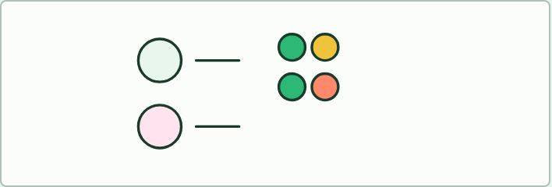
MODEL
12 MIN
Gametes with two coins
THE TASK
Each student plays a plant heterozygous for two genes, YyRr. One coin chooses Y or y, the other chooses R or r. Flip both, write the gamete, and make 40 gametes. Tally the four types on the board. Compare with the grid and with a plant of genotype YyRR. Then two students fuse a gamete each, ten times, to make F2 plants, and the class counts the phenotypes. Is it close to 9: 3: 3: 1?
STUDENTS NEED
Two coins per student, a tally table.
Minutes 18 to 30
Notes:
Minutes 18 to 30 of 60: Gametes with two coins (12 min).
The plan: The activity below. Two coins make a gamete from a double heterozygote. Fill in the four gamete types and their frequencies, then the grid.
The activity: Gametes with two coins. Each student plays a plant heterozygous for two genes, YyRr. One coin chooses Y or y, the other chooses R or r. Flip both, write the gamete, and make 40 gametes. Tally the four types on the board. Compare with the grid and with a plant of genotype YyRR. Then two students fuse a gamete each, ten times, to make F2 plants, and the class counts the phenotypes. Is it close to 9 : 3 : 3 : 1?
Needs: two coins per student, a tally table.
The time: 12 minutes, minutes 18 to 30 of the plan.

Slide 26
STEP 4
20 MIN
The grid
Students predict before the grid fills.
Minutes 30 to 50
Notes:
Minutes 30 to 50 of 60: The grid (20 min).
The plan: Chapter 13's figure and the cross builder in dihybrid mode. Students predict before the grid fills. Then the ratio sort below: match each cross to 9 : 3 : 3 : 1, 1 : 1 : 1 : 1 or all one type.

Slide 27
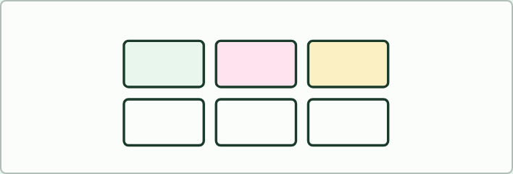
CARD SORT
20 MIN
Sort the ratios
THE TASK
Eight cross cards and three ratio cards (9: 3: 3: 1, 1: 1: 1: 1, one type only). Match each cross to its ratio without drawing a grid when you can: YyRr by YyRr, YyRr by yyrr, YYRR by yyrr, YyRr by YyRR and so on. Then draw grids for the two you were least sure of. Ask students to say why a test cross gives the ratio that it does, and what the F2 of a cross between true-breeding parents looks like.
STUDENTS NEED
Printed cards, one set per pair.
Minutes 30 to 50
Notes:
Minutes 30 to 50 of 60: The grid (20 min).
The plan: Chapter 13's figure and the cross builder in dihybrid mode. Students predict before the grid fills. Then the ratio sort below: match each cross to 9 : 3 : 3 : 1, 1 : 1 : 1 : 1 or all one type.
The activity: Sort the ratios. Eight cross cards and three ratio cards (9 : 3 : 3 : 1, 1 : 1 : 1 : 1, one type only). Match each cross to its ratio without drawing a grid when you can: YyRr by YyRr, YyRr by yyrr, YYRR by yyrr, YyRr by YyRR and so on. Then draw grids for the two you were least sure of. Ask students to say why a test cross gives the ratio that it does, and what the F2 of a cross between true-breeding parents looks like.
Needs: printed cards, one set per pair.
The time: 20 minutes, minutes 30 to 50 of the plan.

Slide 28
PLENARY
Exam practice
Students write gametes, grid and ratio in 8 minutes and peer-mark against the scheme.
Minutes 50 to 60
Notes:
Minutes 50 to 60 of 60: Exam practice (10 min).
The plan: A dihybrid question from the exam maker (in Practise and revise, below). Students write gametes, grid and ratio in 8 minutes and peer-mark against the scheme.

Slide 29
EXIT QUESTION
Before you go
On paper, on your own: Use Punnett grids to predict genotypic and phenotypic ratios in dihybrid crosses of unlinked autosomal genes.
Minutes 50 to 60
Notes:
Minutes 50 to 60 of 60: Exam practice (10 min).
The plan: A dihybrid question from the exam maker (in Practise and revise, below). Students write gametes, grid and ratio in 8 minutes and peer-mark against the scheme.
Collect the slips: they say where to start next lesson.

Slide 30
PRACTISE AND REVISE
Keep going
Exam practice: a fresh paper of exam questions on D3.2 at higher level, marked as you go
The guide, with the animations and the dry lab
This lesson in the guide: 13 Two genes at once
BUILD FOR YOUR CLASS
ALREADY ON THE SITE FOR D3.2
CARD SETS ON SPLYCR
Tarsia puzzle, dominoes and picture reveal on D3.2, built from its key terms and ready to print
A pub quiz with rounds on D3.2, to present or run with no projector
An escape room built from the question bank on D3.2
Lesson: Linked Genes & Chi-Squared
Lesson: Dihybrid Crosses & Test Crosses
Lesson: Inheritance
Summary doodle: Inheritance
Quiz: Inheritance (HL)
Quiz: Inheritance
Revision map: D3.2 Inheritance, to fill in
Exam questions: D3.2 in the exam maker, a paper with its markscheme
Open a set to host it as a class game, or make a copy to edit.
D3.2 Inheritance
How this was made. The course structure, the activities and the teaching choices come from my own classroom, my presentations and my years of teaching IB and AP Biology. I use Claude, an AI, to help write and build the interactive guides, lesson plans, slides and practice questions, and to draw the diagrams and code the interactives. I direct the work and review it against the IB and AP specifications before it goes live.
Minute 60: after the lesson
Notes:
Every link here is live. Set the exam practice paper for homework: it is fresh each time, marked as students go and saved to their Exam practice when they are signed in.
Exam practice: https://www.biologybybradford.com/exam-maker/sit?topics=D3.2&level=HL&paper=quiz&marks=15&src=ep
The guide: https://www.biologybybradford.com/guides/ib-biology-d3-2-inheritance

