Slide 1
IB Biology D3.2
LESSON 7 OF 8
HL
BY THE END YOU CAN
Inheritance
Find the loci of human genes and their polypeptide products in a database (D3.2.18)
Explain autosomal gene linkage (D3.2.19)
Identify recombinants in crosses involving two linked or unlinked genes (D3.2.20)
Genes that travel together
D3.2.18 to D3.2.20
The loci of human genes, linkage on a chromosome, recombinants made by crossing over, and reading a test cross
60 minutes · chapter 14
Minute 0
Notes:
IB Biology D3.2, Inheritance. Lesson 7 of 8: Genes that travel together (higher level), 60 minutes.
The plan, minute by minute (each slide's footer says where you are):
0 to 6 min (6) Do now
6 to 21 min (15) Where are the genes?
21 to 33 min (12) Linkage and the vertical line
33 to 50 min (17) Crossing over by hand
50 to 60 min (10) Counting recombinants
What students get wrong:
Recombinants are mutants. A recombinant has a new combination of existing alleles, made by crossing over, not a new allele.
Stretch and support:
Support: a pre-drawn chromosome pair with the loci marked, to colour in when crossing over.
Stretch: in the test cross above, what would the four classes look like if the recombinants were half of all the offspring? Close to 1 : 1 : 1 : 1, as if the genes were unlinked.
The lesson plan to print: https://www.biologybybradford.com/guides/downloads/ib-biology-d3-2-inheritance-lesson-7-plan.pdf

Slide 2
DO NOW
Do now
A chromosome carries many genes.
If two genes sit on the same chromosome, will they be passed on together?
Students write a one-line prediction and a reason.
6:00
minutes
Start now: the timer is running.
Minutes 0 to 6
Notes:
Minutes 0 to 6 of 60: Do now (6 min).
The plan: A chromosome carries many genes. If two genes sit on the same chromosome, will they be passed on together? Students write a one-line prediction and a reason.
Start a 6 minute timer as they come in.

Slide 3
STEP 2
15 MIN
Where are the genes?
Students look up two genes from the card, write each locus and polypeptide, and say whether the pair could assort independently.
Minutes 6 to 21
Notes:
Minutes 6 to 21 of 60: Where are the genes? (15 min).
The plan: The gene database task below. Students look up two genes from the card, write each locus and polypeptide, and say whether the pair could assort independently.

Slide 4
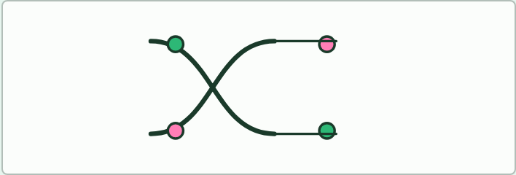
MODEL
15 MIN
Crossing over with pipe cleaners
THE TASK
Pairs take two pipe cleaners (green and pink) with two beads on each, one near each end, to stand for the alleles of two genes. Twist the two cleaners together at one point and cut at the twist, then swap the cut ends. Read off the two new chromosomes. Which combinations are parental and which are recombinant? Do it once with the twist between the beads, once with it outside them. Repeat with beads close together and far apart, and tally how often the twist falls between them.
STUDENTS NEED
Pipe cleaners in two colours, beads, scissors.
Minutes 6 to 21
Notes:
Minutes 6 to 21 of 60: Where are the genes? (15 min).
The plan: The gene database task below. Students look up two genes from the card, write each locus and polypeptide, and say whether the pair could assort independently.
The activity: Crossing over with pipe cleaners. Pairs take two pipe cleaners (green and pink) with two beads on each, one near each end, to stand for the alleles of two genes. Twist the two cleaners together at one point and cut at the twist, then swap the cut ends. Read off the two new chromosomes. Which combinations are parental and which are recombinant? Do it once with the twist between the beads, once with it outside them. Repeat with beads close together and far apart, and tally how often the twist falls between them.
Needs: pipe cleaners in two colours, beads, scissors.
The time: 15 minutes, minutes 6 to 21 of the plan.

Slide 5
STEP 3
12 MIN
Linkage and the vertical line
Students rewrite one genotype with the vertical line notation and name which alleles travel together.
Minutes 21 to 33
Notes:
Minutes 21 to 33 of 60: Linkage and the vertical line (12 min).
The plan: Chapter 14's figure. Students rewrite one genotype with the vertical line notation and name which alleles travel together. Then the predict box on the test cross.

Slide 6
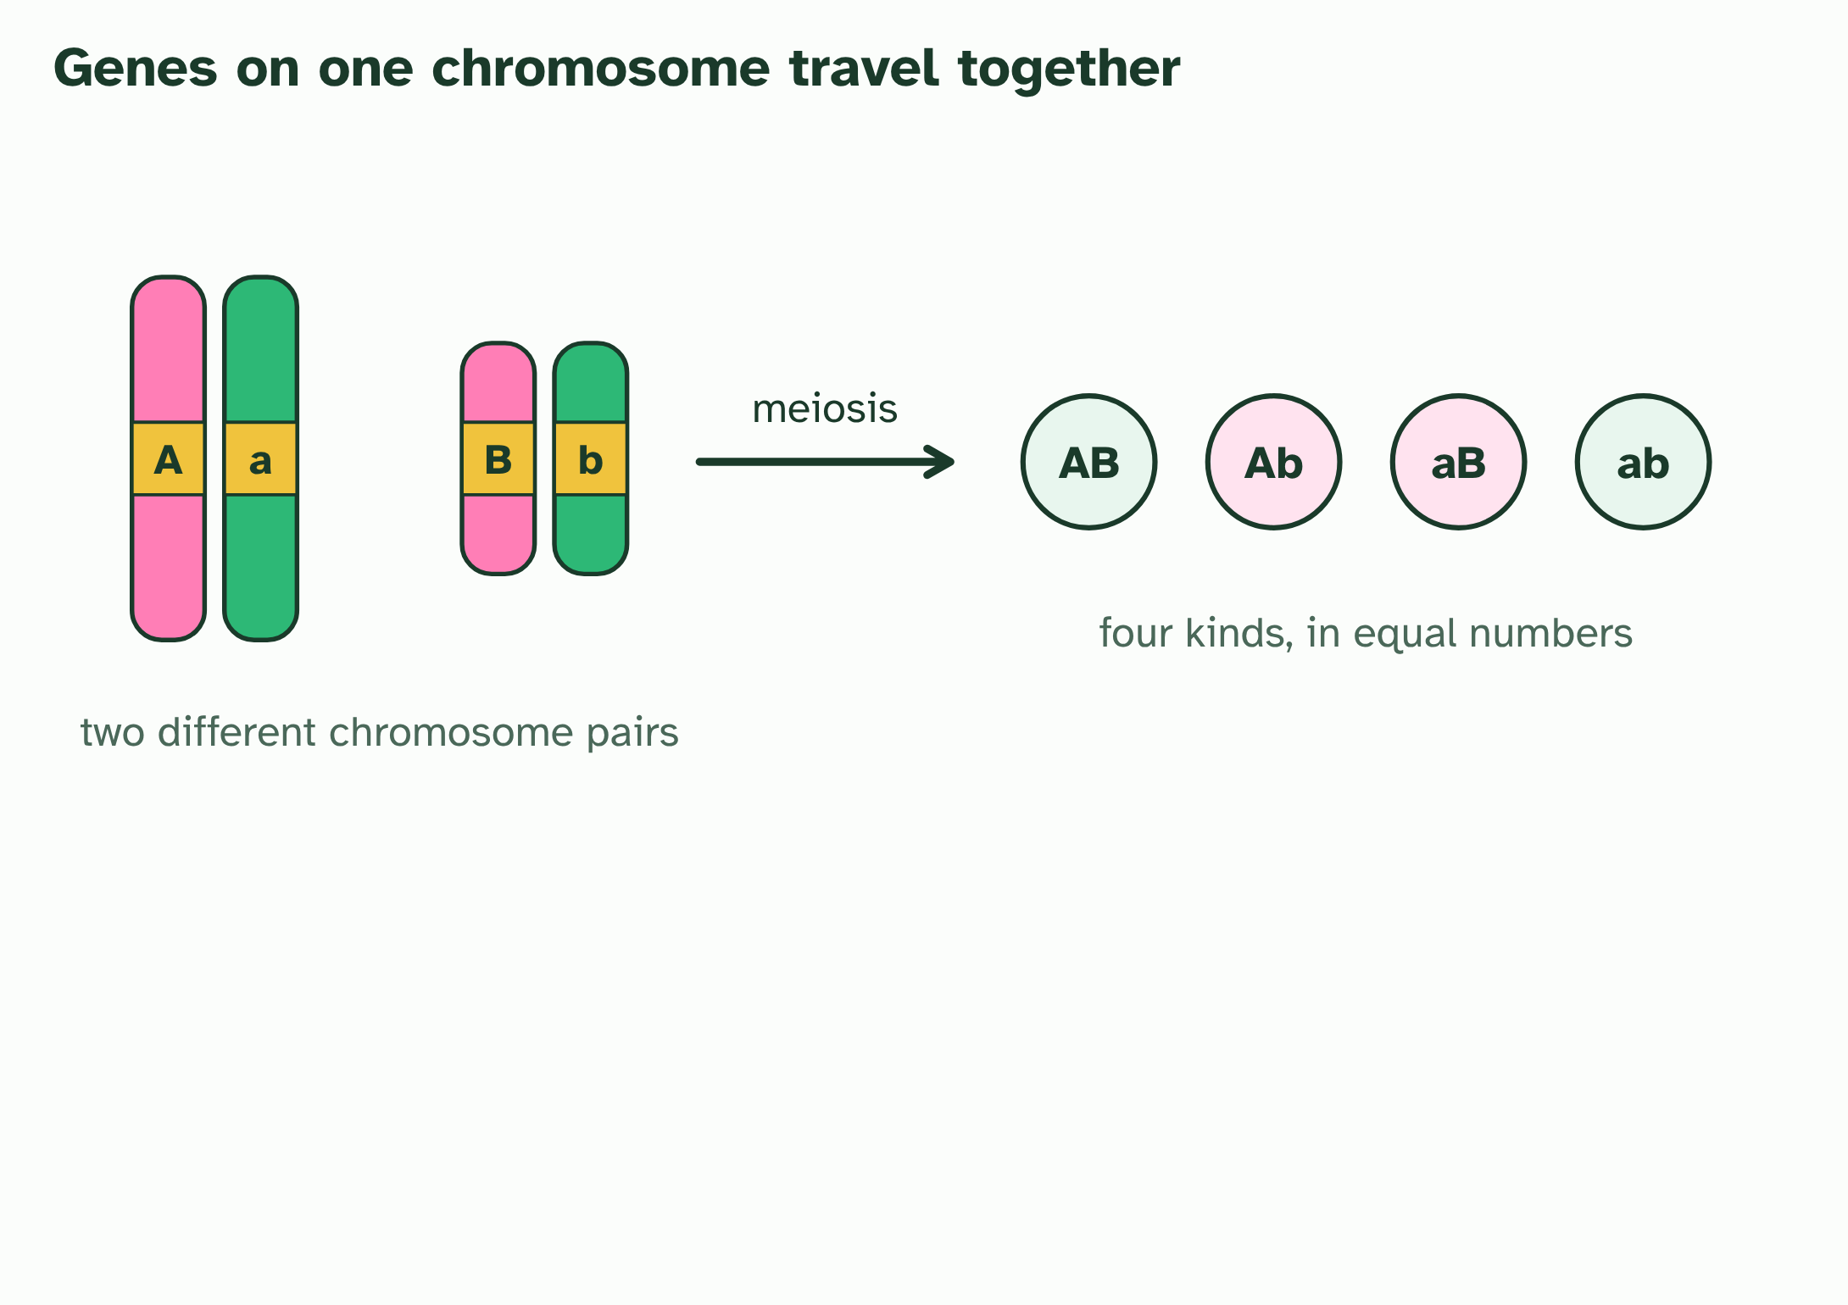
CHAPTER 14 · D3.2.18 D3.2.19 D3.2.20 Gene loci, linkage and recombinants
1 / 4
Genes that travel together
Unlinked genes sit on different chromosome pairs, so all four kinds of gamete are equally likely.
Minutes 21 to 33
Notes:
Minutes 21 to 33 of 60: Linkage and the vertical line (12 min).
The plan: Chapter 14's figure. Students rewrite one genotype with the vertical line notation and name which alleles travel together. Then the predict box on the test cross.
Independent assortment works only if the genes are on different chromosomes. A chromosome carries hundreds or thousands of genes, so most genes share a chromosome with others. Genes on the same chromosome are linked: they travel together in meiosis because they sit on the same piece of DNA.
A gene database lists each human gene with its locus (the chromosome and the position on it) and the polypeptide it codes for, so you can look pairs up. Try the genes for the beta chain of haemoglobin (HBB) and the alpha chain (HBA1 and HBA2): they sit on different chromosomes, so they assort independently. Then look at the genes next to HBB, such as HBD for the delta chain: they are close neighbours on the same chromosome, so they are linked. Your teacher will name a database.
Linked alleles are shown with a vertical line for each homologous chromosome and the alleles beside it: AB over ab means A and B are on one chromosome and a and b on its partner. With no crossing over, only two kinds of gamete form, AB and ab: the combinations that were already on the chromosomes, called parental types.
But chromosomes do swap pieces. In prophase I, homologous chromosomes pair up and non-sister chromatids can cross over. If a crossover falls between the two genes, some gametes get Ab or aB. A gamete, a genotype or a phenotype with a combination of alleles that differs from the combinations on the parent's chromosomes is a recombinant. The further apart two genes are, the more often a crossover falls between them, so the more recombinants. Genes far enough apart to give 50% recombinants behave as if unlinked.
The test cross shows this. Cross an AaBb individual with an aabb one. The aabb parent adds only ab, so each offspring's phenotype shows the gamete it got from the heterozygote. Unlinked genes give 1 : 1 : 1 : 1, half of them recombinants. Linked genes give two large parental classes and two small recombinant classes. The recombinant frequency is the recombinants divided by all the offspring. You can find recombinants in gametes, in the genotypes of offspring and in their phenotypes.
Try it yourself in the dry lab: choose unlinked genes or genes linked at different distances, set up a test cross and count the offspring. Or try the linked or not? mystery.

Slide 7
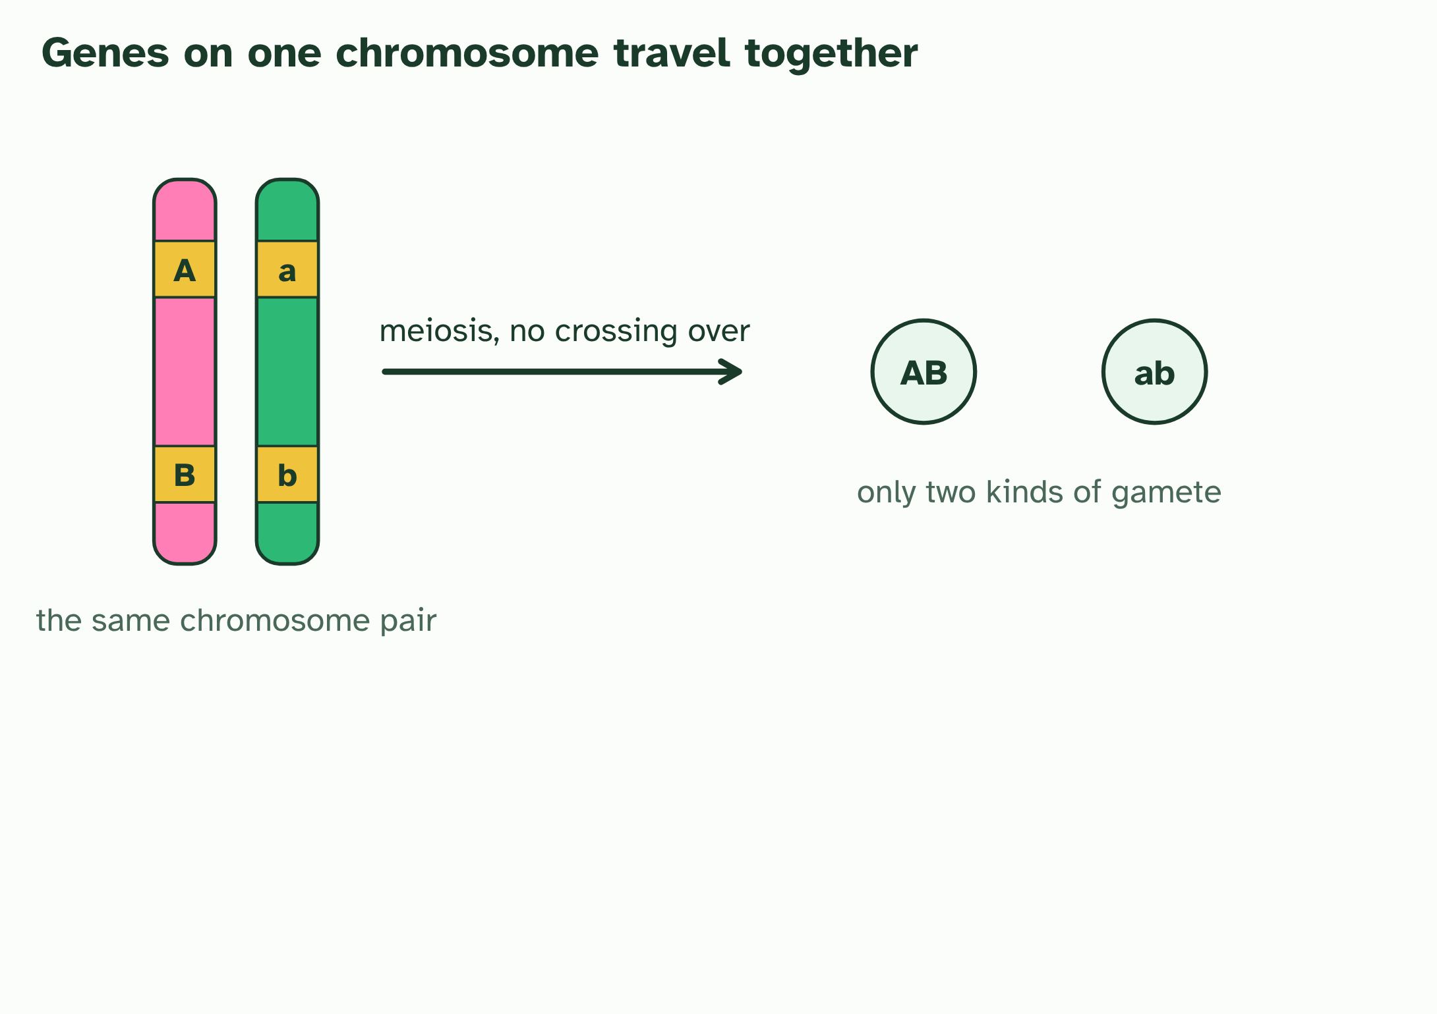
CHAPTER 14 · D3.2.18 D3.2.19 D3.2.20 Gene loci, linkage and recombinants
2 / 4
Genes that travel together
Linked genes sit on the same chromosome. With no crossing over, only the two parental gametes, AB and ab, are made.
Minutes 21 to 33
Notes:
Minutes 21 to 33 of 60: Linkage and the vertical line (12 min).
The plan: Chapter 14's figure. Students rewrite one genotype with the vertical line notation and name which alleles travel together. Then the predict box on the test cross.
Independent assortment works only if the genes are on different chromosomes. A chromosome carries hundreds or thousands of genes, so most genes share a chromosome with others. Genes on the same chromosome are linked: they travel together in meiosis because they sit on the same piece of DNA.
A gene database lists each human gene with its locus (the chromosome and the position on it) and the polypeptide it codes for, so you can look pairs up. Try the genes for the beta chain of haemoglobin (HBB) and the alpha chain (HBA1 and HBA2): they sit on different chromosomes, so they assort independently. Then look at the genes next to HBB, such as HBD for the delta chain: they are close neighbours on the same chromosome, so they are linked. Your teacher will name a database.
Linked alleles are shown with a vertical line for each homologous chromosome and the alleles beside it: AB over ab means A and B are on one chromosome and a and b on its partner. With no crossing over, only two kinds of gamete form, AB and ab: the combinations that were already on the chromosomes, called parental types.
But chromosomes do swap pieces. In prophase I, homologous chromosomes pair up and non-sister chromatids can cross over. If a crossover falls between the two genes, some gametes get Ab or aB. A gamete, a genotype or a phenotype with a combination of alleles that differs from the combinations on the parent's chromosomes is a recombinant. The further apart two genes are, the more often a crossover falls between them, so the more recombinants. Genes far enough apart to give 50% recombinants behave as if unlinked.
The test cross shows this. Cross an AaBb individual with an aabb one. The aabb parent adds only ab, so each offspring's phenotype shows the gamete it got from the heterozygote. Unlinked genes give 1 : 1 : 1 : 1, half of them recombinants. Linked genes give two large parental classes and two small recombinant classes. The recombinant frequency is the recombinants divided by all the offspring. You can find recombinants in gametes, in the genotypes of offspring and in their phenotypes.
Try it yourself in the dry lab: choose unlinked genes or genes linked at different distances, set up a test cross and count the offspring. Or try the linked or not? mystery.

Slide 8
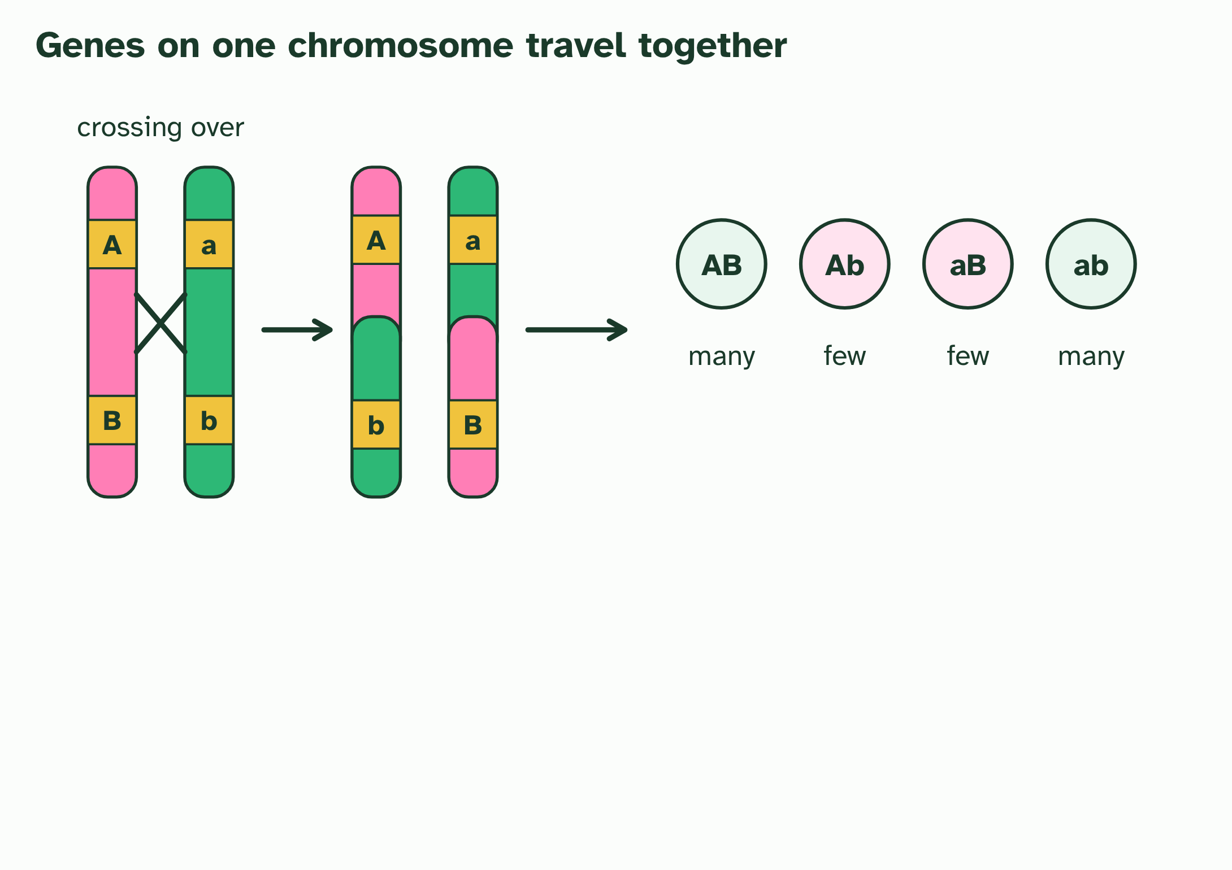
CHAPTER 14 · D3.2.18 D3.2.19 D3.2.20 Gene loci, linkage and recombinants
3 / 4
Genes that travel together
Crossing over between the genes swaps the ends of two chromatids and makes the recombinant gametes Ab and aB. The other two chromatids are unchanged, so recombinants are few.
Minutes 21 to 33
Notes:
Minutes 21 to 33 of 60: Linkage and the vertical line (12 min).
The plan: Chapter 14's figure. Students rewrite one genotype with the vertical line notation and name which alleles travel together. Then the predict box on the test cross.
Independent assortment works only if the genes are on different chromosomes. A chromosome carries hundreds or thousands of genes, so most genes share a chromosome with others. Genes on the same chromosome are linked: they travel together in meiosis because they sit on the same piece of DNA.
A gene database lists each human gene with its locus (the chromosome and the position on it) and the polypeptide it codes for, so you can look pairs up. Try the genes for the beta chain of haemoglobin (HBB) and the alpha chain (HBA1 and HBA2): they sit on different chromosomes, so they assort independently. Then look at the genes next to HBB, such as HBD for the delta chain: they are close neighbours on the same chromosome, so they are linked. Your teacher will name a database.
Linked alleles are shown with a vertical line for each homologous chromosome and the alleles beside it: AB over ab means A and B are on one chromosome and a and b on its partner. With no crossing over, only two kinds of gamete form, AB and ab: the combinations that were already on the chromosomes, called parental types.
But chromosomes do swap pieces. In prophase I, homologous chromosomes pair up and non-sister chromatids can cross over. If a crossover falls between the two genes, some gametes get Ab or aB. A gamete, a genotype or a phenotype with a combination of alleles that differs from the combinations on the parent's chromosomes is a recombinant. The further apart two genes are, the more often a crossover falls between them, so the more recombinants. Genes far enough apart to give 50% recombinants behave as if unlinked.
The test cross shows this. Cross an AaBb individual with an aabb one. The aabb parent adds only ab, so each offspring's phenotype shows the gamete it got from the heterozygote. Unlinked genes give 1 : 1 : 1 : 1, half of them recombinants. Linked genes give two large parental classes and two small recombinant classes. The recombinant frequency is the recombinants divided by all the offspring. You can find recombinants in gametes, in the genotypes of offspring and in their phenotypes.
Try it yourself in the dry lab: choose unlinked genes or genes linked at different distances, set up a test cross and count the offspring. Or try the linked or not? mystery.

Slide 9
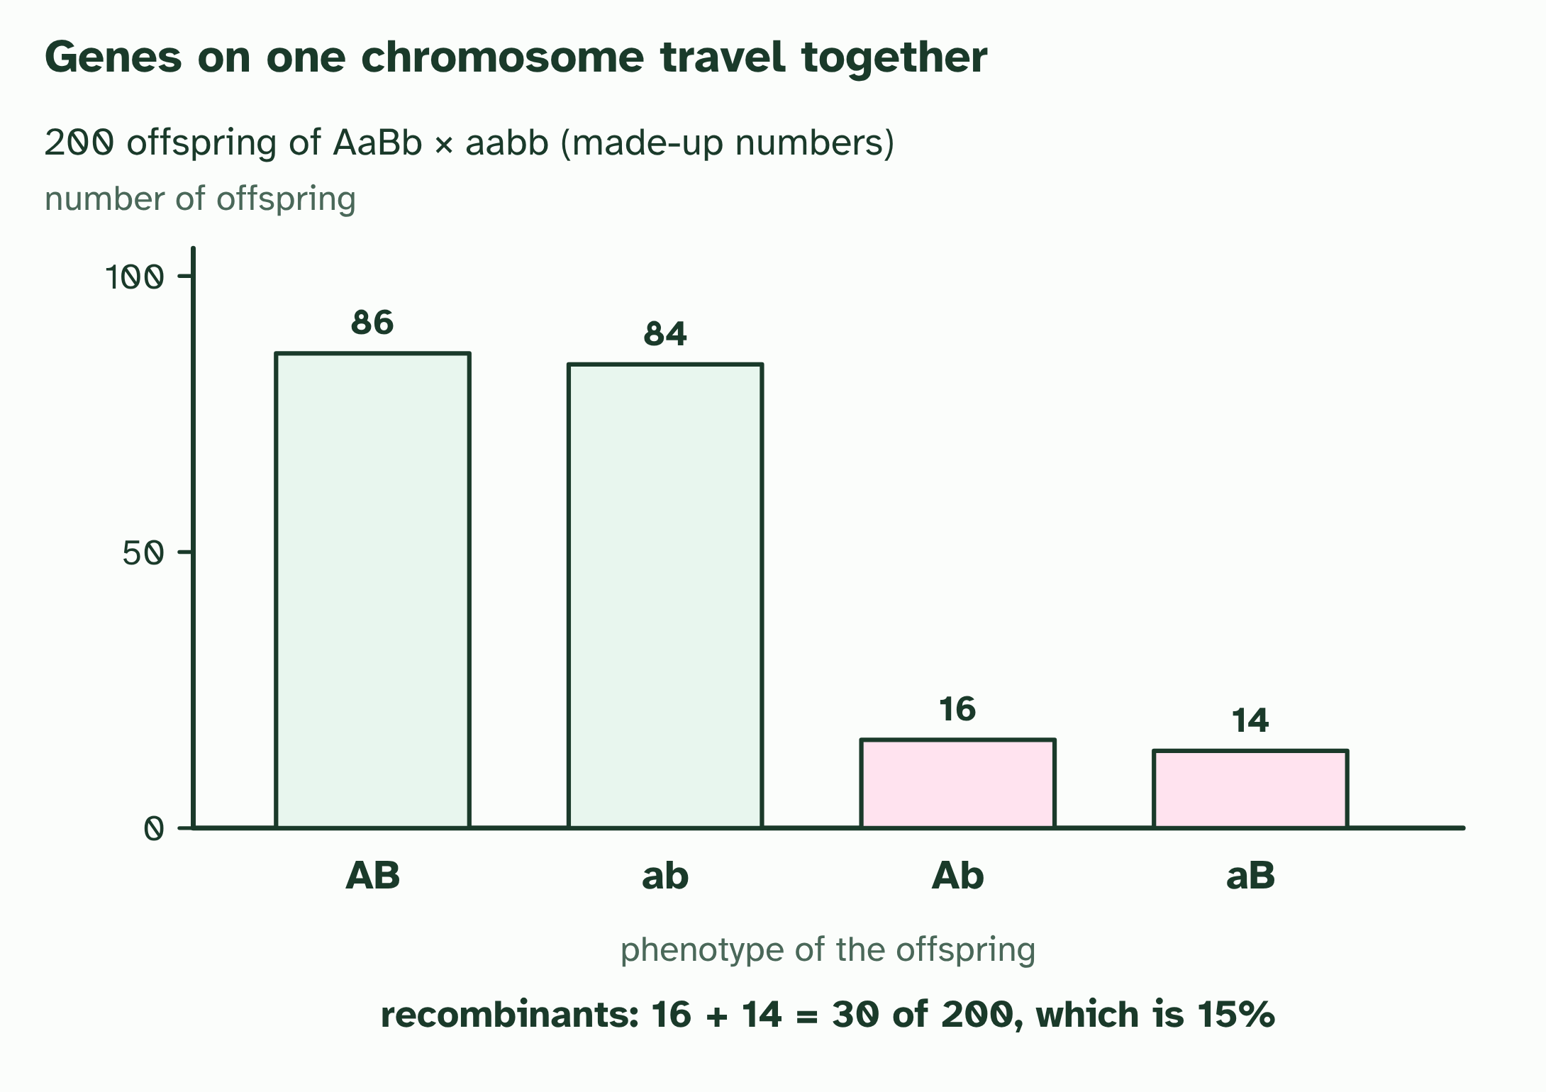
CHAPTER 14 · D3.2.18 D3.2.19 D3.2.20 Gene loci, linkage and recombinants
4 / 4
Genes that travel together
A test cross (AaBb × aabb) shows it: mostly parental types and a few recombinants. Recombinant frequency = 30 ÷ 200 = 15%.
Minutes 21 to 33
Notes:
Minutes 21 to 33 of 60: Linkage and the vertical line (12 min).
The plan: Chapter 14's figure. Students rewrite one genotype with the vertical line notation and name which alleles travel together. Then the predict box on the test cross.
Independent assortment works only if the genes are on different chromosomes. A chromosome carries hundreds or thousands of genes, so most genes share a chromosome with others. Genes on the same chromosome are linked: they travel together in meiosis because they sit on the same piece of DNA.
A gene database lists each human gene with its locus (the chromosome and the position on it) and the polypeptide it codes for, so you can look pairs up. Try the genes for the beta chain of haemoglobin (HBB) and the alpha chain (HBA1 and HBA2): they sit on different chromosomes, so they assort independently. Then look at the genes next to HBB, such as HBD for the delta chain: they are close neighbours on the same chromosome, so they are linked. Your teacher will name a database.
Linked alleles are shown with a vertical line for each homologous chromosome and the alleles beside it: AB over ab means A and B are on one chromosome and a and b on its partner. With no crossing over, only two kinds of gamete form, AB and ab: the combinations that were already on the chromosomes, called parental types.
But chromosomes do swap pieces. In prophase I, homologous chromosomes pair up and non-sister chromatids can cross over. If a crossover falls between the two genes, some gametes get Ab or aB. A gamete, a genotype or a phenotype with a combination of alleles that differs from the combinations on the parent's chromosomes is a recombinant. The further apart two genes are, the more often a crossover falls between them, so the more recombinants. Genes far enough apart to give 50% recombinants behave as if unlinked.
The test cross shows this. Cross an AaBb individual with an aabb one. The aabb parent adds only ab, so each offspring's phenotype shows the gamete it got from the heterozygote. Unlinked genes give 1 : 1 : 1 : 1, half of them recombinants. Linked genes give two large parental classes and two small recombinant classes. The recombinant frequency is the recombinants divided by all the offspring. You can find recombinants in gametes, in the genotypes of offspring and in their phenotypes.
Try it yourself in the dry lab: choose unlinked genes or genes linked at different distances, set up a test cross and count the offspring. Or try the linked or not? mystery.

Slide 10
CHAPTER 14 · D3.2.18 D3.2.19 D3.2.20 Gene loci, linkage and recombinants
Genes that travel together
Genes on the same chromosome are linked: they travel together in meiosis because they sit on the same piece of DNA.
Then look at the genes next to HBB, such as HBD for the delta chain: they are close neighbours on the same chromosome, so they are linked.
Linked alleles are shown with a vertical line for each homologous chromosome and the alleles beside it: AB over ab means A and B are on one chromosome and a and b on its partner.
A gamete, a genotype or a phenotype with a combination of alleles that differs from the combinations on the parent's chromosomes is a recombinant.
Minutes 21 to 33
Notes:
Minutes 21 to 33 of 60: Linkage and the vertical line (12 min).
The plan: Chapter 14's figure. Students rewrite one genotype with the vertical line notation and name which alleles travel together. Then the predict box on the test cross.
Independent assortment works only if the genes are on different chromosomes. A chromosome carries hundreds or thousands of genes, so most genes share a chromosome with others. Genes on the same chromosome are linked: they travel together in meiosis because they sit on the same piece of DNA.
A gene database lists each human gene with its locus (the chromosome and the position on it) and the polypeptide it codes for, so you can look pairs up. Try the genes for the beta chain of haemoglobin (HBB) and the alpha chain (HBA1 and HBA2): they sit on different chromosomes, so they assort independently. Then look at the genes next to HBB, such as HBD for the delta chain: they are close neighbours on the same chromosome, so they are linked. Your teacher will name a database.
Linked alleles are shown with a vertical line for each homologous chromosome and the alleles beside it: AB over ab means A and B are on one chromosome and a and b on its partner. With no crossing over, only two kinds of gamete form, AB and ab: the combinations that were already on the chromosomes, called parental types.
But chromosomes do swap pieces. In prophase I, homologous chromosomes pair up and non-sister chromatids can cross over. If a crossover falls between the two genes, some gametes get Ab or aB. A gamete, a genotype or a phenotype with a combination of alleles that differs from the combinations on the parent's chromosomes is a recombinant. The further apart two genes are, the more often a crossover falls between them, so the more recombinants. Genes far enough apart to give 50% recombinants behave as if unlinked.
The test cross shows this. Cross an AaBb individual with an aabb one. The aabb parent adds only ab, so each offspring's phenotype shows the gamete it got from the heterozygote. Unlinked genes give 1 : 1 : 1 : 1, half of them recombinants. Linked genes give two large parental classes and two small recombinant classes. The recombinant frequency is the recombinants divided by all the offspring. You can find recombinants in gametes, in the genotypes of offspring and in their phenotypes.
Try it yourself in the dry lab: choose unlinked genes or genes linked at different distances, set up a test cross and count the offspring. Or try the linked or not? mystery.

Slide 11
PREDICT
A test cross AaBb × aabb gives 48 AB, 47 ab, 3 Ab and 2 aB. What does this suggest?
A The genes are unlinked, so all four classes should be equal
B The genes are on different chromosomes, with recombinants common
C The genes are linked, and crossovers are rare between them
Minutes 21 to 33
Notes:
Minutes 21 to 33 of 60: Linkage and the vertical line (12 min).
The plan: Chapter 14's figure. Students rewrite one genotype with the vertical line notation and name which alleles travel together. Then the predict box on the test cross.
Ask for a show of hands, or mini whiteboards, before revealing. (Answer: C, on the next slide.)

Slide 12
WHAT HAPPENS
A test cross AaBb × aabb gives 48 AB, 47 ab, 3 Ab and 2 aB. What does this suggest?
A The genes are unlinked, so all four classes should be equal
B The genes are on different chromosomes, with recombinants common
C The genes are linked, and crossovers are rare between them
The genes are linked, and crossovers between them are rare. The two parental types, AB and ab, are far commoner than the recombinants Ab and aB. Unlinked genes would give four roughly equal classes.
Minutes 21 to 33
Notes:
Minutes 21 to 33 of 60: Linkage and the vertical line (12 min).
The plan: Chapter 14's figure. Students rewrite one genotype with the vertical line notation and name which alleles travel together. Then the predict box on the test cross.
Answer: C. The genes are linked, and crossovers between them are rare. The two parental types, AB and ab, are far commoner than the recombinants Ab and aB. Unlinked genes would give four roughly equal classes.

Slide 13
WATCH OUT
Linked genes are not "always inherited together": crossing over separates them sometimes. And a recombinant is not a mutant. No allele has changed; only the combination of alleles is new.
Minutes 21 to 33
Notes:
Minutes 21 to 33 of 60: Linkage and the vertical line (12 min).
The plan: Chapter 14's figure. Students rewrite one genotype with the vertical line notation and name which alleles travel together. Then the predict box on the test cross.
A common mistake: say it, then ask who can say why it is wrong.

Slide 14
STEP 4
17 MIN
Crossing over by hand
Pairs cross over once between two loci, read off the gametes and say which are recombinants.
Minutes 33 to 50
Notes:
Minutes 33 to 50 of 60: Crossing over by hand (17 min).
The plan: The pipe-cleaner model below. Pairs cross over once between two loci, read off the gametes and say which are recombinants. Repeat with the loci close together, then far apart.

Slide 15
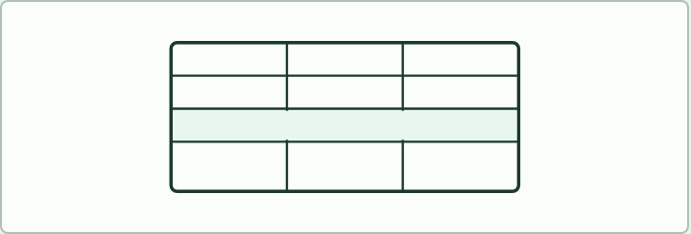
DATA TASK
17 MIN
Gene loci database
THE TASK
Students open a human gene database that your school can reach (the NCBI Gene and Ensembl databases are two) and look up the genes for the haemoglobin subunits. For each, record the chromosome, the position and the polypeptide it codes for. The beta globin gene (HBB) and the alpha globin genes (HBA1 and HBA2) are on different chromosomes, and a related gene (HBD) lies next to HBB. Ask which pairs could assort independently and which would be linked.
STUDENTS NEED
Devices with internet access, a recording sheet.
Minutes 33 to 50
Notes:
Minutes 33 to 50 of 60: Crossing over by hand (17 min).
The plan: The pipe-cleaner model below. Pairs cross over once between two loci, read off the gametes and say which are recombinants. Repeat with the loci close together, then far apart.
The activity: Gene loci database. Students open a human gene database that your school can reach (the NCBI Gene and Ensembl databases are two) and look up the genes for the haemoglobin subunits. For each, record the chromosome, the position and the polypeptide it codes for. The beta globin gene (HBB) and the alpha globin genes (HBA1 and HBA2) are on different chromosomes, and a related gene (HBD) lies next to HBB. Ask which pairs could assort independently and which would be linked. If you cannot use the database, give the table from the card and ask the same questions.
Needs: devices with internet access, a recording sheet.
The time: 17 minutes, minutes 33 to 50 of the plan.

Slide 16
PLENARY
Counting recombinants
Students pick out the recombinants and give the recombinant percentage (15 percent).
Discuss what a result near 50 percent would mean.
Minutes 50 to 60
Notes:
Minutes 50 to 60 of 60: Counting recombinants (10 min).
The plan: A test cross gave 86, 84, 16 and 14 offspring in the four classes. Students pick out the recombinants and give the recombinant percentage (15 percent). Discuss what a result near 50 percent would mean.

Slide 17
EXIT QUESTION
Before you go
On paper, on your own: Identify recombinants in crosses involving two linked or unlinked genes.
Minutes 50 to 60
Notes:
Minutes 50 to 60 of 60: Counting recombinants (10 min).
The plan: A test cross gave 86, 84, 16 and 14 offspring in the four classes. Students pick out the recombinants and give the recombinant percentage (15 percent). Discuss what a result near 50 percent would mean.
Collect the slips: they say where to start next lesson.

Slide 18
PRACTISE AND REVISE
Keep going
Exam practice: a fresh paper of exam questions on D3.2 at higher level, marked as you go
The guide, with the animations and the dry lab
This lesson in the guide: 14 Genes that travel together
BUILD FOR YOUR CLASS
ALREADY ON THE SITE FOR D3.2
CARD SETS ON SPLYCR
Tarsia puzzle, dominoes and picture reveal on D3.2, built from its key terms and ready to print
A pub quiz with rounds on D3.2, to present or run with no projector
An escape room built from the question bank on D3.2
Lesson: Linked Genes & Chi-Squared
Lesson: Dihybrid Crosses & Test Crosses
Lesson: Inheritance
Summary doodle: Inheritance
Quiz: Inheritance (HL)
Quiz: Inheritance
Revision map: D3.2 Inheritance, to fill in
Exam questions: D3.2 in the exam maker, a paper with its markscheme
Open a set to host it as a class game, or make a copy to edit.
D3.2 Inheritance
How this was made. The course structure, the activities and the teaching choices come from my own classroom, my presentations and my years of teaching IB and AP Biology. I use Claude, an AI, to help write and build the interactive guides, lesson plans, slides and practice questions, and to draw the diagrams and code the interactives. I direct the work and review it against the IB and AP specifications before it goes live.
Minute 60: after the lesson
Notes:
Every link here is live. Set the exam practice paper for homework: it is fresh each time, marked as students go and saved to their Exam practice when they are signed in.
Exam practice: https://www.biologybybradford.com/exam-maker/sit?topics=D3.2&level=HL&paper=quiz&marks=15&src=ep
The guide: https://www.biologybybradford.com/guides/ib-biology-d3-2-inheritance

