Slide 1
IB Biology D3.2
LESSON 8 OF 8
HL
BY THE END YOU CAN
Inheritance
Use a chi-squared test on data from a dihybrid cross (D3.2.21)
Is it chance? Chi-squared and the dry lab
D3.2.21
Using the chi-squared test to decide whether a dihybrid cross matches the expected ratio, and applying it in a simulated experiment
60 minutes · chapter 15 · the dry lab
Minute 0
Notes:
IB Biology D3.2, Inheritance. Lesson 8 of 8: Is it chance? Chi-squared and the dry lab (higher level), 60 minutes.
The plan, minute by minute (each slide's footer says where you are):
0 to 5 min (5) Do now
5 to 17 min (12) The five steps
17 to 32 min (15) The bead bag
32 to 55 min (23) The dry lab
55 to 60 min (5) Plenary: the decision
What students get wrong:
"Not rejecting the null hypothesis proves it." It means the data are consistent with chance, not that the genes are unlinked.
"Any difference under 5 percent is chance." The 0.05 probability level is not a percentage difference in the counts. It is the chance of a value this large if the null hypothesis is true.
Stretch and support:
Support: a table with the observed, expected, difference, squared and divided columns ready to fill in.
Stretch: why does a very large brood make it easier to reject the null hypothesis, even for a tiny departure from the ratio?
The lesson plan to print: https://www.biologybybradford.com/guides/downloads/ib-biology-d3-2-inheritance-lesson-8-plan.pdf

Slide 2
DO NOW
Do now
Flip a coin 10 times.
What if you get 7 and 3?
9 and 1?
5:00
minutes
Start now: the timer is running.
Minutes 0 to 5
Notes:
Minutes 0 to 5 of 60: Do now (5 min).
The plan: Flip a coin 10 times. Heads and tails 5 and 5 is expected. What if you get 7 and 3? 9 and 1? Write where you would start to doubt the coin.
Start a 5 minute timer as they come in.

Slide 3
STEP 2
12 MIN
The five steps
Chapter 15: Is it chance? The chi-squared test
Minutes 5 to 17
Notes:
Minutes 5 to 17 of 60: The five steps (12 min).
The plan: Chapter 15's figure and the Remember it tiles. Work the worked example together: say the null and alternative hypotheses, find the expected numbers, total (O - E)² ÷ E, find the degrees of freedom and compare with the critical value.

Slide 4
REMEMBER IT
The five steps of a chi-squared test
H
E
C
D
C
Hungry
Elves
Cook
Delicious
Cakes
Minutes 5 to 17
Notes:
Minutes 5 to 17 of 60: The five steps (12 min).
The plan: Chapter 15's figure and the Remember it tiles. Work the worked example together: say the null and alternative hypotheses, find the expected numbers, total (O - E)² ÷ E, find the degrees of freedom and compare with the critical value.
Ask the class what each letter stands for before revealing.

Slide 5
REMEMBER IT
The five steps of a chi-squared test
H
E
C
D
C
Hungry
Elves
Cook
Delicious
Cakes
Hypotheses
Expected
Calculate
Degrees of freedom
Compare
state the null and the alternative
work out the expected counts
χ² = sum of (O − E)² ÷ E
number of classes minus 1
with the critical value at p = 0.05
Minutes 5 to 17
Notes:
Minutes 5 to 17 of 60: The five steps (12 min).
The plan: Chapter 15's figure and the Remember it tiles. Work the worked example together: say the null and alternative hypotheses, find the expected numbers, total (O - E)² ÷ E, find the degrees of freedom and compare with the critical value.
Hungry: Hypotheses (state the null and the alternative)
Elves: Expected (work out the expected counts)
Cook: Calculate (χ² = sum of (O − E)² ÷ E)
Delicious: Degrees of freedom (number of classes minus 1)
Cakes: Compare (with the critical value at p = 0.05)

Slide 6
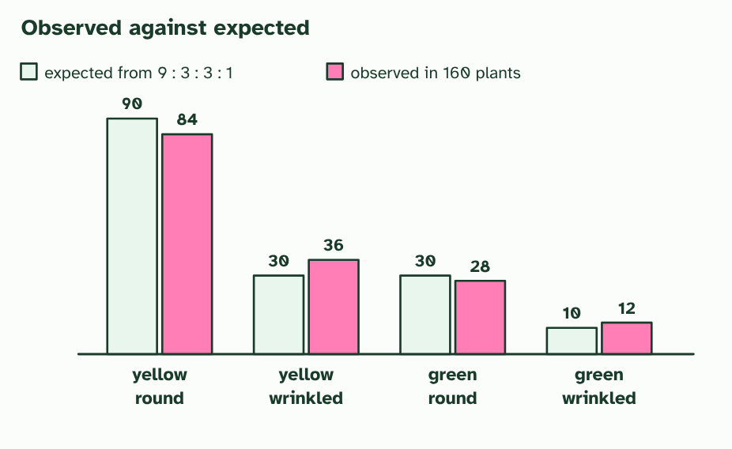
CHAPTER 15 · D3.2.21 The chi-squared test
1 / 4
Is it chance? The chi-squared test
160 F2 plants: the expected counts from 9 : 3 : 3 : 1 (90, 30, 30 and 10) against observed counts (made up).
Minutes 5 to 17
Notes:
Minutes 5 to 17 of 60: The five steps (12 min).
The plan: Chapter 15's figure and the Remember it tiles. Work the worked example together: say the null and alternative hypotheses, find the expected numbers, total (O - E)² ÷ E, find the degrees of freedom and compare with the critical value.
Real offspring never match the expected ratio exactly. From 160 plants from a 9 : 3 : 3 : 1 cross you would not expect exactly 90, 30, 30 and 10, even when the genes are unlinked, because chance decides which gametes meet. So when is a difference too big to blame on chance? A chi-squared test answers that.
Begin with two hypotheses. The null hypothesis says there is no real difference between observed and expected: the genes are unlinked, and chance explains the scatter. The alternative hypothesis says there is a real difference, for example that the genes are linked.
The test gives χ² = the sum of (O − E)² ÷ E over every class, where O is observed and E is expected. The bigger the differences, the bigger χ². Compare it with a critical value from a table, chosen by the degrees of freedom (the number of classes minus 1, so 3 for four phenotype classes) and the significance level, p = 0.05. If χ² is bigger than the critical value, the difference is statistically significant: a difference this large would arise by chance alone less than 5% of the time, so you reject the null hypothesis. If χ² is smaller, chance could explain the difference and you do not reject it.
The dry lab does the arithmetic with you: breed a brood and test it, then decide whether to reject the null hypothesis.
Example: Critical values at p = 0.05 1 degree of freedom: 3.84. 2: 5.99. 3: 7.81. 4: 9.49.

Slide 7
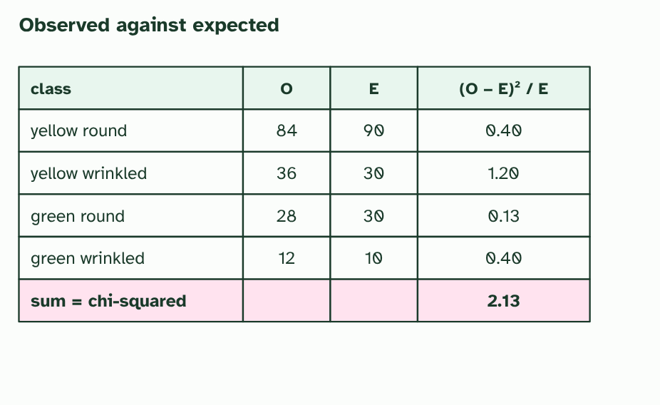
CHAPTER 15 · D3.2.21 The chi-squared test
2 / 4
Is it chance? The chi-squared test
χ² is the sum of (O − E)² ÷ E over the four classes: 2.13.
Minutes 5 to 17
Notes:
Minutes 5 to 17 of 60: The five steps (12 min).
The plan: Chapter 15's figure and the Remember it tiles. Work the worked example together: say the null and alternative hypotheses, find the expected numbers, total (O - E)² ÷ E, find the degrees of freedom and compare with the critical value.
Real offspring never match the expected ratio exactly. From 160 plants from a 9 : 3 : 3 : 1 cross you would not expect exactly 90, 30, 30 and 10, even when the genes are unlinked, because chance decides which gametes meet. So when is a difference too big to blame on chance? A chi-squared test answers that.
Begin with two hypotheses. The null hypothesis says there is no real difference between observed and expected: the genes are unlinked, and chance explains the scatter. The alternative hypothesis says there is a real difference, for example that the genes are linked.
The test gives χ² = the sum of (O − E)² ÷ E over every class, where O is observed and E is expected. The bigger the differences, the bigger χ². Compare it with a critical value from a table, chosen by the degrees of freedom (the number of classes minus 1, so 3 for four phenotype classes) and the significance level, p = 0.05. If χ² is bigger than the critical value, the difference is statistically significant: a difference this large would arise by chance alone less than 5% of the time, so you reject the null hypothesis. If χ² is smaller, chance could explain the difference and you do not reject it.
The dry lab does the arithmetic with you: breed a brood and test it, then decide whether to reject the null hypothesis.
Example: Critical values at p = 0.05 1 degree of freedom: 3.84. 2: 5.99. 3: 7.81. 4: 9.49.

Slide 8
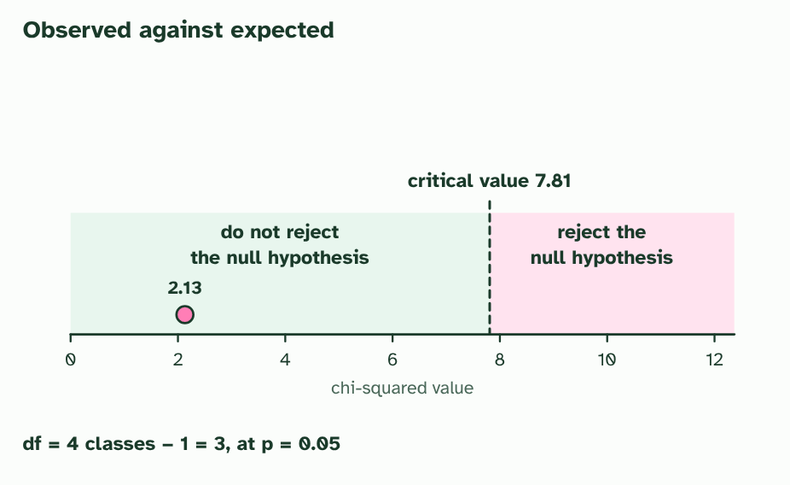
CHAPTER 15 · D3.2.21 The chi-squared test
3 / 4
Is it chance? The chi-squared test
With 3 degrees of freedom and p = 0.05 the critical value is 7.81. 2.13 is below it, so you do not reject the null hypothesis: chance can explain the difference.
Minutes 5 to 17
Notes:
Minutes 5 to 17 of 60: The five steps (12 min).
The plan: Chapter 15's figure and the Remember it tiles. Work the worked example together: say the null and alternative hypotheses, find the expected numbers, total (O - E)² ÷ E, find the degrees of freedom and compare with the critical value.
Real offspring never match the expected ratio exactly. From 160 plants from a 9 : 3 : 3 : 1 cross you would not expect exactly 90, 30, 30 and 10, even when the genes are unlinked, because chance decides which gametes meet. So when is a difference too big to blame on chance? A chi-squared test answers that.
Begin with two hypotheses. The null hypothesis says there is no real difference between observed and expected: the genes are unlinked, and chance explains the scatter. The alternative hypothesis says there is a real difference, for example that the genes are linked.
The test gives χ² = the sum of (O − E)² ÷ E over every class, where O is observed and E is expected. The bigger the differences, the bigger χ². Compare it with a critical value from a table, chosen by the degrees of freedom (the number of classes minus 1, so 3 for four phenotype classes) and the significance level, p = 0.05. If χ² is bigger than the critical value, the difference is statistically significant: a difference this large would arise by chance alone less than 5% of the time, so you reject the null hypothesis. If χ² is smaller, chance could explain the difference and you do not reject it.
The dry lab does the arithmetic with you: breed a brood and test it, then decide whether to reject the null hypothesis.
Example: Critical values at p = 0.05 1 degree of freedom: 3.84. 2: 5.99. 3: 7.81. 4: 9.49.

Slide 9
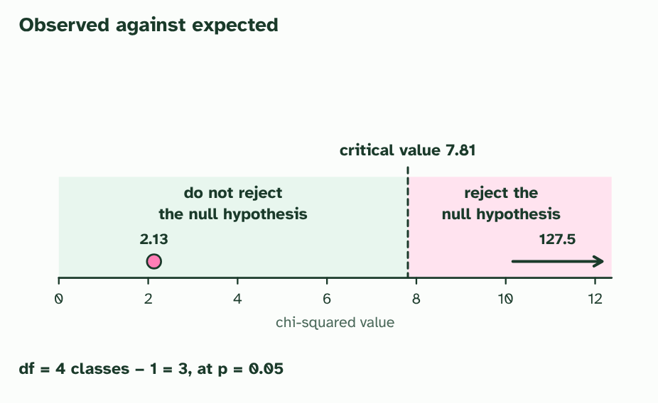
CHAPTER 15 · D3.2.21 The chi-squared test
4 / 4
Is it chance? The chi-squared test
A test cross of linked genes (made-up counts 112, 21, 18 and 109 from 260 offspring) gives χ² = 127.5, far past 7.81. Reject the null: the genes are probably linked.
Minutes 5 to 17
Notes:
Minutes 5 to 17 of 60: The five steps (12 min).
The plan: Chapter 15's figure and the Remember it tiles. Work the worked example together: say the null and alternative hypotheses, find the expected numbers, total (O - E)² ÷ E, find the degrees of freedom and compare with the critical value.
Real offspring never match the expected ratio exactly. From 160 plants from a 9 : 3 : 3 : 1 cross you would not expect exactly 90, 30, 30 and 10, even when the genes are unlinked, because chance decides which gametes meet. So when is a difference too big to blame on chance? A chi-squared test answers that.
Begin with two hypotheses. The null hypothesis says there is no real difference between observed and expected: the genes are unlinked, and chance explains the scatter. The alternative hypothesis says there is a real difference, for example that the genes are linked.
The test gives χ² = the sum of (O − E)² ÷ E over every class, where O is observed and E is expected. The bigger the differences, the bigger χ². Compare it with a critical value from a table, chosen by the degrees of freedom (the number of classes minus 1, so 3 for four phenotype classes) and the significance level, p = 0.05. If χ² is bigger than the critical value, the difference is statistically significant: a difference this large would arise by chance alone less than 5% of the time, so you reject the null hypothesis. If χ² is smaller, chance could explain the difference and you do not reject it.
The dry lab does the arithmetic with you: breed a brood and test it, then decide whether to reject the null hypothesis.
Example: Critical values at p = 0.05 1 degree of freedom: 3.84. 2: 5.99. 3: 7.81. 4: 9.49.

Slide 10
CHAPTER 15 · D3.2.21 The chi-squared test
Is it chance? The chi-squared test
A chi-squared test answers that.
The null hypothesis says there is no real difference between observed and expected: the genes are unlinked, and chance explains the scatter.
If χ² is bigger than the critical value, the difference is statistically significant: a difference this large would arise by chance alone less than 5% of the time, so you reject the null hypothesis.
The dry lab does the arithmetic with you: breed a brood and test it, then decide whether to reject the null hypothesis.
Minutes 5 to 17
Notes:
Minutes 5 to 17 of 60: The five steps (12 min).
The plan: Chapter 15's figure and the Remember it tiles. Work the worked example together: say the null and alternative hypotheses, find the expected numbers, total (O - E)² ÷ E, find the degrees of freedom and compare with the critical value.
Real offspring never match the expected ratio exactly. From 160 plants from a 9 : 3 : 3 : 1 cross you would not expect exactly 90, 30, 30 and 10, even when the genes are unlinked, because chance decides which gametes meet. So when is a difference too big to blame on chance? A chi-squared test answers that.
Begin with two hypotheses. The null hypothesis says there is no real difference between observed and expected: the genes are unlinked, and chance explains the scatter. The alternative hypothesis says there is a real difference, for example that the genes are linked.
The test gives χ² = the sum of (O − E)² ÷ E over every class, where O is observed and E is expected. The bigger the differences, the bigger χ². Compare it with a critical value from a table, chosen by the degrees of freedom (the number of classes minus 1, so 3 for four phenotype classes) and the significance level, p = 0.05. If χ² is bigger than the critical value, the difference is statistically significant: a difference this large would arise by chance alone less than 5% of the time, so you reject the null hypothesis. If χ² is smaller, chance could explain the difference and you do not reject it.
The dry lab does the arithmetic with you: breed a brood and test it, then decide whether to reject the null hypothesis.
Example: Critical values at p = 0.05 1 degree of freedom: 3.84. 2: 5.99. 3: 7.81. 4: 9.49.

Slide 11
PREDICT
A chi-squared value of 2.1 with 3 degrees of freedom is compared with a critical value of 7.81. What do you conclude?
A Reject the null hypothesis, because the result is significant
B Do not reject the null: chance could explain it
C Accept the alternative, because the observed numbers differ
Minutes 5 to 17
Notes:
Minutes 5 to 17 of 60: The five steps (12 min).
The plan: Chapter 15's figure and the Remember it tiles. Work the worked example together: say the null and alternative hypotheses, find the expected numbers, total (O - E)² ÷ E, find the degrees of freedom and compare with the critical value.
Ask for a show of hands, or mini whiteboards, before revealing. (Answer: B, on the next slide.)

Slide 12
WHAT HAPPENS
A chi-squared value of 2.1 with 3 degrees of freedom is compared with a critical value of 7.81. What do you conclude?
A Reject the null hypothesis, because the result is significant
B Do not reject the null: chance could explain it
C Accept the alternative, because the observed numbers differ
Do not reject the null hypothesis. 2.1 is below 7.81, so a difference this size can easily arise by chance when the genes are unlinked. The numbers do differ from the expected ones, but not by more than chance alone would explain.
Minutes 5 to 17
Notes:
Minutes 5 to 17 of 60: The five steps (12 min).
The plan: Chapter 15's figure and the Remember it tiles. Work the worked example together: say the null and alternative hypotheses, find the expected numbers, total (O - E)² ÷ E, find the degrees of freedom and compare with the critical value.
Answer: B. Do not reject the null hypothesis. 2.1 is below 7.81, so a difference this size can easily arise by chance when the genes are unlinked. The numbers do differ from the expected ones, but not by more than chance alone would explain.

Slide 13
WATCH OUT
A result that is not significant does not prove the null hypothesis: it means these data are not enough to reject it. And a significant result says the data differ from the expected ratio, not why. Linkage is the explanation to test next. The 5% level is a convention: about 1 test in 20 on unlinked genes would look significant by chance alone.
Minutes 5 to 17
Notes:
Minutes 5 to 17 of 60: The five steps (12 min).
The plan: Chapter 15's figure and the Remember it tiles. Work the worked example together: say the null and alternative hypotheses, find the expected numbers, total (O - E)² ÷ E, find the degrees of freedom and compare with the critical value.
A common mistake: say it, then ask who can say why it is wrong.

Slide 14
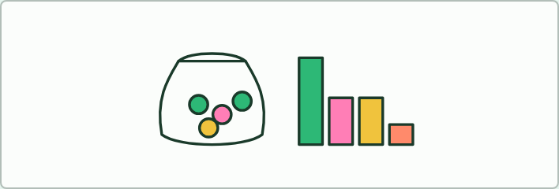
MODEL
15 MIN
The bead bag
THE TASK
Each group has a bag with 9 parts green round, 3 green wrinkled, 3 yellow round and 1 yellow wrinkled (for example 90, 30, 30 and 10 beads, or a proportion of it). Draw 80 beads with replacement, shaking between draws, tally the four colours, and work out chi-squared against the 9: 3: 3: 1 expectation. Compare it with the critical value for 3 degrees of freedom. Pool the class results on the board: about 1 group in 20 should reject the null hypothesis even though the bag is right. Ask what this tells you about what a rejection means.
STUDENTS NEED
Bags of four colours of beads, a calculator, the critical value table.
Minutes 17 to 32
Notes:
Minutes 17 to 32 of 60: The bead bag (15 min).
The plan: The activity below. Each group samples from a bag of beads in a 9 : 3 : 3 : 1 ratio and tests its sample. How many groups reject the null hypothesis, and what should that number be?
The activity: The bead bag. Each group has a bag with 9 parts green round, 3 green wrinkled, 3 yellow round and 1 yellow wrinkled (for example 90, 30, 30 and 10 beads, or a proportion of it). Draw 80 beads with replacement, shaking between draws, tally the four colours, and work out chi-squared against the 9 : 3 : 3 : 1 expectation. Compare it with the critical value for 3 degrees of freedom. Pool the class results on the board: about 1 group in 20 should reject the null hypothesis even though the bag is right. Ask what this tells you about what a rejection means.
Needs: bags of four colours of beads, a calculator, the critical value table.
The time: 15 minutes, minutes 17 to 32 of the plan.

Slide 15
STEP 4
23 MIN
The dry lab
Students choose unlinked or linked genes, make a test cross and test the brood against 1.
Minutes 32 to 55
Notes:
Minutes 32 to 55 of 60: The dry lab (23 min).
The plan: The dry lab, in pairs. Students choose unlinked or linked genes, make a test cross and test the brood against 1 : 1 : 1 : 1. Then the mystery: breed as many broods as needed and give a verdict. The coach under the bench covers repeats and evaluation.

Slide 16
DRY LAB
23 MIN
Fly crosses: linked or not?
THE TASK
The dry lab above, with the tasks and questions under it. It works on a phone as well as a laptop, and the results download as a CSV for pooling. The genes are invented and the fly is made up, so say so in the debrief. The coach under the bench takes students through variables, repeats and evaluation.
STUDENTS NEED
One device per pair.
Minutes 32 to 55
Notes:
Minutes 32 to 55 of 60: The dry lab (23 min).
The plan: The dry lab, in pairs. Students choose unlinked or linked genes, make a test cross and test the brood against 1 : 1 : 1 : 1. Then the mystery: breed as many broods as needed and give a verdict. The coach under the bench covers repeats and evaluation.
The activity: Fly crosses: linked or not?. The dry lab above, with the tasks and questions under it. It works on a phone as well as a laptop, and the results download as a CSV for pooling. The genes are invented and the fly is made up, so say so in the debrief. The coach under the bench takes students through variables, repeats and evaluation.
Needs: one device per pair.
The time: 23 minutes, minutes 32 to 55 of the plan.

Slide 17
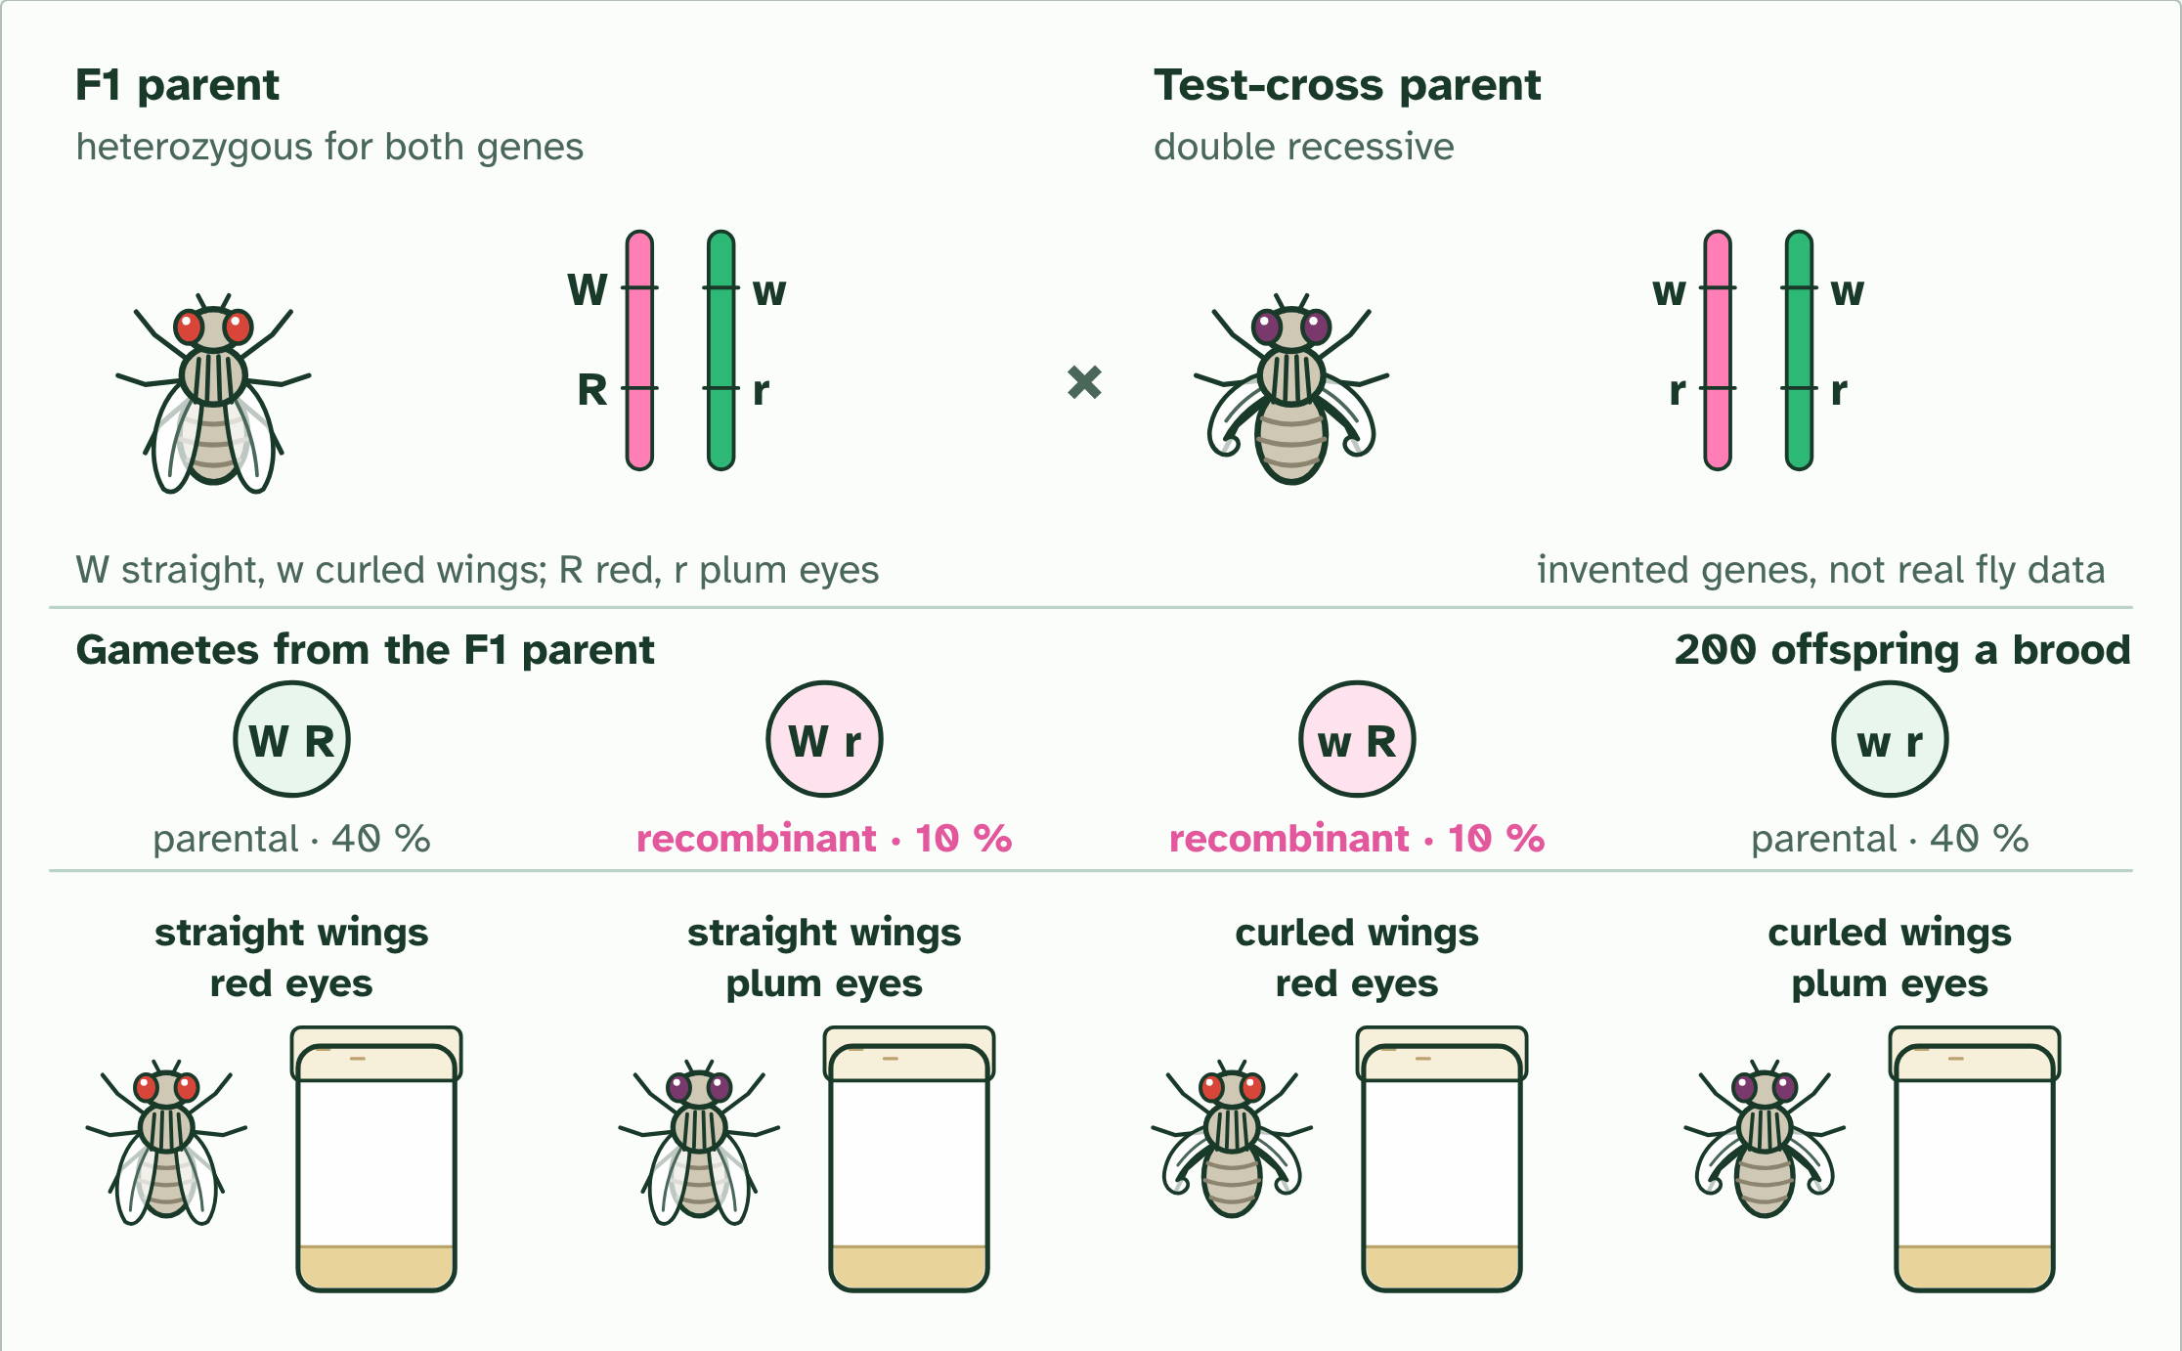
DRY LAB
Fly crosses: linked or not?
Your question: Do two genes on the same chromosome sort independently, as genes on different chromosomes do? Start with one pair of genes and one cross, work out the ratio you expect if they are unlinked, then see what a real brood gives you.
What you can change: Whether the two genes sit on different chromosomes or are linked at 40, 20 or 5 percent recombination, the cross (a test cross or F1 by F1), and the size of the brood (100, 200, 500 or 1000). The genes are invented and are not real fruit fly data. Change one thing at a time.
What to record: For each brood: the settings, the count of each of the four phenotypes, the percentage of recombinants, the expected counts, your chi-squared value, the degrees of freedom, and your decision to reject or not reject the null hypothesis. Repeat each set-up at least three times: broods scatter, as real ones do. The coach under the bench helps you plan, process and evaluate.
Run it: biologybybradford.com/guides/ib-biology-d3-2-inheritance#lab
Minutes 32 to 55
Notes:
Minutes 32 to 55 of 60: The dry lab (23 min).
The plan: The dry lab, in pairs. Students choose unlinked or linked genes, make a test cross and test the brood against 1 : 1 : 1 : 1. Then the mystery: breed as many broods as needed and give a verdict. The coach under the bench covers repeats and evaluation.
The dry lab runs in the guide: https://www.biologybybradford.com/guides/ib-biology-d3-2-inheritance#lab

Slide 18
PLENARY
Plenary: the decision
Each pair states one decision in a full sentence: "The value of... is... than the critical value, so we... the null hypothesis, so...".
Minutes 55 to 60
Notes:
Minutes 55 to 60 of 60: Plenary: the decision (5 min).
The plan: Each pair states one decision in a full sentence: "The value of ... is ... than the critical value, so we ... the null hypothesis, so ...". Take two and correct the wording together.

Slide 19
EXIT QUESTION
Before you go
On paper, on your own: one thing the dry lab showed, and one way the model differs from the real thing.
Minutes 55 to 60
Notes:
Minutes 55 to 60 of 60: Plenary: the decision (5 min).
The plan: Each pair states one decision in a full sentence: "The value of ... is ... than the critical value, so we ... the null hypothesis, so ...". Take two and correct the wording together.
Collect the slips: they say where to start next lesson.

Slide 20
PRACTISE AND REVISE
Keep going
Exam practice: a fresh paper of exam questions on D3.2 at higher level, marked as you go
The guide, with the animations and the dry lab
This lesson in the guide: 15 Is it chance? The chi-squared test, the dry lab
BUILD FOR YOUR CLASS
ALREADY ON THE SITE FOR D3.2
CARD SETS ON SPLYCR
Tarsia puzzle, dominoes and picture reveal on D3.2, built from its key terms and ready to print
A pub quiz with rounds on D3.2, to present or run with no projector
An escape room built from the question bank on D3.2
Lesson: Linked Genes & Chi-Squared
Lesson: Dihybrid Crosses & Test Crosses
Lesson: Inheritance
Summary doodle: Inheritance
Quiz: Inheritance (HL)
Quiz: Inheritance
Revision map: D3.2 Inheritance, to fill in
Exam questions: D3.2 in the exam maker, a paper with its markscheme
Open a set to host it as a class game, or make a copy to edit.
D3.2 Inheritance
How this was made. The course structure, the activities and the teaching choices come from my own classroom, my presentations and my years of teaching IB and AP Biology. I use Claude, an AI, to help write and build the interactive guides, lesson plans, slides and practice questions, and to draw the diagrams and code the interactives. I direct the work and review it against the IB and AP specifications before it goes live.
Minute 60: after the lesson
Notes:
Every link here is live. Set the exam practice paper for homework: it is fresh each time, marked as students go and saved to their Exam practice when they are signed in.
Exam practice: https://www.biologybybradford.com/exam-maker/sit?topics=D3.2&level=HL&paper=quiz&marks=15&src=ep
The guide: https://www.biologybybradford.com/guides/ib-biology-d3-2-inheritance

