Slide 1
IB Biology D4.1
LESSON 1 OF 6
BY THE END YOU CAN
Natural selection
Explain natural selection as the mechanism of evolution, and why Darwin's explanation replacing Lamarck's was a paradigm shift (D4.1.1)
Explain how mutation makes new alleles and sexual reproduction makes new combinations of them (D4.1.2)
Explain how overproduction of offspring and competition for limited resources promote natural selection (D4.1.3)
Explain how abiotic factors such as a hard frost act as density-independent selection pressures (D4.1.4)
Variation, pressure and ICE AGE
D4.1.1 to D4.1.4
Natural selection as the mechanism of evolution, and its first three ingredients: variation, overproduction and the pressures that sort the winners
60 minutes · chapters 1, 2, 3
Minute 0
Notes:
IB Biology D4.1, Natural selection. Lesson 1 of 6: Variation, pressure and ICE AGE, 60 minutes.
The plan, minute by minute (each slide's footer says where you are):
0 to 8 min (8) Do now: Who am I?
8 to 18 min (10) Four claims
18 to 28 min (10) Watch ICE AGE
28 to 40 min (12) Where variation comes from
40 to 55 min (15) Too many young, and the frost
55 to 60 min (5) Exit: ICE AGE on a new case
What students get wrong:
"Animals adapt because they need to." The variation is already there, produced by chance; the environment sorts it. Make students say "individuals with the allele left more offspring".
"Natural selection is for the good of the species." It favours whatever raises an individual's reproductive success, even if it costs the species later.
"Individuals evolve." A population evolves across generations. Ask "what changed, and in whom?".
Mutations happen because they are needed. They are chance changes in the base sequence; the environment only decides whether they help.
"Natural selection makes perfect organisms." It sorts what variation exists, under current conditions, so every organism is a compromise.
Stretch and support:
Support: give the captions of each figure as a cut-up storyboard to put in order, and use the key terms (tap the dotted words) as a glossary.
Support: the ICE AGE tiles (Icy Cubs Eat Anything, Growing Enormous) on the board for every lesson.
Stretch: why can natural selection not make a trait the population has no allele for, and what would have to happen first?
The lesson plan to print: https://www.biologybybradford.com/guides/downloads/ib-biology-d4-1-natural-selection-lesson-1-plan.pdf

Slide 2
DO NOW
Who am I?
Each student wears a card with a key word on a headband (variation, mutation, carrying capacity, abiotic factor, paradigm shift, selection pressure, competition, adaptation) and finds out what it is by asking the class yes or no questions.
8:00
minutes
Start now: the timer is running.
Minutes 0 to 8
Notes:
Minutes 0 to 8 of 60: Do now: Who am I? (8 min).
The plan: Each student wears a card with a key word on a headband (variation, mutation, carrying capacity, abiotic factor, paradigm shift, selection pressure, competition, adaptation) and finds out what it is by asking the class yes or no questions. The class may not say the word. Keep the words on the board; students use them all lesson.
Start a 8 minute timer as they come in.

Slide 3
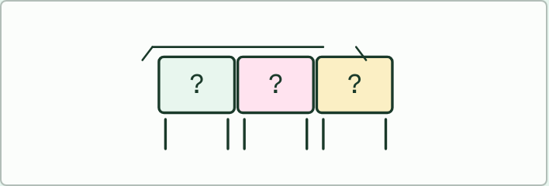
GAME
8 MIN
Who am I?
THE TASK
Each student wears a card with a key word on a headband and finds out what it is by asking the class yes or no questions. Use variation, mutation, carrying capacity, abiotic factor, paradigm shift, selection pressure, competition and adaptation. The class may answer only yes, no or "sort of". Replay with a partner who must give a hint when you are stuck.
STUDENTS NEED
Eight headbands or sticky notes, the key words written on cards.
Minutes 0 to 8
Notes:
Minutes 0 to 8 of 60: Do now: Who am I? (8 min).
The plan: Each student wears a card with a key word on a headband (variation, mutation, carrying capacity, abiotic factor, paradigm shift, selection pressure, competition, adaptation) and finds out what it is by asking the class yes or no questions. The class may not say the word. Keep the words on the board; students use them all lesson.
The activity: Who am I?. Each student wears a card with a key word on a headband and finds out what it is by asking the class yes or no questions. Use variation, mutation, carrying capacity, abiotic factor, paradigm shift, selection pressure, competition and adaptation. The class may answer only yes, no or "sort of". Replay with a partner who must give a hint when you are stuck.
Needs: eight headbands or sticky notes, the key words written on cards.
The time: 8 minutes, minutes 0 to 8 of the plan.

Slide 4
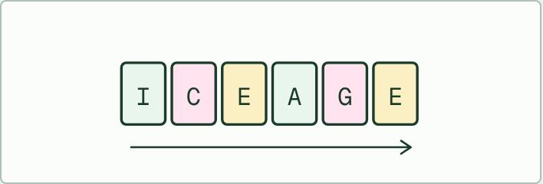
WRITING
IF THERE IS TIME
ICE AGE on a fresh example
THE TASK
Give a new population, not one from the guide, such as an island population of lizards whose food changes (invent the details, and make clear it is invented). On six strips, pairs write what happens at each of Inherited variation, Competition, Environmental pressure, Adaptations, Genes and Evolution, then order and read them aloud. Check that each strip is about the example, not just the definition, and that "Genes" is about allele frequencies.
STUDENTS NEED
Six blank strips per pair, the invented case on a card.
Minutes 0 to 8
Notes:
Minutes 0 to 8 of 60: Do now: Who am I? (8 min).
The plan: Each student wears a card with a key word on a headband (variation, mutation, carrying capacity, abiotic factor, paradigm shift, selection pressure, competition, adaptation) and finds out what it is by asking the class yes or no questions. The class may not say the word. Keep the words on the board; students use them all lesson.
The activity: ICE AGE on a fresh example. Give a new population, not one from the guide, such as an island population of lizards whose food changes (invent the details, and make clear it is invented). On six strips, pairs write what happens at each of Inherited variation, Competition, Environmental pressure, Adaptations, Genes and Evolution, then order and read them aloud. Check that each strip is about the example, not just the definition, and that "Genes" is about allele frequencies.
Needs: six blank strips per pair, the invented case on a card.
The plan sets no time of its own for this activity: use it in this step, in place of part of it, or for homework.

Slide 5
STEP 2
10 MIN
Four claims
Students decide true or false and say why before opening each answer.
Collect the wording of each slip on the board: "needs", "for the good of the species", "trying to", "strongest".
Minutes 8 to 18
Notes:
Minutes 8 to 18 of 60: Four claims (10 min).
The plan: Chapter 1's four predict boxes, in pairs. Students decide true or false and say why before opening each answer. Collect the wording of each slip on the board: "needs", "for the good of the species", "trying to", "strongest". Say once that ICE AGE is a teaching aid, not an IB term.

Slide 6
PREDICT
Claim 1: "Natural selection gives organisms what they need to survive."
A True: when a population needs a trait badly enough, selection supplies it over the generations
B False: it favours only variation that already exists, and it cannot know what is needed
C Partly: it gives each individual what it needs, but only when the need is urgent enough
Minutes 8 to 18
Notes:
Minutes 8 to 18 of 60: Four claims (10 min).
The plan: Chapter 1's four predict boxes, in pairs. Students decide true or false and say why before opening each answer. Collect the wording of each slip on the board: "needs", "for the good of the species", "trying to", "strongest". Say once that ICE AGE is a teaching aid, not an IB term.
Ask for a show of hands, or mini whiteboards, before revealing. (Answer: B, on the next slide.)

Slide 7
WHAT HAPPENS
Claim 1: "Natural selection gives organisms what they need to survive."
A True: when a population needs a trait badly enough, selection supplies it over the generations
B False: it favours only variation that already exists, and it cannot know what is needed
C Partly: it gives each individual what it needs, but only when the need is urgent enough
False. Natural selection has no foresight. It can only favour versions of a trait that already exist in the population. If no individual happens to carry a helpful version, the population simply does badly.
Minutes 8 to 18
Notes:
Minutes 8 to 18 of 60: Four claims (10 min).
The plan: Chapter 1's four predict boxes, in pairs. Students decide true or false and say why before opening each answer. Collect the wording of each slip on the board: "needs", "for the good of the species", "trying to", "strongest". Say once that ICE AGE is a teaching aid, not an IB term.
Answer: B. False. Natural selection has no foresight. It can only favour versions of a trait that already exist in the population. If no individual happens to carry a helpful version, the population simply does badly.

Slide 8
STEP 3
10 MIN
Watch ICE AGE
Students write one sentence a letter on a six-box strip, using the film's population.
Minutes 18 to 28
Notes:
Minutes 18 to 28 of 60: Watch ICE AGE (10 min).
The plan: Chapter 1's ICE AGE film, paused at each of the six letters. Students write one sentence a letter on a six-box strip, using the film's population. Finish by turning over chapter 1's Remember it tiles. Land on the paradigm shift: Darwin replaced Lamarck's idea because his explained more.

Slide 9
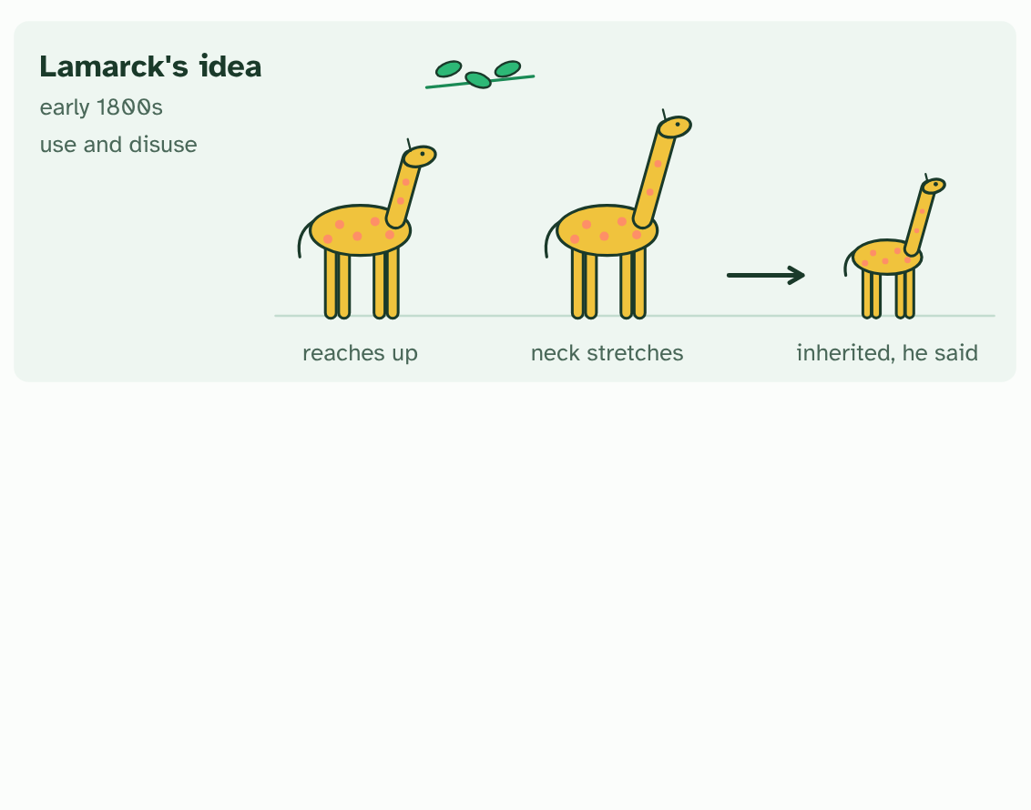
CHAPTER 1 · D4.1.1 Natural selection drives evolution
1 / 5
Evolution has a mechanism
Lamarck's idea: a giraffe stretches for leaves, its neck lengthens, and it passes the change on.
Minutes 18 to 28
Notes:
Minutes 18 to 28 of 60: Watch ICE AGE (10 min).
The plan: Chapter 1's ICE AGE film, paused at each of the six letters. Students write one sentence a letter on a six-box strip, using the film's population. Finish by turning over chapter 1's Remember it tiles. Land on the paradigm shift: Darwin replaced Lamarck's idea because his explained more.
Long before Darwin, many naturalists suspected that species change over time. What nobody had was a convincing explanation of how. Jean-Baptiste Lamarck, in the early 1800s, suggested that animals change by using or not using their parts, and pass those changes on. A giraffe stretches for leaves, its neck lengthens, and its calf is born with a longer neck. It sounds sensible, and it is wrong (chapter 4 shows why).
In 1859 Charles Darwin published a different mechanism, natural selection. Individuals in a population differ. More young are born than can survive. The ones whose traits suit the conditions leave more offspring, and the traits they carry become commoner. Nothing has to try, and nothing is planned.
The process never stops. Every generation of every population is being sorted, over billions of years, and the accumulated result is the biodiversity of life on Earth.
Darwin's idea replacing Lamarck's is a classic paradigm shift. That is the nature of science: an explanation is kept while it fits the evidence, and replaced when a better one arrives.
To keep the logic of natural selection in order, use the mnemonic below. ICE AGE is a teaching aid, not an IB term. The next three chapters take its letters one at a time.
Four claims about natural selection. Each one is a common slip. Decide, then check.

Slide 10
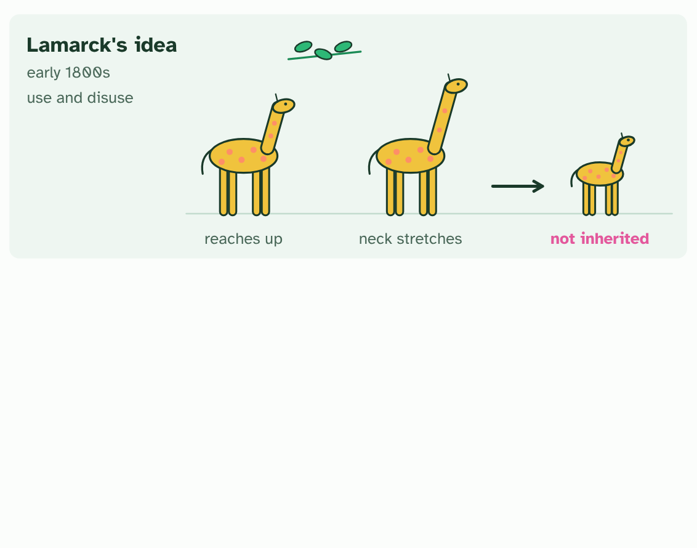
CHAPTER 1 · D4.1.1 Natural selection drives evolution
2 / 5
Evolution has a mechanism
In fact the calf hatches with an ordinary neck: a change gained in life is not inherited (chapter 4).
Minutes 18 to 28
Notes:
Minutes 18 to 28 of 60: Watch ICE AGE (10 min).
The plan: Chapter 1's ICE AGE film, paused at each of the six letters. Students write one sentence a letter on a six-box strip, using the film's population. Finish by turning over chapter 1's Remember it tiles. Land on the paradigm shift: Darwin replaced Lamarck's idea because his explained more.
Long before Darwin, many naturalists suspected that species change over time. What nobody had was a convincing explanation of how. Jean-Baptiste Lamarck, in the early 1800s, suggested that animals change by using or not using their parts, and pass those changes on. A giraffe stretches for leaves, its neck lengthens, and its calf is born with a longer neck. It sounds sensible, and it is wrong (chapter 4 shows why).
In 1859 Charles Darwin published a different mechanism, natural selection. Individuals in a population differ. More young are born than can survive. The ones whose traits suit the conditions leave more offspring, and the traits they carry become commoner. Nothing has to try, and nothing is planned.
The process never stops. Every generation of every population is being sorted, over billions of years, and the accumulated result is the biodiversity of life on Earth.
Darwin's idea replacing Lamarck's is a classic paradigm shift. That is the nature of science: an explanation is kept while it fits the evidence, and replaced when a better one arrives.
To keep the logic of natural selection in order, use the mnemonic below. ICE AGE is a teaching aid, not an IB term. The next three chapters take its letters one at a time.
Four claims about natural selection. Each one is a common slip. Decide, then check.

Slide 11
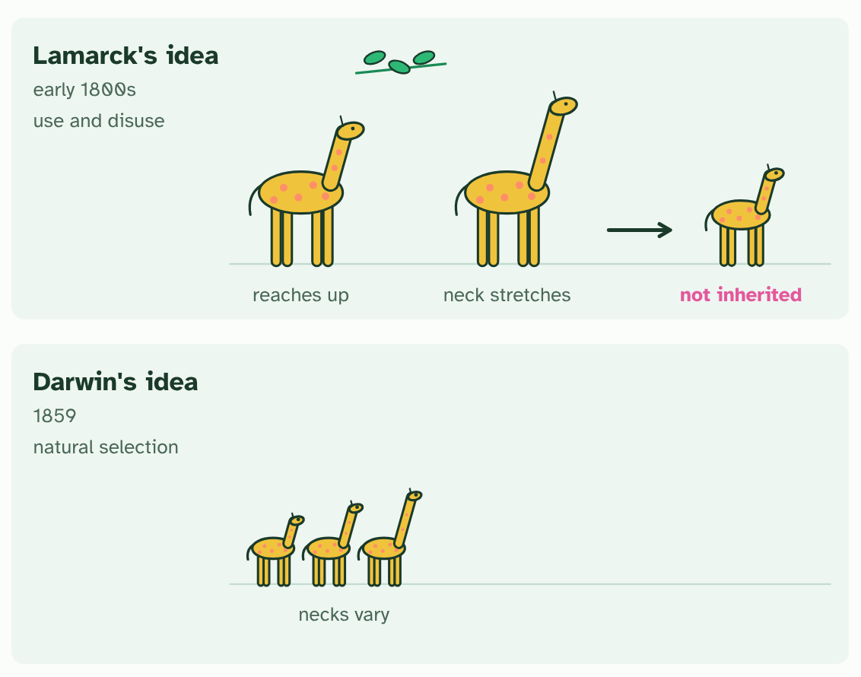
CHAPTER 1 · D4.1.1 Natural selection drives evolution
3 / 5
Evolution has a mechanism
Darwin's idea starts with variation: the necks in a population are not all the same.
Minutes 18 to 28
Notes:
Minutes 18 to 28 of 60: Watch ICE AGE (10 min).
The plan: Chapter 1's ICE AGE film, paused at each of the six letters. Students write one sentence a letter on a six-box strip, using the film's population. Finish by turning over chapter 1's Remember it tiles. Land on the paradigm shift: Darwin replaced Lamarck's idea because his explained more.
Long before Darwin, many naturalists suspected that species change over time. What nobody had was a convincing explanation of how. Jean-Baptiste Lamarck, in the early 1800s, suggested that animals change by using or not using their parts, and pass those changes on. A giraffe stretches for leaves, its neck lengthens, and its calf is born with a longer neck. It sounds sensible, and it is wrong (chapter 4 shows why).
In 1859 Charles Darwin published a different mechanism, natural selection. Individuals in a population differ. More young are born than can survive. The ones whose traits suit the conditions leave more offspring, and the traits they carry become commoner. Nothing has to try, and nothing is planned.
The process never stops. Every generation of every population is being sorted, over billions of years, and the accumulated result is the biodiversity of life on Earth.
Darwin's idea replacing Lamarck's is a classic paradigm shift. That is the nature of science: an explanation is kept while it fits the evidence, and replaced when a better one arrives.
To keep the logic of natural selection in order, use the mnemonic below. ICE AGE is a teaching aid, not an IB term. The next three chapters take its letters one at a time.
Four claims about natural selection. Each one is a common slip. Decide, then check.

Slide 12
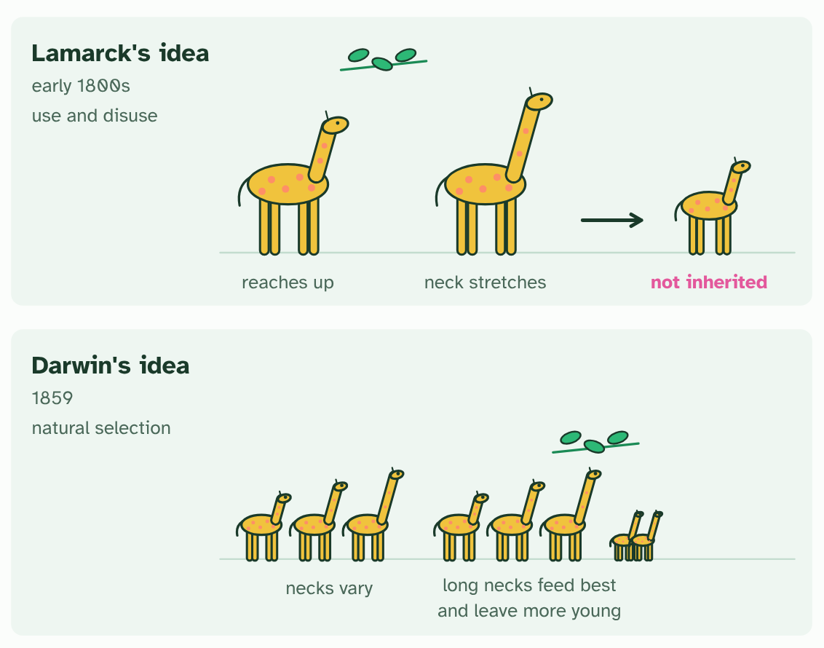
CHAPTER 1 · D4.1.1 Natural selection drives evolution
4 / 5
Evolution has a mechanism
Long necks feed best in the lean season and leave more young. The alleles go with them.
Minutes 18 to 28
Notes:
Minutes 18 to 28 of 60: Watch ICE AGE (10 min).
The plan: Chapter 1's ICE AGE film, paused at each of the six letters. Students write one sentence a letter on a six-box strip, using the film's population. Finish by turning over chapter 1's Remember it tiles. Land on the paradigm shift: Darwin replaced Lamarck's idea because his explained more.
Long before Darwin, many naturalists suspected that species change over time. What nobody had was a convincing explanation of how. Jean-Baptiste Lamarck, in the early 1800s, suggested that animals change by using or not using their parts, and pass those changes on. A giraffe stretches for leaves, its neck lengthens, and its calf is born with a longer neck. It sounds sensible, and it is wrong (chapter 4 shows why).
In 1859 Charles Darwin published a different mechanism, natural selection. Individuals in a population differ. More young are born than can survive. The ones whose traits suit the conditions leave more offspring, and the traits they carry become commoner. Nothing has to try, and nothing is planned.
The process never stops. Every generation of every population is being sorted, over billions of years, and the accumulated result is the biodiversity of life on Earth.
Darwin's idea replacing Lamarck's is a classic paradigm shift. That is the nature of science: an explanation is kept while it fits the evidence, and replaced when a better one arrives.
To keep the logic of natural selection in order, use the mnemonic below. ICE AGE is a teaching aid, not an IB term. The next three chapters take its letters one at a time.
Four claims about natural selection. Each one is a common slip. Decide, then check.

Slide 13
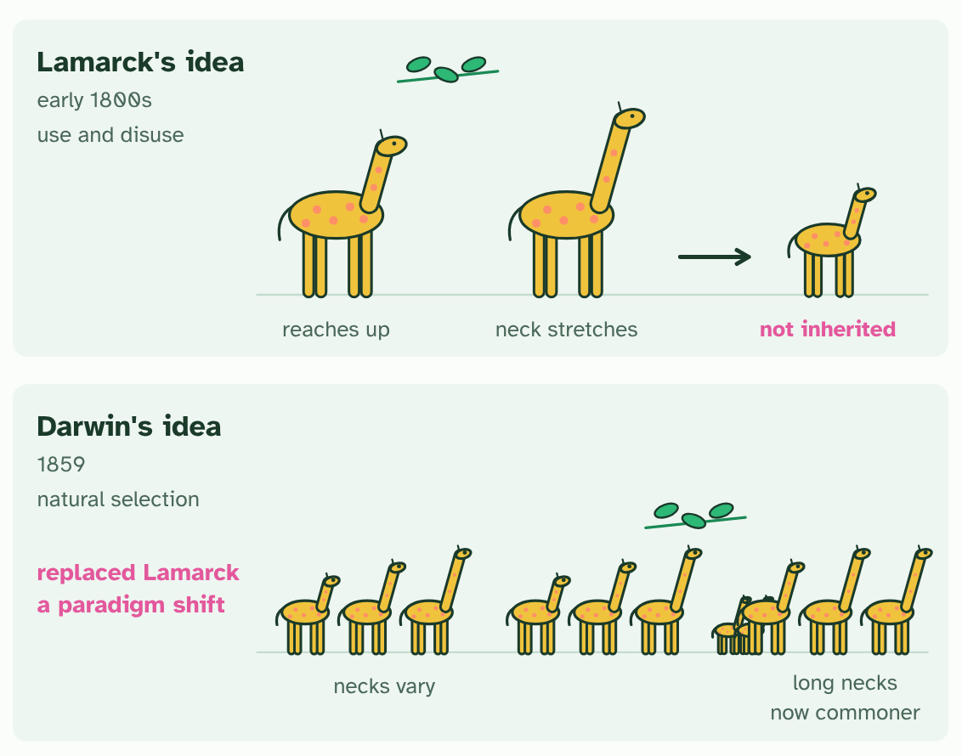
CHAPTER 1 · D4.1.1 Natural selection drives evolution
5 / 5
Evolution has a mechanism
Generations later, long necks are commoner. The explanation was replaced: a paradigm shift.
Minutes 18 to 28
Notes:
Minutes 18 to 28 of 60: Watch ICE AGE (10 min).
The plan: Chapter 1's ICE AGE film, paused at each of the six letters. Students write one sentence a letter on a six-box strip, using the film's population. Finish by turning over chapter 1's Remember it tiles. Land on the paradigm shift: Darwin replaced Lamarck's idea because his explained more.
Long before Darwin, many naturalists suspected that species change over time. What nobody had was a convincing explanation of how. Jean-Baptiste Lamarck, in the early 1800s, suggested that animals change by using or not using their parts, and pass those changes on. A giraffe stretches for leaves, its neck lengthens, and its calf is born with a longer neck. It sounds sensible, and it is wrong (chapter 4 shows why).
In 1859 Charles Darwin published a different mechanism, natural selection. Individuals in a population differ. More young are born than can survive. The ones whose traits suit the conditions leave more offspring, and the traits they carry become commoner. Nothing has to try, and nothing is planned.
The process never stops. Every generation of every population is being sorted, over billions of years, and the accumulated result is the biodiversity of life on Earth.
Darwin's idea replacing Lamarck's is a classic paradigm shift. That is the nature of science: an explanation is kept while it fits the evidence, and replaced when a better one arrives.
To keep the logic of natural selection in order, use the mnemonic below. ICE AGE is a teaching aid, not an IB term. The next three chapters take its letters one at a time.
Four claims about natural selection. Each one is a common slip. Decide, then check.

Slide 14
CHAPTER 1 · D4.1.1 Natural selection drives evolution
Evolution has a mechanism
In 1859 Charles Darwin published a different mechanism, natural selection.
Darwin's idea replacing Lamarck's is a classic paradigm shift.
To keep the logic of natural selection in order, use the mnemonic below.
Four claims about natural selection.
Minutes 18 to 28
Notes:
Minutes 18 to 28 of 60: Watch ICE AGE (10 min).
The plan: Chapter 1's ICE AGE film, paused at each of the six letters. Students write one sentence a letter on a six-box strip, using the film's population. Finish by turning over chapter 1's Remember it tiles. Land on the paradigm shift: Darwin replaced Lamarck's idea because his explained more.
Long before Darwin, many naturalists suspected that species change over time. What nobody had was a convincing explanation of how. Jean-Baptiste Lamarck, in the early 1800s, suggested that animals change by using or not using their parts, and pass those changes on. A giraffe stretches for leaves, its neck lengthens, and its calf is born with a longer neck. It sounds sensible, and it is wrong (chapter 4 shows why).
In 1859 Charles Darwin published a different mechanism, natural selection. Individuals in a population differ. More young are born than can survive. The ones whose traits suit the conditions leave more offspring, and the traits they carry become commoner. Nothing has to try, and nothing is planned.
The process never stops. Every generation of every population is being sorted, over billions of years, and the accumulated result is the biodiversity of life on Earth.
Darwin's idea replacing Lamarck's is a classic paradigm shift. That is the nature of science: an explanation is kept while it fits the evidence, and replaced when a better one arrives.
To keep the logic of natural selection in order, use the mnemonic below. ICE AGE is a teaching aid, not an IB term. The next three chapters take its letters one at a time.
Four claims about natural selection. Each one is a common slip. Decide, then check.

Slide 15
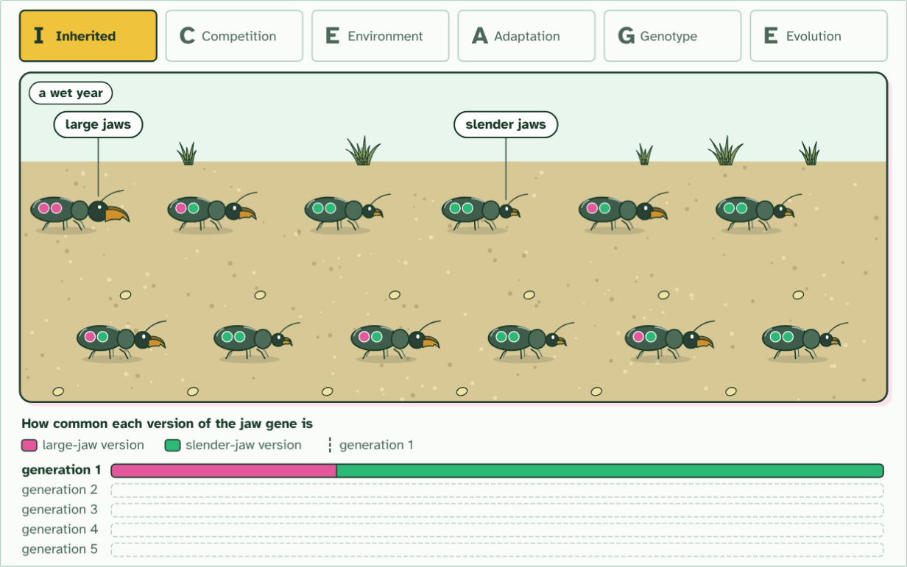
CHAPTER 1 · D4.1.1 Natural selection drives evolution
generation 1
1 / 6
Evolution has a mechanism
Inherited variation. Jaws differ, set by the two versions of a jaw gene that each beetle carries (the pips): pink large, green slender.
Minutes 18 to 28
Notes:
Minutes 18 to 28 of 60: Watch ICE AGE (10 min).
The plan: Chapter 1's ICE AGE film, paused at each of the six letters. Students write one sentence a letter on a six-box strip, using the film's population. Finish by turning over chapter 1's Remember it tiles. Land on the paradigm shift: Darwin replaced Lamarck's idea because his explained more.
Long before Darwin, many naturalists suspected that species change over time. What nobody had was a convincing explanation of how. Jean-Baptiste Lamarck, in the early 1800s, suggested that animals change by using or not using their parts, and pass those changes on. A giraffe stretches for leaves, its neck lengthens, and its calf is born with a longer neck. It sounds sensible, and it is wrong (chapter 4 shows why).
In 1859 Charles Darwin published a different mechanism, natural selection. Individuals in a population differ. More young are born than can survive. The ones whose traits suit the conditions leave more offspring, and the traits they carry become commoner. Nothing has to try, and nothing is planned.
The process never stops. Every generation of every population is being sorted, over billions of years, and the accumulated result is the biodiversity of life on Earth.
Darwin's idea replacing Lamarck's is a classic paradigm shift. That is the nature of science: an explanation is kept while it fits the evidence, and replaced when a better one arrives.
To keep the logic of natural selection in order, use the mnemonic below. ICE AGE is a teaching aid, not an IB term. The next three chapters take its letters one at a time.
Four claims about natural selection. Each one is a common slip. Decide, then check.
The animation "Watch it happen: ICE AGE in one population", paused at 7.0 s. The next slides go on through it, then play it.

Slide 16
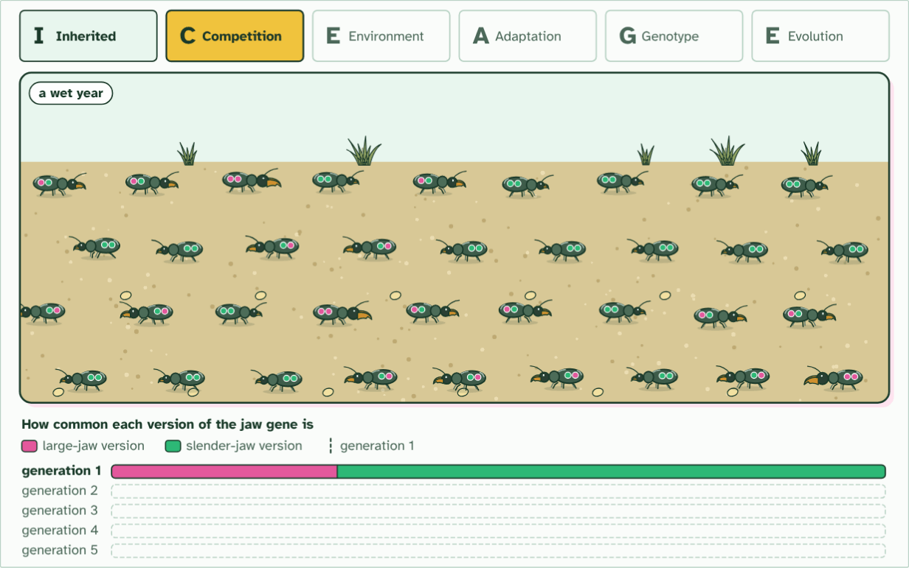
CHAPTER 1 · D4.1.1 Natural selection drives evolution
36 young, food for 12
2 / 6
Evolution has a mechanism
Competition. Twelve beetles leave thirty-six young, three times as many as the ground can feed.
Minutes 18 to 28
Notes:
Minutes 18 to 28 of 60: Watch ICE AGE (10 min).
The plan: Chapter 1's ICE AGE film, paused at each of the six letters. Students write one sentence a letter on a six-box strip, using the film's population. Finish by turning over chapter 1's Remember it tiles. Land on the paradigm shift: Darwin replaced Lamarck's idea because his explained more.
Long before Darwin, many naturalists suspected that species change over time. What nobody had was a convincing explanation of how. Jean-Baptiste Lamarck, in the early 1800s, suggested that animals change by using or not using their parts, and pass those changes on. A giraffe stretches for leaves, its neck lengthens, and its calf is born with a longer neck. It sounds sensible, and it is wrong (chapter 4 shows why).
In 1859 Charles Darwin published a different mechanism, natural selection. Individuals in a population differ. More young are born than can survive. The ones whose traits suit the conditions leave more offspring, and the traits they carry become commoner. Nothing has to try, and nothing is planned.
The process never stops. Every generation of every population is being sorted, over billions of years, and the accumulated result is the biodiversity of life on Earth.
Darwin's idea replacing Lamarck's is a classic paradigm shift. That is the nature of science: an explanation is kept while it fits the evidence, and replaced when a better one arrives.
To keep the logic of natural selection in order, use the mnemonic below. ICE AGE is a teaching aid, not an IB term. The next three chapters take its letters one at a time.
Four claims about natural selection. Each one is a common slip. Decide, then check.
The animation "Watch it happen: ICE AGE in one population", paused at 18.0 s. The next slides go on through it, then play it.

Slide 17
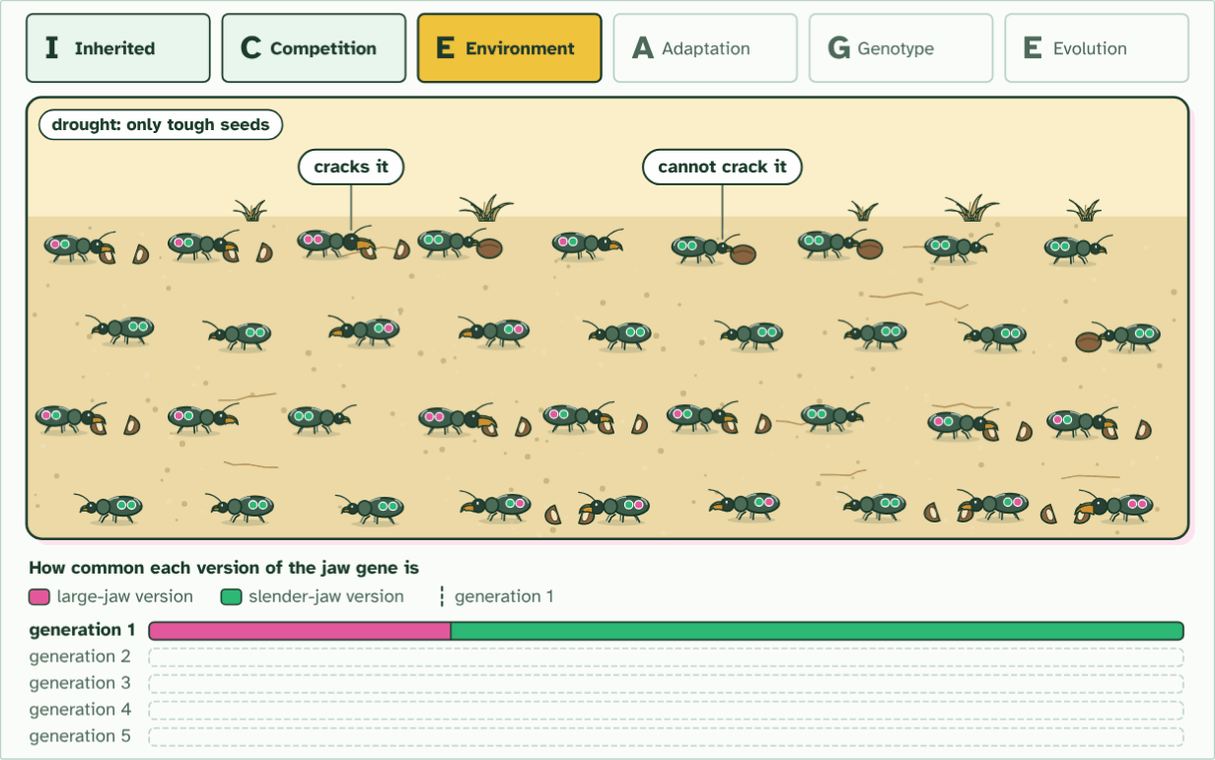
CHAPTER 1 · D4.1.1 Natural selection drives evolution
36 young, food for 12
3 / 6
Evolution has a mechanism
Environmental pressure. A drought leaves only tough seeds. Large jaws crack them; slender jaws cannot, and those beetles starve.
Minutes 18 to 28
Notes:
Minutes 18 to 28 of 60: Watch ICE AGE (10 min).
The plan: Chapter 1's ICE AGE film, paused at each of the six letters. Students write one sentence a letter on a six-box strip, using the film's population. Finish by turning over chapter 1's Remember it tiles. Land on the paradigm shift: Darwin replaced Lamarck's idea because his explained more.
Long before Darwin, many naturalists suspected that species change over time. What nobody had was a convincing explanation of how. Jean-Baptiste Lamarck, in the early 1800s, suggested that animals change by using or not using their parts, and pass those changes on. A giraffe stretches for leaves, its neck lengthens, and its calf is born with a longer neck. It sounds sensible, and it is wrong (chapter 4 shows why).
In 1859 Charles Darwin published a different mechanism, natural selection. Individuals in a population differ. More young are born than can survive. The ones whose traits suit the conditions leave more offspring, and the traits they carry become commoner. Nothing has to try, and nothing is planned.
The process never stops. Every generation of every population is being sorted, over billions of years, and the accumulated result is the biodiversity of life on Earth.
Darwin's idea replacing Lamarck's is a classic paradigm shift. That is the nature of science: an explanation is kept while it fits the evidence, and replaced when a better one arrives.
To keep the logic of natural selection in order, use the mnemonic below. ICE AGE is a teaching aid, not an IB term. The next three chapters take its letters one at a time.
Four claims about natural selection. Each one is a common slip. Decide, then check.
The animation "Watch it happen: ICE AGE in one population", paused at 27.0 s. The next slides go on through it, then play it.

Slide 18
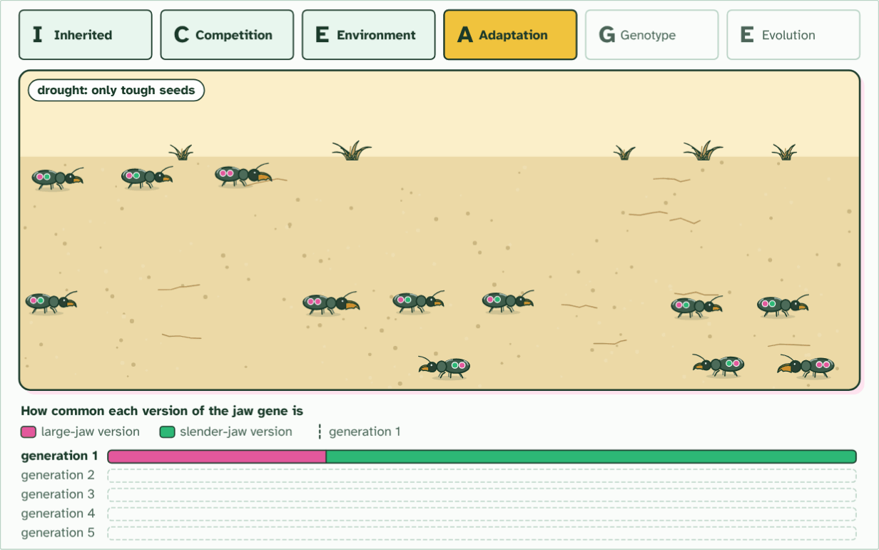
CHAPTER 1 · D4.1.1 Natural selection drives evolution
12 of 36 survive
4 / 6
Evolution has a mechanism
Adaptation. The twelve survivors all have large or medium jaws, the trait that suits a dry year. Every one carries the large-jaw version.
Minutes 18 to 28
Notes:
Minutes 18 to 28 of 60: Watch ICE AGE (10 min).
The plan: Chapter 1's ICE AGE film, paused at each of the six letters. Students write one sentence a letter on a six-box strip, using the film's population. Finish by turning over chapter 1's Remember it tiles. Land on the paradigm shift: Darwin replaced Lamarck's idea because his explained more.
Long before Darwin, many naturalists suspected that species change over time. What nobody had was a convincing explanation of how. Jean-Baptiste Lamarck, in the early 1800s, suggested that animals change by using or not using their parts, and pass those changes on. A giraffe stretches for leaves, its neck lengthens, and its calf is born with a longer neck. It sounds sensible, and it is wrong (chapter 4 shows why).
In 1859 Charles Darwin published a different mechanism, natural selection. Individuals in a population differ. More young are born than can survive. The ones whose traits suit the conditions leave more offspring, and the traits they carry become commoner. Nothing has to try, and nothing is planned.
The process never stops. Every generation of every population is being sorted, over billions of years, and the accumulated result is the biodiversity of life on Earth.
Darwin's idea replacing Lamarck's is a classic paradigm shift. That is the nature of science: an explanation is kept while it fits the evidence, and replaced when a better one arrives.
To keep the logic of natural selection in order, use the mnemonic below. ICE AGE is a teaching aid, not an IB term. The next three chapters take its letters one at a time.
Four claims about natural selection. Each one is a common slip. Decide, then check.
The animation "Watch it happen: ICE AGE in one population", paused at 37.0 s. The next slides go on through it, then play it.

Slide 19
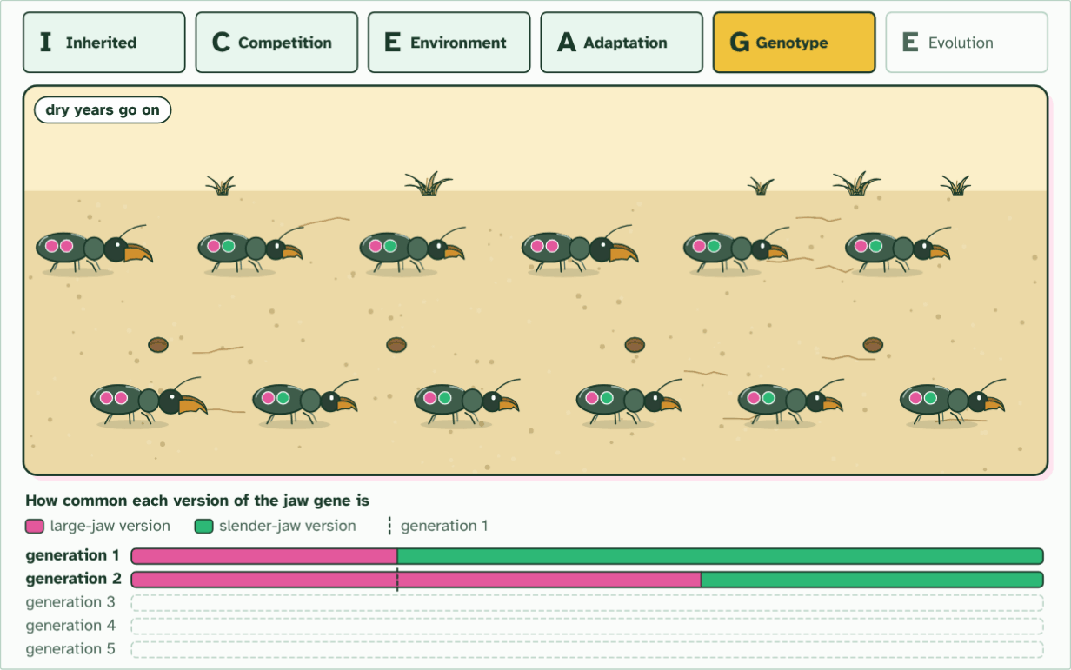
CHAPTER 1 · D4.1.1 Natural selection drives evolution
generation 2
5 / 6
Evolution has a mechanism
Genotype frequencies change. Only survivors breed, so the large-jaw version of the gene is more common in generation 2.
Minutes 18 to 28
Notes:
Minutes 18 to 28 of 60: Watch ICE AGE (10 min).
The plan: Chapter 1's ICE AGE film, paused at each of the six letters. Students write one sentence a letter on a six-box strip, using the film's population. Finish by turning over chapter 1's Remember it tiles. Land on the paradigm shift: Darwin replaced Lamarck's idea because his explained more.
Long before Darwin, many naturalists suspected that species change over time. What nobody had was a convincing explanation of how. Jean-Baptiste Lamarck, in the early 1800s, suggested that animals change by using or not using their parts, and pass those changes on. A giraffe stretches for leaves, its neck lengthens, and its calf is born with a longer neck. It sounds sensible, and it is wrong (chapter 4 shows why).
In 1859 Charles Darwin published a different mechanism, natural selection. Individuals in a population differ. More young are born than can survive. The ones whose traits suit the conditions leave more offspring, and the traits they carry become commoner. Nothing has to try, and nothing is planned.
The process never stops. Every generation of every population is being sorted, over billions of years, and the accumulated result is the biodiversity of life on Earth.
Darwin's idea replacing Lamarck's is a classic paradigm shift. That is the nature of science: an explanation is kept while it fits the evidence, and replaced when a better one arrives.
To keep the logic of natural selection in order, use the mnemonic below. ICE AGE is a teaching aid, not an IB term. The next three chapters take its letters one at a time.
Four claims about natural selection. Each one is a common slip. Decide, then check.
The animation "Watch it happen: ICE AGE in one population", paused at 48.0 s. The next slides go on through it, then play it.

Slide 20
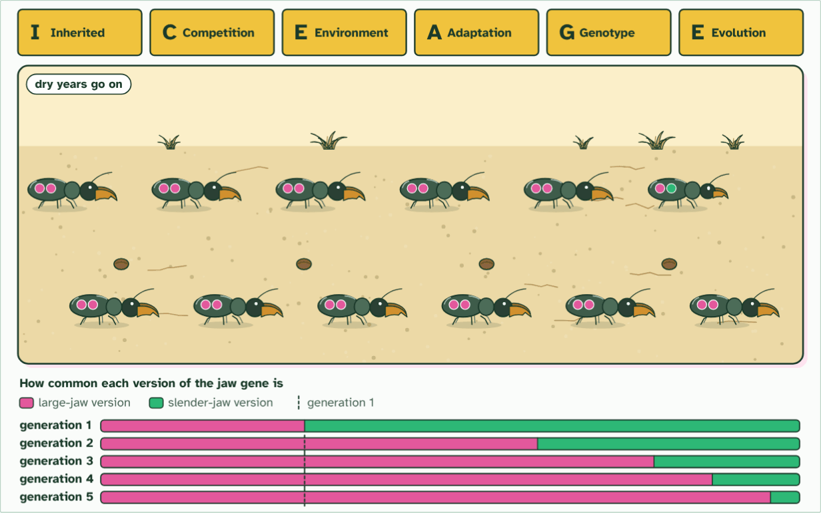
CHAPTER 1 · D4.1.1 Natural selection drives evolution
generation 5
6 / 6
Evolution has a mechanism
Evolution. The dry years go on. By generation 5 nearly every beetle has large jaws: no beetle changed, the population did.
Minutes 18 to 28
Notes:
Minutes 18 to 28 of 60: Watch ICE AGE (10 min).
The plan: Chapter 1's ICE AGE film, paused at each of the six letters. Students write one sentence a letter on a six-box strip, using the film's population. Finish by turning over chapter 1's Remember it tiles. Land on the paradigm shift: Darwin replaced Lamarck's idea because his explained more.
Long before Darwin, many naturalists suspected that species change over time. What nobody had was a convincing explanation of how. Jean-Baptiste Lamarck, in the early 1800s, suggested that animals change by using or not using their parts, and pass those changes on. A giraffe stretches for leaves, its neck lengthens, and its calf is born with a longer neck. It sounds sensible, and it is wrong (chapter 4 shows why).
In 1859 Charles Darwin published a different mechanism, natural selection. Individuals in a population differ. More young are born than can survive. The ones whose traits suit the conditions leave more offspring, and the traits they carry become commoner. Nothing has to try, and nothing is planned.
The process never stops. Every generation of every population is being sorted, over billions of years, and the accumulated result is the biodiversity of life on Earth.
Darwin's idea replacing Lamarck's is a classic paradigm shift. That is the nature of science: an explanation is kept while it fits the evidence, and replaced when a better one arrives.
To keep the logic of natural selection in order, use the mnemonic below. ICE AGE is a teaching aid, not an IB term. The next three chapters take its letters one at a time.
Four claims about natural selection. Each one is a common slip. Decide, then check.
The animation "Watch it happen: ICE AGE in one population", paused at 64.5 s. The next slides go on through it, then play it.

Slide 21
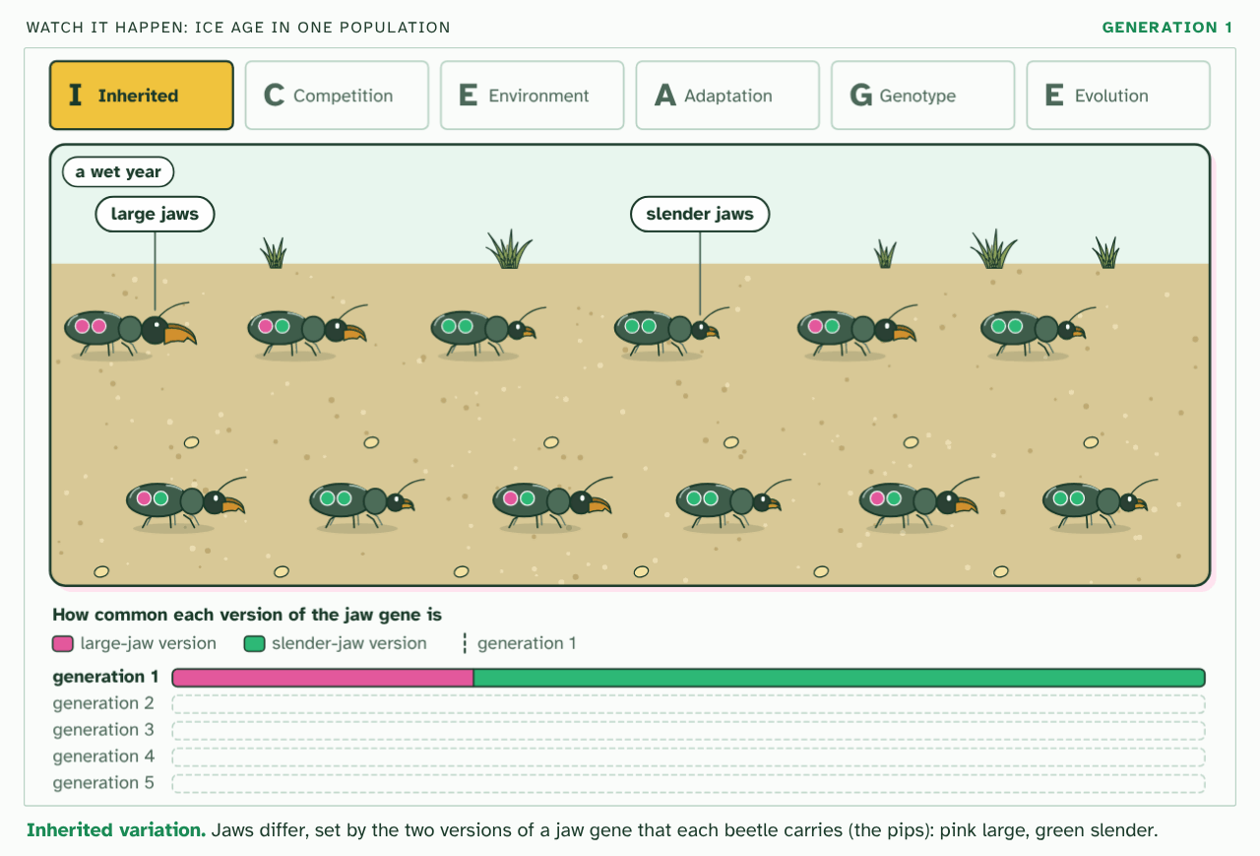
CHAPTER 1 · D4.1.1 Natural selection drives evolution
PLAY IT
Evolution has a mechanism
Watch it happen: ICE AGE in one population: click to play. It loops every 66 seconds.
Minutes 18 to 28
Notes:
Minutes 18 to 28 of 60: Watch ICE AGE (10 min).
The plan: Chapter 1's ICE AGE film, paused at each of the six letters. Students write one sentence a letter on a six-box strip, using the film's population. Finish by turning over chapter 1's Remember it tiles. Land on the paradigm shift: Darwin replaced Lamarck's idea because his explained more.
The video is iceage-e9217c.mp4, one loop of the animation in the guide. It plays in PowerPoint and Keynote. Google Slides does not play a video embedded in a .pptx: download iceage-e9217c.mp4 (https://www.biologybybradford.com/guides/downloads/scenes/iceage-e9217c.mp4), upload it to Google Drive, then Insert > Video > Google Drive.
In the guide the class can change it as it runs: https://www.biologybybradford.com/guides/ib-biology-d4-1-natural-selection#mechanism
What it shows, in order:
1. Inherited variation. Jaws differ, set by the two versions of a jaw gene that each beetle carries (the pips): pink large, green slender.
2. Competition. Twelve beetles leave thirty-six young, three times as many as the ground can feed.
3. Environmental pressure. A drought leaves only tough seeds. Large jaws crack them; slender jaws cannot, and those beetles starve.
4. Adaptation. The twelve survivors all have large or medium jaws, the trait that suits a dry year. Every one carries the large-jaw version.
5. Genotype frequencies change. Only survivors breed, so the large-jaw version of the gene is more common in generation 2.
6. Evolution. The dry years go on. By generation 5 nearly every beetle has large jaws: no beetle changed, the population did.

Slide 22
WATCH OUT
Three more slips. Individuals do not evolve: a population does, across generations. Mutations do not happen because they are needed: they are chance changes (chapter 2). Natural selection does not make perfect organisms: it sorts what variation is on offer, under today's conditions, so every organism is a compromise.
Minutes 18 to 28
Notes:
Minutes 18 to 28 of 60: Watch ICE AGE (10 min).
The plan: Chapter 1's ICE AGE film, paused at each of the six letters. Students write one sentence a letter on a six-box strip, using the film's population. Finish by turning over chapter 1's Remember it tiles. Land on the paradigm shift: Darwin replaced Lamarck's idea because his explained more.
A common mistake: say it, then ask who can say why it is wrong.

Slide 23
REMEMBER IT
The logic of natural selection: ICE AGE
I
C
E
A
G
E
Icy
Cubs
Eat
Anything
Growing
Enormous
Minutes 18 to 28
Notes:
Minutes 18 to 28 of 60: Watch ICE AGE (10 min).
The plan: Chapter 1's ICE AGE film, paused at each of the six letters. Students write one sentence a letter on a six-box strip, using the film's population. Finish by turning over chapter 1's Remember it tiles. Land on the paradigm shift: Darwin replaced Lamarck's idea because his explained more.
Ask the class what each letter stands for before revealing.

Slide 24
REMEMBER IT
The logic of natural selection: ICE AGE
I
C
E
A
G
E
Icy
Cubs
Eat
Anything
Growing
Enormous
Inherited variation
Competition
Environmental pressure
Adaptations
Genes (alleles)
Evolution
the population varies, and the variation is heritable
more young are born than resources can support
some survive and breed more than others
helpful traits are selected for
allele frequencies change from one generation to the next
the population has changed
Minutes 18 to 28
Notes:
Minutes 18 to 28 of 60: Watch ICE AGE (10 min).
The plan: Chapter 1's ICE AGE film, paused at each of the six letters. Students write one sentence a letter on a six-box strip, using the film's population. Finish by turning over chapter 1's Remember it tiles. Land on the paradigm shift: Darwin replaced Lamarck's idea because his explained more.
Icy: Inherited variation (the population varies, and the variation is heritable)
Cubs: Competition (more young are born than resources can support)
Eat: Environmental pressure (some survive and breed more than others)
Anything: Adaptations (helpful traits are selected for)
Growing: Genes (alleles) (allele frequencies change from one generation to the next)
Enormous: Evolution (the population has changed)

Slide 25
STEP 4
12 MIN
Where variation comes from
Students sketch the two sources, new allele and new combination, in two boxes.
Ask: why does a new allele need a mutation, and why can sexual reproduction not make one?
Minutes 28 to 40
Notes:
Minutes 28 to 40 of 60: Where variation comes from (12 min).
The plan: Chapter 2's figure, step by step, and its predict box. Students sketch the two sources, new allele and new combination, in two boxes. Ask: why does a new allele need a mutation, and why can sexual reproduction not make one?

Slide 26
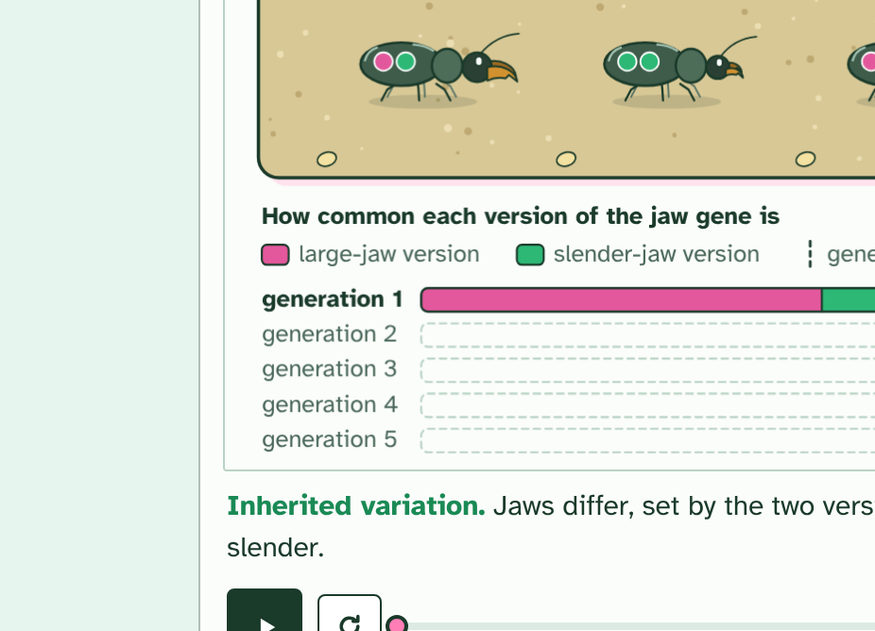
CHAPTER 2 · D4.1.2 Where variation comes from (I in ICE AGE)
1 / 4
Variation to select from
A gene is a sequence of bases. This version is one allele of the gene.
Minutes 28 to 40
Notes:
Minutes 28 to 40 of 60: Where variation comes from (12 min).
The plan: Chapter 2's figure, step by step, and its predict box. Students sketch the two sources, new allele and new combination, in two boxes. Ask: why does a new allele need a mutation, and why can sexual reproduction not make one?
Selection can only choose between things that differ. In any sexually reproducing population, individuals differ in their heritable traits because they differ in their alleles. Two processes keep supplying them.
Mutation is the only source of brand new alleles. A copying slip, or damage to DNA, changes the base sequence of a gene, and the changed version is a new allele. Mutations happen by chance, with no regard for need. Most do nothing noticeable, some are harmful, and a few turn out to be useful under some conditions. Only a mutation in the cells that make gametes can be passed on.
Sexual reproduction makes new combinations of the alleles that already exist. In meiosis, crossing over swaps pieces between a pair of chromosomes, and independent assortment sends each pair's chromosomes to the gametes at random (a person can make more than eight million different chromosome mixes this way alone, before any crossing over). Fertilisation then joins two gametes that met by chance. So no two siblings, apart from identical twins, have the same set of alleles.
Put the two together. Mutation adds alleles to the population's stock. Sexual reproduction shuffles that stock into endless new individuals. Without both, there would be nothing for selection to act on, and no change.

Slide 27
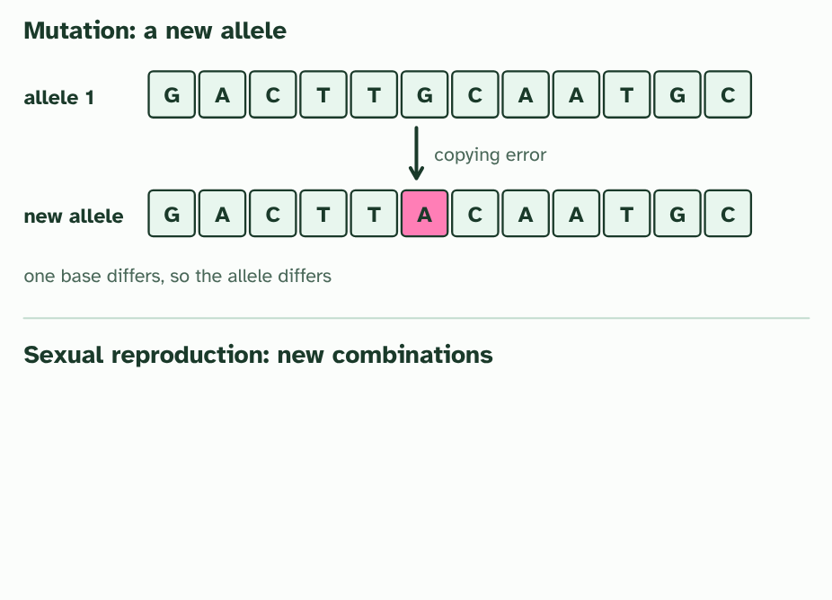
CHAPTER 2 · D4.1.2 Where variation comes from (I in ICE AGE)
2 / 4
Variation to select from
A copying error changes one base. The changed sequence is a new allele: mutation makes new alleles.
Minutes 28 to 40
Notes:
Minutes 28 to 40 of 60: Where variation comes from (12 min).
The plan: Chapter 2's figure, step by step, and its predict box. Students sketch the two sources, new allele and new combination, in two boxes. Ask: why does a new allele need a mutation, and why can sexual reproduction not make one?
Selection can only choose between things that differ. In any sexually reproducing population, individuals differ in their heritable traits because they differ in their alleles. Two processes keep supplying them.
Mutation is the only source of brand new alleles. A copying slip, or damage to DNA, changes the base sequence of a gene, and the changed version is a new allele. Mutations happen by chance, with no regard for need. Most do nothing noticeable, some are harmful, and a few turn out to be useful under some conditions. Only a mutation in the cells that make gametes can be passed on.
Sexual reproduction makes new combinations of the alleles that already exist. In meiosis, crossing over swaps pieces between a pair of chromosomes, and independent assortment sends each pair's chromosomes to the gametes at random (a person can make more than eight million different chromosome mixes this way alone, before any crossing over). Fertilisation then joins two gametes that met by chance. So no two siblings, apart from identical twins, have the same set of alleles.
Put the two together. Mutation adds alleles to the population's stock. Sexual reproduction shuffles that stock into endless new individuals. Without both, there would be nothing for selection to act on, and no change.

Slide 28
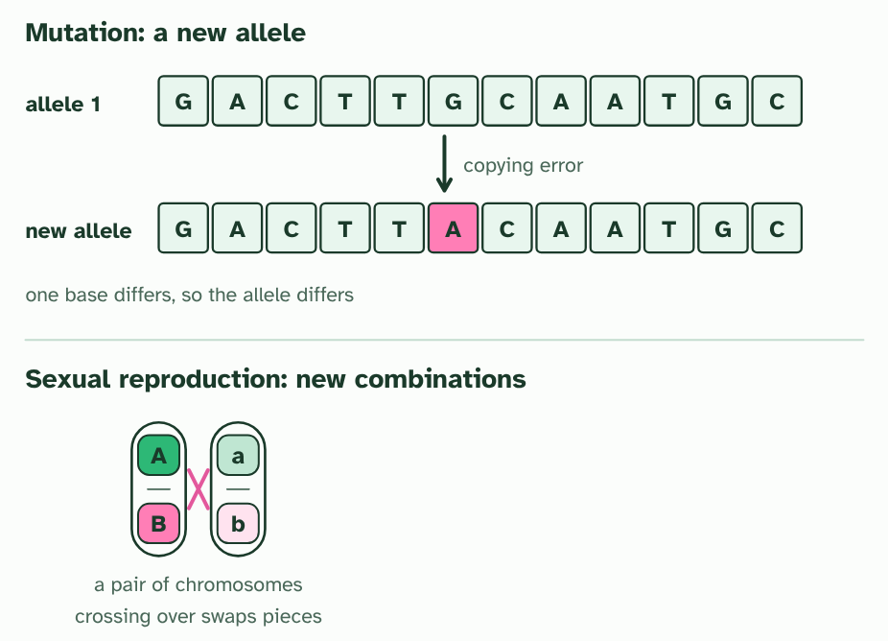
CHAPTER 2 · D4.1.2 Where variation comes from (I in ICE AGE)
3 / 4
Variation to select from
In meiosis, crossing over swaps pieces between a pair of chromosomes that carry the alleles A, B and a, b.
Minutes 28 to 40
Notes:
Minutes 28 to 40 of 60: Where variation comes from (12 min).
The plan: Chapter 2's figure, step by step, and its predict box. Students sketch the two sources, new allele and new combination, in two boxes. Ask: why does a new allele need a mutation, and why can sexual reproduction not make one?
Selection can only choose between things that differ. In any sexually reproducing population, individuals differ in their heritable traits because they differ in their alleles. Two processes keep supplying them.
Mutation is the only source of brand new alleles. A copying slip, or damage to DNA, changes the base sequence of a gene, and the changed version is a new allele. Mutations happen by chance, with no regard for need. Most do nothing noticeable, some are harmful, and a few turn out to be useful under some conditions. Only a mutation in the cells that make gametes can be passed on.
Sexual reproduction makes new combinations of the alleles that already exist. In meiosis, crossing over swaps pieces between a pair of chromosomes, and independent assortment sends each pair's chromosomes to the gametes at random (a person can make more than eight million different chromosome mixes this way alone, before any crossing over). Fertilisation then joins two gametes that met by chance. So no two siblings, apart from identical twins, have the same set of alleles.
Put the two together. Mutation adds alleles to the population's stock. Sexual reproduction shuffles that stock into endless new individuals. Without both, there would be nothing for selection to act on, and no change.

Slide 29
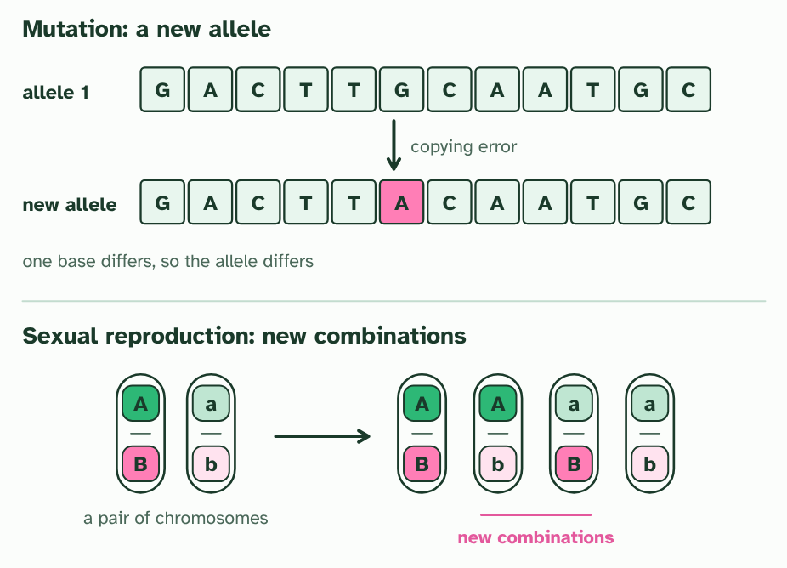
CHAPTER 2 · D4.1.2 Where variation comes from (I in ICE AGE)
4 / 4
Variation to select from
The gametes carry combinations that neither chromosome had before: sexual reproduction makes new combinations of alleles.
Minutes 28 to 40
Notes:
Minutes 28 to 40 of 60: Where variation comes from (12 min).
The plan: Chapter 2's figure, step by step, and its predict box. Students sketch the two sources, new allele and new combination, in two boxes. Ask: why does a new allele need a mutation, and why can sexual reproduction not make one?
Selection can only choose between things that differ. In any sexually reproducing population, individuals differ in their heritable traits because they differ in their alleles. Two processes keep supplying them.
Mutation is the only source of brand new alleles. A copying slip, or damage to DNA, changes the base sequence of a gene, and the changed version is a new allele. Mutations happen by chance, with no regard for need. Most do nothing noticeable, some are harmful, and a few turn out to be useful under some conditions. Only a mutation in the cells that make gametes can be passed on.
Sexual reproduction makes new combinations of the alleles that already exist. In meiosis, crossing over swaps pieces between a pair of chromosomes, and independent assortment sends each pair's chromosomes to the gametes at random (a person can make more than eight million different chromosome mixes this way alone, before any crossing over). Fertilisation then joins two gametes that met by chance. So no two siblings, apart from identical twins, have the same set of alleles.
Put the two together. Mutation adds alleles to the population's stock. Sexual reproduction shuffles that stock into endless new individuals. Without both, there would be nothing for selection to act on, and no change.

Slide 30
CHAPTER 2 · D4.1.2 Where variation comes from (I in ICE AGE)
Variation to select from
Mutation is the only source of brand new alleles.
Mutations happen by chance, with no regard for need.
Only a mutation in the cells that make gametes can be passed on.
Mutation adds alleles to the population's stock.
Minutes 28 to 40
Notes:
Minutes 28 to 40 of 60: Where variation comes from (12 min).
The plan: Chapter 2's figure, step by step, and its predict box. Students sketch the two sources, new allele and new combination, in two boxes. Ask: why does a new allele need a mutation, and why can sexual reproduction not make one?
Selection can only choose between things that differ. In any sexually reproducing population, individuals differ in their heritable traits because they differ in their alleles. Two processes keep supplying them.
Mutation is the only source of brand new alleles. A copying slip, or damage to DNA, changes the base sequence of a gene, and the changed version is a new allele. Mutations happen by chance, with no regard for need. Most do nothing noticeable, some are harmful, and a few turn out to be useful under some conditions. Only a mutation in the cells that make gametes can be passed on.
Sexual reproduction makes new combinations of the alleles that already exist. In meiosis, crossing over swaps pieces between a pair of chromosomes, and independent assortment sends each pair's chromosomes to the gametes at random (a person can make more than eight million different chromosome mixes this way alone, before any crossing over). Fertilisation then joins two gametes that met by chance. So no two siblings, apart from identical twins, have the same set of alleles.
Put the two together. Mutation adds alleles to the population's stock. Sexual reproduction shuffles that stock into endless new individuals. Without both, there would be nothing for selection to act on, and no change.

Slide 31
PREDICT
Where does the very first copy of a new allele come from?
A Crossing over during meiosis, which shuffles the alleles each parent already has
B A mutation in the DNA of a cell that goes on to make gametes
C Natural selection, which builds the alleles that the population needs most
Minutes 28 to 40
Notes:
Minutes 28 to 40 of 60: Where variation comes from (12 min).
The plan: Chapter 2's figure, step by step, and its predict box. Students sketch the two sources, new allele and new combination, in two boxes. Ask: why does a new allele need a mutation, and why can sexual reproduction not make one?
Ask for a show of hands, or mini whiteboards, before revealing. (Answer: B, on the next slide.)

Slide 32
WHAT HAPPENS
Where does the very first copy of a new allele come from?
A Crossing over during meiosis, which shuffles the alleles each parent already has
B A mutation in the DNA of a cell that goes on to make gametes
C Natural selection, which builds the alleles that the population needs most
A mutation. Crossing over and independent assortment only recombine alleles that are already in the population, and natural selection can only sort alleles that exist. A change in the base sequence is the one event that makes an allele that was not there before.
Minutes 28 to 40
Notes:
Minutes 28 to 40 of 60: Where variation comes from (12 min).
The plan: Chapter 2's figure, step by step, and its predict box. Students sketch the two sources, new allele and new combination, in two boxes. Ask: why does a new allele need a mutation, and why can sexual reproduction not make one?
Answer: B. A mutation. Crossing over and independent assortment only recombine alleles that are already in the population, and natural selection can only sort alleles that exist. A change in the base sequence is the one event that makes an allele that was not there before.

Slide 33
WATCH OUT
A mutation is not a response to a problem. A bacterium does not mutate because an antibiotic is near, and a beetle does not mutate because the winter is cold. The mutation arrives by chance, and the environment decides whether it helps.
Minutes 28 to 40
Notes:
Minutes 28 to 40 of 60: Where variation comes from (12 min).
The plan: Chapter 2's figure, step by step, and its predict box. Students sketch the two sources, new allele and new combination, in two boxes. Ask: why does a new allele need a mutation, and why can sexual reproduction not make one?
A common mistake: say it, then ask who can say why it is wrong.

Slide 34
STEP 5
15 MIN
Too many young, and the frost
Chapter 3: More offspring than the world can feed
Minutes 40 to 55
Notes:
Minutes 40 to 55 of 60: Too many young, and the frost (15 min).
The plan: Chapter 3's figure: the four places and twelve young, then the two patches of seedlings. Take the frost predict box before step 5. Then ask for one resource that could limit a population of your choice and one abiotic factor. Link: what mechanisms minimise competition (B4.2).

Slide 35
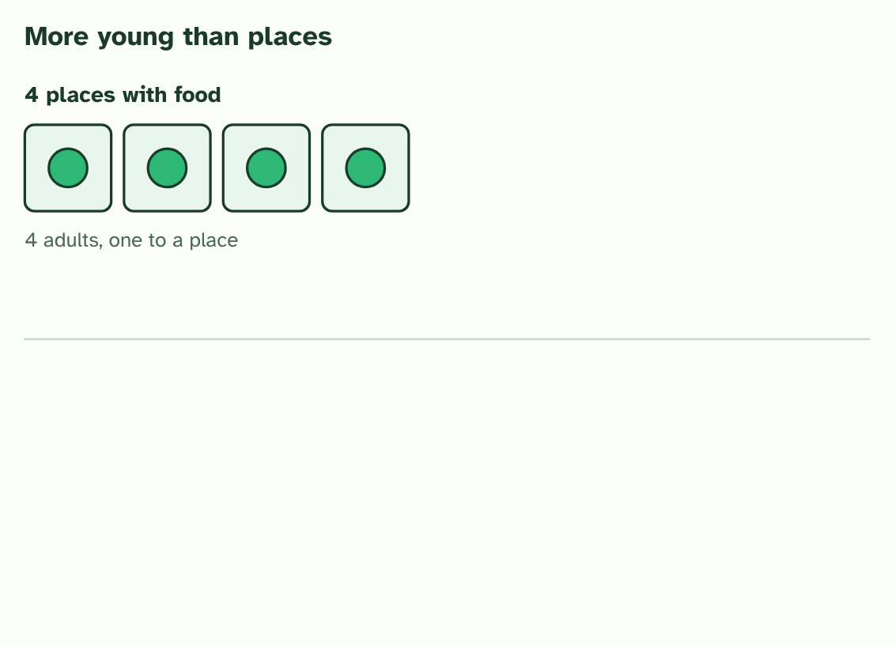
CHAPTER 3 · D4.1.3 D4.1.4 Overproduction and pressures (C and E in ICE AGE)
1 / 5
More offspring than the world can feed
A habitat has four places with enough food, and four adults hold them.
Minutes 40 to 55
Notes:
Minutes 40 to 55 of 60: Too many young, and the frost (15 min).
The plan: Chapter 3's figure: the four places and twelve young, then the two patches of seedlings. Take the frost predict box before step 5. Then ask for one resource that could limit a population of your choice and one abiotic factor. Link: what mechanisms minimise competition (B4.2).
Most species make far more offspring than ever survive. A frog lays hundreds or thousands of eggs, and an oak drops thousands of acorns. If every one grew up and bred, the population would explode. It does not, because the place where it lives can support only so many.
The carrying capacity is that limit. It is set by whatever runs short first: food, water, shelter or nesting sites, space, and for plants light and mineral nutrients. When there are more young than the resources can supply, they compete. Individuals of the same species need the same things, so competition within a species is especially sharp, and the ones that win leave more offspring.
Not every pressure is about running short. An abiotic factor such as a heatwave, a hard frost, a drought or a flood can kill or spare individuals according to their traits. These are density-independent factors: a frost that kills half of a sparse patch of seedlings kills about half of a crowded patch too. A seedling with an allele that lets it tolerate cold has a better chance of surviving the frost and setting seed.
Any factor that makes some individuals more likely to survive and reproduce than others is a selection pressure. Food, water, nest sites and cold are all selection pressures. In ICE AGE this chapter is C, for competition, and E, for the environmental pressure that sorts the winners from the rest.
Example: Linking question What mechanisms minimise competition? Species can share a place without fighting over everything: one feeds high in the tree and one low, one by day and one by night, young and adults eat different foods (tadpoles and frogs), territories space individuals out, and seeds are carried away from the parent plant. Sharing out resources like this is the subject of B4.2 (ecological niches).

Slide 36
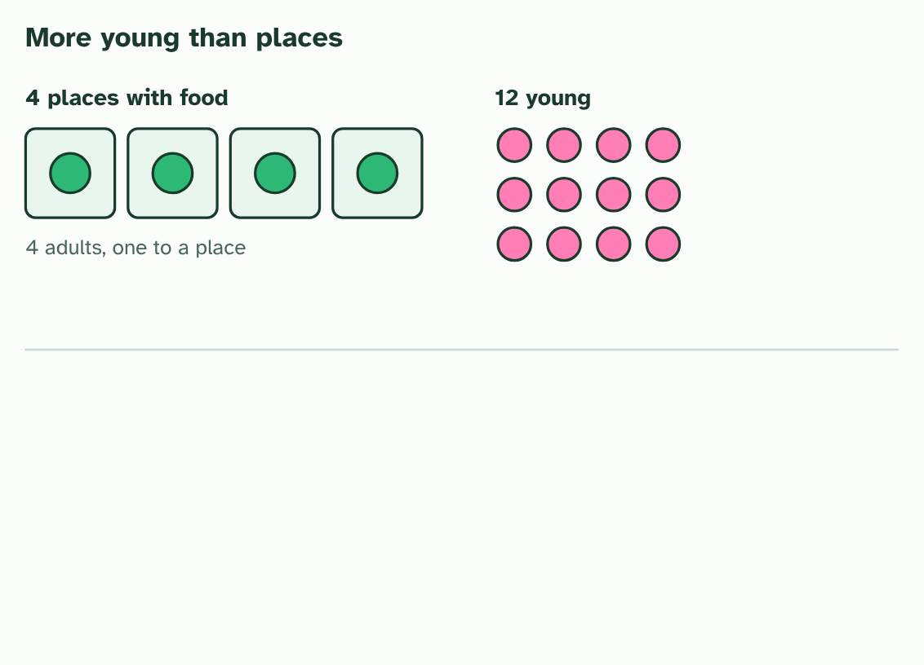
CHAPTER 3 · D4.1.3 D4.1.4 Overproduction and pressures (C and E in ICE AGE)
2 / 5
More offspring than the world can feed
The adults raise twelve young: far more than the places can hold.
Minutes 40 to 55
Notes:
Minutes 40 to 55 of 60: Too many young, and the frost (15 min).
The plan: Chapter 3's figure: the four places and twelve young, then the two patches of seedlings. Take the frost predict box before step 5. Then ask for one resource that could limit a population of your choice and one abiotic factor. Link: what mechanisms minimise competition (B4.2).
Most species make far more offspring than ever survive. A frog lays hundreds or thousands of eggs, and an oak drops thousands of acorns. If every one grew up and bred, the population would explode. It does not, because the place where it lives can support only so many.
The carrying capacity is that limit. It is set by whatever runs short first: food, water, shelter or nesting sites, space, and for plants light and mineral nutrients. When there are more young than the resources can supply, they compete. Individuals of the same species need the same things, so competition within a species is especially sharp, and the ones that win leave more offspring.
Not every pressure is about running short. An abiotic factor such as a heatwave, a hard frost, a drought or a flood can kill or spare individuals according to their traits. These are density-independent factors: a frost that kills half of a sparse patch of seedlings kills about half of a crowded patch too. A seedling with an allele that lets it tolerate cold has a better chance of surviving the frost and setting seed.
Any factor that makes some individuals more likely to survive and reproduce than others is a selection pressure. Food, water, nest sites and cold are all selection pressures. In ICE AGE this chapter is C, for competition, and E, for the environmental pressure that sorts the winners from the rest.
Example: Linking question What mechanisms minimise competition? Species can share a place without fighting over everything: one feeds high in the tree and one low, one by day and one by night, young and adults eat different foods (tadpoles and frogs), territories space individuals out, and seeds are carried away from the parent plant. Sharing out resources like this is the subject of B4.2 (ecological niches).

Slide 37
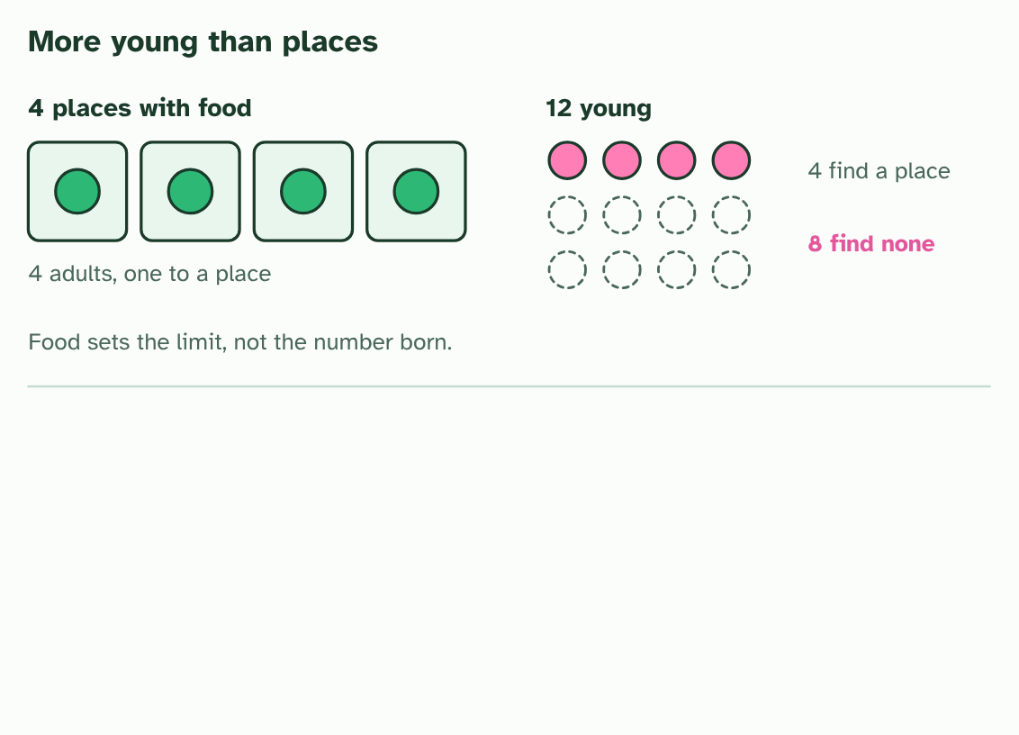
CHAPTER 3 · D4.1.3 D4.1.4 Overproduction and pressures (C and E in ICE AGE)
3 / 5
More offspring than the world can feed
The young compete. Only four find a place; eight find none. The limit is the food, not the number born.
Minutes 40 to 55
Notes:
Minutes 40 to 55 of 60: Too many young, and the frost (15 min).
The plan: Chapter 3's figure: the four places and twelve young, then the two patches of seedlings. Take the frost predict box before step 5. Then ask for one resource that could limit a population of your choice and one abiotic factor. Link: what mechanisms minimise competition (B4.2).
Most species make far more offspring than ever survive. A frog lays hundreds or thousands of eggs, and an oak drops thousands of acorns. If every one grew up and bred, the population would explode. It does not, because the place where it lives can support only so many.
The carrying capacity is that limit. It is set by whatever runs short first: food, water, shelter or nesting sites, space, and for plants light and mineral nutrients. When there are more young than the resources can supply, they compete. Individuals of the same species need the same things, so competition within a species is especially sharp, and the ones that win leave more offspring.
Not every pressure is about running short. An abiotic factor such as a heatwave, a hard frost, a drought or a flood can kill or spare individuals according to their traits. These are density-independent factors: a frost that kills half of a sparse patch of seedlings kills about half of a crowded patch too. A seedling with an allele that lets it tolerate cold has a better chance of surviving the frost and setting seed.
Any factor that makes some individuals more likely to survive and reproduce than others is a selection pressure. Food, water, nest sites and cold are all selection pressures. In ICE AGE this chapter is C, for competition, and E, for the environmental pressure that sorts the winners from the rest.
Example: Linking question What mechanisms minimise competition? Species can share a place without fighting over everything: one feeds high in the tree and one low, one by day and one by night, young and adults eat different foods (tadpoles and frogs), territories space individuals out, and seeds are carried away from the parent plant. Sharing out resources like this is the subject of B4.2 (ecological niches).

Slide 38
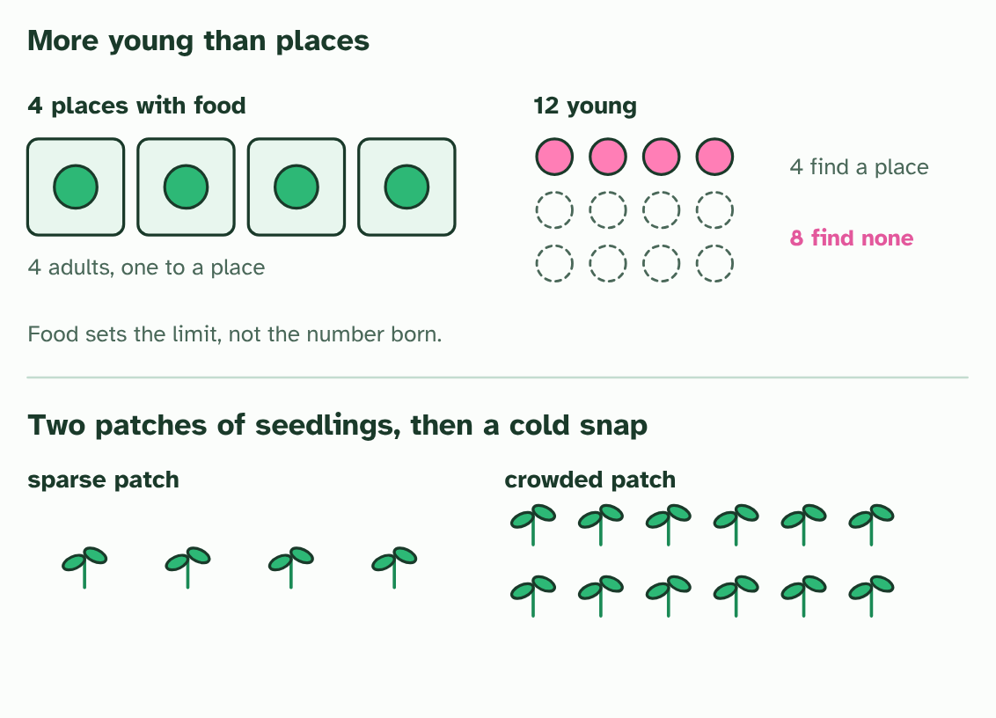
CHAPTER 3 · D4.1.3 D4.1.4 Overproduction and pressures (C and E in ICE AGE)
4 / 5
More offspring than the world can feed
A different pressure: two patches of seedlings, one sparse and one crowded.
Minutes 40 to 55
Notes:
Minutes 40 to 55 of 60: Too many young, and the frost (15 min).
The plan: Chapter 3's figure: the four places and twelve young, then the two patches of seedlings. Take the frost predict box before step 5. Then ask for one resource that could limit a population of your choice and one abiotic factor. Link: what mechanisms minimise competition (B4.2).
Most species make far more offspring than ever survive. A frog lays hundreds or thousands of eggs, and an oak drops thousands of acorns. If every one grew up and bred, the population would explode. It does not, because the place where it lives can support only so many.
The carrying capacity is that limit. It is set by whatever runs short first: food, water, shelter or nesting sites, space, and for plants light and mineral nutrients. When there are more young than the resources can supply, they compete. Individuals of the same species need the same things, so competition within a species is especially sharp, and the ones that win leave more offspring.
Not every pressure is about running short. An abiotic factor such as a heatwave, a hard frost, a drought or a flood can kill or spare individuals according to their traits. These are density-independent factors: a frost that kills half of a sparse patch of seedlings kills about half of a crowded patch too. A seedling with an allele that lets it tolerate cold has a better chance of surviving the frost and setting seed.
Any factor that makes some individuals more likely to survive and reproduce than others is a selection pressure. Food, water, nest sites and cold are all selection pressures. In ICE AGE this chapter is C, for competition, and E, for the environmental pressure that sorts the winners from the rest.
Example: Linking question What mechanisms minimise competition? Species can share a place without fighting over everything: one feeds high in the tree and one low, one by day and one by night, young and adults eat different foods (tadpoles and frogs), territories space individuals out, and seeds are carried away from the parent plant. Sharing out resources like this is the subject of B4.2 (ecological niches).

Slide 39
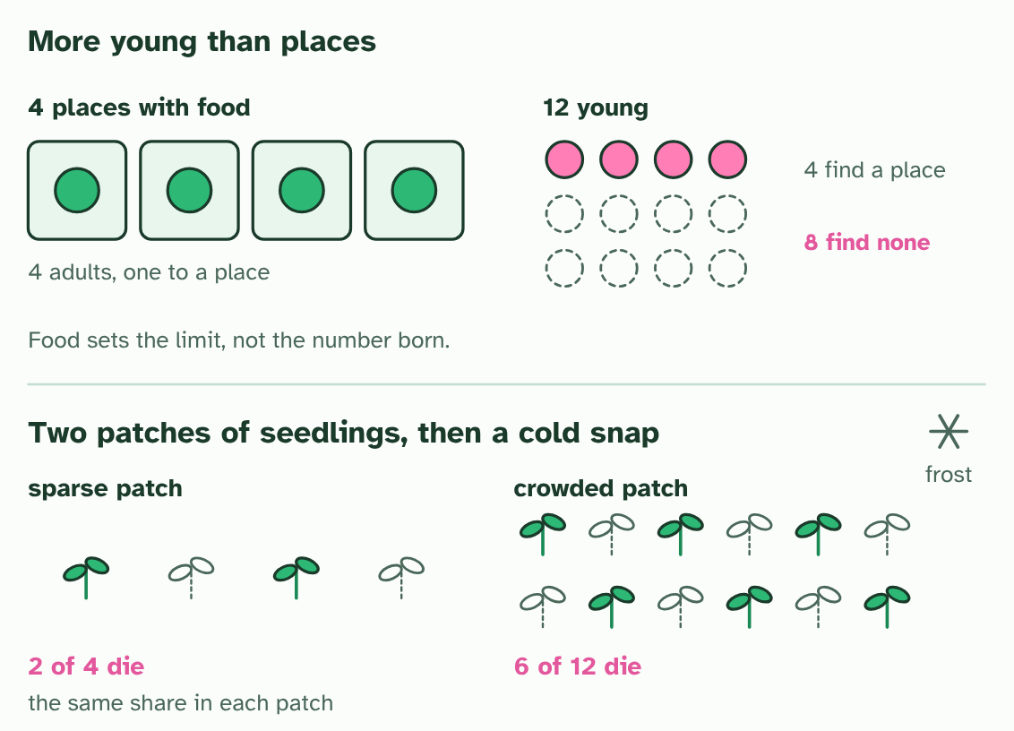
CHAPTER 3 · D4.1.3 D4.1.4 Overproduction and pressures (C and E in ICE AGE)
5 / 5
More offspring than the world can feed
A cold snap kills half of each. It is density-independent: the share lost does not depend on the crowd.
Minutes 40 to 55
Notes:
Minutes 40 to 55 of 60: Too many young, and the frost (15 min).
The plan: Chapter 3's figure: the four places and twelve young, then the two patches of seedlings. Take the frost predict box before step 5. Then ask for one resource that could limit a population of your choice and one abiotic factor. Link: what mechanisms minimise competition (B4.2).
Most species make far more offspring than ever survive. A frog lays hundreds or thousands of eggs, and an oak drops thousands of acorns. If every one grew up and bred, the population would explode. It does not, because the place where it lives can support only so many.
The carrying capacity is that limit. It is set by whatever runs short first: food, water, shelter or nesting sites, space, and for plants light and mineral nutrients. When there are more young than the resources can supply, they compete. Individuals of the same species need the same things, so competition within a species is especially sharp, and the ones that win leave more offspring.
Not every pressure is about running short. An abiotic factor such as a heatwave, a hard frost, a drought or a flood can kill or spare individuals according to their traits. These are density-independent factors: a frost that kills half of a sparse patch of seedlings kills about half of a crowded patch too. A seedling with an allele that lets it tolerate cold has a better chance of surviving the frost and setting seed.
Any factor that makes some individuals more likely to survive and reproduce than others is a selection pressure. Food, water, nest sites and cold are all selection pressures. In ICE AGE this chapter is C, for competition, and E, for the environmental pressure that sorts the winners from the rest.
Example: Linking question What mechanisms minimise competition? Species can share a place without fighting over everything: one feeds high in the tree and one low, one by day and one by night, young and adults eat different foods (tadpoles and frogs), territories space individuals out, and seeds are carried away from the parent plant. Sharing out resources like this is the subject of B4.2 (ecological niches).

Slide 40
CHAPTER 3 · D4.1.3 D4.1.4 Overproduction and pressures (C and E in ICE AGE)
More offspring than the world can feed
The carrying capacity is that limit.
When there are more young than the resources can supply, they compete.
An abiotic factor such as a heatwave, a hard frost, a drought or a flood can kill or spare individuals according to their traits.
These are density-independent factors: a frost that kills half of a sparse patch of seedlings kills about half of a crowded patch too.
Minutes 40 to 55
Notes:
Minutes 40 to 55 of 60: Too many young, and the frost (15 min).
The plan: Chapter 3's figure: the four places and twelve young, then the two patches of seedlings. Take the frost predict box before step 5. Then ask for one resource that could limit a population of your choice and one abiotic factor. Link: what mechanisms minimise competition (B4.2).
Most species make far more offspring than ever survive. A frog lays hundreds or thousands of eggs, and an oak drops thousands of acorns. If every one grew up and bred, the population would explode. It does not, because the place where it lives can support only so many.
The carrying capacity is that limit. It is set by whatever runs short first: food, water, shelter or nesting sites, space, and for plants light and mineral nutrients. When there are more young than the resources can supply, they compete. Individuals of the same species need the same things, so competition within a species is especially sharp, and the ones that win leave more offspring.
Not every pressure is about running short. An abiotic factor such as a heatwave, a hard frost, a drought or a flood can kill or spare individuals according to their traits. These are density-independent factors: a frost that kills half of a sparse patch of seedlings kills about half of a crowded patch too. A seedling with an allele that lets it tolerate cold has a better chance of surviving the frost and setting seed.
Any factor that makes some individuals more likely to survive and reproduce than others is a selection pressure. Food, water, nest sites and cold are all selection pressures. In ICE AGE this chapter is C, for competition, and E, for the environmental pressure that sorts the winners from the rest.
Example: Linking question What mechanisms minimise competition? Species can share a place without fighting over everything: one feeds high in the tree and one low, one by day and one by night, young and adults eat different foods (tadpoles and frogs), territories space individuals out, and seeds are carried away from the parent plant. Sharing out resources like this is the subject of B4.2 (ecological niches).

Slide 41
PREDICT
A late frost kills 60% of the seedlings in a sparse patch. How will a crowded patch of the same plant fare?
A A larger share will die, because crowded seedlings are weaker and the cold finishes them
B A smaller share will die, because the crowd shelters each seedling from the cold
C About the same share will die: the frost does not count heads
Minutes 40 to 55
Notes:
Minutes 40 to 55 of 60: Too many young, and the frost (15 min).
The plan: Chapter 3's figure: the four places and twelve young, then the two patches of seedlings. Take the frost predict box before step 5. Then ask for one resource that could limit a population of your choice and one abiotic factor. Link: what mechanisms minimise competition (B4.2).
Ask for a show of hands, or mini whiteboards, before revealing. (Answer: C, on the next slide.)

Slide 42
WHAT HAPPENS
A late frost kills 60% of the seedlings in a sparse patch. How will a crowded patch of the same plant fare?
A A larger share will die, because crowded seedlings are weaker and the cold finishes them
B A smaller share will die, because the crowd shelters each seedling from the cold
C About the same share will die: the frost does not count heads
About the same share. A density-independent factor affects individuals in the same way whether they are crowded or sparse. The ones with a heritable tolerance of cold, in either patch, are the ones that survive.
Minutes 40 to 55
Notes:
Minutes 40 to 55 of 60: Too many young, and the frost (15 min).
The plan: Chapter 3's figure: the four places and twelve young, then the two patches of seedlings. Take the frost predict box before step 5. Then ask for one resource that could limit a population of your choice and one abiotic factor. Link: what mechanisms minimise competition (B4.2).
Answer: C. About the same share. A density-independent factor affects individuals in the same way whether they are crowded or sparse. The ones with a heritable tolerance of cold, in either patch, are the ones that survive.

Slide 43
PLENARY
Can you now...
Explain natural selection as the mechanism of evolution, and why Darwin's explanation replacing Lamarck's was a paradigm shift (D4.1.1)
Explain how mutation makes new alleles and sexual reproduction makes new combinations of them (D4.1.2)
Explain how overproduction of offspring and competition for limited resources promote natural selection (D4.1.3)
Explain how abiotic factors such as a hard frost act as density-independent selection pressures (D4.1.4)
Minutes 55 to 60
Notes:
Minutes 55 to 60 of 60: Exit: ICE AGE on a new case (5 min).
The plan: Give a short invented case (beetles on a dark lava flow, say). Students write one line for I, C and E. Collect on the way out.
Thumbs up, sideways or down on each goal before the exit question. The goals come from the statements this lesson covers.

Slide 44
EXIT QUESTION
ICE AGE on a new case
Students write one line for I, C and E.
Minutes 55 to 60
Notes:
Minutes 55 to 60 of 60: Exit: ICE AGE on a new case (5 min).
The plan: Give a short invented case (beetles on a dark lava flow, say). Students write one line for I, C and E. Collect on the way out.

Slide 45
PRACTISE AND REVISE
Keep going
Exam practice: a fresh paper of exam questions on D4.1 at standard level, marked as you go
The guide, with the animations and the dry lab
This lesson in the guide: 1 Evolution has a mechanism, 2 Variation to select from, 3 More offspring than the world can feed
BUILD FOR YOUR CLASS
ALREADY ON THE SITE FOR D4.1
CARD SETS ON SPLYCR
Tarsia puzzle, dominoes and picture reveal on D4.1, built from its key terms and ready to print
A pub quiz with rounds on D4.1, to present or run with no projector
An escape room built from the question bank on D4.1
Lesson: Hardy–Weinberg & Chi-Squared
Quiz: Natural Selection
Revision map: D4.1 Natural selection, to fill in
Exam questions: D4.1 in the exam maker, a paper with its markscheme
Open a set to host it as a class game, or make a copy to edit.
D4.1 Natural Selection
How this was made. The course structure, the activities and the teaching choices come from my own classroom, my presentations and my years of teaching IB and AP Biology. I use Claude, an AI, to help write and build the interactive guides, lesson plans, slides and practice questions, and to draw the diagrams and code the interactives. I direct the work and review it against the IB and AP specifications before it goes live.
Minute 60: after the lesson
Notes:
Every link here is live. Set the exam practice paper for homework: it is fresh each time, marked as students go and saved to their Exam practice when they are signed in.
Exam practice: https://www.biologybybradford.com/exam-maker/sit?topics=D4.1&level=SL&paper=quiz&marks=15&src=ep
The guide: https://www.biologybybradford.com/guides/ib-biology-d4-1-natural-selection

