Slide 1
IB Biology D4.1
LESSON 2 OF 6
BY THE END YOU CAN
Natural selection
Use fitness, adaptation, survival and reproduction to explain why some individuals leave more offspring than others (D4.1.5)
Explain why only heritable traits can be selected, and why traits acquired in a lifetime cannot (D4.1.6)
Explain how competing for mates and being chosen drive the evolution of traits such as the plumage of birds of paradise (D4.1.7)
Fitness, heritability and choosing a mate
D4.1.5 to D4.1.7
Fitness as survival and reproduction, why only heritable traits are selected, and sexual selection as a pressure of its own
60 minutes · chapters 4, 5
Minute 0
Notes:
IB Biology D4.1, Natural selection. Lesson 2 of 6: Fitness, heritability and choosing a mate, 60 minutes.
The plan, minute by minute (each slide's footer says where you are):
0 to 5 min (5) Do now
5 to 13 min (8) Fitness is offspring
13 to 28 min (15) Chopsticks
28 to 38 min (10) Run a population
38 to 53 min (15) Compete or choose?
53 to 60 min (7) Exit
What students get wrong:
"Fittest means strongest." It means most offspring that survive to breed. The small, plain animal with six young is fitter than the powerful one with none.
Acquired traits are inherited. Muscles, scars and the effects of extra food are not encoded in the base sequence of the genes in the gametes.
Sexual selection is "survival of the fittest". It can lower survival. What it raises is mating success.
Stretch and support:
Support: give the captions of each figure as a cut-up storyboard to put in order, and use the key terms (tap the dotted words) as a glossary.
Support: the ICE AGE tiles (Icy Cubs Eat Anything, Growing Enormous) on the board for every lesson.
Stretch: a costly display can be an honest sign of health because it is hard to fake. What would stop a weak male from faking it?
The lesson plan to print: https://www.biologybybradford.com/guides/downloads/ib-biology-d4-1-natural-selection-lesson-2-plan.pdf

Slide 2
DO NOW
Do now
Chapter 4's first predict box: the cat that lived 15 years with no surviving kittens, against the cat that lived 6 years with eight.
5:00
minutes
Start now: the timer is running.
Minutes 0 to 5
Notes:
Minutes 0 to 5 of 60: Do now (5 min).
The plan: Chapter 4's first predict box: the cat that lived 15 years with no surviving kittens, against the cat that lived 6 years with eight. Vote, then defend the vote. Leave the votes up until the figure.
Start a 5 minute timer as they come in.

Slide 3
PREDICT
A cat lives 15 years but raises no surviving kittens. A second cat lives 6 years and raises 8 kittens that all breed. Which has the higher fitness?
A The second, because it left more offspring that went on to breed
B The first, because it lived longer and so had more chances to pass on its alleles
C Neither, because fitness describes a whole population and not single animals
Minutes 0 to 5
Notes:
Minutes 0 to 5 of 60: Do now (5 min).
The plan: Chapter 4's first predict box: the cat that lived 15 years with no surviving kittens, against the cat that lived 6 years with eight. Vote, then defend the vote. Leave the votes up until the figure.
Ask for a show of hands, or mini whiteboards, before revealing. (Answer: A, on the next slide.)

Slide 4
WHAT HAPPENS
A cat lives 15 years but raises no surviving kittens. A second cat lives 6 years and raises 8 kittens that all breed. Which has the higher fitness?
A The second, because it left more offspring that went on to breed
B The first, because it lived longer and so had more chances to pass on its alleles
C Neither, because fitness describes a whole population and not single animals
The second cat. Fitness is about the alleles that reach the next generation, so offspring that survive to breed are what count. The first cat survived well but its fitness, as far as evolution is concerned, is zero.
Minutes 0 to 5
Notes:
Minutes 0 to 5 of 60: Do now (5 min).
The plan: Chapter 4's first predict box: the cat that lived 15 years with no surviving kittens, against the cat that lived 6 years with eight. Vote, then defend the vote. Leave the votes up until the figure.
Answer: A. The second cat. Fitness is about the alleles that reach the next generation, so offspring that survive to breed are what count. The first cat survived well but its fitness, as far as evolution is concerned, is zero.

Slide 5
STEP 2
8 MIN
Fitness is offspring
Chapter 4: Who survives, who breeds
Minutes 5 to 13
Notes:
Minutes 5 to 13 of 60: Fitness is offspring (8 min).
The plan: Chapter 4's figure, steps 1 to 3, then the acquired steps 4 and 5 with the weight-lifter predict box. Write the definition of fitness only after the figure. Ask: why is an acquired trait not heritable? (not encoded in the base sequence of the gametes' genes).

Slide 6
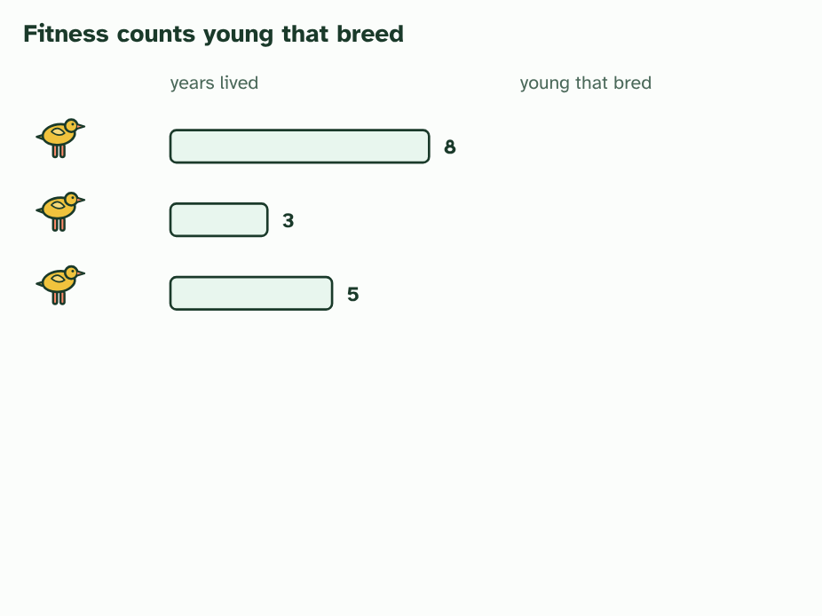
CHAPTER 4 · D4.1.5 D4.1.6 Fitness and heredity (A, G and E in ICE AGE)
1 / 5
Who survives, who breeds
Three birds, and how many years each lived.
Minutes 5 to 13
Notes:
Minutes 5 to 13 of 60: Fitness is offspring (8 min).
The plan: Chapter 4's figure, steps 1 to 3, then the acquired steps 4 and 5 with the weight-lifter predict box. Write the definition of fitness only after the figure. Ask: why is an acquired trait not heritable? (not encoded in the base sequence of the gametes' genes).
Look closely at any population and the individuals differ in how well they are suited to their surroundings. Each of these helpful differences is an adaptation. In a crowd competing for the same limited food, the individuals with the better adaptations are more likely to survive, and to breed. That is natural selection through competition within a species, which is the case you are asked to study.
What selection really measures is fitness. Fitness has two parts: the survival value of a genotype (how likely it is to live long enough to breed) and its reproductive potential (how many offspring it tends to leave). An animal that lives to a great age but leaves no young has fitness of zero, because none of its alleles reach the next generation.
One more condition has to hold. The trait must be heritable. Only differences in alleles are handed down. A body-builder's muscles, a scar, a clipped hedge or a bird that grew large on extra food all arise from what happened in life, and are not encoded in the base sequence of the genes in the gametes. They die with the individual and are not evolution.
Put the pieces in ICE AGE order. Adaptations help some individuals survive and breed (A). Their alleles become commoner in the next generation (G). The population has changed (E). Then the whole cycle starts again with the new generation.
Example: Linking question How do intraspecific interactions differ from interspecific interactions? Intraspecific interactions are between individuals of one species, such as competing for the same food or mates, and they drive selection between the alleles in one gene pool. Interspecific interactions are between different species: predation, parasitism, mutualism and competition between species. Each can act as a selection pressure on the other species. C4.1 (populations and communities) takes both further.

Slide 7
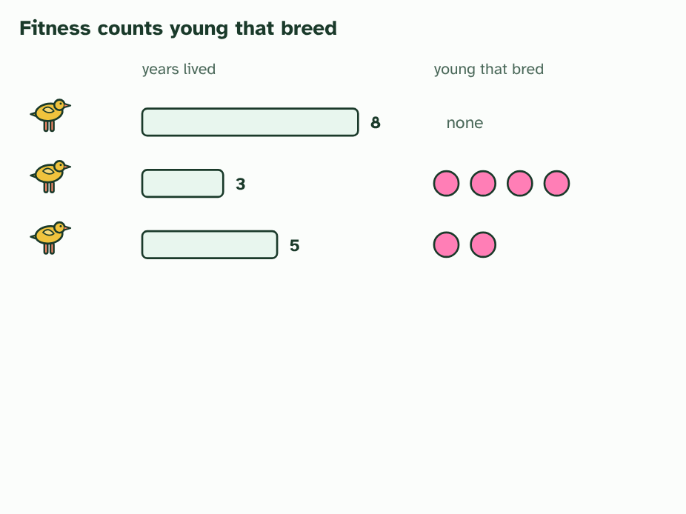
CHAPTER 4 · D4.1.5 D4.1.6 Fitness and heredity (A, G and E in ICE AGE)
2 / 5
Who survives, who breeds
And how many young each raised that reached breeding age.
Minutes 5 to 13
Notes:
Minutes 5 to 13 of 60: Fitness is offspring (8 min).
The plan: Chapter 4's figure, steps 1 to 3, then the acquired steps 4 and 5 with the weight-lifter predict box. Write the definition of fitness only after the figure. Ask: why is an acquired trait not heritable? (not encoded in the base sequence of the gametes' genes).
Look closely at any population and the individuals differ in how well they are suited to their surroundings. Each of these helpful differences is an adaptation. In a crowd competing for the same limited food, the individuals with the better adaptations are more likely to survive, and to breed. That is natural selection through competition within a species, which is the case you are asked to study.
What selection really measures is fitness. Fitness has two parts: the survival value of a genotype (how likely it is to live long enough to breed) and its reproductive potential (how many offspring it tends to leave). An animal that lives to a great age but leaves no young has fitness of zero, because none of its alleles reach the next generation.
One more condition has to hold. The trait must be heritable. Only differences in alleles are handed down. A body-builder's muscles, a scar, a clipped hedge or a bird that grew large on extra food all arise from what happened in life, and are not encoded in the base sequence of the genes in the gametes. They die with the individual and are not evolution.
Put the pieces in ICE AGE order. Adaptations help some individuals survive and breed (A). Their alleles become commoner in the next generation (G). The population has changed (E). Then the whole cycle starts again with the new generation.
Example: Linking question How do intraspecific interactions differ from interspecific interactions? Intraspecific interactions are between individuals of one species, such as competing for the same food or mates, and they drive selection between the alleles in one gene pool. Interspecific interactions are between different species: predation, parasitism, mutualism and competition between species. Each can act as a selection pressure on the other species. C4.1 (populations and communities) takes both further.

Slide 8
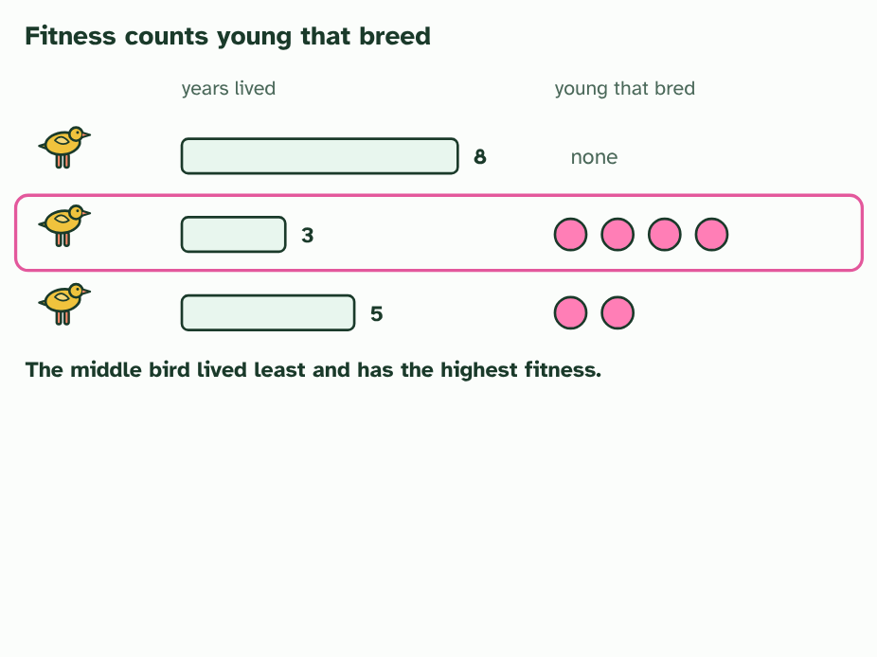
CHAPTER 4 · D4.1.5 D4.1.6 Fitness and heredity (A, G and E in ICE AGE)
3 / 5
Who survives, who breeds
The bird that lived least has the highest fitness. Survival matters only because it lets an animal reproduce.
Minutes 5 to 13
Notes:
Minutes 5 to 13 of 60: Fitness is offspring (8 min).
The plan: Chapter 4's figure, steps 1 to 3, then the acquired steps 4 and 5 with the weight-lifter predict box. Write the definition of fitness only after the figure. Ask: why is an acquired trait not heritable? (not encoded in the base sequence of the gametes' genes).
Look closely at any population and the individuals differ in how well they are suited to their surroundings. Each of these helpful differences is an adaptation. In a crowd competing for the same limited food, the individuals with the better adaptations are more likely to survive, and to breed. That is natural selection through competition within a species, which is the case you are asked to study.
What selection really measures is fitness. Fitness has two parts: the survival value of a genotype (how likely it is to live long enough to breed) and its reproductive potential (how many offspring it tends to leave). An animal that lives to a great age but leaves no young has fitness of zero, because none of its alleles reach the next generation.
One more condition has to hold. The trait must be heritable. Only differences in alleles are handed down. A body-builder's muscles, a scar, a clipped hedge or a bird that grew large on extra food all arise from what happened in life, and are not encoded in the base sequence of the genes in the gametes. They die with the individual and are not evolution.
Put the pieces in ICE AGE order. Adaptations help some individuals survive and breed (A). Their alleles become commoner in the next generation (G). The population has changed (E). Then the whole cycle starts again with the new generation.
Example: Linking question How do intraspecific interactions differ from interspecific interactions? Intraspecific interactions are between individuals of one species, such as competing for the same food or mates, and they drive selection between the alleles in one gene pool. Interspecific interactions are between different species: predation, parasitism, mutualism and competition between species. Each can act as a selection pressure on the other species. C4.1 (populations and communities) takes both further.

Slide 9
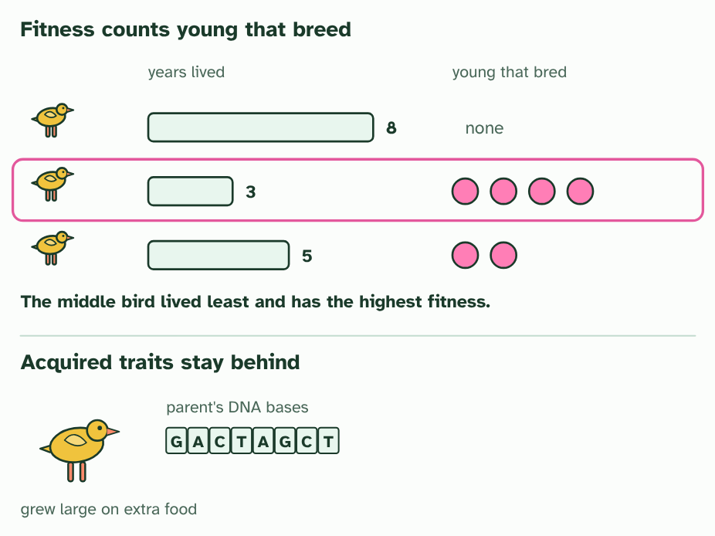
CHAPTER 4 · D4.1.5 D4.1.6 Fitness and heredity (A, G and E in ICE AGE)
4 / 5
Who survives, who breeds
A parent grew large on extra food. Its DNA bases are the same as before: the size was acquired.
Minutes 5 to 13
Notes:
Minutes 5 to 13 of 60: Fitness is offspring (8 min).
The plan: Chapter 4's figure, steps 1 to 3, then the acquired steps 4 and 5 with the weight-lifter predict box. Write the definition of fitness only after the figure. Ask: why is an acquired trait not heritable? (not encoded in the base sequence of the gametes' genes).
Look closely at any population and the individuals differ in how well they are suited to their surroundings. Each of these helpful differences is an adaptation. In a crowd competing for the same limited food, the individuals with the better adaptations are more likely to survive, and to breed. That is natural selection through competition within a species, which is the case you are asked to study.
What selection really measures is fitness. Fitness has two parts: the survival value of a genotype (how likely it is to live long enough to breed) and its reproductive potential (how many offspring it tends to leave). An animal that lives to a great age but leaves no young has fitness of zero, because none of its alleles reach the next generation.
One more condition has to hold. The trait must be heritable. Only differences in alleles are handed down. A body-builder's muscles, a scar, a clipped hedge or a bird that grew large on extra food all arise from what happened in life, and are not encoded in the base sequence of the genes in the gametes. They die with the individual and are not evolution.
Put the pieces in ICE AGE order. Adaptations help some individuals survive and breed (A). Their alleles become commoner in the next generation (G). The population has changed (E). Then the whole cycle starts again with the new generation.
Example: Linking question How do intraspecific interactions differ from interspecific interactions? Intraspecific interactions are between individuals of one species, such as competing for the same food or mates, and they drive selection between the alleles in one gene pool. Interspecific interactions are between different species: predation, parasitism, mutualism and competition between species. Each can act as a selection pressure on the other species. C4.1 (populations and communities) takes both further.

Slide 10
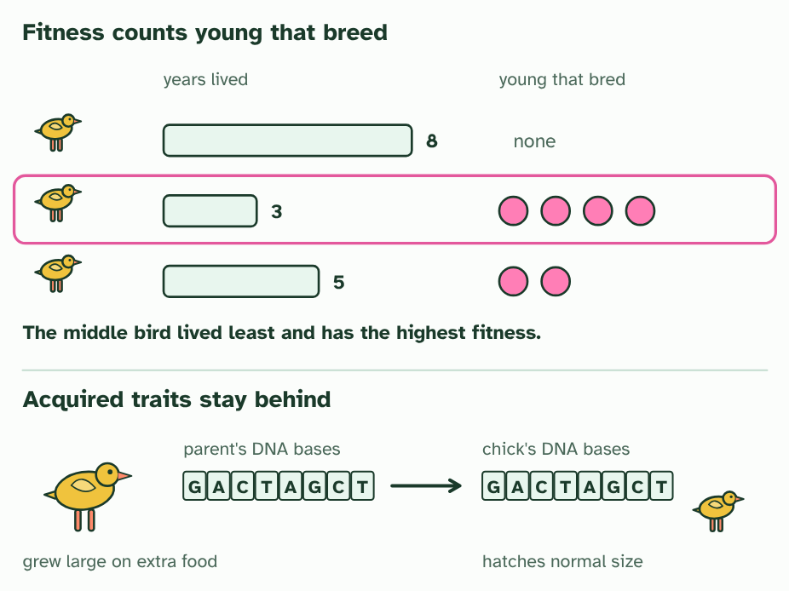
CHAPTER 4 · D4.1.5 D4.1.6 Fitness and heredity (A, G and E in ICE AGE)
5 / 5
Who survives, who breeds
The chick inherits the same bases and hatches a normal size: an acquired trait is not heritable.
Minutes 5 to 13
Notes:
Minutes 5 to 13 of 60: Fitness is offspring (8 min).
The plan: Chapter 4's figure, steps 1 to 3, then the acquired steps 4 and 5 with the weight-lifter predict box. Write the definition of fitness only after the figure. Ask: why is an acquired trait not heritable? (not encoded in the base sequence of the gametes' genes).
Look closely at any population and the individuals differ in how well they are suited to their surroundings. Each of these helpful differences is an adaptation. In a crowd competing for the same limited food, the individuals with the better adaptations are more likely to survive, and to breed. That is natural selection through competition within a species, which is the case you are asked to study.
What selection really measures is fitness. Fitness has two parts: the survival value of a genotype (how likely it is to live long enough to breed) and its reproductive potential (how many offspring it tends to leave). An animal that lives to a great age but leaves no young has fitness of zero, because none of its alleles reach the next generation.
One more condition has to hold. The trait must be heritable. Only differences in alleles are handed down. A body-builder's muscles, a scar, a clipped hedge or a bird that grew large on extra food all arise from what happened in life, and are not encoded in the base sequence of the genes in the gametes. They die with the individual and are not evolution.
Put the pieces in ICE AGE order. Adaptations help some individuals survive and breed (A). Their alleles become commoner in the next generation (G). The population has changed (E). Then the whole cycle starts again with the new generation.
Example: Linking question How do intraspecific interactions differ from interspecific interactions? Intraspecific interactions are between individuals of one species, such as competing for the same food or mates, and they drive selection between the alleles in one gene pool. Interspecific interactions are between different species: predation, parasitism, mutualism and competition between species. Each can act as a selection pressure on the other species. C4.1 (populations and communities) takes both further.

Slide 11
CHAPTER 4 · D4.1.5 D4.1.6 Fitness and heredity (A, G and E in ICE AGE)
Who survives, who breeds
Each of these helpful differences is an adaptation.
In a crowd competing for the same limited food, the individuals with the better adaptations are more likely to survive, and to breed.
What selection really measures is fitness.
Fitness has two parts: the survival value of a genotype (how likely it is to live long enough to breed) and its reproductive potential (how many offspring it tends to leave).
Minutes 5 to 13
Notes:
Minutes 5 to 13 of 60: Fitness is offspring (8 min).
The plan: Chapter 4's figure, steps 1 to 3, then the acquired steps 4 and 5 with the weight-lifter predict box. Write the definition of fitness only after the figure. Ask: why is an acquired trait not heritable? (not encoded in the base sequence of the gametes' genes).
Look closely at any population and the individuals differ in how well they are suited to their surroundings. Each of these helpful differences is an adaptation. In a crowd competing for the same limited food, the individuals with the better adaptations are more likely to survive, and to breed. That is natural selection through competition within a species, which is the case you are asked to study.
What selection really measures is fitness. Fitness has two parts: the survival value of a genotype (how likely it is to live long enough to breed) and its reproductive potential (how many offspring it tends to leave). An animal that lives to a great age but leaves no young has fitness of zero, because none of its alleles reach the next generation.
One more condition has to hold. The trait must be heritable. Only differences in alleles are handed down. A body-builder's muscles, a scar, a clipped hedge or a bird that grew large on extra food all arise from what happened in life, and are not encoded in the base sequence of the genes in the gametes. They die with the individual and are not evolution.
Put the pieces in ICE AGE order. Adaptations help some individuals survive and breed (A). Their alleles become commoner in the next generation (G). The population has changed (E). Then the whole cycle starts again with the new generation.
Example: Linking question How do intraspecific interactions differ from interspecific interactions? Intraspecific interactions are between individuals of one species, such as competing for the same food or mates, and they drive selection between the alleles in one gene pool. Interspecific interactions are between different species: predation, parasitism, mutualism and competition between species. Each can act as a selection pressure on the other species. C4.1 (populations and communities) takes both further.

Slide 12
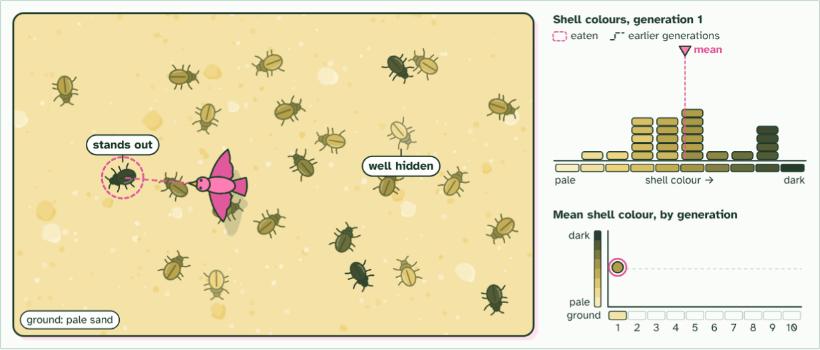
CHAPTER 4 · D4.1.5 D4.1.6 Fitness and heredity (A, G and E in ICE AGE)
generation 1
1 / 3
Who survives, who breeds
Birds spot the beetles that stand out. The best hidden survive and breed.
Minutes 5 to 13
Notes:
Minutes 5 to 13 of 60: Fitness is offspring (8 min).
The plan: Chapter 4's figure, steps 1 to 3, then the acquired steps 4 and 5 with the weight-lifter predict box. Write the definition of fitness only after the figure. Ask: why is an acquired trait not heritable? (not encoded in the base sequence of the gametes' genes).
Look closely at any population and the individuals differ in how well they are suited to their surroundings. Each of these helpful differences is an adaptation. In a crowd competing for the same limited food, the individuals with the better adaptations are more likely to survive, and to breed. That is natural selection through competition within a species, which is the case you are asked to study.
What selection really measures is fitness. Fitness has two parts: the survival value of a genotype (how likely it is to live long enough to breed) and its reproductive potential (how many offspring it tends to leave). An animal that lives to a great age but leaves no young has fitness of zero, because none of its alleles reach the next generation.
One more condition has to hold. The trait must be heritable. Only differences in alleles are handed down. A body-builder's muscles, a scar, a clipped hedge or a bird that grew large on extra food all arise from what happened in life, and are not encoded in the base sequence of the genes in the gametes. They die with the individual and are not evolution.
Put the pieces in ICE AGE order. Adaptations help some individuals survive and breed (A). Their alleles become commoner in the next generation (G). The population has changed (E). Then the whole cycle starts again with the new generation.
Example: Linking question How do intraspecific interactions differ from interspecific interactions? Intraspecific interactions are between individuals of one species, such as competing for the same food or mates, and they drive selection between the alleles in one gene pool. Interspecific interactions are between different species: predation, parasitism, mutualism and competition between species. Each can act as a selection pressure on the other species. C4.1 (populations and communities) takes both further.
The animation "Watch it happen: a population changes", paused at 3.2 s. The next slides go on through it, then play it.

Slide 13
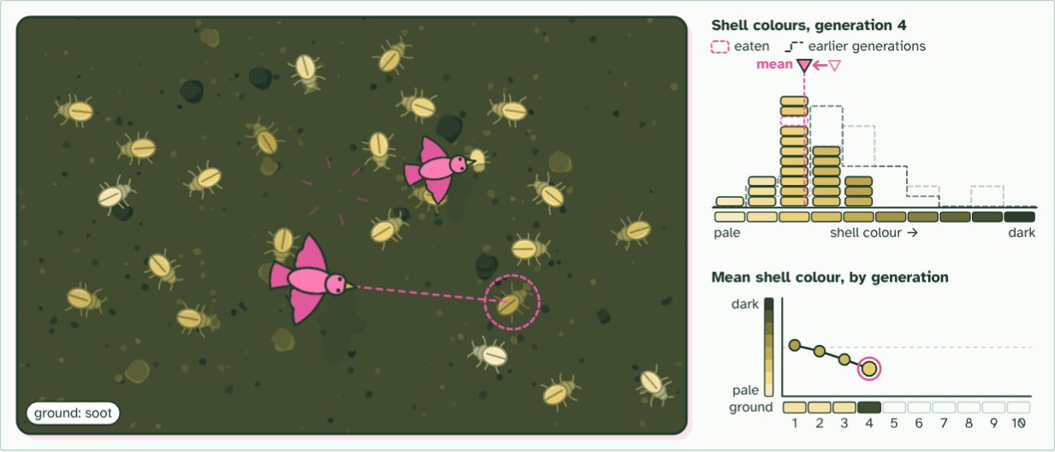
CHAPTER 4 · D4.1.5 D4.1.6 Fitness and heredity (A, G and E in ICE AGE)
generation 4
2 / 3
Who survives, who breeds
Then soot from a fire darkens the ground. Now the pale beetles stand out.
Minutes 5 to 13
Notes:
Minutes 5 to 13 of 60: Fitness is offspring (8 min).
The plan: Chapter 4's figure, steps 1 to 3, then the acquired steps 4 and 5 with the weight-lifter predict box. Write the definition of fitness only after the figure. Ask: why is an acquired trait not heritable? (not encoded in the base sequence of the gametes' genes).
Look closely at any population and the individuals differ in how well they are suited to their surroundings. Each of these helpful differences is an adaptation. In a crowd competing for the same limited food, the individuals with the better adaptations are more likely to survive, and to breed. That is natural selection through competition within a species, which is the case you are asked to study.
What selection really measures is fitness. Fitness has two parts: the survival value of a genotype (how likely it is to live long enough to breed) and its reproductive potential (how many offspring it tends to leave). An animal that lives to a great age but leaves no young has fitness of zero, because none of its alleles reach the next generation.
One more condition has to hold. The trait must be heritable. Only differences in alleles are handed down. A body-builder's muscles, a scar, a clipped hedge or a bird that grew large on extra food all arise from what happened in life, and are not encoded in the base sequence of the genes in the gametes. They die with the individual and are not evolution.
Put the pieces in ICE AGE order. Adaptations help some individuals survive and breed (A). Their alleles become commoner in the next generation (G). The population has changed (E). Then the whole cycle starts again with the new generation.
Example: Linking question How do intraspecific interactions differ from interspecific interactions? Intraspecific interactions are between individuals of one species, such as competing for the same food or mates, and they drive selection between the alleles in one gene pool. Interspecific interactions are between different species: predation, parasitism, mutualism and competition between species. Each can act as a selection pressure on the other species. C4.1 (populations and communities) takes both further.
The animation "Watch it happen: a population changes", paused at 12.4 s. The next slides go on through it, then play it.

Slide 14
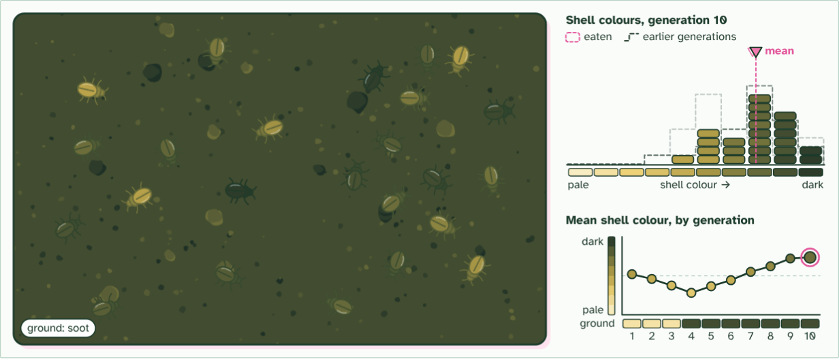
CHAPTER 4 · D4.1.5 D4.1.6 Fitness and heredity (A, G and E in ICE AGE)
generation 10
3 / 3
Who survives, who breeds
No beetle ever changed its shell. The population changed: that is evolution.
Minutes 5 to 13
Notes:
Minutes 5 to 13 of 60: Fitness is offspring (8 min).
The plan: Chapter 4's figure, steps 1 to 3, then the acquired steps 4 and 5 with the weight-lifter predict box. Write the definition of fitness only after the figure. Ask: why is an acquired trait not heritable? (not encoded in the base sequence of the gametes' genes).
Look closely at any population and the individuals differ in how well they are suited to their surroundings. Each of these helpful differences is an adaptation. In a crowd competing for the same limited food, the individuals with the better adaptations are more likely to survive, and to breed. That is natural selection through competition within a species, which is the case you are asked to study.
What selection really measures is fitness. Fitness has two parts: the survival value of a genotype (how likely it is to live long enough to breed) and its reproductive potential (how many offspring it tends to leave). An animal that lives to a great age but leaves no young has fitness of zero, because none of its alleles reach the next generation.
One more condition has to hold. The trait must be heritable. Only differences in alleles are handed down. A body-builder's muscles, a scar, a clipped hedge or a bird that grew large on extra food all arise from what happened in life, and are not encoded in the base sequence of the genes in the gametes. They die with the individual and are not evolution.
Put the pieces in ICE AGE order. Adaptations help some individuals survive and breed (A). Their alleles become commoner in the next generation (G). The population has changed (E). Then the whole cycle starts again with the new generation.
Example: Linking question How do intraspecific interactions differ from interspecific interactions? Intraspecific interactions are between individuals of one species, such as competing for the same food or mates, and they drive selection between the alleles in one gene pool. Interspecific interactions are between different species: predation, parasitism, mutualism and competition between species. Each can act as a selection pressure on the other species. C4.1 (populations and communities) takes both further.
The animation "Watch it happen: a population changes", paused at 23.0 s. The next slides go on through it, then play it.

Slide 15
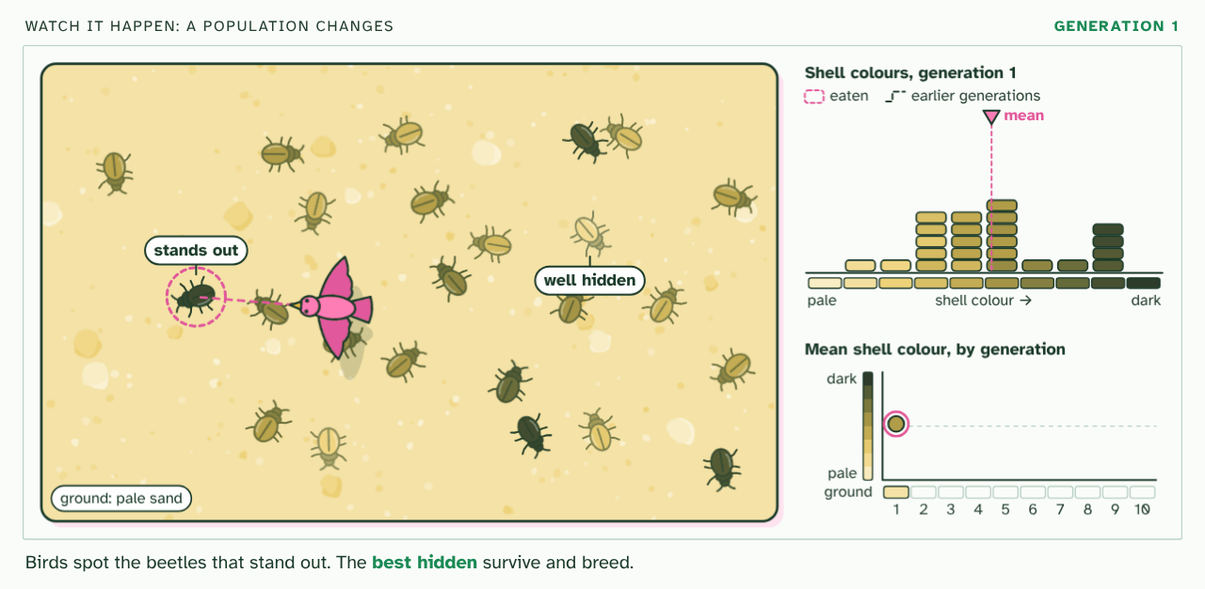
CHAPTER 4 · D4.1.5 D4.1.6 Fitness and heredity (A, G and E in ICE AGE)
PLAY IT
Who survives, who breeds
Watch it happen: a population changes: click to play. It loops every 24 seconds.
Minutes 5 to 13
Notes:
Minutes 5 to 13 of 60: Fitness is offspring (8 min).
The plan: Chapter 4's figure, steps 1 to 3, then the acquired steps 4 and 5 with the weight-lifter predict box. Write the definition of fitness only after the figure. Ask: why is an acquired trait not heritable? (not encoded in the base sequence of the gametes' genes).
The video is selection-1f3022.mp4, one loop of the animation in the guide. It plays in PowerPoint and Keynote. Google Slides does not play a video embedded in a .pptx: download selection-1f3022.mp4 (https://www.biologybybradford.com/guides/downloads/scenes/selection-1f3022.mp4), upload it to Google Drive, then Insert > Video > Google Drive.
In the guide the class can change it as it runs: https://www.biologybybradford.com/guides/ib-biology-d4-1-natural-selection#fitness
What it shows, in order:
1. Birds spot the beetles that stand out. The best hidden survive and breed.
2. Then soot from a fire darkens the ground. Now the pale beetles stand out.
3. No beetle ever changed its shell. The population changed: that is evolution.

Slide 16
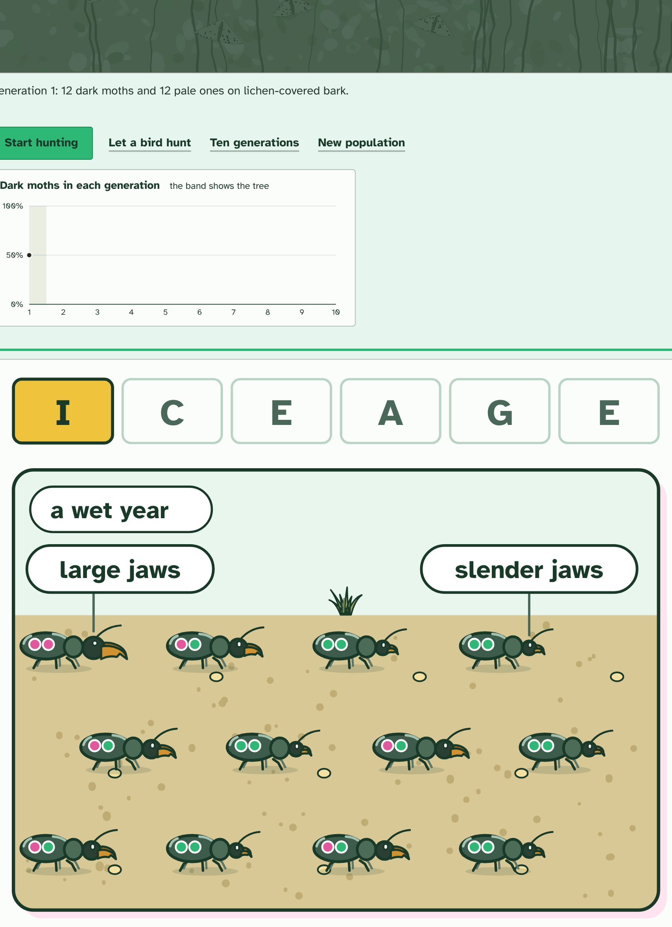
CHAPTER 4 · D4.1.5 D4.1.6 Fitness and heredity (A, G and E in ICE AGE)
1 / 3
Who survives, who breeds
Generation 1: the beetles' jaws vary, slender to large, and each carries two copies of the jaw gene (the pips: pink for large, green for slender). Which letter is this?
Minutes 5 to 13
Notes:
Minutes 5 to 13 of 60: Fitness is offspring (8 min).
The plan: Chapter 4's figure, steps 1 to 3, then the acquired steps 4 and 5 with the weight-lifter predict box. Write the definition of fitness only after the figure. Ask: why is an acquired trait not heritable? (not encoded in the base sequence of the gametes' genes).
Look closely at any population and the individuals differ in how well they are suited to their surroundings. Each of these helpful differences is an adaptation. In a crowd competing for the same limited food, the individuals with the better adaptations are more likely to survive, and to breed. That is natural selection through competition within a species, which is the case you are asked to study.
What selection really measures is fitness. Fitness has two parts: the survival value of a genotype (how likely it is to live long enough to breed) and its reproductive potential (how many offspring it tends to leave). An animal that lives to a great age but leaves no young has fitness of zero, because none of its alleles reach the next generation.
One more condition has to hold. The trait must be heritable. Only differences in alleles are handed down. A body-builder's muscles, a scar, a clipped hedge or a bird that grew large on extra food all arise from what happened in life, and are not encoded in the base sequence of the genes in the gametes. They die with the individual and are not evolution.
Put the pieces in ICE AGE order. Adaptations help some individuals survive and breed (A). Their alleles become commoner in the next generation (G). The population has changed (E). Then the whole cycle starts again with the new generation.
Example: Linking question How do intraspecific interactions differ from interspecific interactions? Intraspecific interactions are between individuals of one species, such as competing for the same food or mates, and they drive selection between the alleles in one gene pool. Interspecific interactions are between different species: predation, parasitism, mutualism and competition between species. Each can act as a selection pressure on the other species. C4.1 (populations and communities) takes both further.

Slide 17
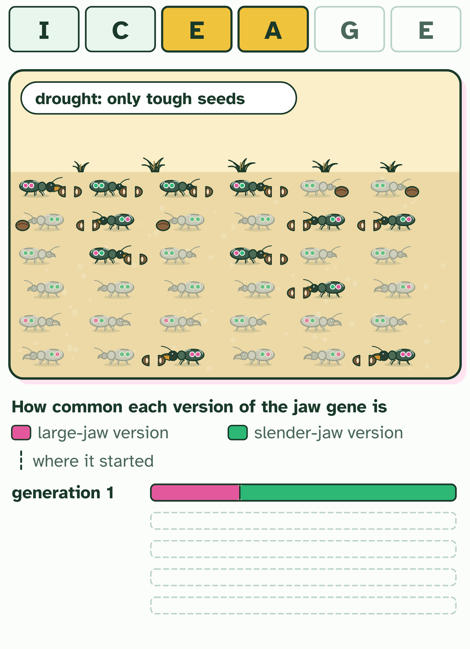
CHAPTER 4 · D4.1.5 D4.1.6 Fitness and heredity (A, G and E in ICE AGE)
2 / 3
Who survives, who breeds
A drought leaves only tough seeds: who cracks them, and who starves? Predict before you run it.
Minutes 5 to 13
Notes:
Minutes 5 to 13 of 60: Fitness is offspring (8 min).
The plan: Chapter 4's figure, steps 1 to 3, then the acquired steps 4 and 5 with the weight-lifter predict box. Write the definition of fitness only after the figure. Ask: why is an acquired trait not heritable? (not encoded in the base sequence of the gametes' genes).
Look closely at any population and the individuals differ in how well they are suited to their surroundings. Each of these helpful differences is an adaptation. In a crowd competing for the same limited food, the individuals with the better adaptations are more likely to survive, and to breed. That is natural selection through competition within a species, which is the case you are asked to study.
What selection really measures is fitness. Fitness has two parts: the survival value of a genotype (how likely it is to live long enough to breed) and its reproductive potential (how many offspring it tends to leave). An animal that lives to a great age but leaves no young has fitness of zero, because none of its alleles reach the next generation.
One more condition has to hold. The trait must be heritable. Only differences in alleles are handed down. A body-builder's muscles, a scar, a clipped hedge or a bird that grew large on extra food all arise from what happened in life, and are not encoded in the base sequence of the genes in the gametes. They die with the individual and are not evolution.
Put the pieces in ICE AGE order. Adaptations help some individuals survive and breed (A). Their alleles become commoner in the next generation (G). The population has changed (E). Then the whole cycle starts again with the new generation.
Example: Linking question How do intraspecific interactions differ from interspecific interactions? Intraspecific interactions are between individuals of one species, such as competing for the same food or mates, and they drive selection between the alleles in one gene pool. Interspecific interactions are between different species: predation, parasitism, mutualism and competition between species. Each can act as a selection pressure on the other species. C4.1 (populations and communities) takes both further.

Slide 18
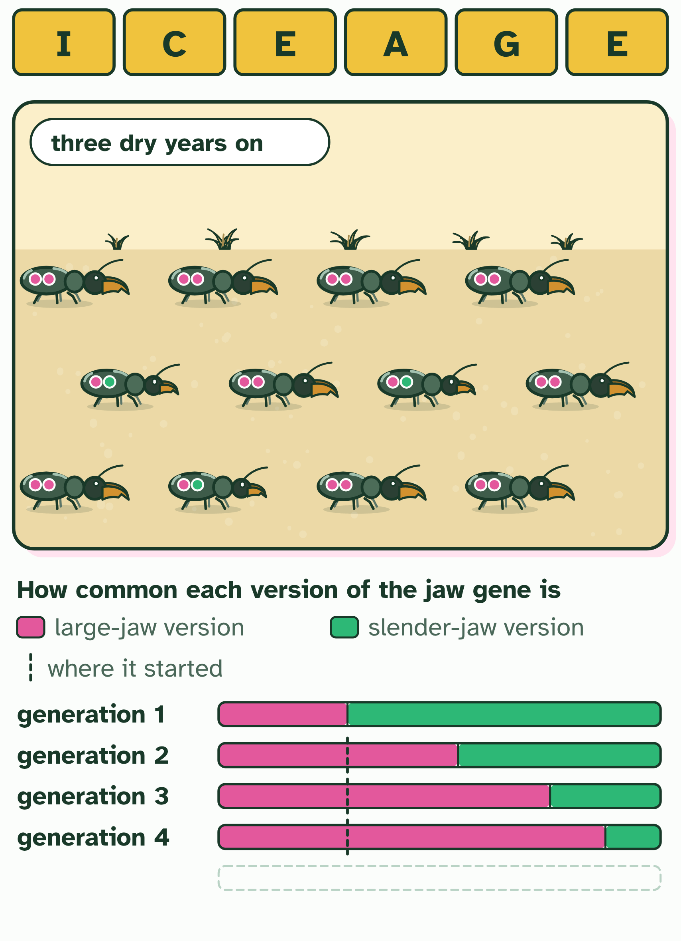
CHAPTER 4 · D4.1.5 D4.1.6 Fitness and heredity (A, G and E in ICE AGE)
3 / 3
Who survives, who breeds
Three dry years on. What has happened to the population, and to any one beetle?
Minutes 5 to 13
Notes:
Minutes 5 to 13 of 60: Fitness is offspring (8 min).
The plan: Chapter 4's figure, steps 1 to 3, then the acquired steps 4 and 5 with the weight-lifter predict box. Write the definition of fitness only after the figure. Ask: why is an acquired trait not heritable? (not encoded in the base sequence of the gametes' genes).
Look closely at any population and the individuals differ in how well they are suited to their surroundings. Each of these helpful differences is an adaptation. In a crowd competing for the same limited food, the individuals with the better adaptations are more likely to survive, and to breed. That is natural selection through competition within a species, which is the case you are asked to study.
What selection really measures is fitness. Fitness has two parts: the survival value of a genotype (how likely it is to live long enough to breed) and its reproductive potential (how many offspring it tends to leave). An animal that lives to a great age but leaves no young has fitness of zero, because none of its alleles reach the next generation.
One more condition has to hold. The trait must be heritable. Only differences in alleles are handed down. A body-builder's muscles, a scar, a clipped hedge or a bird that grew large on extra food all arise from what happened in life, and are not encoded in the base sequence of the genes in the gametes. They die with the individual and are not evolution.
Put the pieces in ICE AGE order. Adaptations help some individuals survive and breed (A). Their alleles become commoner in the next generation (G). The population has changed (E). Then the whole cycle starts again with the new generation.
Example: Linking question How do intraspecific interactions differ from interspecific interactions? Intraspecific interactions are between individuals of one species, such as competing for the same food or mates, and they drive selection between the alleles in one gene pool. Interspecific interactions are between different species: predation, parasitism, mutualism and competition between species. Each can act as a selection pressure on the other species. C4.1 (populations and communities) takes both further.

Slide 19
CHAPTER 4 · D4.1.5 D4.1.6 Fitness and heredity (A, G and E in ICE AGE)
Who survives, who breeds
Each of these helpful differences is an adaptation.
In a crowd competing for the same limited food, the individuals with the better adaptations are more likely to survive, and to breed.
What selection really measures is fitness.
Fitness has two parts: the survival value of a genotype (how likely it is to live long enough to breed) and its reproductive potential (how many offspring it tends to leave).
Minutes 5 to 13
Notes:
Minutes 5 to 13 of 60: Fitness is offspring (8 min).
The plan: Chapter 4's figure, steps 1 to 3, then the acquired steps 4 and 5 with the weight-lifter predict box. Write the definition of fitness only after the figure. Ask: why is an acquired trait not heritable? (not encoded in the base sequence of the gametes' genes).
Look closely at any population and the individuals differ in how well they are suited to their surroundings. Each of these helpful differences is an adaptation. In a crowd competing for the same limited food, the individuals with the better adaptations are more likely to survive, and to breed. That is natural selection through competition within a species, which is the case you are asked to study.
What selection really measures is fitness. Fitness has two parts: the survival value of a genotype (how likely it is to live long enough to breed) and its reproductive potential (how many offspring it tends to leave). An animal that lives to a great age but leaves no young has fitness of zero, because none of its alleles reach the next generation.
One more condition has to hold. The trait must be heritable. Only differences in alleles are handed down. A body-builder's muscles, a scar, a clipped hedge or a bird that grew large on extra food all arise from what happened in life, and are not encoded in the base sequence of the genes in the gametes. They die with the individual and are not evolution.
Put the pieces in ICE AGE order. Adaptations help some individuals survive and breed (A). Their alleles become commoner in the next generation (G). The population has changed (E). Then the whole cycle starts again with the new generation.
Example: Linking question How do intraspecific interactions differ from interspecific interactions? Intraspecific interactions are between individuals of one species, such as competing for the same food or mates, and they drive selection between the alleles in one gene pool. Interspecific interactions are between different species: predation, parasitism, mutualism and competition between species. Each can act as a selection pressure on the other species. C4.1 (populations and communities) takes both further.

Slide 20
WATCH OUT
Fitness is not fitness training. Nothing you gain by exercise, diet or injury changes the alleles you pass on, and a long life is worth nothing to evolution unless it comes with offspring.
Minutes 5 to 13
Notes:
Minutes 5 to 13 of 60: Fitness is offspring (8 min).
The plan: Chapter 4's figure, steps 1 to 3, then the acquired steps 4 and 5 with the weight-lifter predict box. Write the definition of fitness only after the figure. Ask: why is an acquired trait not heritable? (not encoded in the base sequence of the gametes' genes).
A common mistake: say it, then ask who can say why it is wrong.

Slide 21
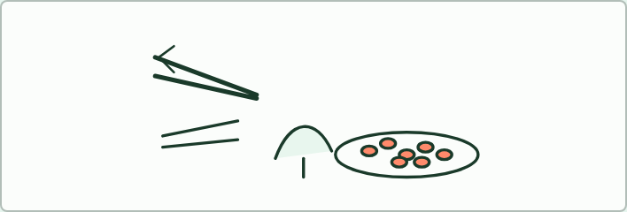
PRACTICAL
15 MIN
Chopsticks
THE TASK
Students are birds with a utensil for a beak: chopsticks, tweezers, a spoon, a clothes peg. A dish of small slippery food is the island. Each bird has 20 seconds to move as much food as it can into a cup. Birds that move less than a set number do not breed; the rest each "have chicks" that use the same utensil. Run three rounds with the new generation and tally the utensils. Which beak is commoner each round, and why? Then name each letter of ICE AGE in the activity.
STUDENTS NEED
Five kinds of utensil, enough for every student to have one; a dish of dried beans or rice; cups; a timer; a tally table on the board.
Minutes 13 to 28
Notes:
Minutes 13 to 28 of 60: Chopsticks (15 min).
The plan: The practical below: students are birds with a utensil for a beak, and the food is something small and slippery. Three rounds, with the successful utensils becoming commoner each round. Then tie it to ICE AGE on the board.
The activity: Chopsticks. Students are birds with a utensil for a beak: chopsticks, tweezers, a spoon, a clothes peg. A dish of small slippery food is the island. Each bird has 20 seconds to move as much food as it can into a cup. Birds that move less than a set number do not breed; the rest each "have chicks" that use the same utensil. Run three rounds with the new generation and tally the utensils. Which beak is commoner each round, and why? Then name each letter of ICE AGE in the activity.
Needs: five kinds of utensil, enough for every student to have one; a dish of dried beans or rice; cups; a timer; a tally table on the board.
The time: 15 minutes, minutes 13 to 28 of the plan.

Slide 22
STEP 4
10 MIN
Run a population
The ICE AGE game, in pairs, rounds on the letters and on the heritable case.
Minutes 28 to 38
Notes:
Minutes 28 to 38 of 60: Run a population (10 min).
The plan: The ICE AGE game, in pairs, rounds on the letters and on the heritable case. Take notes on any round where pairs disagree and discuss it in the plenary. The peppered moth game is the alternative for classes that know the story.

Slide 23
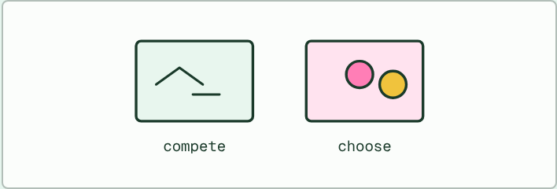
CARD SORT
15 MIN
Compete or choose?
THE TASK
Eight cards for pairs: stags clashing antlers, a peahen picking between displaying males, frogs calling, males defending a territory, females comparing song, males wrestling over a nest, birds of paradise dancing for visiting females, and males displaying at one another. Sort into intrasexual (members of one sex compete) and intersexual (one sex chooses), and add a cost for each.
STUDENTS NEED
Printed cards, one set per pair.
Minutes 38 to 53
Notes:
Minutes 38 to 53 of 60: Compete or choose? (15 min).
The plan: Chapter 5's figure and predict box, then the card sort below: intrasexual (compete) or intersexual (choose). Press on the costs: what is the price of a long tail, and when is it worth paying? Birds of paradise are the example to name in an answer.
The activity: Compete or choose?. Eight cards for pairs: stags clashing antlers, a peahen picking between displaying males, frogs calling, males defending a territory, females comparing song, males wrestling over a nest, birds of paradise dancing for visiting females, and males displaying at one another. Sort into intrasexual (members of one sex compete) and intersexual (one sex chooses), and add a cost for each.
Needs: printed cards, one set per pair.
The time: 15 minutes, minutes 38 to 53 of the plan.

Slide 24
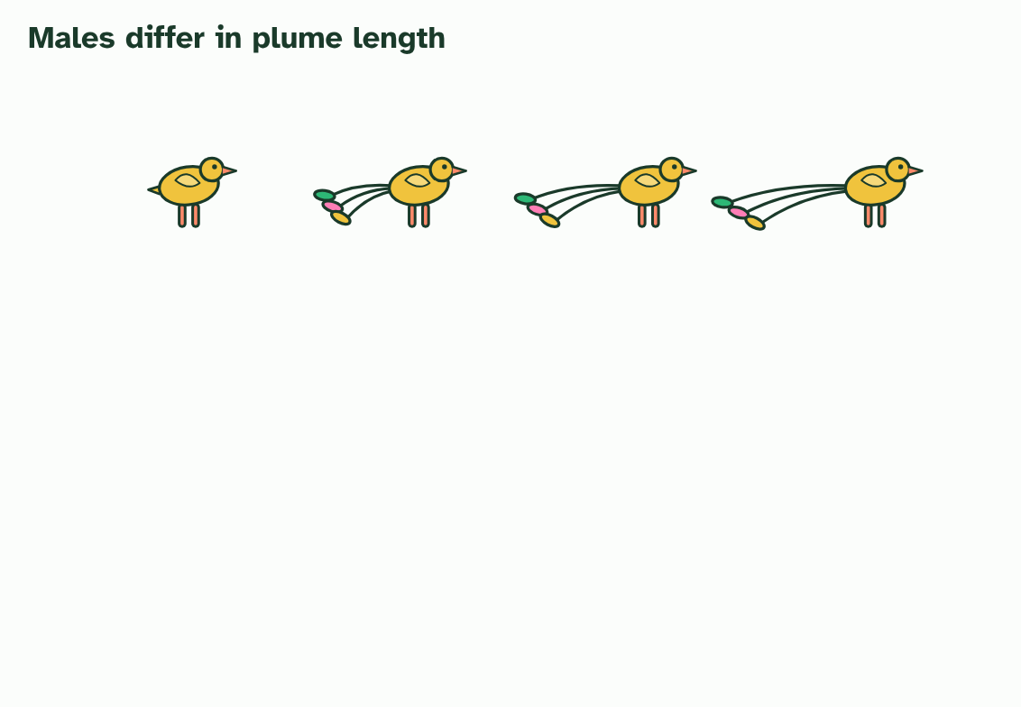
CHAPTER 5 · D4.1.7 Sexual selection
1 / 4
Choosing a mate
Four males of one species, with plumes of different lengths.
Minutes 38 to 53
Notes:
Minutes 38 to 53 of 60: Compete or choose? (15 min).
The plan: Chapter 5's figure and predict box, then the card sort below: intrasexual (compete) or intersexual (choose). Press on the costs: what is the price of a long tail, and when is it worth paying? Birds of paradise are the example to name in an answer.
Surviving is not enough: an animal has to find a mate. In many animals that is a contest of its own, and the traits that win it can be different from the ones that help you survive. Sexual selection is selection for success in getting mates.
It comes in two forms. In intrasexual selection members of one sex, usually males, compete with each other for access to mates: stags fight, and males display at one another. In intersexual selection one sex, usually females, chooses among the other.
A trait that wins mates is often a sign of overall fitness. A glossy coat, bright colour, loud call or large antler is hard to grow and keep up without good health and a good diet. A chooser that prefers it is, in effect, choosing a mate in good condition, and her offspring inherit the alleles that built the display and the allele for choosing it.
The male birds of paradise show it best. In many species the males have spectacular plumage, and perform elaborate displays and dances to the females that come to watch and pick. Each generation, the males with the finest displays leave the most young, and the plumage gets more extreme.
But the display has costs. Long feathers hinder flight, bright colour is easier for predators to see, and displaying takes energy and time that could go into feeding. A trait of this kind spreads only while the extra young it brings outweigh the extra risk. Natural selection and sexual selection can pull in opposite directions, and the next chapter is a real experiment on that tug of war.
Example: Frogs. In many species the males call to attract females, and females tend to be drawn to louder calls. Calling costs energy, and it also tells predators where the caller is.

Slide 25
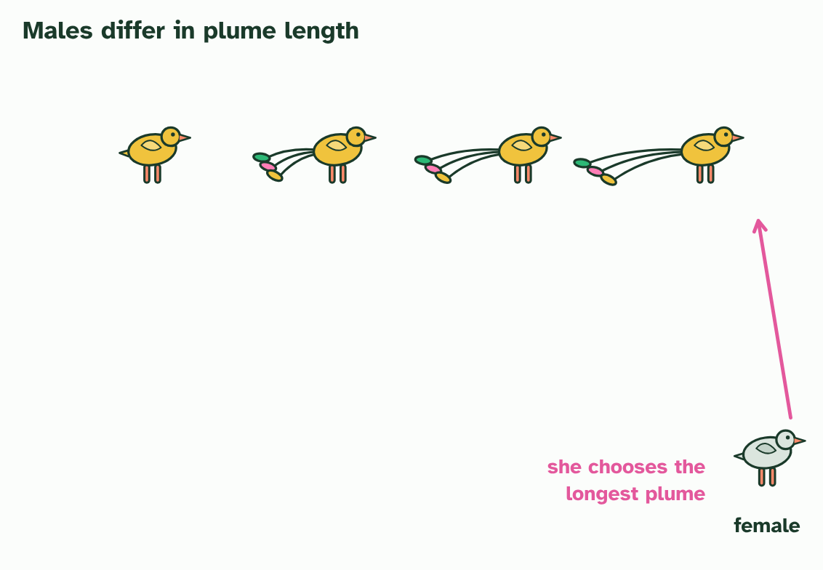
CHAPTER 5 · D4.1.7 Sexual selection
2 / 4
Choosing a mate
A female looks them over, and chooses the longest plume.
Minutes 38 to 53
Notes:
Minutes 38 to 53 of 60: Compete or choose? (15 min).
The plan: Chapter 5's figure and predict box, then the card sort below: intrasexual (compete) or intersexual (choose). Press on the costs: what is the price of a long tail, and when is it worth paying? Birds of paradise are the example to name in an answer.
Surviving is not enough: an animal has to find a mate. In many animals that is a contest of its own, and the traits that win it can be different from the ones that help you survive. Sexual selection is selection for success in getting mates.
It comes in two forms. In intrasexual selection members of one sex, usually males, compete with each other for access to mates: stags fight, and males display at one another. In intersexual selection one sex, usually females, chooses among the other.
A trait that wins mates is often a sign of overall fitness. A glossy coat, bright colour, loud call or large antler is hard to grow and keep up without good health and a good diet. A chooser that prefers it is, in effect, choosing a mate in good condition, and her offspring inherit the alleles that built the display and the allele for choosing it.
The male birds of paradise show it best. In many species the males have spectacular plumage, and perform elaborate displays and dances to the females that come to watch and pick. Each generation, the males with the finest displays leave the most young, and the plumage gets more extreme.
But the display has costs. Long feathers hinder flight, bright colour is easier for predators to see, and displaying takes energy and time that could go into feeding. A trait of this kind spreads only while the extra young it brings outweigh the extra risk. Natural selection and sexual selection can pull in opposite directions, and the next chapter is a real experiment on that tug of war.
Example: Frogs. In many species the males call to attract females, and females tend to be drawn to louder calls. Calling costs energy, and it also tells predators where the caller is.

Slide 26
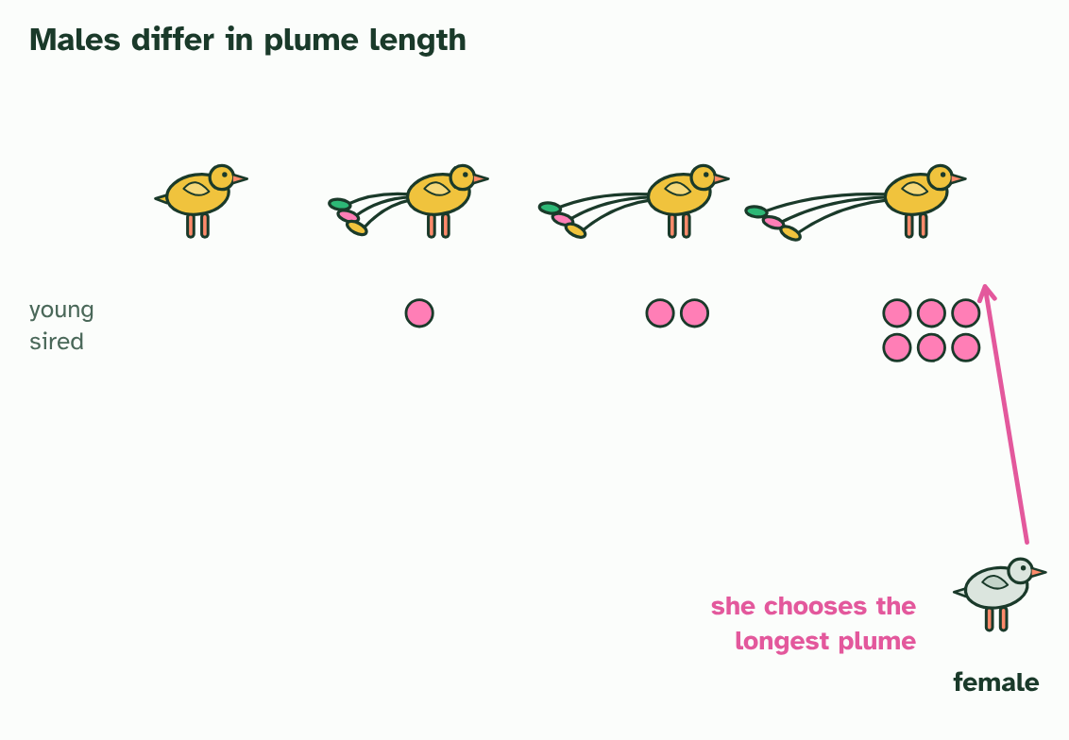
CHAPTER 5 · D4.1.7 Sexual selection
3 / 4
Choosing a mate
The male she chooses sires the most young, and they inherit his alleles for a long plume.
Minutes 38 to 53
Notes:
Minutes 38 to 53 of 60: Compete or choose? (15 min).
The plan: Chapter 5's figure and predict box, then the card sort below: intrasexual (compete) or intersexual (choose). Press on the costs: what is the price of a long tail, and when is it worth paying? Birds of paradise are the example to name in an answer.
Surviving is not enough: an animal has to find a mate. In many animals that is a contest of its own, and the traits that win it can be different from the ones that help you survive. Sexual selection is selection for success in getting mates.
It comes in two forms. In intrasexual selection members of one sex, usually males, compete with each other for access to mates: stags fight, and males display at one another. In intersexual selection one sex, usually females, chooses among the other.
A trait that wins mates is often a sign of overall fitness. A glossy coat, bright colour, loud call or large antler is hard to grow and keep up without good health and a good diet. A chooser that prefers it is, in effect, choosing a mate in good condition, and her offspring inherit the alleles that built the display and the allele for choosing it.
The male birds of paradise show it best. In many species the males have spectacular plumage, and perform elaborate displays and dances to the females that come to watch and pick. Each generation, the males with the finest displays leave the most young, and the plumage gets more extreme.
But the display has costs. Long feathers hinder flight, bright colour is easier for predators to see, and displaying takes energy and time that could go into feeding. A trait of this kind spreads only while the extra young it brings outweigh the extra risk. Natural selection and sexual selection can pull in opposite directions, and the next chapter is a real experiment on that tug of war.
Example: Frogs. In many species the males call to attract females, and females tend to be drawn to louder calls. Calling costs energy, and it also tells predators where the caller is.

Slide 27
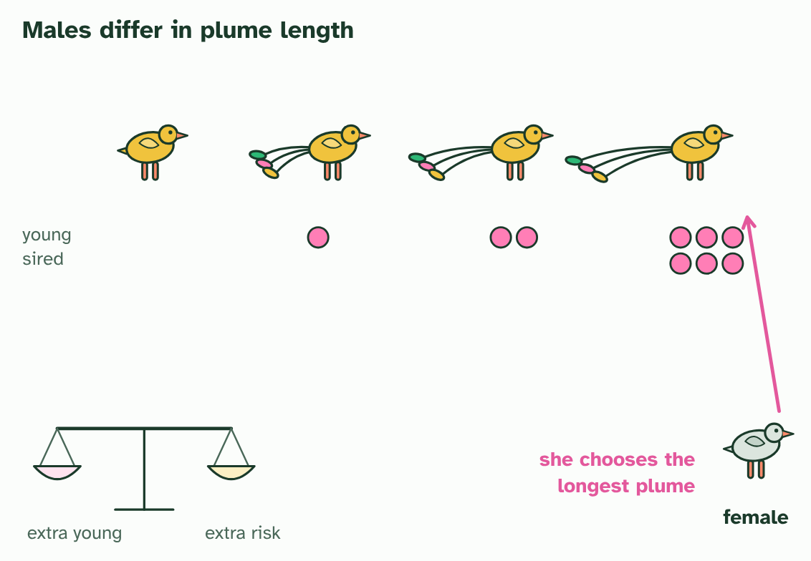
CHAPTER 5 · D4.1.7 Sexual selection
4 / 4
Choosing a mate
But a long plume has a cost: it spreads only while the extra young outweigh the extra risk.
Minutes 38 to 53
Notes:
Minutes 38 to 53 of 60: Compete or choose? (15 min).
The plan: Chapter 5's figure and predict box, then the card sort below: intrasexual (compete) or intersexual (choose). Press on the costs: what is the price of a long tail, and when is it worth paying? Birds of paradise are the example to name in an answer.
Surviving is not enough: an animal has to find a mate. In many animals that is a contest of its own, and the traits that win it can be different from the ones that help you survive. Sexual selection is selection for success in getting mates.
It comes in two forms. In intrasexual selection members of one sex, usually males, compete with each other for access to mates: stags fight, and males display at one another. In intersexual selection one sex, usually females, chooses among the other.
A trait that wins mates is often a sign of overall fitness. A glossy coat, bright colour, loud call or large antler is hard to grow and keep up without good health and a good diet. A chooser that prefers it is, in effect, choosing a mate in good condition, and her offspring inherit the alleles that built the display and the allele for choosing it.
The male birds of paradise show it best. In many species the males have spectacular plumage, and perform elaborate displays and dances to the females that come to watch and pick. Each generation, the males with the finest displays leave the most young, and the plumage gets more extreme.
But the display has costs. Long feathers hinder flight, bright colour is easier for predators to see, and displaying takes energy and time that could go into feeding. A trait of this kind spreads only while the extra young it brings outweigh the extra risk. Natural selection and sexual selection can pull in opposite directions, and the next chapter is a real experiment on that tug of war.
Example: Frogs. In many species the males call to attract females, and females tend to be drawn to louder calls. Calling costs energy, and it also tells predators where the caller is.

Slide 28
CHAPTER 5 · D4.1.7 Sexual selection
Choosing a mate
Sexual selection is selection for success in getting mates.
In intrasexual selection members of one sex, usually males, compete with each other for access to mates: stags fight, and males display at one another.
In intersexual selection one sex, usually females, chooses among the other.
Natural selection and sexual selection can pull in opposite directions, and the next chapter is a real experiment on that tug of war.
Minutes 38 to 53
Notes:
Minutes 38 to 53 of 60: Compete or choose? (15 min).
The plan: Chapter 5's figure and predict box, then the card sort below: intrasexual (compete) or intersexual (choose). Press on the costs: what is the price of a long tail, and when is it worth paying? Birds of paradise are the example to name in an answer.
Surviving is not enough: an animal has to find a mate. In many animals that is a contest of its own, and the traits that win it can be different from the ones that help you survive. Sexual selection is selection for success in getting mates.
It comes in two forms. In intrasexual selection members of one sex, usually males, compete with each other for access to mates: stags fight, and males display at one another. In intersexual selection one sex, usually females, chooses among the other.
A trait that wins mates is often a sign of overall fitness. A glossy coat, bright colour, loud call or large antler is hard to grow and keep up without good health and a good diet. A chooser that prefers it is, in effect, choosing a mate in good condition, and her offspring inherit the alleles that built the display and the allele for choosing it.
The male birds of paradise show it best. In many species the males have spectacular plumage, and perform elaborate displays and dances to the females that come to watch and pick. Each generation, the males with the finest displays leave the most young, and the plumage gets more extreme.
But the display has costs. Long feathers hinder flight, bright colour is easier for predators to see, and displaying takes energy and time that could go into feeding. A trait of this kind spreads only while the extra young it brings outweigh the extra risk. Natural selection and sexual selection can pull in opposite directions, and the next chapter is a real experiment on that tug of war.
Example: Frogs. In many species the males call to attract females, and females tend to be drawn to louder calls. Calling costs energy, and it also tells predators where the caller is.

Slide 29
PREDICT
A male's bright tail makes him easier for predators to catch. How can the trait still spread through the population?
A It cannot, because any trait that lowers survival is always removed
B Only if the extra matings it brings outweigh the extra risk of being caught
C It will, because bright males live longer when predators learn to avoid them
Minutes 38 to 53
Notes:
Minutes 38 to 53 of 60: Compete or choose? (15 min).
The plan: Chapter 5's figure and predict box, then the card sort below: intrasexual (compete) or intersexual (choose). Press on the costs: what is the price of a long tail, and when is it worth paying? Birds of paradise are the example to name in an answer.
Ask for a show of hands, or mini whiteboards, before revealing. (Answer: B, on the next slide.)

Slide 30
WHAT HAPPENS
A male's bright tail makes him easier for predators to catch. How can the trait still spread through the population?
A It cannot, because any trait that lowers survival is always removed
B Only if the extra matings it brings outweigh the extra risk of being caught
C It will, because bright males live longer when predators learn to avoid them
It can spread only if the extra matings it brings outweigh the extra risk. A trait that costs survival can still raise fitness if the males that carry it leave more offspring. Where the risk wins, the trait is selected against, which is what the next chapter shows.
Minutes 38 to 53
Notes:
Minutes 38 to 53 of 60: Compete or choose? (15 min).
The plan: Chapter 5's figure and predict box, then the card sort below: intrasexual (compete) or intersexual (choose). Press on the costs: what is the price of a long tail, and when is it worth paying? Birds of paradise are the example to name in an answer.
Answer: B. It can spread only if the extra matings it brings outweigh the extra risk. A trait that costs survival can still raise fitness if the males that carry it leave more offspring. Where the risk wins, the trait is selected against, which is what the next chapter shows.

Slide 31
WATCH OUT
Sexual selection is not "survival of the fittest" in the sense of the strongest staying alive. A male that is eaten the day after mating has still passed on his alleles, and one that lives for years but never mates has not.
Minutes 38 to 53
Notes:
Minutes 38 to 53 of 60: Compete or choose? (15 min).
The plan: Chapter 5's figure and predict box, then the card sort below: intrasexual (compete) or intersexual (choose). Press on the costs: what is the price of a long tail, and when is it worth paying? Birds of paradise are the example to name in an answer.
A common mistake: say it, then ask who can say why it is wrong.

Slide 32
PLENARY
Can you now...
Use fitness, adaptation, survival and reproduction to explain why some individuals leave more offspring than others (D4.1.5)
Explain why only heritable traits can be selected, and why traits acquired in a lifetime cannot (D4.1.6)
Explain how competing for mates and being chosen drive the evolution of traits such as the plumage of birds of paradise (D4.1.7)
Minutes 53 to 60
Notes:
Minutes 53 to 60 of 60: Exit (7 min).
The plan: Two sentences: one that explains why the male with the largest antlers may not be the one with the highest fitness, and one that uses the word "heritable".
Thumbs up, sideways or down on each goal before the exit question. The goals come from the statements this lesson covers.

Slide 33
EXIT QUESTION
Before you go
Two sentences.
Minutes 53 to 60
Notes:
Minutes 53 to 60 of 60: Exit (7 min).
The plan: Two sentences: one that explains why the male with the largest antlers may not be the one with the highest fitness, and one that uses the word "heritable".

Slide 34
PRACTISE AND REVISE
Keep going
Exam practice: a fresh paper of exam questions on D4.1 at standard level, marked as you go
The guide, with the animations and the dry lab
This lesson in the guide: 4 Who survives, who breeds, 5 Choosing a mate
BUILD FOR YOUR CLASS
ALREADY ON THE SITE FOR D4.1
CARD SETS ON SPLYCR
Tarsia puzzle, dominoes and picture reveal on D4.1, built from its key terms and ready to print
A pub quiz with rounds on D4.1, to present or run with no projector
An escape room built from the question bank on D4.1
Lesson: Hardy–Weinberg & Chi-Squared
Quiz: Natural Selection
Revision map: D4.1 Natural selection, to fill in
Exam questions: D4.1 in the exam maker, a paper with its markscheme
Open a set to host it as a class game, or make a copy to edit.
D4.1 Natural Selection
How this was made. The course structure, the activities and the teaching choices come from my own classroom, my presentations and my years of teaching IB and AP Biology. I use Claude, an AI, to help write and build the interactive guides, lesson plans, slides and practice questions, and to draw the diagrams and code the interactives. I direct the work and review it against the IB and AP specifications before it goes live.
Minute 60: after the lesson
Notes:
Every link here is live. Set the exam practice paper for homework: it is fresh each time, marked as students go and saved to their Exam practice when they are signed in.
Exam practice: https://www.biologybybradford.com/exam-maker/sit?topics=D4.1&level=SL&paper=quiz&marks=15&src=ep
The guide: https://www.biologybybradford.com/guides/ib-biology-d4-1-natural-selection

