Slide 1
IB Biology D4.1
LESSON 3 OF 6
BY THE END YOU CAN
Natural selection
Interpret data from Endler's guppy experiments, and explain how controlling the predator separates sexual from natural selection (D4.1.8)
Endler's guppies
D4.1.8
Interpreting data from a controlled experiment on sexual and natural selection, and planning one of your own
60 minutes · chapter 6 · the dry lab
Minute 0
Notes:
IB Biology D4.1, Natural selection. Lesson 3 of 6: Endler's guppies, 60 minutes.
The plan, minute by minute (each slide's footer says where you are):
0 to 6 min (6) Do now: predict the ponds
6 to 18 min (12) The experiment
18 to 28 min (10) Reading the data
28 to 53 min (25) The dry lab
53 to 60 min (7) Plenary: what does it model?
What students get wrong:
Individual guppies lose their spots. The change is in the population across generations.
Stretch and support:
Support: give the captions of each figure as a cut-up storyboard to put in order, and use the key terms (tap the dotted words) as a glossary.
Support: give a writing frame for the plenary: "The experiment modelled... It left out...".
Stretch: what extra control pond or measurement would show whether spots are heritable, and not just something the ponds caused?
The lesson plan to print: https://www.biologybybradford.com/guides/downloads/ib-biology-d4-1-natural-selection-lesson-3-plan.pdf

Slide 2
DO NOW
Predict the ponds
On a mini whiteboard, sketch a graph of the males' mean spots against generations for three ponds: no predator, a weak predator and a dangerous one.
6:00
minutes
Start now: the timer is running.
Minutes 0 to 6
Notes:
Minutes 0 to 6 of 60: Do now: predict the ponds (6 min).
The plan: On a mini whiteboard, sketch a graph of the males' mean spots against generations for three ponds: no predator, a weak predator and a dangerous one. No numbers. Hold them up. Keep them for the end of the lesson.
Start a 6 minute timer as they come in.

Slide 3
STEP 2
12 MIN
The experiment
Students name the independent variable (the predator), the dependent variable (spots on the males), and what is kept the same, before step 3 shows it.
Ask: why is the pond with no predator needed, and why start with the same fish in each?
Minutes 6 to 18
Notes:
Minutes 6 to 18 of 60: The experiment (12 min).
The plan: Chapter 6's figure. Students name the independent variable (the predator), the dependent variable (spots on the males), and what is kept the same, before step 3 shows it. Ask: why is the pond with no predator needed, and why start with the same fish in each?

Slide 4
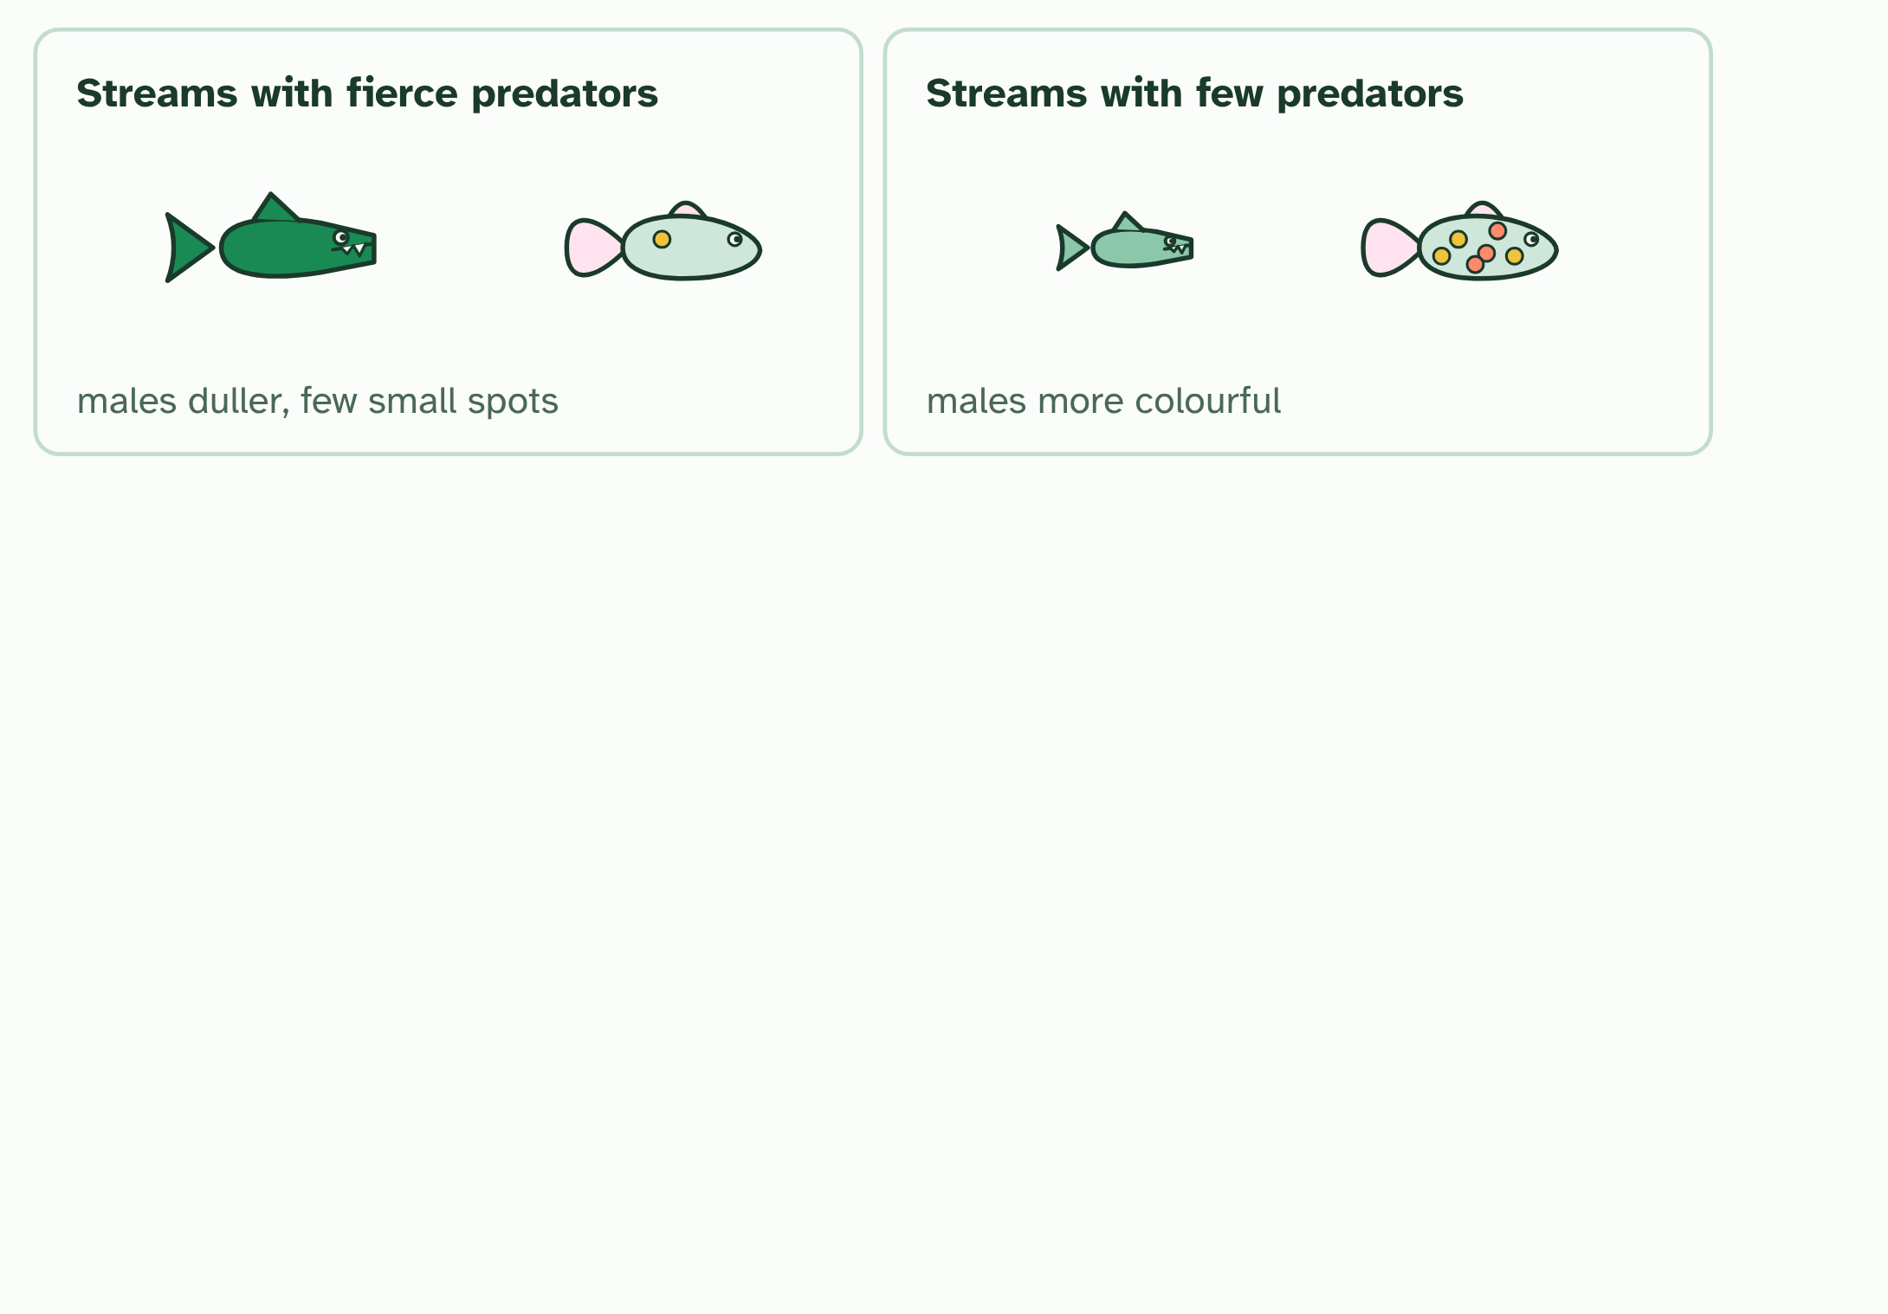
CHAPTER 6 · D4.1.8 Modelling selection: Endler's guppies
1 / 4
Two pressures, tested
In the wild, males in streams with fierce predators are duller than males in streams with few.
Minutes 6 to 18
Notes:
Minutes 6 to 18 of 60: The experiment (12 min).
The plan: Chapter 6's figure. Students name the independent variable (the predator), the dependent variable (spots on the males), and what is kept the same, before step 3 shows it. Ask: why is the pond with no predator needed, and why start with the same fish in each?
Wild guppies (Poecilia reticulata) live in streams in Trinidad. The males carry spots of orange, black and shimmering colours, and the females are plain. Females tend to prefer the more colourful males, which is sexual selection pushing towards brighter males. But a bright male is also easier for a predator to see, which is natural selection pushing towards duller males.
The balance depends on the predators. Streams with dangerous predators have duller males, and streams with few predators have more colourful ones. That is a pattern, not a proof: streams differ in many other ways too.
John Endler tested it as a scientist should, by controlling everything except the thing he suspected. He set up ponds with the same starting guppies, the same food and the same conditions, and changed one thing, the predator: none, a weak predator, or a dangerous one. Then he followed the males' spots over many generations. The experiment models the streams: it is simpler than nature, so one pressure can be isolated and measured.
His result, in the direction that matters: where the predator was dangerous, the males came to have fewer and duller spots. Where there was no predator, or only a weak one, they ended up more colourful than they started. Predation is a strong selection pressure, strong enough to reverse what sexual selection builds.
The dry lab at the end of this guide lets you run the ponds yourself, then change the predator, the strength of mate choice and the number of generations.
Example: Reading data like this Ask four questions of any graph of mean spots per male against generations. Where does each pond start (the same place, if the start was controlled)? Which way does each line move? Do the lines separate as the generations pass? And which pond is the control, the baseline the others are compared with? Differences between ponds, not changes inside one, are what show selection.

Slide 5
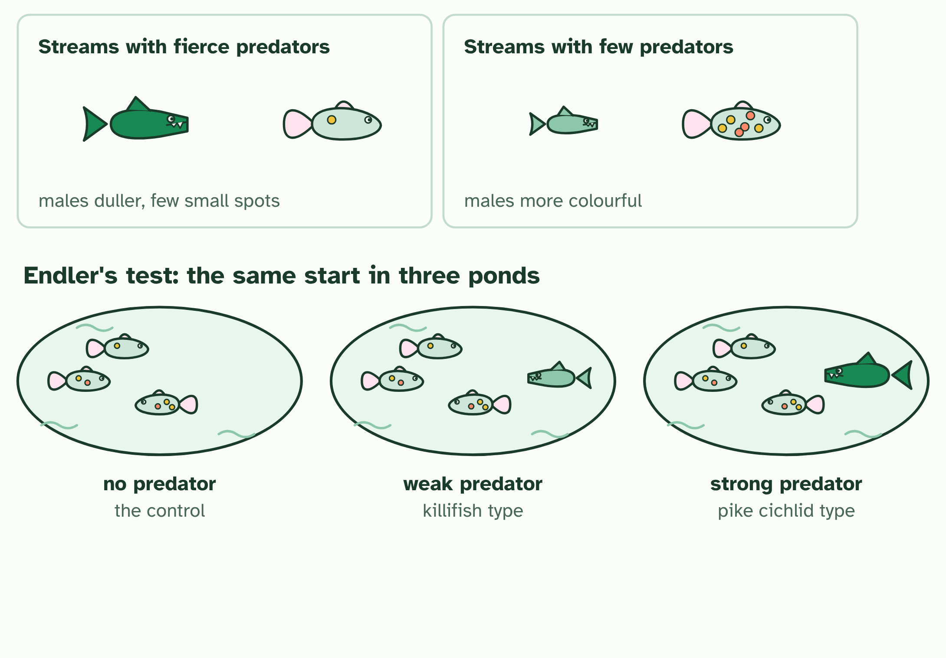
CHAPTER 6 · D4.1.8 Modelling selection: Endler's guppies
2 / 4
Two pressures, tested
Endler set up three ponds with the same starting guppies: no predator, a weak predator and a dangerous one.
Minutes 6 to 18
Notes:
Minutes 6 to 18 of 60: The experiment (12 min).
The plan: Chapter 6's figure. Students name the independent variable (the predator), the dependent variable (spots on the males), and what is kept the same, before step 3 shows it. Ask: why is the pond with no predator needed, and why start with the same fish in each?
Wild guppies (Poecilia reticulata) live in streams in Trinidad. The males carry spots of orange, black and shimmering colours, and the females are plain. Females tend to prefer the more colourful males, which is sexual selection pushing towards brighter males. But a bright male is also easier for a predator to see, which is natural selection pushing towards duller males.
The balance depends on the predators. Streams with dangerous predators have duller males, and streams with few predators have more colourful ones. That is a pattern, not a proof: streams differ in many other ways too.
John Endler tested it as a scientist should, by controlling everything except the thing he suspected. He set up ponds with the same starting guppies, the same food and the same conditions, and changed one thing, the predator: none, a weak predator, or a dangerous one. Then he followed the males' spots over many generations. The experiment models the streams: it is simpler than nature, so one pressure can be isolated and measured.
His result, in the direction that matters: where the predator was dangerous, the males came to have fewer and duller spots. Where there was no predator, or only a weak one, they ended up more colourful than they started. Predation is a strong selection pressure, strong enough to reverse what sexual selection builds.
The dry lab at the end of this guide lets you run the ponds yourself, then change the predator, the strength of mate choice and the number of generations.
Example: Reading data like this Ask four questions of any graph of mean spots per male against generations. Where does each pond start (the same place, if the start was controlled)? Which way does each line move? Do the lines separate as the generations pass? And which pond is the control, the baseline the others are compared with? Differences between ponds, not changes inside one, are what show selection.

Slide 6
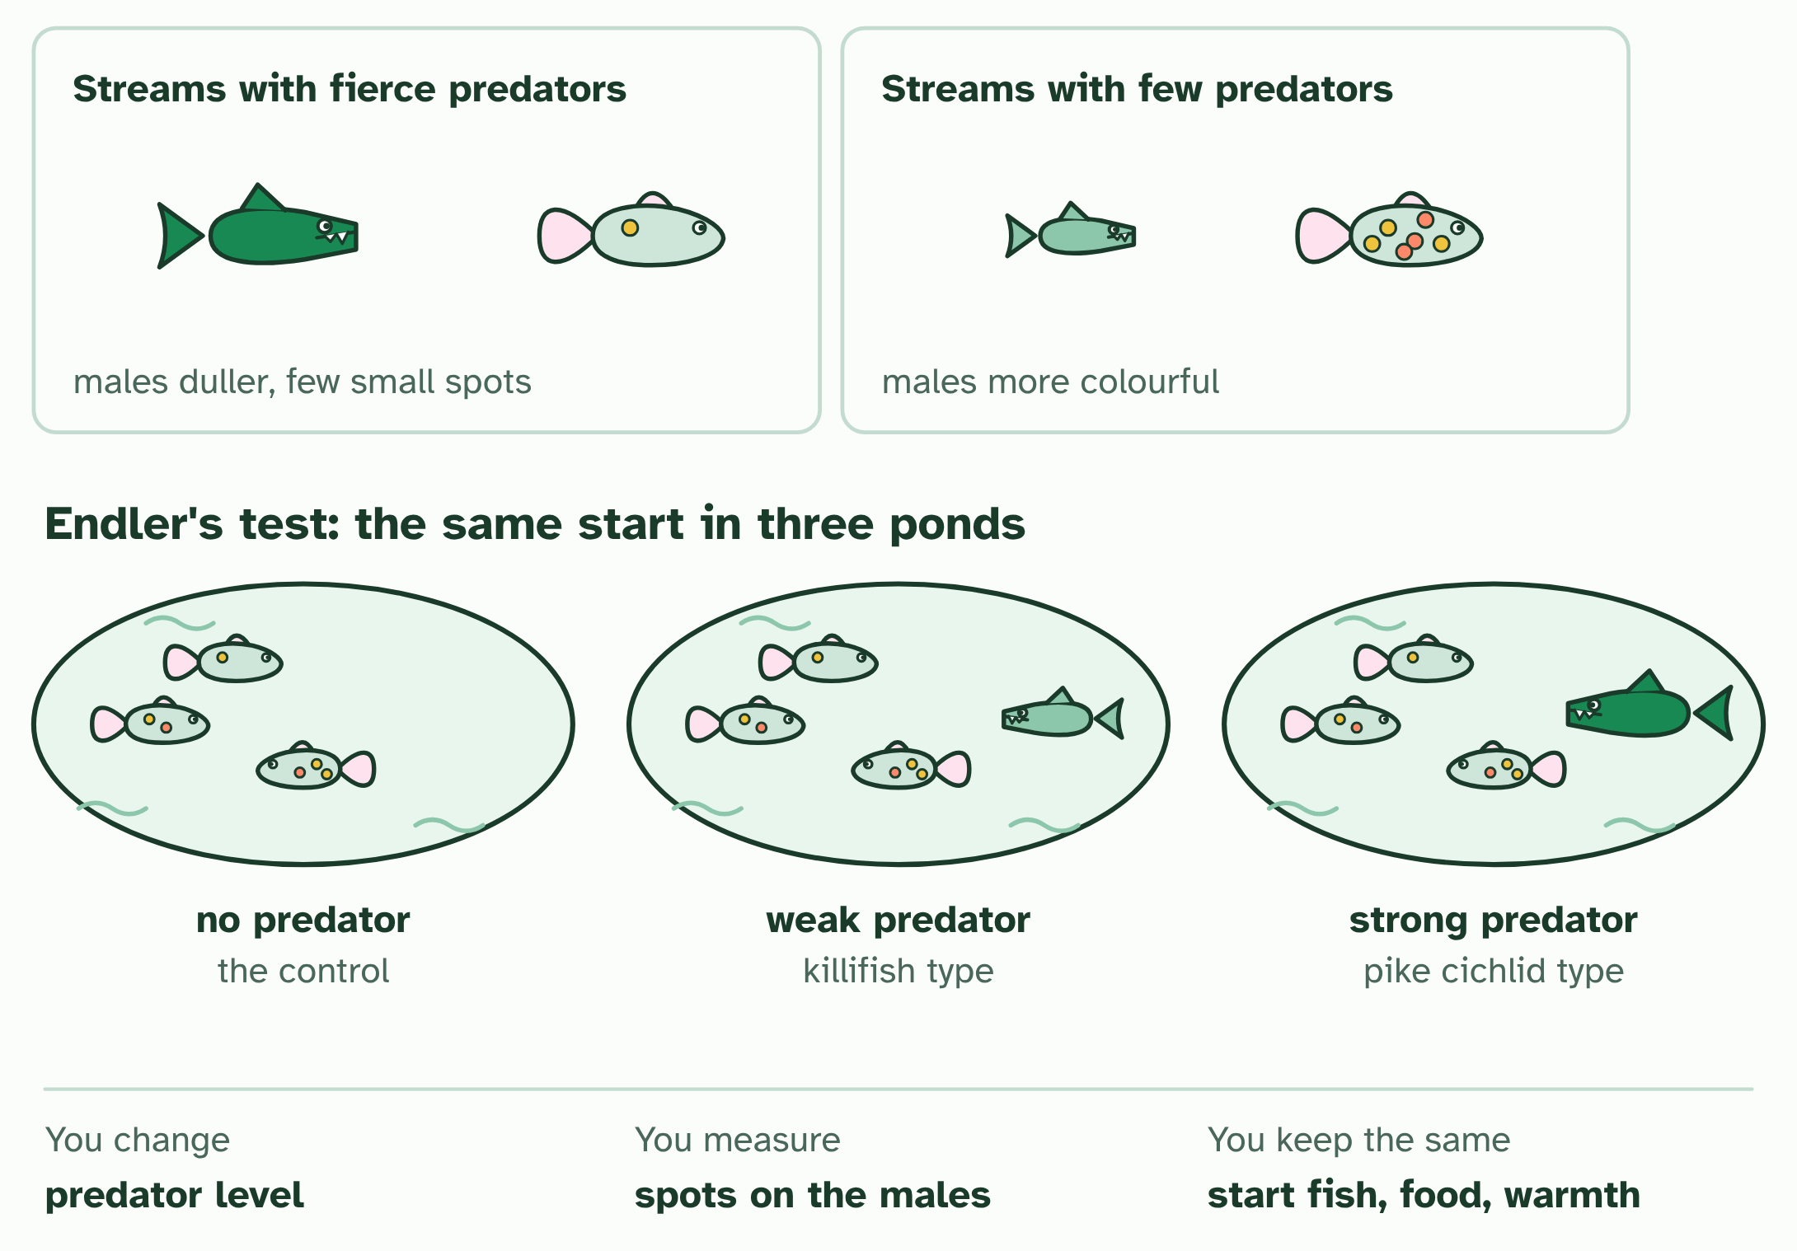
CHAPTER 6 · D4.1.8 Modelling selection: Endler's guppies
3 / 4
Two pressures, tested
He changed one thing, the predator, measured the males' spots, and kept everything else the same.
Minutes 6 to 18
Notes:
Minutes 6 to 18 of 60: The experiment (12 min).
The plan: Chapter 6's figure. Students name the independent variable (the predator), the dependent variable (spots on the males), and what is kept the same, before step 3 shows it. Ask: why is the pond with no predator needed, and why start with the same fish in each?
Wild guppies (Poecilia reticulata) live in streams in Trinidad. The males carry spots of orange, black and shimmering colours, and the females are plain. Females tend to prefer the more colourful males, which is sexual selection pushing towards brighter males. But a bright male is also easier for a predator to see, which is natural selection pushing towards duller males.
The balance depends on the predators. Streams with dangerous predators have duller males, and streams with few predators have more colourful ones. That is a pattern, not a proof: streams differ in many other ways too.
John Endler tested it as a scientist should, by controlling everything except the thing he suspected. He set up ponds with the same starting guppies, the same food and the same conditions, and changed one thing, the predator: none, a weak predator, or a dangerous one. Then he followed the males' spots over many generations. The experiment models the streams: it is simpler than nature, so one pressure can be isolated and measured.
His result, in the direction that matters: where the predator was dangerous, the males came to have fewer and duller spots. Where there was no predator, or only a weak one, they ended up more colourful than they started. Predation is a strong selection pressure, strong enough to reverse what sexual selection builds.
The dry lab at the end of this guide lets you run the ponds yourself, then change the predator, the strength of mate choice and the number of generations.
Example: Reading data like this Ask four questions of any graph of mean spots per male against generations. Where does each pond start (the same place, if the start was controlled)? Which way does each line move? Do the lines separate as the generations pass? And which pond is the control, the baseline the others are compared with? Differences between ponds, not changes inside one, are what show selection.

Slide 7
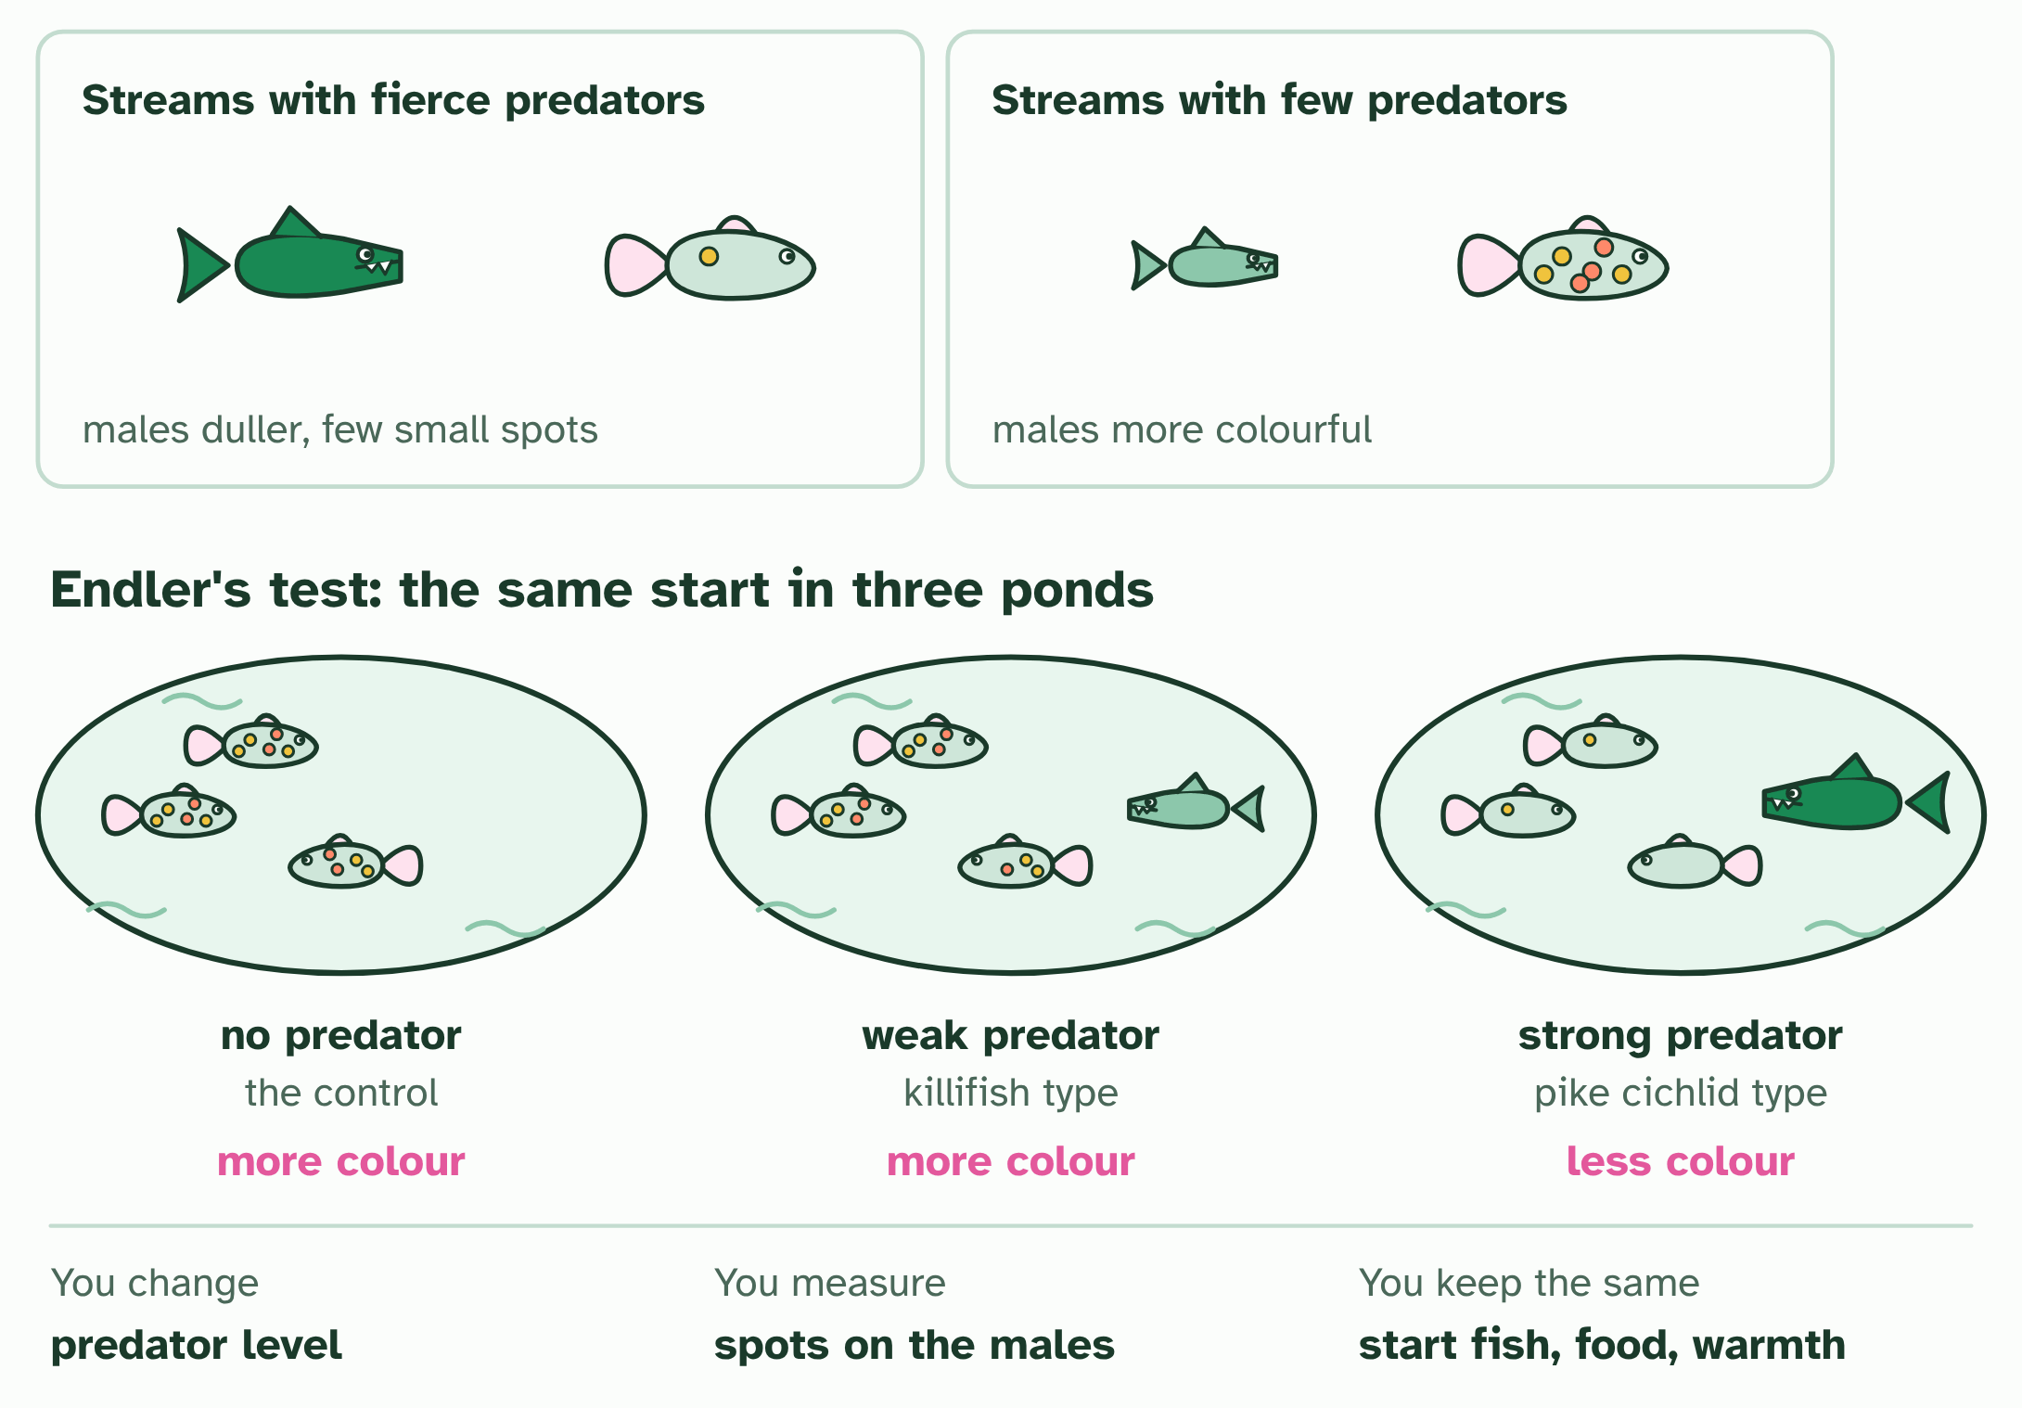
CHAPTER 6 · D4.1.8 Modelling selection: Endler's guppies
4 / 4
Two pressures, tested
After the generations: more colour with no or a weak predator, less colour with the dangerous one.
Minutes 6 to 18
Notes:
Minutes 6 to 18 of 60: The experiment (12 min).
The plan: Chapter 6's figure. Students name the independent variable (the predator), the dependent variable (spots on the males), and what is kept the same, before step 3 shows it. Ask: why is the pond with no predator needed, and why start with the same fish in each?
Wild guppies (Poecilia reticulata) live in streams in Trinidad. The males carry spots of orange, black and shimmering colours, and the females are plain. Females tend to prefer the more colourful males, which is sexual selection pushing towards brighter males. But a bright male is also easier for a predator to see, which is natural selection pushing towards duller males.
The balance depends on the predators. Streams with dangerous predators have duller males, and streams with few predators have more colourful ones. That is a pattern, not a proof: streams differ in many other ways too.
John Endler tested it as a scientist should, by controlling everything except the thing he suspected. He set up ponds with the same starting guppies, the same food and the same conditions, and changed one thing, the predator: none, a weak predator, or a dangerous one. Then he followed the males' spots over many generations. The experiment models the streams: it is simpler than nature, so one pressure can be isolated and measured.
His result, in the direction that matters: where the predator was dangerous, the males came to have fewer and duller spots. Where there was no predator, or only a weak one, they ended up more colourful than they started. Predation is a strong selection pressure, strong enough to reverse what sexual selection builds.
The dry lab at the end of this guide lets you run the ponds yourself, then change the predator, the strength of mate choice and the number of generations.
Example: Reading data like this Ask four questions of any graph of mean spots per male against generations. Where does each pond start (the same place, if the start was controlled)? Which way does each line move? Do the lines separate as the generations pass? And which pond is the control, the baseline the others are compared with? Differences between ponds, not changes inside one, are what show selection.

Slide 8
CHAPTER 6 · D4.1.8 Modelling selection: Endler's guppies
Two pressures, tested
Wild guppies (Poecilia reticulata) live in streams in Trinidad.
The balance depends on the predators.
John Endler tested it as a scientist should, by controlling everything except the thing he suspected.
Minutes 6 to 18
Notes:
Minutes 6 to 18 of 60: The experiment (12 min).
The plan: Chapter 6's figure. Students name the independent variable (the predator), the dependent variable (spots on the males), and what is kept the same, before step 3 shows it. Ask: why is the pond with no predator needed, and why start with the same fish in each?
Wild guppies (Poecilia reticulata) live in streams in Trinidad. The males carry spots of orange, black and shimmering colours, and the females are plain. Females tend to prefer the more colourful males, which is sexual selection pushing towards brighter males. But a bright male is also easier for a predator to see, which is natural selection pushing towards duller males.
The balance depends on the predators. Streams with dangerous predators have duller males, and streams with few predators have more colourful ones. That is a pattern, not a proof: streams differ in many other ways too.
John Endler tested it as a scientist should, by controlling everything except the thing he suspected. He set up ponds with the same starting guppies, the same food and the same conditions, and changed one thing, the predator: none, a weak predator, or a dangerous one. Then he followed the males' spots over many generations. The experiment models the streams: it is simpler than nature, so one pressure can be isolated and measured.
His result, in the direction that matters: where the predator was dangerous, the males came to have fewer and duller spots. Where there was no predator, or only a weak one, they ended up more colourful than they started. Predation is a strong selection pressure, strong enough to reverse what sexual selection builds.
The dry lab at the end of this guide lets you run the ponds yourself, then change the predator, the strength of mate choice and the number of generations.
Example: Reading data like this Ask four questions of any graph of mean spots per male against generations. Where does each pond start (the same place, if the start was controlled)? Which way does each line move? Do the lines separate as the generations pass? And which pond is the control, the baseline the others are compared with? Differences between ponds, not changes inside one, are what show selection.

Slide 9
PREDICT
In the pond with the dangerous predator, males end up with fewer spots. What is the best explanation?
A Males that show a lot of colour are caught more often, so duller males leave more offspring
B Each male gradually loses its spots when it is hunted, and keeps them when it is safe
C Females in the dangerous ponds stop preferring bright males, so the males stop growing spots
Minutes 6 to 18
Notes:
Minutes 6 to 18 of 60: The experiment (12 min).
The plan: Chapter 6's figure. Students name the independent variable (the predator), the dependent variable (spots on the males), and what is kept the same, before step 3 shows it. Ask: why is the pond with no predator needed, and why start with the same fish in each?
Ask for a show of hands, or mini whiteboards, before revealing. (Answer: A, on the next slide.)

Slide 10
WHAT HAPPENS
In the pond with the dangerous predator, males end up with fewer spots. What is the best explanation?
A Males that show a lot of colour are caught more often, so duller males leave more offspring
B Each male gradually loses its spots when it is hunted, and keeps them when it is safe
C Females in the dangerous ponds stop preferring bright males, so the males stop growing spots
Colourful males are caught more often, so duller males leave more young and the alleles for fewer spots become commoner. It is natural selection by predation against sexual selection by females. The change shows up between generations, not within one male's life.
Minutes 6 to 18
Notes:
Minutes 6 to 18 of 60: The experiment (12 min).
The plan: Chapter 6's figure. Students name the independent variable (the predator), the dependent variable (spots on the males), and what is kept the same, before step 3 shows it. Ask: why is the pond with no predator needed, and why start with the same fish in each?
Answer: A. Colourful males are caught more often, so duller males leave more young and the alleles for fewer spots become commoner. It is natural selection by predation against sexual selection by females. The change shows up between generations, not within one male's life.

Slide 11
WATCH OUT
A single male does not change colour in response to the predator. The change is in the population, across generations, as males with some alleles leave more young than others. Check which one a result is claiming.
Minutes 6 to 18
Notes:
Minutes 6 to 18 of 60: The experiment (12 min).
The plan: Chapter 6's figure. Students name the independent variable (the predator), the dependent variable (spots on the males), and what is kept the same, before step 3 shows it. Ask: why is the pond with no predator needed, and why start with the same fish in each?
A common mistake: say it, then ask who can say why it is wrong.

Slide 12
STEP 3
10 MIN
Reading the data
The four questions in chapter 6 ("Reading data like this").
Minutes 18 to 28
Notes:
Minutes 18 to 28 of 60: Reading the data (10 min).
The plan: The four questions in chapter 6 ("Reading data like this"): the start, the direction, the separation and the control. Apply them to the class's whiteboards first, then to a real graph from the dry lab.

Slide 13
DRY LAB
10 MIN
Endler's guppy ponds
THE TASK
The dry lab above, with the tasks and questions under it. It works on a phone as well as a laptop, and the results table downloads as a CSV for the class's pooled graph. The IA coach under the bench takes students through variables, repeats and uncertainty.
STUDENTS NEED
One device per pair.
Minutes 18 to 28
Notes:
Minutes 18 to 28 of 60: Reading the data (10 min).
The plan: The four questions in chapter 6 ("Reading data like this"): the start, the direction, the separation and the control. Apply them to the class's whiteboards first, then to a real graph from the dry lab.
The activity: Endler's guppy ponds. The dry lab above, with the tasks and questions under it. It works on a phone as well as a laptop, and the results table downloads as a CSV for the class's pooled graph. The IA coach under the bench takes students through variables, repeats and uncertainty.
Needs: one device per pair.
The time: 10 minutes, minutes 18 to 28 of the plan.

Slide 14
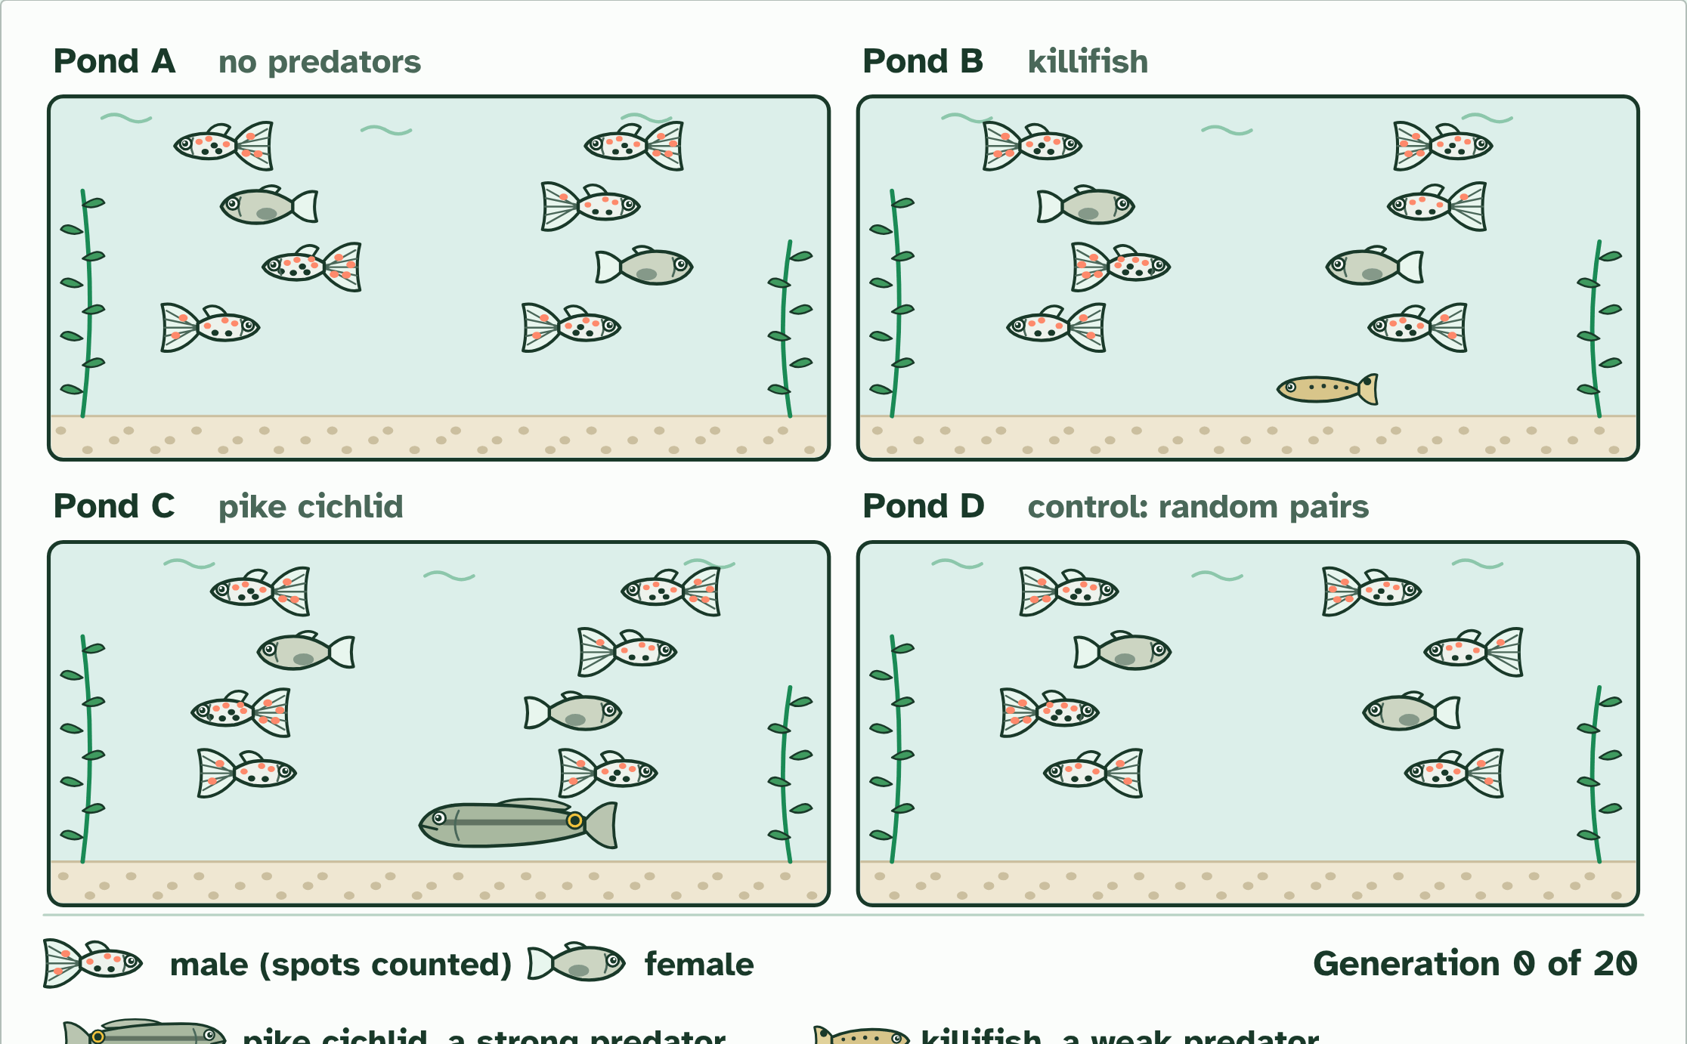
DRY LAB
Endler's guppy ponds
Your question: What decides how colourful male guppies become? Do females choosing the brightest males always win, or does it depend on the predator? Start with one pond and one change, then compare it with a control pond.
What you can change: The predator in each pond (none, weak, strong, or the control, where mating is random and nothing is selected), how strongly the females prefer colourful males (none, weak, strong), the number of generations (10, 20 or 30) and the spots the males start with (6, 9 or 12). Change one thing at a time and keep the rest the same.
What to record: For each run: the settings, the mean number of spots per male each generation, the mean colour area, how many of the plainest and showiest males survived, and how many young each fathered. Repeat each set-up at least three times: the runs scatter, as real populations do. The coach under the bench helps you plan, process and evaluate.
Run it: biologybybradford.com/guides/ib-biology-d4-1-natural-selection#lab
Minutes 18 to 28
Notes:
Minutes 18 to 28 of 60: Reading the data (10 min).
The plan: The four questions in chapter 6 ("Reading data like this"): the start, the direction, the separation and the control. Apply them to the class's whiteboards first, then to a real graph from the dry lab.
The dry lab runs in the guide: https://www.biologybybradford.com/guides/ib-biology-d4-1-natural-selection#lab

Slide 15
STEP 4
25 MIN
The dry lab
Students record every run and bring the class's results together on the board.
Minutes 28 to 53
Notes:
Minutes 28 to 53 of 60: The dry lab (25 min).
The plan: The dry lab, in pairs. Run the no-predator pond (A), the strong predator pond (C) and the control (D) three times each, then change the strength of mate choice. Students record every run and bring the class's results together on the board. Point out the IA coach under the bench: the structure of a good investigation is variables, repeats and uncertainty.

Slide 16
PLENARY
Plenary: what does it model?
What did the experiment model, and what did it leave out?
Minutes 53 to 60
Notes:
Minutes 53 to 60 of 60: Plenary: what does it model? (7 min).
The plan: Back to the whiteboards. What did the experiment model, and what did it leave out? (Real streams have many other pressures; ponds are small.) Link to the nature of science: experiments control one factor to test a cause.

Slide 17
EXIT QUESTION
Before you go
On paper, on your own: one thing the dry lab showed, and one way the model differs from the real thing.
Minutes 53 to 60
Notes:
Minutes 53 to 60 of 60: Plenary: what does it model? (7 min).
The plan: Back to the whiteboards. What did the experiment model, and what did it leave out? (Real streams have many other pressures; ponds are small.) Link to the nature of science: experiments control one factor to test a cause.
Collect the slips: they say where to start next lesson.

Slide 18
PRACTISE AND REVISE
Keep going
Exam practice: a fresh paper of exam questions on D4.1 at standard level, marked as you go
The guide, with the animations and the dry lab
This lesson in the guide: 6 Two pressures, tested, the dry lab
BUILD FOR YOUR CLASS
ALREADY ON THE SITE FOR D4.1
CARD SETS ON SPLYCR
Tarsia puzzle, dominoes and picture reveal on D4.1, built from its key terms and ready to print
A pub quiz with rounds on D4.1, to present or run with no projector
An escape room built from the question bank on D4.1
Lesson: Hardy–Weinberg & Chi-Squared
Quiz: Natural Selection
Revision map: D4.1 Natural selection, to fill in
Exam questions: D4.1 in the exam maker, a paper with its markscheme
Open a set to host it as a class game, or make a copy to edit.
D4.1 Natural Selection
How this was made. The course structure, the activities and the teaching choices come from my own classroom, my presentations and my years of teaching IB and AP Biology. I use Claude, an AI, to help write and build the interactive guides, lesson plans, slides and practice questions, and to draw the diagrams and code the interactives. I direct the work and review it against the IB and AP specifications before it goes live.
Minute 60: after the lesson
Notes:
Every link here is live. Set the exam practice paper for homework: it is fresh each time, marked as students go and saved to their Exam practice when they are signed in.
Exam practice: https://www.biologybybradford.com/exam-maker/sit?topics=D4.1&level=SL&paper=quiz&marks=15&src=ep
The guide: https://www.biologybybradford.com/guides/ib-biology-d4-1-natural-selection

