Slide 1
IB Biology D4.1
LESSON 4 OF 6
HL
BY THE END YOU CAN
Natural selection
Describe a gene pool, and calculate and compare allele frequencies in a population, using a database for a human example (D4.1.9, D4.1.10)
Explain neo-Darwinism: how selection between individuals changes allele frequencies in the gene pool (D4.1.11)
Gene pools and neo-Darwinism
D4.1.9 to D4.1.11
Describing a population by its allele frequencies, and defining evolution as a change in them
60 minutes · chapters 7, 8
Minute 0
Notes:
IB Biology D4.1, Natural selection. Lesson 4 of 6: Gene pools and neo-Darwinism (higher level), 60 minutes.
The plan, minute by minute (each slide's footer says where you are):
0 to 6 min (6) Do now: marbles in a bag
6 to 16 min (10) The gene pool
16 to 34 min (18) Search a database
34 to 48 min (14) Selection by hand
48 to 55 min (7) Watch ICE AGE again
55 to 60 min (5) Exit
What students get wrong:
Counting individuals instead of alleles. 50 diploid individuals hold 100 alleles of a gene, not 50.
Stretch and support:
Support: a worked example of allele counting for a population of five individuals on the board.
Stretch: the sickle allele is common where malaria is common. Why does the heterozygote's advantage stop it from being removed?
The lesson plan to print: https://www.biologybybradford.com/guides/downloads/ib-biology-d4-1-natural-selection-lesson-4-plan.pdf

Slide 2
DO NOW
Marbles in a bag
Pairs get a bag of 20 coloured marbles for one gene.
Do the two frequencies add to 1?
Compare bags across the room.
6:00
minutes
Start now: the timer is running.
Minutes 0 to 6
Notes:
Minutes 0 to 6 of 60: Do now: marbles in a bag (6 min).
The plan: Pairs get a bag of 20 coloured marbles for one gene. Count the alleles of each colour and write the frequency of each as a decimal. Do the two frequencies add to 1? Compare bags across the room.
Start a 6 minute timer as they come in.

Slide 3
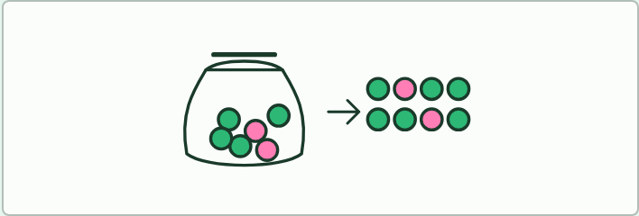
MODEL · HL
6 MIN
Marbles in a bag
THE TASK
Part 1 (the Do now): pairs share a bag of 20 marbles for one gene, green allele A and pink allele a. They count the alleles, write each frequency as a decimal and check that the two add to 1. Part 2 (lesson step three): pairs lay out chapter 8's population with 40 marbles, 20 green J and 20 pink j, in twenty pairs (4 JJ, 12 Jj, 4 jj). They take out every jj pair, recount the survivors' alleles and find the new frequency of J. Ask what happened to the individuals, and what to the gene pool.
STUDENTS NEED
Coloured beads or marbles in two colours, small bags, a table for the counts.
Minutes 0 to 6
Notes:
Minutes 0 to 6 of 60: Do now: marbles in a bag (6 min).
The plan: Pairs get a bag of 20 coloured marbles for one gene. Count the alleles of each colour and write the frequency of each as a decimal. Do the two frequencies add to 1? Compare bags across the room.
The activity: Marbles in a bag. Part 1 (the Do now): pairs share a bag of 20 marbles for one gene, green allele A and pink allele a. They count the alleles, write each frequency as a decimal and check that the two add to 1. Part 2 (lesson step three): pairs lay out chapter 8's population with 40 marbles, 20 green J and 20 pink j, in twenty pairs (4 JJ, 12 Jj, 4 jj). They take out every jj pair, recount the survivors' alleles and find the new frequency of J. Ask what happened to the individuals, and what to the gene pool.
Needs: coloured beads or marbles in two colours, small bags, a table for the counts.
The time: 6 minutes, minutes 0 to 6 of the plan.

Slide 4
STEP 2
10 MIN
The gene pool
Chapter 7: The gene pool
Minutes 6 to 16
Notes:
Minutes 6 to 16 of 60: The gene pool (10 min).
The plan: Chapter 7's figure and its predict box (count alleles, not individuals). Define gene pool and allele frequency, and note the isolated populations in the last step.

Slide 5
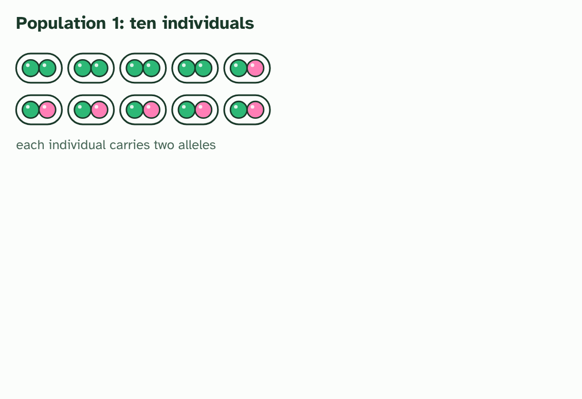
CHAPTER 7 · D4.1.9 D4.1.10 The gene pool and allele frequencies
1 / 4
The gene pool
Ten individuals, each carrying two alleles of one gene: allele A in green, allele a in pink.
Minutes 6 to 16
Notes:
Minutes 6 to 16 of 60: The gene pool (10 min).
The plan: Chapter 7's figure and its predict box (count alleles, not individuals). Define gene pool and allele frequency, and note the isolated populations in the last step.
Natural selection happens to individuals, but evolution is a change in the population. To describe that change you need a way to describe a whole population's genes at once. A gene pool is all the genes and their different alleles in a population. Picture every allele of every individual tipped into one bag.
The useful number to take from a gene pool is an allele frequency: how common each allele is. Count the copies of one allele, and divide by the total number of alleles of that gene in the population. A diploid individual has two alleles of each gene, so a population of 10 has 20. Frequencies of all the alleles of a gene add up to 1, or 100%.
Two populations that are geographically isolated, with few or no individuals breeding across the gap, build up different gene pools. Their allele frequencies differ, because the pressures on each side differ and no alleles pass between the two. Comparing allele frequencies between populations is a way to see how far apart their gene pools have become.
Real allele frequencies are stored in public databases of human populations, and you are asked to search one. Your teacher will name the database your class uses. A search like this works with any of them.
Example: Your search, in six steps Open the database your teacher names, and search for a gene or a variant. A good choice is the sickle-cell allele of the haemoglobin beta gene (HBB; the variant is called rs334).Find the table of allele frequencies by population.Choose two populations from different parts of the world, for instance one from West Africa and one from northern Europe.Write down the frequency of the same allele in each.Compare them. Which is higher, and by roughly how much?Suggest a reason. The sickle allele protects heterozygotes against malaria, so where malaria has been common its frequency has been pushed up.No database to hand? The pattern you should find is that the allele is absent or very rare in the northern European populations and common in several West African ones.

Slide 6
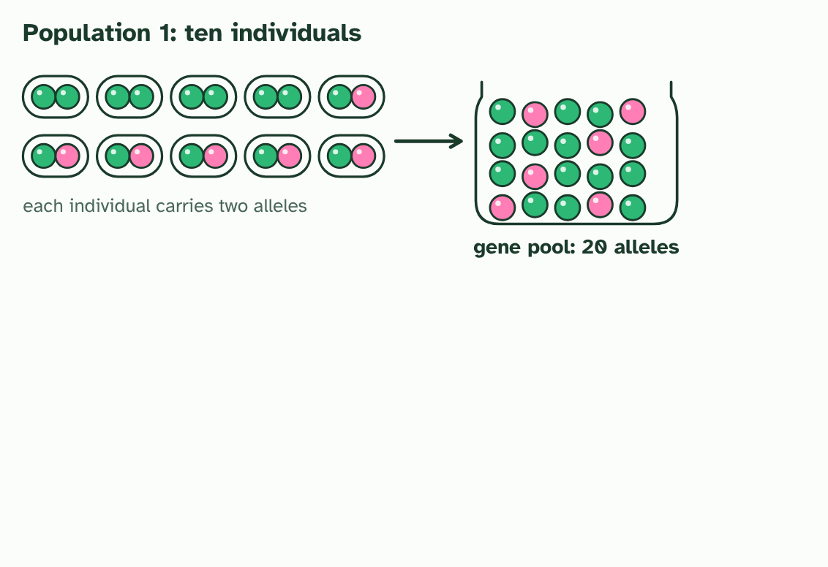
CHAPTER 7 · D4.1.9 D4.1.10 The gene pool and allele frequencies
2 / 4
The gene pool
Tip every allele into one jar: the gene pool, 20 alleles, 14 of them A and 6 of them a.
Minutes 6 to 16
Notes:
Minutes 6 to 16 of 60: The gene pool (10 min).
The plan: Chapter 7's figure and its predict box (count alleles, not individuals). Define gene pool and allele frequency, and note the isolated populations in the last step.
Natural selection happens to individuals, but evolution is a change in the population. To describe that change you need a way to describe a whole population's genes at once. A gene pool is all the genes and their different alleles in a population. Picture every allele of every individual tipped into one bag.
The useful number to take from a gene pool is an allele frequency: how common each allele is. Count the copies of one allele, and divide by the total number of alleles of that gene in the population. A diploid individual has two alleles of each gene, so a population of 10 has 20. Frequencies of all the alleles of a gene add up to 1, or 100%.
Two populations that are geographically isolated, with few or no individuals breeding across the gap, build up different gene pools. Their allele frequencies differ, because the pressures on each side differ and no alleles pass between the two. Comparing allele frequencies between populations is a way to see how far apart their gene pools have become.
Real allele frequencies are stored in public databases of human populations, and you are asked to search one. Your teacher will name the database your class uses. A search like this works with any of them.
Example: Your search, in six steps Open the database your teacher names, and search for a gene or a variant. A good choice is the sickle-cell allele of the haemoglobin beta gene (HBB; the variant is called rs334).Find the table of allele frequencies by population.Choose two populations from different parts of the world, for instance one from West Africa and one from northern Europe.Write down the frequency of the same allele in each.Compare them. Which is higher, and by roughly how much?Suggest a reason. The sickle allele protects heterozygotes against malaria, so where malaria has been common its frequency has been pushed up.No database to hand? The pattern you should find is that the allele is absent or very rare in the northern European populations and common in several West African ones.

Slide 7
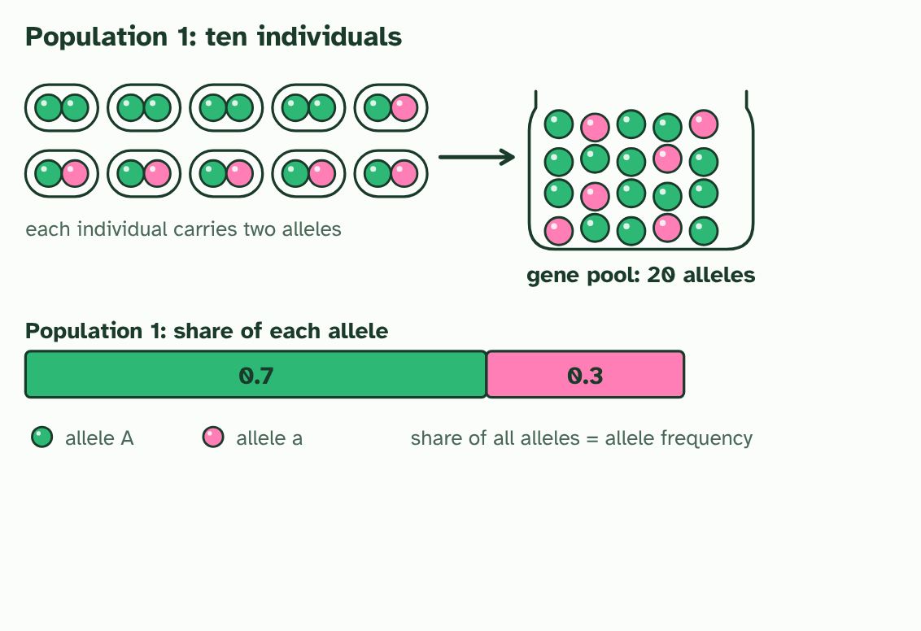
CHAPTER 7 · D4.1.9 D4.1.10 The gene pool and allele frequencies
3 / 4
The gene pool
The allele frequency of A is 14 out of 20, which is 0.7. The frequencies of A and a add to 1.
Minutes 6 to 16
Notes:
Minutes 6 to 16 of 60: The gene pool (10 min).
The plan: Chapter 7's figure and its predict box (count alleles, not individuals). Define gene pool and allele frequency, and note the isolated populations in the last step.
Natural selection happens to individuals, but evolution is a change in the population. To describe that change you need a way to describe a whole population's genes at once. A gene pool is all the genes and their different alleles in a population. Picture every allele of every individual tipped into one bag.
The useful number to take from a gene pool is an allele frequency: how common each allele is. Count the copies of one allele, and divide by the total number of alleles of that gene in the population. A diploid individual has two alleles of each gene, so a population of 10 has 20. Frequencies of all the alleles of a gene add up to 1, or 100%.
Two populations that are geographically isolated, with few or no individuals breeding across the gap, build up different gene pools. Their allele frequencies differ, because the pressures on each side differ and no alleles pass between the two. Comparing allele frequencies between populations is a way to see how far apart their gene pools have become.
Real allele frequencies are stored in public databases of human populations, and you are asked to search one. Your teacher will name the database your class uses. A search like this works with any of them.
Example: Your search, in six steps Open the database your teacher names, and search for a gene or a variant. A good choice is the sickle-cell allele of the haemoglobin beta gene (HBB; the variant is called rs334).Find the table of allele frequencies by population.Choose two populations from different parts of the world, for instance one from West Africa and one from northern Europe.Write down the frequency of the same allele in each.Compare them. Which is higher, and by roughly how much?Suggest a reason. The sickle allele protects heterozygotes against malaria, so where malaria has been common its frequency has been pushed up.No database to hand? The pattern you should find is that the allele is absent or very rare in the northern European populations and common in several West African ones.

Slide 8
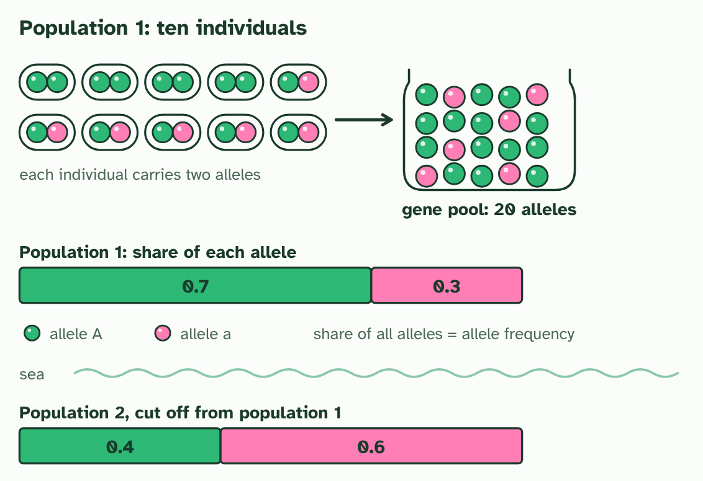
CHAPTER 7 · D4.1.9 D4.1.10 The gene pool and allele frequencies
4 / 4
The gene pool
A second population, cut off from the first, has different frequencies: 0.4 and 0.6.
Minutes 6 to 16
Notes:
Minutes 6 to 16 of 60: The gene pool (10 min).
The plan: Chapter 7's figure and its predict box (count alleles, not individuals). Define gene pool and allele frequency, and note the isolated populations in the last step.
Natural selection happens to individuals, but evolution is a change in the population. To describe that change you need a way to describe a whole population's genes at once. A gene pool is all the genes and their different alleles in a population. Picture every allele of every individual tipped into one bag.
The useful number to take from a gene pool is an allele frequency: how common each allele is. Count the copies of one allele, and divide by the total number of alleles of that gene in the population. A diploid individual has two alleles of each gene, so a population of 10 has 20. Frequencies of all the alleles of a gene add up to 1, or 100%.
Two populations that are geographically isolated, with few or no individuals breeding across the gap, build up different gene pools. Their allele frequencies differ, because the pressures on each side differ and no alleles pass between the two. Comparing allele frequencies between populations is a way to see how far apart their gene pools have become.
Real allele frequencies are stored in public databases of human populations, and you are asked to search one. Your teacher will name the database your class uses. A search like this works with any of them.
Example: Your search, in six steps Open the database your teacher names, and search for a gene or a variant. A good choice is the sickle-cell allele of the haemoglobin beta gene (HBB; the variant is called rs334).Find the table of allele frequencies by population.Choose two populations from different parts of the world, for instance one from West Africa and one from northern Europe.Write down the frequency of the same allele in each.Compare them. Which is higher, and by roughly how much?Suggest a reason. The sickle allele protects heterozygotes against malaria, so where malaria has been common its frequency has been pushed up.No database to hand? The pattern you should find is that the allele is absent or very rare in the northern European populations and common in several West African ones.

Slide 9
CHAPTER 7 · D4.1.9 D4.1.10 The gene pool and allele frequencies
The gene pool
A gene pool is all the genes and their different alleles in a population.
The useful number to take from a gene pool is an allele frequency: how common each allele is.
Two populations that are geographically isolated, with few or no individuals breeding across the gap, build up different gene pools.
Comparing allele frequencies between populations is a way to see how far apart their gene pools have become.
Minutes 6 to 16
Notes:
Minutes 6 to 16 of 60: The gene pool (10 min).
The plan: Chapter 7's figure and its predict box (count alleles, not individuals). Define gene pool and allele frequency, and note the isolated populations in the last step.
Natural selection happens to individuals, but evolution is a change in the population. To describe that change you need a way to describe a whole population's genes at once. A gene pool is all the genes and their different alleles in a population. Picture every allele of every individual tipped into one bag.
The useful number to take from a gene pool is an allele frequency: how common each allele is. Count the copies of one allele, and divide by the total number of alleles of that gene in the population. A diploid individual has two alleles of each gene, so a population of 10 has 20. Frequencies of all the alleles of a gene add up to 1, or 100%.
Two populations that are geographically isolated, with few or no individuals breeding across the gap, build up different gene pools. Their allele frequencies differ, because the pressures on each side differ and no alleles pass between the two. Comparing allele frequencies between populations is a way to see how far apart their gene pools have become.
Real allele frequencies are stored in public databases of human populations, and you are asked to search one. Your teacher will name the database your class uses. A search like this works with any of them.
Example: Your search, in six steps Open the database your teacher names, and search for a gene or a variant. A good choice is the sickle-cell allele of the haemoglobin beta gene (HBB; the variant is called rs334).Find the table of allele frequencies by population.Choose two populations from different parts of the world, for instance one from West Africa and one from northern Europe.Write down the frequency of the same allele in each.Compare them. Which is higher, and by roughly how much?Suggest a reason. The sickle allele protects heterozygotes against malaria, so where malaria has been common its frequency has been pushed up.No database to hand? The pattern you should find is that the allele is absent or very rare in the northern European populations and common in several West African ones.

Slide 10
PREDICT
A population of 50 diploid individuals has 30 copies of allele B in its gene pool. What is the frequency of B?
A 0.30, because 30 copies is the same as 30 out of every 100 individuals
B 0.30, because there are 100 alleles in the pool and 30 are B
C 0.60, because 30 of the 50 individuals in the population carry allele B
Minutes 6 to 16
Notes:
Minutes 6 to 16 of 60: The gene pool (10 min).
The plan: Chapter 7's figure and its predict box (count alleles, not individuals). Define gene pool and allele frequency, and note the isolated populations in the last step.
Ask for a show of hands, or mini whiteboards, before revealing. (Answer: B, on the next slide.)

Slide 11
WHAT HAPPENS
A population of 50 diploid individuals has 30 copies of allele B in its gene pool. What is the frequency of B?
A 0.30, because 30 copies is the same as 30 out of every 100 individuals
B 0.30, because there are 100 alleles in the pool and 30 are B
C 0.60, because 30 of the 50 individuals in the population carry allele B
Frequency 0.30. Each of the 50 diploid individuals has two alleles of the gene, so the gene pool holds 100 alleles. The 30 copies of B are 30 out of 100, which is 0.30. Counting individuals instead of alleles is the usual slip.
Minutes 6 to 16
Notes:
Minutes 6 to 16 of 60: The gene pool (10 min).
The plan: Chapter 7's figure and its predict box (count alleles, not individuals). Define gene pool and allele frequency, and note the isolated populations in the last step.
Answer: B. Frequency 0.30. Each of the 50 diploid individuals has two alleles of the gene, so the gene pool holds 100 alleles. The 30 copies of B are 30 out of 100, which is 0.30. Counting individuals instead of alleles is the usual slip.

Slide 12
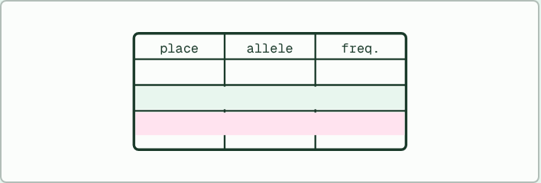
DATA TASK · HL
18 MIN
Search a database
THE TASK
Students open a human allele frequency database your school can reach and find one allele (the sickle-cell allele of the beta haemoglobin gene is a good one) in two populations from different regions. They write both frequencies, say which is higher, and suggest a reason (malaria is the usual one for the sickle allele). If the database is not available, give the table in chapter 7 and ask the same questions.
STUDENTS NEED
Devices with internet access, a recording sheet with space for two populations and the source.
Minutes 16 to 34
Notes:
Minutes 16 to 34 of 60: Search a database (18 min).
The plan: The database task below: students find one allele in two populations from different regions, write down both frequencies and suggest a reason for the difference. A fixed table is on the card if the database is not available.
The activity: Search a database. Students open a human allele frequency database your school can reach and find one allele (the sickle-cell allele of the beta haemoglobin gene is a good one) in two populations from different regions. They write both frequencies, say which is higher, and suggest a reason (malaria is the usual one for the sickle allele). If the database is not available, give the table in chapter 7 and ask the same questions.
Needs: devices with internet access, a recording sheet with space for two populations and the source.
The time: 18 minutes, minutes 16 to 34 of the plan.

Slide 13
STEP 4
14 MIN
Selection by hand
Chapter 8: Selection shifts allele frequencies
Minutes 34 to 48
Notes:
Minutes 34 to 48 of 60: Selection by hand (14 min).
The plan: Chapter 8's figure, with the marbles: pairs lay out the twenty beetles as 40 marbles, take out every jj pair, then recount the survivors' alleles. Check the frequency of J against the figure's 0.625. Define neo-Darwinism: Darwin plus genetics.

Slide 14
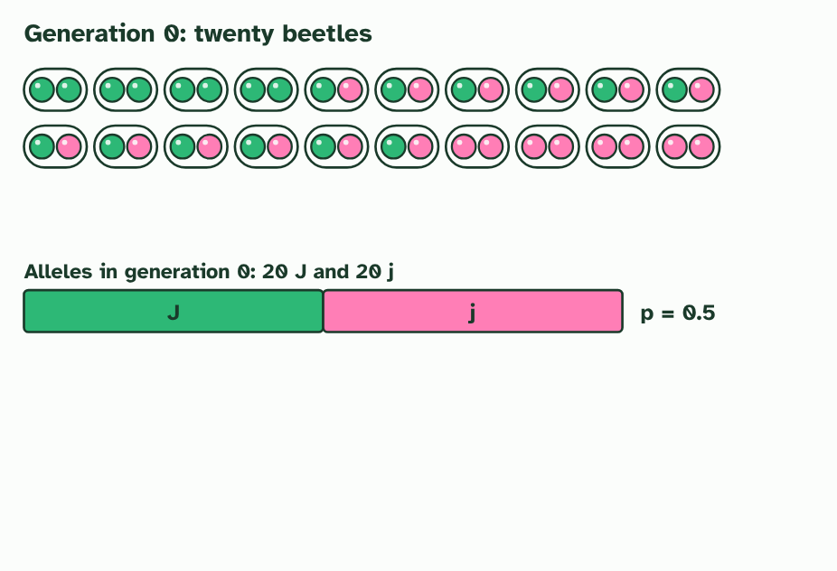
CHAPTER 8 · D4.1.11 Selection changes allele frequencies
1 / 4
Selection shifts allele frequencies
Twenty beetles, each with two alleles of a jaw gene. Across the population, J and j are equally common: p = 0.5.
Minutes 34 to 48
Notes:
Minutes 34 to 48 of 60: Selection by hand (14 min).
The plan: Chapter 8's figure, with the marbles: pairs lay out the twenty beetles as 40 marbles, take out every jj pair, then recount the survivors' alleles. Check the frequency of J against the figure's 0.625. Define neo-Darwinism: Darwin plus genetics.
Darwin explained evolution without knowing how traits are inherited. The missing piece came later, with the study of genes: Mendel's results on inheritance were rediscovered in the early 1900s, and then DNA was found to carry the code. Biologists joined Darwin's natural selection to genetics in what is now called neo-Darwinism.
That gives a sharper definition. Evolution is a change in the allele frequencies of a gene pool over generations. Mutation adds new alleles, and natural selection is a process that changes how common each one is: individuals differ in their heritable traits, so they differ in how many offspring they leave, and so the alleles that go with the successful traits become more common in the gene pool.
The figure runs one population by hand. Twenty beetles have two alleles for jaw strength: J (the dominant one) lets a beetle crack tough seeds, and j does not. A drought leaves only tough seeds. Beetles with two j alleles cannot feed and do not breed. The survivors carry 20 J out of 32 alleles, so the frequency of J has risen from 0.5 to 0.625. No beetle changed. The gene pool did.
Two points to carry away. Selection acts on phenotypes, the traits that individuals show, but evolution is read in alleles, in the population. And an allele does not vanish just because the trait it causes is disadvantageous: here j is still carried by the surviving Jj beetles.

Slide 15
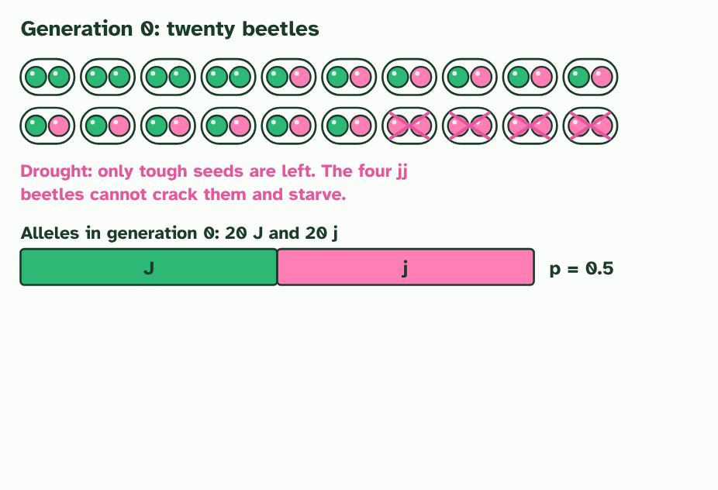
CHAPTER 8 · D4.1.11 Selection changes allele frequencies
2 / 4
Selection shifts allele frequencies
A drought leaves only tough seeds. The four jj beetles cannot feed and do not breed.
Minutes 34 to 48
Notes:
Minutes 34 to 48 of 60: Selection by hand (14 min).
The plan: Chapter 8's figure, with the marbles: pairs lay out the twenty beetles as 40 marbles, take out every jj pair, then recount the survivors' alleles. Check the frequency of J against the figure's 0.625. Define neo-Darwinism: Darwin plus genetics.
Darwin explained evolution without knowing how traits are inherited. The missing piece came later, with the study of genes: Mendel's results on inheritance were rediscovered in the early 1900s, and then DNA was found to carry the code. Biologists joined Darwin's natural selection to genetics in what is now called neo-Darwinism.
That gives a sharper definition. Evolution is a change in the allele frequencies of a gene pool over generations. Mutation adds new alleles, and natural selection is a process that changes how common each one is: individuals differ in their heritable traits, so they differ in how many offspring they leave, and so the alleles that go with the successful traits become more common in the gene pool.
The figure runs one population by hand. Twenty beetles have two alleles for jaw strength: J (the dominant one) lets a beetle crack tough seeds, and j does not. A drought leaves only tough seeds. Beetles with two j alleles cannot feed and do not breed. The survivors carry 20 J out of 32 alleles, so the frequency of J has risen from 0.5 to 0.625. No beetle changed. The gene pool did.
Two points to carry away. Selection acts on phenotypes, the traits that individuals show, but evolution is read in alleles, in the population. And an allele does not vanish just because the trait it causes is disadvantageous: here j is still carried by the surviving Jj beetles.

Slide 16
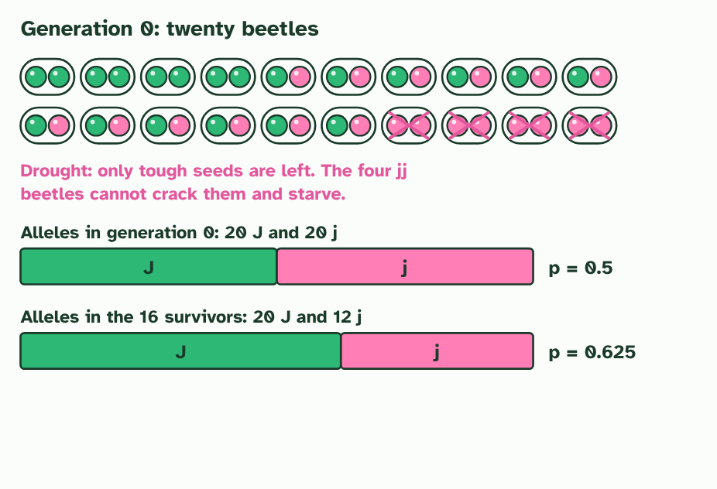
CHAPTER 8 · D4.1.11 Selection changes allele frequencies
3 / 4
Selection shifts allele frequencies
Count the alleles of the 16 survivors: 20 J and 12 j. The frequency of J is now 0.625.
Minutes 34 to 48
Notes:
Minutes 34 to 48 of 60: Selection by hand (14 min).
The plan: Chapter 8's figure, with the marbles: pairs lay out the twenty beetles as 40 marbles, take out every jj pair, then recount the survivors' alleles. Check the frequency of J against the figure's 0.625. Define neo-Darwinism: Darwin plus genetics.
Darwin explained evolution without knowing how traits are inherited. The missing piece came later, with the study of genes: Mendel's results on inheritance were rediscovered in the early 1900s, and then DNA was found to carry the code. Biologists joined Darwin's natural selection to genetics in what is now called neo-Darwinism.
That gives a sharper definition. Evolution is a change in the allele frequencies of a gene pool over generations. Mutation adds new alleles, and natural selection is a process that changes how common each one is: individuals differ in their heritable traits, so they differ in how many offspring they leave, and so the alleles that go with the successful traits become more common in the gene pool.
The figure runs one population by hand. Twenty beetles have two alleles for jaw strength: J (the dominant one) lets a beetle crack tough seeds, and j does not. A drought leaves only tough seeds. Beetles with two j alleles cannot feed and do not breed. The survivors carry 20 J out of 32 alleles, so the frequency of J has risen from 0.5 to 0.625. No beetle changed. The gene pool did.
Two points to carry away. Selection acts on phenotypes, the traits that individuals show, but evolution is read in alleles, in the population. And an allele does not vanish just because the trait it causes is disadvantageous: here j is still carried by the surviving Jj beetles.

Slide 17
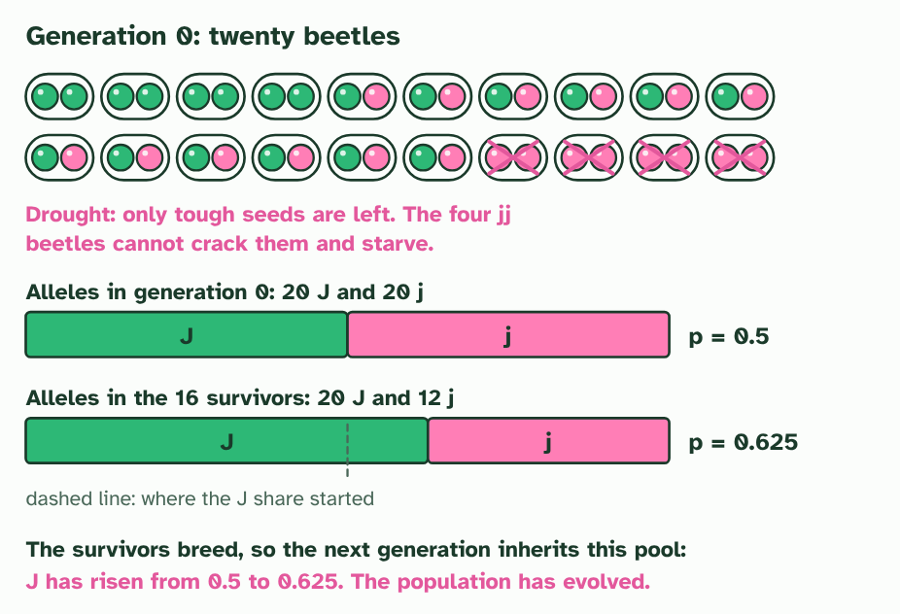
CHAPTER 8 · D4.1.11 Selection changes allele frequencies
4 / 4
Selection shifts allele frequencies
The survivors breed, so their gene pool is the next generation's. The allele frequency has changed: evolution.
Minutes 34 to 48
Notes:
Minutes 34 to 48 of 60: Selection by hand (14 min).
The plan: Chapter 8's figure, with the marbles: pairs lay out the twenty beetles as 40 marbles, take out every jj pair, then recount the survivors' alleles. Check the frequency of J against the figure's 0.625. Define neo-Darwinism: Darwin plus genetics.
Darwin explained evolution without knowing how traits are inherited. The missing piece came later, with the study of genes: Mendel's results on inheritance were rediscovered in the early 1900s, and then DNA was found to carry the code. Biologists joined Darwin's natural selection to genetics in what is now called neo-Darwinism.
That gives a sharper definition. Evolution is a change in the allele frequencies of a gene pool over generations. Mutation adds new alleles, and natural selection is a process that changes how common each one is: individuals differ in their heritable traits, so they differ in how many offspring they leave, and so the alleles that go with the successful traits become more common in the gene pool.
The figure runs one population by hand. Twenty beetles have two alleles for jaw strength: J (the dominant one) lets a beetle crack tough seeds, and j does not. A drought leaves only tough seeds. Beetles with two j alleles cannot feed and do not breed. The survivors carry 20 J out of 32 alleles, so the frequency of J has risen from 0.5 to 0.625. No beetle changed. The gene pool did.
Two points to carry away. Selection acts on phenotypes, the traits that individuals show, but evolution is read in alleles, in the population. And an allele does not vanish just because the trait it causes is disadvantageous: here j is still carried by the surviving Jj beetles.

Slide 18
CHAPTER 8 · D4.1.11 Selection changes allele frequencies
Selection shifts allele frequencies
Biologists joined Darwin's natural selection to genetics in what is now called neo-Darwinism.
That gives a sharper definition.
The figure runs one population by hand.
Minutes 34 to 48
Notes:
Minutes 34 to 48 of 60: Selection by hand (14 min).
The plan: Chapter 8's figure, with the marbles: pairs lay out the twenty beetles as 40 marbles, take out every jj pair, then recount the survivors' alleles. Check the frequency of J against the figure's 0.625. Define neo-Darwinism: Darwin plus genetics.
Darwin explained evolution without knowing how traits are inherited. The missing piece came later, with the study of genes: Mendel's results on inheritance were rediscovered in the early 1900s, and then DNA was found to carry the code. Biologists joined Darwin's natural selection to genetics in what is now called neo-Darwinism.
That gives a sharper definition. Evolution is a change in the allele frequencies of a gene pool over generations. Mutation adds new alleles, and natural selection is a process that changes how common each one is: individuals differ in their heritable traits, so they differ in how many offspring they leave, and so the alleles that go with the successful traits become more common in the gene pool.
The figure runs one population by hand. Twenty beetles have two alleles for jaw strength: J (the dominant one) lets a beetle crack tough seeds, and j does not. A drought leaves only tough seeds. Beetles with two j alleles cannot feed and do not breed. The survivors carry 20 J out of 32 alleles, so the frequency of J has risen from 0.5 to 0.625. No beetle changed. The gene pool did.
Two points to carry away. Selection acts on phenotypes, the traits that individuals show, but evolution is read in alleles, in the population. And an allele does not vanish just because the trait it causes is disadvantageous: here j is still carried by the surviving Jj beetles.

Slide 19
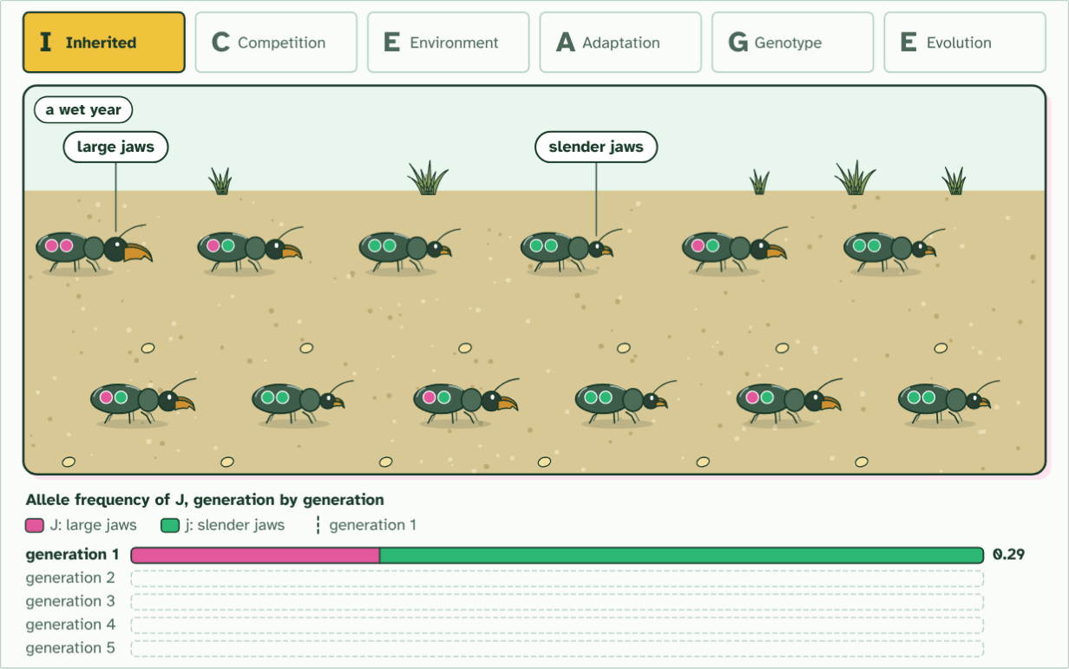
CHAPTER 8 · D4.1.11 Selection changes allele frequencies
generation 1
1 / 6
Selection shifts allele frequencies
Inherited variation. Jaws differ, set by the two alleles of a jaw gene that each beetle carries (the pips): pink J large, green j slender.
Minutes 34 to 48
Notes:
Minutes 34 to 48 of 60: Selection by hand (14 min).
The plan: Chapter 8's figure, with the marbles: pairs lay out the twenty beetles as 40 marbles, take out every jj pair, then recount the survivors' alleles. Check the frequency of J against the figure's 0.625. Define neo-Darwinism: Darwin plus genetics.
Darwin explained evolution without knowing how traits are inherited. The missing piece came later, with the study of genes: Mendel's results on inheritance were rediscovered in the early 1900s, and then DNA was found to carry the code. Biologists joined Darwin's natural selection to genetics in what is now called neo-Darwinism.
That gives a sharper definition. Evolution is a change in the allele frequencies of a gene pool over generations. Mutation adds new alleles, and natural selection is a process that changes how common each one is: individuals differ in their heritable traits, so they differ in how many offspring they leave, and so the alleles that go with the successful traits become more common in the gene pool.
The figure runs one population by hand. Twenty beetles have two alleles for jaw strength: J (the dominant one) lets a beetle crack tough seeds, and j does not. A drought leaves only tough seeds. Beetles with two j alleles cannot feed and do not breed. The survivors carry 20 J out of 32 alleles, so the frequency of J has risen from 0.5 to 0.625. No beetle changed. The gene pool did.
Two points to carry away. Selection acts on phenotypes, the traits that individuals show, but evolution is read in alleles, in the population. And an allele does not vanish just because the trait it causes is disadvantageous: here j is still carried by the surviving Jj beetles.
The animation "Watch it happen: allele frequencies shift", paused at 7.0 s. The next slides go on through it, then play it.

Slide 20
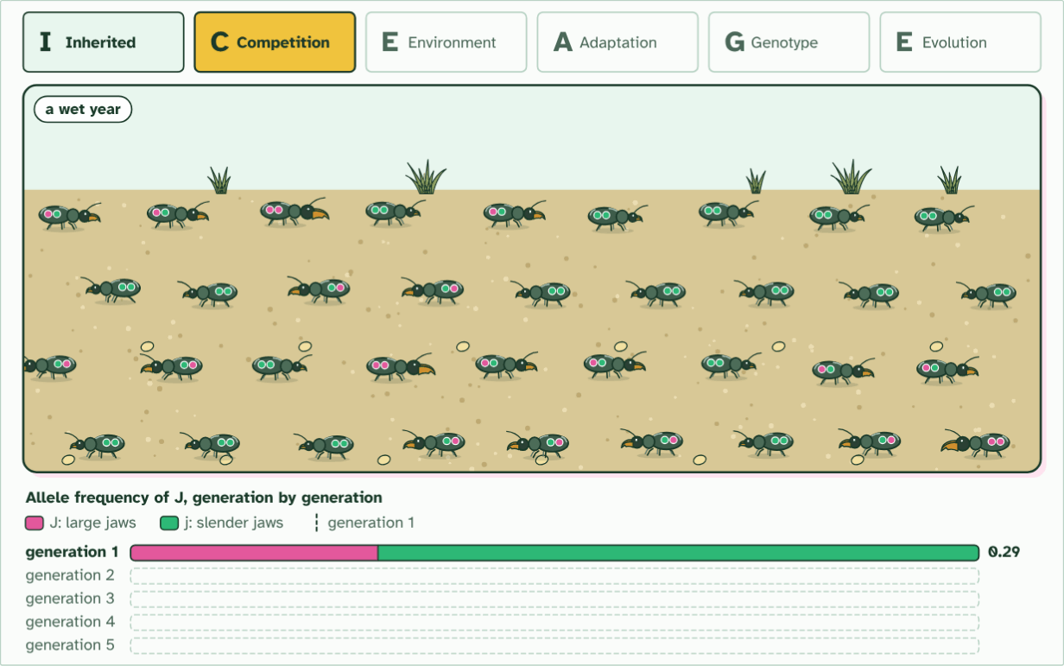
CHAPTER 8 · D4.1.11 Selection changes allele frequencies
36 young, food for 12
2 / 6
Selection shifts allele frequencies
Competition. Twelve beetles leave thirty-six young, three times as many as the ground can feed.
Minutes 34 to 48
Notes:
Minutes 34 to 48 of 60: Selection by hand (14 min).
The plan: Chapter 8's figure, with the marbles: pairs lay out the twenty beetles as 40 marbles, take out every jj pair, then recount the survivors' alleles. Check the frequency of J against the figure's 0.625. Define neo-Darwinism: Darwin plus genetics.
Darwin explained evolution without knowing how traits are inherited. The missing piece came later, with the study of genes: Mendel's results on inheritance were rediscovered in the early 1900s, and then DNA was found to carry the code. Biologists joined Darwin's natural selection to genetics in what is now called neo-Darwinism.
That gives a sharper definition. Evolution is a change in the allele frequencies of a gene pool over generations. Mutation adds new alleles, and natural selection is a process that changes how common each one is: individuals differ in their heritable traits, so they differ in how many offspring they leave, and so the alleles that go with the successful traits become more common in the gene pool.
The figure runs one population by hand. Twenty beetles have two alleles for jaw strength: J (the dominant one) lets a beetle crack tough seeds, and j does not. A drought leaves only tough seeds. Beetles with two j alleles cannot feed and do not breed. The survivors carry 20 J out of 32 alleles, so the frequency of J has risen from 0.5 to 0.625. No beetle changed. The gene pool did.
Two points to carry away. Selection acts on phenotypes, the traits that individuals show, but evolution is read in alleles, in the population. And an allele does not vanish just because the trait it causes is disadvantageous: here j is still carried by the surviving Jj beetles.
The animation "Watch it happen: allele frequencies shift", paused at 18.0 s. The next slides go on through it, then play it.

Slide 21
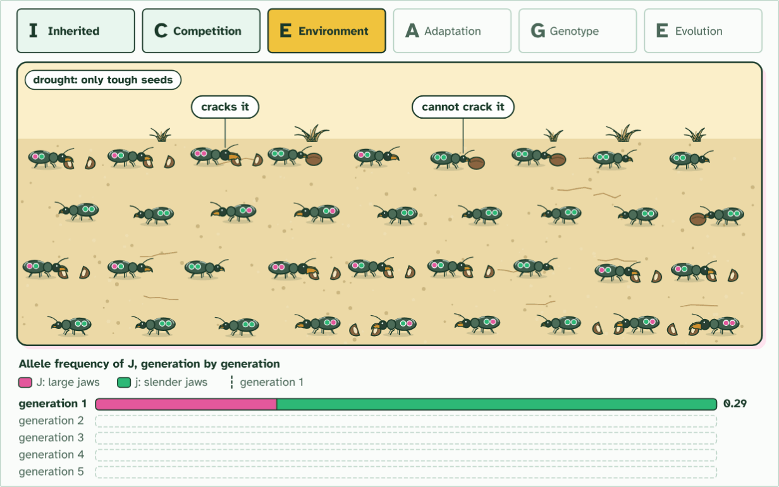
CHAPTER 8 · D4.1.11 Selection changes allele frequencies
36 young, food for 12
3 / 6
Selection shifts allele frequencies
Environmental pressure. A drought leaves only tough seeds. Large jaws crack them; slender jaws cannot, and those beetles starve.
Minutes 34 to 48
Notes:
Minutes 34 to 48 of 60: Selection by hand (14 min).
The plan: Chapter 8's figure, with the marbles: pairs lay out the twenty beetles as 40 marbles, take out every jj pair, then recount the survivors' alleles. Check the frequency of J against the figure's 0.625. Define neo-Darwinism: Darwin plus genetics.
Darwin explained evolution without knowing how traits are inherited. The missing piece came later, with the study of genes: Mendel's results on inheritance were rediscovered in the early 1900s, and then DNA was found to carry the code. Biologists joined Darwin's natural selection to genetics in what is now called neo-Darwinism.
That gives a sharper definition. Evolution is a change in the allele frequencies of a gene pool over generations. Mutation adds new alleles, and natural selection is a process that changes how common each one is: individuals differ in their heritable traits, so they differ in how many offspring they leave, and so the alleles that go with the successful traits become more common in the gene pool.
The figure runs one population by hand. Twenty beetles have two alleles for jaw strength: J (the dominant one) lets a beetle crack tough seeds, and j does not. A drought leaves only tough seeds. Beetles with two j alleles cannot feed and do not breed. The survivors carry 20 J out of 32 alleles, so the frequency of J has risen from 0.5 to 0.625. No beetle changed. The gene pool did.
Two points to carry away. Selection acts on phenotypes, the traits that individuals show, but evolution is read in alleles, in the population. And an allele does not vanish just because the trait it causes is disadvantageous: here j is still carried by the surviving Jj beetles.
The animation "Watch it happen: allele frequencies shift", paused at 27.0 s. The next slides go on through it, then play it.

Slide 22
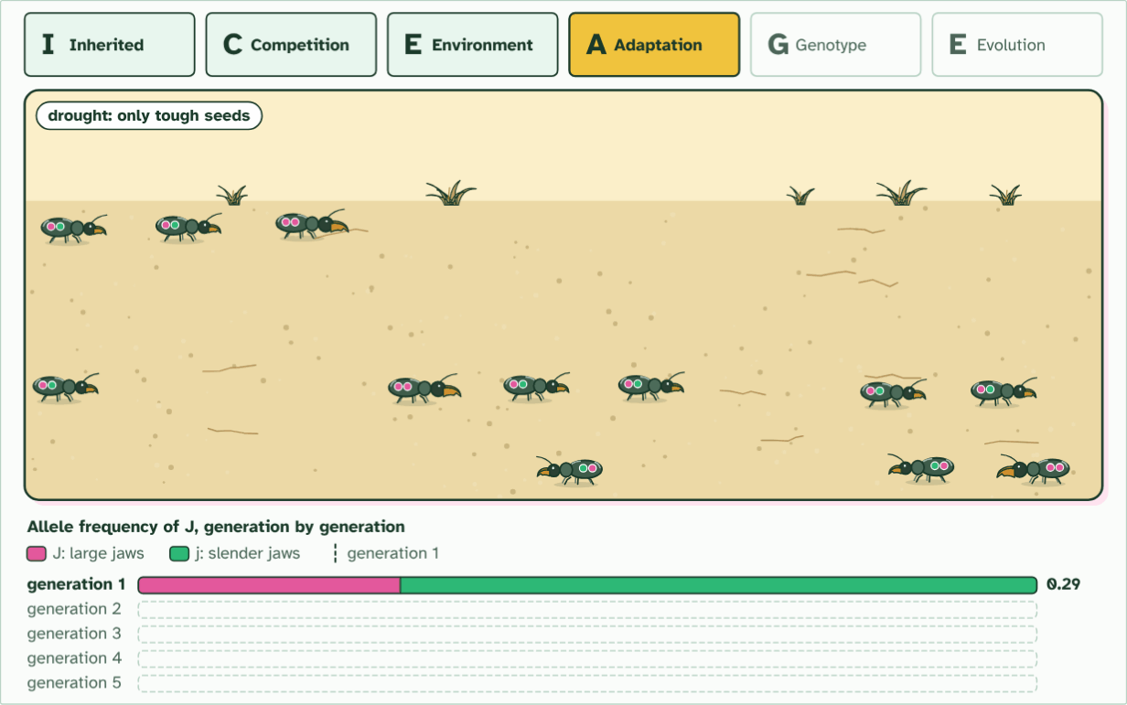
CHAPTER 8 · D4.1.11 Selection changes allele frequencies
12 of 36 survive
4 / 6
Selection shifts allele frequencies
Adaptation. The twelve survivors all have large or medium jaws, the trait that suits a dry year. Every one carries J.
Minutes 34 to 48
Notes:
Minutes 34 to 48 of 60: Selection by hand (14 min).
The plan: Chapter 8's figure, with the marbles: pairs lay out the twenty beetles as 40 marbles, take out every jj pair, then recount the survivors' alleles. Check the frequency of J against the figure's 0.625. Define neo-Darwinism: Darwin plus genetics.
Darwin explained evolution without knowing how traits are inherited. The missing piece came later, with the study of genes: Mendel's results on inheritance were rediscovered in the early 1900s, and then DNA was found to carry the code. Biologists joined Darwin's natural selection to genetics in what is now called neo-Darwinism.
That gives a sharper definition. Evolution is a change in the allele frequencies of a gene pool over generations. Mutation adds new alleles, and natural selection is a process that changes how common each one is: individuals differ in their heritable traits, so they differ in how many offspring they leave, and so the alleles that go with the successful traits become more common in the gene pool.
The figure runs one population by hand. Twenty beetles have two alleles for jaw strength: J (the dominant one) lets a beetle crack tough seeds, and j does not. A drought leaves only tough seeds. Beetles with two j alleles cannot feed and do not breed. The survivors carry 20 J out of 32 alleles, so the frequency of J has risen from 0.5 to 0.625. No beetle changed. The gene pool did.
Two points to carry away. Selection acts on phenotypes, the traits that individuals show, but evolution is read in alleles, in the population. And an allele does not vanish just because the trait it causes is disadvantageous: here j is still carried by the surviving Jj beetles.
The animation "Watch it happen: allele frequencies shift", paused at 37.0 s. The next slides go on through it, then play it.

Slide 23
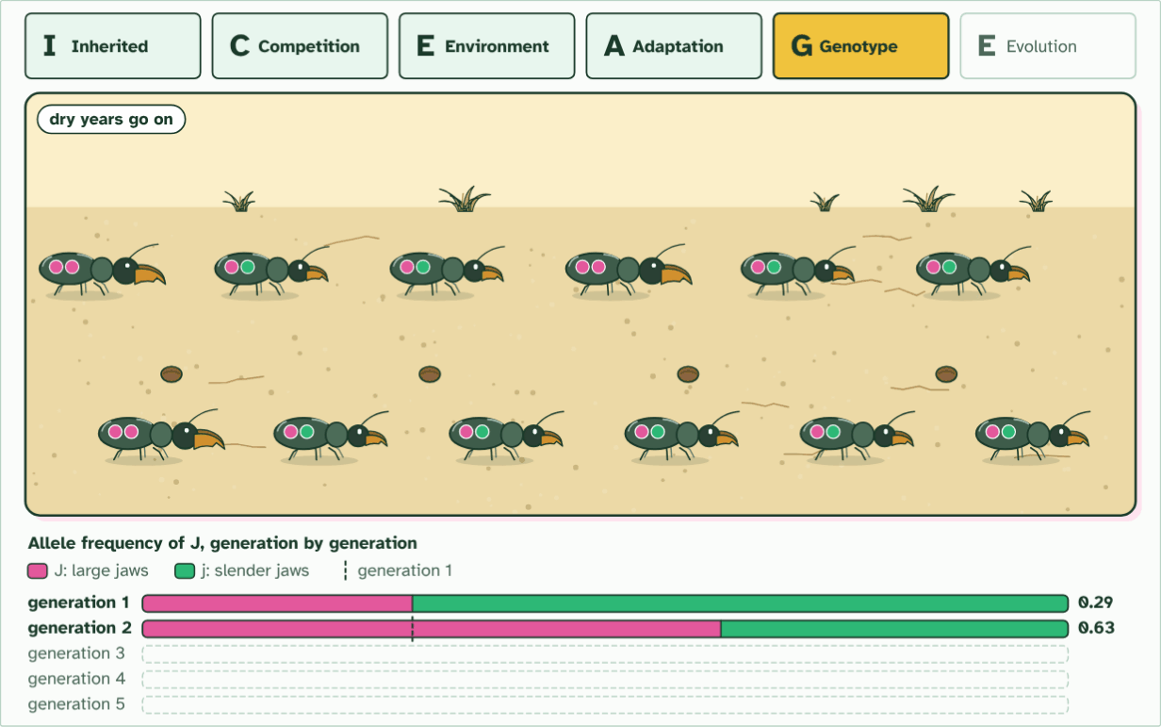
CHAPTER 8 · D4.1.11 Selection changes allele frequencies
generation 2
5 / 6
Selection shifts allele frequencies
Genotype frequencies change. Only survivors breed, so the allele frequency of J rises in generation 2.
Minutes 34 to 48
Notes:
Minutes 34 to 48 of 60: Selection by hand (14 min).
The plan: Chapter 8's figure, with the marbles: pairs lay out the twenty beetles as 40 marbles, take out every jj pair, then recount the survivors' alleles. Check the frequency of J against the figure's 0.625. Define neo-Darwinism: Darwin plus genetics.
Darwin explained evolution without knowing how traits are inherited. The missing piece came later, with the study of genes: Mendel's results on inheritance were rediscovered in the early 1900s, and then DNA was found to carry the code. Biologists joined Darwin's natural selection to genetics in what is now called neo-Darwinism.
That gives a sharper definition. Evolution is a change in the allele frequencies of a gene pool over generations. Mutation adds new alleles, and natural selection is a process that changes how common each one is: individuals differ in their heritable traits, so they differ in how many offspring they leave, and so the alleles that go with the successful traits become more common in the gene pool.
The figure runs one population by hand. Twenty beetles have two alleles for jaw strength: J (the dominant one) lets a beetle crack tough seeds, and j does not. A drought leaves only tough seeds. Beetles with two j alleles cannot feed and do not breed. The survivors carry 20 J out of 32 alleles, so the frequency of J has risen from 0.5 to 0.625. No beetle changed. The gene pool did.
Two points to carry away. Selection acts on phenotypes, the traits that individuals show, but evolution is read in alleles, in the population. And an allele does not vanish just because the trait it causes is disadvantageous: here j is still carried by the surviving Jj beetles.
The animation "Watch it happen: allele frequencies shift", paused at 48.0 s. The next slides go on through it, then play it.

Slide 24
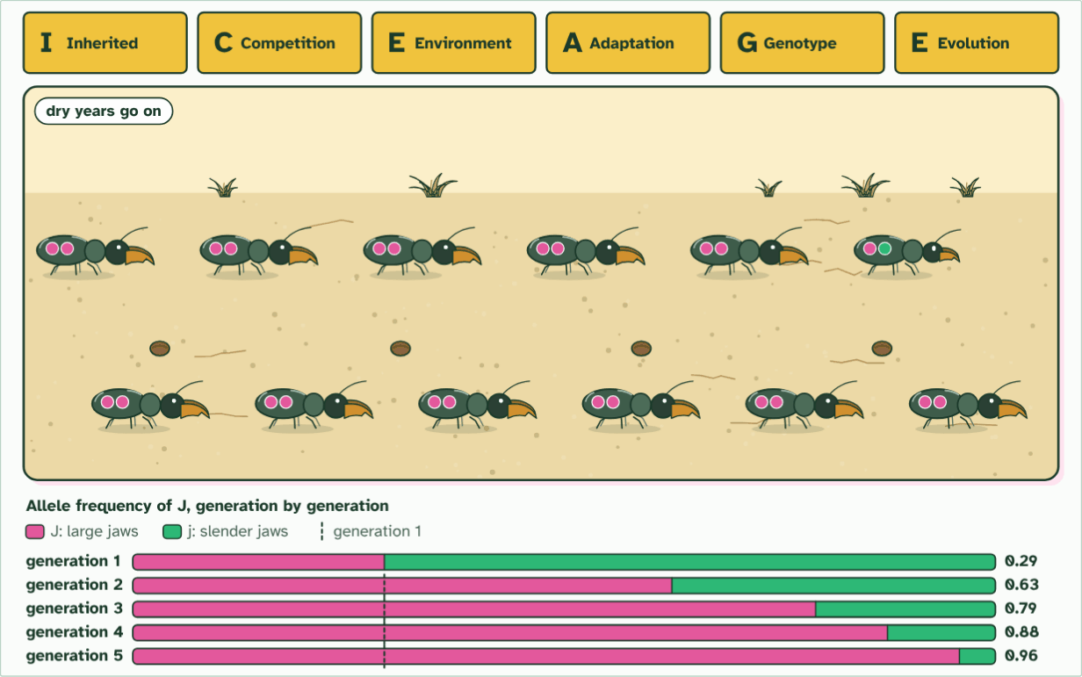
CHAPTER 8 · D4.1.11 Selection changes allele frequencies
generation 5
6 / 6
Selection shifts allele frequencies
Evolution. The dry years go on. By generation 5 nearly every beetle has large jaws: no beetle changed, the population did.
Minutes 34 to 48
Notes:
Minutes 34 to 48 of 60: Selection by hand (14 min).
The plan: Chapter 8's figure, with the marbles: pairs lay out the twenty beetles as 40 marbles, take out every jj pair, then recount the survivors' alleles. Check the frequency of J against the figure's 0.625. Define neo-Darwinism: Darwin plus genetics.
Darwin explained evolution without knowing how traits are inherited. The missing piece came later, with the study of genes: Mendel's results on inheritance were rediscovered in the early 1900s, and then DNA was found to carry the code. Biologists joined Darwin's natural selection to genetics in what is now called neo-Darwinism.
That gives a sharper definition. Evolution is a change in the allele frequencies of a gene pool over generations. Mutation adds new alleles, and natural selection is a process that changes how common each one is: individuals differ in their heritable traits, so they differ in how many offspring they leave, and so the alleles that go with the successful traits become more common in the gene pool.
The figure runs one population by hand. Twenty beetles have two alleles for jaw strength: J (the dominant one) lets a beetle crack tough seeds, and j does not. A drought leaves only tough seeds. Beetles with two j alleles cannot feed and do not breed. The survivors carry 20 J out of 32 alleles, so the frequency of J has risen from 0.5 to 0.625. No beetle changed. The gene pool did.
Two points to carry away. Selection acts on phenotypes, the traits that individuals show, but evolution is read in alleles, in the population. And an allele does not vanish just because the trait it causes is disadvantageous: here j is still carried by the surviving Jj beetles.
The animation "Watch it happen: allele frequencies shift", paused at 64.5 s. The next slides go on through it, then play it.

Slide 25
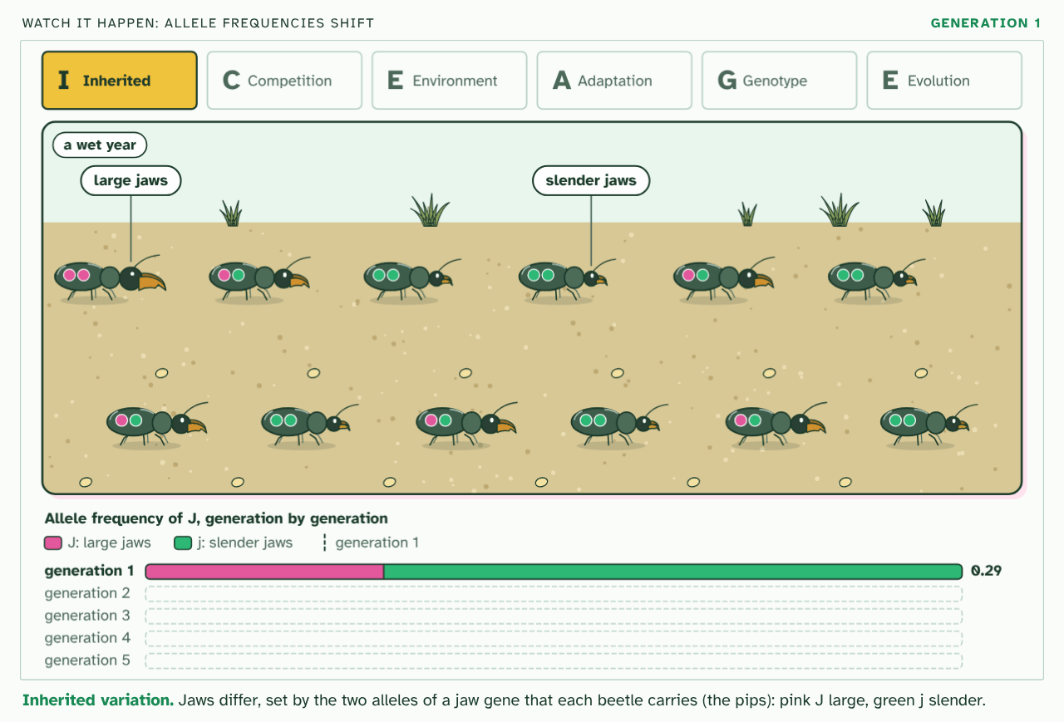
CHAPTER 8 · D4.1.11 Selection changes allele frequencies
PLAY IT
Selection shifts allele frequencies
Watch it happen: allele frequencies shift: click to play. It loops every 66 seconds.
Minutes 34 to 48
Notes:
Minutes 34 to 48 of 60: Selection by hand (14 min).
The plan: Chapter 8's figure, with the marbles: pairs lay out the twenty beetles as 40 marbles, take out every jj pair, then recount the survivors' alleles. Check the frequency of J against the figure's 0.625. Define neo-Darwinism: Darwin plus genetics.
The video is iceage-f1d54b.mp4, one loop of the animation in the guide. It plays in PowerPoint and Keynote. Google Slides does not play a video embedded in a .pptx: download iceage-f1d54b.mp4 (https://www.biologybybradford.com/guides/downloads/scenes/iceage-f1d54b.mp4), upload it to Google Drive, then Insert > Video > Google Drive.
In the guide the class can change it as it runs: https://www.biologybybradford.com/guides/ib-biology-d4-1-natural-selection#neodarwin
What it shows, in order:
1. Inherited variation. Jaws differ, set by the two alleles of a jaw gene that each beetle carries (the pips): pink J large, green j slender.
2. Competition. Twelve beetles leave thirty-six young, three times as many as the ground can feed.
3. Environmental pressure. A drought leaves only tough seeds. Large jaws crack them; slender jaws cannot, and those beetles starve.
4. Adaptation. The twelve survivors all have large or medium jaws, the trait that suits a dry year. Every one carries J.
5. Genotype frequencies change. Only survivors breed, so the allele frequency of J rises in generation 2.
6. Evolution. The dry years go on. By generation 5 nearly every beetle has large jaws: no beetle changed, the population did.

Slide 26
PREDICT
In the beetle example, the J share of the gene pool was 0.5 before the drought and 20 of the 32 alleles of the survivors. What is it among the survivors?
A 0.625, because 20 of the 32 surviving alleles are J
B 0.5, because every J allele survived and none was lost
C 0.75, because the four jj beetles carried no J alleles
Minutes 34 to 48
Notes:
Minutes 34 to 48 of 60: Selection by hand (14 min).
The plan: Chapter 8's figure, with the marbles: pairs lay out the twenty beetles as 40 marbles, take out every jj pair, then recount the survivors' alleles. Check the frequency of J against the figure's 0.625. Define neo-Darwinism: Darwin plus genetics.
Ask for a show of hands, or mini whiteboards, before revealing. (Answer: A, on the next slide.)

Slide 27
WHAT HAPPENS
In the beetle example, the J share of the gene pool was 0.5 before the drought and 20 of the 32 alleles of the survivors. What is it among the survivors?
A 0.625, because 20 of the 32 surviving alleles are J
B 0.5, because every J allele survived and none was lost
C 0.75, because the four jj beetles carried no J alleles
0.625. After the drought the 16 survivors carry 32 alleles, 20 of them J. The frequency is 20 out of 32. Some j alleles were lost with the jj beetles but most survive in the Jj beetles, so the pool shifts toward J without j disappearing.
Minutes 34 to 48
Notes:
Minutes 34 to 48 of 60: Selection by hand (14 min).
The plan: Chapter 8's figure, with the marbles: pairs lay out the twenty beetles as 40 marbles, take out every jj pair, then recount the survivors' alleles. Check the frequency of J against the figure's 0.625. Define neo-Darwinism: Darwin plus genetics.
Answer: A. 0.625. After the drought the 16 survivors carry 32 alleles, 20 of them J. The frequency is 20 out of 32. Some j alleles were lost with the jj beetles but most survive in the Jj beetles, so the pool shifts toward J without j disappearing.

Slide 28
WATCH OUT
The frequency of an allele can change without any one individual changing at all. Do not write "the beetles evolved"; write "the allele frequency in the population changed".
Minutes 34 to 48
Notes:
Minutes 34 to 48 of 60: Selection by hand (14 min).
The plan: Chapter 8's figure, with the marbles: pairs lay out the twenty beetles as 40 marbles, take out every jj pair, then recount the survivors' alleles. Check the frequency of J against the figure's 0.625. Define neo-Darwinism: Darwin plus genetics.
A common mistake: say it, then ask who can say why it is wrong.

Slide 29
STEP 5
7 MIN
Watch ICE AGE again
Where is the allele frequency in each letter?
Ask: why did no individual evolve?
Minutes 48 to 55
Notes:
Minutes 48 to 55 of 60: Watch ICE AGE again (7 min).
The plan: The higher level ICE AGE film in chapter 8. Where is the allele frequency in each letter? Ask: why did no individual evolve?

Slide 30
PLENARY
Can you now...
Describe a gene pool, and calculate and compare allele frequencies in a population, using a database for a human example (D4.1.9, D4.1.10)
Explain neo-Darwinism: how selection between individuals changes allele frequencies in the gene pool (D4.1.11)
Minutes 55 to 60
Notes:
Minutes 55 to 60 of 60: Exit (5 min).
The plan: Write a definition of evolution in terms of allele frequency, and an example from today in one sentence.
Thumbs up, sideways or down on each goal before the exit question. The goals come from the statements this lesson covers.

Slide 31
EXIT QUESTION
Before you go
Write a definition of evolution in terms of allele frequency, and an example from today in one sentence.
Minutes 55 to 60
Notes:
Minutes 55 to 60 of 60: Exit (5 min).
The plan: Write a definition of evolution in terms of allele frequency, and an example from today in one sentence.

Slide 32
PRACTISE AND REVISE
Keep going
Exam practice: a fresh paper of exam questions on D4.1 at higher level, marked as you go
The guide, with the animations and the dry lab
This lesson in the guide: 7 The gene pool, 8 Selection shifts allele frequencies
BUILD FOR YOUR CLASS
ALREADY ON THE SITE FOR D4.1
CARD SETS ON SPLYCR
Tarsia puzzle, dominoes and picture reveal on D4.1, built from its key terms and ready to print
A pub quiz with rounds on D4.1, to present or run with no projector
An escape room built from the question bank on D4.1
Lesson: Hardy–Weinberg & Chi-Squared
Quiz: Natural Selection (HL)
Quiz: Natural Selection
Revision map: D4.1 Natural selection, to fill in
Exam questions: D4.1 in the exam maker, a paper with its markscheme
Open a set to host it as a class game, or make a copy to edit.
D4.1 Natural Selection
How this was made. The course structure, the activities and the teaching choices come from my own classroom, my presentations and my years of teaching IB and AP Biology. I use Claude, an AI, to help write and build the interactive guides, lesson plans, slides and practice questions, and to draw the diagrams and code the interactives. I direct the work and review it against the IB and AP specifications before it goes live.
Minute 60: after the lesson
Notes:
Every link here is live. Set the exam practice paper for homework: it is fresh each time, marked as students go and saved to their Exam practice when they are signed in.
Exam practice: https://www.biologybybradford.com/exam-maker/sit?topics=D4.1&level=HL&paper=quiz&marks=15&src=ep
The guide: https://www.biologybybradford.com/guides/ib-biology-d4-1-natural-selection

