Slide 1
IB Biology D4.1
LESSON 5 OF 6
HL
BY THE END YOU CAN
Natural selection
Distinguish directional, stabilising and disruptive selection, and explain why all three change allele frequencies (D4.1.12)
Use the Hardy-Weinberg equation to calculate allele and genotype frequencies, and say what its five conditions tell you (D4.1.13, D4.1.14)
Three kinds of selection, and Hardy-Weinberg
D4.1.12 to D4.1.14
Directional, stabilising and disruptive selection, and using the Hardy-Weinberg equation and its conditions
60 minutes · chapters 9, 10
Minute 0
Notes:
IB Biology D4.1, Natural selection. Lesson 5 of 6: Three kinds of selection, and Hardy-Weinberg (higher level), 60 minutes.
The plan, minute by minute (each slide's footer says where you are):
0 to 5 min (5) Do now
5 to 15 min (10) Three curves
15 to 25 min (10) The square
25 to 45 min (20) Problem set
45 to 55 min (10) Switch off a condition
55 to 60 min (5) Exit
What students get wrong:
Stabilising selection is no selection. It removes both extremes, so it still changes allele frequencies; only the average stays the same.
q² is the allele frequency. It is the frequency of the recessive genotype; q is the allele.
Recessive alleles disappear when they are harmful. Most copies are hidden in heterozygotes.
Stretch and support:
Support: the square for p = 0.6 pre-drawn, to colour in.
Stretch: in problem 6, what single extra fact would settle which allele is which?
The lesson plan to print: https://www.biologybybradford.com/guides/downloads/ib-biology-d4-1-natural-selection-lesson-5-plan.pdf

Slide 2
DO NOW
Do now
Draw a bell curve for beak depth.
Which kind of selection is it?
5:00
minutes
Start now: the timer is running.
Minutes 0 to 5
Notes:
Minutes 0 to 5 of 60: Do now (5 min).
The plan: Draw a bell curve for beak depth. Shade the part that a pressure removes and redraw the population after, for the pressure the teacher names: a sudden cold snap that only kills small birds. Which kind of selection is it?
Start a 5 minute timer as they come in.

Slide 3
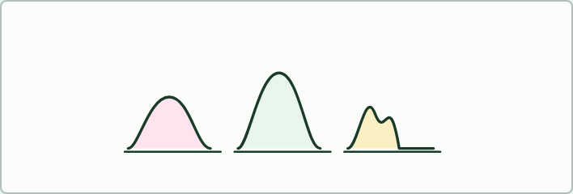
WRITING · HL
THE LESSON
Three kinds of selection
THE TASK
Pairs invent one new example (funny is allowed, impossible is not) for each of directional, stabilising and disruptive selection, with a sketch of the curve before and after and a line saying which alleles become more common. Swap and check: does each example remove the right part of the curve?
STUDENTS NEED
Mini whiteboards or squared paper.
Minutes 0 to 5
Notes:
Minutes 0 to 5 of 60: Do now (5 min).
The plan: Draw a bell curve for beak depth. Shade the part that a pressure removes and redraw the population after, for the pressure the teacher names: a sudden cold snap that only kills small birds. Which kind of selection is it?
The activity: Three kinds of selection. Pairs invent one new example (funny is allowed, impossible is not) for each of directional, stabilising and disruptive selection, with a sketch of the curve before and after and a line saying which alleles become more common. Swap and check: does each example remove the right part of the curve?
Needs: mini whiteboards or squared paper.
The lesson is built round this activity: the steps that follow run it.

Slide 4
STEP 2
10 MIN
Three curves
Students use the Remember it tiles (Drive, Squeeze, Divide) and write one new example of each (the funnier the better) on the card below.
Minutes 5 to 15
Notes:
Minutes 5 to 15 of 60: Three curves (10 min).
The plan: Chapter 9's figure and the film, one kind at a time. Students use the Remember it tiles (Drive, Squeeze, Divide) and write one new example of each (the funnier the better) on the card below. Then the predict box on birth weight.

Slide 5
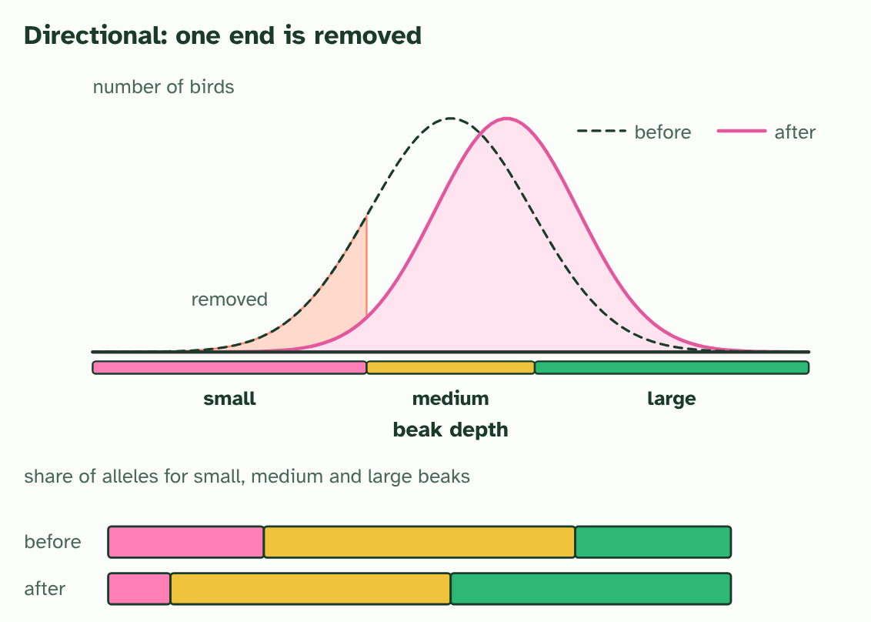
CHAPTER 9 · D4.1.12 Directional, stabilising and disruptive selection
1 / 3
Three ways selection can act
Directional: one tail of the curve is removed, and the whole curve shifts. Alleles for large beaks become commoner.
Minutes 5 to 15
Notes:
Minutes 5 to 15 of 60: Three curves (10 min).
The plan: Chapter 9's figure and the film, one kind at a time. Students use the Remember it tiles (Drive, Squeeze, Divide) and write one new example of each (the funnier the better) on the card below. Then the predict box on birth weight.
A trait such as beak depth varies in a population, and most birds sit near the middle. Which individuals are favoured depends on the pressure, and the shape of the whole distribution shows which of three patterns is acting.
In directional selection one extreme is favoured, so the whole population shifts towards it. Antibiotic resistance in bacteria is the standard case: the resistant extreme survives, and resistance alleles become more common.
In stabilising selection the middle is favoured and both extremes are removed. Human birth weight is the classic example: very small and very large babies have lower survival than average ones, so the range narrows around the middle.
In disruptive selection both extremes are favoured and the middle is removed. Imagine a bird on an island with only very hard seeds and very soft seeds: deep beaks crack the hard, shallow beaks pick up the soft, and middling beaks do neither well. The population may split into two forms.
All three change allele frequencies. This is the point students most often miss for stabilising selection, because the average does not move. But the alleles that push the trait to the extremes are removed, so their frequencies fall, and the alleles for the middle form rise. Any selection that sorts individuals by a heritable trait leaves the gene pool changed.

Slide 6
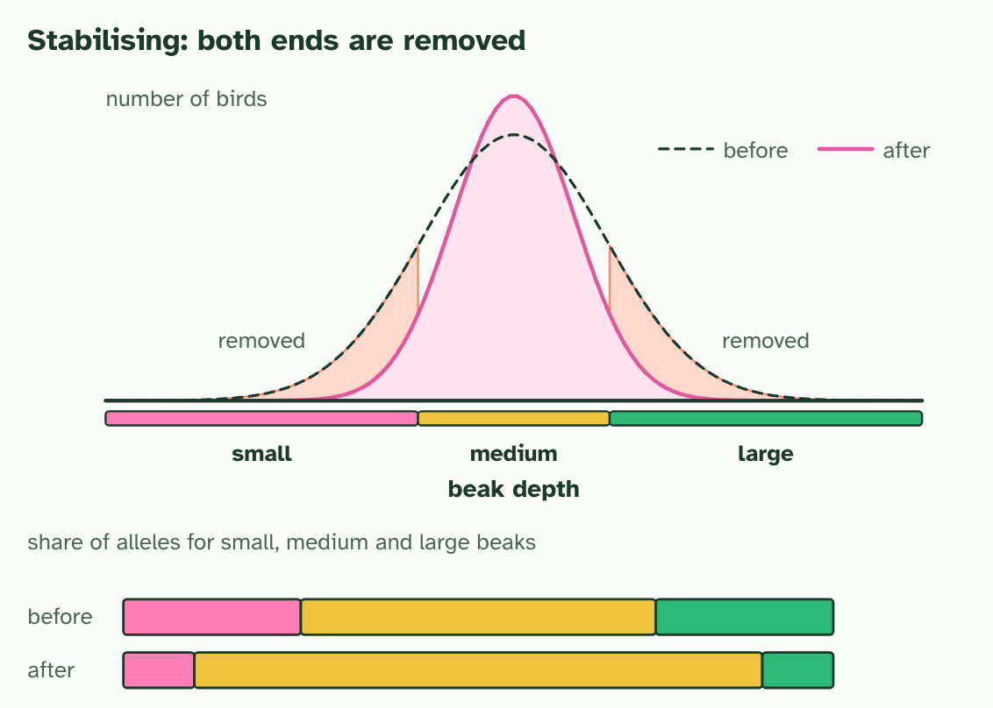
CHAPTER 9 · D4.1.12 Directional, stabilising and disruptive selection
2 / 3
Three ways selection can act
Stabilising: both tails are removed and the curve narrows. Alleles for the extremes become rarer.
Minutes 5 to 15
Notes:
Minutes 5 to 15 of 60: Three curves (10 min).
The plan: Chapter 9's figure and the film, one kind at a time. Students use the Remember it tiles (Drive, Squeeze, Divide) and write one new example of each (the funnier the better) on the card below. Then the predict box on birth weight.
A trait such as beak depth varies in a population, and most birds sit near the middle. Which individuals are favoured depends on the pressure, and the shape of the whole distribution shows which of three patterns is acting.
In directional selection one extreme is favoured, so the whole population shifts towards it. Antibiotic resistance in bacteria is the standard case: the resistant extreme survives, and resistance alleles become more common.
In stabilising selection the middle is favoured and both extremes are removed. Human birth weight is the classic example: very small and very large babies have lower survival than average ones, so the range narrows around the middle.
In disruptive selection both extremes are favoured and the middle is removed. Imagine a bird on an island with only very hard seeds and very soft seeds: deep beaks crack the hard, shallow beaks pick up the soft, and middling beaks do neither well. The population may split into two forms.
All three change allele frequencies. This is the point students most often miss for stabilising selection, because the average does not move. But the alleles that push the trait to the extremes are removed, so their frequencies fall, and the alleles for the middle form rise. Any selection that sorts individuals by a heritable trait leaves the gene pool changed.

Slide 7
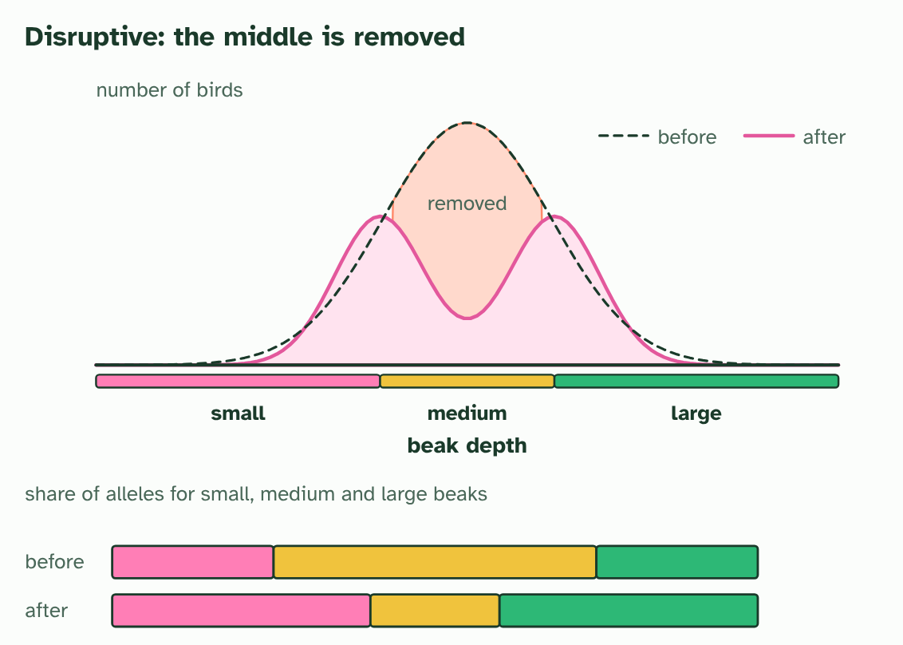
CHAPTER 9 · D4.1.12 Directional, stabilising and disruptive selection
3 / 3
Three ways selection can act
Disruptive: the middle is removed and the curve splits in two. Alleles for both extremes become commoner.
Minutes 5 to 15
Notes:
Minutes 5 to 15 of 60: Three curves (10 min).
The plan: Chapter 9's figure and the film, one kind at a time. Students use the Remember it tiles (Drive, Squeeze, Divide) and write one new example of each (the funnier the better) on the card below. Then the predict box on birth weight.
A trait such as beak depth varies in a population, and most birds sit near the middle. Which individuals are favoured depends on the pressure, and the shape of the whole distribution shows which of three patterns is acting.
In directional selection one extreme is favoured, so the whole population shifts towards it. Antibiotic resistance in bacteria is the standard case: the resistant extreme survives, and resistance alleles become more common.
In stabilising selection the middle is favoured and both extremes are removed. Human birth weight is the classic example: very small and very large babies have lower survival than average ones, so the range narrows around the middle.
In disruptive selection both extremes are favoured and the middle is removed. Imagine a bird on an island with only very hard seeds and very soft seeds: deep beaks crack the hard, shallow beaks pick up the soft, and middling beaks do neither well. The population may split into two forms.
All three change allele frequencies. This is the point students most often miss for stabilising selection, because the average does not move. But the alleles that push the trait to the extremes are removed, so their frequencies fall, and the alleles for the middle form rise. Any selection that sorts individuals by a heritable trait leaves the gene pool changed.

Slide 8
CHAPTER 9 · D4.1.12 Directional, stabilising and disruptive selection
Three ways selection can act
In directional selection one extreme is favoured, so the whole population shifts towards it.
In stabilising selection the middle is favoured and both extremes are removed.
In disruptive selection both extremes are favoured and the middle is removed.
This is the point students most often miss for stabilising selection, because the average does not move.
Minutes 5 to 15
Notes:
Minutes 5 to 15 of 60: Three curves (10 min).
The plan: Chapter 9's figure and the film, one kind at a time. Students use the Remember it tiles (Drive, Squeeze, Divide) and write one new example of each (the funnier the better) on the card below. Then the predict box on birth weight.
A trait such as beak depth varies in a population, and most birds sit near the middle. Which individuals are favoured depends on the pressure, and the shape of the whole distribution shows which of three patterns is acting.
In directional selection one extreme is favoured, so the whole population shifts towards it. Antibiotic resistance in bacteria is the standard case: the resistant extreme survives, and resistance alleles become more common.
In stabilising selection the middle is favoured and both extremes are removed. Human birth weight is the classic example: very small and very large babies have lower survival than average ones, so the range narrows around the middle.
In disruptive selection both extremes are favoured and the middle is removed. Imagine a bird on an island with only very hard seeds and very soft seeds: deep beaks crack the hard, shallow beaks pick up the soft, and middling beaks do neither well. The population may split into two forms.
All three change allele frequencies. This is the point students most often miss for stabilising selection, because the average does not move. But the alleles that push the trait to the extremes are removed, so their frequencies fall, and the alleles for the middle form rise. Any selection that sorts individuals by a heritable trait leaves the gene pool changed.

Slide 9
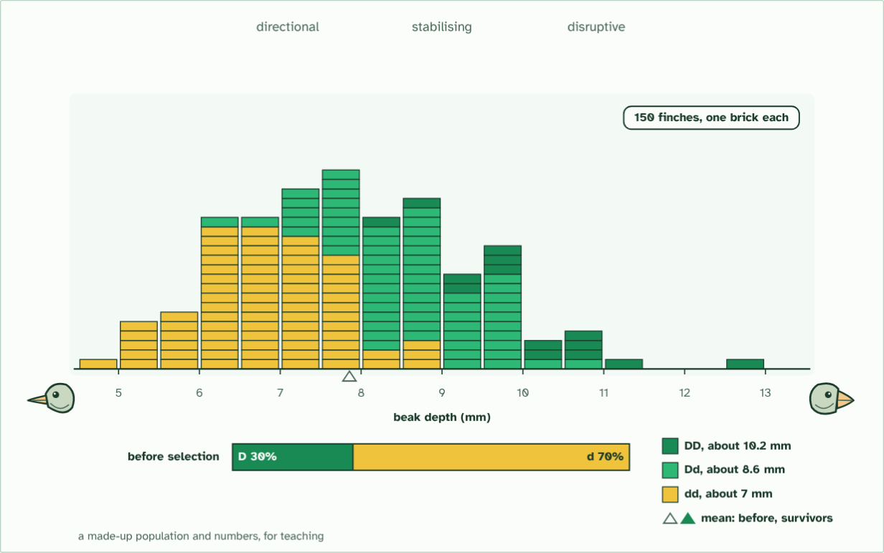
CHAPTER 9 · D4.1.12 Directional, stabilising and disruptive selection
one generation: 150 finches
1 / 4
Three ways selection can act
One population of 150 finches: how deep each beak is. One gene adds about 1.6 mm for each D allele; other genes and food add the rest. D is 30% of the alleles.
Minutes 5 to 15
Notes:
Minutes 5 to 15 of 60: Three curves (10 min).
The plan: Chapter 9's figure and the film, one kind at a time. Students use the Remember it tiles (Drive, Squeeze, Divide) and write one new example of each (the funnier the better) on the card below. Then the predict box on birth weight.
A trait such as beak depth varies in a population, and most birds sit near the middle. Which individuals are favoured depends on the pressure, and the shape of the whole distribution shows which of three patterns is acting.
In directional selection one extreme is favoured, so the whole population shifts towards it. Antibiotic resistance in bacteria is the standard case: the resistant extreme survives, and resistance alleles become more common.
In stabilising selection the middle is favoured and both extremes are removed. Human birth weight is the classic example: very small and very large babies have lower survival than average ones, so the range narrows around the middle.
In disruptive selection both extremes are favoured and the middle is removed. Imagine a bird on an island with only very hard seeds and very soft seeds: deep beaks crack the hard, shallow beaks pick up the soft, and middling beaks do neither well. The population may split into two forms.
All three change allele frequencies. This is the point students most often miss for stabilising selection, because the average does not move. But the alleles that push the trait to the extremes are removed, so their frequencies fall, and the alleles for the middle form rise. Any selection that sorts individuals by a heritable trait leaves the gene pool changed.
The animation "Watch it happen: one population, three kinds of selection", paused at 2.5 s. The next slides go on through it, then play it.

Slide 10
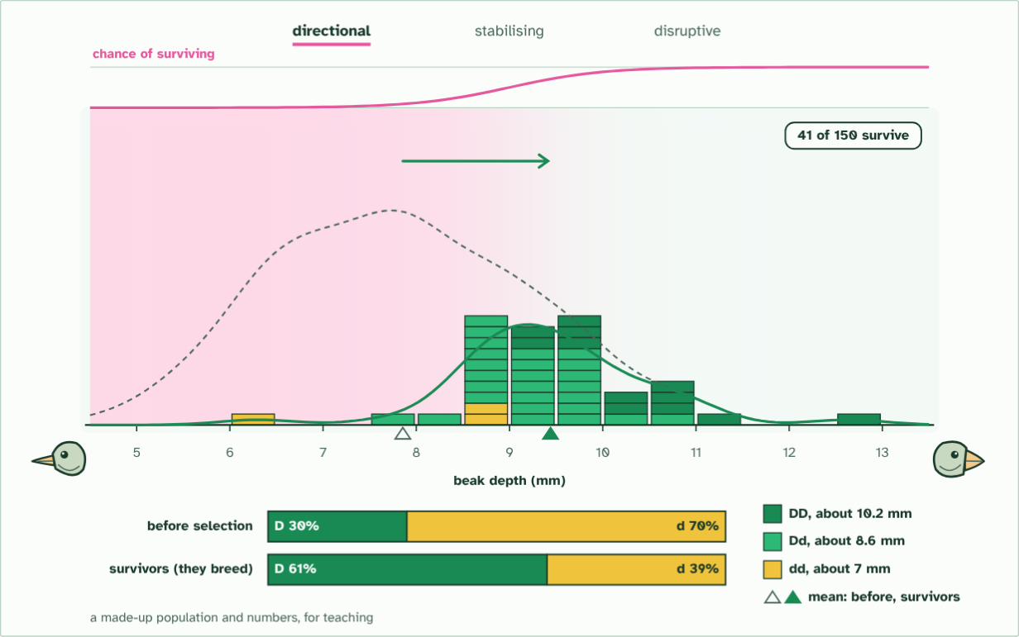
CHAPTER 9 · D4.1.12 Directional, stabilising and disruptive selection
directional: D 30% to 61%
2 / 4
Three ways selection can act
The survivors breed. Their mean moves deeper, and D rises from 30% to 61% of the alleles they pass on.
Minutes 5 to 15
Notes:
Minutes 5 to 15 of 60: Three curves (10 min).
The plan: Chapter 9's figure and the film, one kind at a time. Students use the Remember it tiles (Drive, Squeeze, Divide) and write one new example of each (the funnier the better) on the card below. Then the predict box on birth weight.
A trait such as beak depth varies in a population, and most birds sit near the middle. Which individuals are favoured depends on the pressure, and the shape of the whole distribution shows which of three patterns is acting.
In directional selection one extreme is favoured, so the whole population shifts towards it. Antibiotic resistance in bacteria is the standard case: the resistant extreme survives, and resistance alleles become more common.
In stabilising selection the middle is favoured and both extremes are removed. Human birth weight is the classic example: very small and very large babies have lower survival than average ones, so the range narrows around the middle.
In disruptive selection both extremes are favoured and the middle is removed. Imagine a bird on an island with only very hard seeds and very soft seeds: deep beaks crack the hard, shallow beaks pick up the soft, and middling beaks do neither well. The population may split into two forms.
All three change allele frequencies. This is the point students most often miss for stabilising selection, because the average does not move. But the alleles that push the trait to the extremes are removed, so their frequencies fall, and the alleles for the middle form rise. Any selection that sorts individuals by a heritable trait leaves the gene pool changed.
The animation "Watch it happen: one population, three kinds of selection", paused at 14.0 s. The next slides go on through it, then play it.

Slide 11
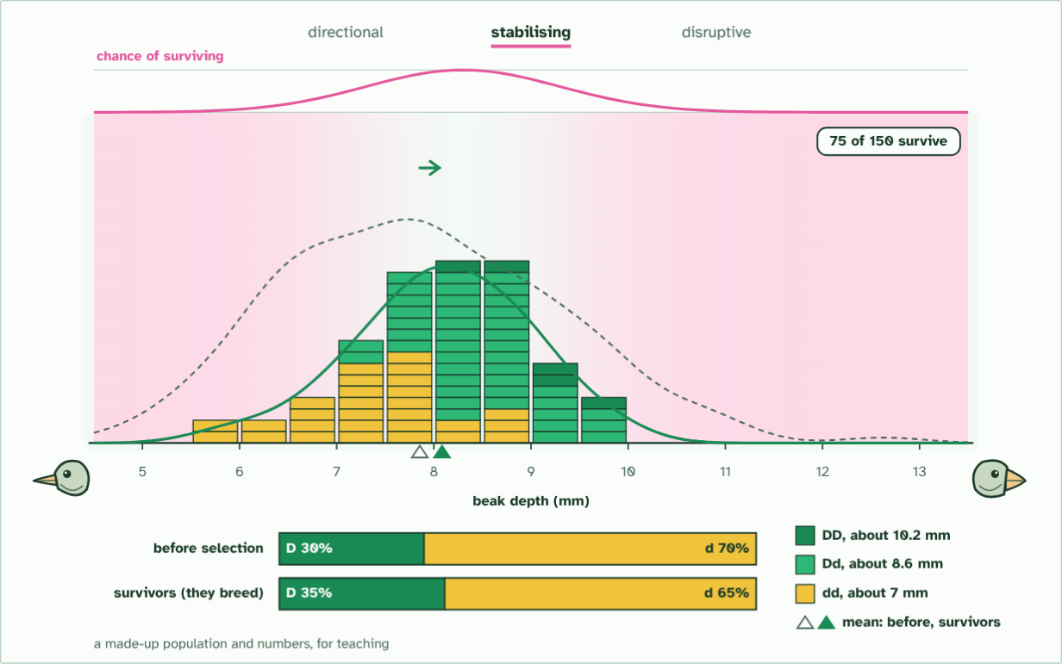
CHAPTER 9 · D4.1.12 Directional, stabilising and disruptive selection
stabilising: D 30% to 35%
3 / 4
Three ways selection can act
The spread narrows. D still shifts, 30% to 35%: the favoured middle is mostly Dd, so more D is kept than before.
Minutes 5 to 15
Notes:
Minutes 5 to 15 of 60: Three curves (10 min).
The plan: Chapter 9's figure and the film, one kind at a time. Students use the Remember it tiles (Drive, Squeeze, Divide) and write one new example of each (the funnier the better) on the card below. Then the predict box on birth weight.
A trait such as beak depth varies in a population, and most birds sit near the middle. Which individuals are favoured depends on the pressure, and the shape of the whole distribution shows which of three patterns is acting.
In directional selection one extreme is favoured, so the whole population shifts towards it. Antibiotic resistance in bacteria is the standard case: the resistant extreme survives, and resistance alleles become more common.
In stabilising selection the middle is favoured and both extremes are removed. Human birth weight is the classic example: very small and very large babies have lower survival than average ones, so the range narrows around the middle.
In disruptive selection both extremes are favoured and the middle is removed. Imagine a bird on an island with only very hard seeds and very soft seeds: deep beaks crack the hard, shallow beaks pick up the soft, and middling beaks do neither well. The population may split into two forms.
All three change allele frequencies. This is the point students most often miss for stabilising selection, because the average does not move. But the alleles that push the trait to the extremes are removed, so their frequencies fall, and the alleles for the middle form rise. Any selection that sorts individuals by a heritable trait leaves the gene pool changed.
The animation "Watch it happen: one population, three kinds of selection", paused at 26.0 s. The next slides go on through it, then play it.

Slide 12
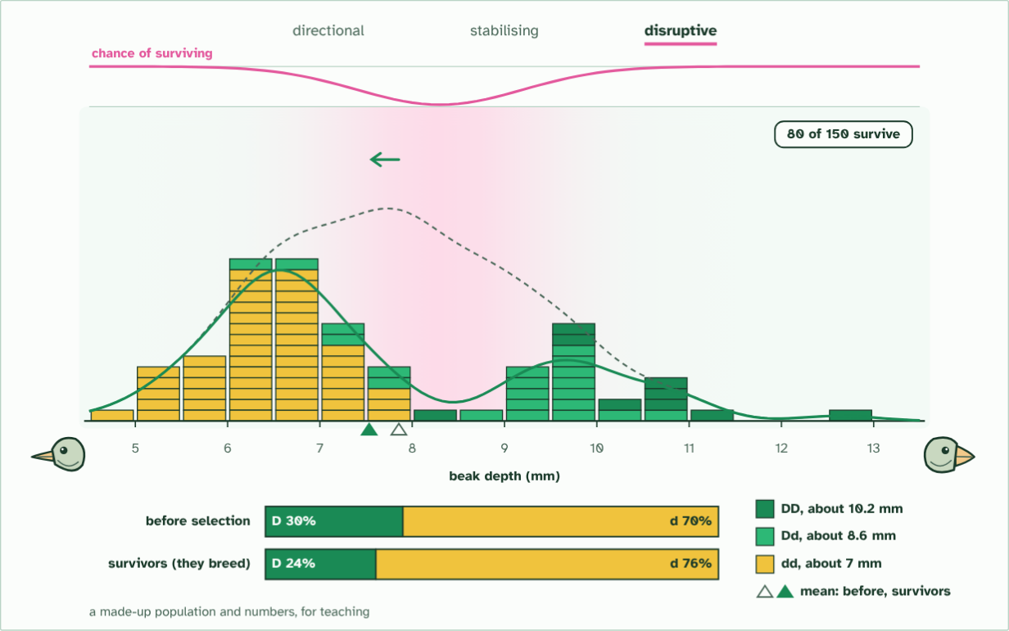
CHAPTER 9 · D4.1.12 Directional, stabilising and disruptive selection
disruptive: D 30% to 24%
4 / 4
Three ways selection can act
Two peaks are left. The middle was mostly Dd, so D falls, 30% to 24%. All three kinds change allele frequency.
Minutes 5 to 15
Notes:
Minutes 5 to 15 of 60: Three curves (10 min).
The plan: Chapter 9's figure and the film, one kind at a time. Students use the Remember it tiles (Drive, Squeeze, Divide) and write one new example of each (the funnier the better) on the card below. Then the predict box on birth weight.
A trait such as beak depth varies in a population, and most birds sit near the middle. Which individuals are favoured depends on the pressure, and the shape of the whole distribution shows which of three patterns is acting.
In directional selection one extreme is favoured, so the whole population shifts towards it. Antibiotic resistance in bacteria is the standard case: the resistant extreme survives, and resistance alleles become more common.
In stabilising selection the middle is favoured and both extremes are removed. Human birth weight is the classic example: very small and very large babies have lower survival than average ones, so the range narrows around the middle.
In disruptive selection both extremes are favoured and the middle is removed. Imagine a bird on an island with only very hard seeds and very soft seeds: deep beaks crack the hard, shallow beaks pick up the soft, and middling beaks do neither well. The population may split into two forms.
All three change allele frequencies. This is the point students most often miss for stabilising selection, because the average does not move. But the alleles that push the trait to the extremes are removed, so their frequencies fall, and the alleles for the middle form rise. Any selection that sorts individuals by a heritable trait leaves the gene pool changed.
The animation "Watch it happen: one population, three kinds of selection", paused at 38.0 s. The next slides go on through it, then play it.

Slide 13
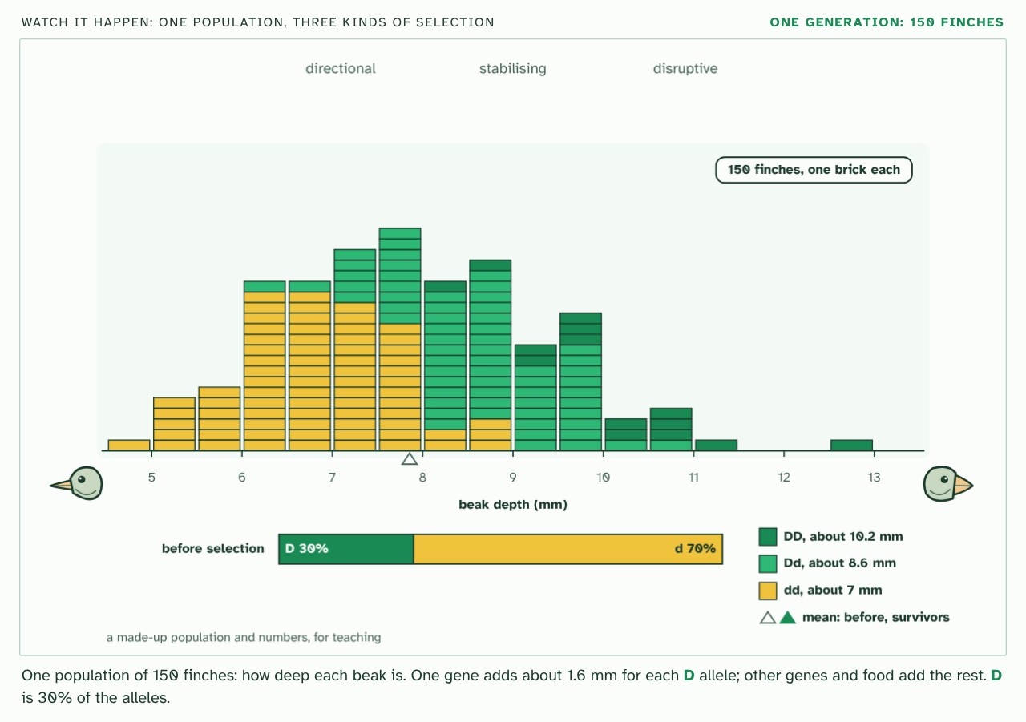
CHAPTER 9 · D4.1.12 Directional, stabilising and disruptive selection
PLAY IT
Three ways selection can act
Watch it happen: one population, three kinds of selection: click to play. It loops every 39 seconds.
Minutes 5 to 15
Notes:
Minutes 5 to 15 of 60: Three curves (10 min).
The plan: Chapter 9's figure and the film, one kind at a time. Students use the Remember it tiles (Drive, Squeeze, Divide) and write one new example of each (the funnier the better) on the card below. Then the predict box on birth weight.
The video is selection-types-f1d54b.mp4, one loop of the animation in the guide. It plays in PowerPoint and Keynote. Google Slides does not play a video embedded in a .pptx: download selection-types-f1d54b.mp4 (https://www.biologybybradford.com/guides/downloads/scenes/selection-types-f1d54b.mp4), upload it to Google Drive, then Insert > Video > Google Drive.
In the guide the class can change it as it runs: https://www.biologybybradford.com/guides/ib-biology-d4-1-natural-selection#modes
What it shows, in order:
1. One population of 150 finches: how deep each beak is. One gene adds about 1.6 mm for each D allele; other genes and food add the rest. D is 30% of the alleles.
2. The survivors breed. Their mean moves deeper, and D rises from 30% to 61% of the alleles they pass on.
3. The spread narrows. D still shifts, 30% to 35%: the favoured middle is mostly Dd, so more D is kept than before.
4. Two peaks are left. The middle was mostly Dd, so D falls, 30% to 24%. All three kinds change allele frequency.

Slide 14
PREDICT
Babies of very low and very high birth weight are less likely to survive than babies of average weight. Which kind of selection is this?
A Directional selection, because birth weight is being pushed in one direction
B Disruptive selection, because birth weights at both extremes are being favoured
C Stabilising selection, because both extremes are removed
Minutes 5 to 15
Notes:
Minutes 5 to 15 of 60: Three curves (10 min).
The plan: Chapter 9's figure and the film, one kind at a time. Students use the Remember it tiles (Drive, Squeeze, Divide) and write one new example of each (the funnier the better) on the card below. Then the predict box on birth weight.
Ask for a show of hands, or mini whiteboards, before revealing. (Answer: C, on the next slide.)

Slide 15
WHAT HAPPENS
Babies of very low and very high birth weight are less likely to survive than babies of average weight. Which kind of selection is this?
A Directional selection, because birth weight is being pushed in one direction
B Disruptive selection, because birth weights at both extremes are being favoured
C Stabilising selection, because both extremes are removed
Stabilising selection. Both the smallest and the largest are removed, so the range narrows around the average and the average itself stays the same. It still changes allele frequencies: the alleles that push weight to the extremes become rarer.
Minutes 5 to 15
Notes:
Minutes 5 to 15 of 60: Three curves (10 min).
The plan: Chapter 9's figure and the film, one kind at a time. Students use the Remember it tiles (Drive, Squeeze, Divide) and write one new example of each (the funnier the better) on the card below. Then the predict box on birth weight.
Answer: C. Stabilising selection. Both the smallest and the largest are removed, so the range narrows around the average and the average itself stays the same. It still changes allele frequencies: the alleles that push weight to the extremes become rarer.

Slide 16
WATCH OUT
Stabilising selection is not "no selection". The average stays the same because selection is at work: it keeps removing the extremes. Remember that all three kinds change allele frequencies.
Minutes 5 to 15
Notes:
Minutes 5 to 15 of 60: Three curves (10 min).
The plan: Chapter 9's figure and the film, one kind at a time. Students use the Remember it tiles (Drive, Squeeze, Divide) and write one new example of each (the funnier the better) on the card below. Then the predict box on birth weight.
A common mistake: say it, then ask who can say why it is wrong.

Slide 17
REMEMBER IT
The three kinds of selection
D
S
D
Drive
Squeeze
Divide
Minutes 5 to 15
Notes:
Minutes 5 to 15 of 60: Three curves (10 min).
The plan: Chapter 9's figure and the film, one kind at a time. Students use the Remember it tiles (Drive, Squeeze, Divide) and write one new example of each (the funnier the better) on the card below. Then the predict box on birth weight.
Ask the class what each letter stands for before revealing.

Slide 18
REMEMBER IT
The three kinds of selection
D
S
D
Drive
Squeeze
Divide
Directional
Stabilising
Disruptive
one end is removed and the mean shifts
both ends are removed and the range narrows
the middle is removed and two groups emerge
Minutes 5 to 15
Notes:
Minutes 5 to 15 of 60: Three curves (10 min).
The plan: Chapter 9's figure and the film, one kind at a time. Students use the Remember it tiles (Drive, Squeeze, Divide) and write one new example of each (the funnier the better) on the card below. Then the predict box on birth weight.
Drive: Directional (one end is removed and the mean shifts)
Squeeze: Stabilising (both ends are removed and the range narrows)
Divide: Disruptive (the middle is removed and two groups emerge)

Slide 19

PROBLEM SET · HL
10 MIN
Hardy-Weinberg problems
THE TASK
Six problems, in order. (1) A recessive trait with q² = 0.25: find q, p and the carriers. q = 0.5, p = 0.5, Aa = 0.5. (2) p = 0.8: genotype frequencies, and how many of 500 are Aa. 0.64, 0.32, 0.04; 160. (3) Of 1000 beetles, 360 are recessive: how many are AA and how many Aa? q = 0.6, p = 0.4: AA 160, Aa 480. (4) Counts of 90 AA, 60 Aa and 50 aa: find the allele frequencies and say whether the population is in equilibrium. A = 0.6, a = 0.4; expected 0.36, 0.48, 0.16, observed 0.45, 0.30, 0.25, so no: too few heterozygotes. (5) A recessive condition affects 1 person in 10 000: roughly how many carry it? q = 0.01, 2pq = 0.0198, about 1 in 50. (6) A gene at equilibrium has 0.32 heterozygotes: what are p and q? 0.8 and 0.2, or 0.2 and 0.8: you cannot tell which allele is which without one more genotype frequency.
STUDENTS NEED
Printed problems, calculators, a copy of chapter 10's figure.
Minutes 5 to 15
Notes:
Minutes 5 to 15 of 60: Three curves (10 min).
The plan: Chapter 9's figure and the film, one kind at a time. Students use the Remember it tiles (Drive, Squeeze, Divide) and write one new example of each (the funnier the better) on the card below. Then the predict box on birth weight.
The activity: Hardy-Weinberg problems. Six problems, in order. (1) A recessive trait with q² = 0.25: find q, p and the carriers. q = 0.5, p = 0.5, Aa = 0.5. (2) p = 0.8: genotype frequencies, and how many of 500 are Aa. 0.64, 0.32, 0.04; 160. (3) Of 1000 beetles, 360 are recessive: how many are AA and how many Aa? q = 0.6, p = 0.4: AA 160, Aa 480. (4) Counts of 90 AA, 60 Aa and 50 aa: find the allele frequencies and say whether the population is in equilibrium. A = 0.6, a = 0.4; expected 0.36, 0.48, 0.16, observed 0.45, 0.30, 0.25, so no: too few heterozygotes. (5) A recessive condition affects 1 person in 10 000: roughly how many carry it? q = 0.01, 2pq = 0.0198, about 1 in 50. (6) A gene at equilibrium has 0.32 heterozygotes: what are p and q? 0.8 and 0.2, or 0.2 and 0.8: you cannot tell which allele is which without one more genotype frequency.
Needs: printed problems, calculators, a copy of chapter 10's figure.
The time: 10 minutes, minutes 5 to 15 of the plan.

Slide 20
STEP 3
10 MIN
The square
Students redraw the square for p = 0.7, then use it to find the genotype frequencies.
Minutes 15 to 25
Notes:
Minutes 15 to 25 of 60: The square (10 min).
The plan: Chapter 10's figure: why p² + 2pq + q² = 1. Students redraw the square for p = 0.7, then use it to find the genotype frequencies.

Slide 21
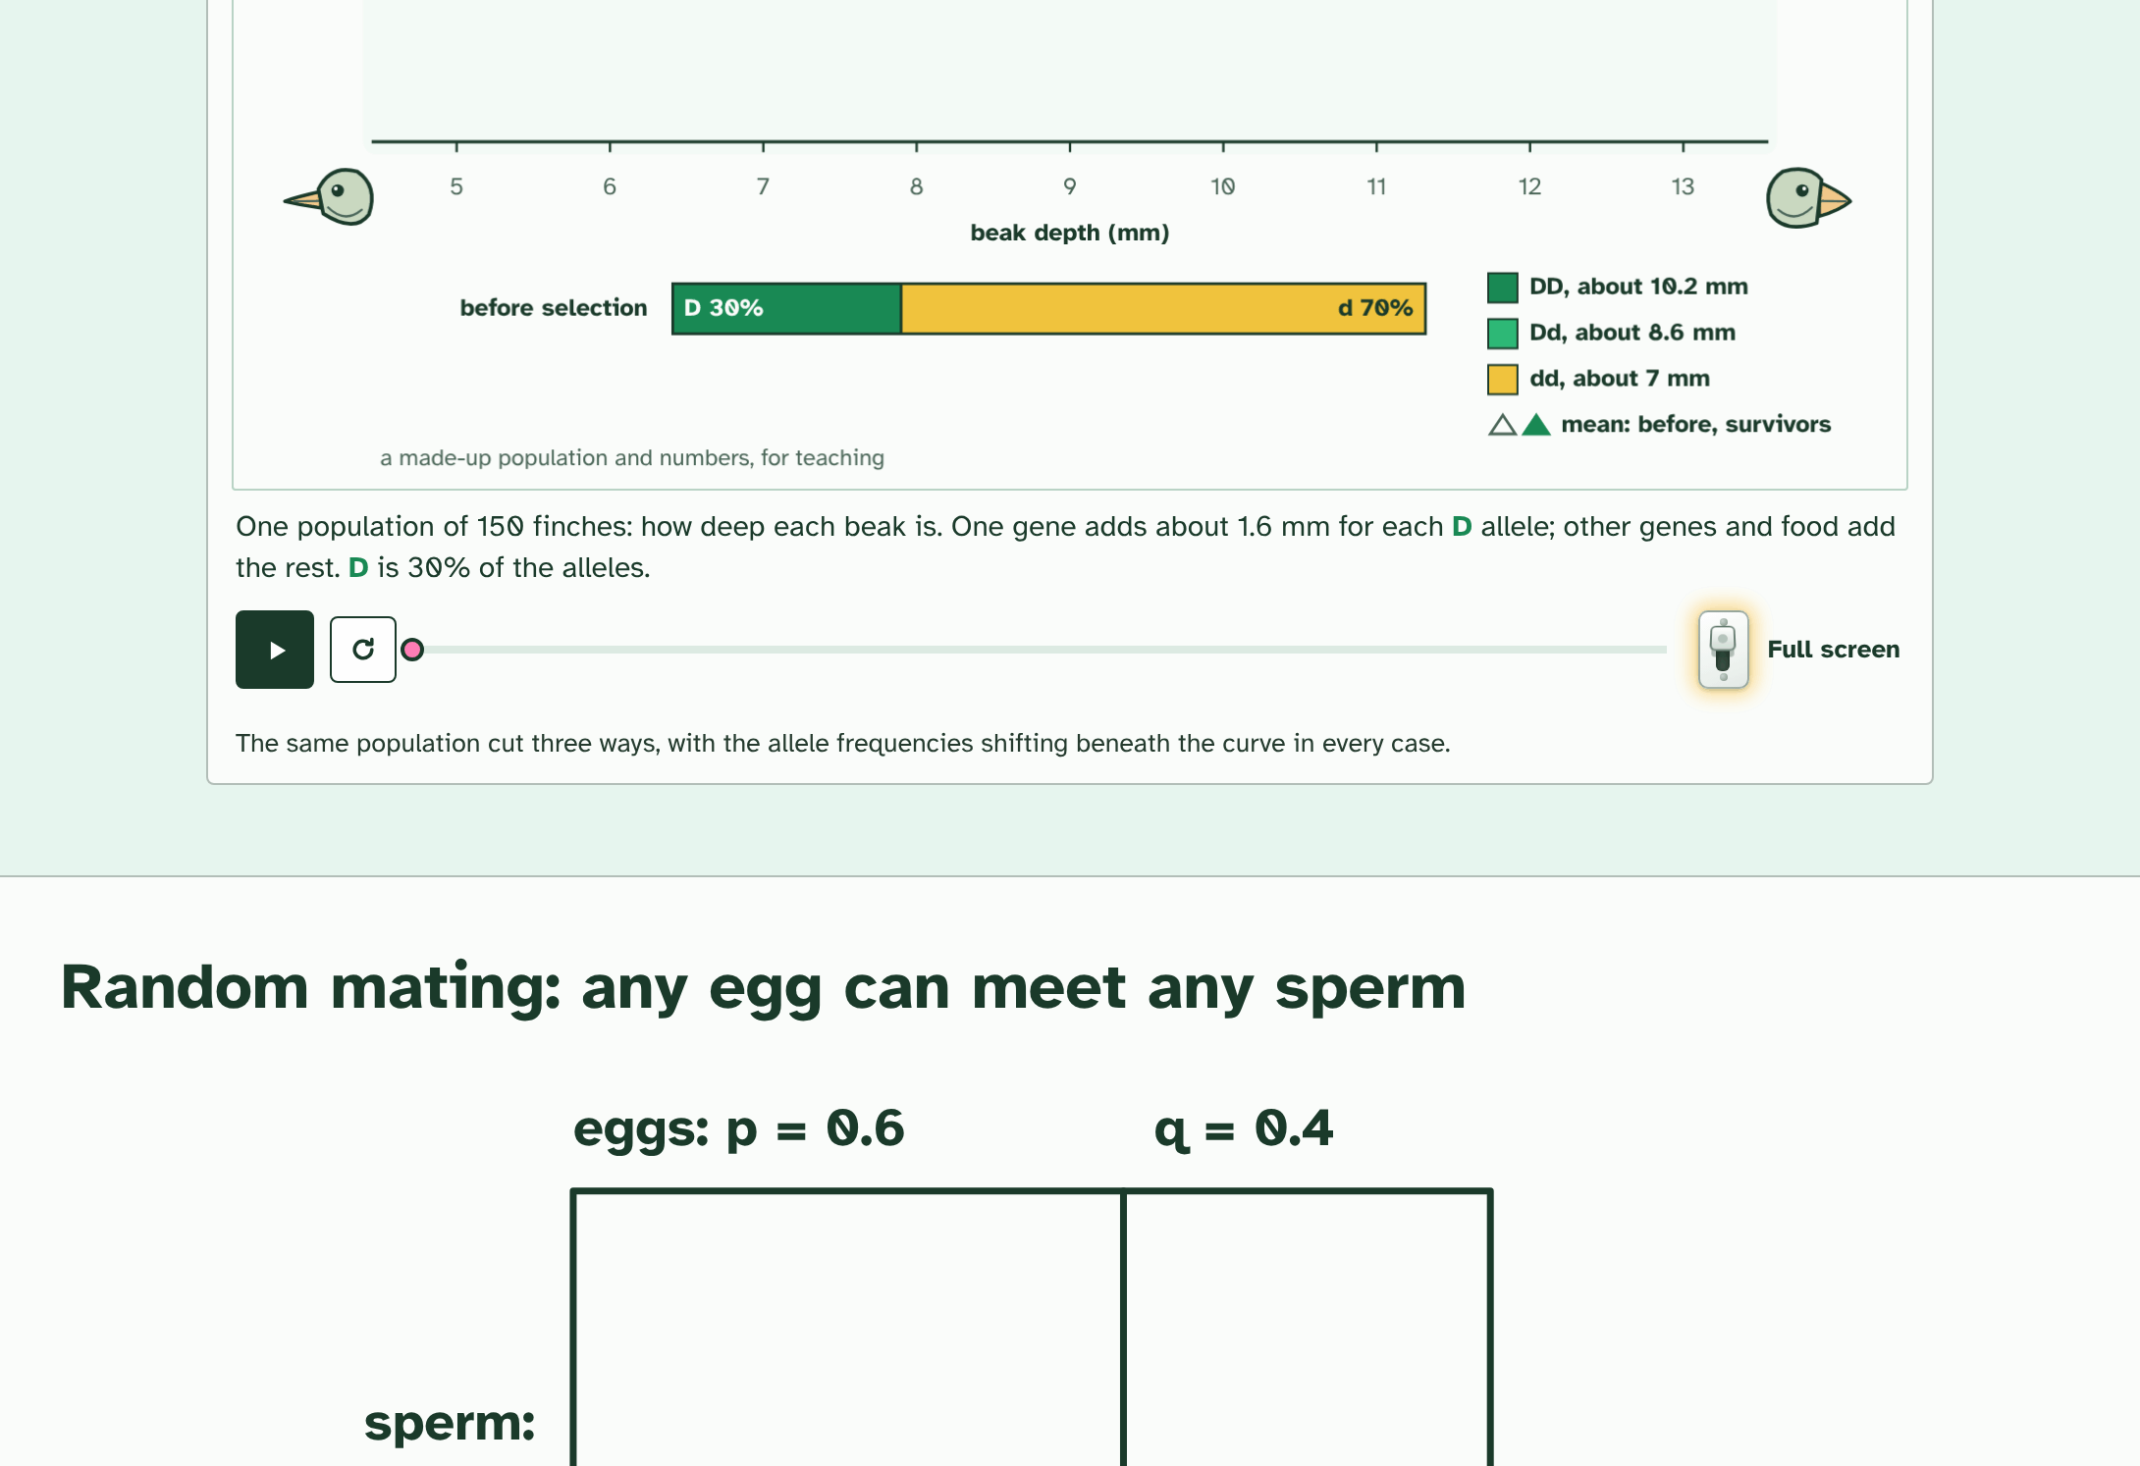
CHAPTER 10 · D4.1.13 D4.1.14 The Hardy-Weinberg equation
1 / 4
What a population would be like if it were not evolving
Egg and sperm alleles meet at random. If the frequency of A is p = 0.6 and of a is q = 0.4, each edge of the square is split in those proportions.
Minutes 15 to 25
Notes:
Minutes 15 to 25 of 60: The square (10 min).
The plan: Chapter 10's figure: why p² + 2pq + q² = 1. Students redraw the square for p = 0.7, then use it to find the genotype frequencies.
To tell whether a population is evolving you need something to compare it with. The Hardy-Weinberg equation gives it: the genotype frequencies you would expect in a population in genetic equilibrium, where the allele frequencies stay the same from one generation to the next.
For a gene with two alleles, let p be the frequency of one (A) and q the frequency of the other (a). They are the only alleles, so p + q = 1. With random mating, any egg can meet any sperm, so the genotype frequencies are the square of that: p² + 2pq + q² = 1, where p² is AA, 2pq is Aa and q² is aa. The figure shows why the middle term is double: there are two ways to be a heterozygote.
You can use it two ways. From the allele frequencies, work out the genotypes. Or, if one genotype is known, work back to the alleles. The one you can usually see is the homozygous recessive, whose frequency is q² : take the square root to get q, then p = 1 − q.
The equation holds only if five conditions are met. If real data do not fit it, one of them is failing, and the population is evolving.
Example: Worked example In a population of 200 beetles, 18 are green, which is a recessive trait. q² = 18/200 = 0.09, so q = 0.3 and p = 0.7. The heterozygotes are 2pq = 2 × 0.7 × 0.3 = 0.42, which is 84 beetles. Check: AA = 0.49 (98 beetles), Aa = 0.42 (84), aa = 0.09 (18); 98 + 84 + 18 = 200.

Slide 22
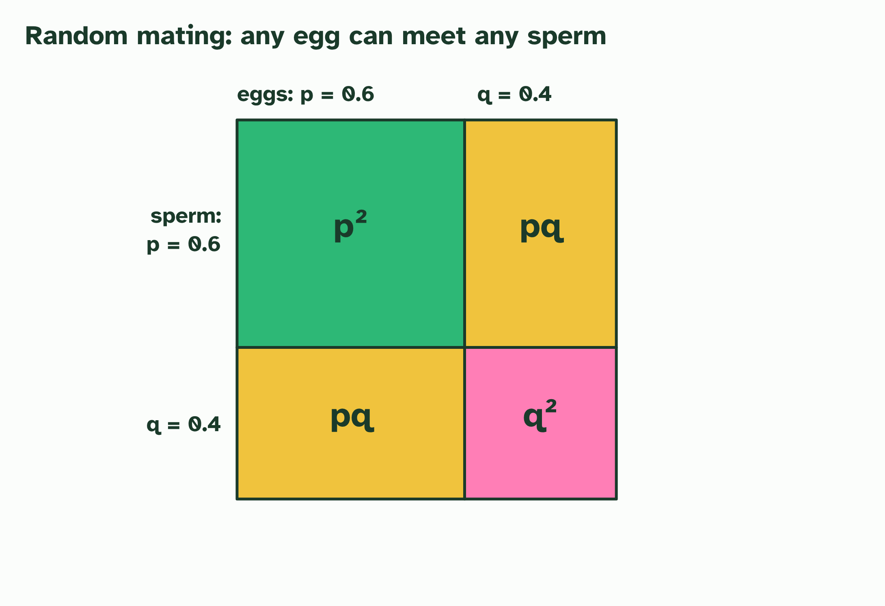
CHAPTER 10 · D4.1.13 D4.1.14 The Hardy-Weinberg equation
2 / 4
What a population would be like if it were not evolving
The four areas are the four ways eggs and sperm can combine: p², pq, pq and q².
Minutes 15 to 25
Notes:
Minutes 15 to 25 of 60: The square (10 min).
The plan: Chapter 10's figure: why p² + 2pq + q² = 1. Students redraw the square for p = 0.7, then use it to find the genotype frequencies.
To tell whether a population is evolving you need something to compare it with. The Hardy-Weinberg equation gives it: the genotype frequencies you would expect in a population in genetic equilibrium, where the allele frequencies stay the same from one generation to the next.
For a gene with two alleles, let p be the frequency of one (A) and q the frequency of the other (a). They are the only alleles, so p + q = 1. With random mating, any egg can meet any sperm, so the genotype frequencies are the square of that: p² + 2pq + q² = 1, where p² is AA, 2pq is Aa and q² is aa. The figure shows why the middle term is double: there are two ways to be a heterozygote.
You can use it two ways. From the allele frequencies, work out the genotypes. Or, if one genotype is known, work back to the alleles. The one you can usually see is the homozygous recessive, whose frequency is q² : take the square root to get q, then p = 1 − q.
The equation holds only if five conditions are met. If real data do not fit it, one of them is failing, and the population is evolving.
Example: Worked example In a population of 200 beetles, 18 are green, which is a recessive trait. q² = 18/200 = 0.09, so q = 0.3 and p = 0.7. The heterozygotes are 2pq = 2 × 0.7 × 0.3 = 0.42, which is 84 beetles. Check: AA = 0.49 (98 beetles), Aa = 0.42 (84), aa = 0.09 (18); 98 + 84 + 18 = 200.

Slide 23
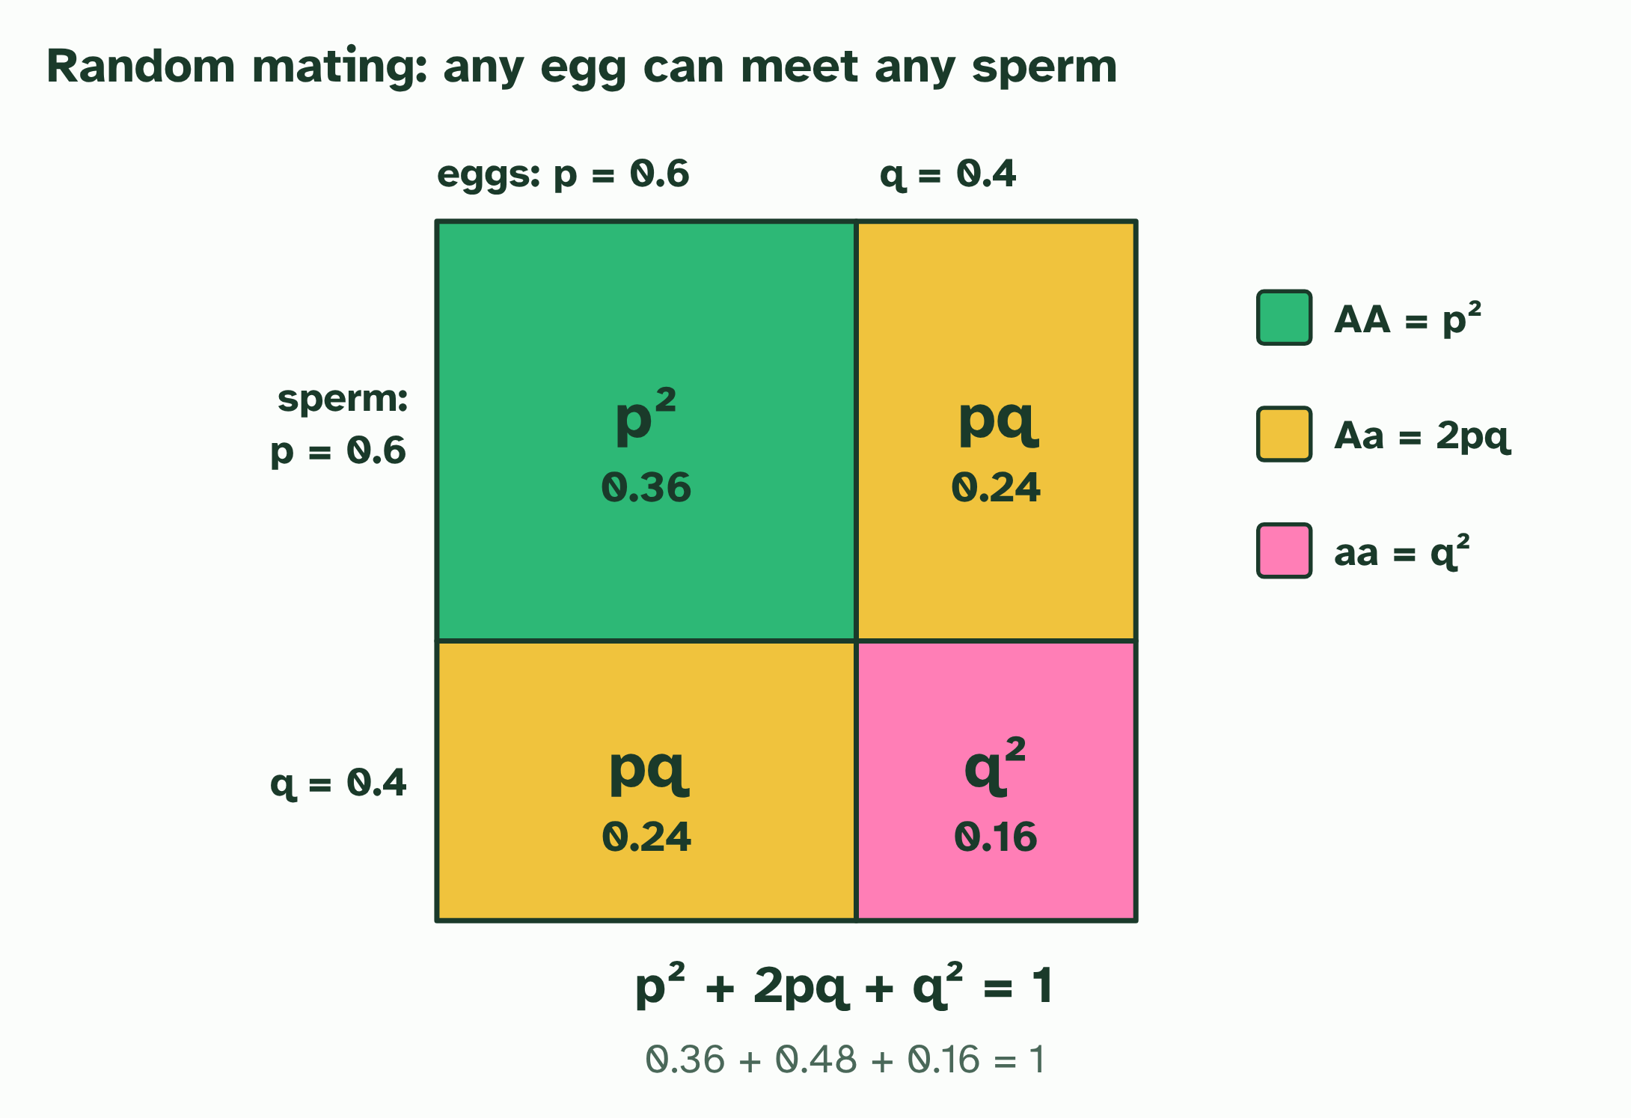
CHAPTER 10 · D4.1.13 D4.1.14 The Hardy-Weinberg equation
3 / 4
What a population would be like if it were not evolving
AA is p² = 0.36, Aa is 2pq = 0.48 and aa is q² = 0.16. Together they make 1.
Minutes 15 to 25
Notes:
Minutes 15 to 25 of 60: The square (10 min).
The plan: Chapter 10's figure: why p² + 2pq + q² = 1. Students redraw the square for p = 0.7, then use it to find the genotype frequencies.
To tell whether a population is evolving you need something to compare it with. The Hardy-Weinberg equation gives it: the genotype frequencies you would expect in a population in genetic equilibrium, where the allele frequencies stay the same from one generation to the next.
For a gene with two alleles, let p be the frequency of one (A) and q the frequency of the other (a). They are the only alleles, so p + q = 1. With random mating, any egg can meet any sperm, so the genotype frequencies are the square of that: p² + 2pq + q² = 1, where p² is AA, 2pq is Aa and q² is aa. The figure shows why the middle term is double: there are two ways to be a heterozygote.
You can use it two ways. From the allele frequencies, work out the genotypes. Or, if one genotype is known, work back to the alleles. The one you can usually see is the homozygous recessive, whose frequency is q² : take the square root to get q, then p = 1 − q.
The equation holds only if five conditions are met. If real data do not fit it, one of them is failing, and the population is evolving.
Example: Worked example In a population of 200 beetles, 18 are green, which is a recessive trait. q² = 18/200 = 0.09, so q = 0.3 and p = 0.7. The heterozygotes are 2pq = 2 × 0.7 × 0.3 = 0.42, which is 84 beetles. Check: AA = 0.49 (98 beetles), Aa = 0.42 (84), aa = 0.09 (18); 98 + 84 + 18 = 200.

Slide 24
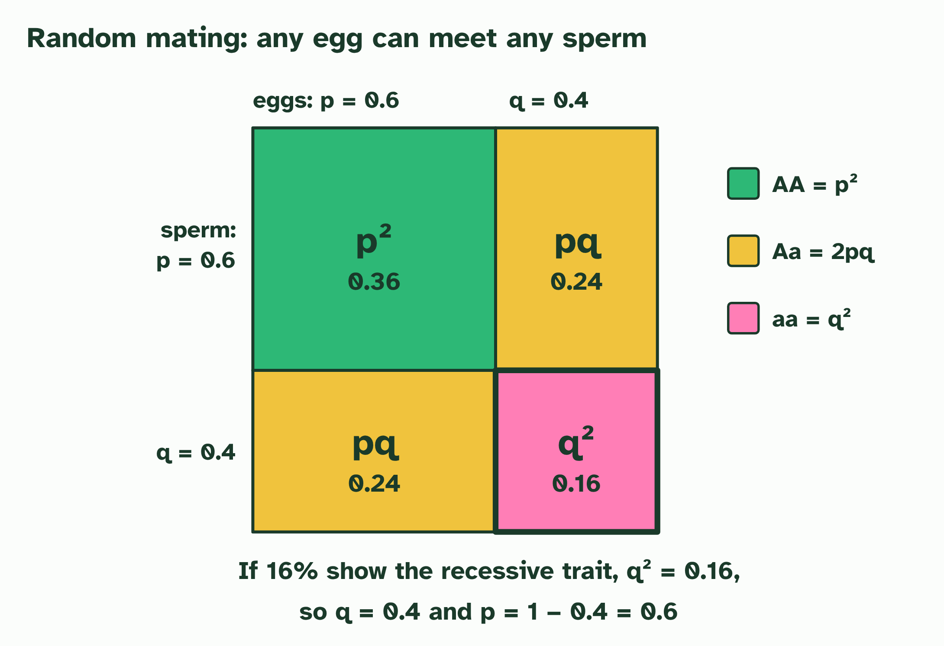
CHAPTER 10 · D4.1.13 D4.1.14 The Hardy-Weinberg equation
4 / 4
What a population would be like if it were not evolving
Working back: if 16% show the recessive trait, q² = 0.16, so q = 0.4 and p = 0.6.
Minutes 15 to 25
Notes:
Minutes 15 to 25 of 60: The square (10 min).
The plan: Chapter 10's figure: why p² + 2pq + q² = 1. Students redraw the square for p = 0.7, then use it to find the genotype frequencies.
To tell whether a population is evolving you need something to compare it with. The Hardy-Weinberg equation gives it: the genotype frequencies you would expect in a population in genetic equilibrium, where the allele frequencies stay the same from one generation to the next.
For a gene with two alleles, let p be the frequency of one (A) and q the frequency of the other (a). They are the only alleles, so p + q = 1. With random mating, any egg can meet any sperm, so the genotype frequencies are the square of that: p² + 2pq + q² = 1, where p² is AA, 2pq is Aa and q² is aa. The figure shows why the middle term is double: there are two ways to be a heterozygote.
You can use it two ways. From the allele frequencies, work out the genotypes. Or, if one genotype is known, work back to the alleles. The one you can usually see is the homozygous recessive, whose frequency is q² : take the square root to get q, then p = 1 − q.
The equation holds only if five conditions are met. If real data do not fit it, one of them is failing, and the population is evolving.
Example: Worked example In a population of 200 beetles, 18 are green, which is a recessive trait. q² = 18/200 = 0.09, so q = 0.3 and p = 0.7. The heterozygotes are 2pq = 2 × 0.7 × 0.3 = 0.42, which is 84 beetles. Check: AA = 0.49 (98 beetles), Aa = 0.42 (84), aa = 0.09 (18); 98 + 84 + 18 = 200.

Slide 25
CHAPTER 10 · D4.1.13 D4.1.14 The Hardy-Weinberg equation
What a population would be like if it were not evolving
The Hardy-Weinberg equation gives it: the genotype frequencies you would expect in a population in genetic equilibrium, where the allele frequencies stay the same from one generation to the next.
For a gene with two alleles, let p be the frequency of one (A) and q the frequency of the other (a).
You can use it two ways.
Minutes 15 to 25
Notes:
Minutes 15 to 25 of 60: The square (10 min).
The plan: Chapter 10's figure: why p² + 2pq + q² = 1. Students redraw the square for p = 0.7, then use it to find the genotype frequencies.
To tell whether a population is evolving you need something to compare it with. The Hardy-Weinberg equation gives it: the genotype frequencies you would expect in a population in genetic equilibrium, where the allele frequencies stay the same from one generation to the next.
For a gene with two alleles, let p be the frequency of one (A) and q the frequency of the other (a). They are the only alleles, so p + q = 1. With random mating, any egg can meet any sperm, so the genotype frequencies are the square of that: p² + 2pq + q² = 1, where p² is AA, 2pq is Aa and q² is aa. The figure shows why the middle term is double: there are two ways to be a heterozygote.
You can use it two ways. From the allele frequencies, work out the genotypes. Or, if one genotype is known, work back to the alleles. The one you can usually see is the homozygous recessive, whose frequency is q² : take the square root to get q, then p = 1 − q.
The equation holds only if five conditions are met. If real data do not fit it, one of them is failing, and the population is evolving.
Example: Worked example In a population of 200 beetles, 18 are green, which is a recessive trait. q² = 18/200 = 0.09, so q = 0.3 and p = 0.7. The heterozygotes are 2pq = 2 × 0.7 × 0.3 = 0.42, which is 84 beetles. Check: AA = 0.49 (98 beetles), Aa = 0.42 (84), aa = 0.09 (18); 98 + 84 + 18 = 200.

Slide 26
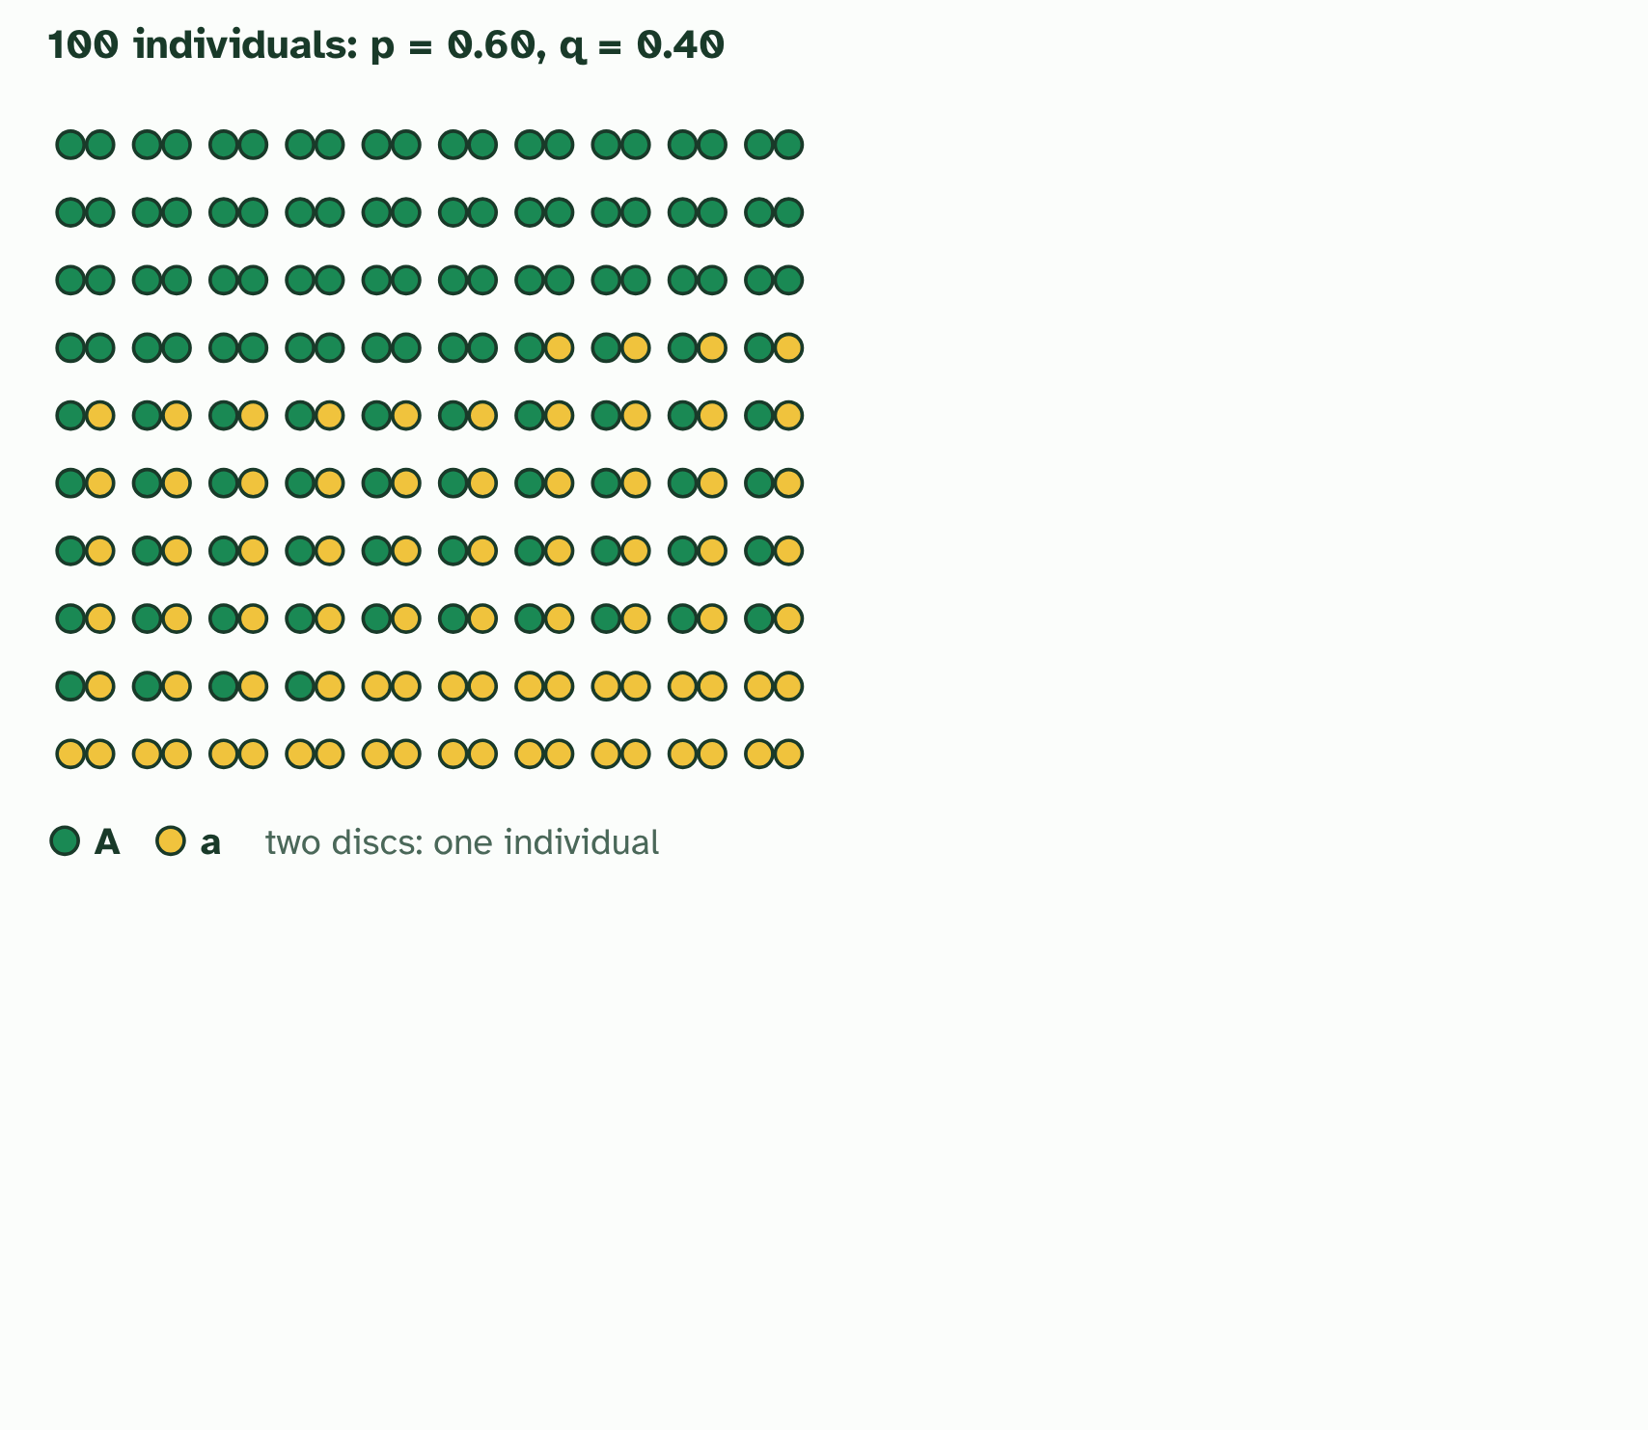
CHAPTER 10 · D4.1.13 D4.1.14 The Hardy-Weinberg equation
1 / 3
What a population would be like if it were not evolving
One gene, two alleles: p is the frequency of A, q of a, and p + q = 1. Here p = 0.60.
Minutes 15 to 25
Notes:
Minutes 15 to 25 of 60: The square (10 min).
The plan: Chapter 10's figure: why p² + 2pq + q² = 1. Students redraw the square for p = 0.7, then use it to find the genotype frequencies.
To tell whether a population is evolving you need something to compare it with. The Hardy-Weinberg equation gives it: the genotype frequencies you would expect in a population in genetic equilibrium, where the allele frequencies stay the same from one generation to the next.
For a gene with two alleles, let p be the frequency of one (A) and q the frequency of the other (a). They are the only alleles, so p + q = 1. With random mating, any egg can meet any sperm, so the genotype frequencies are the square of that: p² + 2pq + q² = 1, where p² is AA, 2pq is Aa and q² is aa. The figure shows why the middle term is double: there are two ways to be a heterozygote.
You can use it two ways. From the allele frequencies, work out the genotypes. Or, if one genotype is known, work back to the alleles. The one you can usually see is the homozygous recessive, whose frequency is q² : take the square root to get q, then p = 1 − q.
The equation holds only if five conditions are met. If real data do not fit it, one of them is failing, and the population is evolving.
Example: Worked example In a population of 200 beetles, 18 are green, which is a recessive trait. q² = 18/200 = 0.09, so q = 0.3 and p = 0.7. The heterozygotes are 2pq = 2 × 0.7 × 0.3 = 0.42, which is 84 beetles. Check: AA = 0.49 (98 beetles), Aa = 0.42 (84), aa = 0.09 (18); 98 + 84 + 18 = 200.

Slide 27
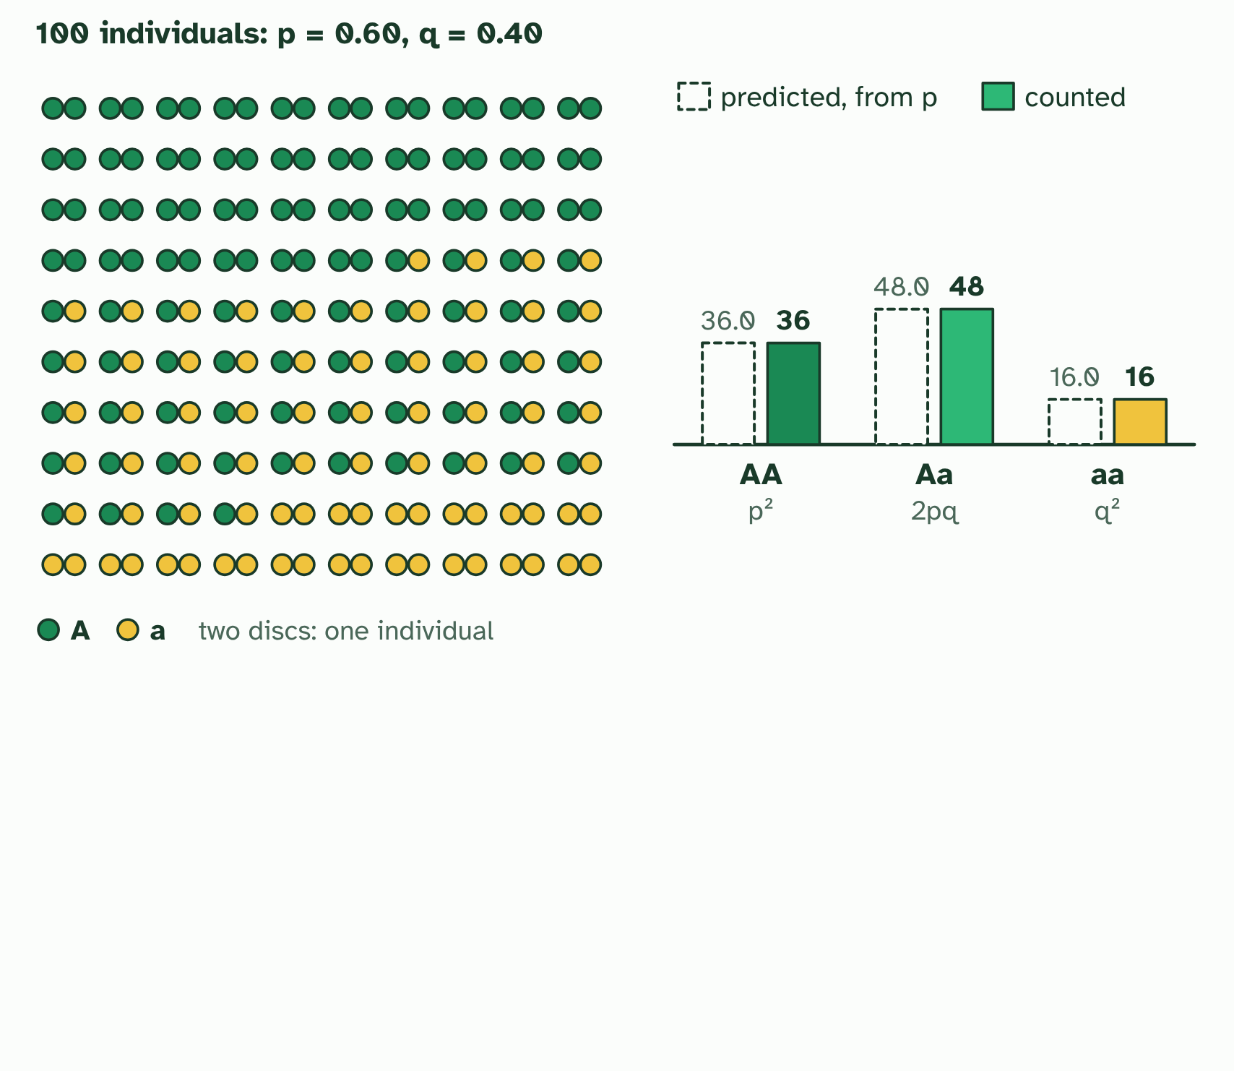
CHAPTER 10 · D4.1.13 D4.1.14 The Hardy-Weinberg equation
2 / 3
What a population would be like if it were not evolving
Hardy-Weinberg predicts the genotypes from p and q: p² + 2pq + q² = 1. When every condition is met, the counts fit.
Minutes 15 to 25
Notes:
Minutes 15 to 25 of 60: The square (10 min).
The plan: Chapter 10's figure: why p² + 2pq + q² = 1. Students redraw the square for p = 0.7, then use it to find the genotype frequencies.
To tell whether a population is evolving you need something to compare it with. The Hardy-Weinberg equation gives it: the genotype frequencies you would expect in a population in genetic equilibrium, where the allele frequencies stay the same from one generation to the next.
For a gene with two alleles, let p be the frequency of one (A) and q the frequency of the other (a). They are the only alleles, so p + q = 1. With random mating, any egg can meet any sperm, so the genotype frequencies are the square of that: p² + 2pq + q² = 1, where p² is AA, 2pq is Aa and q² is aa. The figure shows why the middle term is double: there are two ways to be a heterozygote.
You can use it two ways. From the allele frequencies, work out the genotypes. Or, if one genotype is known, work back to the alleles. The one you can usually see is the homozygous recessive, whose frequency is q² : take the square root to get q, then p = 1 − q.
The equation holds only if five conditions are met. If real data do not fit it, one of them is failing, and the population is evolving.
Example: Worked example In a population of 200 beetles, 18 are green, which is a recessive trait. q² = 18/200 = 0.09, so q = 0.3 and p = 0.7. The heterozygotes are 2pq = 2 × 0.7 × 0.3 = 0.42, which is 84 beetles. Check: AA = 0.49 (98 beetles), Aa = 0.42 (84), aa = 0.09 (18); 98 + 84 + 18 = 200.

Slide 28
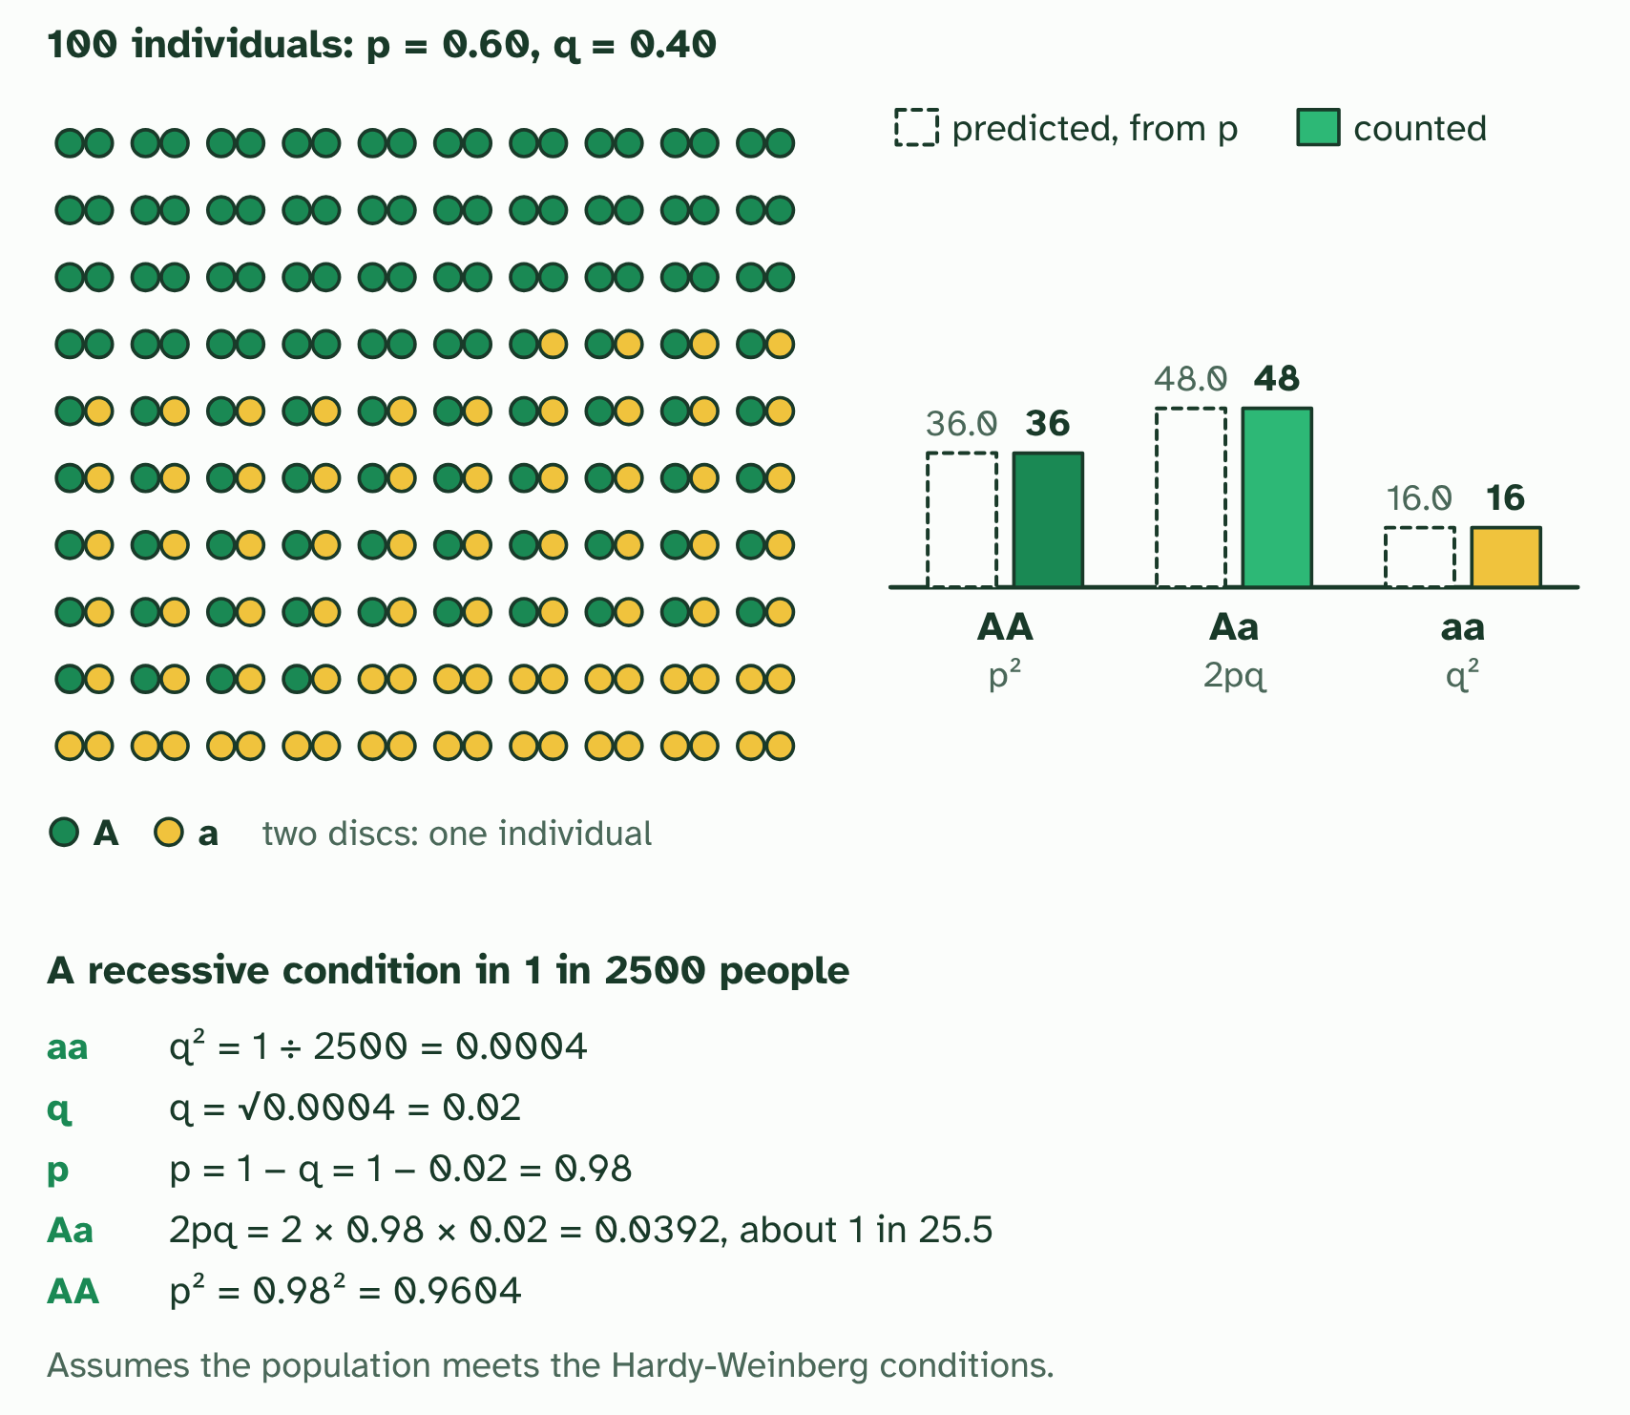
CHAPTER 10 · D4.1.13 D4.1.14 The Hardy-Weinberg equation
3 / 3
What a population would be like if it were not evolving
It works backwards too. From the aa frequency, 1 in 2500: q = 0.02, p = 0.98, and carriers 2pq = 0.0392, about 1 in 26.
Minutes 15 to 25
Notes:
Minutes 15 to 25 of 60: The square (10 min).
The plan: Chapter 10's figure: why p² + 2pq + q² = 1. Students redraw the square for p = 0.7, then use it to find the genotype frequencies.
To tell whether a population is evolving you need something to compare it with. The Hardy-Weinberg equation gives it: the genotype frequencies you would expect in a population in genetic equilibrium, where the allele frequencies stay the same from one generation to the next.
For a gene with two alleles, let p be the frequency of one (A) and q the frequency of the other (a). They are the only alleles, so p + q = 1. With random mating, any egg can meet any sperm, so the genotype frequencies are the square of that: p² + 2pq + q² = 1, where p² is AA, 2pq is Aa and q² is aa. The figure shows why the middle term is double: there are two ways to be a heterozygote.
You can use it two ways. From the allele frequencies, work out the genotypes. Or, if one genotype is known, work back to the alleles. The one you can usually see is the homozygous recessive, whose frequency is q² : take the square root to get q, then p = 1 − q.
The equation holds only if five conditions are met. If real data do not fit it, one of them is failing, and the population is evolving.
Example: Worked example In a population of 200 beetles, 18 are green, which is a recessive trait. q² = 18/200 = 0.09, so q = 0.3 and p = 0.7. The heterozygotes are 2pq = 2 × 0.7 × 0.3 = 0.42, which is 84 beetles. Check: AA = 0.49 (98 beetles), Aa = 0.42 (84), aa = 0.09 (18); 98 + 84 + 18 = 200.

Slide 29
CHAPTER 10 · D4.1.13 D4.1.14 The Hardy-Weinberg equation
What a population would be like if it were not evolving
The Hardy-Weinberg equation gives it: the genotype frequencies you would expect in a population in genetic equilibrium, where the allele frequencies stay the same from one generation to the next.
For a gene with two alleles, let p be the frequency of one (A) and q the frequency of the other (a).
You can use it two ways.
Minutes 15 to 25
Notes:
Minutes 15 to 25 of 60: The square (10 min).
The plan: Chapter 10's figure: why p² + 2pq + q² = 1. Students redraw the square for p = 0.7, then use it to find the genotype frequencies.
To tell whether a population is evolving you need something to compare it with. The Hardy-Weinberg equation gives it: the genotype frequencies you would expect in a population in genetic equilibrium, where the allele frequencies stay the same from one generation to the next.
For a gene with two alleles, let p be the frequency of one (A) and q the frequency of the other (a). They are the only alleles, so p + q = 1. With random mating, any egg can meet any sperm, so the genotype frequencies are the square of that: p² + 2pq + q² = 1, where p² is AA, 2pq is Aa and q² is aa. The figure shows why the middle term is double: there are two ways to be a heterozygote.
You can use it two ways. From the allele frequencies, work out the genotypes. Or, if one genotype is known, work back to the alleles. The one you can usually see is the homozygous recessive, whose frequency is q² : take the square root to get q, then p = 1 − q.
The equation holds only if five conditions are met. If real data do not fit it, one of them is failing, and the population is evolving.
Example: Worked example In a population of 200 beetles, 18 are green, which is a recessive trait. q² = 18/200 = 0.09, so q = 0.3 and p = 0.7. The heterozygotes are 2pq = 2 × 0.7 × 0.3 = 0.42, which is 84 beetles. Check: AA = 0.49 (98 beetles), Aa = 0.42 (84), aa = 0.09 (18); 98 + 84 + 18 = 200.

Slide 30
PREDICT
A recessive condition affects 1 person in 2500. Roughly how many people in the population are carriers (heterozygous)?
A About 1 in 25, since 2pq is about 0.04
B About 1 in 2500, the same as the number affected
C About 1 in 50, since the frequency of the allele q is 0.02
Minutes 15 to 25
Notes:
Minutes 15 to 25 of 60: The square (10 min).
The plan: Chapter 10's figure: why p² + 2pq + q² = 1. Students redraw the square for p = 0.7, then use it to find the genotype frequencies.
Ask for a show of hands, or mini whiteboards, before revealing. (Answer: A, on the next slide.)

Slide 31
WHAT HAPPENS
A recessive condition affects 1 person in 2500. Roughly how many people in the population are carriers (heterozygous)?
A About 1 in 25, since 2pq is about 0.04
B About 1 in 2500, the same as the number affected
C About 1 in 50, since the frequency of the allele q is 0.02
About 1 in 25. q² = 1/2500 = 0.0004, so q = 0.02 and p = 0.98. The carriers are 2pq = 2 × 0.98 × 0.02 = 0.039, which is about 1 in 25. Carriers are far commoner than affected people because most copies of a rare recessive allele sit hidden in heterozygotes.
Minutes 15 to 25
Notes:
Minutes 15 to 25 of 60: The square (10 min).
The plan: Chapter 10's figure: why p² + 2pq + q² = 1. Students redraw the square for p = 0.7, then use it to find the genotype frequencies.
Answer: A. About 1 in 25. q² = 1/2500 = 0.0004, so q = 0.02 and p = 0.98. The carriers are 2pq = 2 × 0.98 × 0.02 = 0.039, which is about 1 in 25. Carriers are far commoner than affected people because most copies of a rare recessive allele sit hidden in heterozygotes.

Slide 32
REMEMBER IT
The five Hardy-Weinberg conditions
L
R
M
M
S
Large
Rats
Make
Most
Spaghetti
Minutes 15 to 25
Notes:
Minutes 15 to 25 of 60: The square (10 min).
The plan: Chapter 10's figure: why p² + 2pq + q² = 1. Students redraw the square for p = 0.7, then use it to find the genotype frequencies.
Ask the class what each letter stands for before revealing.

Slide 33
REMEMBER IT
The five Hardy-Weinberg conditions
L
R
M
M
S
Large
Rats
Make
Most
Spaghetti
Large population
Random mating
Migration: none
Mutation: none
Selection: none
big enough that chance does not shift the frequencies
no mate choice by genotype, no inbreeding
no alleles arrive or leave
no new alleles appear
every genotype survives and breeds equally well
Minutes 15 to 25
Notes:
Minutes 15 to 25 of 60: The square (10 min).
The plan: Chapter 10's figure: why p² + 2pq + q² = 1. Students redraw the square for p = 0.7, then use it to find the genotype frequencies.
Large: Large population (big enough that chance does not shift the frequencies)
Rats: Random mating (no mate choice by genotype, no inbreeding)
Make: Migration: none (no alleles arrive or leave)
Most: Mutation: none (no new alleles appear)
Spaghetti: Selection: none (every genotype survives and breeds equally well)

Slide 34
STEP 4
20 MIN
Problem set
The Hardy-Weinberg set below, in pairs, in order.
Minutes 25 to 45
Notes:
Minutes 25 to 45 of 60: Problem set (20 min).
The plan: The Hardy-Weinberg set below, in pairs, in order. Walk round for the common slip: q² is the frequency of the recessive genotype, not of the allele. Take the last problem as a class.

Slide 35
STEP 5
10 MIN
Switch off a condition
The Hardy-Weinberg tool in chapter 10: turn off one condition at a time and describe what it does to the population against the prediction.
Minutes 45 to 55
Notes:
Minutes 45 to 55 of 60: Switch off a condition (10 min).
The plan: The Hardy-Weinberg tool in chapter 10: turn off one condition at a time and describe what it does to the population against the prediction. Match each to a real case (a small island, inbreeding, a new mutation, a predator that takes one genotype, a new arrival).

Slide 36
PLENARY
Can you now...
Distinguish directional, stabilising and disruptive selection, and explain why all three change allele frequencies (D4.1.12)
Use the Hardy-Weinberg equation to calculate allele and genotype frequencies, and say what its five conditions tell you (D4.1.13, D4.1.14)
Minutes 55 to 60
Notes:
Minutes 55 to 60 of 60: Exit (5 min).
The plan: The five conditions from memory (the Remember it tiles), and which one is broken when the genotypes do not fit.
Thumbs up, sideways or down on each goal before the exit question. The goals come from the statements this lesson covers.

Slide 37
EXIT QUESTION
Before you go
The five conditions from memory (the Remember it tiles), and which one is broken when the genotypes do not fit.
Minutes 55 to 60
Notes:
Minutes 55 to 60 of 60: Exit (5 min).
The plan: The five conditions from memory (the Remember it tiles), and which one is broken when the genotypes do not fit.

Slide 38
PRACTISE AND REVISE
Keep going
Exam practice: a fresh paper of exam questions on D4.1 at higher level, marked as you go
The guide, with the animations and the dry lab
This lesson in the guide: 9 Three ways selection can act, 10 What a population would be like if it were not evolving
BUILD FOR YOUR CLASS
ALREADY ON THE SITE FOR D4.1
CARD SETS ON SPLYCR
Tarsia puzzle, dominoes and picture reveal on D4.1, built from its key terms and ready to print
A pub quiz with rounds on D4.1, to present or run with no projector
An escape room built from the question bank on D4.1
Lesson: Hardy–Weinberg & Chi-Squared
Quiz: Natural Selection (HL)
Quiz: Natural Selection
Revision map: D4.1 Natural selection, to fill in
Exam questions: D4.1 in the exam maker, a paper with its markscheme
Open a set to host it as a class game, or make a copy to edit.
D4.1 Natural Selection
How this was made. The course structure, the activities and the teaching choices come from my own classroom, my presentations and my years of teaching IB and AP Biology. I use Claude, an AI, to help write and build the interactive guides, lesson plans, slides and practice questions, and to draw the diagrams and code the interactives. I direct the work and review it against the IB and AP specifications before it goes live.
Minute 60: after the lesson
Notes:
Every link here is live. Set the exam practice paper for homework: it is fresh each time, marked as students go and saved to their Exam practice when they are signed in.
Exam practice: https://www.biologybybradford.com/exam-maker/sit?topics=D4.1&level=HL&paper=quiz&marks=15&src=ep
The guide: https://www.biologybybradford.com/guides/ib-biology-d4-1-natural-selection

