Slide 1
IB Biology D4.1
LESSON 6 OF 6
HL
BY THE END YOU CAN
Natural selection
Distinguish artificial selection from natural selection, and explain antibiotic resistance as natural selection (D4.1.15)
Artificial selection, and putting it together
D4.1.15
Artificial selection against natural selection, antibiotic resistance as natural selection, and a consolidation of the whole subtopic
60 minutes · chapter 11
Minute 0
Notes:
IB Biology D4.1, Natural selection. Lesson 6 of 6: Artificial selection, and putting it together (higher level), 60 minutes.
The plan, minute by minute (each slide's footer says where you are):
0 to 5 min (5) Do now
5 to 15 min (10) Choose the parents
15 to 25 min (10) Natural or artificial?
25 to 45 min (20) ICE AGE on a fresh case
45 to 55 min (10) Exam practice
55 to 60 min (5) Exit
What students get wrong:
"Natural selection makes perfect organisms." It sorts what variation exists, under current conditions, so every organism is a compromise.
"The antibiotic caused the resistance." The mutation was already there, or arose by chance; the antibiotic only changed who survived.
Stretch and support:
Stretch: breeders choose for one trait. Why do other traits sometimes change at the same time?
The lesson plan to print: https://www.biologybybradford.com/guides/downloads/ib-biology-d4-1-natural-selection-lesson-6-plan.pdf

Slide 2
DO NOW
Do now
Vote: antibiotic resistance in bacteria is artificial selection or natural selection?
5:00
minutes
Start now: the timer is running.
Minutes 0 to 5
Notes:
Minutes 0 to 5 of 60: Do now (5 min).
The plan: Vote: antibiotic resistance in bacteria is artificial selection or natural selection? Keep the votes up.
Start a 5 minute timer as they come in.

Slide 3

MODEL · HL
10 MIN
Choose the parents
THE TASK
Each group gets ten cards, each with a number from 1 to 10 for a trait (the size of a cob). They pick the two highest as parents. Offspring values are the parents' mean plus the roll of two dice (first die minus second), and the teacher deals the next ten cards that way. After three rounds, they plot the class mean each round. What happened to the mean, and to the spread?
STUDENTS NEED
Ten cards per group, two dice, a results grid.
Minutes 5 to 15
Notes:
Minutes 5 to 15 of 60: Choose the parents (10 min).
The plan: The dice model below, three rounds. Plot the class mean each round on the board. What happened to the variation as the breeder chose?
The activity: Choose the parents. Each group gets ten cards, each with a number from 1 to 10 for a trait (the size of a cob). They pick the two highest as parents. Offspring values are the parents' mean plus the roll of two dice (first die minus second), and the teacher deals the next ten cards that way. After three rounds, they plot the class mean each round. What happened to the mean, and to the spread?
Needs: ten cards per group, two dice, a results grid.
The time: 10 minutes, minutes 5 to 15 of the plan.

Slide 4
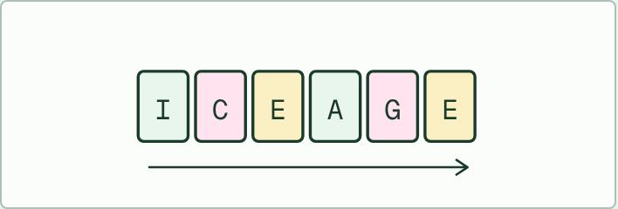
WRITING
10 MIN
ICE AGE on a fresh example
THE TASK
Give a new population, not one from the guide, such as an island population of lizards whose food changes (invent the details, and make clear it is invented). On six strips, pairs write what happens at each of Inherited variation, Competition, Environmental pressure, Adaptations, Genes and Evolution, then order and read them aloud. Check that each strip is about the example, not just the definition, and that "Genes" is about allele frequencies.
STUDENTS NEED
Six blank strips per pair, the invented case on a card.
Minutes 5 to 15
Notes:
Minutes 5 to 15 of 60: Choose the parents (10 min).
The plan: The dice model below, three rounds. Plot the class mean each round on the board. What happened to the variation as the breeder chose?
The activity: ICE AGE on a fresh example. Give a new population, not one from the guide, such as an island population of lizards whose food changes (invent the details, and make clear it is invented). On six strips, pairs write what happens at each of Inherited variation, Competition, Environmental pressure, Adaptations, Genes and Evolution, then order and read them aloud. Check that each strip is about the example, not just the definition, and that "Genes" is about allele frequencies.
Needs: six blank strips per pair, the invented case on a card.
The time: 10 minutes, minutes 5 to 15 of the plan.

Slide 5
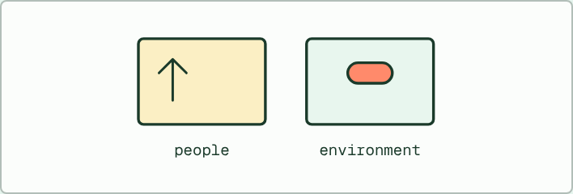
CARD SORT · HL
10 MIN
Natural or artificial?
THE TASK
Eight cards: farmers breeding the heaviest dairy cows; antibiotic resistance in a hospital ward; a breeder keeping only the gentlest puppies; insecticide resistance in a pest; bigger maize cobs over centuries; a dry year in which tough-seeded plants spread; a greenhouse grower choosing the tallest seedlings; resistant weeds after a herbicide. Sort into artificial selection (a person chooses the parents) and natural selection, then argue about any card where the line is unclear.
STUDENTS NEED
Printed cards, one set per pair.
Minutes 15 to 25
Notes:
Minutes 15 to 25 of 60: Natural or artificial? (10 min).
The plan: Chapter 11's figure, then the card sort below. Go back to the vote: the antibiotic was a pressure nobody meant to apply with those consequences, so it is natural selection.
The activity: Natural or artificial?. Eight cards: farmers breeding the heaviest dairy cows; antibiotic resistance in a hospital ward; a breeder keeping only the gentlest puppies; insecticide resistance in a pest; bigger maize cobs over centuries; a dry year in which tough-seeded plants spread; a greenhouse grower choosing the tallest seedlings; resistant weeds after a herbicide. Sort into artificial selection (a person chooses the parents) and natural selection, then argue about any card where the line is unclear.
Needs: printed cards, one set per pair.
The time: 10 minutes, minutes 15 to 25 of the plan.

Slide 6
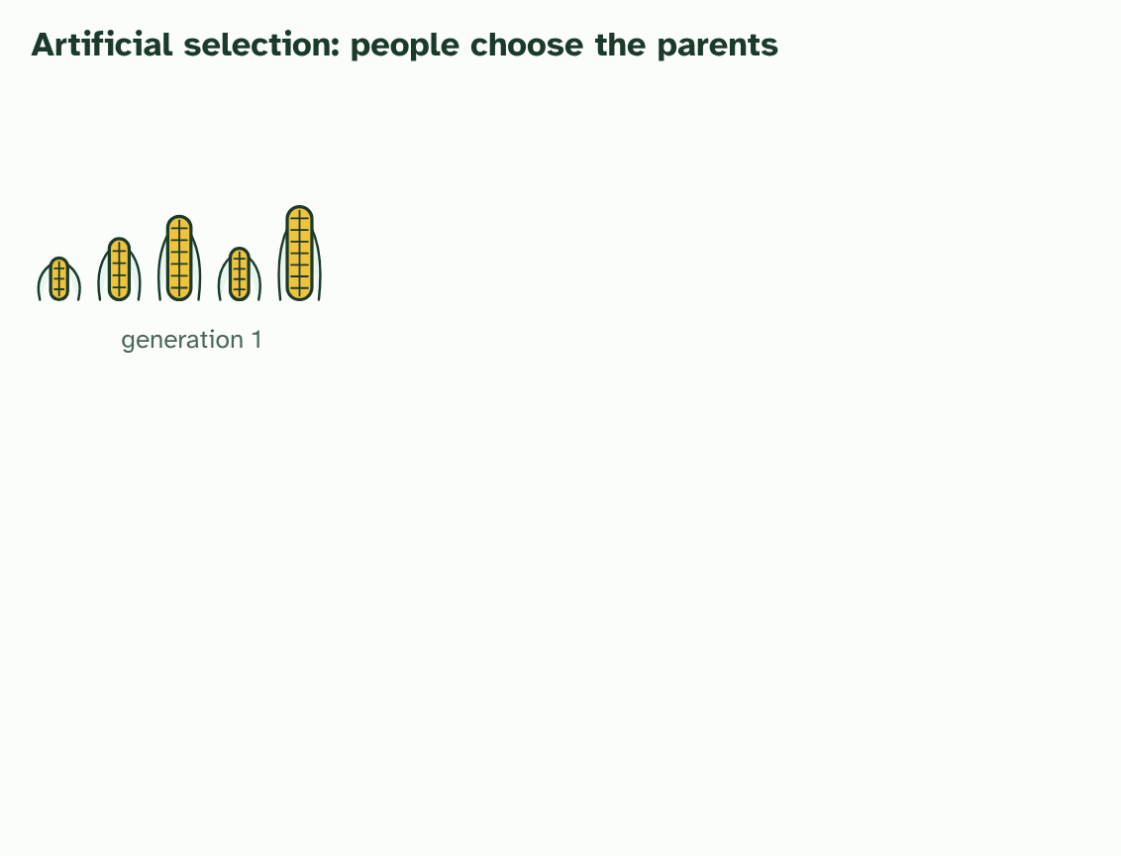
CHAPTER 11 · D4.1.15 Artificial selection
1 / 5
Artificial selection and its side effects
A crop varies in the size of its cobs. Each plant's size is partly heritable.
Minutes 15 to 25
Notes:
Minutes 15 to 25 of 60: Natural or artificial? (10 min).
The plan: Chapter 11's figure, then the card sort below. Go back to the vote: the antibiotic was a pressure nobody meant to apply with those consequences, so it is natural selection.
Artificial selection is natural selection with a person choosing the parents. Farmers and breeders pick the individuals with the traits they want, the biggest cobs, the best milkers, the gentlest dogs, and let only those breed. The alleles that go with the chosen trait become commoner in each generation. It can change a population quickly, because a breeder's choice can be very strict. The A4.1 guide has the examples of crops and domestic animals, and its finches dry lab lets you try selection on a bench, so they are not repeated here.
The key word is deliberate. Humans sometimes change the environment without meaning to, and that can be a selection pressure too. Take an antibiotic. In a huge population of bacteria, mutation has by chance made a few cells resistant. The antibiotic kills the susceptible cells and leaves the resistant ones, which divide with no competitors. The resistance alleles go from rare to common.
Nobody chose the resistant bacteria for breeding, and nobody wanted the result. The antibiotic acted as a selection pressure on variation that already existed, so this is natural selection, an unintended consequence of a human action, not artificial selection. It matters in medicine: the more an antibiotic is used, the stronger the pressure, so using antibiotics only when they are needed slows the spread of resistance.
Example: Compare Artificial selection: a person decides which individuals breed, for a trait they want, and the change is the aim. Natural selection by a human action: the environment decides who survives and breeds, nobody meant it, and the change is a side effect. The mechanism, heritable variation sorted by survival and reproduction, is the same in both.

Slide 7
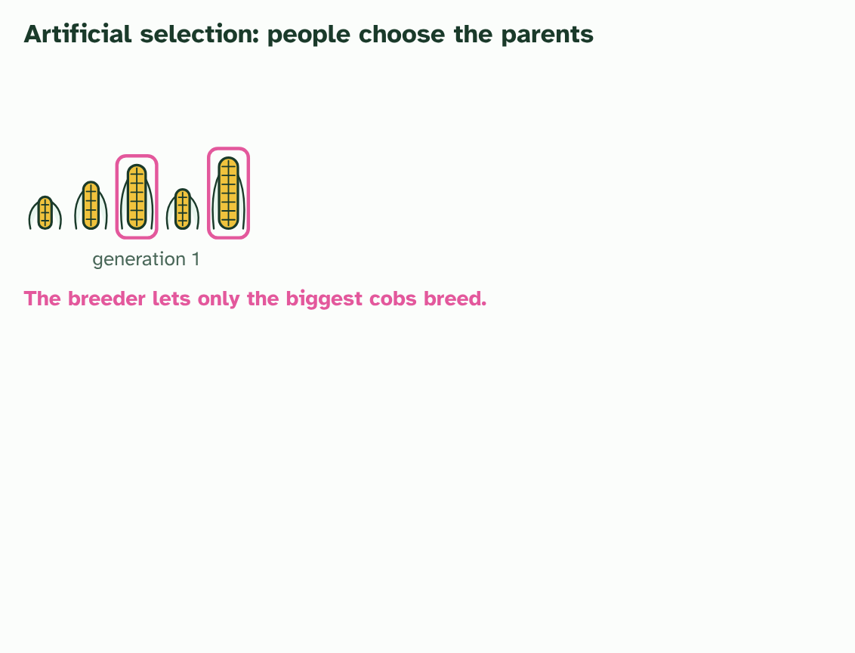
CHAPTER 11 · D4.1.15 Artificial selection
2 / 5
Artificial selection and its side effects
The breeder picks the largest and lets only those breed.
Minutes 15 to 25
Notes:
Minutes 15 to 25 of 60: Natural or artificial? (10 min).
The plan: Chapter 11's figure, then the card sort below. Go back to the vote: the antibiotic was a pressure nobody meant to apply with those consequences, so it is natural selection.
Artificial selection is natural selection with a person choosing the parents. Farmers and breeders pick the individuals with the traits they want, the biggest cobs, the best milkers, the gentlest dogs, and let only those breed. The alleles that go with the chosen trait become commoner in each generation. It can change a population quickly, because a breeder's choice can be very strict. The A4.1 guide has the examples of crops and domestic animals, and its finches dry lab lets you try selection on a bench, so they are not repeated here.
The key word is deliberate. Humans sometimes change the environment without meaning to, and that can be a selection pressure too. Take an antibiotic. In a huge population of bacteria, mutation has by chance made a few cells resistant. The antibiotic kills the susceptible cells and leaves the resistant ones, which divide with no competitors. The resistance alleles go from rare to common.
Nobody chose the resistant bacteria for breeding, and nobody wanted the result. The antibiotic acted as a selection pressure on variation that already existed, so this is natural selection, an unintended consequence of a human action, not artificial selection. It matters in medicine: the more an antibiotic is used, the stronger the pressure, so using antibiotics only when they are needed slows the spread of resistance.
Example: Compare Artificial selection: a person decides which individuals breed, for a trait they want, and the change is the aim. Natural selection by a human action: the environment decides who survives and breeds, nobody meant it, and the change is a side effect. The mechanism, heritable variation sorted by survival and reproduction, is the same in both.

Slide 8
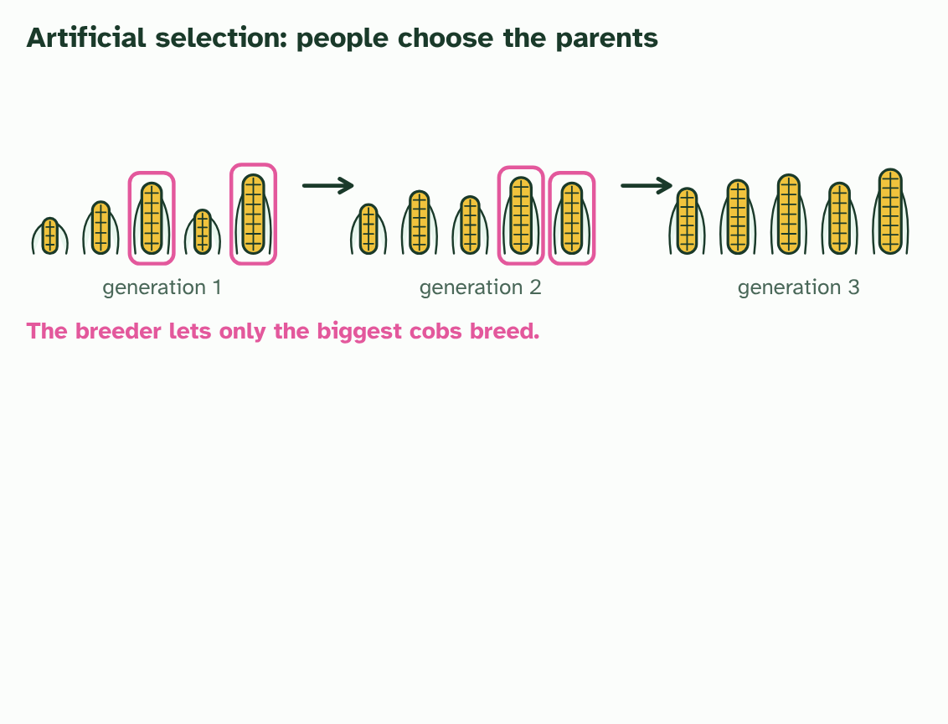
CHAPTER 11 · D4.1.15 Artificial selection
3 / 5
Artificial selection and its side effects
Repeat for a few generations: the cobs get steadily bigger, as the alleles for size become commoner.
Minutes 15 to 25
Notes:
Minutes 15 to 25 of 60: Natural or artificial? (10 min).
The plan: Chapter 11's figure, then the card sort below. Go back to the vote: the antibiotic was a pressure nobody meant to apply with those consequences, so it is natural selection.
Artificial selection is natural selection with a person choosing the parents. Farmers and breeders pick the individuals with the traits they want, the biggest cobs, the best milkers, the gentlest dogs, and let only those breed. The alleles that go with the chosen trait become commoner in each generation. It can change a population quickly, because a breeder's choice can be very strict. The A4.1 guide has the examples of crops and domestic animals, and its finches dry lab lets you try selection on a bench, so they are not repeated here.
The key word is deliberate. Humans sometimes change the environment without meaning to, and that can be a selection pressure too. Take an antibiotic. In a huge population of bacteria, mutation has by chance made a few cells resistant. The antibiotic kills the susceptible cells and leaves the resistant ones, which divide with no competitors. The resistance alleles go from rare to common.
Nobody chose the resistant bacteria for breeding, and nobody wanted the result. The antibiotic acted as a selection pressure on variation that already existed, so this is natural selection, an unintended consequence of a human action, not artificial selection. It matters in medicine: the more an antibiotic is used, the stronger the pressure, so using antibiotics only when they are needed slows the spread of resistance.
Example: Compare Artificial selection: a person decides which individuals breed, for a trait they want, and the change is the aim. Natural selection by a human action: the environment decides who survives and breeds, nobody meant it, and the change is a side effect. The mechanism, heritable variation sorted by survival and reproduction, is the same in both.

Slide 9
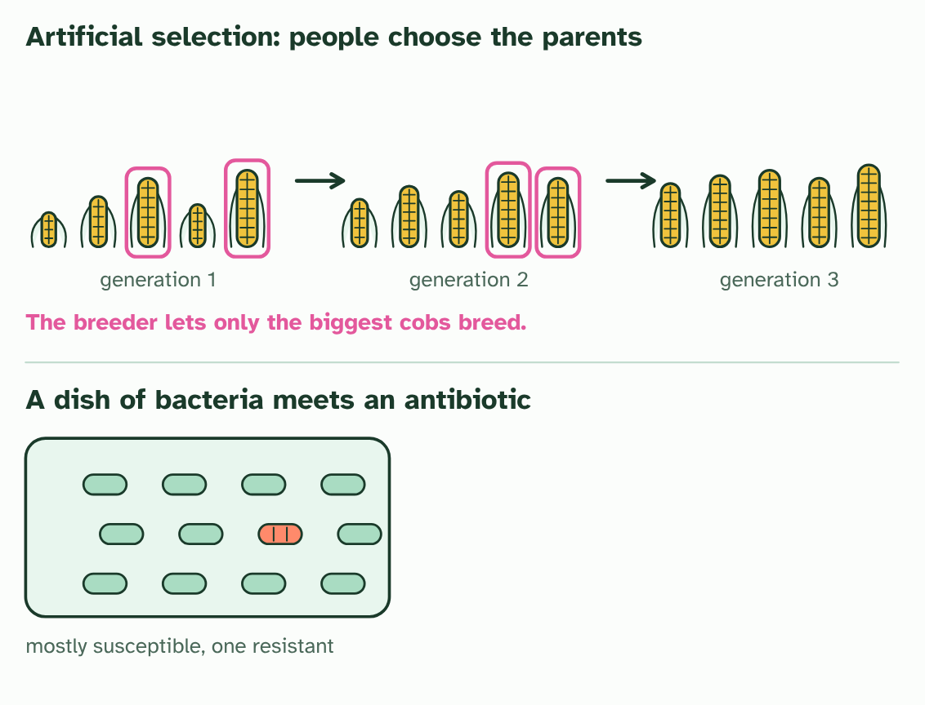
CHAPTER 11 · D4.1.15 Artificial selection
4 / 5
Artificial selection and its side effects
A dish of bacteria with one resistant cell among many susceptible ones.
Minutes 15 to 25
Notes:
Minutes 15 to 25 of 60: Natural or artificial? (10 min).
The plan: Chapter 11's figure, then the card sort below. Go back to the vote: the antibiotic was a pressure nobody meant to apply with those consequences, so it is natural selection.
Artificial selection is natural selection with a person choosing the parents. Farmers and breeders pick the individuals with the traits they want, the biggest cobs, the best milkers, the gentlest dogs, and let only those breed. The alleles that go with the chosen trait become commoner in each generation. It can change a population quickly, because a breeder's choice can be very strict. The A4.1 guide has the examples of crops and domestic animals, and its finches dry lab lets you try selection on a bench, so they are not repeated here.
The key word is deliberate. Humans sometimes change the environment without meaning to, and that can be a selection pressure too. Take an antibiotic. In a huge population of bacteria, mutation has by chance made a few cells resistant. The antibiotic kills the susceptible cells and leaves the resistant ones, which divide with no competitors. The resistance alleles go from rare to common.
Nobody chose the resistant bacteria for breeding, and nobody wanted the result. The antibiotic acted as a selection pressure on variation that already existed, so this is natural selection, an unintended consequence of a human action, not artificial selection. It matters in medicine: the more an antibiotic is used, the stronger the pressure, so using antibiotics only when they are needed slows the spread of resistance.
Example: Compare Artificial selection: a person decides which individuals breed, for a trait they want, and the change is the aim. Natural selection by a human action: the environment decides who survives and breeds, nobody meant it, and the change is a side effect. The mechanism, heritable variation sorted by survival and reproduction, is the same in both.

Slide 10
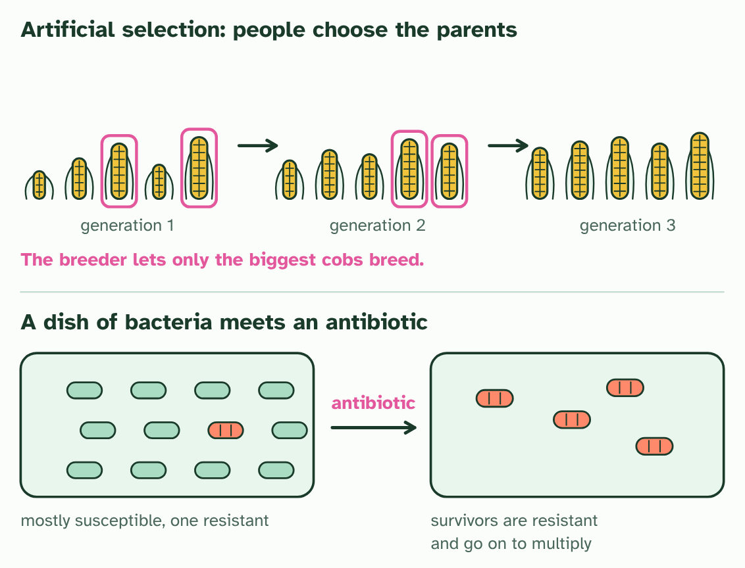
CHAPTER 11 · D4.1.15 Artificial selection
5 / 5
Artificial selection and its side effects
Add an antibiotic: the susceptible cells die, the resistant one multiplies. Nobody chose it, so this is natural selection.
Minutes 15 to 25
Notes:
Minutes 15 to 25 of 60: Natural or artificial? (10 min).
The plan: Chapter 11's figure, then the card sort below. Go back to the vote: the antibiotic was a pressure nobody meant to apply with those consequences, so it is natural selection.
Artificial selection is natural selection with a person choosing the parents. Farmers and breeders pick the individuals with the traits they want, the biggest cobs, the best milkers, the gentlest dogs, and let only those breed. The alleles that go with the chosen trait become commoner in each generation. It can change a population quickly, because a breeder's choice can be very strict. The A4.1 guide has the examples of crops and domestic animals, and its finches dry lab lets you try selection on a bench, so they are not repeated here.
The key word is deliberate. Humans sometimes change the environment without meaning to, and that can be a selection pressure too. Take an antibiotic. In a huge population of bacteria, mutation has by chance made a few cells resistant. The antibiotic kills the susceptible cells and leaves the resistant ones, which divide with no competitors. The resistance alleles go from rare to common.
Nobody chose the resistant bacteria for breeding, and nobody wanted the result. The antibiotic acted as a selection pressure on variation that already existed, so this is natural selection, an unintended consequence of a human action, not artificial selection. It matters in medicine: the more an antibiotic is used, the stronger the pressure, so using antibiotics only when they are needed slows the spread of resistance.
Example: Compare Artificial selection: a person decides which individuals breed, for a trait they want, and the change is the aim. Natural selection by a human action: the environment decides who survives and breeds, nobody meant it, and the change is a side effect. The mechanism, heritable variation sorted by survival and reproduction, is the same in both.

Slide 11
CHAPTER 11 · D4.1.15 Artificial selection
Artificial selection and its side effects
Artificial selection is natural selection with a person choosing the parents.
The antibiotic acted as a selection pressure on variation that already existed, so this is natural selection, an unintended consequence of a human action, not artificial selection.
The key word is deliberate.
Minutes 15 to 25
Notes:
Minutes 15 to 25 of 60: Natural or artificial? (10 min).
The plan: Chapter 11's figure, then the card sort below. Go back to the vote: the antibiotic was a pressure nobody meant to apply with those consequences, so it is natural selection.
Artificial selection is natural selection with a person choosing the parents. Farmers and breeders pick the individuals with the traits they want, the biggest cobs, the best milkers, the gentlest dogs, and let only those breed. The alleles that go with the chosen trait become commoner in each generation. It can change a population quickly, because a breeder's choice can be very strict. The A4.1 guide has the examples of crops and domestic animals, and its finches dry lab lets you try selection on a bench, so they are not repeated here.
The key word is deliberate. Humans sometimes change the environment without meaning to, and that can be a selection pressure too. Take an antibiotic. In a huge population of bacteria, mutation has by chance made a few cells resistant. The antibiotic kills the susceptible cells and leaves the resistant ones, which divide with no competitors. The resistance alleles go from rare to common.
Nobody chose the resistant bacteria for breeding, and nobody wanted the result. The antibiotic acted as a selection pressure on variation that already existed, so this is natural selection, an unintended consequence of a human action, not artificial selection. It matters in medicine: the more an antibiotic is used, the stronger the pressure, so using antibiotics only when they are needed slows the spread of resistance.
Example: Compare Artificial selection: a person decides which individuals breed, for a trait they want, and the change is the aim. Natural selection by a human action: the environment decides who survives and breeds, nobody meant it, and the change is a side effect. The mechanism, heritable variation sorted by survival and reproduction, is the same in both.

Slide 12
PREDICT
Farmers spray a crop with an insecticide. After some years most of the pests resist it. Which kind of selection has taken place?
A Artificial selection, because the farmers chose to use the insecticide on their crop
B Natural selection, because the insecticide killed some pests and spared others
C Neither, because the pests changed their bodies to cope with the poison they met
Minutes 15 to 25
Notes:
Minutes 15 to 25 of 60: Natural or artificial? (10 min).
The plan: Chapter 11's figure, then the card sort below. Go back to the vote: the antibiotic was a pressure nobody meant to apply with those consequences, so it is natural selection.
Ask for a show of hands, or mini whiteboards, before revealing. (Answer: B, on the next slide.)

Slide 13
WHAT HAPPENS
Farmers spray a crop with an insecticide. After some years most of the pests resist it. Which kind of selection has taken place?
A Artificial selection, because the farmers chose to use the insecticide on their crop
B Natural selection, because the insecticide killed some pests and spared others
C Neither, because the pests changed their bodies to cope with the poison they met
Natural selection. The farmers did not choose which pests would breed, and they did not mean to produce resistant ones. The insecticide was a selection pressure that spared the pests with a heritable resistance, and the resistance alleles became commoner. Artificial selection needs a deliberate choice of the parents.
Minutes 15 to 25
Notes:
Minutes 15 to 25 of 60: Natural or artificial? (10 min).
The plan: Chapter 11's figure, then the card sort below. Go back to the vote: the antibiotic was a pressure nobody meant to apply with those consequences, so it is natural selection.
Answer: B. Natural selection. The farmers did not choose which pests would breed, and they did not mean to produce resistant ones. The insecticide was a selection pressure that spared the pests with a heritable resistance, and the resistance alleles became commoner. Artificial selection needs a deliberate choice of the parents.

Slide 14
WATCH OUT
The resistance did not appear "because" of the antibiotic, and the bacteria did not learn to resist. The mutation was already there, or arose by chance. The antibiotic only changed who survived.
Minutes 15 to 25
Notes:
Minutes 15 to 25 of 60: Natural or artificial? (10 min).
The plan: Chapter 11's figure, then the card sort below. Go back to the vote: the antibiotic was a pressure nobody meant to apply with those consequences, so it is natural selection.
A common mistake: say it, then ask who can say why it is wrong.

Slide 15
STEP 4
20 MIN
ICE AGE on a fresh case
Pairs swap and mark each other's against the list of letters.
Then link the six letters to the Hardy-Weinberg conditions: which does selection break?
Minutes 25 to 45
Notes:
Minutes 25 to 45 of 60: ICE AGE on a fresh case (20 min).
The plan: The activity below: a new example, and students put the six letters onto it with their own words. Pairs swap and mark each other's against the list of letters. Then link the six letters to the Hardy-Weinberg conditions: which does selection break?

Slide 16
STEP 5
10 MIN
Exam practice
A written question on D4.1 from the exam maker, set at HL, in 8 minutes, then peer-marked against the markscheme.
Minutes 45 to 55
Notes:
Minutes 45 to 55 of 60: Exam practice (10 min).
The plan: A written question on D4.1 from the exam maker (in Practise and revise, below), set at HL, in 8 minutes, then peer-marked against the markscheme. For homework, the Check step: a fresh paper on D4.1, marked as students go.

Slide 17
PLENARY
Can you now...
Distinguish artificial selection from natural selection, and explain antibiotic resistance as natural selection (D4.1.15)
Minutes 55 to 60
Notes:
Minutes 55 to 60 of 60: Exit (5 min).
The plan: Linking question, in one sentence each: how do intraspecific and interspecific interactions differ, and what is one way competition is reduced?
Thumbs up, sideways or down on each goal before the exit question. The goals come from the statements this lesson covers.

Slide 18
EXIT QUESTION
Before you go
Linking question, in one sentence each: how do intraspecific and interspecific interactions differ, and what is one way competition is reduced?
Minutes 55 to 60
Notes:
Minutes 55 to 60 of 60: Exit (5 min).
The plan: Linking question, in one sentence each: how do intraspecific and interspecific interactions differ, and what is one way competition is reduced?

Slide 19
PRACTISE AND REVISE
Keep going
Exam practice: a fresh paper of exam questions on D4.1 at higher level, marked as you go
The guide, with the animations and the dry lab
This lesson in the guide: 11 Artificial selection and its side effects
BUILD FOR YOUR CLASS
ALREADY ON THE SITE FOR D4.1
CARD SETS ON SPLYCR
Tarsia puzzle, dominoes and picture reveal on D4.1, built from its key terms and ready to print
A pub quiz with rounds on D4.1, to present or run with no projector
An escape room built from the question bank on D4.1
Lesson: Hardy–Weinberg & Chi-Squared
Quiz: Natural Selection (HL)
Quiz: Natural Selection
Revision map: D4.1 Natural selection, to fill in
Exam questions: D4.1 in the exam maker, a paper with its markscheme
Open a set to host it as a class game, or make a copy to edit.
D4.1 Natural Selection
How this was made. The course structure, the activities and the teaching choices come from my own classroom, my presentations and my years of teaching IB and AP Biology. I use Claude, an AI, to help write and build the interactive guides, lesson plans, slides and practice questions, and to draw the diagrams and code the interactives. I direct the work and review it against the IB and AP specifications before it goes live.
Minute 60: after the lesson
Notes:
Every link here is live. Set the exam practice paper for homework: it is fresh each time, marked as students go and saved to their Exam practice when they are signed in.
Exam practice: https://www.biologybybradford.com/exam-maker/sit?topics=D4.1&level=HL&paper=quiz&marks=15&src=ep
The guide: https://www.biologybybradford.com/guides/ib-biology-d4-1-natural-selection

